Slide 1
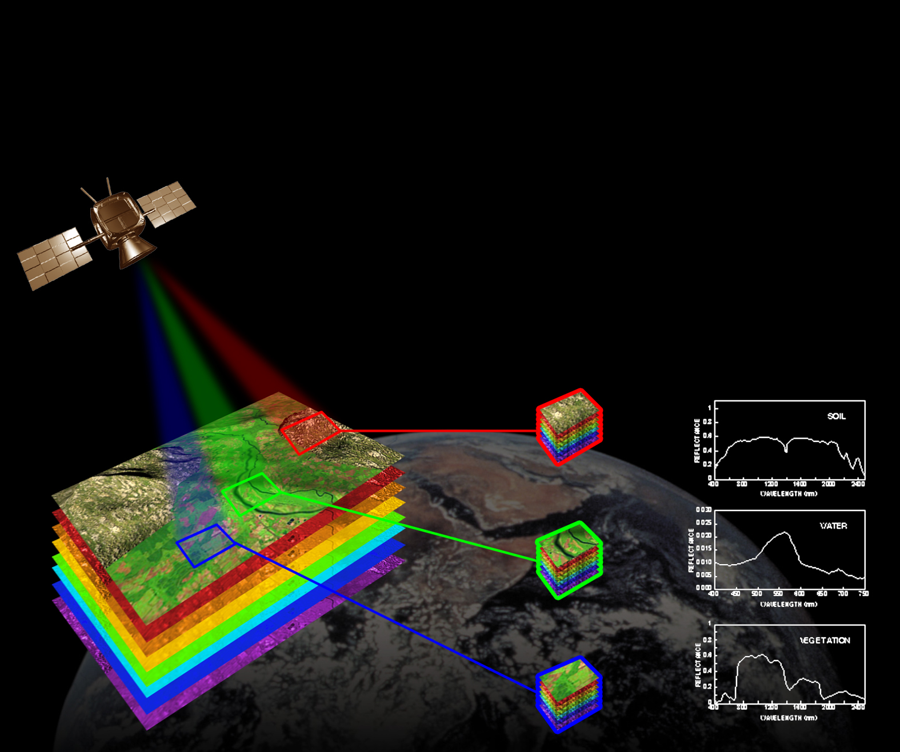


Harmonizing Ground Truth Measurements:
A Novel Approach for Cross-Calibration of Field Spectrometers for CAL/VAL Activity
“Harmonizing Ground Truth Measurements: A Novel Approach for Cross-Calibration of Field Spectrometers for cal val Activity” has been scheduled in the session "S4: Product Harmonization
“Harmonizing Ground Truth Measurements: A Novel Approach for Cross-Calibration of Field Spectrometers for cal val Activity” has been scheduled in the session "S4: Product Harmonization
Eyal Ben-Dor* , Asa Gholizadeh, Luboš Borůvka
Vahid Khosravi, Sharad Gupta
* RSL Porter School for Environment and Earth Sciences, Faculty of Exact Sciences Tel Aviv University

Slide 2
Introduction
There is an urgent need for standards and protocols for field measurement in the era of hyperspectral remote sensing )soil surface, ground truth ect)
Cross calibration of field measurements at the Cal/Val sites is crucial for harmonization

Slide 3
Seed Questions by the Organizers
How many vicarious calibration sites might be needed worldwide to ensure accurate characterization of the radiances and reflectances (L1B and L2 products) returned by spectral imaging missions? And what are the core measurements that should be made at these sites (and uncertainty/performance requirements)?
missions, sites, and campaigns, and how can these be addressed?
What is currently missing to carry out holistic and all-encompassing CAL/VAL activities, and how, for example with which innovations, can this be supported?
How can emerging technologies, such as artificial intelligence and machine learning, be leveraged to improve the accuracy and efficiency of calibration and validation processes
This presentation will try to answer all these questions

Slide 4
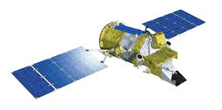
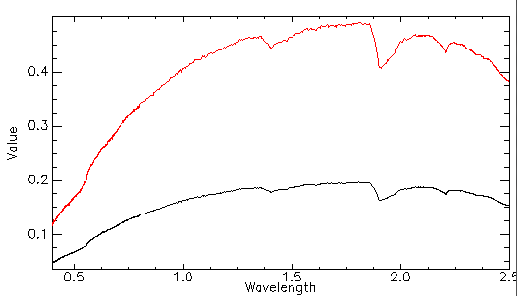
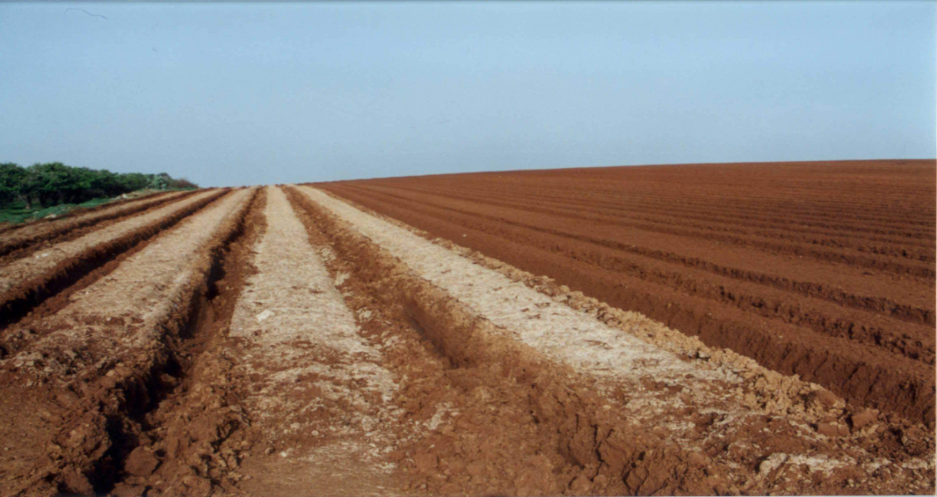
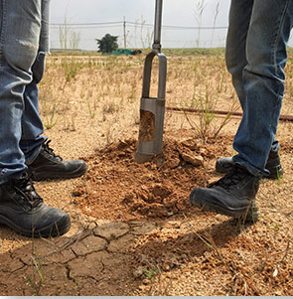
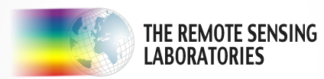
Earth surface is changing from one time to another SOIL
Different spectrum : sealed and plowed - same soil

Slide 5
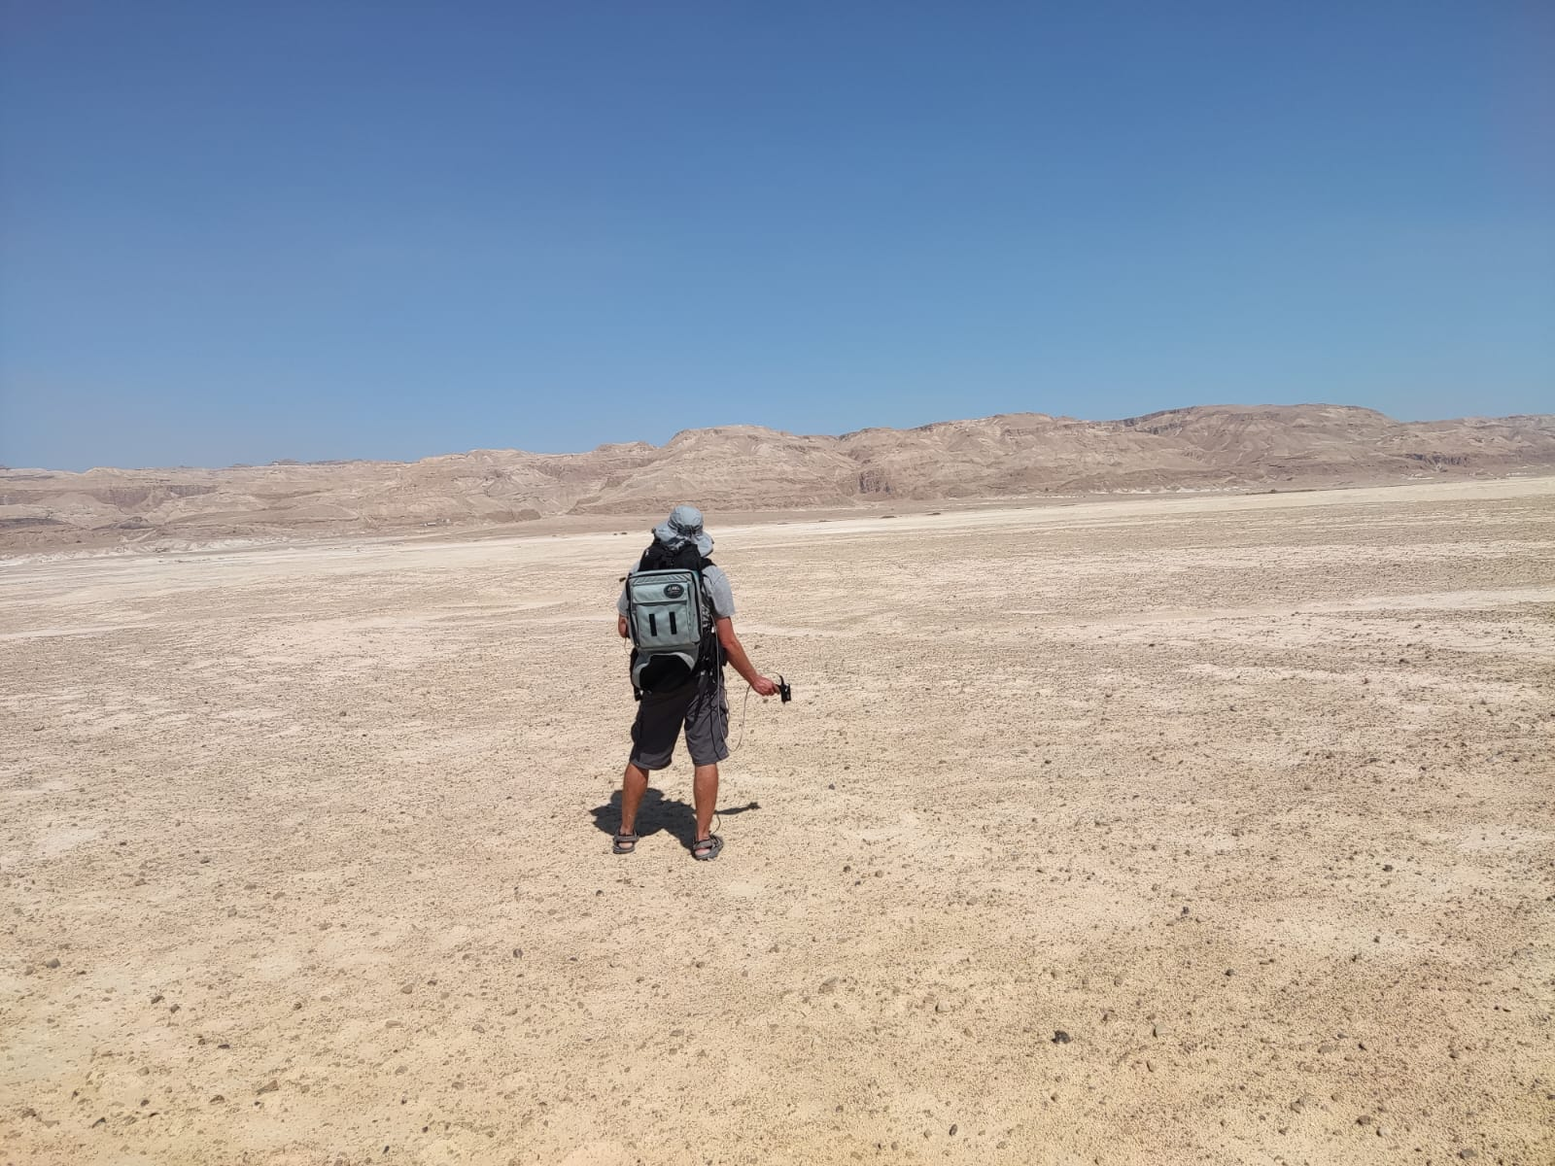
Global Cross Calibration of field (surface) measurements
Fact: Each site uses different spectrometer. Cross Calibration is important with other instruments as well as with the local spectrometer
Vicarious Calibration
Problem : There is no way to generate a reliable cross calibration between sites and on a global scale
CAL/ VAL TEST SITES
Global
CEOS

Slide 6
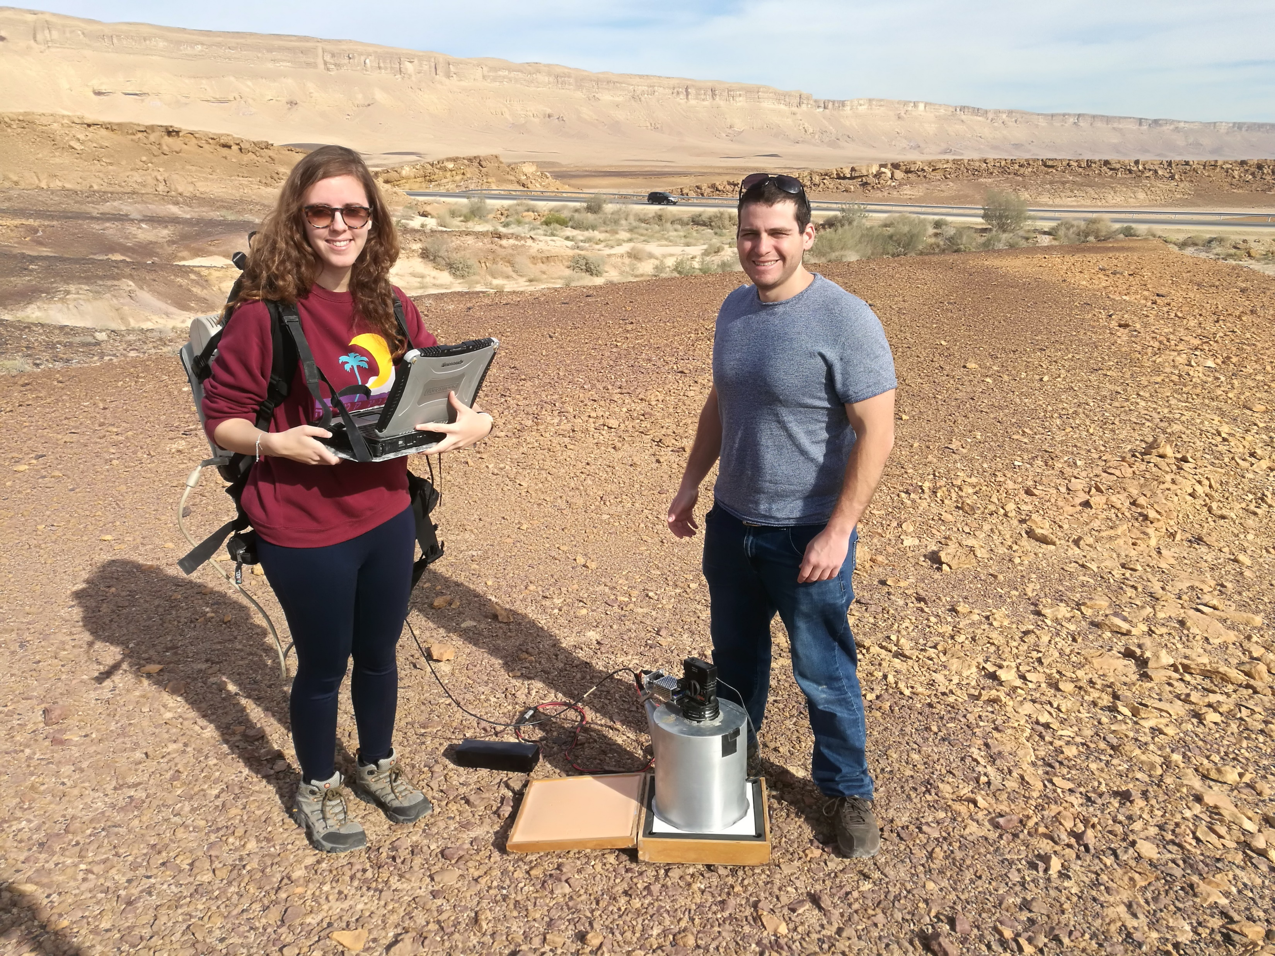
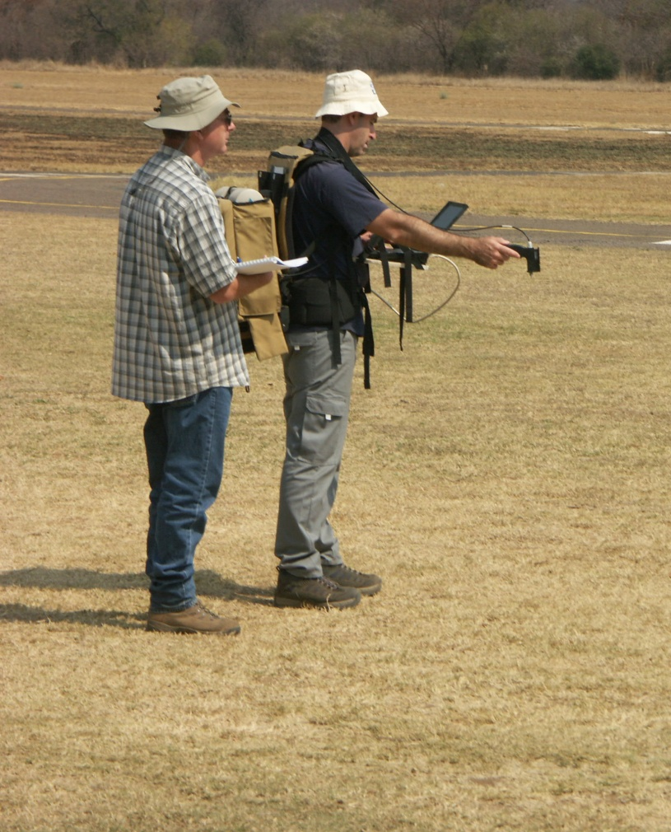
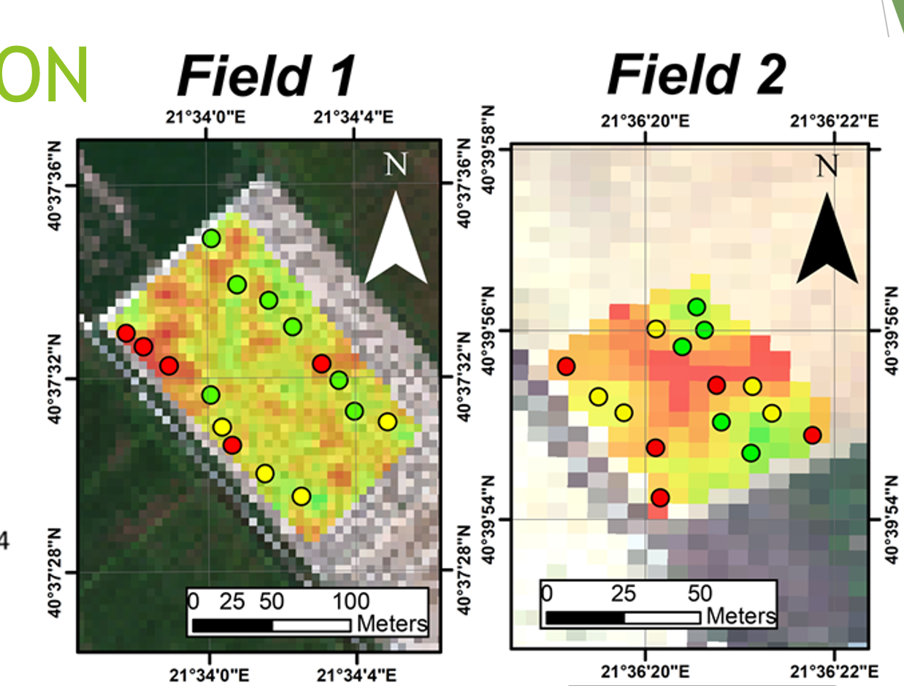
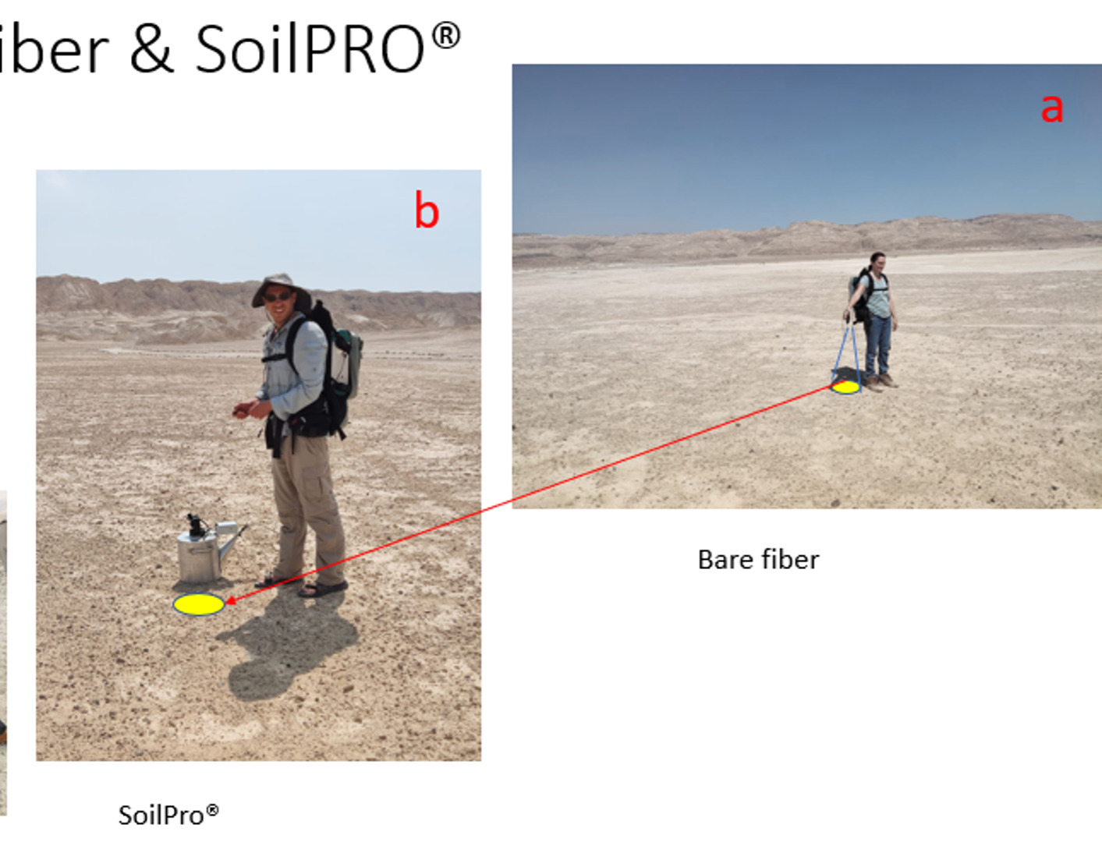
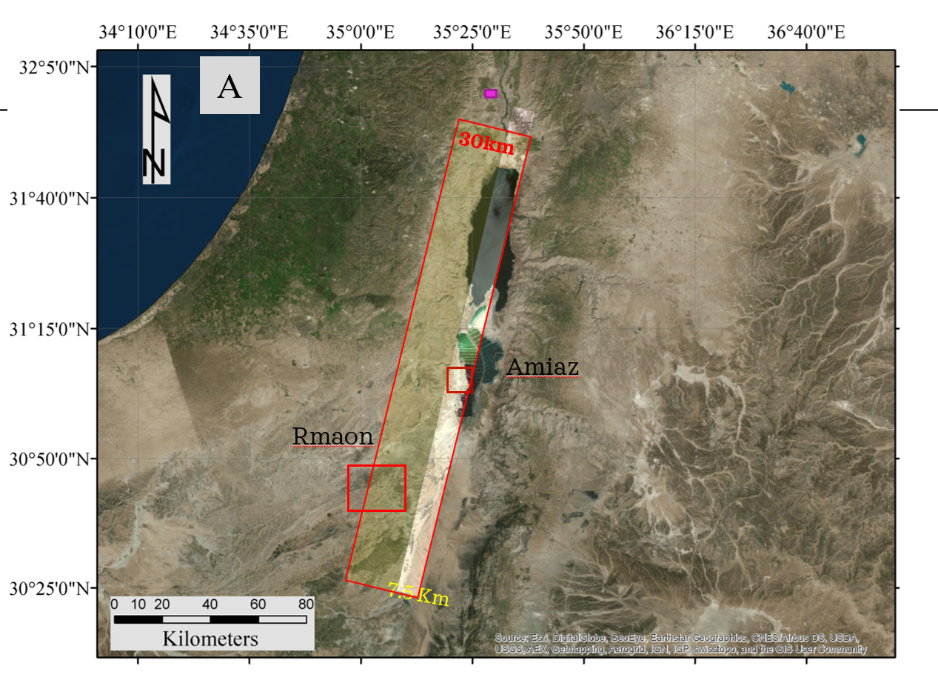
The importance of surface/soil reflectance for remote sensing
Thematic Maps
Ground
Truth
Satellite Overpass
Cal Val

Slide 7

The solution
Harmonization
of the surface spectral measurement

Slide 8

To perform standard measurements and Harmonization of surface reflectance
Inspired by internal standards concept of the lab measurements and the SoilPro® apparatus
Goal
To combine measurements from the same and different users
To harmonize different spectrometers from different locations
To obtain a laboratory quality spectra in the field conditions

Slide 9
The Internal Soil Standard (ISS) idea
systematic effect
No protocol
protocol
Precision
No protocol
ISS
ISS
Accuracy
Non systematic effect
ISS
Internal Soil Standard
protocol
ISS
ISS
Perfect Condition
Target for all

Slide 10
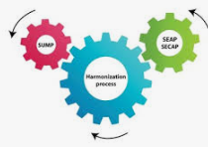
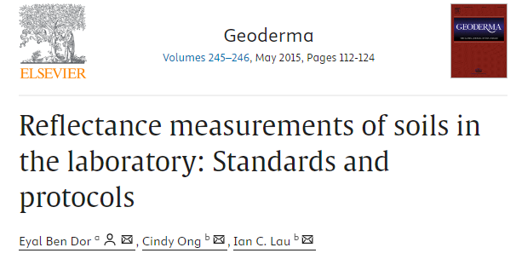
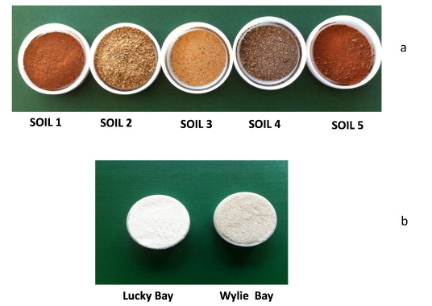
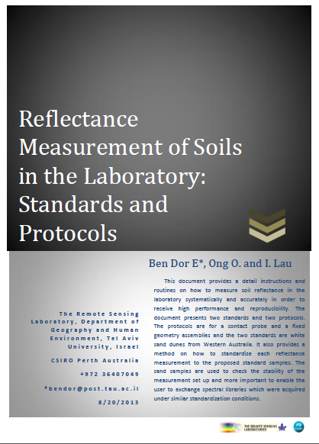

Solution:
Harmonization
standard and protocol
2015 First paper of SSL harmonization of Lab measurements
Chemistry
Spectroscopy
Internal Soil Standard

Slide 11
Using ISS to correct laboratory spectrum from difference spectrometer using the same soil
CSIRO -0 (master)
ISS Corrected
Original

Slide 12
Papers using LB as ISS 2018-2023
Chabrillat, S., Gholizadeh, A., Neumann, C., Berger, D., Milewski, R., Ogen, Y., & Ben-Dor, E. (2019). Preparing a soil spectral library using the Internal Soil Standard (ISS) method: Influence of extreme different humidity laboratory conditions. Geoderma, 355, 113855.
‏Francos, N., Gholizadeh, A., Demattê, J. A. M., & Ben-Dor, E. (2022). Effect of the internal soil standard on the spectral assessment of clay content. Geoderma, 420, 115873.
‏Dor, E. B., Ong, C., & Lau, I. C. (2015). Reflectance measurements of soils in the laboratory: Standards and protocols. Geoderma, 245, 112-124.
Kopačková, V., & Ben-Dor, E. (2016). Normalizing reflectance from different spectrometers and protocols with an internal soil standard. International Journal of Remote Sensing, 37(6), 1276-1290.
‏
Romero, D. J., Ben-Dor, E., Demattê, J. A., e Souza, A. B., Vicente, L. E., Tavares, T. R., ... & Eitelwein, M. T. (2018). Internal soil standard method for the Brazilian soil spectral library: Performance and proximate analysis. Geoderma, 312, 95-103.
Chabrillat, S., Gholizadeh, A., Neumann, C., Berger, D., Milewski, R., Ogen, Y., & Ben-Dor, E. (2019, January). Standards and protocols for the reflectance measurements of soils in the laboratory: Influence of different laboratory humidity conditions and set-ups. In Geophysical Research Abstracts (Vol. 21).‏
‏
Crucil, G., Castaldi, F., Aldana-Jague, E., van Wesemael, B., Macdonald, A., & Van Oost, K. (2019). Assessing the performance of UAS-compatible multispectral and hyperspectral sensors for soil organic carbon prediction. Sustainability, 11(7), 1889.
‏Karyotis, K., Angelopoulou, T., Tziolas, N., Palaiologou, E., Samarinas, N., & Zalidis, G. (2021). Evaluation of a micro-electro mechanical systems spectral sensor for soil properties estimation. Land, 10(1), 63.
‏Gholizadeh, A., Neumann, C., Chabrillat, S., van Wesemael, B., Castaldi, F., Borůvka, L., ... & Hohmann, C. (2021). Soil organic carbon estimation using VNIR–SWIR spectroscopy: The effect of multiple sensors and scanning conditions. Soil and Tillage Research, 211, 105017.
‏Priori, S., Mzid, N., Pascucci, S., Pignatti, S., & Casa, R. (2022). Performance of a portable FT-NIR MEMS spectrometer to predict soil features. Soil Systems, 6(3), 66.
Lau, I. C., Ong, C. C., Laukamp, C., de Caritat, P., & Thomas, M. (2017, July). The acquisition and processing of voluminous spectral reflectance measurements of soils and powders for national datasets. In 2017 IEEE International Geoscience and Remote Sensing Symposium (IGARSS) (pp. 4482-4484). IEEE.
Ward, K. J. (2024). Estimation of soil organic carbon using hyperspectral remote sensing data and a large scale soil spectral library-from laboratory to space.‏
Noble, R. R. P., Henne, A., Stromberg, J., Lau, I. C., Pejcic, B., & Pinchand, G. T. (2024). The effect of biosecurity heat treatment on soils: implications for soil analytical methods and mineral exploration. Geochemistry: Exploration, Environment, Analysis, geochem2024-017.‏
Francos, N., Ogen, Y., & Ben-Dor, E. (2021). Spectral Assessment of Organic Matter with Different Composition Using Reflectance Spectroscopy. Remote Sens. 2021, 13, 1549.‏
Gerritse, R. G., Wallbrink, P. J., & Murray, A. S. (1998). Accumulation of phosphorus and heavy metals in the Swan-Canning Estuary, Western Australia. Estuarine, Coastal and Shelf Science, 47(2), 165-179.‏
Francos, N., Ogen, Y., & Ben-Dor, E. (2021). Spectral assessment of organic matter with different composition using reflectance spectroscopy. Remote Sensing, 13(8), 1549.‏
‏
Angelopoulou, T., Chabrillat, S., Pignatti, S., Milewski, R., Karyotis, K., Brell, M., ... & Zalidis, G. (2023). Evaluation of airborne hyspex and spaceborne PRISMA hyperspectral remote sensing data for soil organic matter and carbonates estimation. Remote Sensing, 15(4), 1106.‏
Mzid, N., Castaldi, F., Tolomio, M., Pascucci, S., Casa, R., & Pignatti, S. (2022). Evaluation of agricultural bare soil properties retrieval from Landsat 8, Sentinel-2 and PRISMA satellite data. Remote Sensing, 14(3), 714.‏
Francos, N., Heller-Pearlshtien, D., Demattê, J. A., Van Wesemael, B., Milewski, R., Chabrillat, S., ... & Ben-Dor, E. (2023). A Spectral Transfer Function to Harmonize Existing Soil Spectral Libraries Generated by Different Protocols. Applied and Environmental Soil Science, 2023(1), 4155390.‏
‏Karyotis, K., Tsakiridis, N. L., Tziolas, N., Samarinas, N., Kalopesa, E., Chatzimisios, P., & Zalidis, G. (2023). On-site soil monitoring using photonics-based sensors and historical soil spectral libraries. Remote Sensing, 15(6), 1624.‏

Slide 13
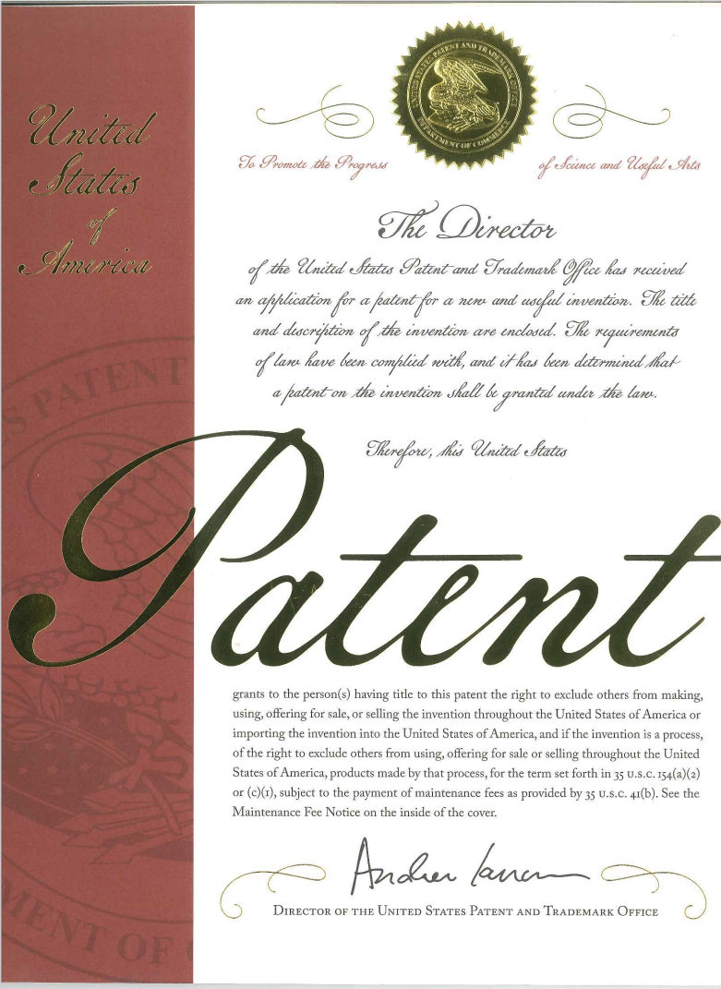
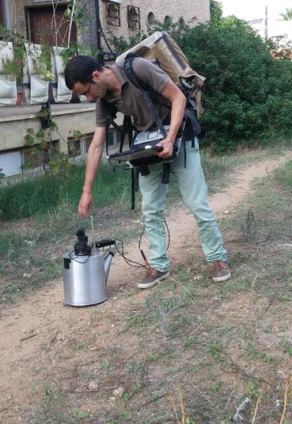
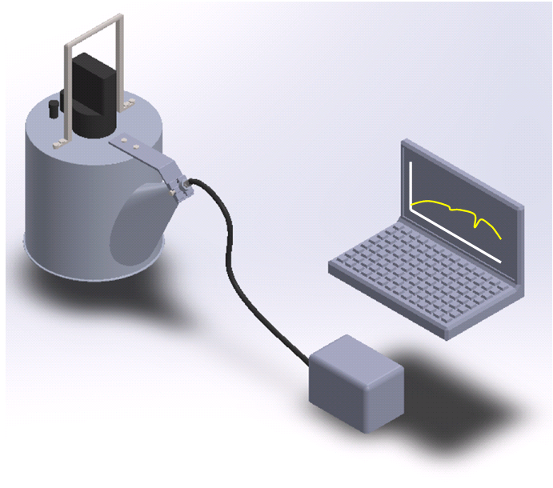
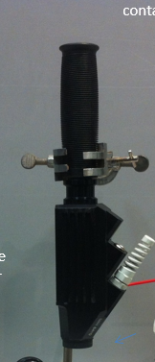
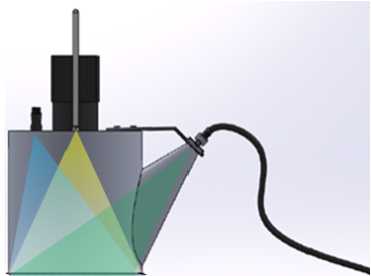
The “SoilPro” takes the advantage of each method (lab and field) and minimize the human/ radiation / geometry uncertainties
Easy and fast to operate
Operational laptop
Constant (lab) geometry
Stable illumination & viewing angel
spectrometer
No atmosphere
Camera & laser pointer
Illumination source
Preserving the surface

Slide 14
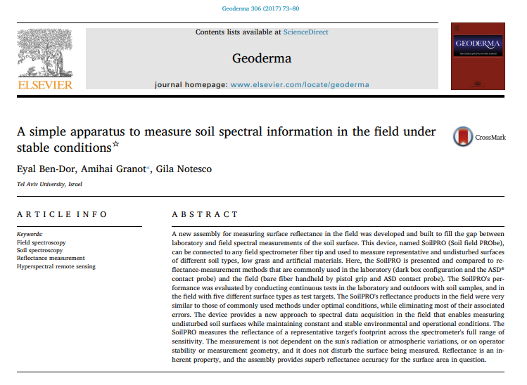
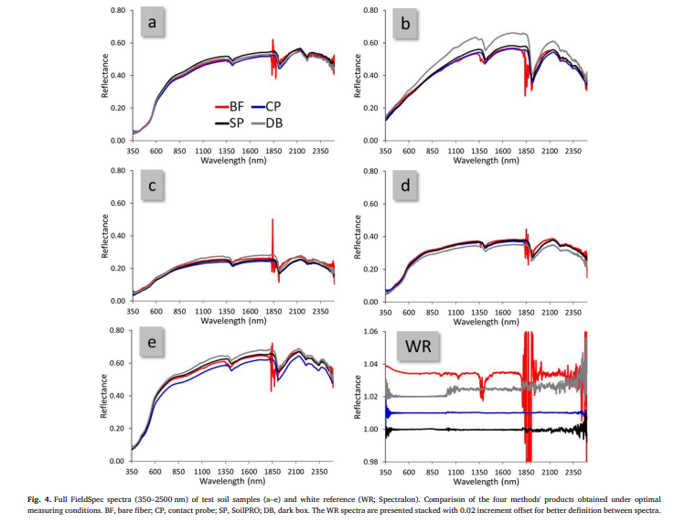
Soil Pro (SP) : Examination Vs Contact Probe (CP) Dark Box ( DB) and Bare Fiber ( BF )
A New Protocol to Measure Soil Reflectance In the Field
2017
Soil field Probe
(SoilPRO® )
The SoilPRO assembly is under patent pending process, Patent application no. Patent Application: No. 62/278,471, Filed: 14/01/2016.
WR measurements after 6 hours

Slide 15

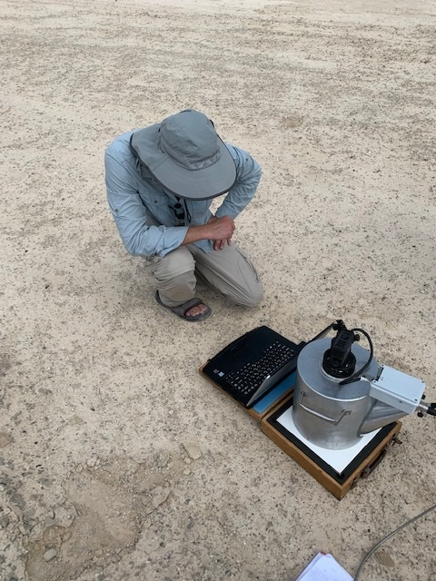
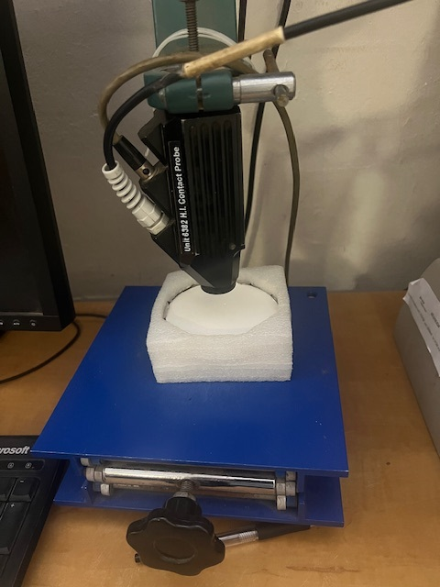
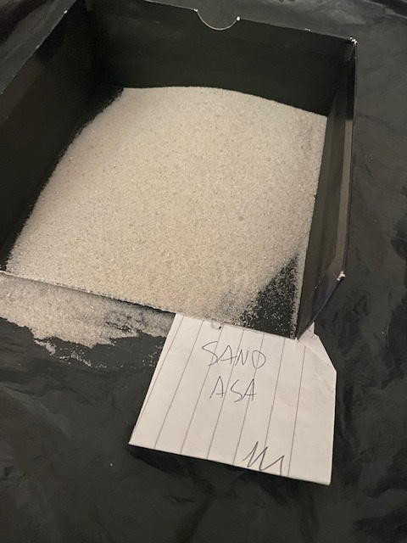
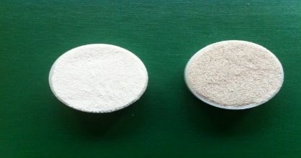
Suggested protocol for harmonization
Harmonization
Ref –Feld-lb
Ref –lab lb
WR-Field
Ref –lab lb
ISS-Field (FISS)
Ref-lab
Field Soil (LB corrected)
Ref –Feld-lb
Lucky Bay
Wiely Bay
Ref –Field
WR-Lab
ISS-Lab
Sand At the User preferences
As a ISS-Field (FISS)
Field Soil
Measurement at Laboratory
(TF)
Transfer Function (TF)
ISS-Field -> ISS-Field-Lab

Slide 16

Material and Methods

Slide 17
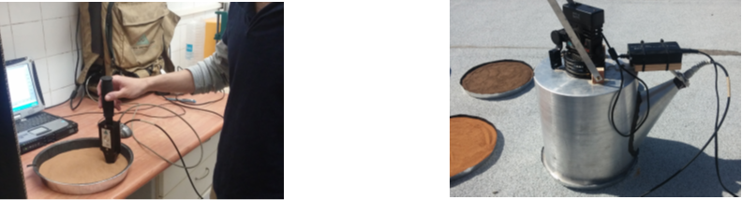
Applying a Ring Test
Material and Methods
The same six soils were shipped and measured at six different labs with CP (with LB as an ISS lab and with the SP (with SAND as an ISS-Field ) – after P4005 protocol
Six Labs:
CZU – Czech Republic ASD FieldSpe , FS4 , SP 2
TAU – Tel Aviv Israel ASD FieldSpec , FS3 - SP 1
ARO – Beit Dagan Israel , FS4 SP 1
BGU – Sde Boker Israel, ASD FieldSpec FS4, SP 1
US – Boston FS4 NG SP3
SE- NaturaSpec SE SP2
FS – ASD Field Spec
SE- Spectral Evolution
SP- SoilPro
CP –Contact Probe
CP with LB and all soils (IEEE SA Protocol chapter 1,2 )
SP With SAND and all (IEEE SA Protocol chapter 1,3 )
CP (Contact Probe)
SP (Soil Probe)

Slide 18
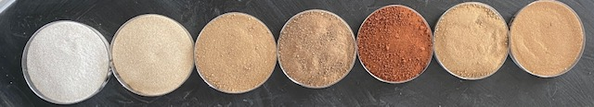
KFAR YONA
SAND
BEIT YANAI
NIR OZ
KOCHAV
NACHBIR
SDE NIZAN
The soils selected for this examination
1
2
3
4
5
6
7
7.5 YR 7/1
2.5Y 7/4
10YR 5/4
2.5YR 2.5/4
2.4YR 3/6
2.5Y 6/6
10YR 6/6
No | Name | Sand | Silt | Clay | OC | CaCO3 | USDA
1 | SDE NIZAN | 81.3 | 9.1 | 9.6 | 0.22 | 6.14 | Psaaents
2 | BEIT YANAI | 78.15 | 14.3 | 10.9 | 0.46 | 14.56 | Quaerzipsamments
3 | NIR OZ | 70.9 | 11.3 | 14.9 | 0.65 | 15.35 | Torrfluvent
4 | KOCHAV | 48.7 | 16.7 | 31.2 | 0.93 | 13.27 | Haplogrid
5 | KFAR YONA | 81.8 | 4.4 | 19.7 | 0.21 | 1.05 | Rhodoxeralf
6 | NACHBIR | 68.8 | 11.9 | 14.9 | 0.32 | 14.08 | Xerothents
7 | SAND

Slide 19
The Instruments used in all six laboratories
Laboratory | Spectrometer | SoilPRO® | Comments
CZU | ASD FieldSpec® 3 (model FSP 350–2500 nm) | # 6 | First measurements after Retuned from calibration (2023)
TAU | ASD FieldSpec® 3 (model FSP 350–2500 nm) | # 1 | Last calibration 2015
ARO | ASD FieldSpec® 4 (model FSP 350–2500 nm) | # 1 | Last calibration 2019
BOKER | ASD FieldSpec® 4 (model FSP 350–2500 nm) | # 1 | Last calibration 2016
US | ASD FieldSpec 4 NG (model FSP 350–2500 nm) | # 2 | Last calibration 2023
SE | Spectral Evolution NaturaSpec (350-2500nm) | # 6 | Last calibration 2024

Slide 20

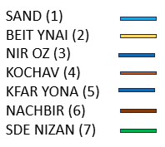
Result 1
The soil spectral of all soils as measured in the TAU laboratory (CP-TAU) corrected to LB (CP LB) and measured in the field by the SoilPRO (SP)
Reflectance
Reflectance
Wavelength (nm)
Wavelength (nm)
Reflectance
Wavelength (nm)

Slide 21
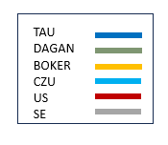
The spectra of SAND sample from CZU as measured in the laboratory and corrected to LB (CP LB), in the field (SP) and in the field corrected to the SAND (SP SAND LB). The 1700nm arrow shows the position where SD was calculated between the spectra
SAND
Reflectance
Reflectance
1700 nm
1700 nm
Reflectance
CP - Contact Prob
SP –Soil Pro
SP SAND LB- Soil Pro Corrected to CZU SAND LB
1700 nm
Wavelength (nm)

Slide 22
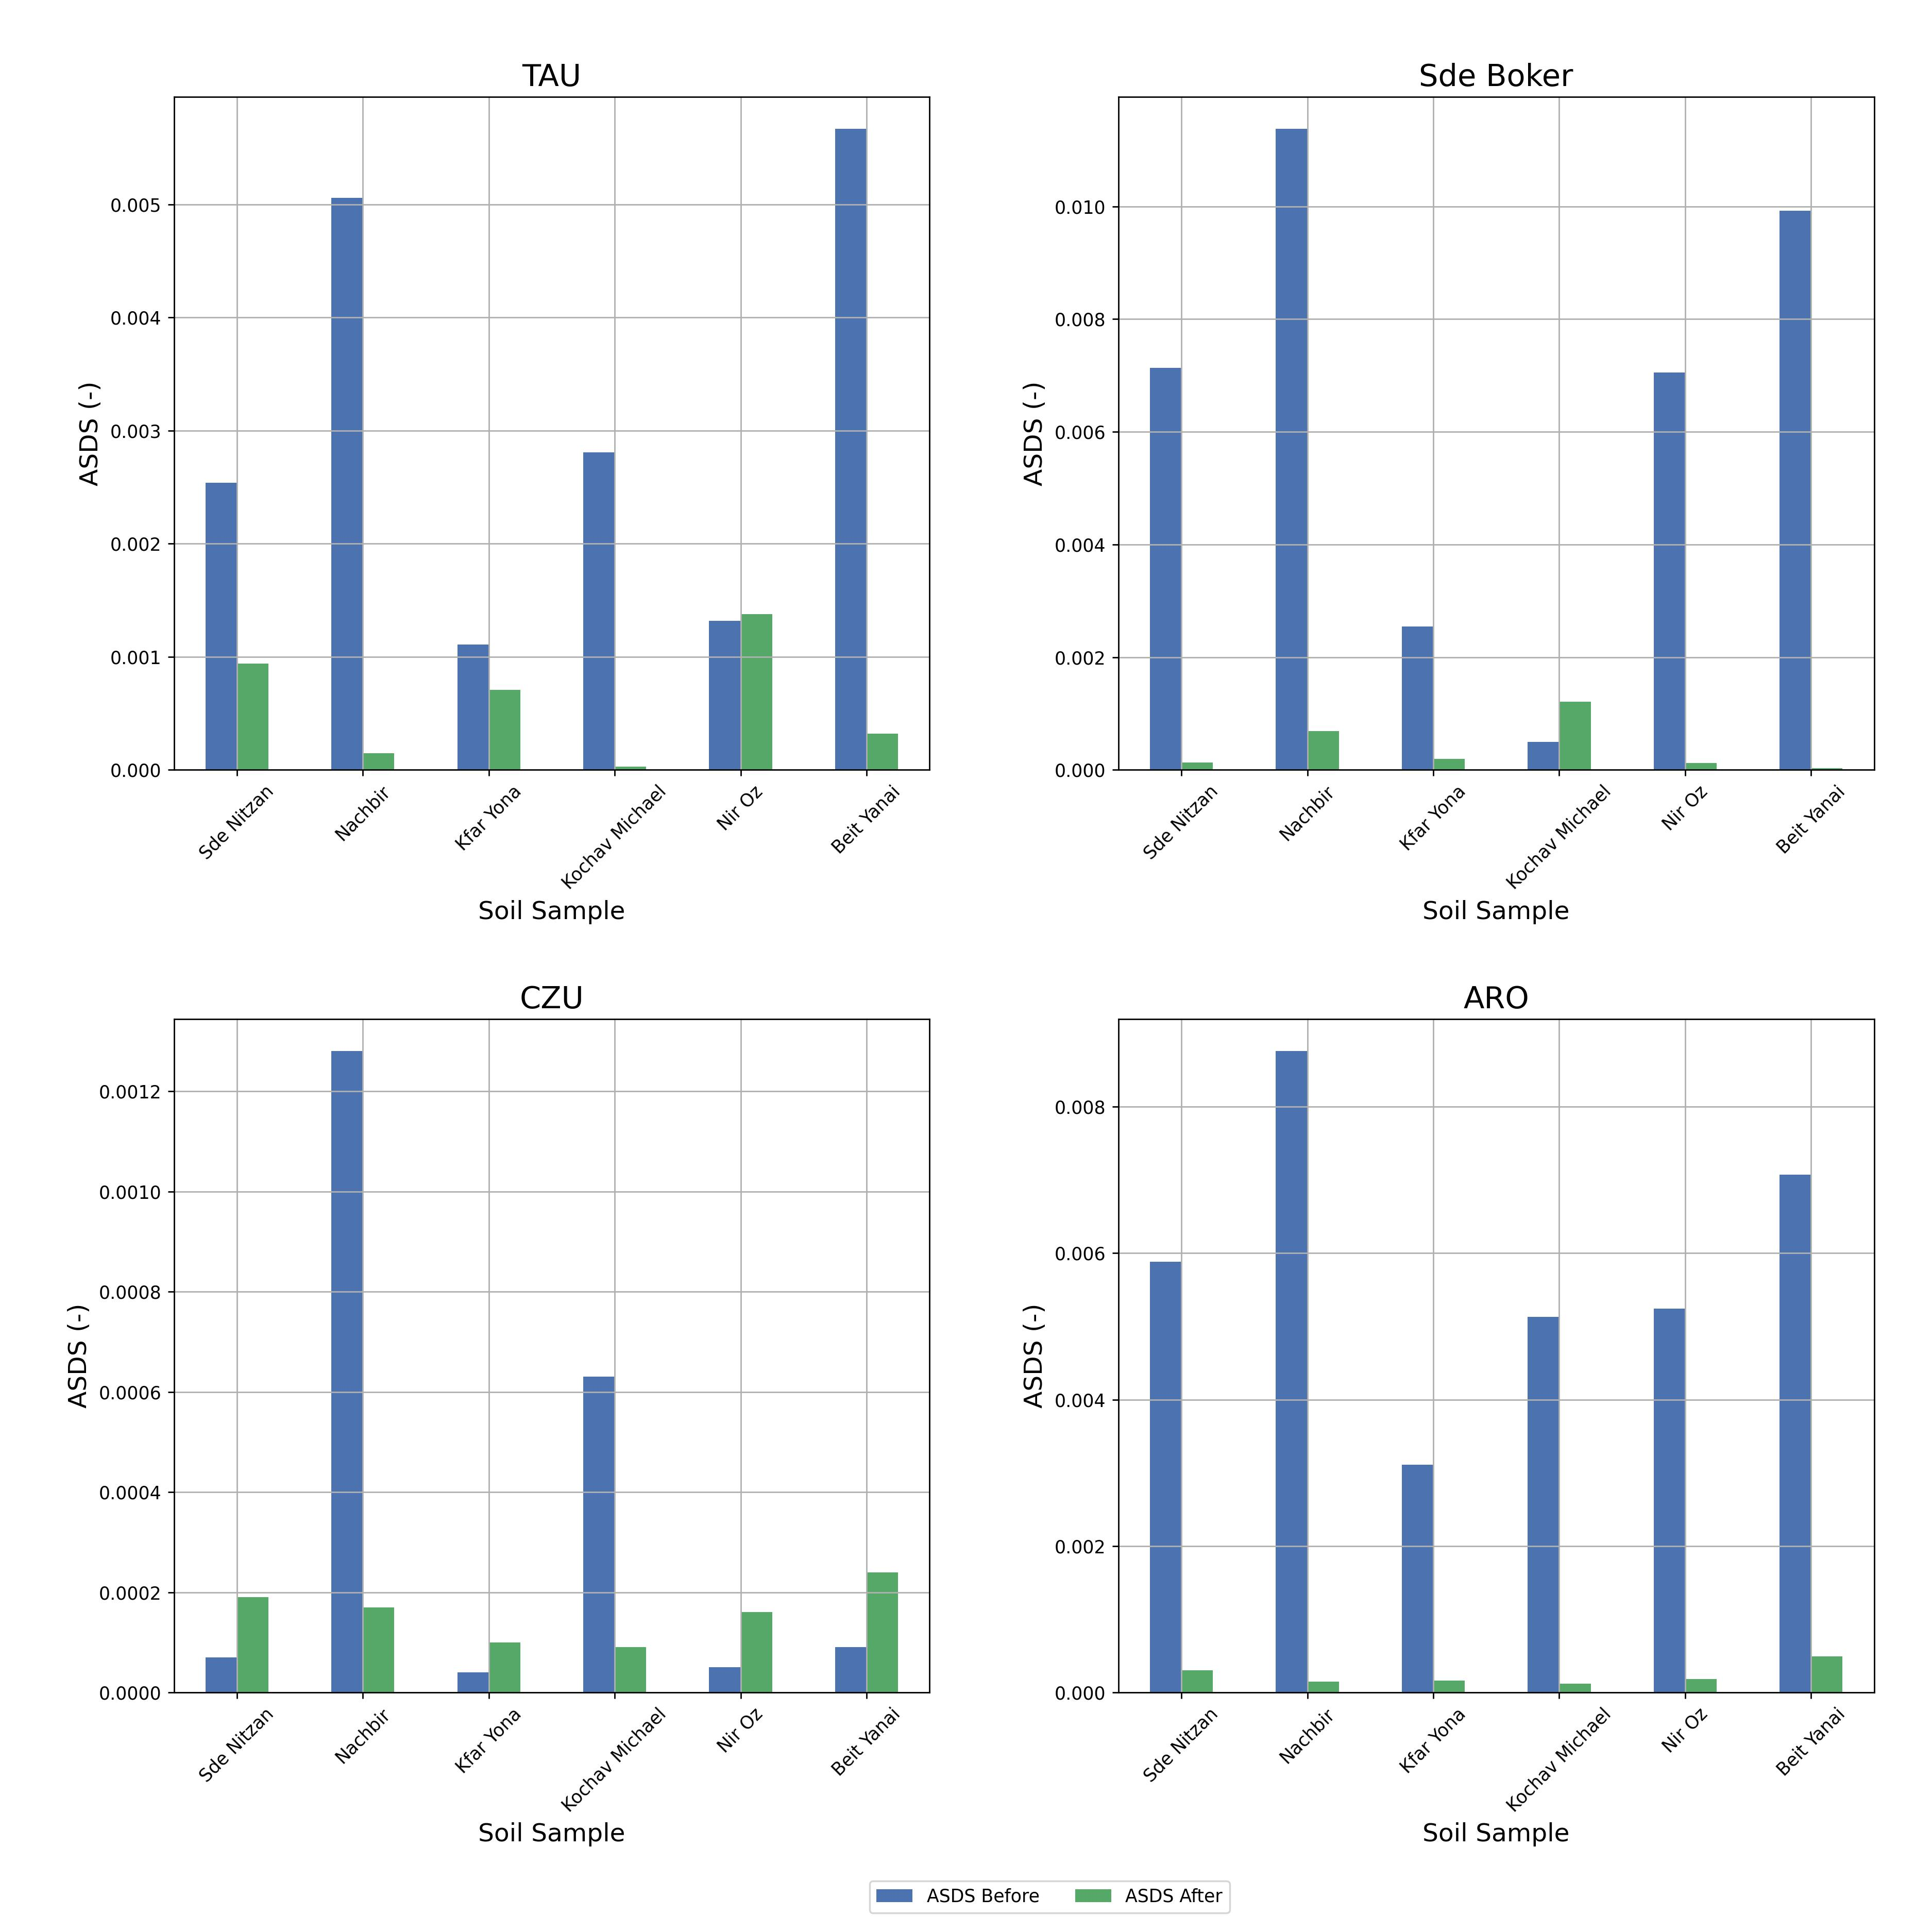
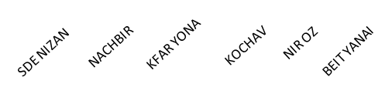
ASDS: Lower number Higher harmonization
TAU
BOKER
ASDS
SDE NIZAN
NACHBIR
KFAR YONA
KOCHAV
NIR OZ
BEIT YANAI
SDE NIZAN
NACHBIR
KFAR YONA
KOCHAV
NIR OZ
BEIT YANAI
ASDS Before
ASDS
NIR Z
CZU
DAGAN
SE
ASDS After
ASDS
SDE NIZAN
NACHBIR
KFAR YONA
KOCHAV
NIR OZ
BEIT YANAI
SDE NIZAN
NACHBIR
KFAR YONA
KOCHAV
NIR OZ
BEIT YANAI
SDE NIZAN
NACHBIR
KFAR YONA
KOCHAV
NIR OZ
BEIT YANAI
Soil SAMPLES

Slide 23
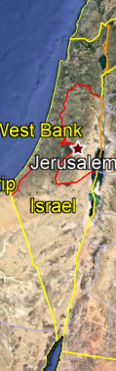
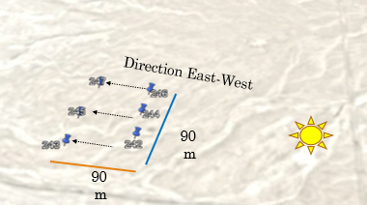
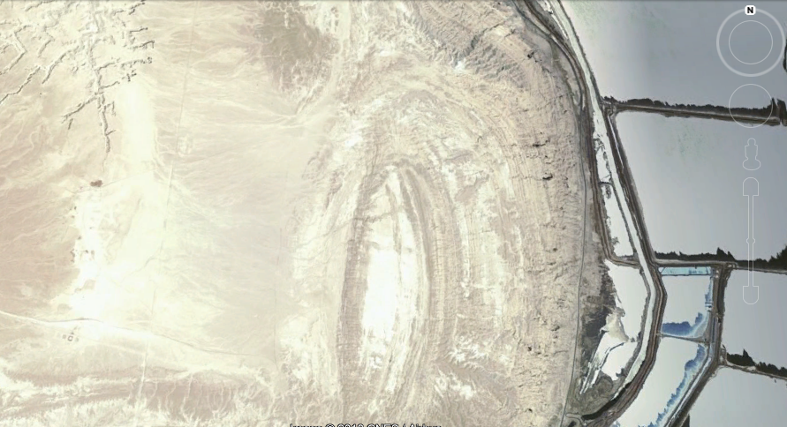
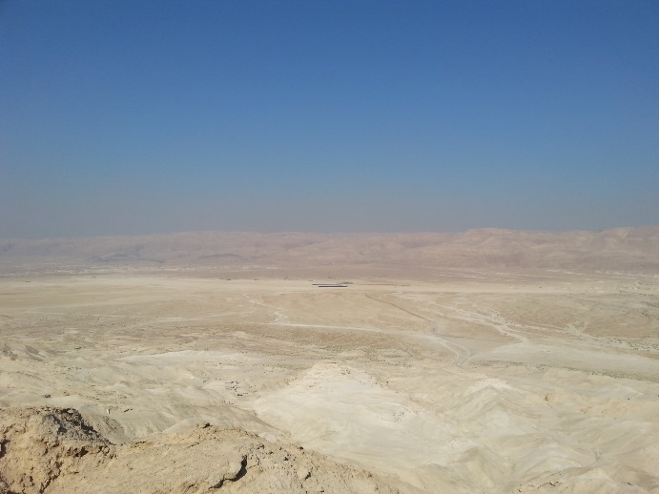




Amiaz Playa a Cal/Val site for EnMAP
Homogeneous bright playa of silty carbonate, easy to access, ideal SVC for HSR sensors
Amiaz
Sedom Mount
5km
3 lines= 30 X 3= 90 points
Between lines = 48 points
Total =138 points

Slide 24
SoilPRO® VS. Bare Fiber
AVG SD 0.038
AVG SD 0.046
Average
SD
SP : all spectrum. Low SD
BF : no Information 1.4, 1.9 mm, high SD

Slide 25
Harmonization in the Cal/Val for EnMAP using two ASDs over two years apart
ASD FS 4, ASD FS 3
2021, 2022
Soil Pro (harmonized)
Bare Fiber

Slide 26
Harmonization scheme in every CAL/VAL site world wide (“cross calibration”)
systematic effect
No protocol
protocol
Precision
No protocol
Absolute reflectance of SAND at Mother spectrometer
FISS
FISS
Different spectrometer at each CAL VAL site
Of the same sample
Accuracy
Non systematic effect
FISS
Internal Soil Standard
Perfect harmonization in every CAL/VAL measurement at any VC site
protocol
FISS
ISSF

Slide 27
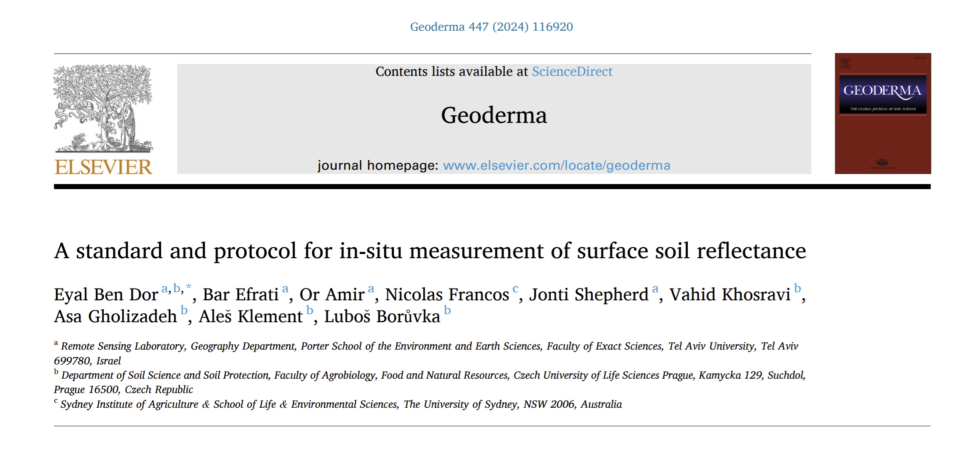
Optimal protocol to measure soil surface reflectance in the field and harmonization of the measurements:
The SoilPRO® approach in IEEE S P4005 WP SG activity

Slide 28
Conclusions
01
02
03
The SP preserve soil (earth) surface condition as seen by RS means (dust, seal, salt, aggregation, litter) with Lab quality
04
The SP is a reliable and easy assembly to measure earth surface in the field with Lab quality
It can be aligned to Lab spectral measurements of soils using (any) SAND that transferers to lab LB
The harmonized SP is a novel method for CAL/VAL enabling standard cross calibration over global VC sites

Slide 29
Answers to the Seed Questions
How many vicarious calibration sites might be needed worldwide to ensure accurate characterization of the radiances and reflectances (L1B and L2 products) returned by spectral imaging missions? And what are the core measurements that should be made at these sites (and uncertainty/performance requirements)?
This presentation suggests that reflectance measuring in a harmonize way through any CAL VAL site . What are the main challenges in harmonizing CAL/VAL approaches across different EO
missions, sites, and campaigns, and how can these be addressed?
Cross calibration: This presentation solve this problem
What is currently missing to carry out holistic and all-encompassing CAL/VAL activities, and how, for example with which innovations, can this be supported?
The SoilPRO® and the IEEE SA P4005 protocol should be adopted
How can emerging technologies, such as artificial intelligence and machine learning, be leveraged to improve the accuracy and efficiency of calibration and validation processes
collecting and Sharing cal val data global wide may open this idea

Slide 30
Thank you for your attention

