Slide 1
Harmonized EnMAP, Landsat and Sentinel-2 Analysis Ready Data cubes for streamlining multisensor environmental monitoring
Akpona Okujeni^{1,2}, Andreas Janz², Lasse Harkort², Christina Karakizi³, Benjamin Jakimow², Sebastian van der Linden⁴, Patrick Hostert²
¹GFZ German Research Centre for Geosciences, Germany, ²Humboldt-Universitaet zu Berlin, Germany, ³Manchester Metropolitan University, United Kingdom, ⁴University of Greifswald, Germany

Slide 2
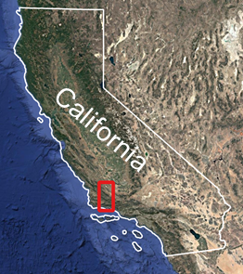
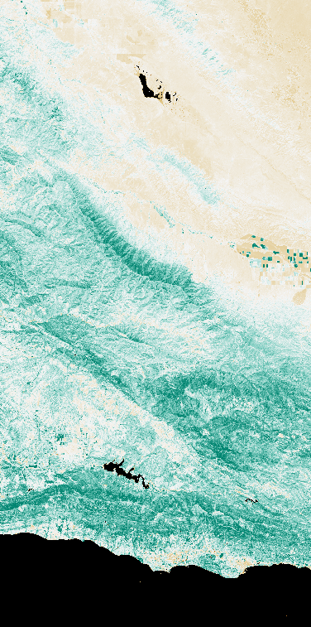
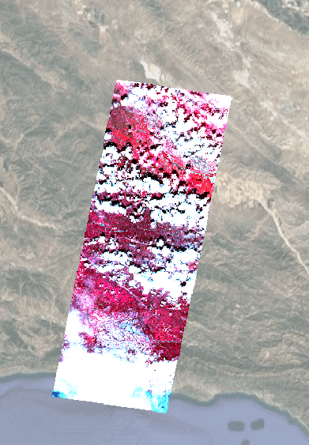
Background
Landsat/Sentinel-2 time series (NDVI)
EnMAP time series
(RGB: 863/660/555 nm)
Effective data harmonization and organization is a prerequisite for exploiting synergies between multi- and hyperspectral time series

Slide 3
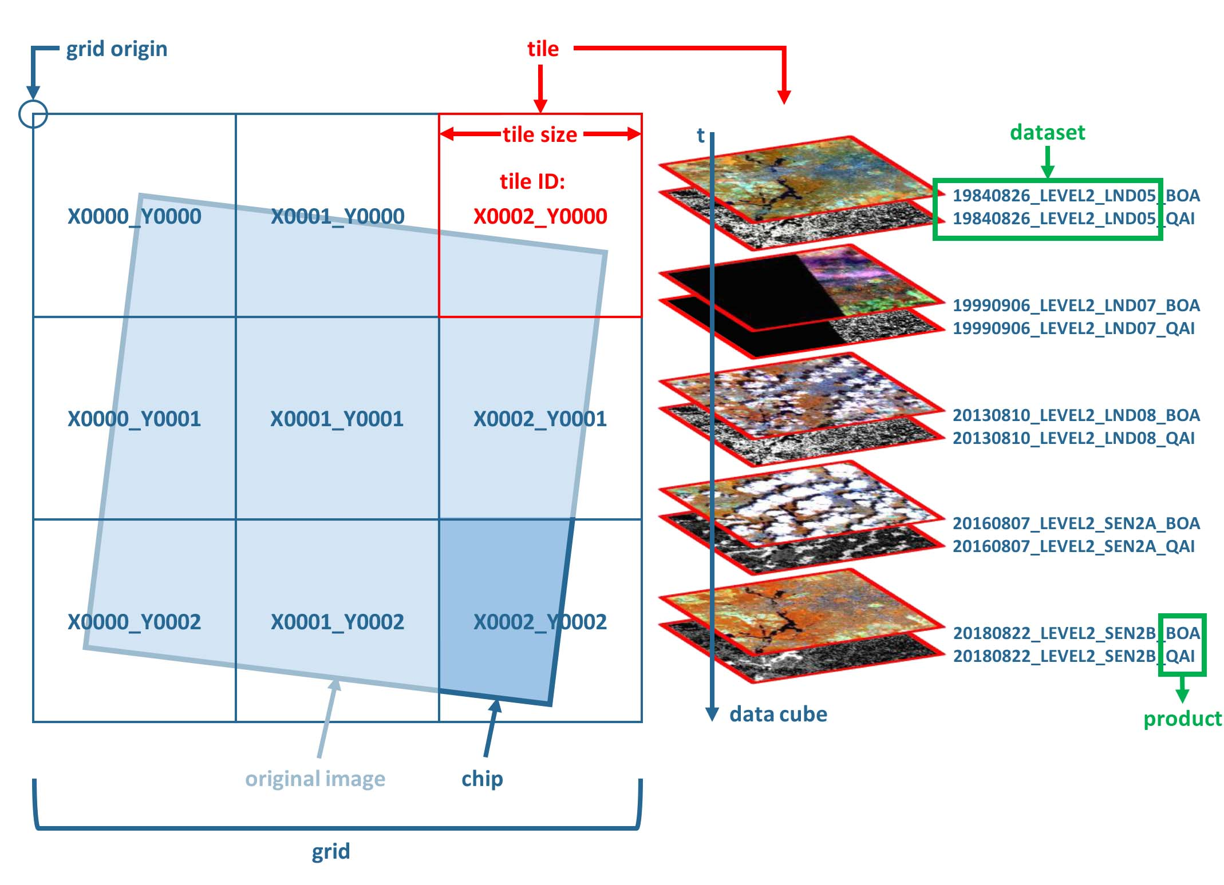
Background
Harmonized multisensor Analysis Ready Data (ARD) cubes streamline time-series processing and enhance time-series applications
e.g. FORCE-enabled harmonized Landsat & Sentinel-2 ARD cube
Consistent radiometric correction
Improved co-registration
Pixel grid alignment
Unified/single coordinate system
Consistent tiling scheme
Frantz (2019)
https://force-eo.readthedocs.io/en/latest/

Slide 4
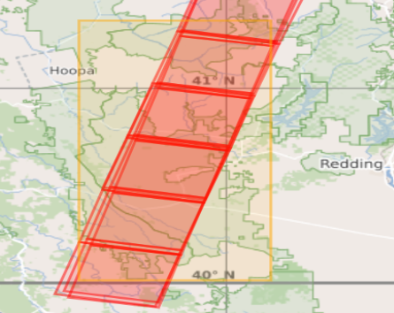
Background
EnMAP L2A ARD is a great source and opens new possibilities for environmental monitoring, but challenges remain…
EnMAP time series processing
Large data volume
No consistent tiling scheme
Co-registration adjustment required
Multisensor applications
Different coordinate systems
Cross-sensor image co-registration
Pixel grid misalignment
https://eoweb.dlr.de/
Streamlining processing of EnMAP L2A ARD poses an research area where further enhancement may be beneficial

Slide 5
Objective
Make use of various open-source tools to develop solutions that streamline the processing of EnMAP L2A ARD
Jakimow et al. (2023)
Scheffler et al. (2017)
https://gdal.org
Improve EnMAP data organization by integration into consistent data cube structure
Harmonize EnMAP with Landsat/Sentinel-2 data for multisensor applications
Poster Session
Scheffler et al. 2024: Latest validation results of the EnMAP Level-2A bottom-of-atmosphere reflectance product produced with the EnMAP Processing Tool (EnPT).
Jakimow et al. 2024: The EnMAP-Box: Advanced visualization and analysis of EnMAP data and beyond.

Slide 6
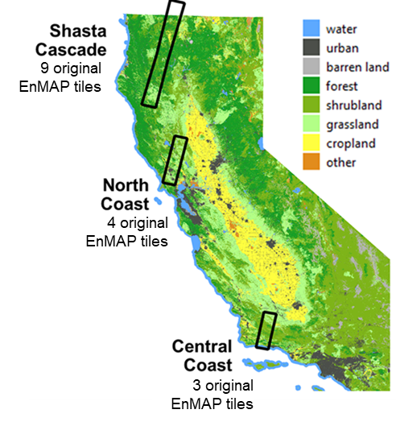
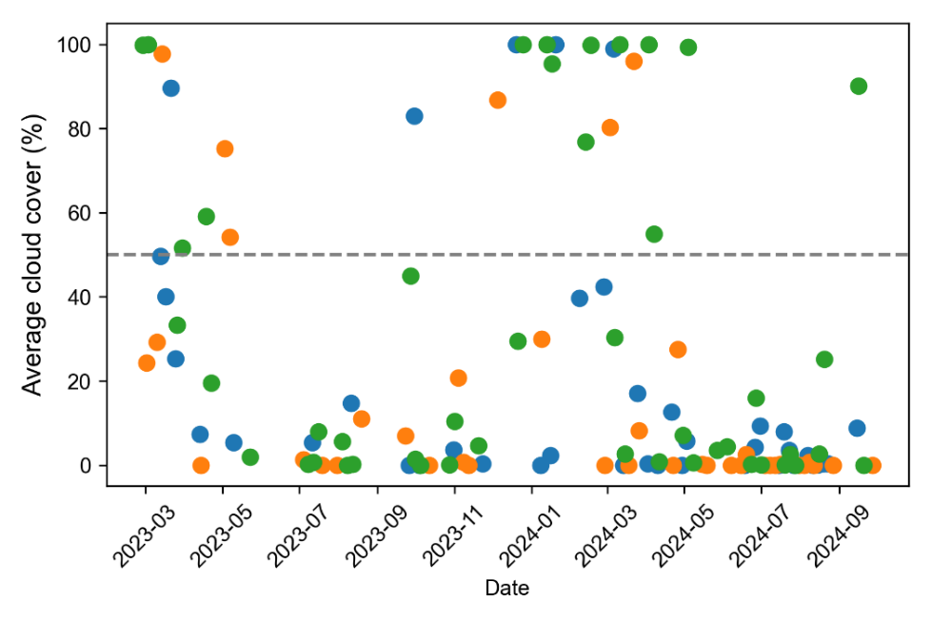
Approach
Retrieval of EnMAP time series for three Californian study sites by requesting 3-4 acquisitions per month per site since March 2023

Slide 7
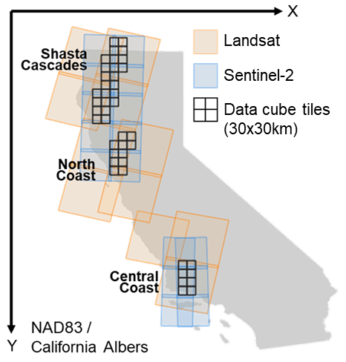
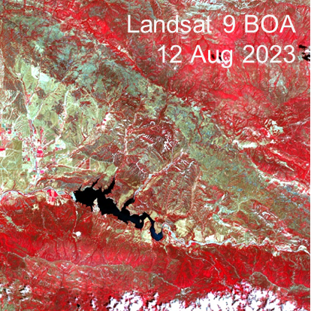
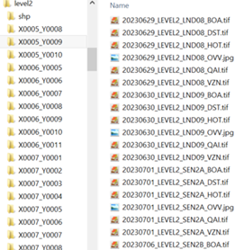
Approach
FORCE-enabled harmonized Landsat & Sentinel-2 data cube, encompassing all imagery since January 2020

Slide 8
Approach
Unpack EnMAP L2A ARD
Jakimow et al. (2023), Scheffler et al. (2017)
Import (raster + metadata)
Spatial alignment
Reprojection
Co-registration
Pixel grid alignment
Landsat / Sentinel-2 cube
Tiling
EnMAP cube

Slide 9
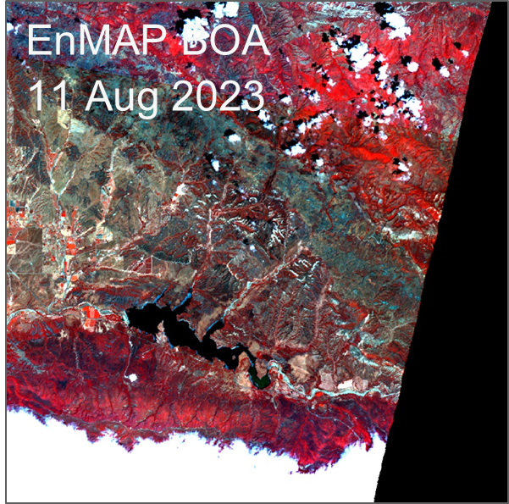
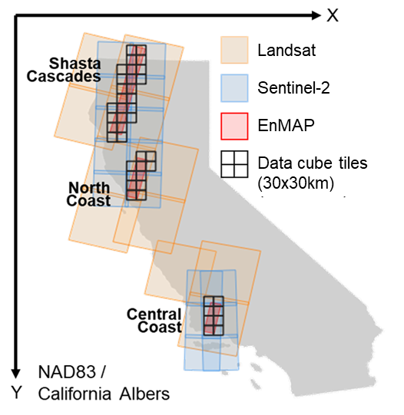
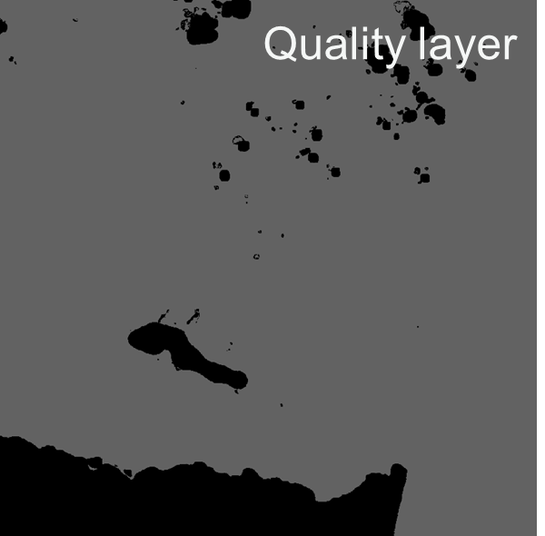
Harmonized ARD cube

Slide 10
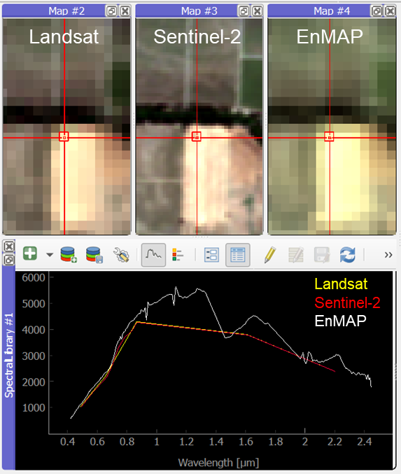
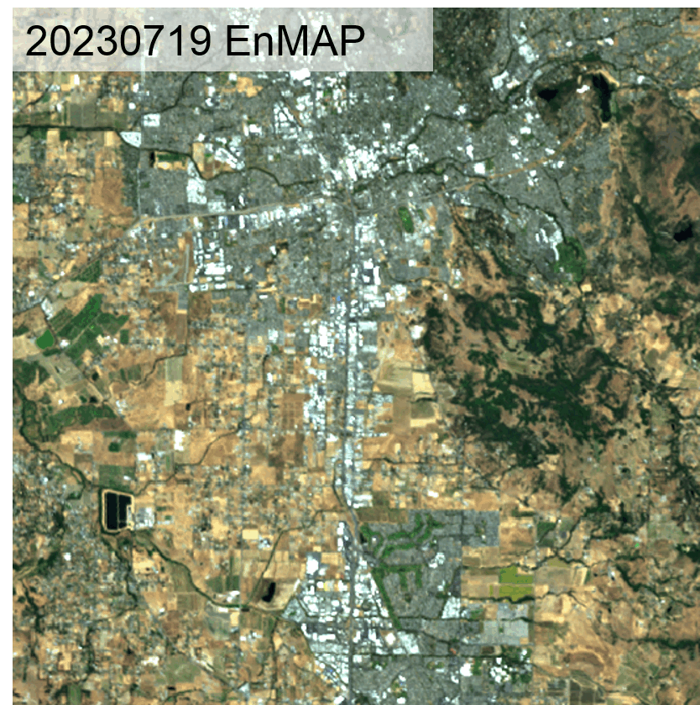
Harmonized ARD cube

Slide 11
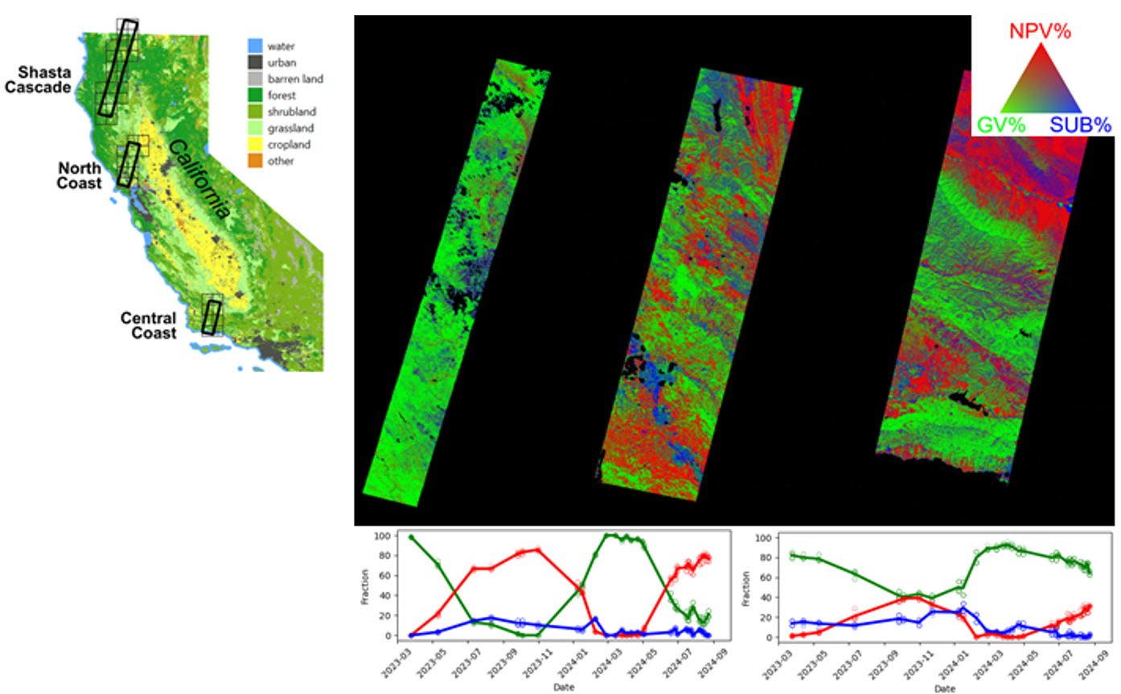
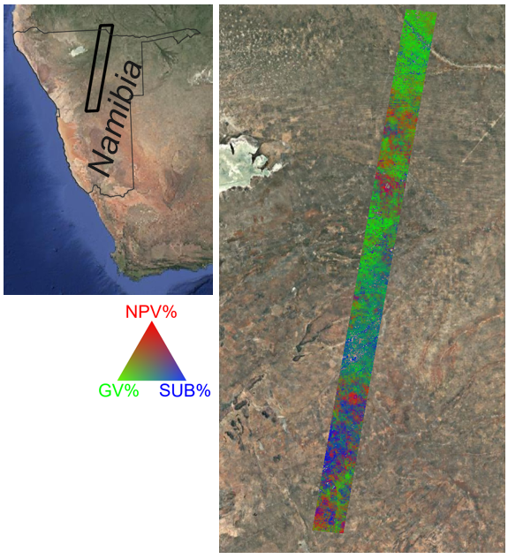
Application example
Time series of Non-Photosynthetic Vegetation (NPV), Green Vegetation (GV), and Substrate (SUB) cover fractions across ecosystems
Talks S9: Open challenges towards high level (L3/L4) global products
Hostert & Serbin: From leaf to space, from spectral bands to spectra – facing new and old challenges in optical remote sensing
Okujeni et al.: A universal retrieval scheme for quantifying time series of non-photosynthetic vegetation across diverse ecosystems from spaceborne hyperspectral data
Okujeni et al. (in prep.)
Harkort et al. (in prep.)

Slide 12
Conclusions
This work provides a workflow that integrates L2 data from different sensors (e.g. EnMAP, Landsat, and Sentinel-2) into a consistent data cube, enabling multisensor time series applications
From a user perspective, users may most benefit from harmonized L2 data and effective data organization. Yet, due to sensor differences, “secondary adjustments” of L2 data or higher level products seem more realistic
How does your work contribute to improving harmonization?
What aspect of harmonization can most benefit users?
At what level of processing is harmonization most necessary?
What is more important, the harmonization on data formats or the harmonization on information content of the products?

Slide 13
Thank you Contact akpona.okujeni@gfz-potsdam.de
EnMAP science projects: EnFireMap, EnMAP-Box, EnMAP-PI 2024-2026

