Slide 1
A universal retrieval scheme for quantifying time series of non-photosynthetic vegetation across diverse ecosystems from spaceborne hyperspectral data
Akpona Okujeni^{1,2}, Lasse Harkort², Dirk Pflugmacher², Sebastian van der Linden³, Patrick Hostert²
¹GFZ German Research Centre for Geosciences, Germany, ²Humboldt-Universitaet zu Berlin, Germany, ³University of Greifswald, Germany

Slide 2
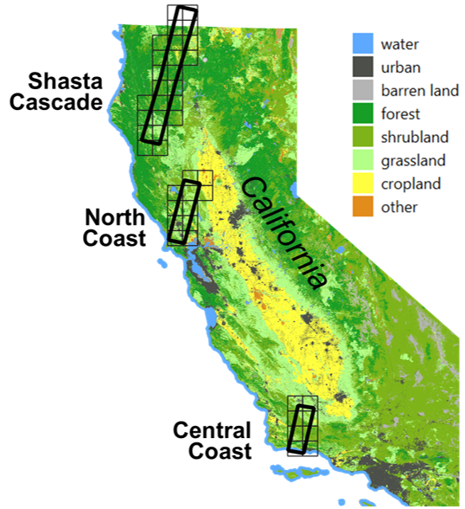
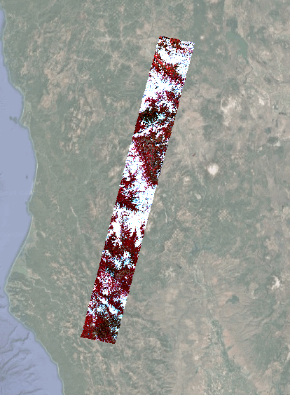
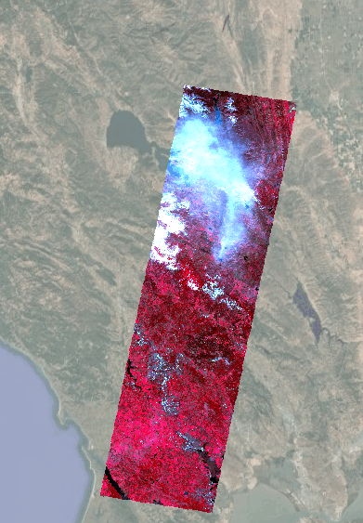
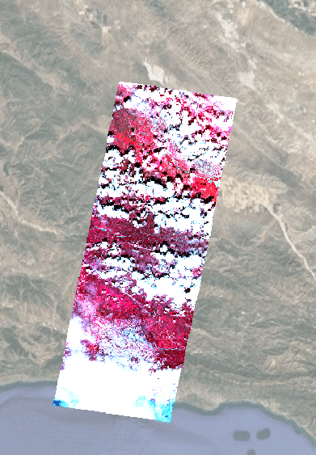
Background
EnMAP time series with close to monthly acquisitions starting from 03/2023 for three Californian sites representing diverse ecoregions
Shasta Cascade
North Coast
Central Coast

Slide 3
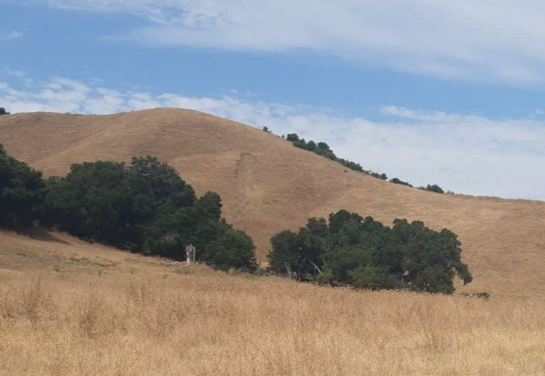
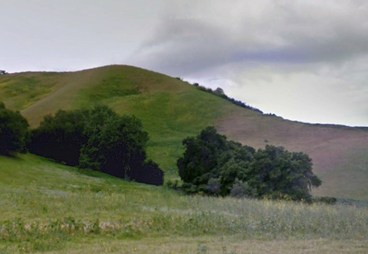
Background
Non-photosynthetic Vegetation (NPV) valuable indicator for many environmental applications
NPV, Green Vegetation (GV) and Substrate (SUB) cover fractions are integral components of fCover products

Slide 4
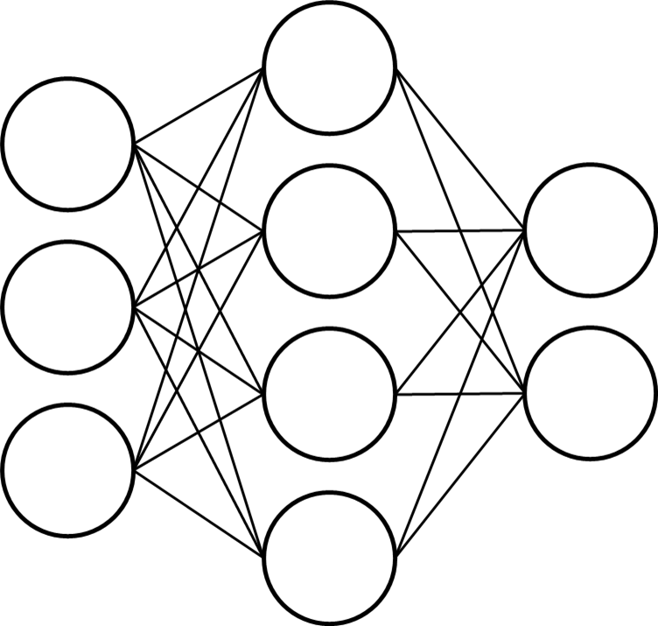
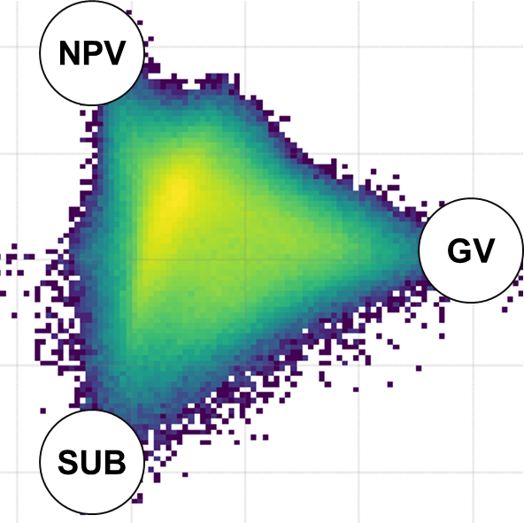
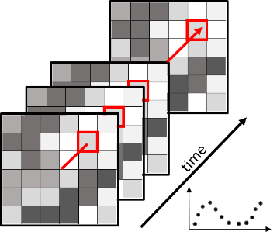
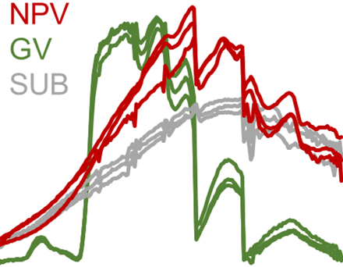
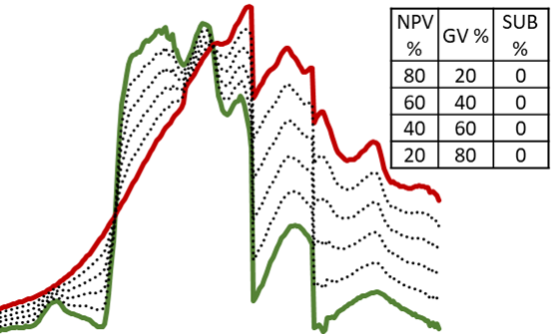
Retrieval scheme
Generalized regression model (NN)
CAI/NDVI feature space for different land cover types
Comprehensive spectral library
Synthetic training data
fCover time series
Spectral databases (EcoSIS)
EnMAP time series
Okujeni et al. (2013), Okujeni et al. (2021), Kowalski et al. (2023), Pham et al. (2024)

Slide 5
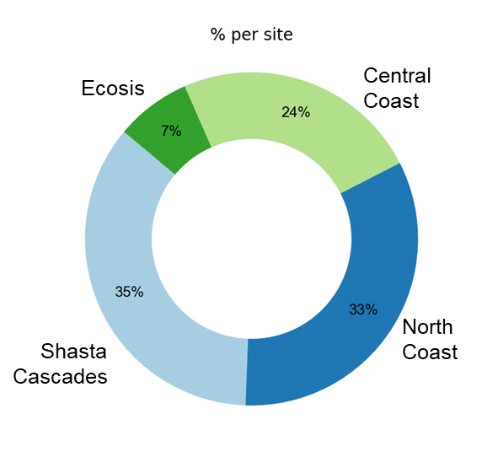
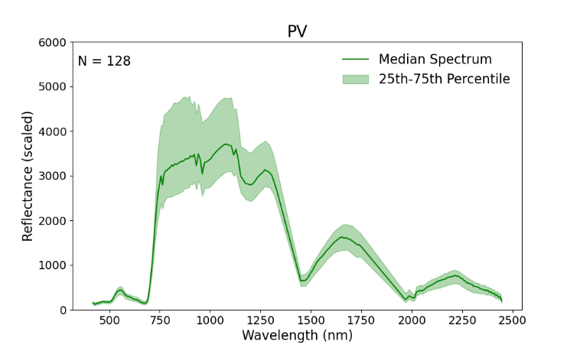
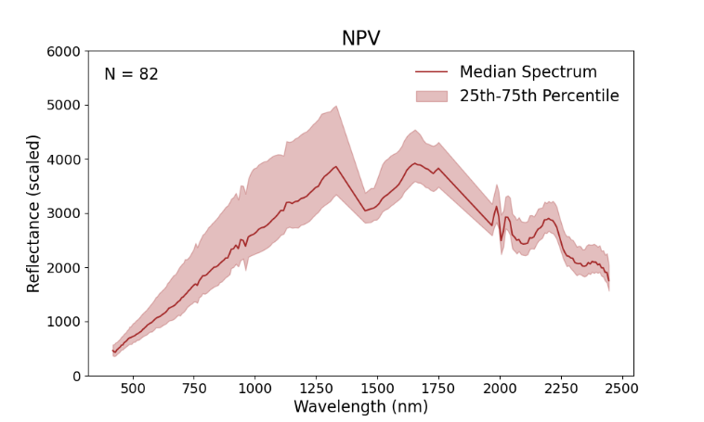
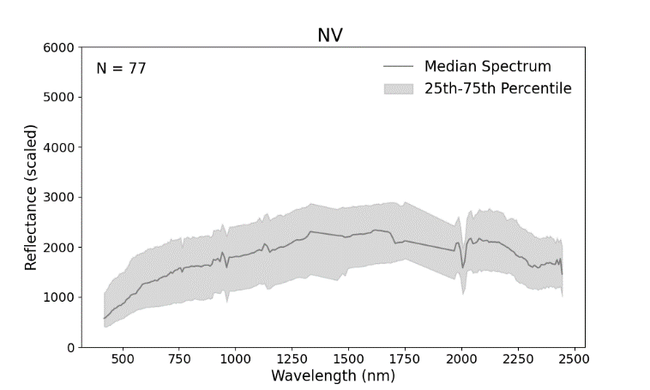
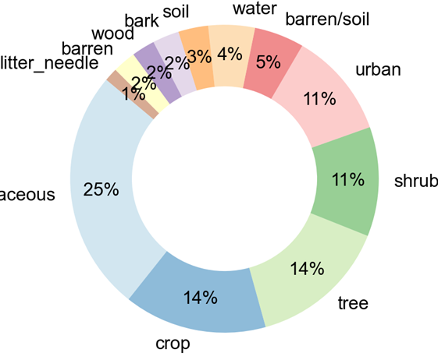
Results – Spectral library
Origin
GV
https://ecosis.org/
NPV
Land cover
SUB

Slide 6
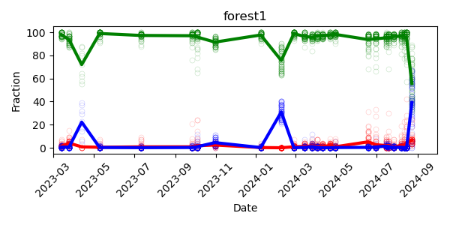
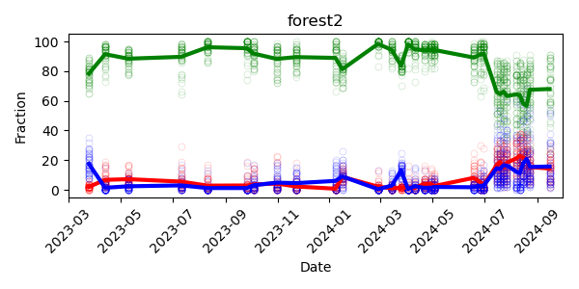
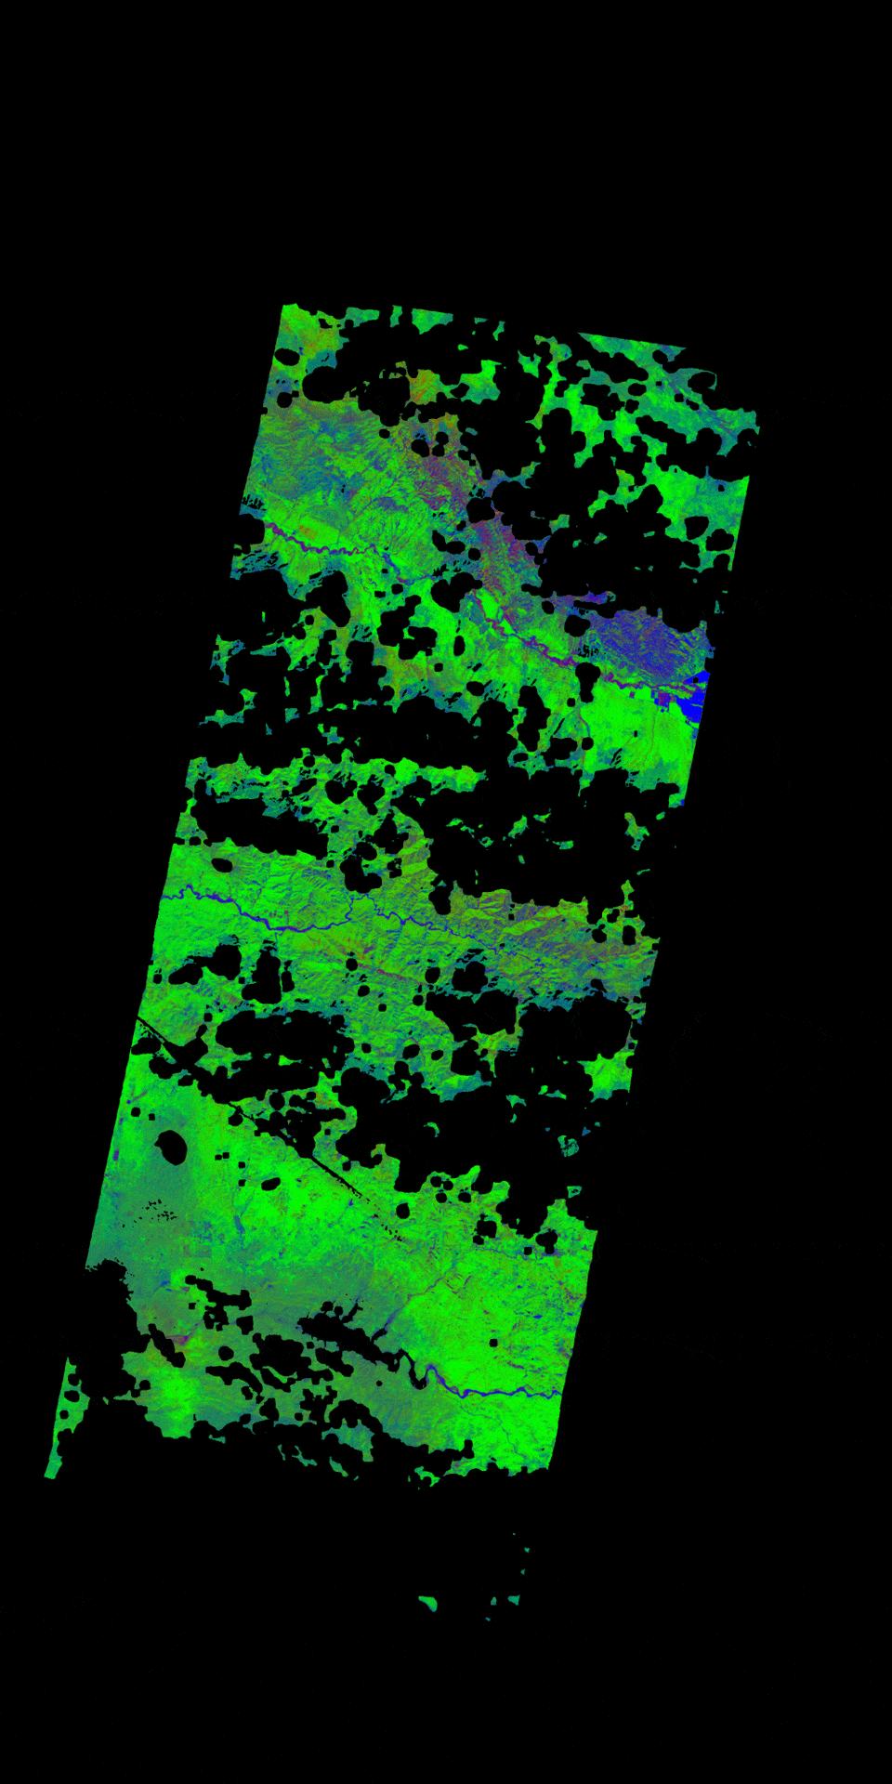
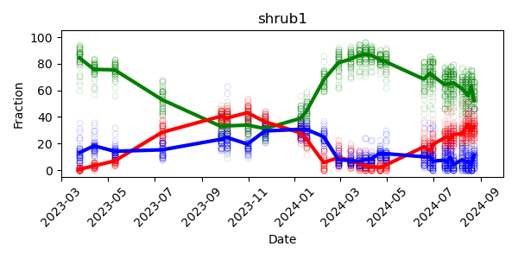
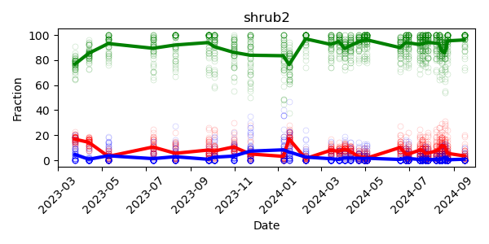
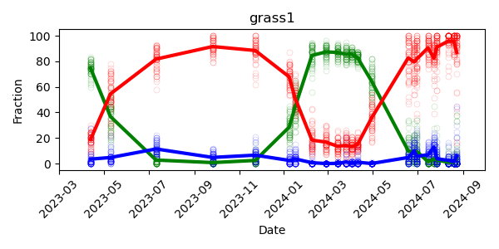
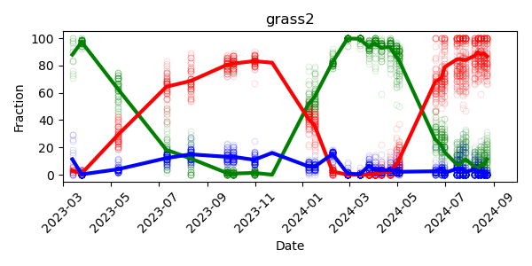
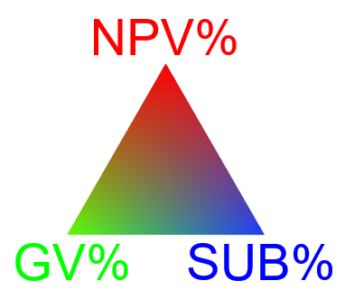
Results – fCover time series
Central Coast
Forest
Lake Fire
Shrubland
Grassland

Slide 7
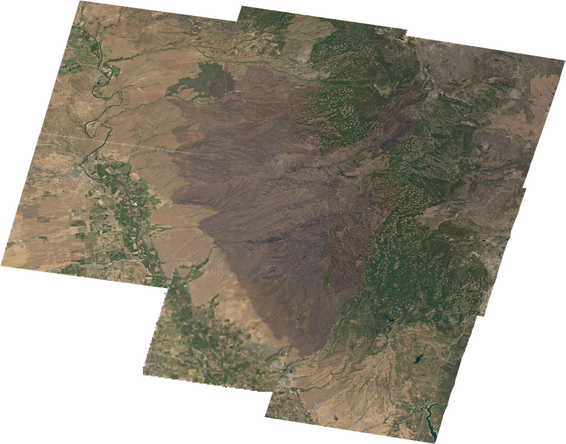
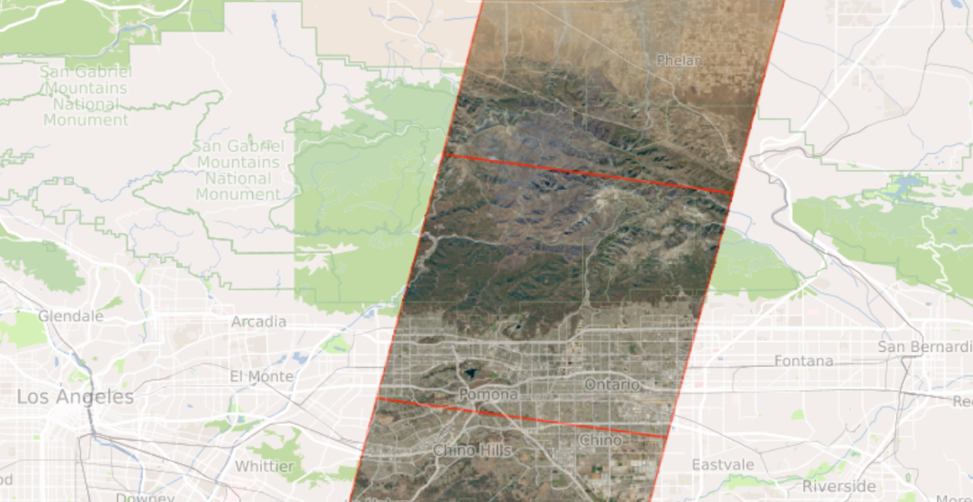
Californian wildfires 2024
Park Fire 07/24/2024 Northern California
Butte % Tehama county
Bridge Fire 09/08/2024 Southern California
Los Angeles & San Bernardino county

Slide 8
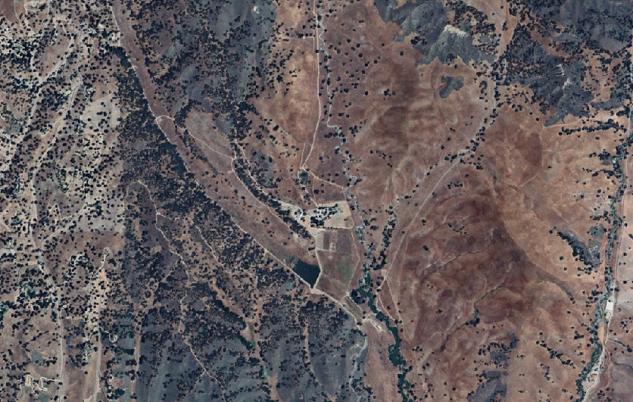
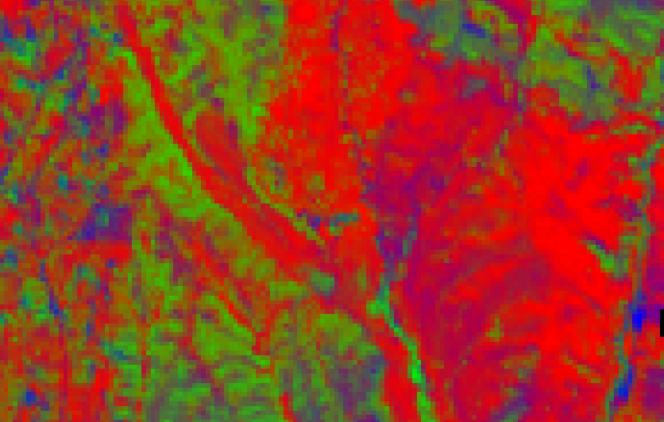
Validation
North Coast - Sedgwick Reserve
2023-07-07
2023-07-11

Slide 9
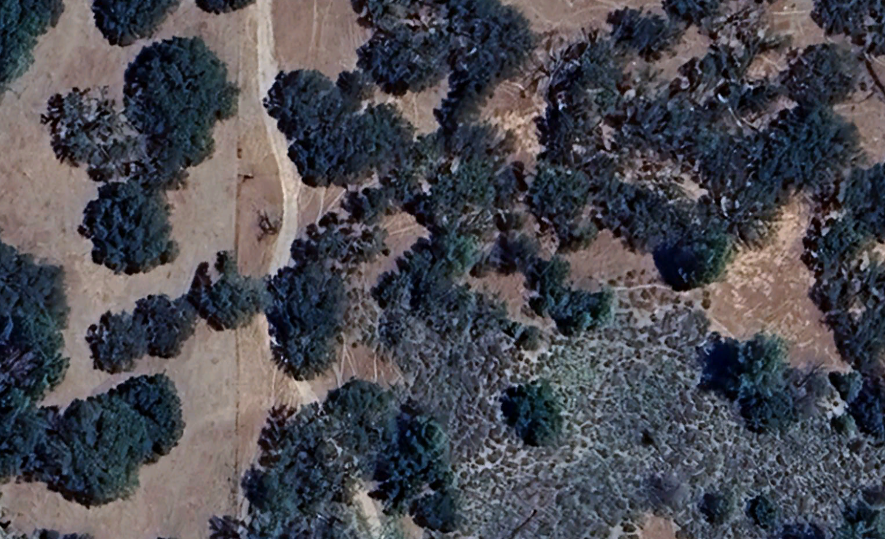
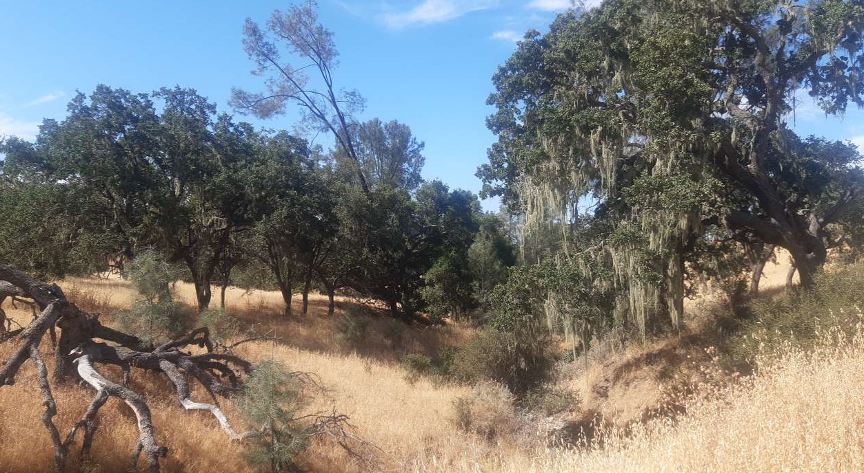
Validation
North Coast - Sedgwick Reserve
Visual interpretation of reference fractions based on VHR imagery
2023-07-07
2023-07-11
Field photography to support visual interpretation

Slide 10
Conclusion
Reproducible approach for fCover time series retrieval across ecosystems from spaceborne imaging spectroscopy data
EnMAP supports development of retrieval algorithms and precursor products, preparing for optimal use of CHIME and SBG data
Consistent and comparable fCover validation requires standardized protocol and community driven efforts for collecting in-situ data

Slide 11
Deadline for abstract submission: November 25th 2024
Organized by Tobias Hank, Stefanie Steinhauser (LMU)
EnMAP science projects: EnFireMap, EnMAP-Box, EnMAP-PI 2024-2026

