Slide 1
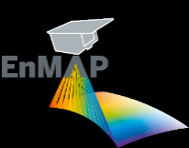
Multitemporal hyperspectral mapping of soil properties for spatially more complete maps
Kathrin J. Ward*¹, Robert Milewski¹, Thomas Schmid², Sabine Chabrillat^{1,3}
*Kathrin.ward@gfz-potsdam.de
1 Helmholtz Centre Potsdam, GFZ German Research Centre for Geosciences, Potsdam, Germany
2 CIEMAT - Centro Investigaciones Energéticas, Medioambientales Y Tecnológicas, Madrid, Spain,
3 Leibniz University Hannover, Institute of soil science, Hannover, Germany
3rd Workshop on International Cooperation in Spaceborne Imaging Spectroscopy, ESA ESTEC, 13.-15.11.2024

Slide 2
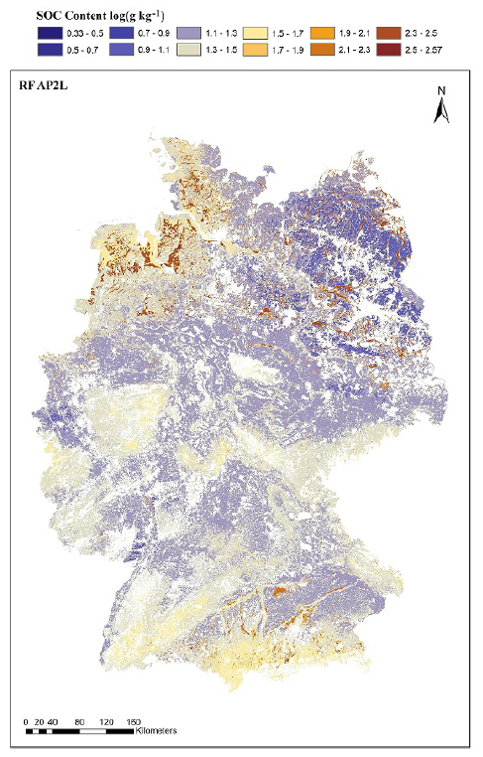
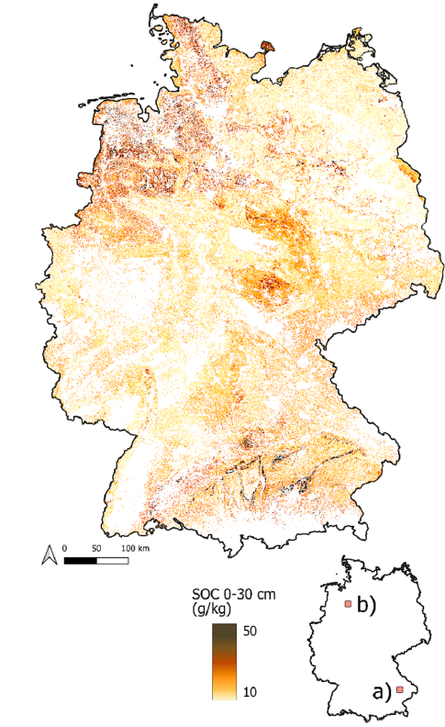
Motivation
Soil degradation: reduction of soil organic carbon (SOC) content / soil erosion → climate change & food security
Regulations & policies to improve monitoring status of soils e.g. SDGs, 4p1000 & Soil Monitoring Law → research on monitoring of spatial/temporal changes of soils
Existing maps: not up-to-date, large effort, low temporal and spatial resolution
Preparation for upcoming hyperspectral missions (Copernicus CHIME and SBG)
German soil inventory
30m grid, 2010-2017
RF using Landsat, DEM, distance
Best RMSE = 5.6 g/kg
German soil inventory + LUCAS
8x8km grid, 2010-2017
BRT, RF, SVR using environmental variables
Best RMSE = 21 g/kg
Broeg et al (2024) Thünen-Institut
Sakhaee A, et al (2022) Thünen-Institut
kathrin.ward@gfz-potsdam.de
Notes:
Our soils are essential for our lives and provide important ecosystem services → but threatened by degradation
EU proposed soil monitoring law (in framework of EU soil strategy for 2030) → RS clearly mentioned
Existing maps: mainly based on point infos → effort
CHIME: Development workflows for soil mapping / monitoring from spaceborne IS data; also for other soil properties unlike SOC that cannot be mapped with multispectral data
Static = update involves new data collection
Effort: extensive field sampling and lab analyses (costly)
LUCAS 14x14km

Slide 3
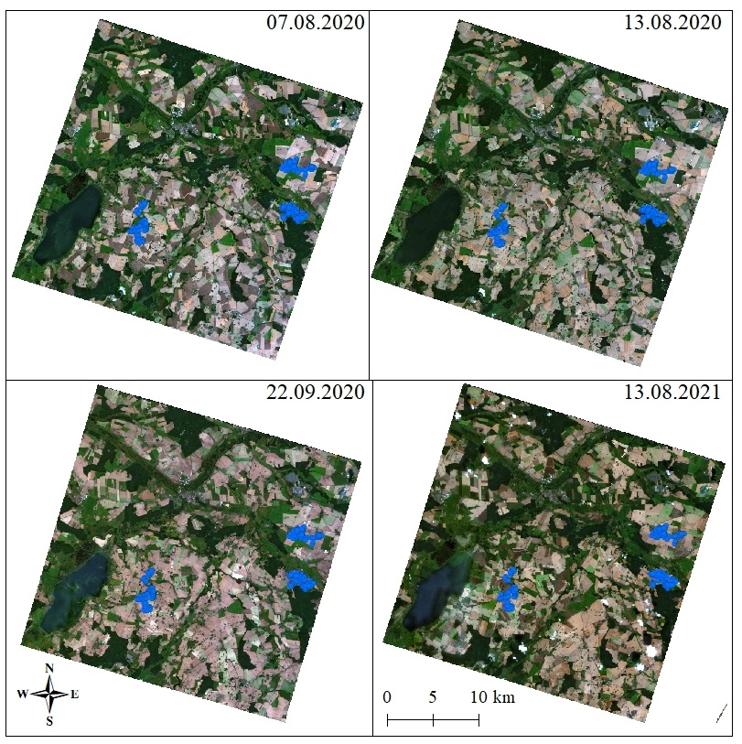
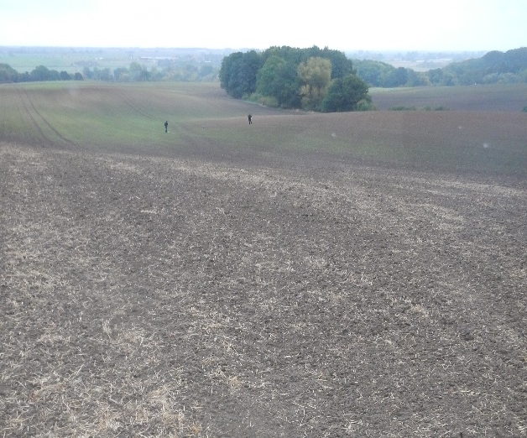
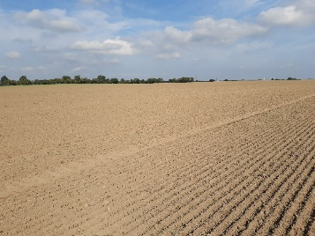
Study site: Germany - Demmin
183 ground reference samples
SOC content
Four PRISMA images: cloud free, exposed soils
kathrin.ward@gfz-potsdam.de
Notes:
Area formed during ice age at Pleistozän (Weichseleiszeit)
Sandy soils ondulated terrain, large fields
Mainly winter wheats, corn and potatos
Klassifikation nach FAO: Gleysols, Regosols, Podluvisols, Cambisols

Slide 4
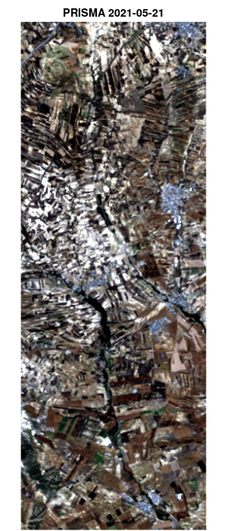
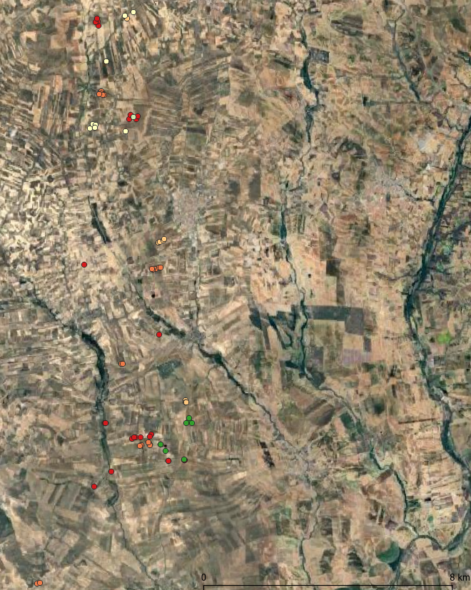
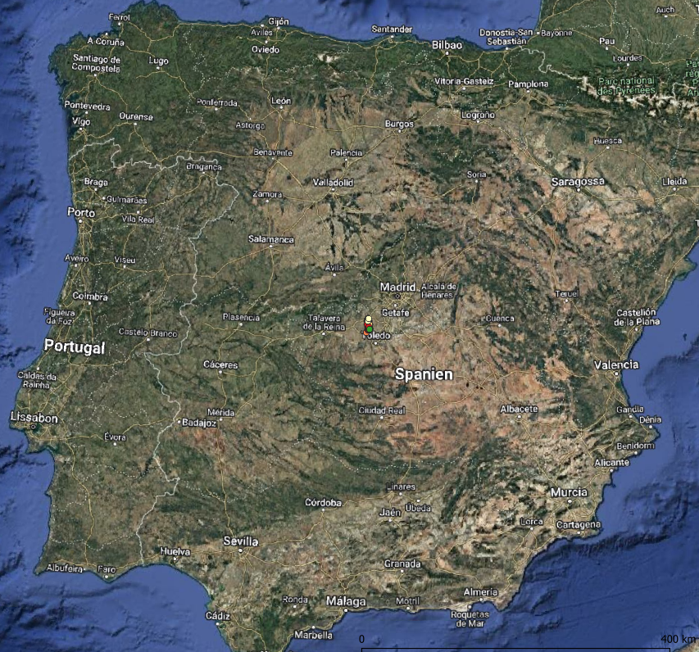
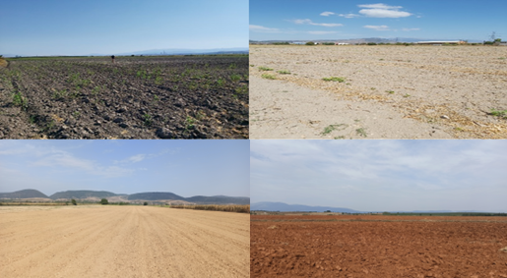
Study site: Spain - Camarena
~70 ground reference samples
Iron oxides, calcium carbonates, texture
Time series of cloud free hyperspectral acquisitions:
Map data: Google Satellite
Soil
samples
May 2021 – Aug. 2024
29 PRISMA
&
7 EnMAP
Photos: R. Milewski
kathrin.ward@gfz-potsdam.de
Notes:
vineyards, olive groves and rain-fed cereal crops
Dryer mediterrainean climate
Smaller fields, sometimes steep slopes

Slide 5
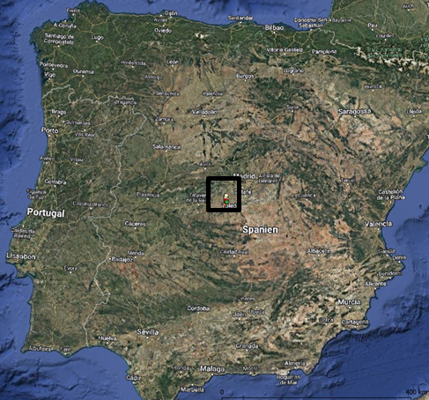
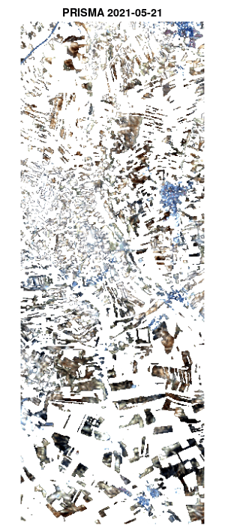
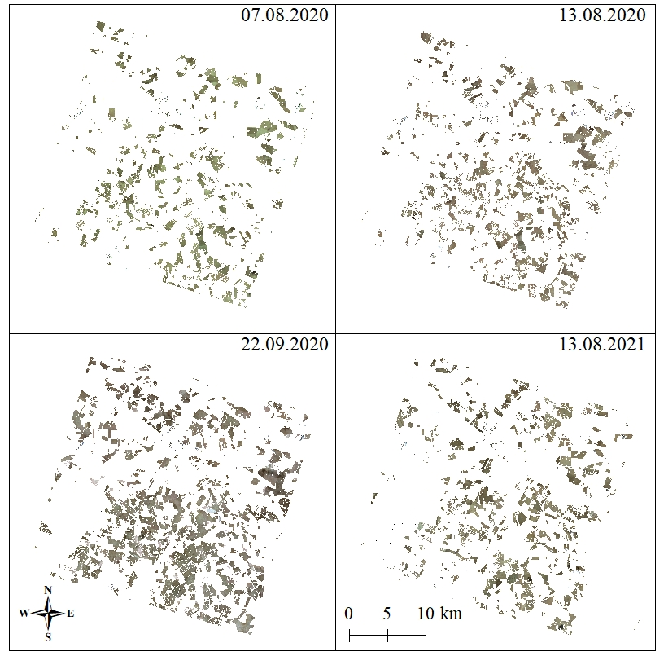
Methods – bare soil maps
Spain - Camarena
Spatially more complete maps
Germany - Demmin
?
?
kathrin.ward@gfz-potsdam.de
Notes:
Bare soil maps: GER: maninly late summer/autumn Spain: mainly summer/autumn
Still not all fields are bare at same date
Benefitial to merge to obtain a multitemporal bare soil composite

Slide 6
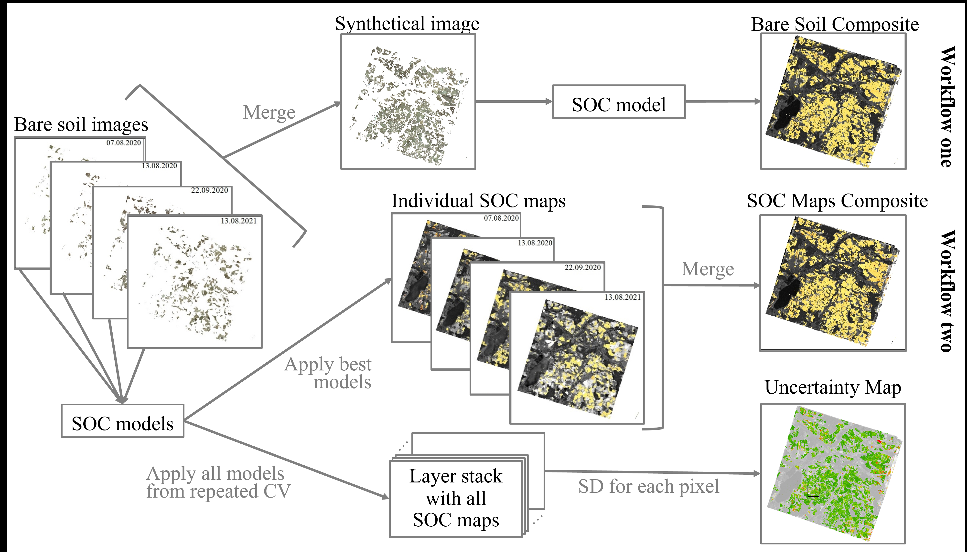
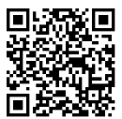
Methods - multitemporal composite workflows
Germany - Demmin
Ward et al. (2024). Estimating Soil Organic Carbon using multitemporal PRISMA imaging spectroscopy data. Geoderma, 450, 117025. https://doi.org/10.1016/j.geoderma.2024.117025
kathrin.ward@gfz-potsdam.de

Slide 7
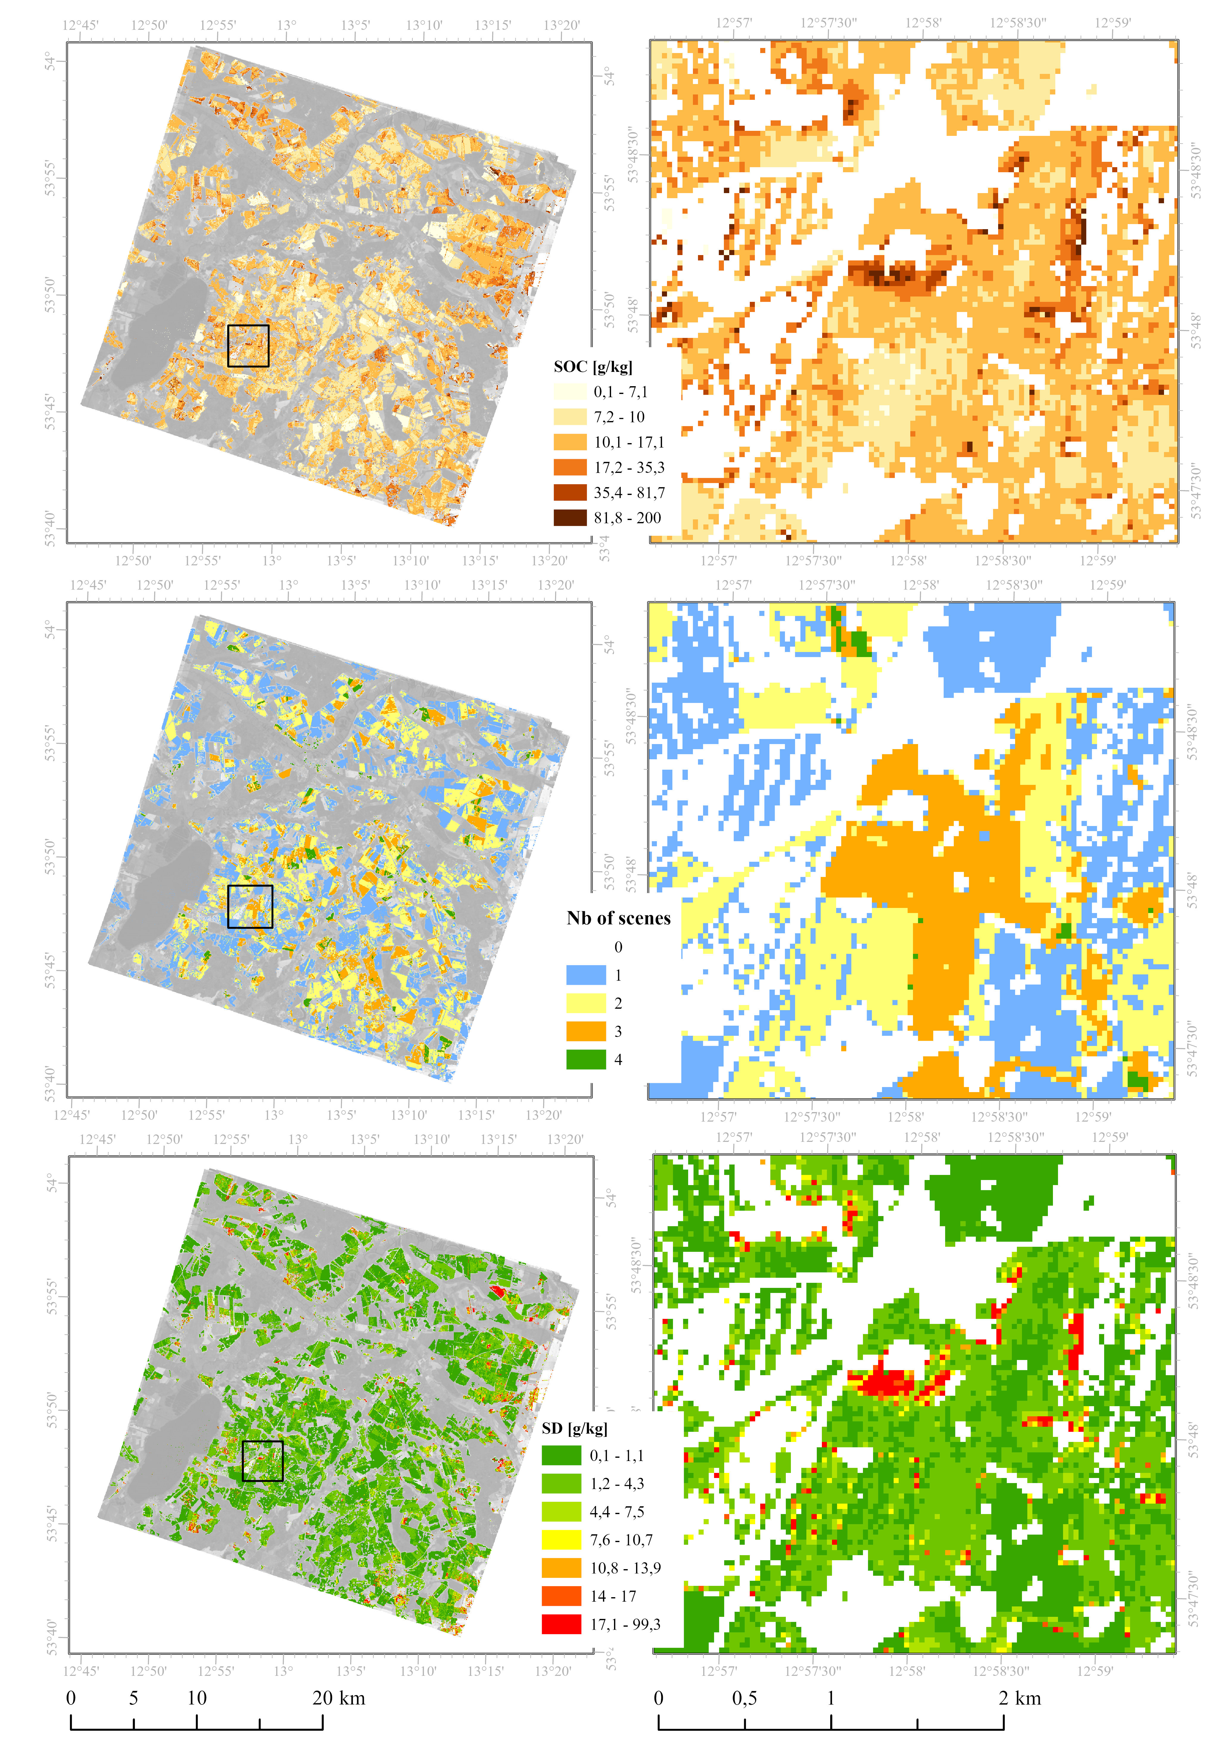
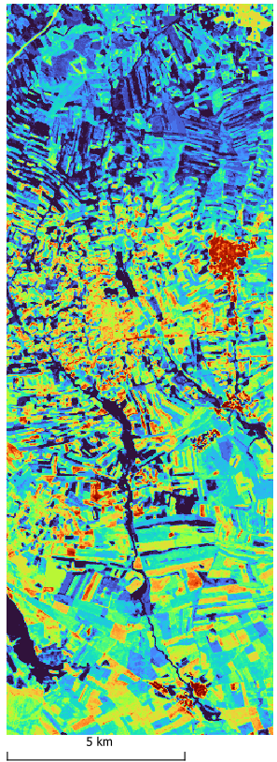
Results
Germany – Demmin
SOC
R²=0.83, RMSE=5 g/kg, RPD=2.4
Spain – Camarena
Iron oxides, Calcium carbonates,….
Work in progress
Frequency bare soil
Ward et al. (2024). https://doi.org/10.1016/j.geoderma.2024.117025
kathrin.ward@gfz-potsdam.de

Slide 8
Conclusions
Germany – Demmin:
Multitemporal hyperspectral workflows developed
Spatially more complete soil properties maps
High accuracies for SOC estimation using PRISMA data
Spain – Camarena
Other soil properties
How many dates should be included in a multitemporal analyses for spatially “complete“ maps?
How can sensors / scenes be homogenized?
Mapping of status quo
Mapping of changes: long time-series, adequat ground reference
kathrin.ward@gfz-potsdam.de
Notes:
Mapping of status quo: assumption of relatively constant soil properties
Are there robust models that can handle the differences between the images?

Slide 9
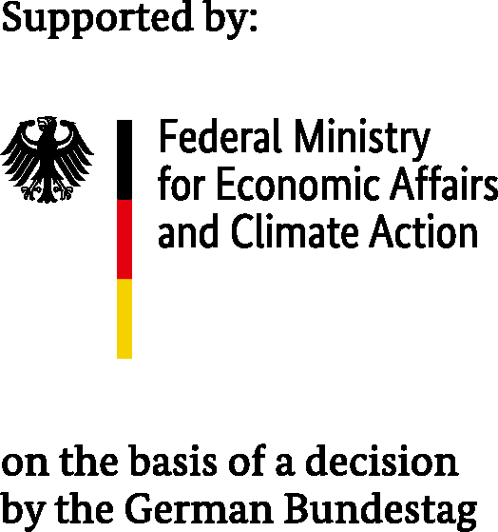
Thank you for your attention!
Dr. Kathrin J. Ward
Kathrin.ward@gfz-potsdam.de
Helmholtz Centre Potsdam, GFZ German Research Centre for Geosciences, Potsdam, Germany
Multitemporal hyperspectral mapping of soil properties for spatially more complete maps
Acknowledgements:
Funded within the EnMAP science program under the German Space Agency at DLR with resources from the German Federal Ministry for Economic Affairs and Climate Action
PRISMA Product - ©ASI - Agenzia Spaziale Italiana - (2020-2024). All rights reserved
3rd Workshop on International Cooperation in Spaceborne Imaging Spectroscopy, ESA ESTEC, 13.-15.11.2024

Slide 10
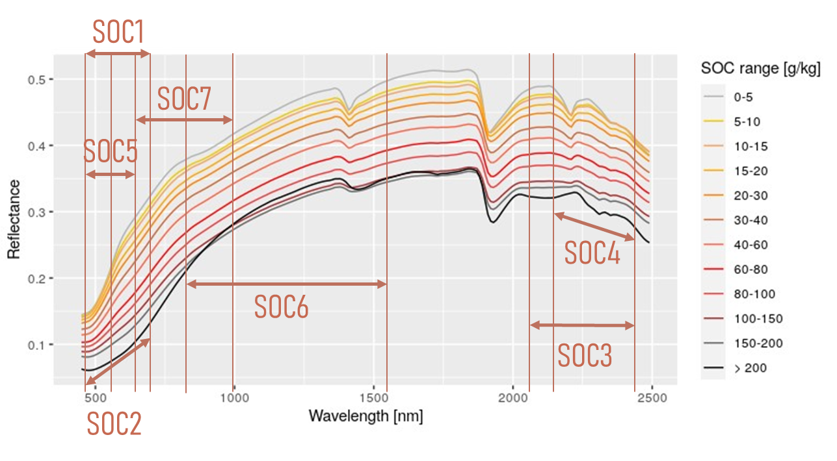
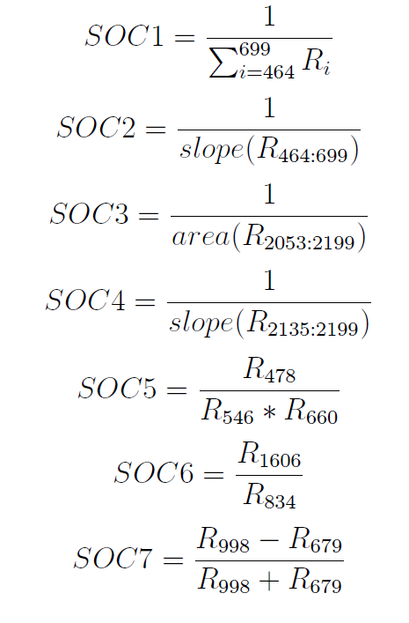
Spectral feature analyses / indices
Germany – Demmin
kathrin.ward@gfz-potsdam.de

