Slide 1
Comparisons of reflectance & mineral identification results FOR seven airborne & spaceborne imaging spectrometer datasets for Cuprite, Nevada
Raymond F. Kokaly
Contributors to the work shown: USGS - Bernard E. Hubbard, Todd M. Hoefen, John M. Meyer, Evan M. Cox, Derek Ensign, and Gregg A. Swayze (emeritus). NASA partners in the Earth Surface and Interior focus area (Ben Phillips & Kevin Reath) and Jet Propulsion Laboratory (Rob Green, Phil Brodrick, David Thompson, & AVIRIS & EMIT teams), Armstrong Flight Research Center, GFZ partners Sabine Chabrillat, Maximillian Brell, Saeid Asadzadeh Anna Buczynska, & DLR EnMAP team
Hyperspectral 2024 - ESA Workshop on International Cooperation in Spaceborne Imaging Spectroscopy
November 13, 2024
Contact: raymond@usgs.gov

Slide 2
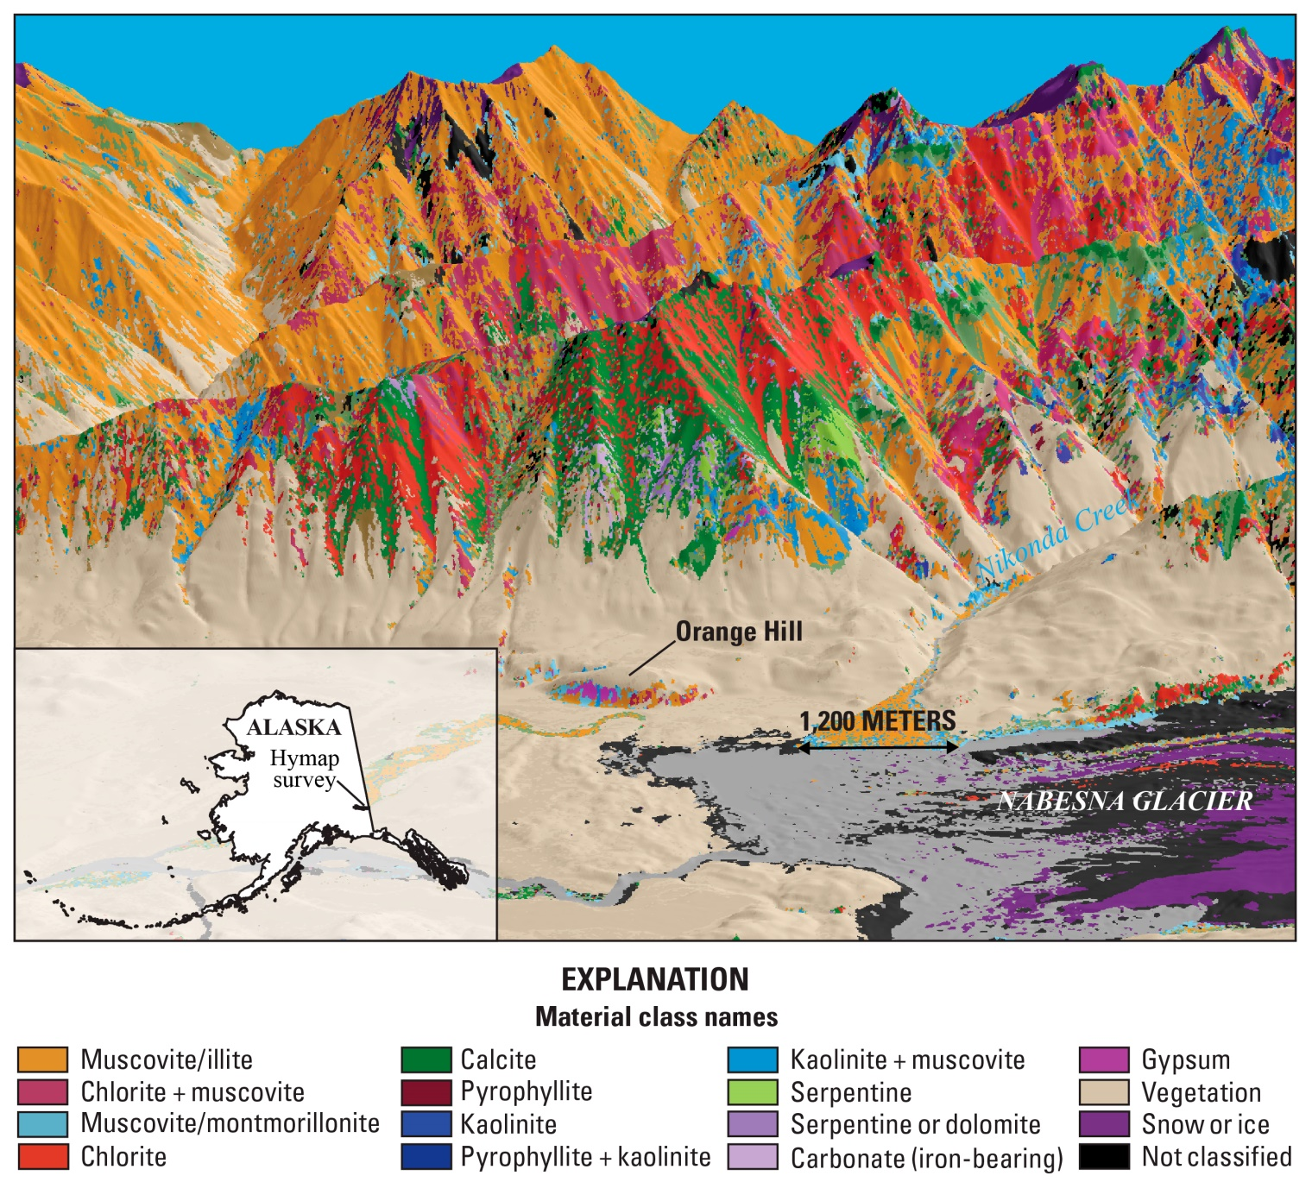
USGS Earth Mapping Resources Initiative (Earth MRI, EMRI)
Modernize the Nation’s geologic knowledge, in particular, critical mineral resources
Collects fundamental geoscience data including:
Airborne geophysical surveys
Lidar surveys for high-resolution elevation and topography
Geochemical surveys
Geologic mapping by State geological surveys
Hyperspectral surveys (new in FY22)
Contacts:
Warren Day (EMRI Science Coordinator)
Darcy McPhee (Mineral Resources Program, EMRI Program Manager)
Raymond Kokaly & Bernard Hubbard (Imaging Spectroscopy task co-leads)
Remote sensing personnel: Todd Hoefen, John Meyer, Evan Cox, Federico Solano
Spectral Vectors to Copper and Gold:
Adapted from Graham et. al.,2018,
Economic Geology 113 (2), 489-510
2

Slide 3
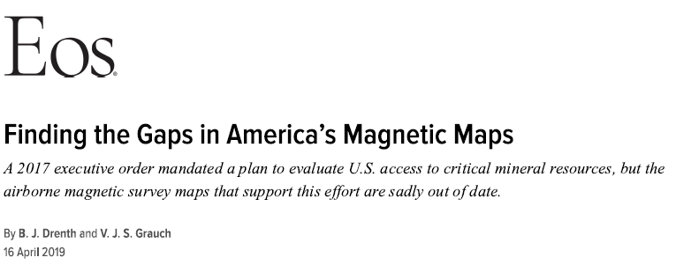
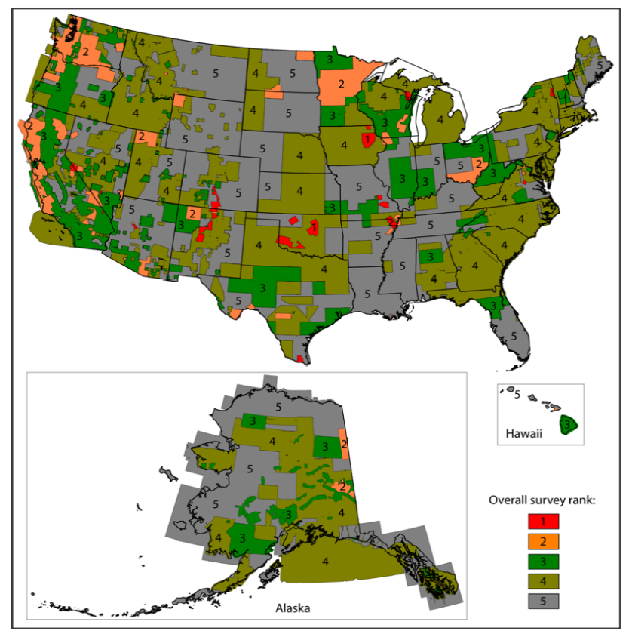
The Nation is Under-mapped; Earth MRI Launched in 2019 by Evaluating Available Data
Hyperspectral evaluations of mineral resources have mostly been at the local scale
Spectral Vectors to Copper and Gold:
Adapted from Graham et. al.,2018,
Economic Geology 113 (2), 489-510

Slide 4
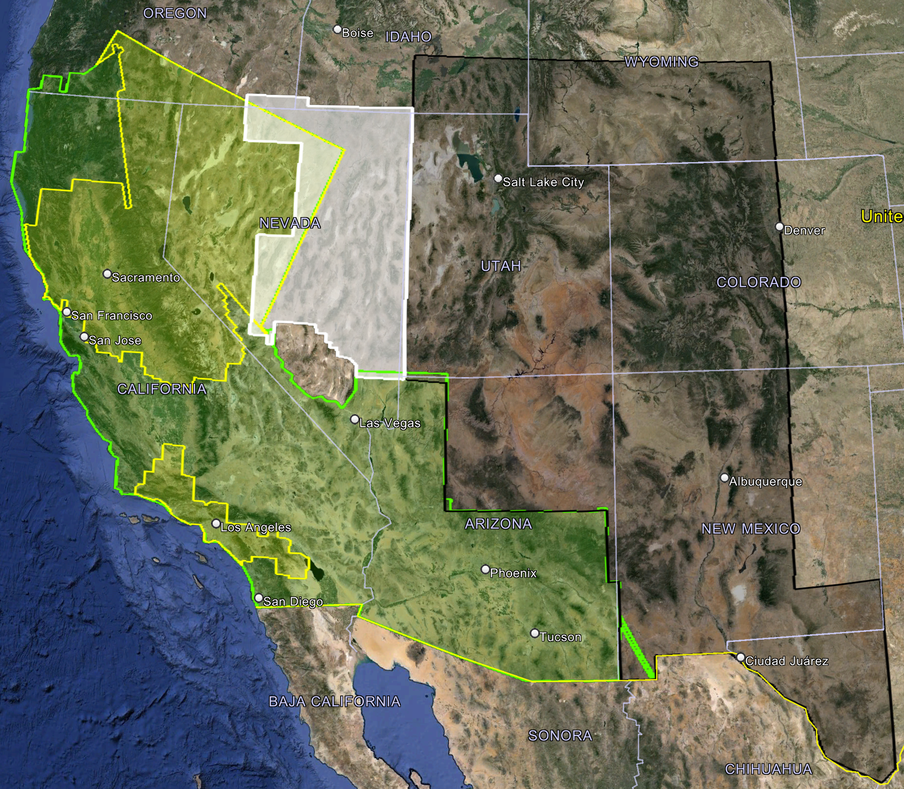
EMRI Hyperspectral Regional – Coverage Goal 2023-2026 AVIRIS-Classic + MASTER (AVIRIS-3 & poss. HyTES2 in 2025+)
Primary 2025 area of coverage is in NE Nevada and SE Oregon, ~155,000 km².
Secondary 2025-2026/2027 area of selected coverage is
~925,000 km² in Arizona, Utah, Idaho, Wyoming, Colorado, New Mexico, and Texas. Anticipated coverage is 35 - 60%, weather permitting.
2023
2024
USGS EMRI AVIRIS-Classic + MASTER acquisitions 2023 to date
~483,000 sq. km
2025
Coverage
USGS-MRP project using archived AVIRIS-Classic + MASTER data
~325,000 sq. km
2018
2025 & 2026/27
Selected
Coverage
EMRI Hyperspectral 2025
AVIRIS-Classic
MASTER, as available
AVIRIS-3, in development
HyTES-2, in selected areas
2025
NOTE: data overlaps to re-collect clouded or snow-covered areas, to improve data quality, to facilitate calibration/validation, and to ensure map continuity.
2025
2026/27
EMRI Hyperspectral 2025 & 2026
AVIRIS-Classic
MASTER, as available
AVIRIS-3, in development
HyTES-2, in selected areas
Preliminary information - subject to revision.

Slide 5
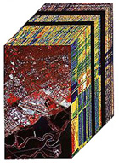
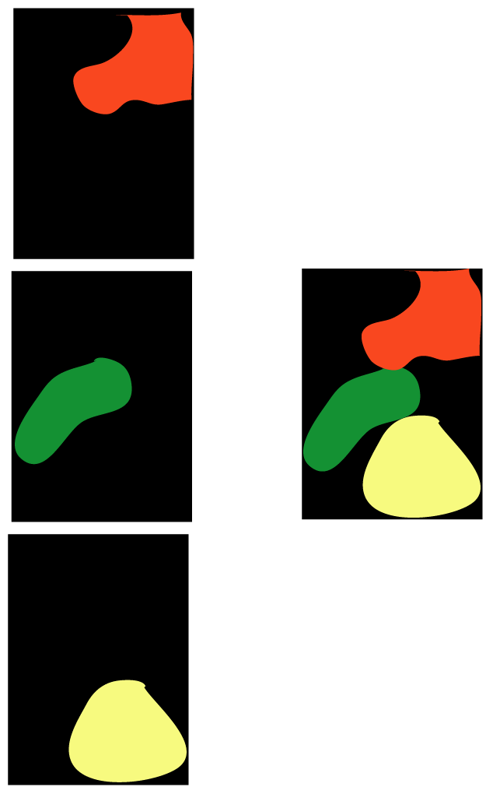
MICA (Material Identification and Characterization Algorithm)
MICA
Command file
Spectral Data
Material Maps
MICA is part of the
USGS software PRISM
(Processing Routines in IDL for Spectroscopic Measurements)
Kokaly, 2011
For latest versio,n contact Raymond Kokaly, USGS raymond@usgs.gov
Reference Spectra
Absorption
Feature
Definition
Continuum
Removal and Linear Regression
Expert Rules
Summary
Map
Material 1
Material 1
Material 2
Material 2
Material 3
Material 3

Slide 6
Validation of Surface Mineral Identifications
AVIRIS-Classic May 21, 2024
AVIRISc1995 map from Swayze et al., 2014
Preliminary information –
subject to revision.

Slide 7
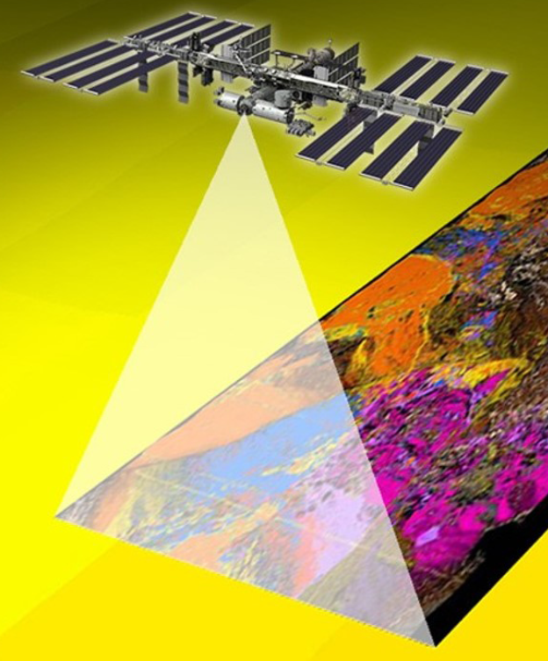
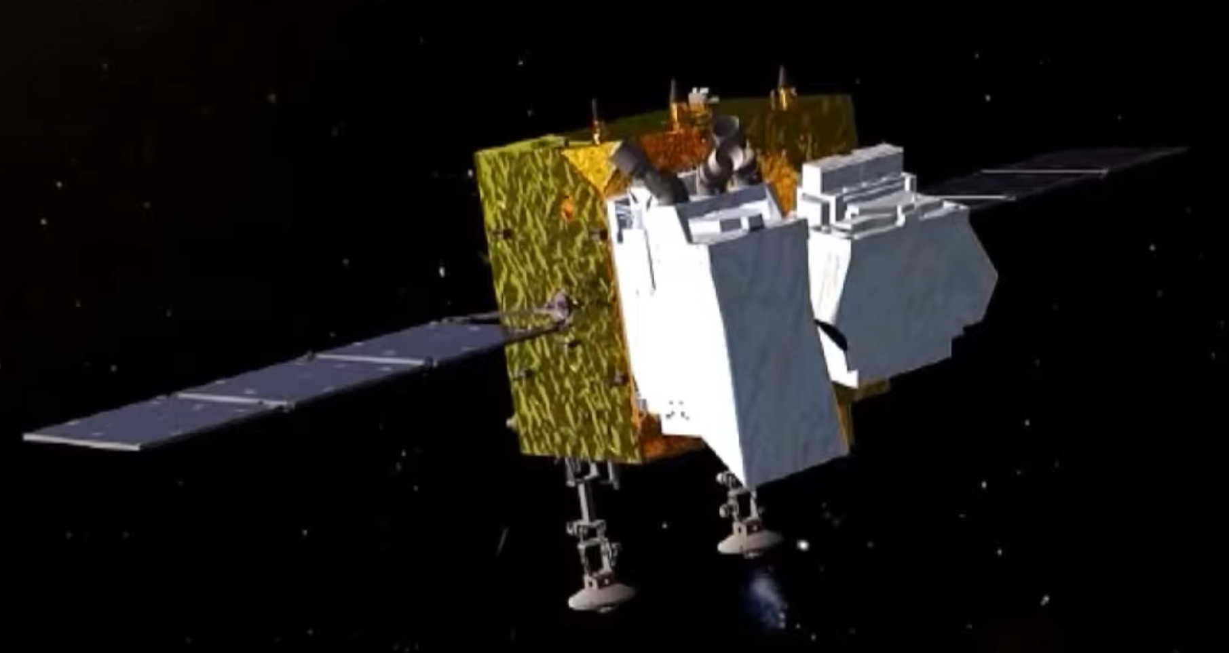
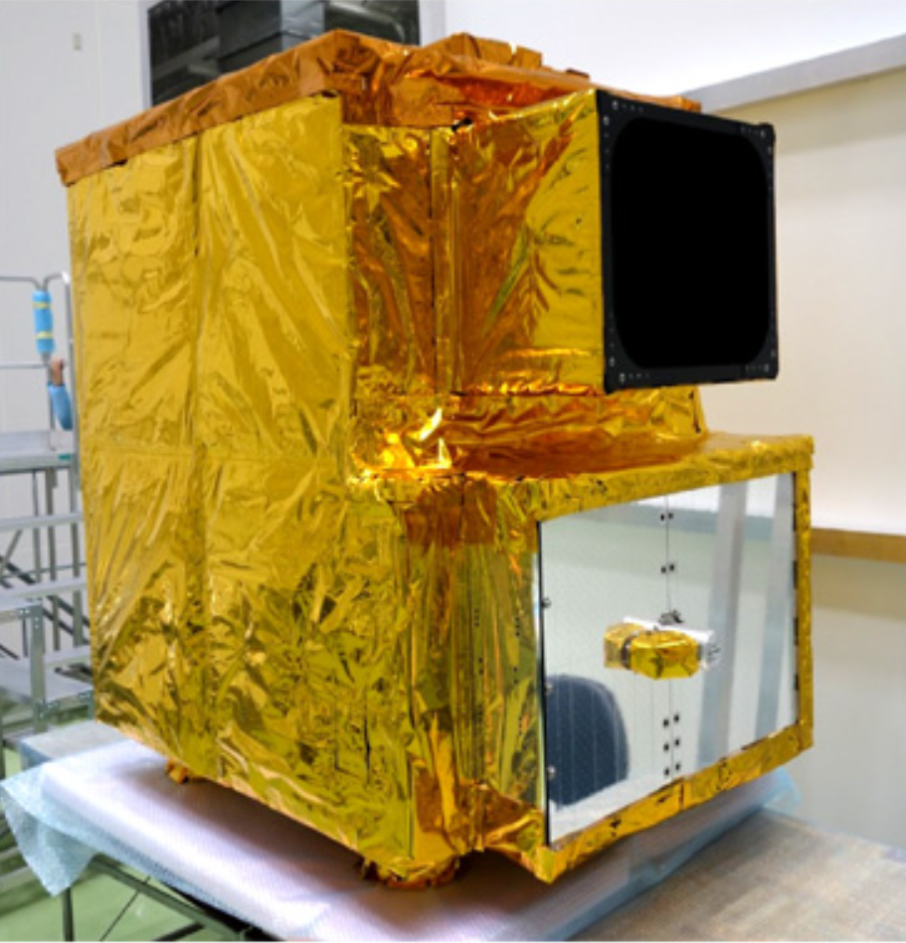
Evaluation of Spaceborne Imaging Spectrometers and Mineral Mapping at Cuprite NV
EMIT
AHSI
on
Gaofen5
(not actual image)
HISUI

Slide 8
Comparisons of Imaging Spectrometers at Cuprite, NV
Imaging Spectrometer | Collection Date | Collection Level | Ground Sampling Distance (GSD) in m | Spectral Bandwidth (nm) | # spectral segments/ detectors | L2 Atmospheric Correction | Field Data for Ground Calibration (GC)
AVIRISc1995 | 1995-06-23 | Airborne | 17 | 8.5 to 10.5 | 4 detectors have same foreoptic | ATREM | 1995-06-25
AVIRISng2014 | 2014-06-25 | Airborne | 10 (by resampling) | ~5.8 average | 1 | ISOFIT | 2017-06-19
AVIRISc2023 & 2024 | 2023-09-18 2024-05-21 | Airborne | 15 | 9.1 to 11.9 | 4 detectors have same foreoptic | ATCOR4r | 2023-09-22 2024-09-10
EnMAP | 2023-07-07 | Spaceborne | 30 | 5.8 to 11.4 | 2, spatially rectified and merged | ATCOR4 | 2022-09-19
HISUI | 2021-10-01 | Spaceborne | 20 | 9 to 13 | 2, spatially rectified and merged | Empirical Line | 2022-09-19
AHSI (Gaofen5) | 2022-05-21 | Spaceborne | 30 | 4.3 to 8.5 | 2, spatially rectified and merged | FLAASH | NONE – not applied
EMIT | 2024-07-27 | Spaceborne | 60 | ~8.6 average | 1 | ISOFIT | 2024-09-10
PRISMA | 2020-08-02 | Spaceborne | 30 | 8.9 to 15.2 | 2, spatially rectified and merged | MODTRAN- based | 2023-09-22
Preliminary information - subject to revision.

Slide 9
Geolocation errors computed for remote sensing data products relative to Landsat 9 base image
Imaging Spectrometer | GSD (x, y) | RMSE (m) Original Geocoding | RMSE (fraction of GSD¹) Original Geocoding
AVIRISng2014 | 10, 10 | 11.4 | 1.14
AVIRISc2023 (2024) | 15, 15 | 17.4 (21.1) | 1.16 (1.41)
EnMAP | 30,30 | 13.7 | 0.46
HISUI | 20,20 | 22.2 | 1.11
AHSI | 30, 30 | 101.8 | 3.39
EMIT | 47.95, 60.18 | 147.3 | 2.45
PRISMA | 30.00035, 29.99959 | 187.0 | 6.23
¹Based on maximum GSD in x- and y-directions
Preliminary information - subject to revision.

Slide 10
Geolocation errors after warping to match Landsat 9 base image
Imaging Spectrometer | Number of GCPs Selected | Warp Polynomial Order | Resampling Method | Warped Image RMSE (m) | Warped Image RMSE (fraction of GSD)
AVIRISng2014 | 67 | 1st | Nearest Neighbor | 7.6 | 0.76
AVIRISc2023 (2024) | 85 (153) | 2nd | Nearest Neighbor | 11.7 (12.7) | 0.78 (0.85)
EnMAP | none | not needed | none | 13.6* | 0.46*
HISUI | 58 | 1st | Nearest Neighbor | 11.9 | 0.60
AHSI | 107 | 1st | Nearest Neighbor | 16.5 | 0.55
EMIT | 62 | 1st | Nearest Neighbor | 46.0 | 0.76
PRISMA | 62 | 2nd | Nearest Neighbor | 16.2 | 0.54
*EnMap image not warped
Preliminary information - subject to revision.

Slide 11
Summary of Geolocation Errors and Improvements
Geocoding errors in original products:
ranged in meters from 11.4 (AVIRISng2014) to 187.0 (PRISMA)
and ranged in fraction of GSD from 0.46 (EnMAP) to 6.23 (PRISMA)
Geocoding errors, after GCP selection and warp to Landsat base image:
ranged in meters from 7.6 (AVIRISng2014) to 46.0 (EMIT)
and ranged in fraction of GSD from 0.54 (PRISMA) to 0.85 (AVIRISc2024)
For spaceborne sensors, average error in fraction of GSD was 2.73 originally and 0.58 after warp.
EnMAP was not warped due to small geocoding error in the original product and no observed improvement when warp was attempted.

Slide 12
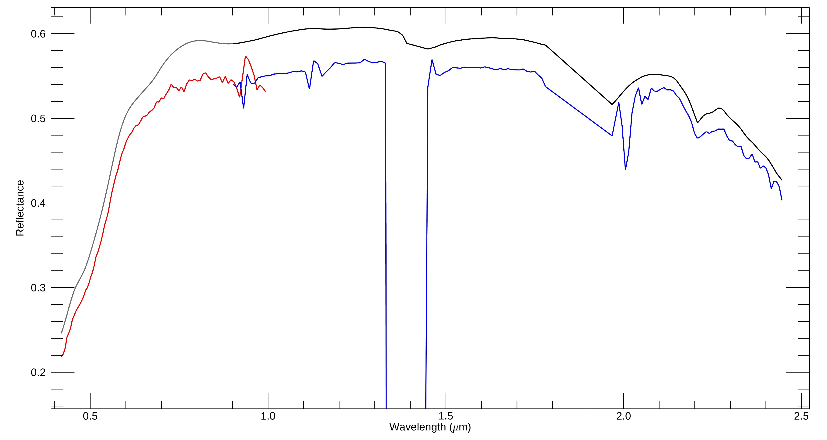
Field 20220918
EnMAP SWIR
L2 reflectance
Spectral artefacts
0.58 –0.92 μm
EnMAP VNIR
L2 reflectance
Residual CO₂
spike
artefacts
> 2.3 μm
Stonewall Flat Playa, NV
EnMAP scene ID
20230707T192008Z_001_V010302

Slide 13
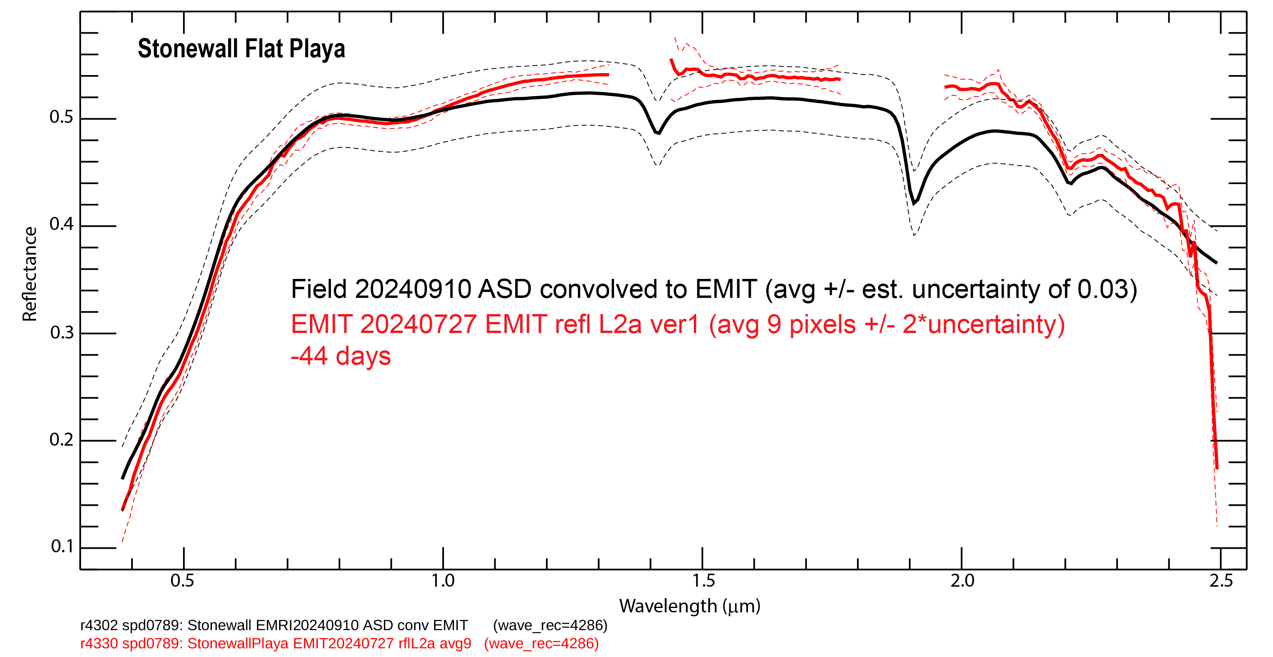
Field 20240910
2.108 μm artefact
Distortion
0.95 – 1.32 μm
Small artefacts
1.45 – 1.63 μm
Distortion
1.95 – 2.08 μm
Small spectral artefacts
0.58 – 0.77 μm
EMIT VSWIR
L2 reflectance
Reflectance falls off for λ < ~0.50
Spikes & spectral
artefact
λ > 2.3 μm
Stonewall Flat Playa, NV
EMIT scene ID
EMIT_L2A_RFL_001_20240427T173257_2311711_009
Preliminary information –
subject to revision.

Slide 14
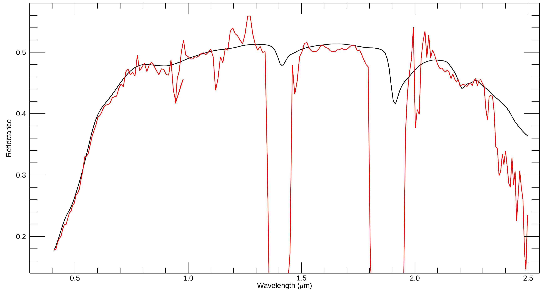
Spectral artefacts
2.02 – 2.18 μm
Field 20230922
Spectral artefacts
1.16 – 1.34 μm
Spectral artefacts
1.48 – 1.76 μm
Spectral artefacts
0.58 –0.92 μm
Residual CO₂
PRISMA VNIR & SWIR
L2 reflectance
Spikes &
spectral artefacts
(rapid falloff)
> 2.3 μm
Stonewall Flat Playa, NV
PRISMA scene ID
PRS_L2D_STD_20200802185105_20200802185110_0001

Slide 15
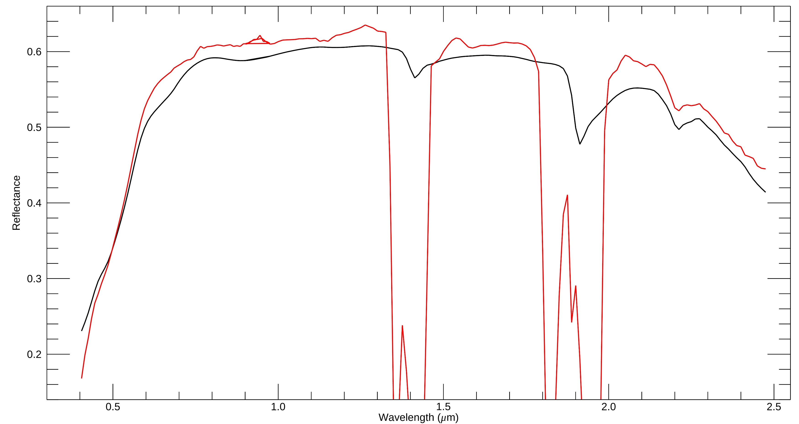
HISUI
VNIR &
SWIR L2
reflectance
Small
spike
artefacts
> 2.3 μm
Field 20220919
Distortions
λ > 1.48 – 1.78 μm
Distorted spectral shape
λ > 0.57 – 1.32 μm
Distortions
λ > 1.98 – 2.13 μm
Reflectance falls off rapidly for λ < ~0.50
Stonewall Flat Playa, NV
PRISMA scene ID
HISUI_HSHL1G_N375W1172_20211001211453_20240131005345

Slide 16
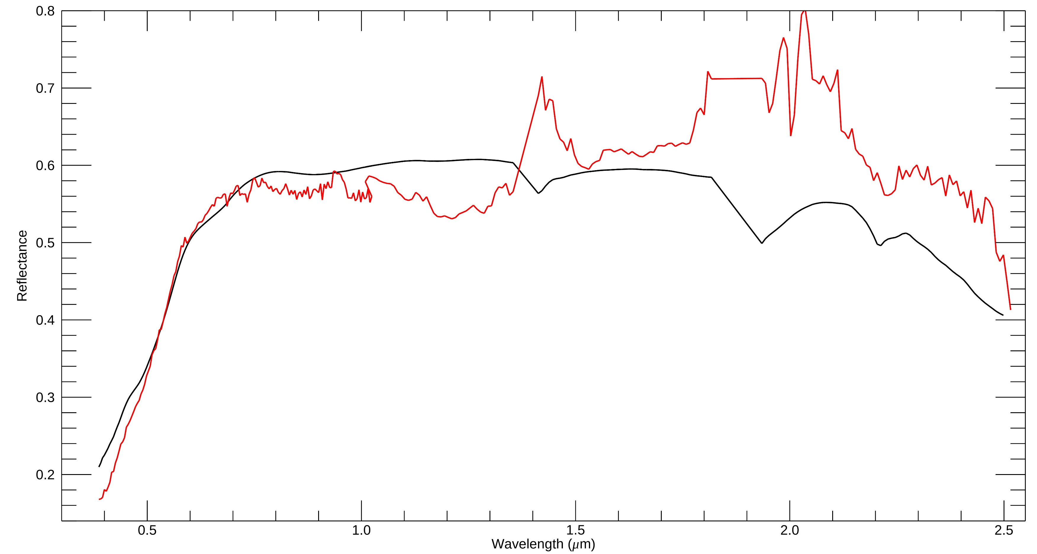
Artefacts suggesting saturation
2.08 to 2.18 μm
Field 20230922
AHSI VNIR &SWIR
L2 reflectance
Spectral artefacts
0.58 – 0.93 μm
Numerous spectral artefacts & distortions
1.01 – 2.50 μm
Reflectance falls off for λ < ~0.51 μm
Stonewall Flat Playa, NV
AHSI scene ID
L2A_GF5B_AHSI_W117.2_N37.7_20220521_003739_L10000134987_VNSW

Slide 17
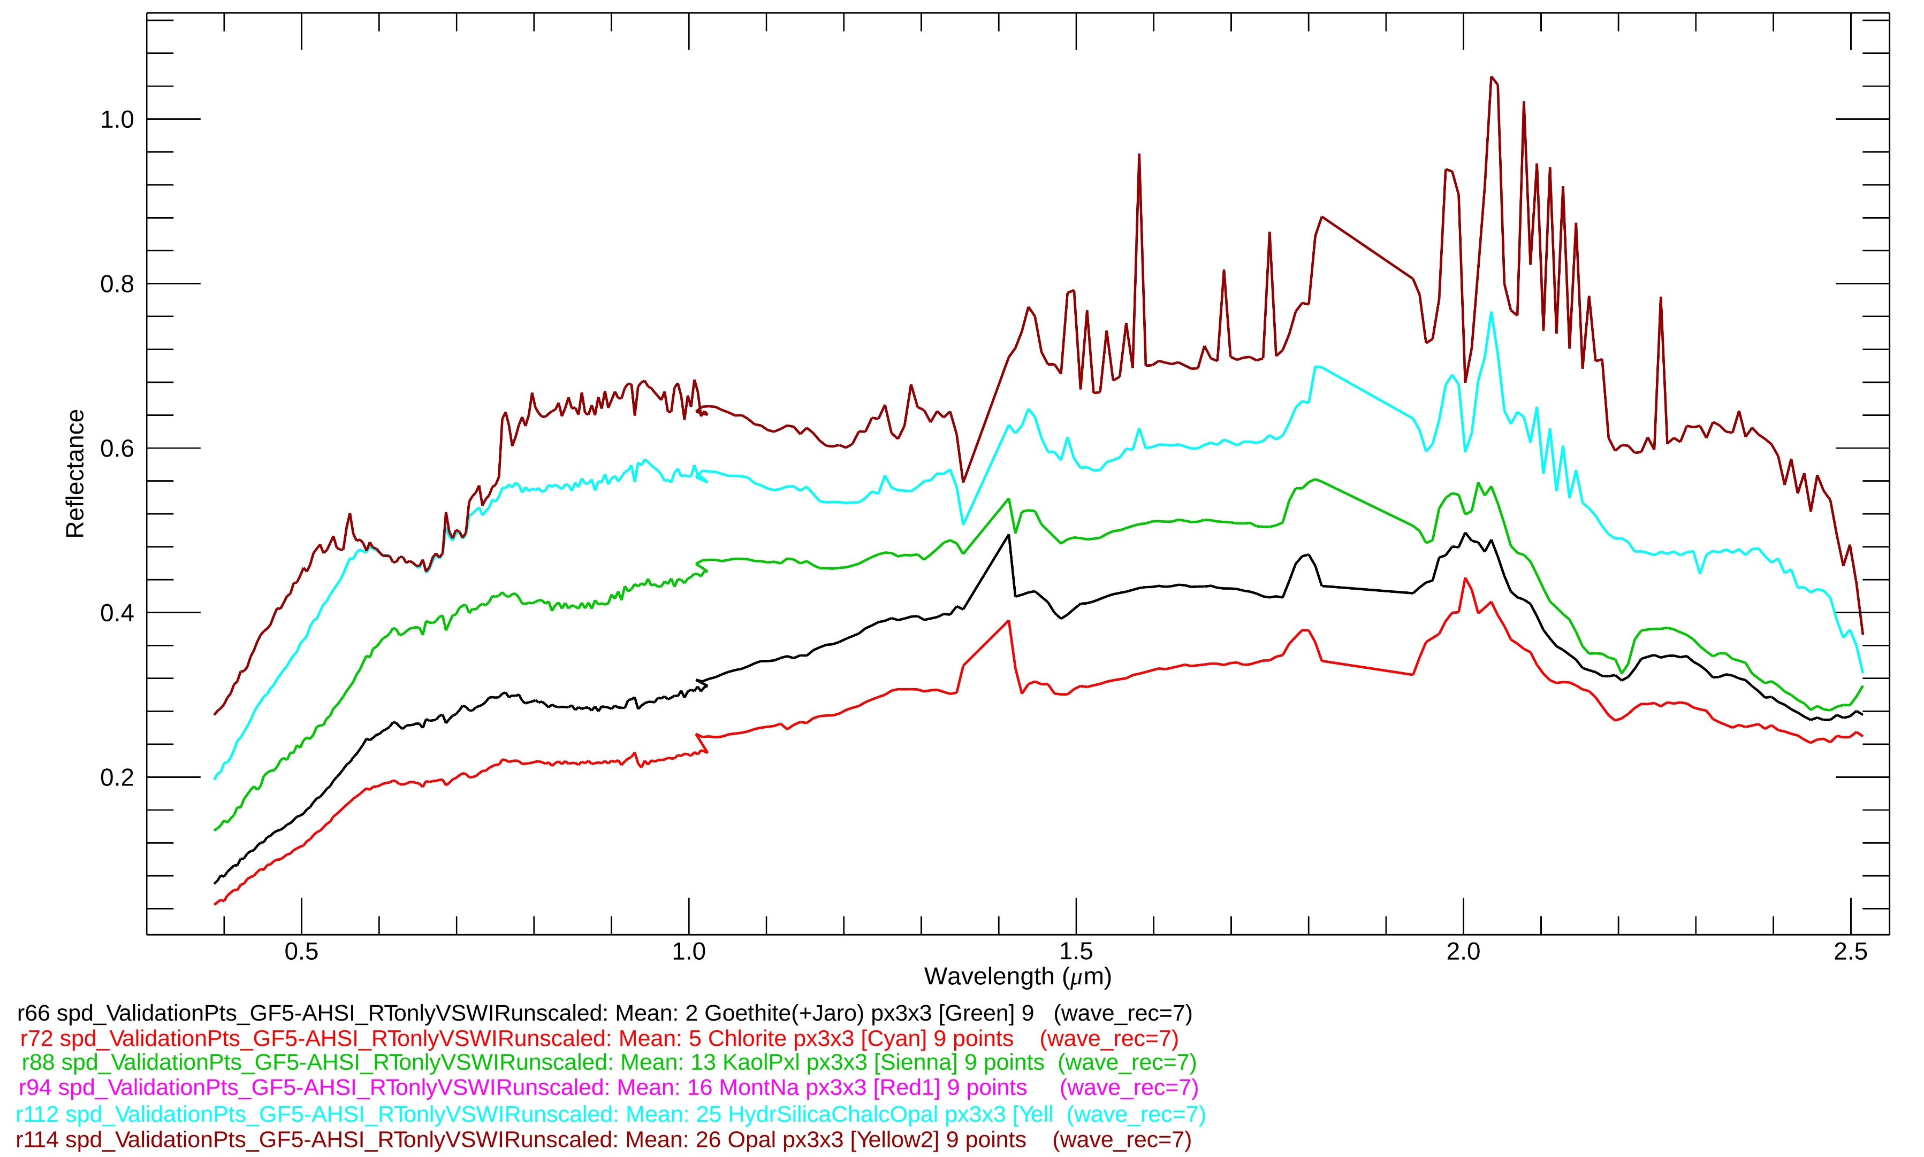
Artefacts potentially due to saturation 1.48 to 1.78 μm
Artefacts suggesting saturation
2.08 to 2.18 μm
AHSI 20220521
reflectance at selected
validation sites
Ground calibration
of AHSI was not successful
due to artefacts
Artefacts suggesting saturation
0.56 to 0.76 μm

Slide 18
Comparison of mineral maps from AVIRISc20230918 to EnMAP20230707
AVIRISc2023 GC
resampled to 30 m
EnMap2023 GC
EnMap2023 L2
Preliminary information – subject to revision.

Slide 19
Comparison of mineral maps from AVIRISc20230918 to EMIT20240727
AVIRISc2023 GC
resampled to 60 m
EMIT2024 GC
EMIT2024 L2
Preliminary information – subject to revision.

Slide 20
Comparison of mineral maps from AVIRISc20230918 to PRISMA20200802
AVIRISc2023 GC
resampled to 30 m
PRISMA2020 GC
PRISMA2023 L2
Preliminary information – subject to revision.

Slide 21
Comparison of mineral maps from AVIRISc20230918 to HISUI20211001
AVIRISc2023 GC
resampled to 20 m
HISUI2021 GC
HISUI2021 L2
Preliminary information – subject to revision.

Slide 22
Comparison of mineral maps from AVIRISc20230918 to AHSI20220521
not computed due
to spectral artefacts
AVIRISc2023 GC
resampled to 30 m
AHSI2022 GC
AHSI2022 L2
Preliminary information – subject to revision.

Slide 23
Comparison of white mica wavelength maps
AVIRISc2023 GC
resampled to 30 m
EnMap2023 L2
AHSI2022 L2
Preliminary information – subject to revision.

Slide 24
Accuracy Assessment of Mapped Mineral Classes relative to XRD and other mineral ID from field samples
Imaging Spectrometer | Accuracy L2 Reflectance Strict Classes | Accuracy L2 Reflectance Grouped* Classes | Accuracy GC Reflectance Strict Classes | Accuracy GC Reflectance Grouped Classes
AVIRISc1995 | - | - | 100% | 100%
AVIRISng2014 | 91% | 91% | 91% | 91%
AVIRISc2023 (2024) | 81% (81%) | 88% (85%) | 100% (100%) | 100% (100%)
EnMAP | 62% | 69% | 71% | 85%
EMIT | 58% | 69% | 65% | 81%
PRISMA | 31% | 31% | 85% | 85%
HISUI | 54% | 69% | 58% | 75%
AHSI | 58% | 65% | - | -
*Grouped classes: 1. all pure alunite, 2. all pure muscovite and illite, and 3. kaolinite crystallinity classes.
Preliminary information - subject to revision.

Slide 25
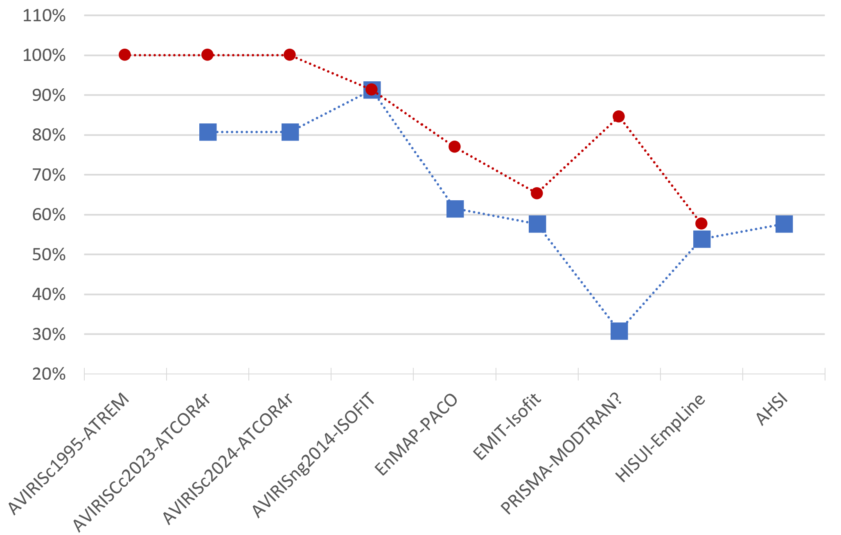
Mineral Classification Accuracy By Sensor for GC (red) and L2 (blue) Strict Mineral Classes
Airborne
Ground-calibrated
(GC) reflectance
L2 reflectance

Slide 26
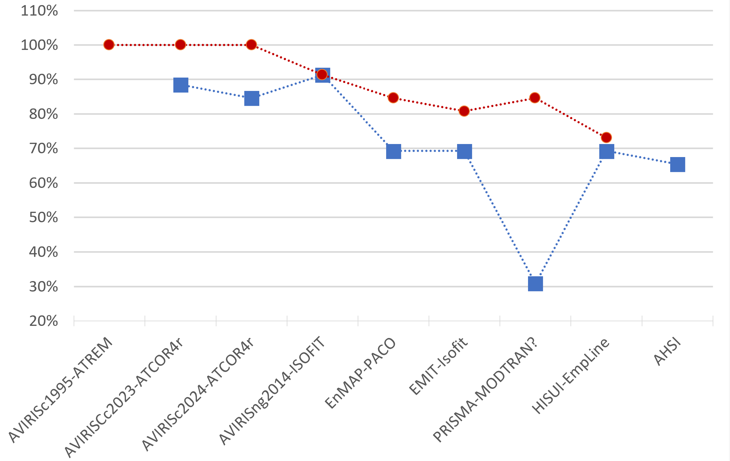
Mineral Classification Accuracy By Sensor for GC (red) and L2 (blue) Grouped Mineral Classes
Airborne
Ground-calibrated
(GC) reflectance
L2 reflectance

Slide 27
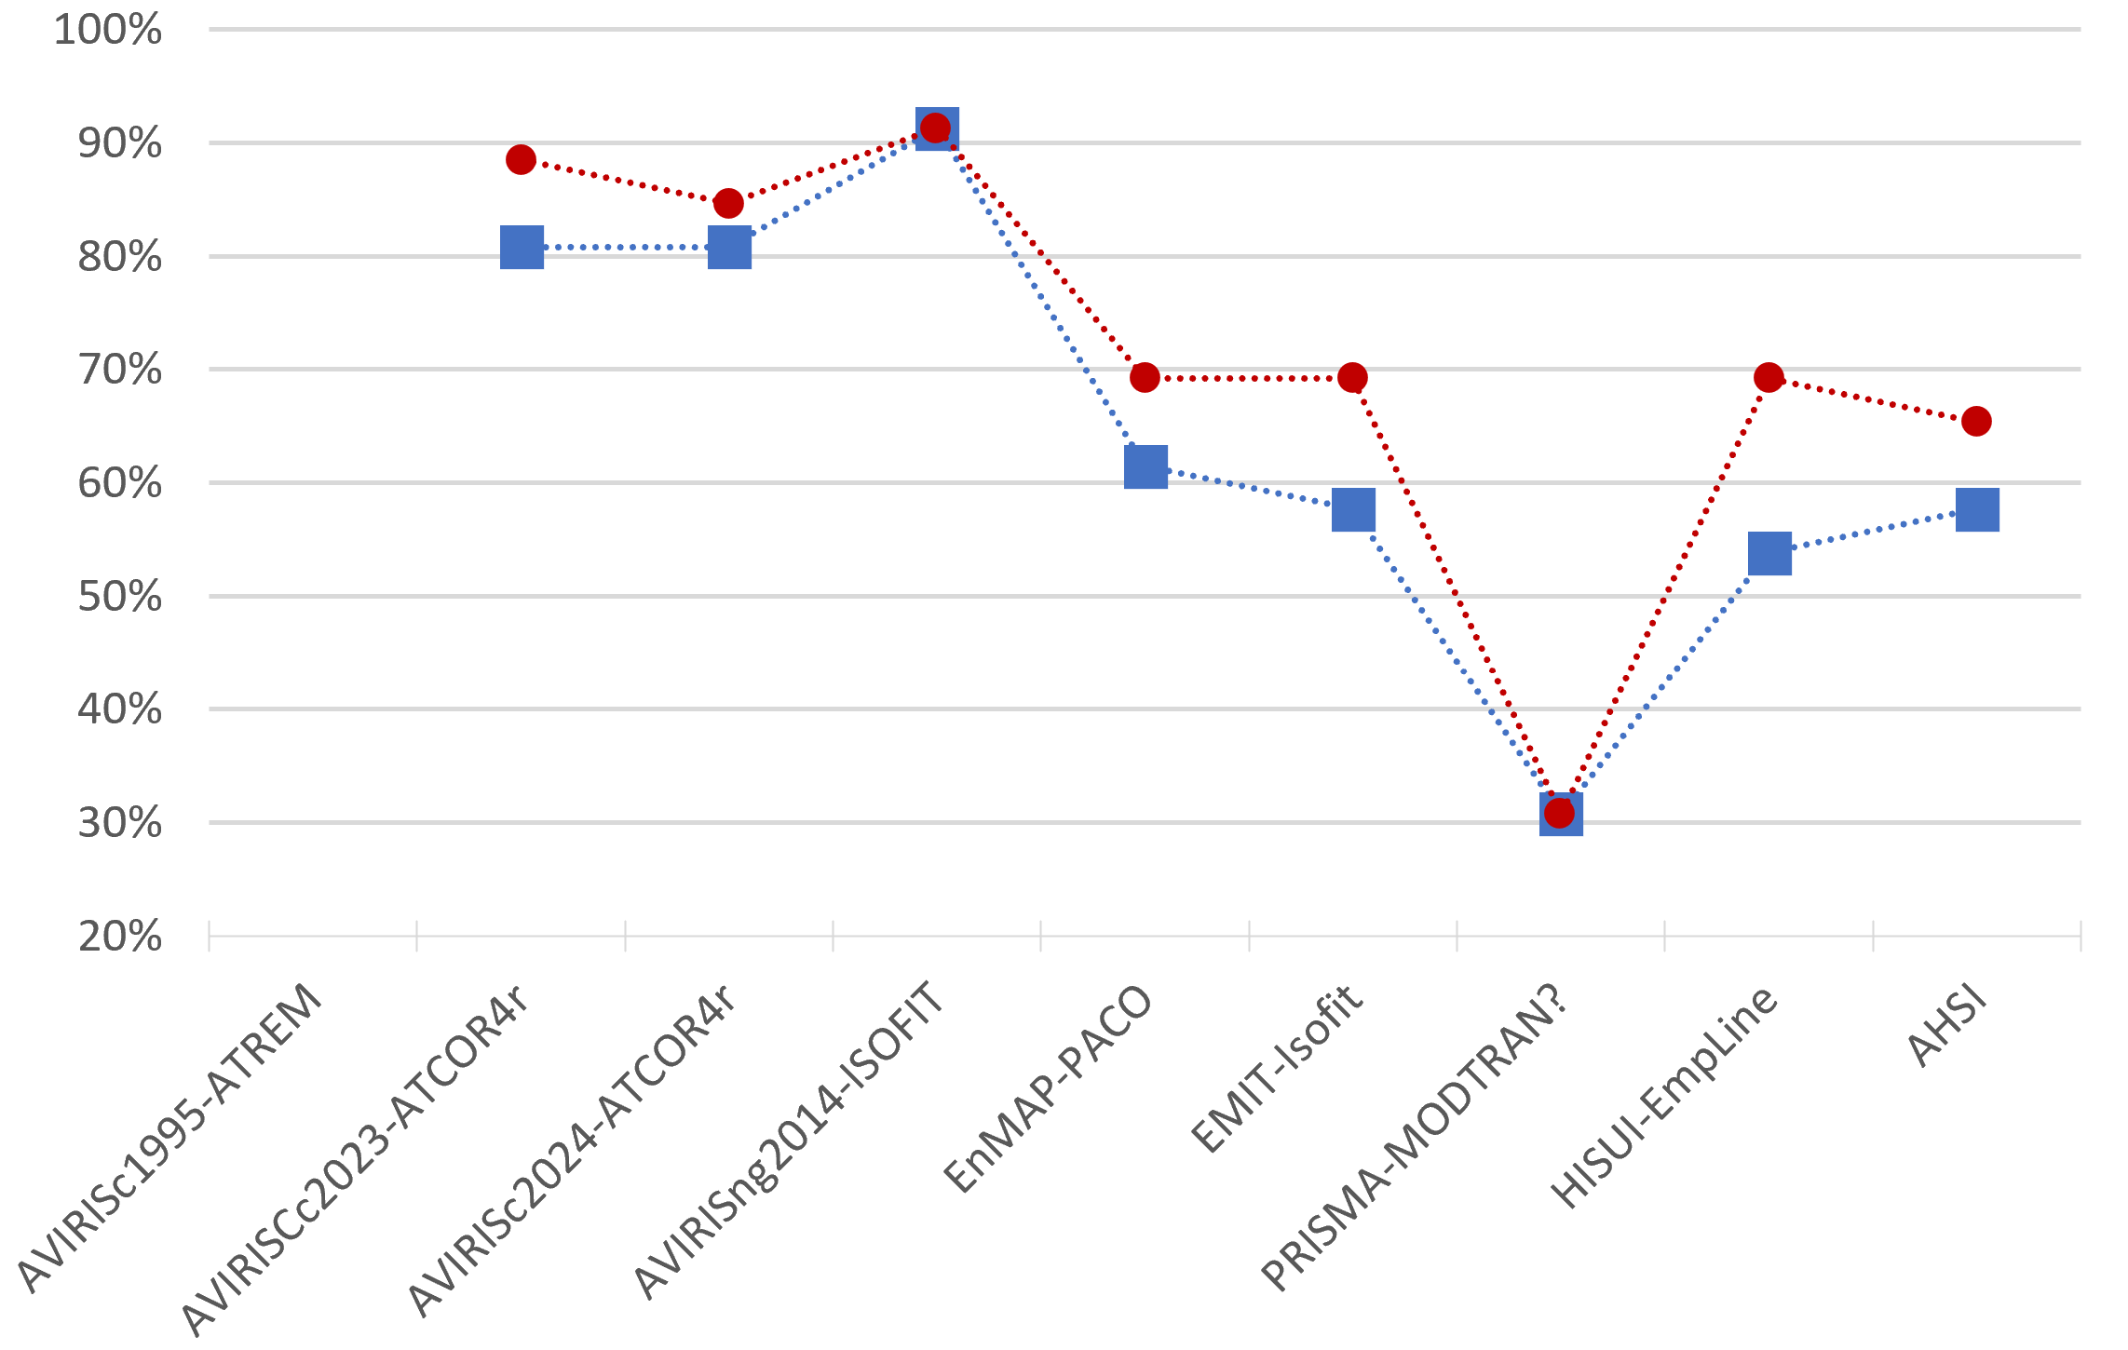
Mineral Classification Accuracy for Grouped (red) and Strict (blue) Classes L2 reflectance
Airborne
Grouped classes
Strict classes

Slide 28
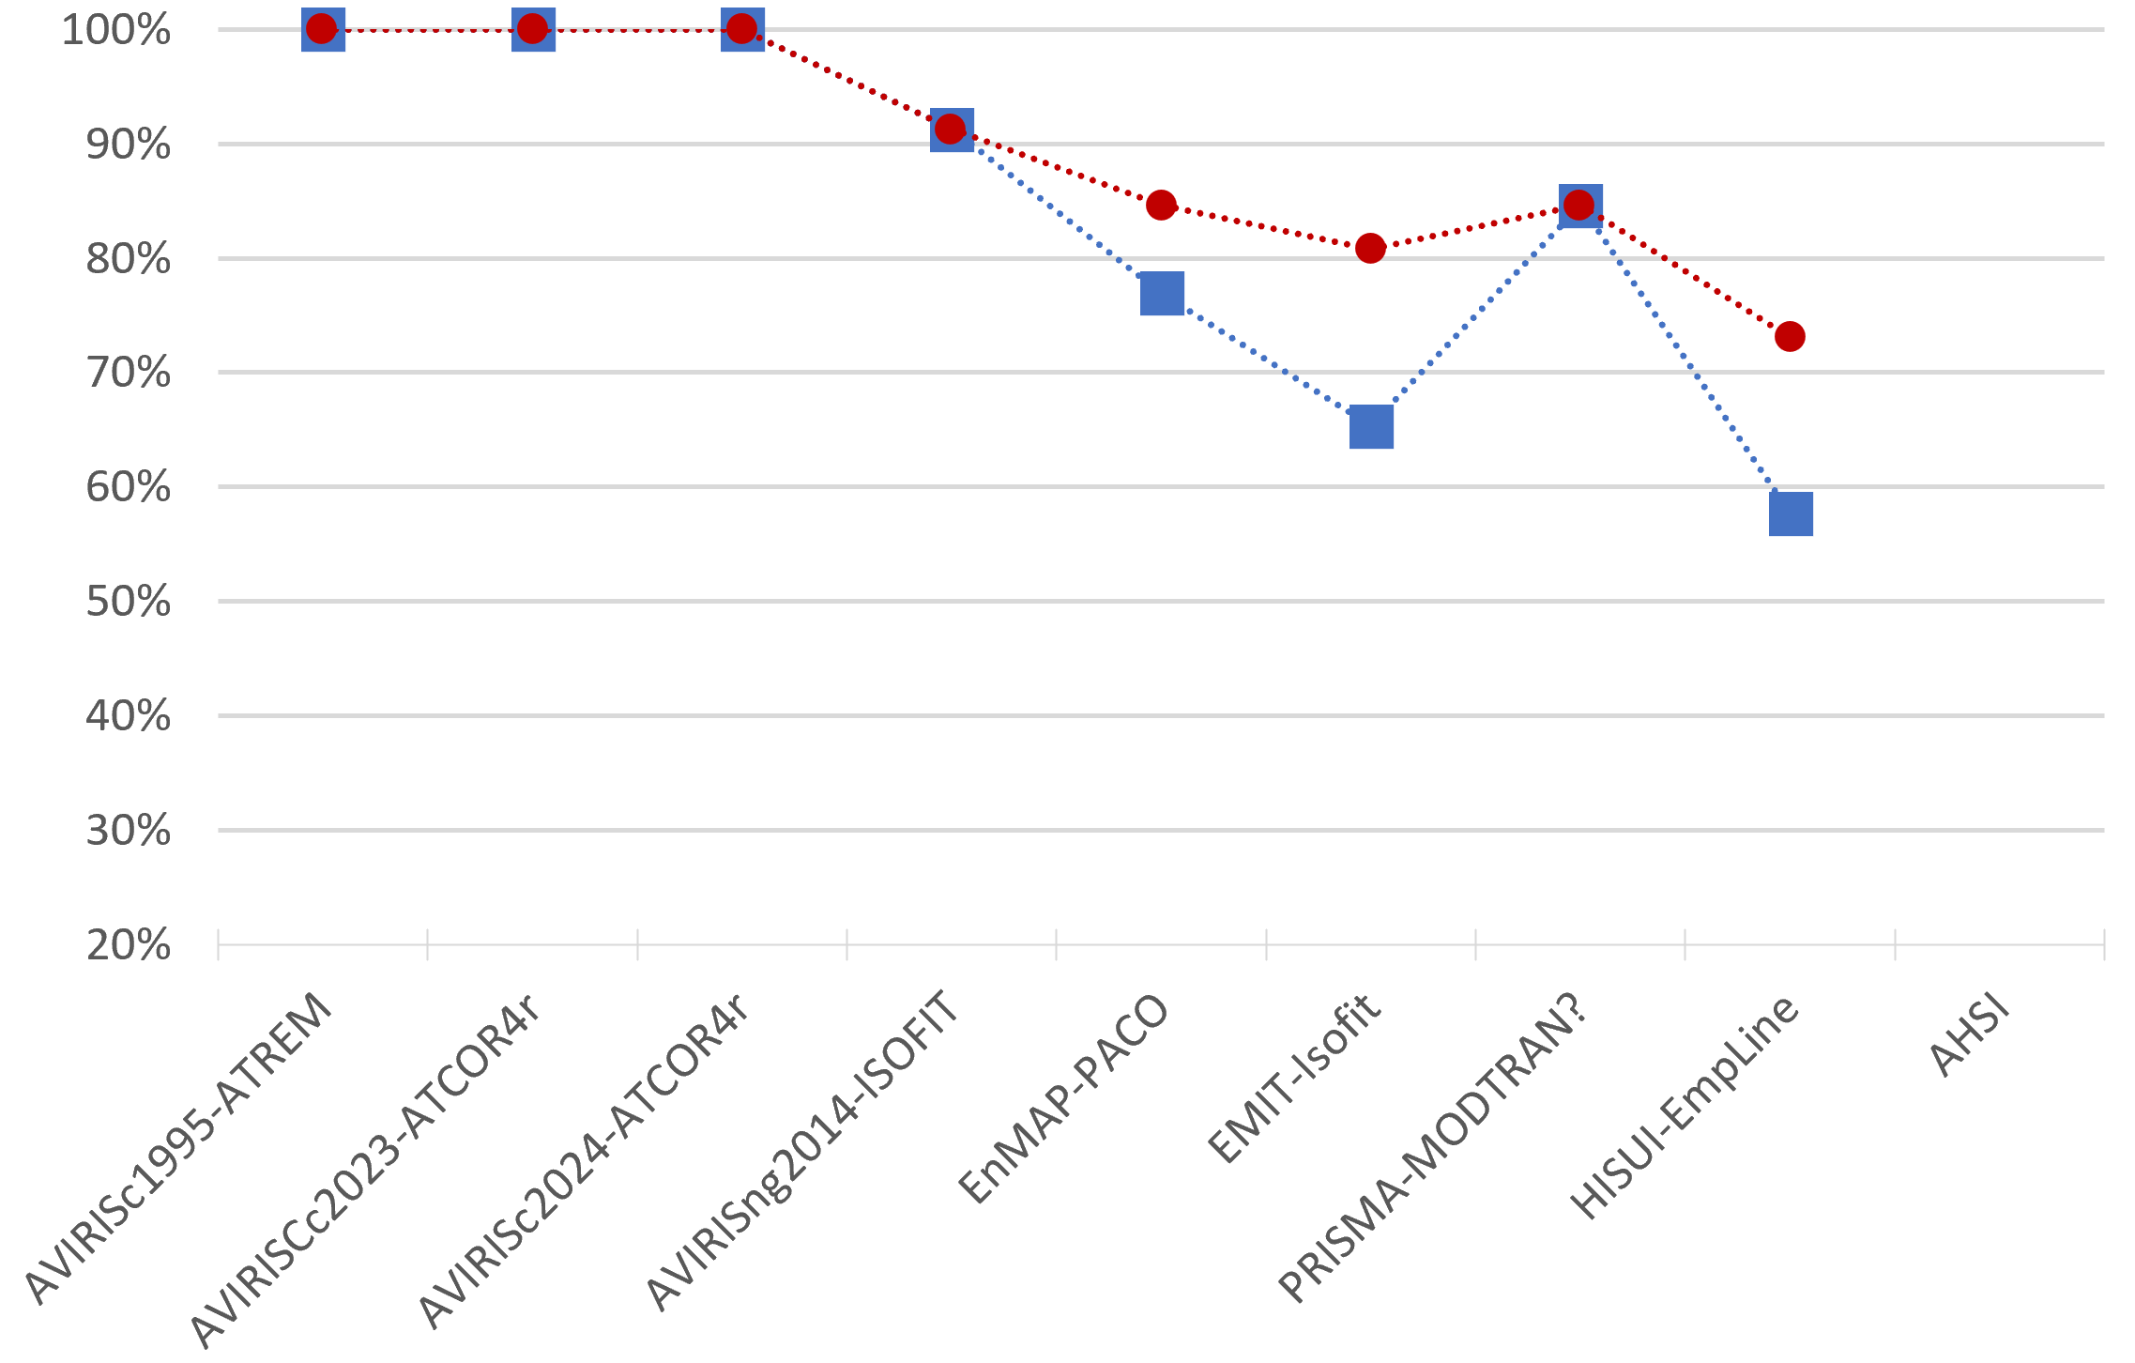
Mineral Classification Accuracy for Grouped (red) and Strict (blue) Classes GC reflectance
Airborne
Grouped classes
Strict classes

Slide 29
Future Efforts & Summary Comments
Continue evaluating remotely sensed images of Cuprite for mineral identification
AISA Fenix1k images at 1 m GSD collected on 2017-09-17
AVIRIS-Classic and AVIRIS-3 data acquisitions in 2025
Spaceborne data collected on other dates
Infrared (~8-12 μm) imaging spectrometer and multispectral data
Field scans with tripod mounted imaging spectrometers (~30 cm pixel size)
Continue collecting field validation samples for mineral characterization.
Develop more geologic proving grounds (IEEE GRSS GSIS working group, funding solicited).
Have PIC sites been measured and surrounding area samples?
Greatest mineral information gains will come from improvement of reflectance for wavelengths 2.3 μm and longer (reduction of spiky artefacts).
Is the MICA spectral feature comparison method of mineral identification sensor agnostic?
Subjectively from a geologic interpretation point of view, the answer is yes. That is, if sensor is well calibrated/characterized, reflectance data are free from artefacts and spectral absorption features are strong (deep), like at Cuprite.
Quantification of similarity needed.

Slide 30
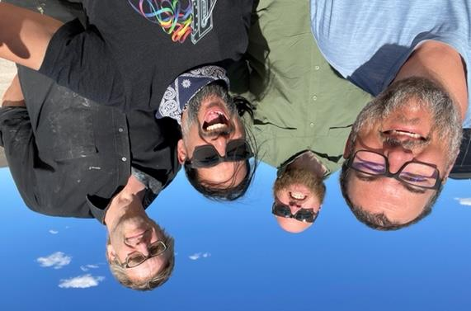
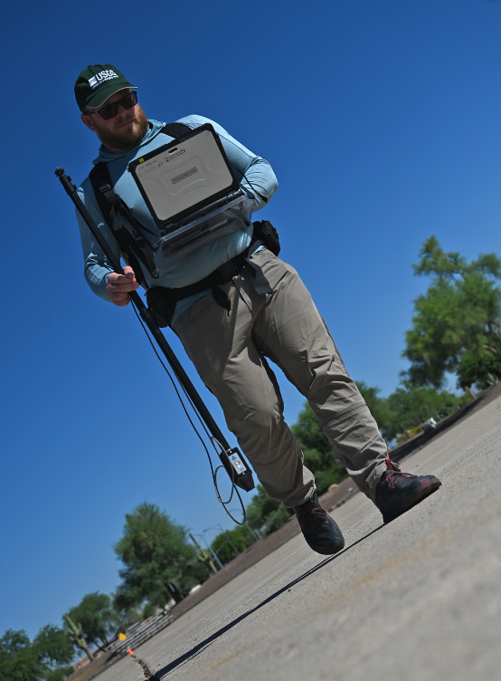
USGS team
Bernard Hubbard
Geologic remote sensing expert at
USGS Geology, Energy & Minerals Science Center (GEMSC)
in Reston, VA
Denver Spectroscopy Group
USGS Geology, Geophysics, and Geochemistry Science Center (GGGSC)
Above left to right: Todd Hoefen, Evan Cox, Ray Kokaly, John Meyer
Right: Derek Ensign
Earth MRI GEMx data available at:
https://aviris.jpl.nasa.gov/GEMX/

Slide 31
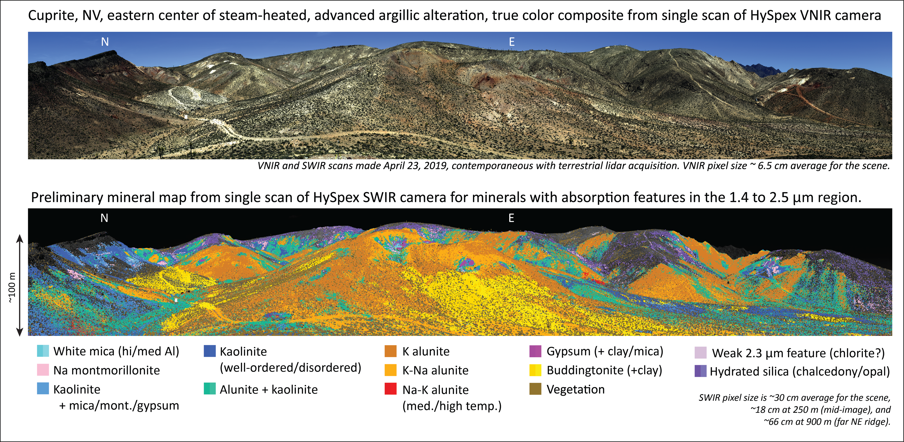
Thank You
Eastern alteration center, Cuprite, NV – Mineral map from tripod-mounted HySpex scan

Slide 33
What is a critical mineral?
The Energy Act of 2020 defines a “critical mineral” as a non-fuel mineral or mineral material essential to the economic or national security of the U.S. and which has a supply chain vulnerable to disruption. Critical minerals are also characterized as serving an essential function in the manufacturing of a product, the absence of which would have significant consequences for the economy or national security.
2022 list of critical minerals includes 50 elements from the periodic table, including many important for batteries and a new energy economy.
https://www.usgs.gov/news/national-news-release/us-geological-survey-releases-2022-list-critical-minerals

Slide 34
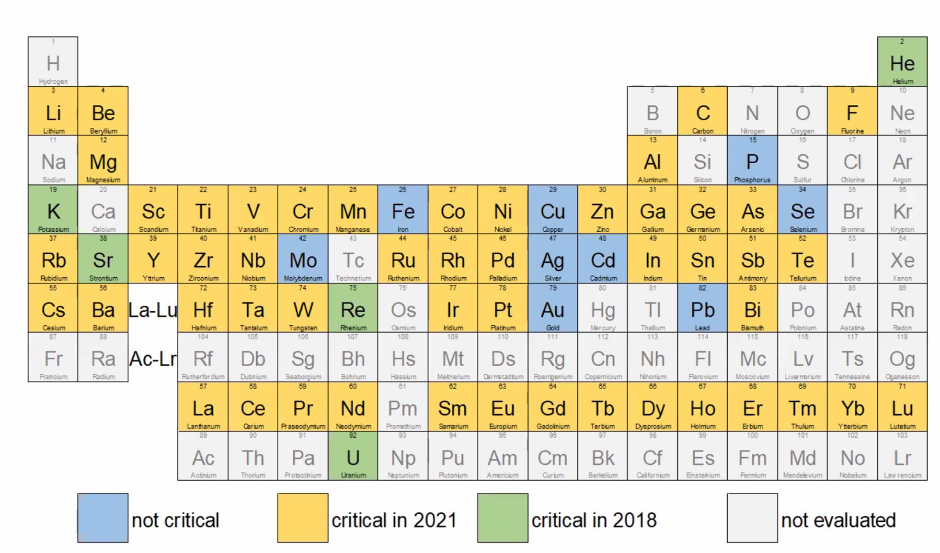
Critical Minerals in 2021

Slide 35
Stonewall Flat Playa calibration site

Slide 36
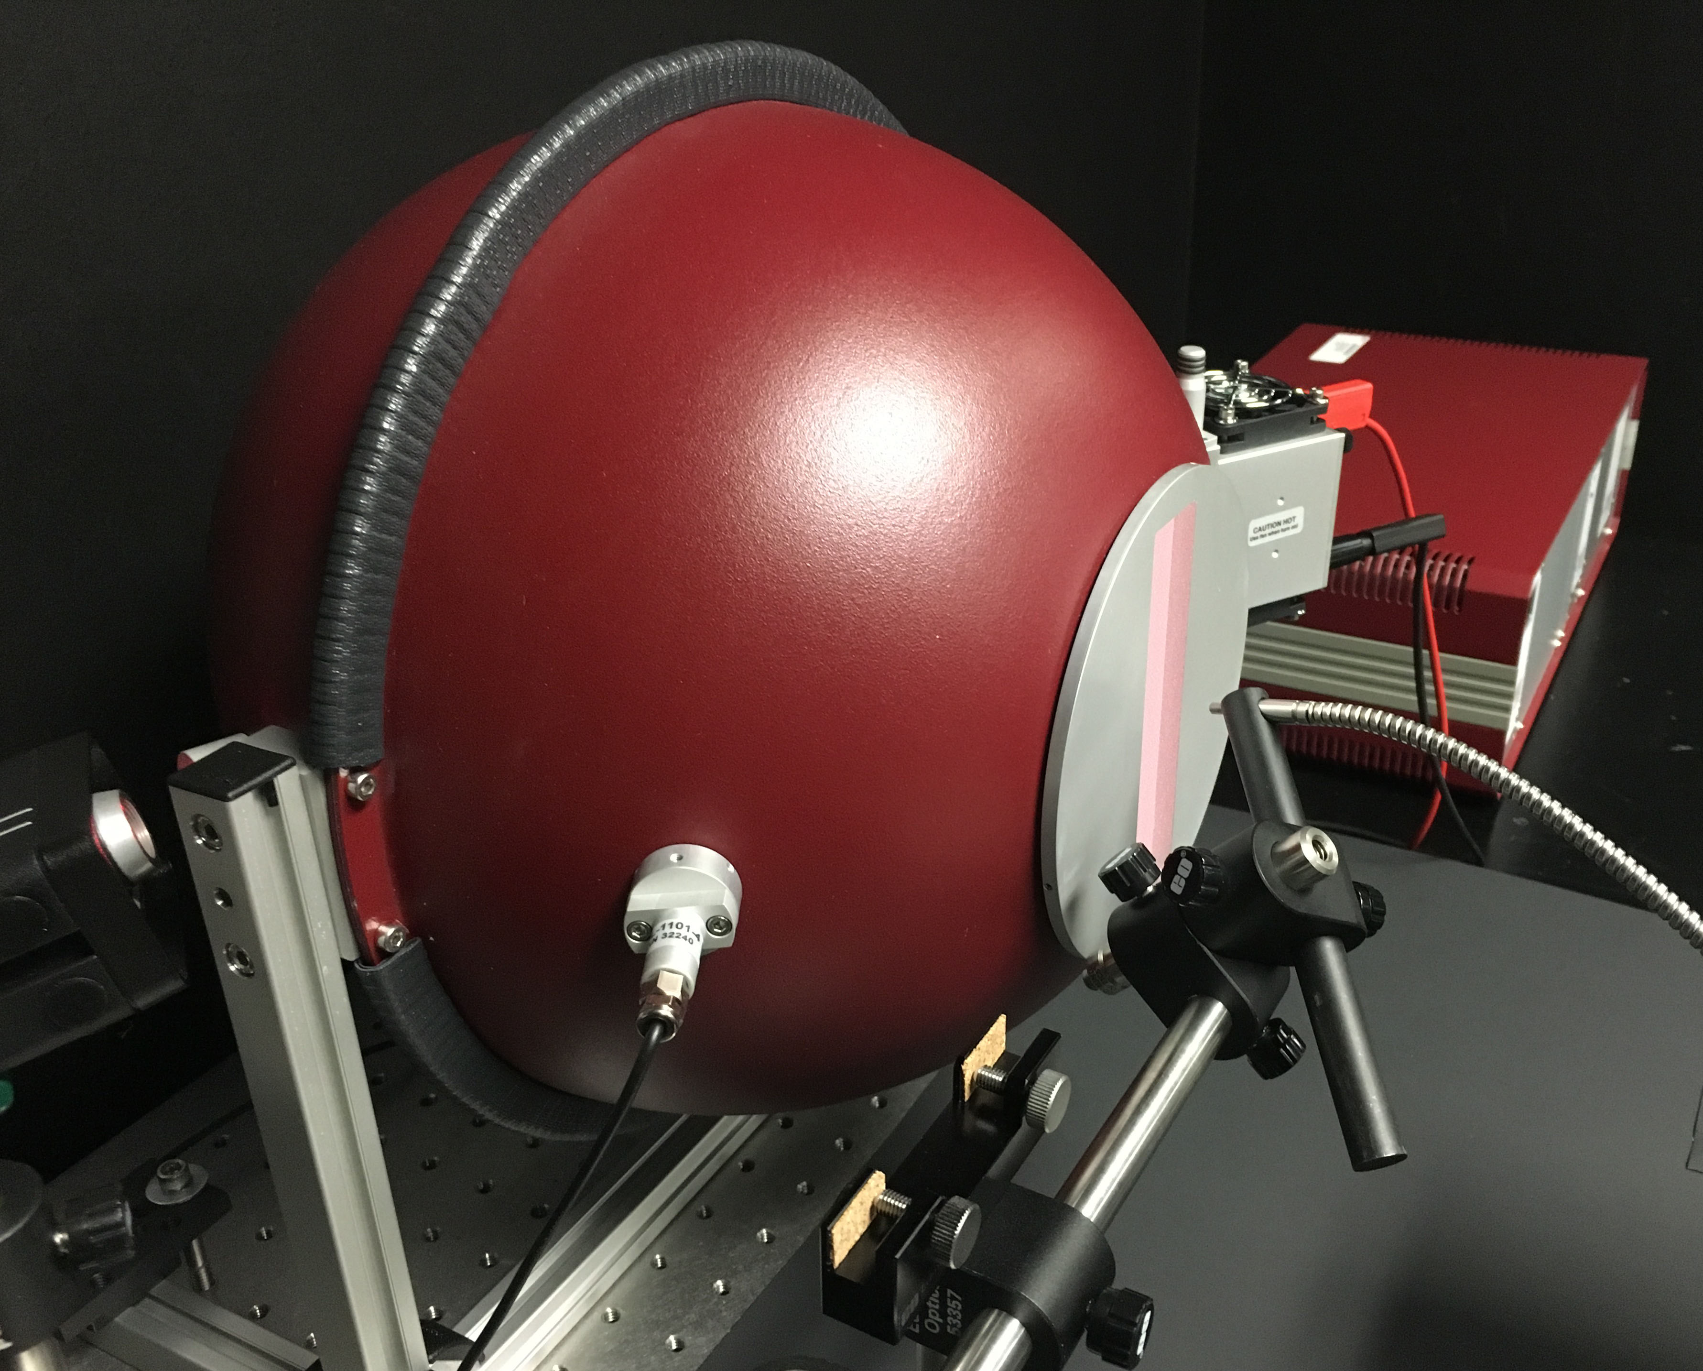
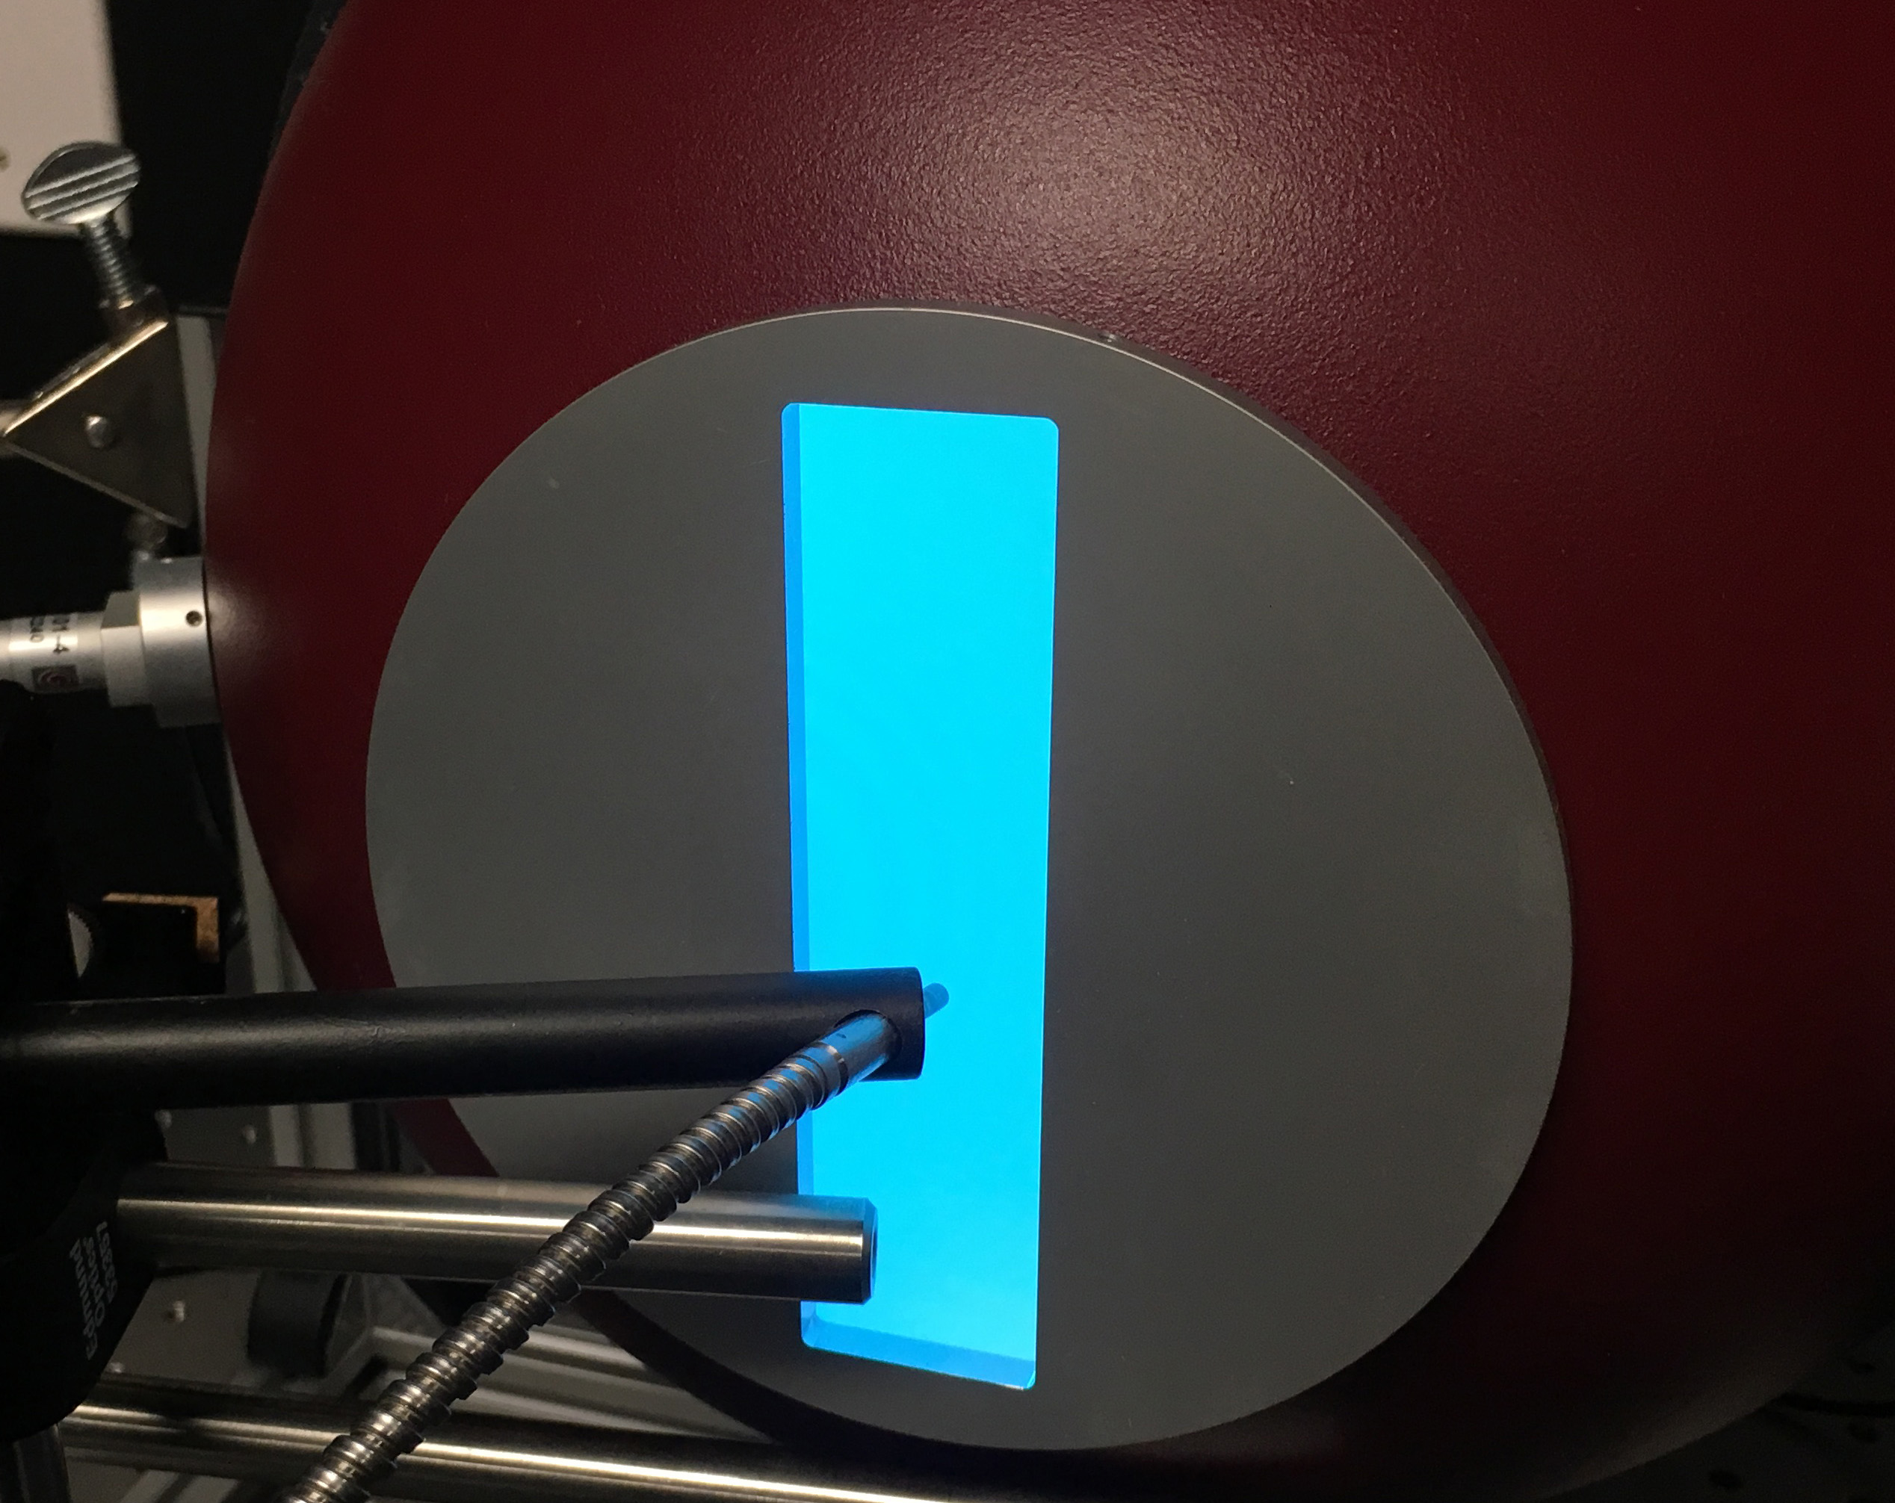
Evaluation of spectrometers: Validation of wavelength performance and determination of bandpass
Lab evaluation
NIST traceable radiance source
Noble gas lamps
Ar, HgAr, Ne, Kr, Xe
Laser HeNe
Transmission reference materials
NIST SRM2035
Corning Glass 5120 & 5121
Mylar plastic
Ho & Pr/Sm in perchlorate
Reflectance reference materials
Labsphere multicomponent REE-doped Spectralon puck

Slide 37
Calibration and Validation of Spectrometers
Bandpass characterization (variation among models & detectors)
ASD FS4 Std Res 18011
ASD FieldPro 6015
EMIT bandpass range
ASD FS4 Hi-ResNG w/
improved VNIR 18594
ASD FS4 Hi-ResNG w/
improved VNIR 18388
Preliminary information - subject to revision. Not for citation or distribution.

Slide 38
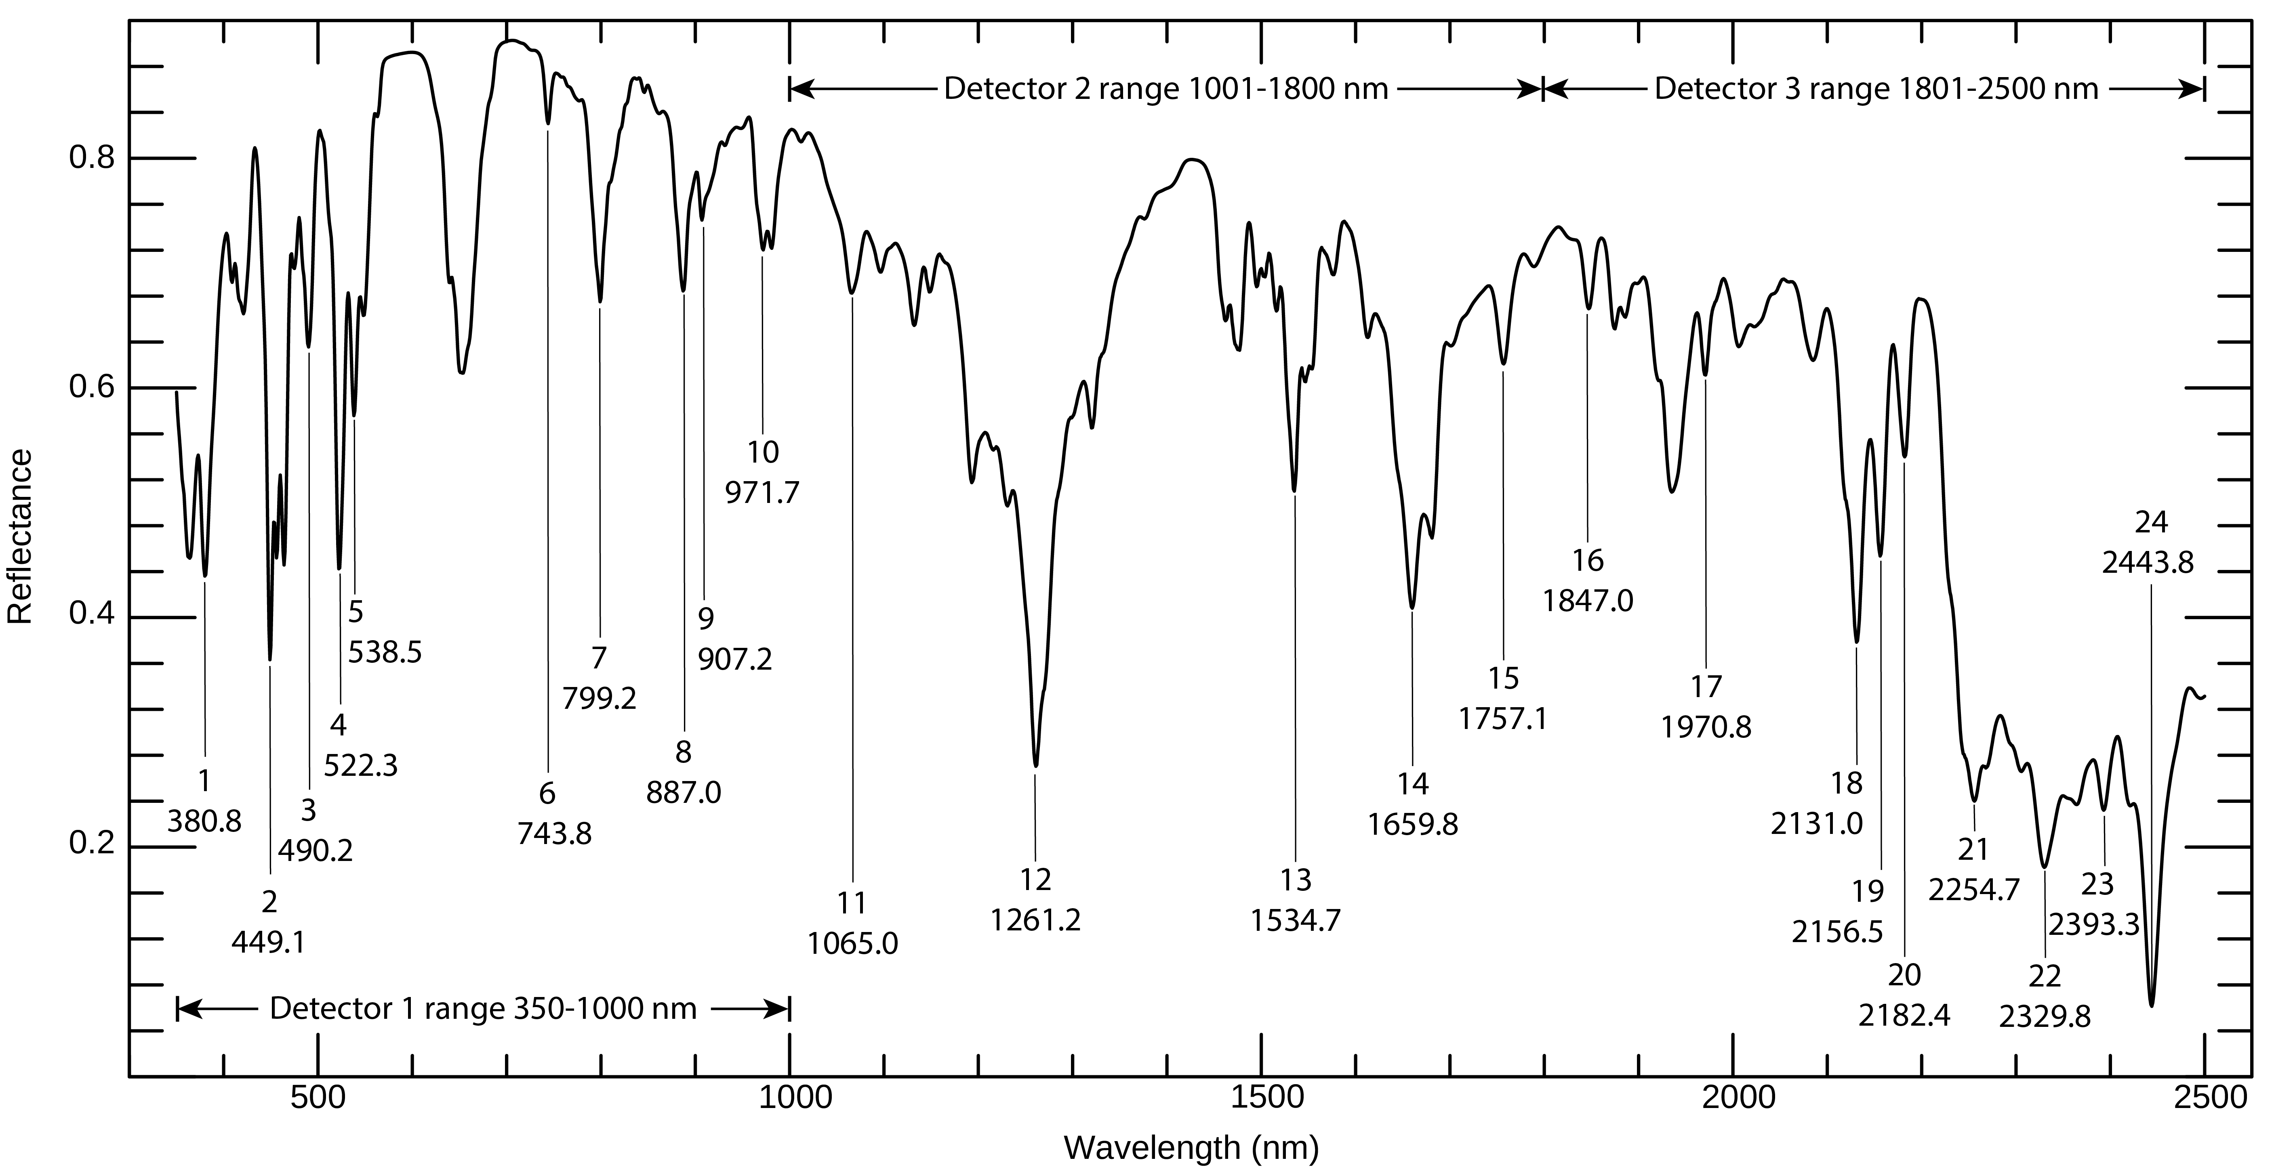
Monitoring sensor changes in lab and field setting
Internal reference standard: Mylar plastic sheet over the multicomponent rare earth element puck from Labsphere
Reference measurement made on benchtop spectrometers, measuring as fine a 0.02 nm sampling and 0.04 nm bandpass
Periodic monitoring of spectrometers in lab (each measurement session; SOP written under USGS QMS)
Episodic monitoring of ASD field spectrometer before, during, and after field campaign
MCREEmylar reference
Combination of multi-component REE doped Spectralon combined with thin Mylar plastic sheet.
MCREEmylar reference used routinely in USGS Denver Spectroscopy Lab, applied to collaborators’ spectrometers, used during the NASA SNOWEX campaign in 2023, and required for contracted data collection

Slide 39
Reflectance Measurement Procedure at Calibration Sites

Slide 40
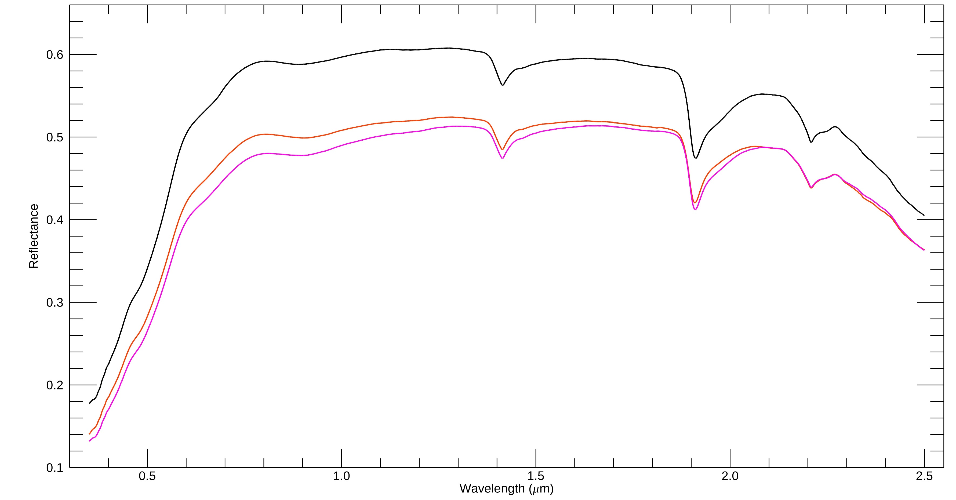
Stonewall Flat Playa – Time Series of Field Measurements
2022-09-19
2024-09-10
2023-09-22

Slide 41
Comparison of
mineral maps
AVIRISc1995
to
AVIRISng20140625
Preliminary information –
subject to revision.

