Slide 1
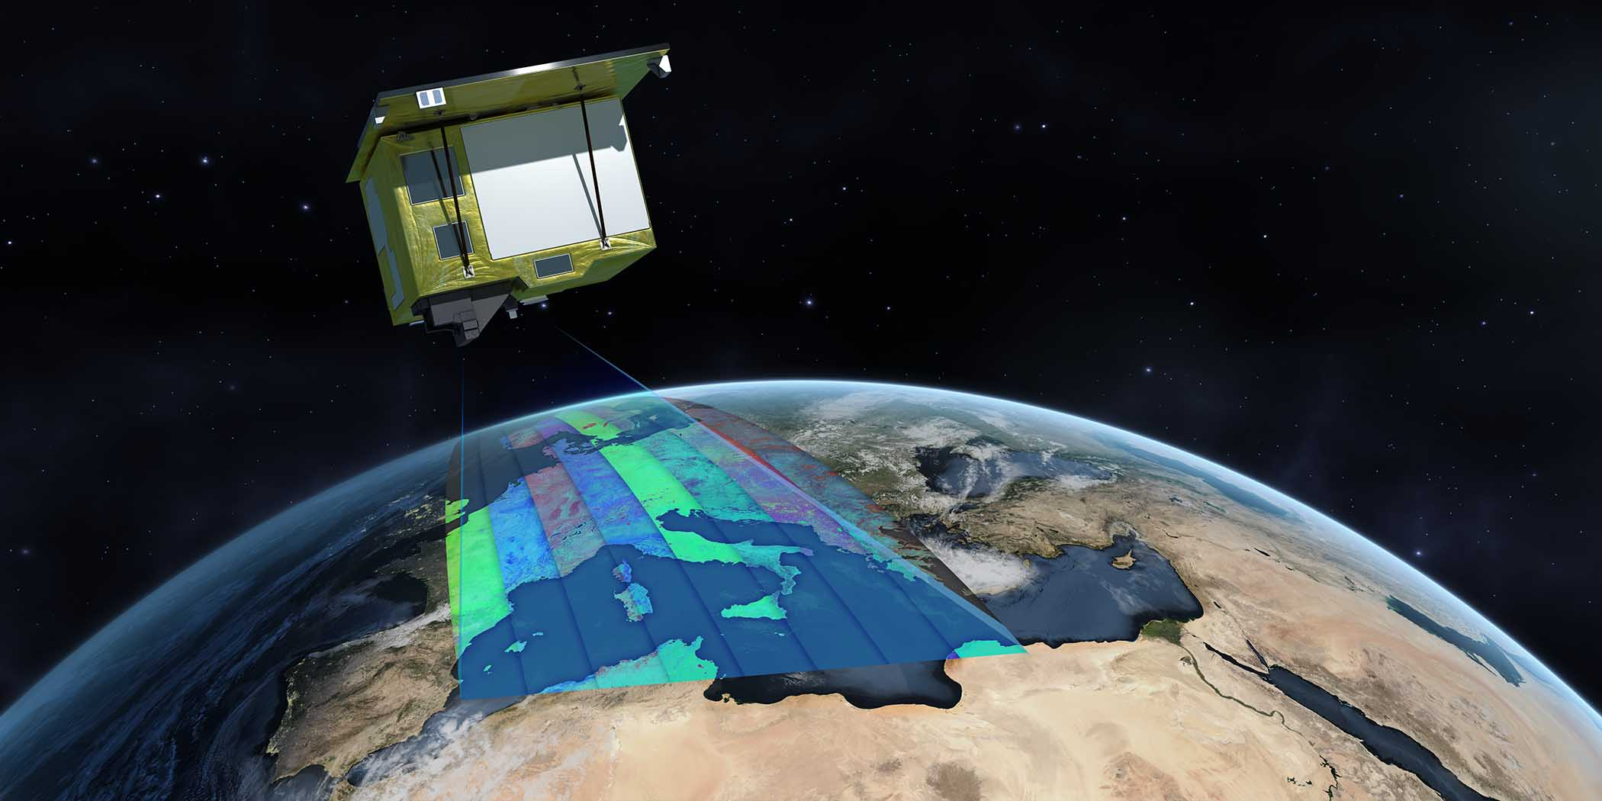
ACIX-III Land
Overview and status of the
Atmospheric Correction
Inter-comparison eXercise
Noelle Cremer Serco for ESA-ESRIN
Kevin Alonso Starion for ESA-ESRIN
Georgia Doxani Serco for ESA-ESRIN
Ferran Gascon ESA-ESRIN
Adam Chlus JPL, Caltech
Philip Brodrick JPL, Caltech
David Thompson JPL, Caltech
Philip Townsend JPL, University of Wisconsin
Angelo Palombo cnr imaa
Federico Santini cnr imaa
Bo-Cai Gao naval research laboratory
Feng Yin university college london
Jorge Vicent-Servera magellium
Quinten Vanhellemont rbins
Raquel de los reyes dlr
Tobias Eckert dlr
Weile wang NASA ames research center
Yaokai liu cas.china
Maximilian brell gfz
Aime Meygret cnes
Sophie Coustance cnes
morgan Farges magellium
3rd Workshop on International Cooperation in Spaceborne Imaging Spectroscopy
13-15 NOV 2024
ESA-ESTEC, Noordwijk, The NetherlandS
Image credit: DLR

Slide 2
ACIX Basis
WHAT?
S
W
The objective is to point out:
Strengths & Weaknesses
Commonalities & Differences
C
D
Definition of the
inter-comparison protocol
Application of the AC processors
Analysis of the results
  Coordinators & Participants
  discuss all the major points and defined the inter-comparison procedure.
  Participants
  applied their AC schemes on a set of test sites keeping the processing parameters constant. The results were submitted for analysis to ACIX coordinators.
  Coordinators
  processed the AC results and assessed the inter-comparison metrics. The results presented and discussed with the participants.

Slide 3
ACIX Organisation
ACIX-III
CMIX-II
Atmospheric Correction
Inter-comparison eXercise
Cloud Masking
Inter-comparison eXercise
Aquatic sites
Land sites
PRISMA
PRISMA, EnMAP
Sentinel-2, Landsat-8
Notes:
Updated inclusion of EnMAP data

Slide 4








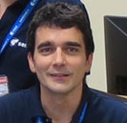
ACIX Organisation
ACIX-III
Atmospheric Correction
Inter-comparison eXercise
With support of:
Aquatic sites
Land sites
PRISMA
PRISMA, EnMAP
Coordination team
Jet Propulsion Laboratory
California Institute of Technology
Kevin Alonso
Noelle Cremer
Georgia Doxani
Ferran Gascon
Adam Chlus
Philip Brodrick
David Thompson
Phil Townsend
Notes:
Updated inclusion of EnMAP data

Slide 5
ACIX History
WHEN?
CMIX
ACIX-II Land
ACIX-II Aqua
10 processors
5 validation datasets
Publication link
Website link
12 processors
120 AERONET sites
Publication link
Website link
8 processors
20 AERONET OC sites
Publication link
Website link
2016
-
2018
2022
-
2025
ACIX
2018
-
2022
11 processors
19 AERONET sites
Publication link
Website link
CMIX-II
ACIX-III Land
ACIX-III Aqua
17 processors
4 validation datasets
8 processors
13 AERONET sites
19 SR sites
18 processors
26 AERONET OC & HYPERNETS sites

Slide 6








ACIX-III Land Participants
WHO?
 | Organization/Entity | Processor
1 | DLR | PACO
2 | University College London | HYPER SIAC
3 | MAGELLIUM | MAGAC
4 | NASA Ames Research Center | GeoNEX-AC
5 | CAS.CHINA | Hikerliu
6 | RBINS | ACOLITE/DSF
7 | CNR Institute of Methodologies for Environmental Analysis (IMAA) | ImaACor
8 | Naval Research Lab, Washington DC USA | ATREM
Notes:
Updated to current ACIX-III participants, added RTM used by processor

Slide 7
ACIX-III Land Structure
START
END
ACIX coordinators
download and pre-process L1 data
HOW?
ACIX coordinators
prepare a synthesis of the results for publication
ACIX participants
access L1data from server
With support of:
Results Inter-Comparison & Publishing
ACIX
Web and server interface
Test and Submission Phase
ACIX
participants
run their atmospheric correction
process
ACIX coordinators
analyse the results and report the inter-comparison outputs
ACIX coordinators
retrieve the submitted results and reports
ACIX participants
submit results and information about processor
End of Test and Submission Phase
Notes:
New version for ACIX-III (same as in current protocol)

Slide 8


ACIX-III Data
With what?

Slide 9
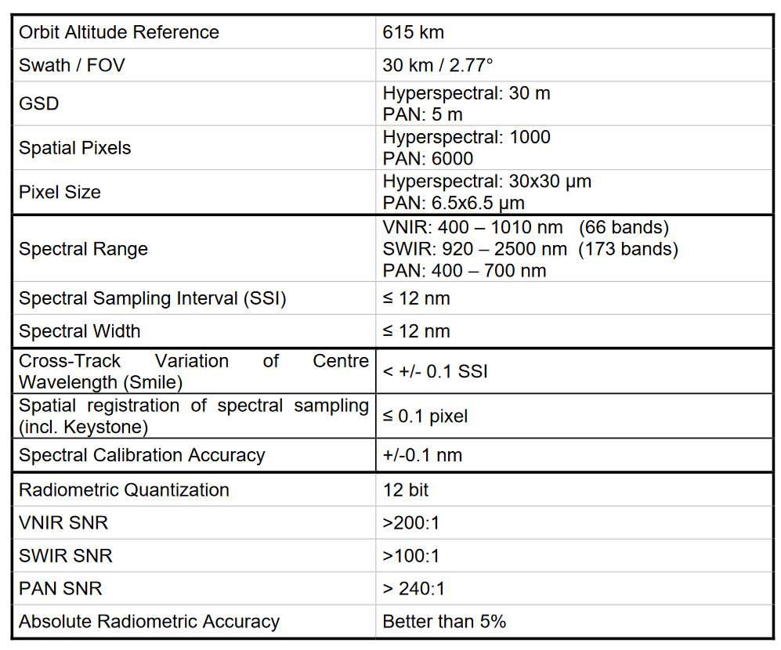
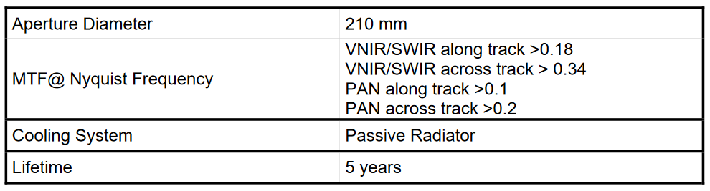
ACIX-III Data: PRISMA
Input Data PRISMA – 46 scenes
PRISMA L1 data: Top-of-Atmosphere Radiance radiometrically corrected and calibrated in physical units. Additional geocorrection and sensor azimuth and zenith angle calculation applied by JPL.
HDF5-EOS format with
VNIR and SWIR Data Cubes,
Geolocation Fields,
Geometric Fields,
Terrain Fields.
Notes:
Added information about L1G product

Slide 10
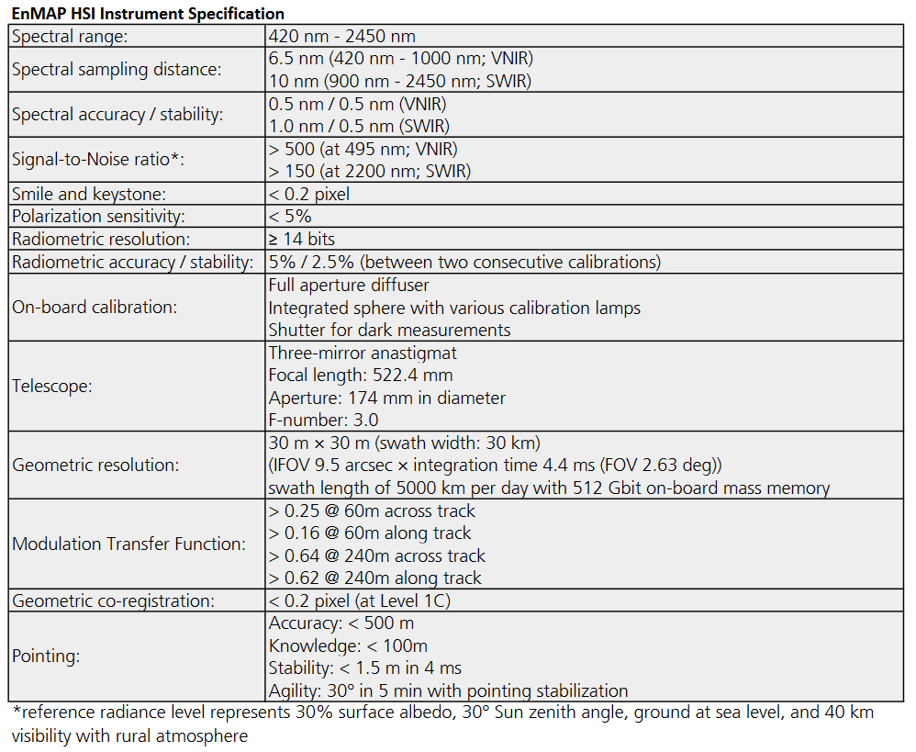
ACIX-III Data: EnMAP
Input Data EnMAP – 44 scenes
EnMAP L1C data: Top-of-Atmosphere Radiance radiometrically corrected, orthorectified and calibrated in physical units, including masks (e.g. cloud and cirrus).
EnMAP Products are distributed as a .zip file with several .tif files and a set of .xml files (including one for the metadata).
Common approach for sensor angle calculation and solar irradiance model distributed with the data.

Slide 11
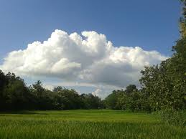

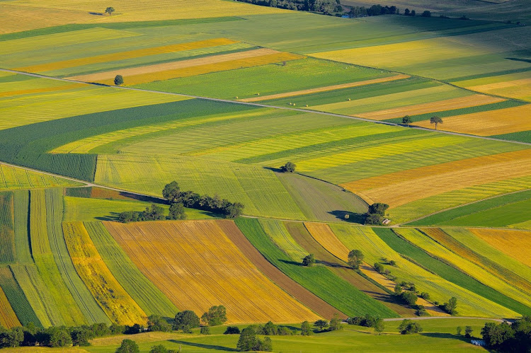
ACIX-III Reference Data
Comparison?
Aerosol
Optical Depth
Surface Reflectance
Water Vapour

Slide 12



ACIX-III Reference Data: AERONET
Aerosol Optical Depth
    AERONET stations
AOE Baotou
Bangkok
TGF Tsukuba
Birdsville
Learmonth
Migal
Sede Boker
Rome Tor Vergata
NEON SJER
NASA Ames
Sioux Falls
GSFC
USDA ALAC
Aerosol Optical Depth
Water Vapour
A E R O N E T
Statistics
No. of samples
R² (Coefficient of determination) RMSE Bias
Estimated AOD (/WV) & compared to Level 1.5
(cloud screened) AERONET data
Interpolate AERONET values @ λ=550 nm using Angstrom Exponent
Average AERONET values over time period within ±15 min from AOD retrieved values (PRISMA/EnMAP overpass)
Average estimated AOD values over an image subset of 9 km x 9 km centred on the AERONET sun-photometer station
    APU analysis
Satellite products
18 products for PRISMA, 12 products for EnMAP over the same AERONET stations

Slide 13




ACIX-III Reference Data: Surface Reflectance
Surface Reflectance
    02. Campaign Data
01. Ground based validation
ESA CHIME & SBG 2021 campaign
Braccagni (Italy)
Rio Tinto (Spain)
Camarena (Spain)
EnMAP validation campaign
Gobabeb (Namibia)
Railroad Valley Playa (USA)
Pinnacles (Australia)
Antarctica
Berlin (Germany)
Black Rock Playa (USA)
Makhtesh Ramon (Israel)
Amiaz Plain (Israel)
RadCalNet
Gobabeb (Namibia)
Railroad Valley Playa (USA)
La Crau (France)
Baotou Sand (China)
HYPERNETS
Gobabeb (Namibia)
ATB (Germany)
Wytham Woods (UK)
Barrax (Spain)
    03. Relative SR inter-comparison
Plotting the spectral profiles per AC approach.
Notes:
Updated to include RVP and Baotou as sites, deleted for AERONET SR

Slide 14
ACIX-III Data Overview
Aerosol
Optical Depth
Water Vapour
Surface Reflectance

Slide 15
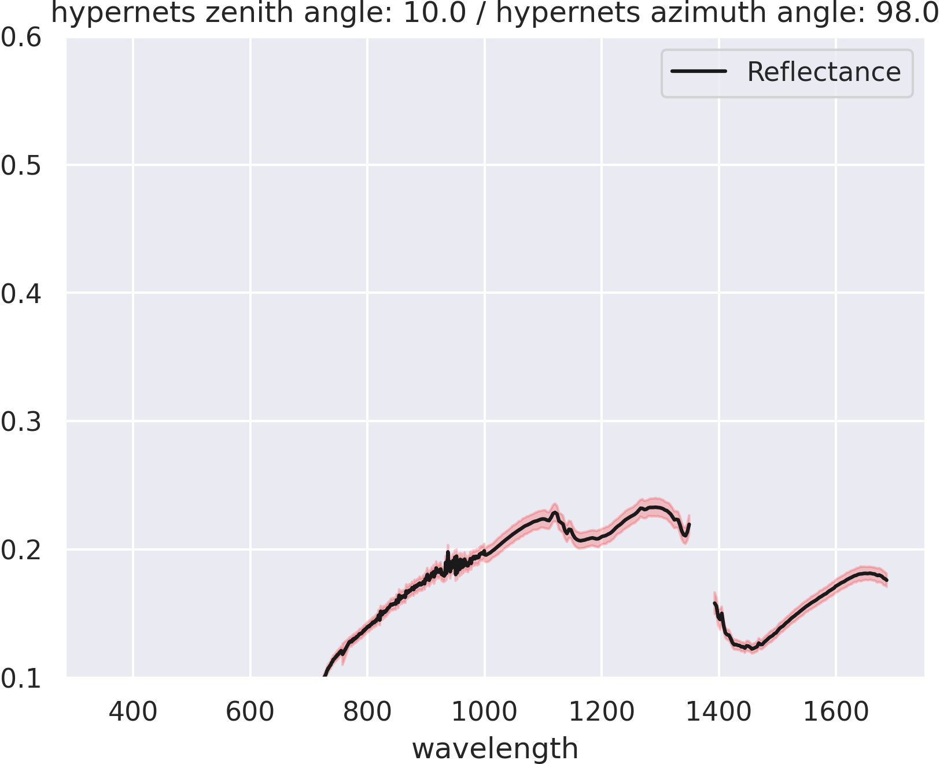
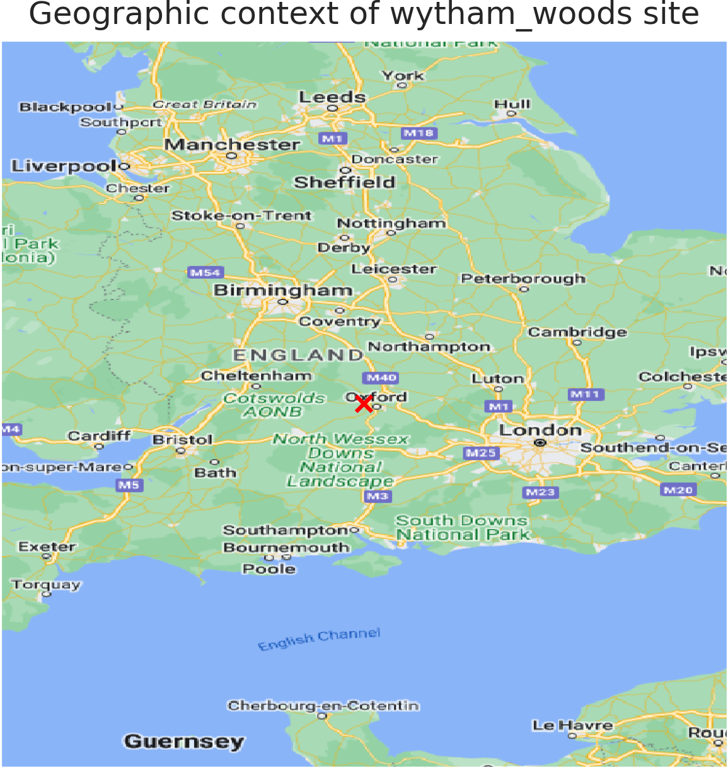
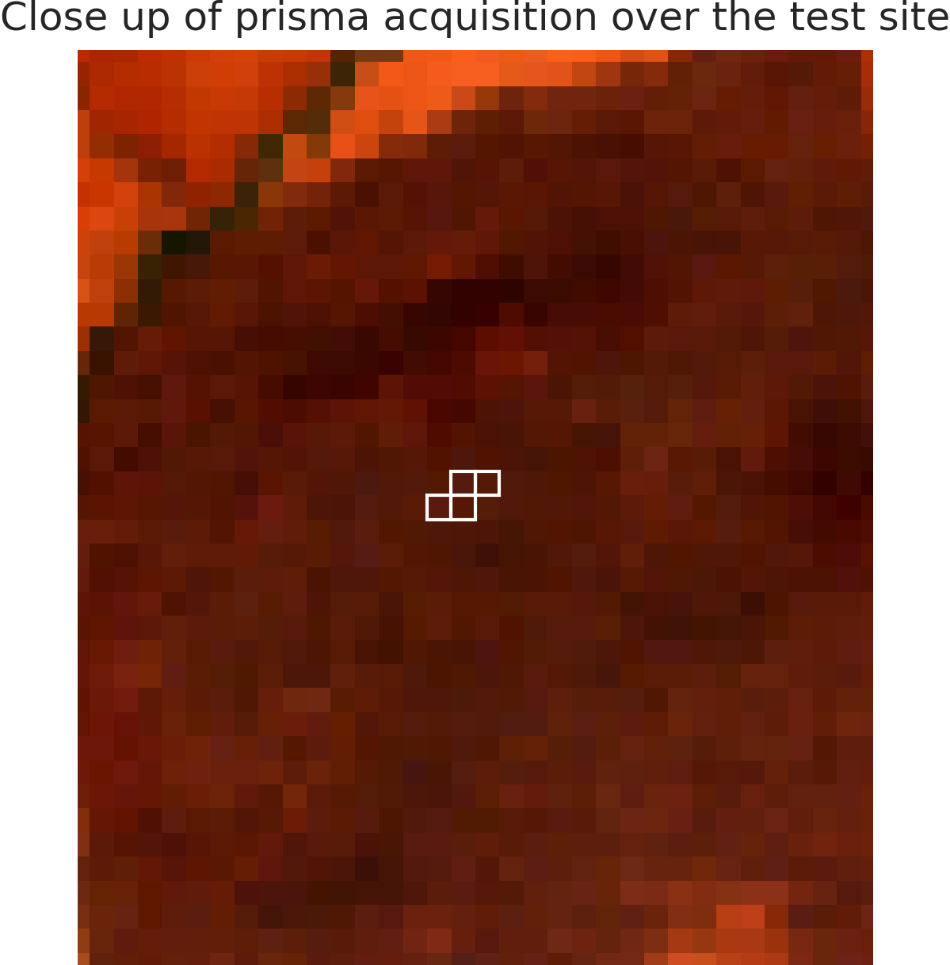
ACIX-III Land: Preliminary results
HYPERNETS: Wytham Woods
Reference measurement
Geographical context and acquisition

Slide 16
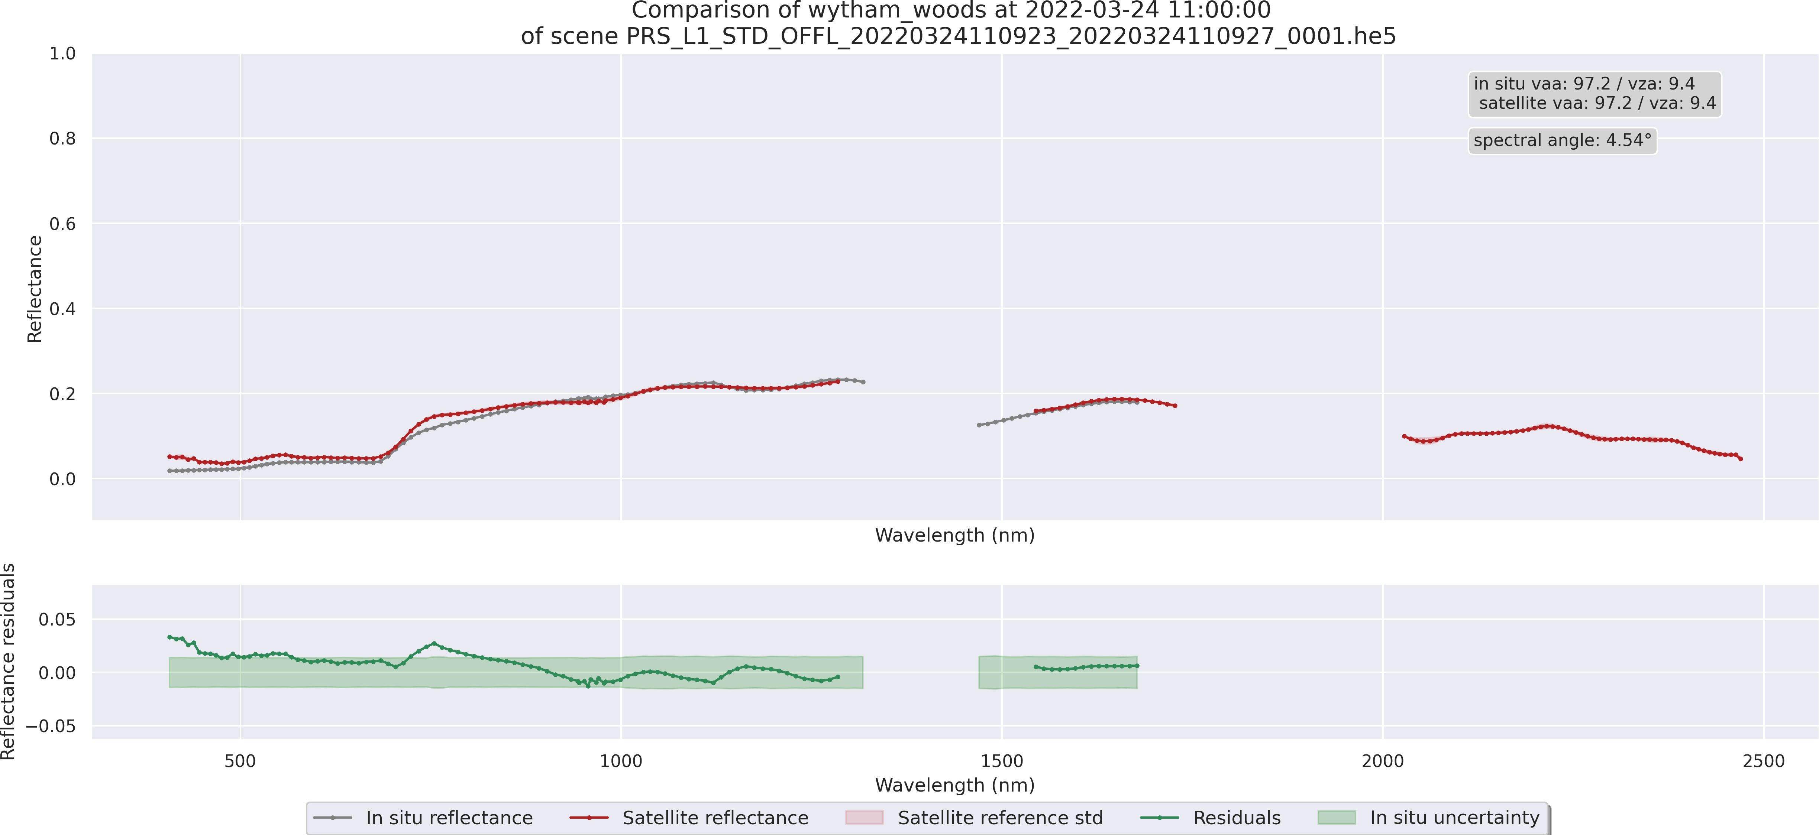
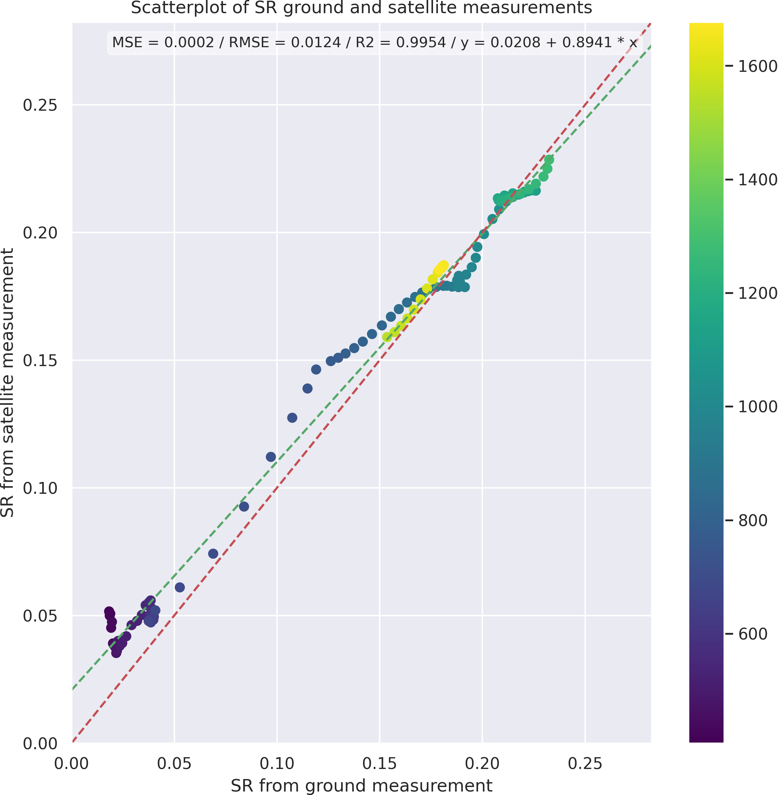
ACIX-III Land: Preliminary results
HYPERNETS: Wytham Woods
Line plot
Scatterplot

Slide 17
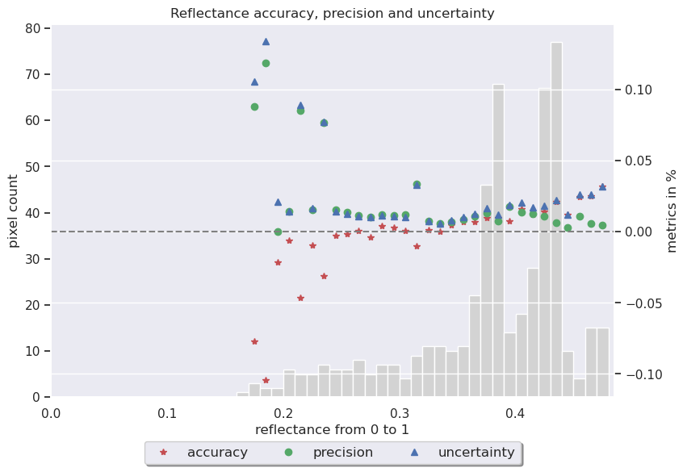
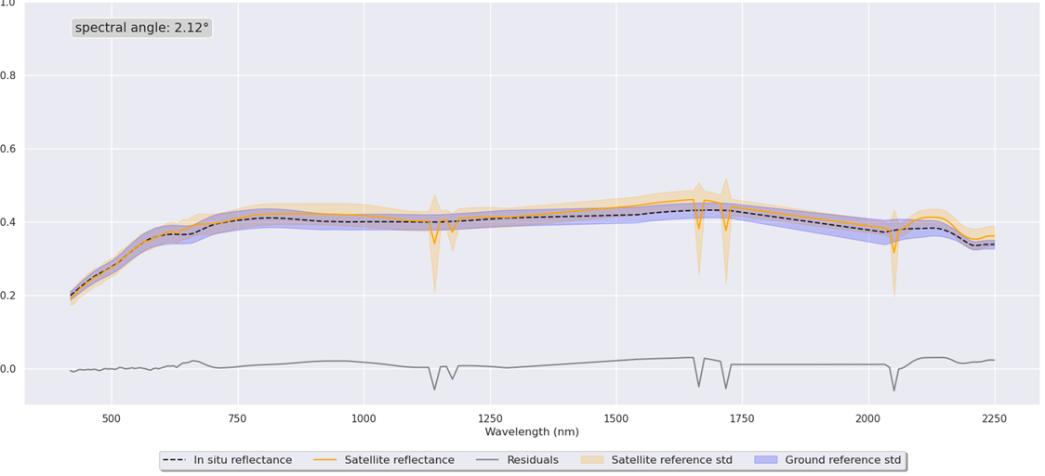
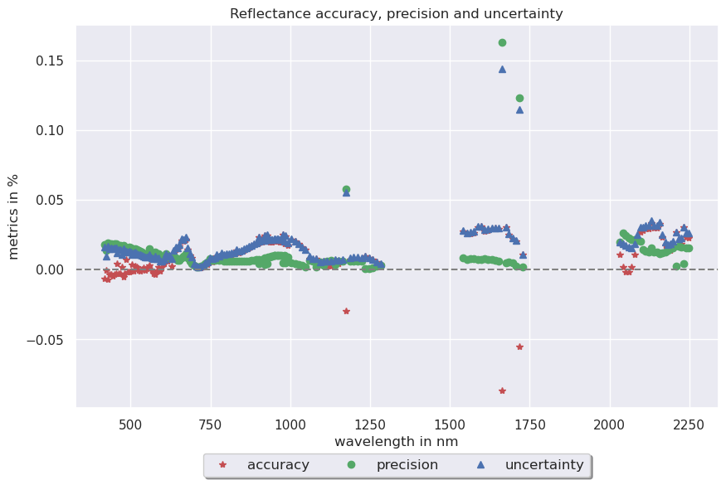
ACIX-III Land: Preliminary results
RadCalNet: Railroad Valley Playa
Line plot of mean over all RVP sites
Accuracy, precision and uncertainty plots

Slide 18
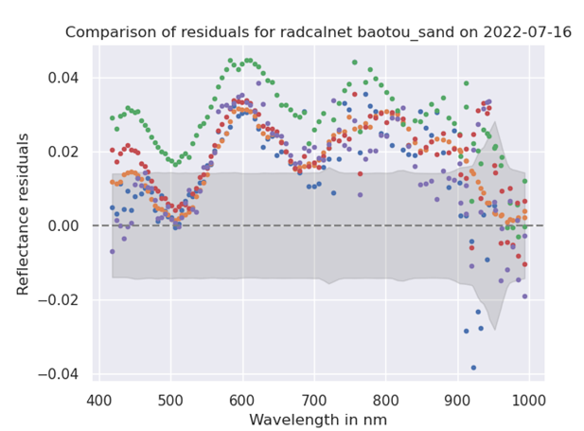
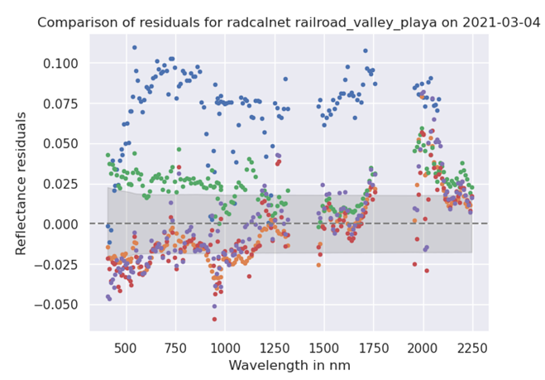
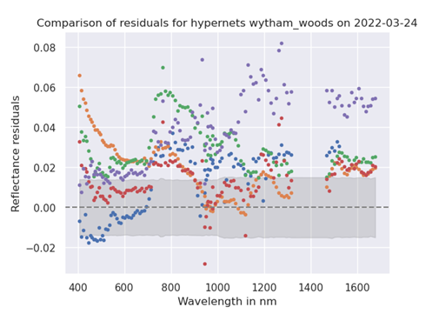
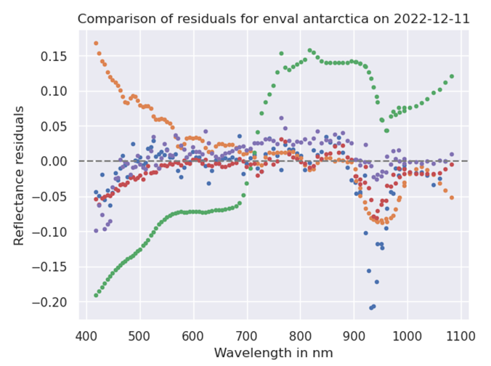
ACIX-III Land: Preliminary results
Examples:
Absolute difference to reference
Baotou Sand
Railroad Valley Playa
Wytham Woods
Antarctica

Slide 19
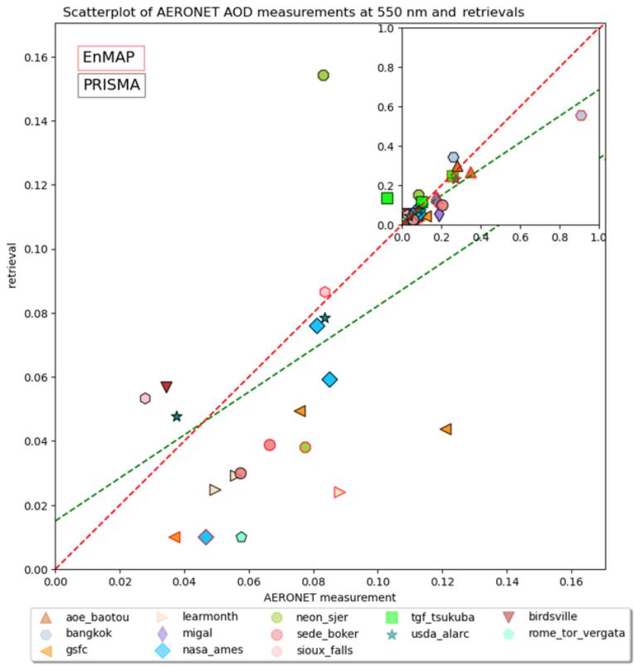
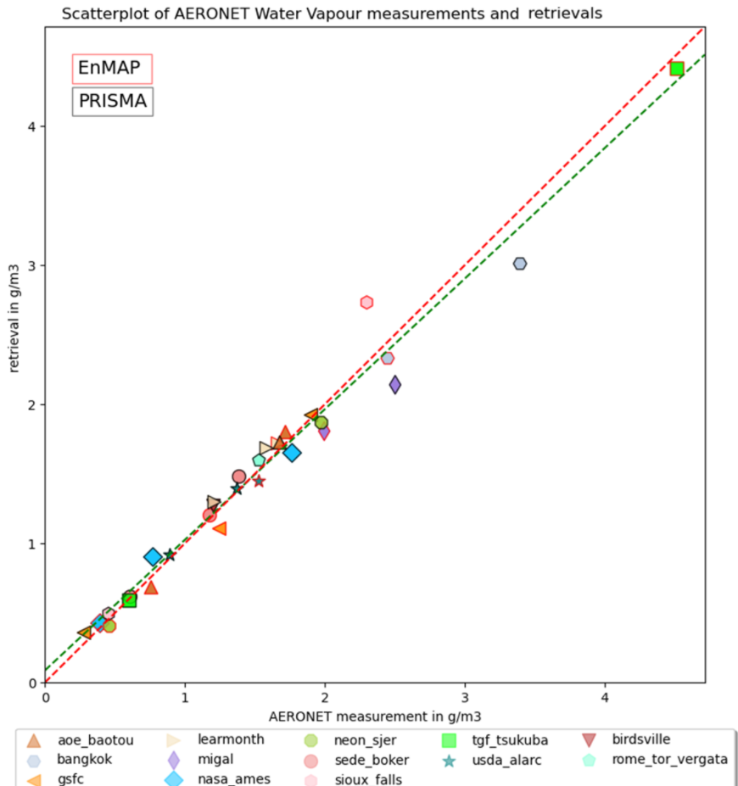
ACIX-III Land: Preliminary results
AOD
WV
Examples:
AOD/WV

Slide 20
ACIX-III Land Timeline
Report Release
to the participants
Presentation at ESA LPS
Results Submission
Start
1st workshop
ESA/ESRIN
(Frascati, Italy)
Invitation to developers
20-21 June 2022
May -
August 2024
March 2025
May / June 2025
Dec 2021
February 2024
Q3 2025
Input Data Distribution
to Participants
Inter-comparison Results
Presentation
2nd workshop
Report
Submission to Scientific Journal
Notes:
Updates timeline

Slide 21
ACIX-III Land Timeline
Report Release
to the participants
Presentation at ESA LPS
Results Submission
Start
1st workshop
ESA/ESRIN
(Frascati, Italy)
Invitation to developers
Next steps:
Comparing: sites, sensors, land covers etc.
Interpretation of results
Creation of reports for each participant
Organisation of results workshop
20-21 June 2022
May -
August 2024
March 2025
May / June 2025
Dec 2021
February 2024
Q3 2025
Input Data Distribution
to Participants
Inter-comparison Results
Presentation
2nd workshop
Report
Submission to Scientific Journal
Notes:
Updates timeline

Slide 22
Thank you for your attention!
1st WS of ACIX-III Land, -Aqua and CMIX-II:
https://earth.esa.int/eogateway/events/1st-workshop-of-acix-iii-land-aqua-and-cmix-ii/agenda

Slide 23
ACIX-III Seed questions
How does your work contribute to improving harmonisation?
  Intercomparison exercises can serve, amongst other inputs, as a basis for a harmonisation process.
What aspect of harmonisation can most benefit users?
  Related to ACIX, benefits include reducing sources of uncertainty and efforts to adapt processors to different data inputs, as well as the number of assumptions made in the workflow developed for a specific sensor.
At what level of processing is harmonisation most necessary (L1B, L1C, L2A, L2B+, L3/L4)?
An awareness of harmonisation at “higher” levels can facilitate already harmonised “lower” levels.
What is more important, the harmonisation on data formats or the harmonization on information content of the products?
  Both are important. The harmonisation of information content seems to be harder to fix at the product level and therefore more important to deal with at an earlier stage.
Notes:
Updates timeline

