Slide 1
A Novel At-Sensor Radiance Harmonization Method
Andreas Baumgartner, Claas Köhler
German Aerospace Center (DLR)

Slide 2
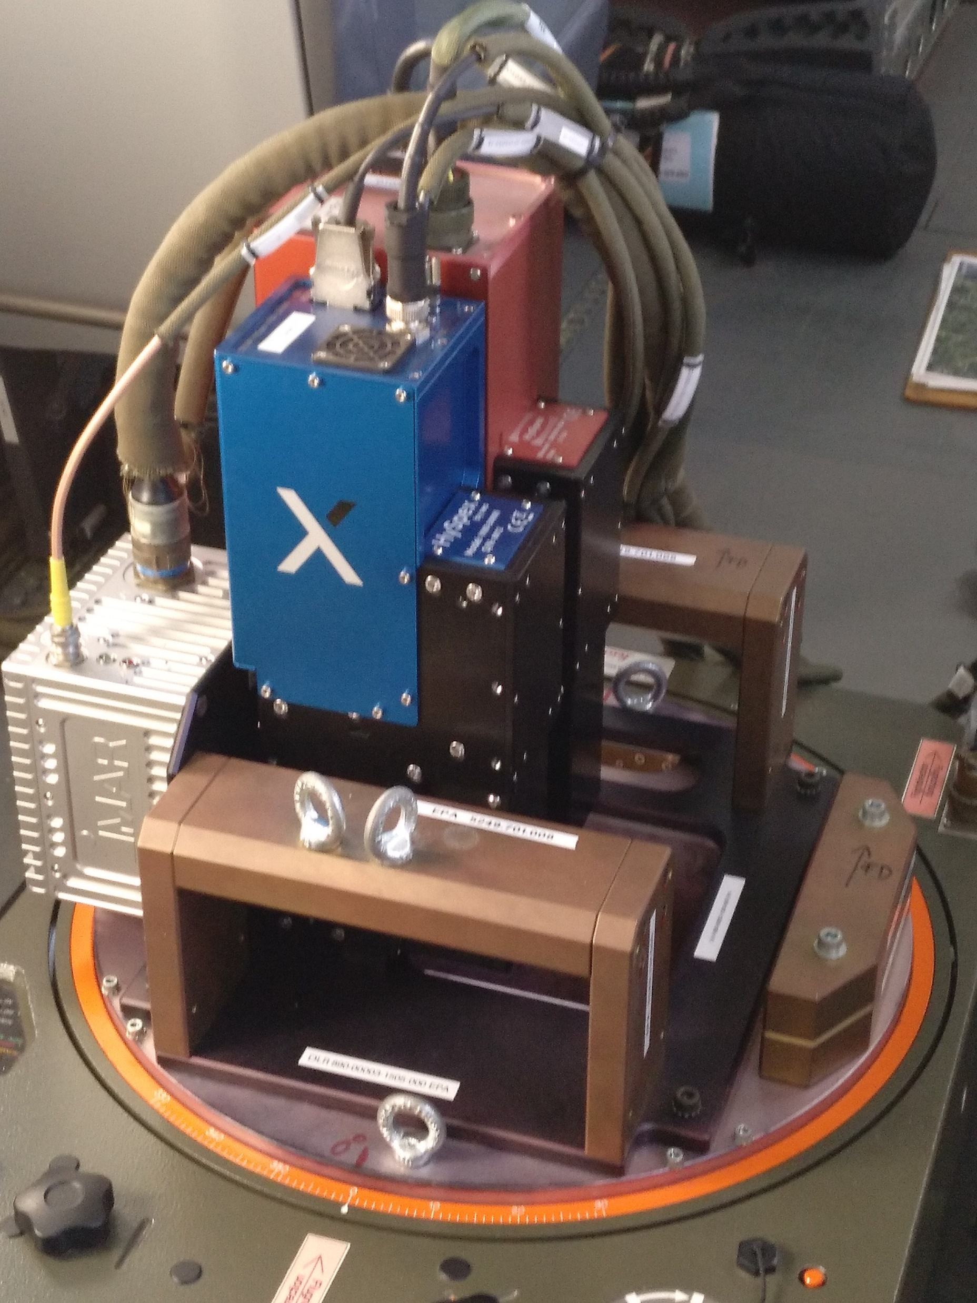
Airborne Sensor Systems
HySpex-B
HySpex VNIR-3400N + SWIR-384
N → Nyquist (sampled)
Operational since 2023
Typical hyperspectral sensor
HySpex (EnMAP demonstrator)
HySpex VNIR-1600 + SWIR-320me
Acquired for EnMAP preparation in 2011
Extensively calibrated
Our advantage: we can recalibrate after each campaign

Slide 3
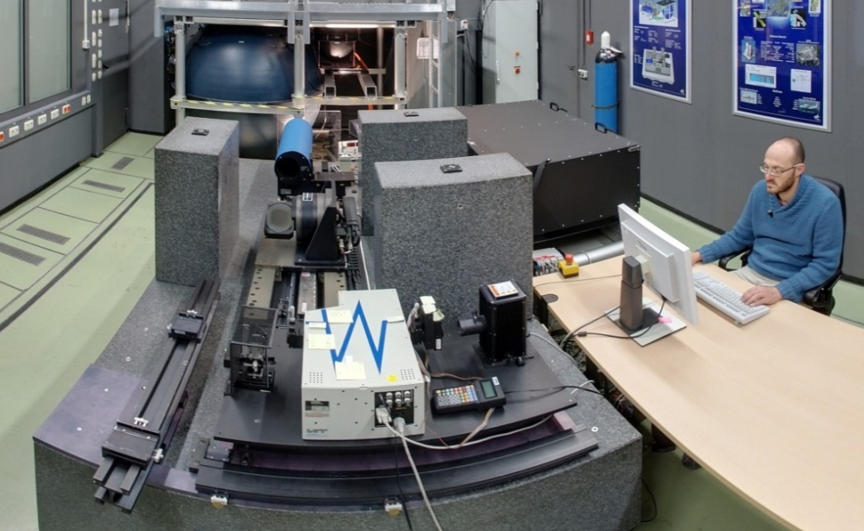
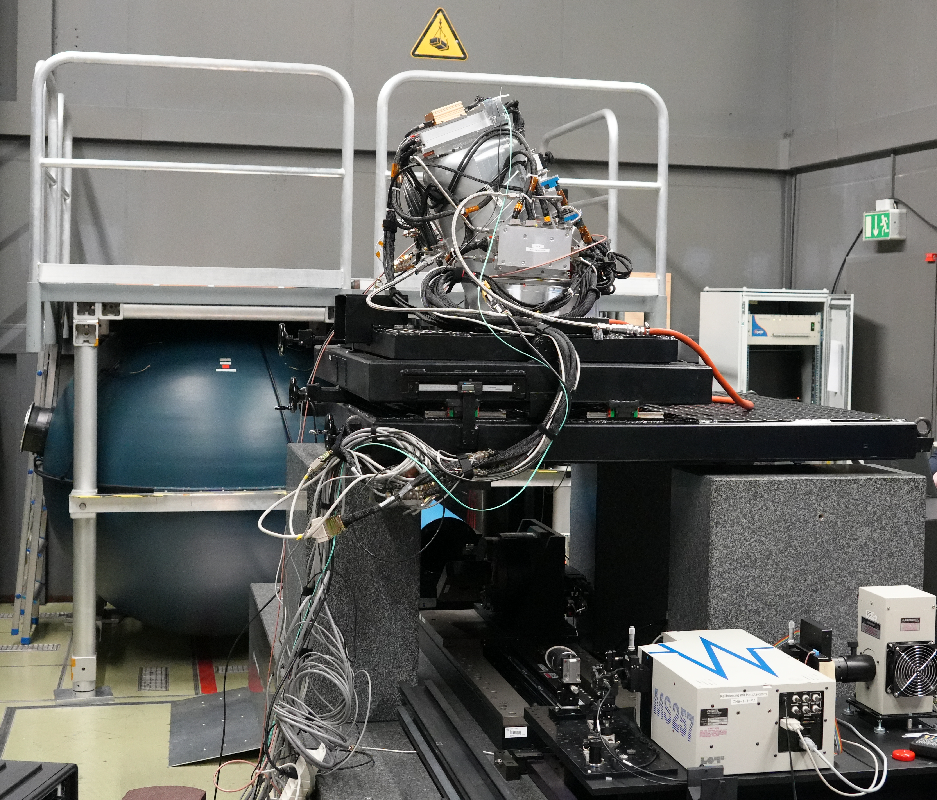
Calibration Home Base (CHB)
Co-funded by ESA
Operational since 2007
Calibration of
angular response
spectral response
radiometric response
polarization
non-linearity
stray light
temperature sensitivity
…
Continuous development
Instruments: HySpex, AVIRIS-4, “EnMAP“, …

Slide 4
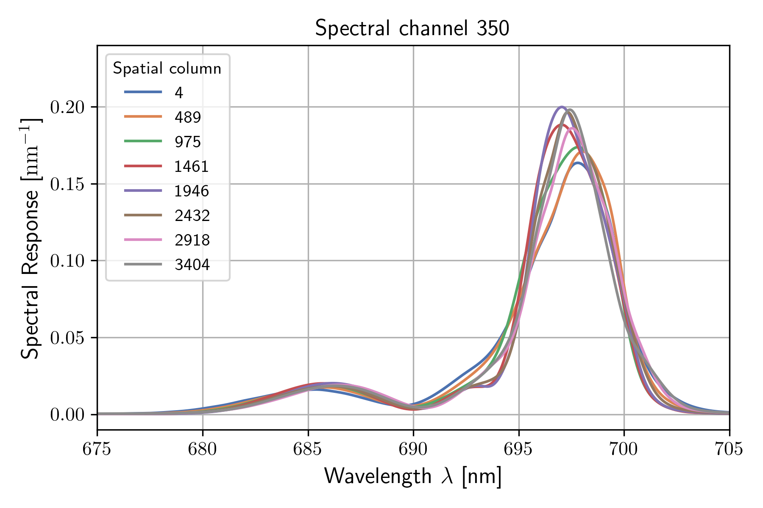
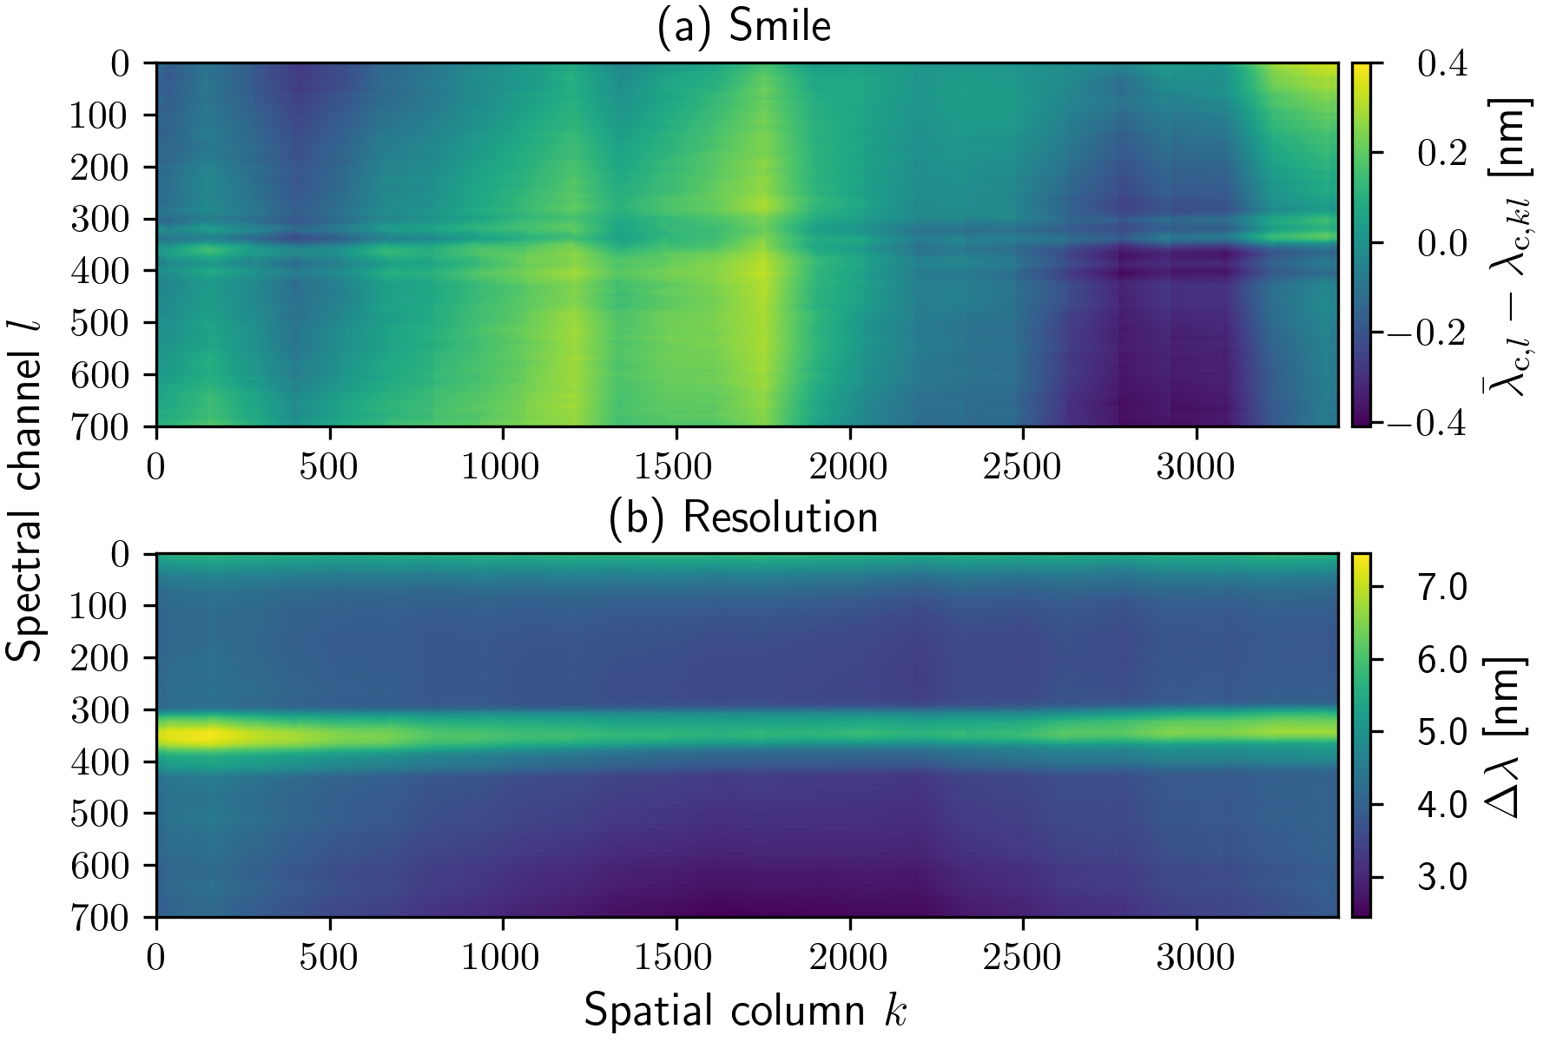
Spectral Calibration Results HySpex VNIR3400-N
Individual SRF for each pixel (cubic spline model)
Complicated SRF shapes → center wavelength + resolution not well defined
Similar results for across-track response functions (ARFs)
order sorting filter edge

Slide 5
Initial Situation
We have a very good understanding (model) of the instrument
But
available L1 algorithms correct only smile and keystone
higher level products do not make use of the full instrument model
How can we make use of the full instrument model
to make data from different detector locations comparable?
to make data from different instruments comparable?
to reduce data complexity?
Do we really need to track the response of each individual pixel in higher level products?

Slide 6
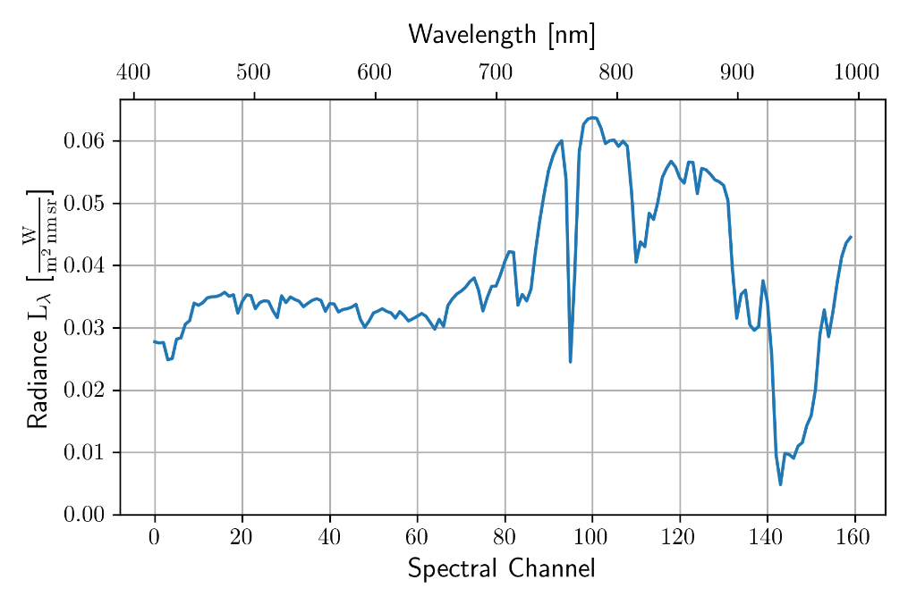
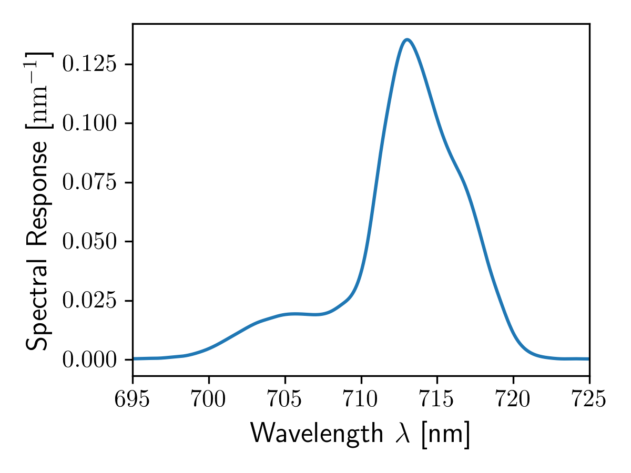
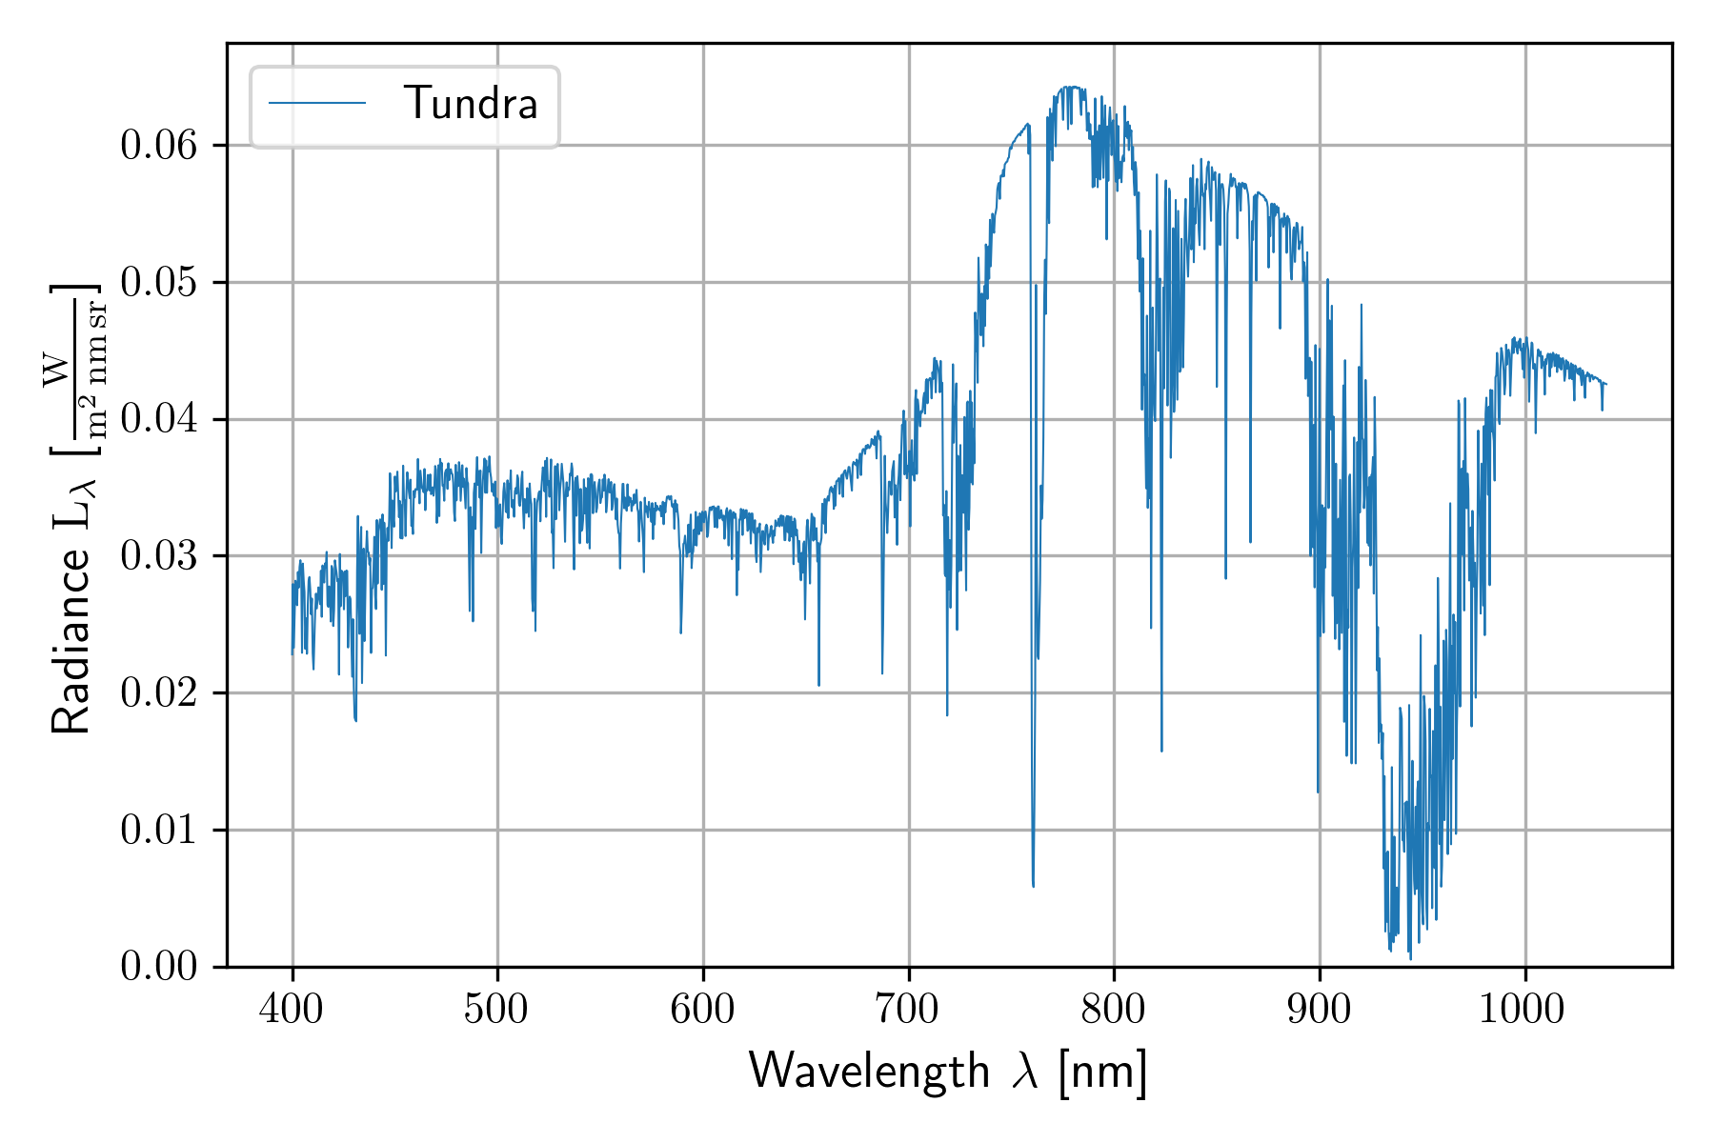
Imaging Equation
For simplicity only spectral case is shown
Measured radiance
Instrument responses
At sensor radiance

Slide 7
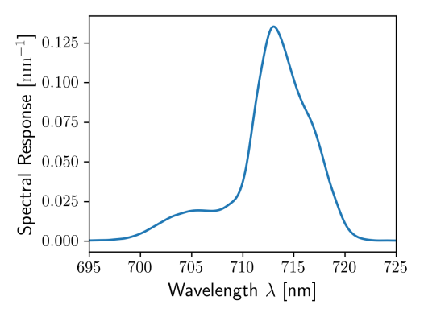
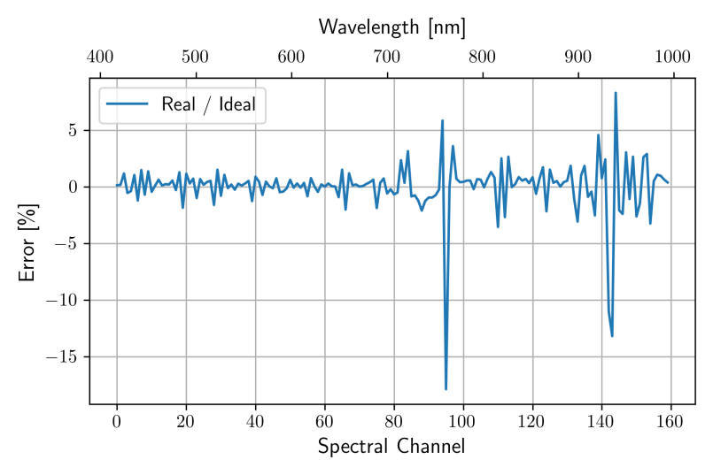
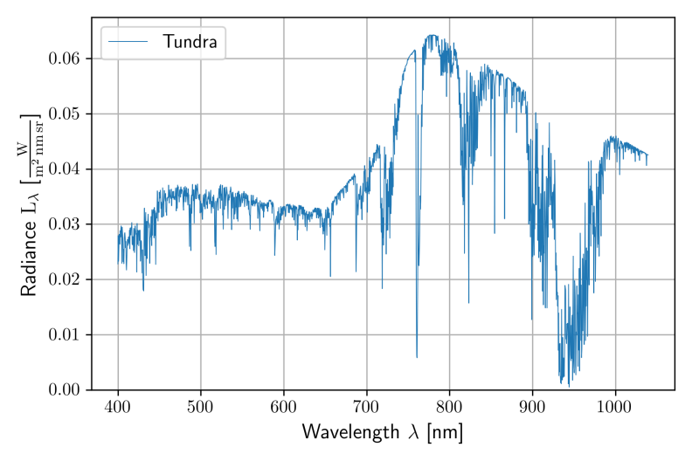
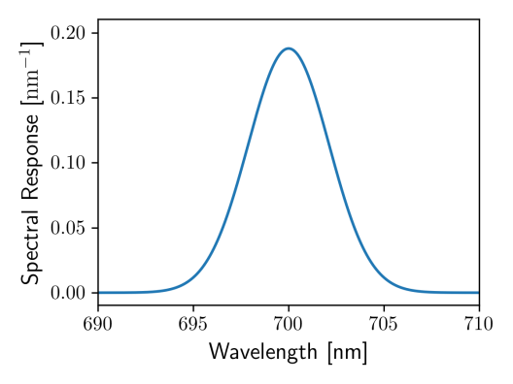
Two Systems - Two Results
System A
Ratio System A / System B
System B

Slide 8
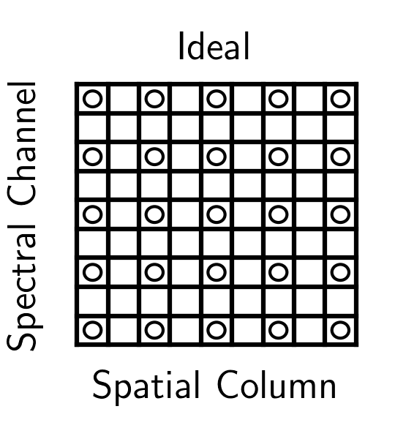
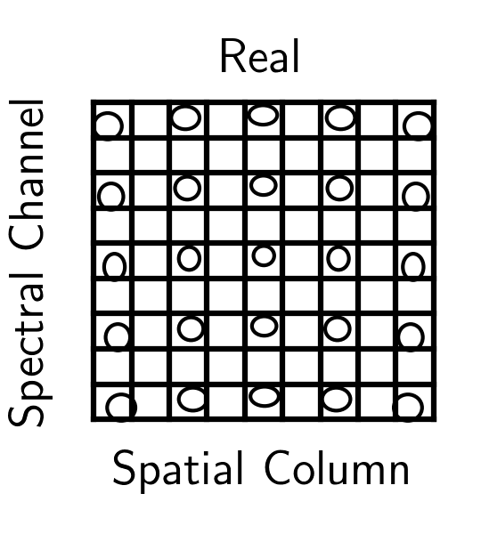
Goal: Converting Data from System A to System B
Each pixel of system B is the weight and sum of all pixels of system A

Slide 9
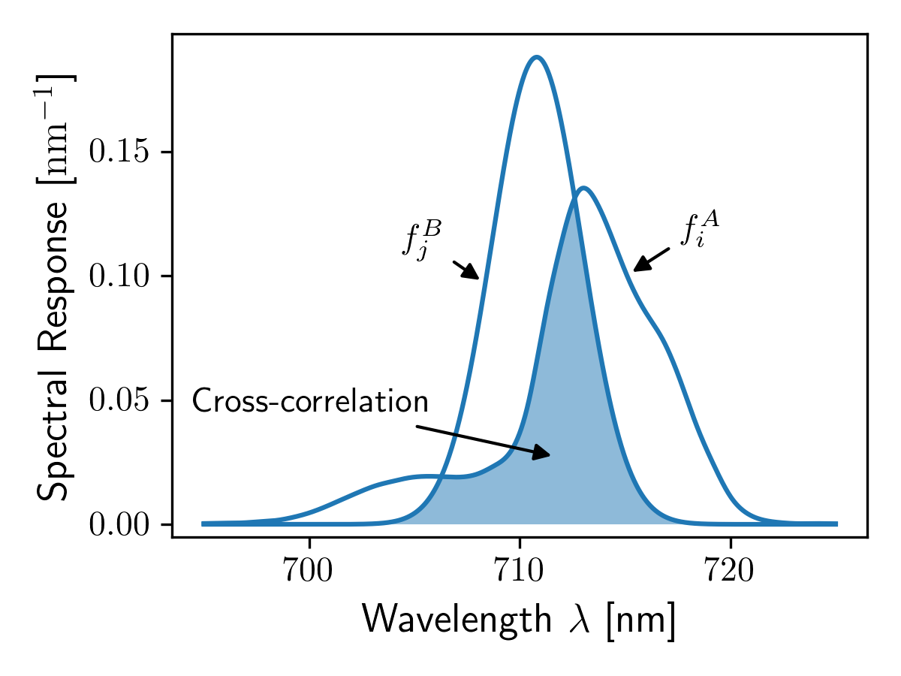
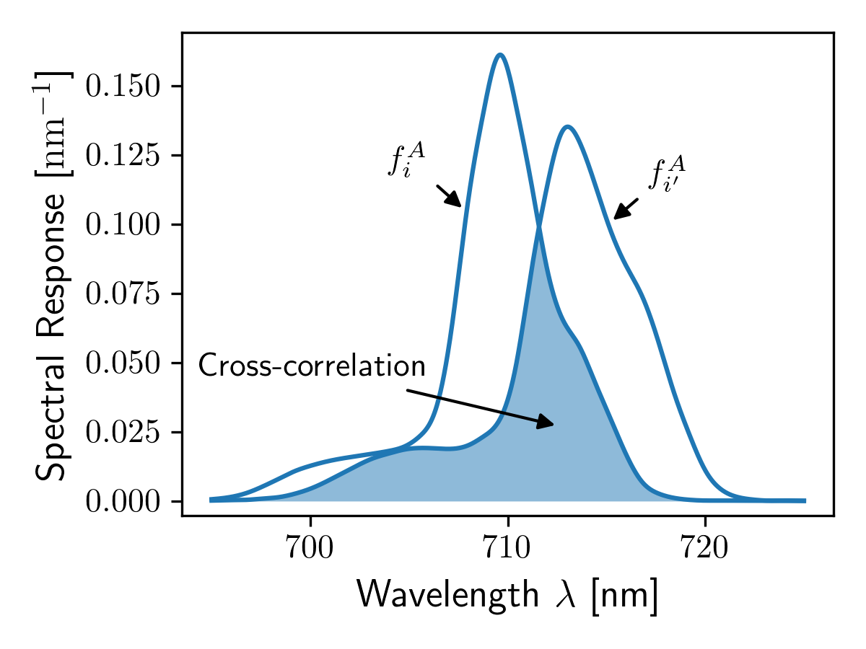
Instrument properties
Transformation matrix can be computed from cross-correlation matrices
Mathematical background in
Baumgartner et al. (2020) doi:10.1364/oe.409626

Slide 10
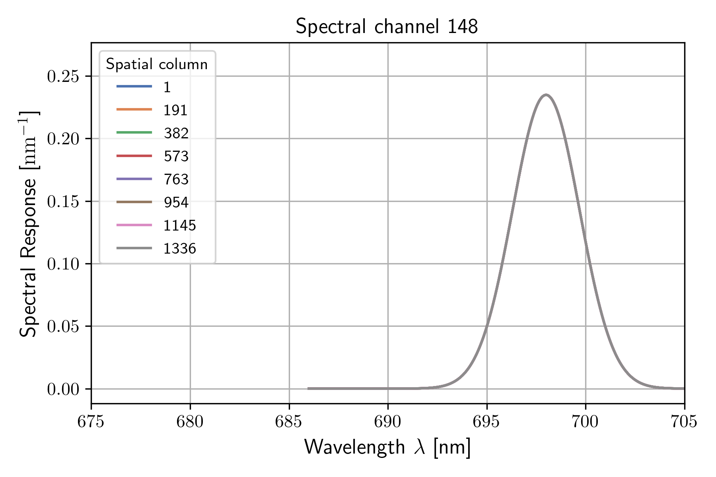
Current HySpex VNIR-3400N Processing Settings
Parameter | Sensor A | Sensor B
Spatial columns | 3408 | 1337
Spectral channels | 700 | 295
Smile [nm] | <0.8 | 0
Keystone [mrad] | <0.14 | 0
Angular resolution [mrad] | 0.09 – 0.43 | 0.44
Spectral resolution [nm] | 2.5 – 7.5 | 4
SRF and ARF shape | Spline model (complicated) | Gaussian
smart binning
smart binning
super resolution

Slide 11
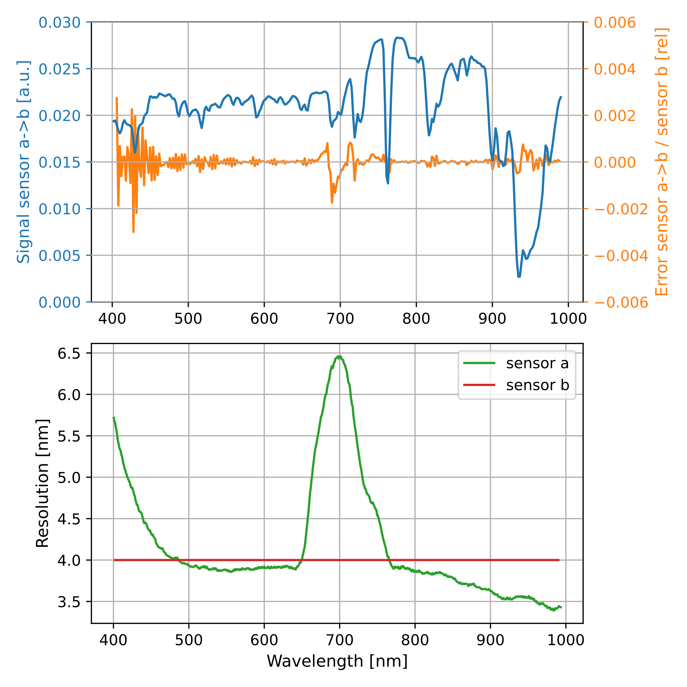
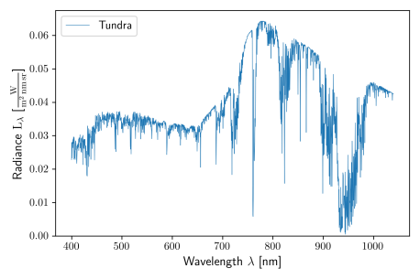
Simulation Results
super resolution
Comparison

Slide 12
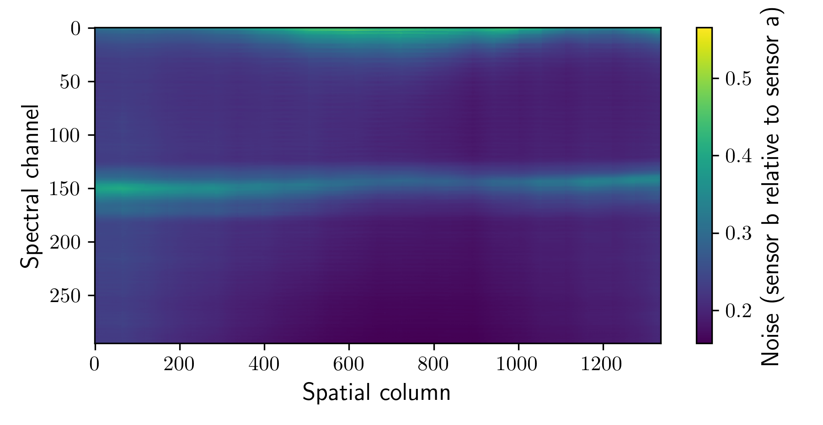
Uncertainties
HySpex VNIR-3400N: Relative noise level change after transformation:

Slide 13
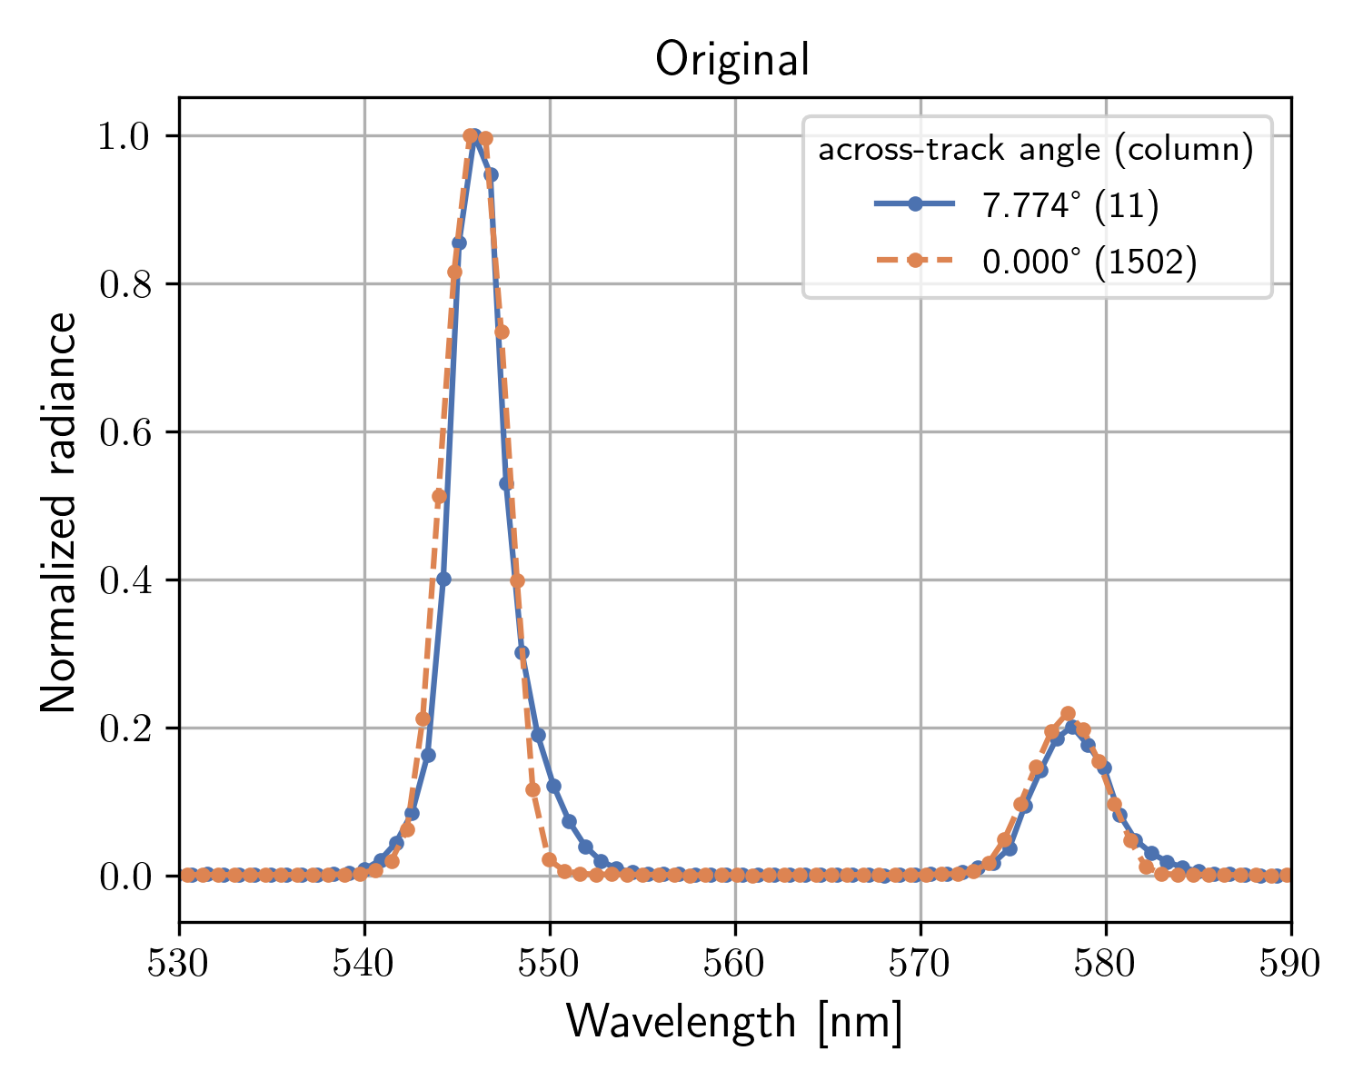
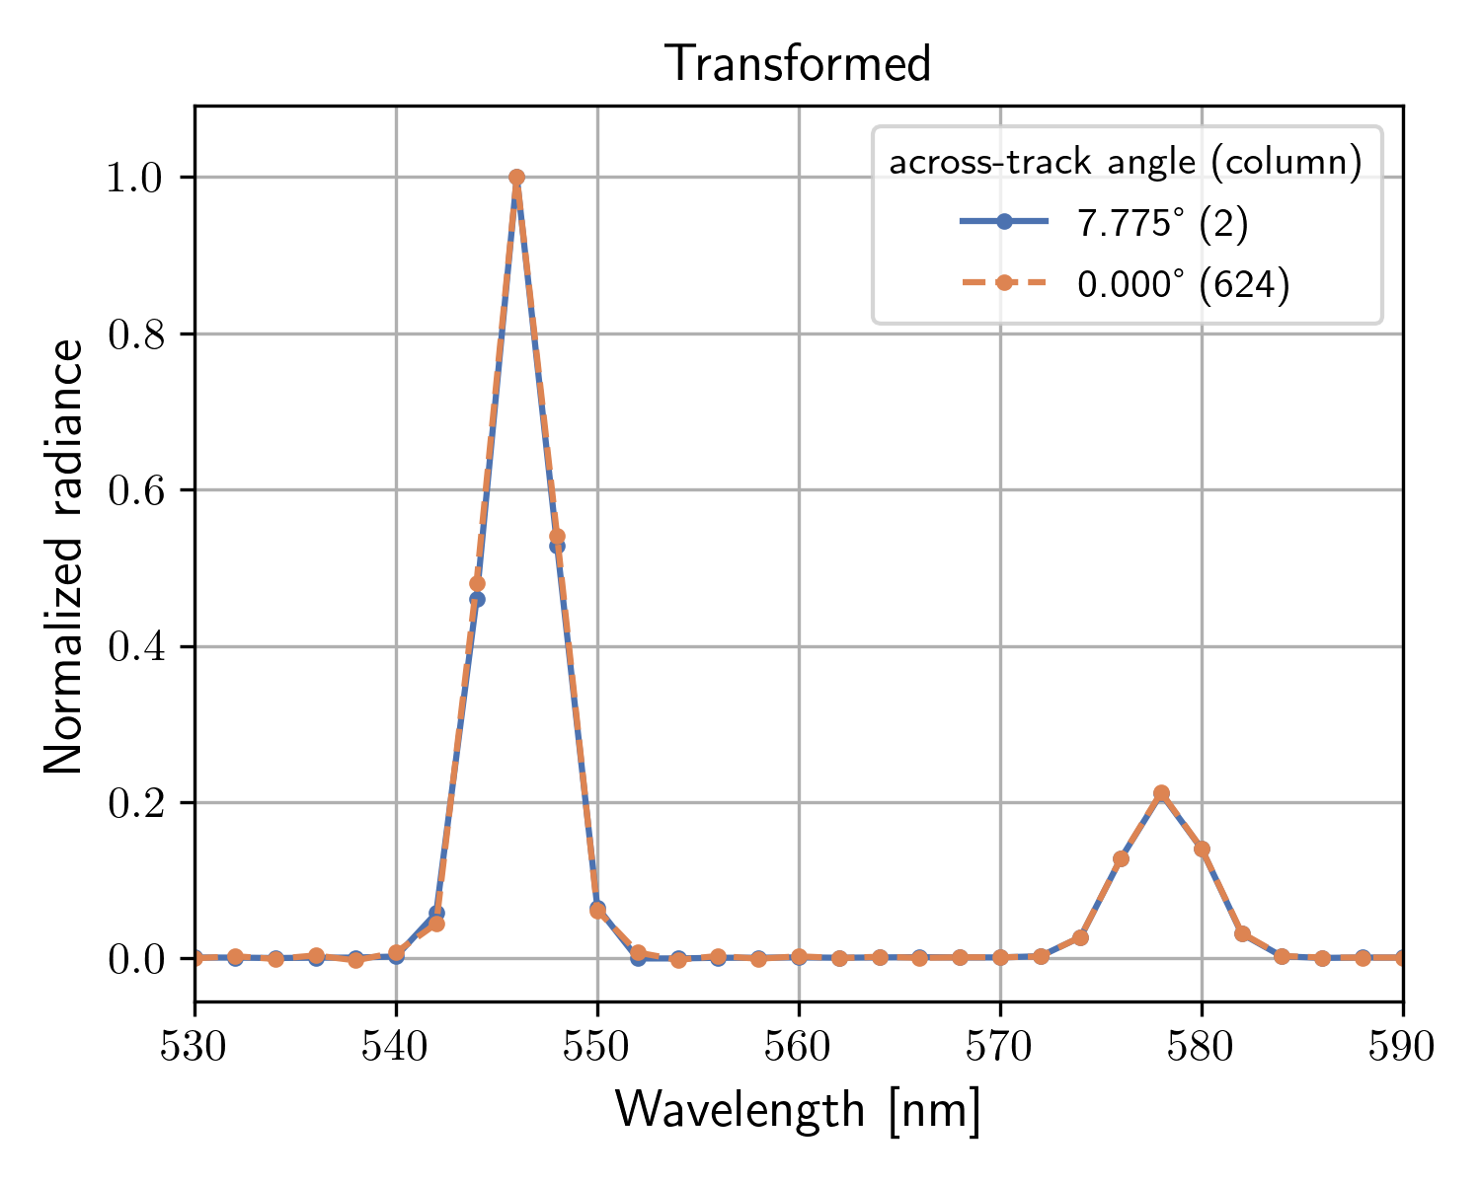
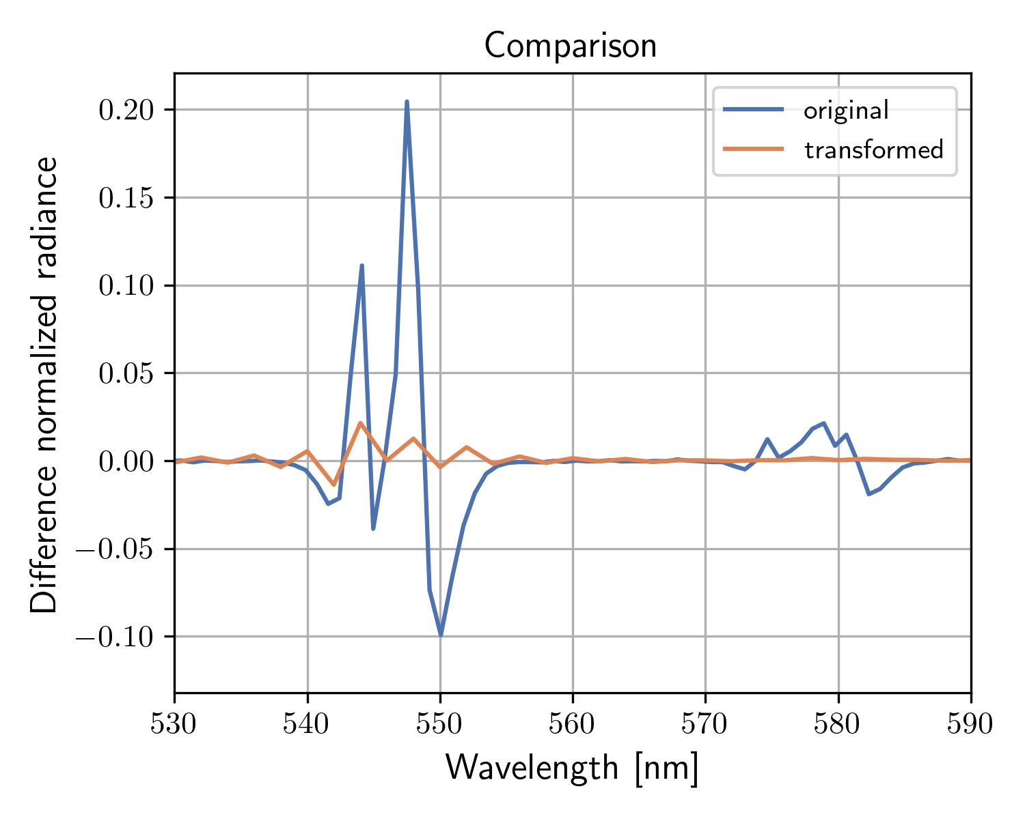
Experimental Validation of HySpex VNIR-3400N
Measurement: Mercury lamp coupled into integrating sphere
Isolated spectral emission lines → high frequency stress test
Comparison of two spatial columns (across-track angles)

Slide 14
Applications
Sensor A | Sensor B | Application
HySpex | ideal HySpex | harmonized L1 product smart binning
HySpex | CHIME | CHIME validation
CHIME | Sentinel-2 | cross-validation
CHIME | Sentinel-5p | wishful thinking!

Slide 15
Conclusion
Matrix based response function harmonization is an efficient tool
Correct several optical artifacts
Reduce data size by smart binning
Reduce complexity of down-stream processing
Deliver L1 products that are easier to adopt by the community
Works also with undersampled instruments!
Our finding have implications on the design of future sensors
Oversampling (spectral & across-track) improves data quality
Smile and keystone should not drive the optical design
Knowledge of the response functions (including in-orbit changes) is of paramount importance

Slide 16
My Answers
How does your work contribute to improving harmonization?
I think the presentation speaks for itself
What aspect of harmonization can most benefit users?
Uniform and comparable data products
At what level of processing is harmonization most necessary (L1B, L1C, L2A, L2B+, L3/L4)?
Depends on instrument and application
What is more important, the harmonization on data formats or the harmonization on information content of the products?
Data formats can be harmonized to a certain degree with wrappers
Product harmonization is more important

Slide 17
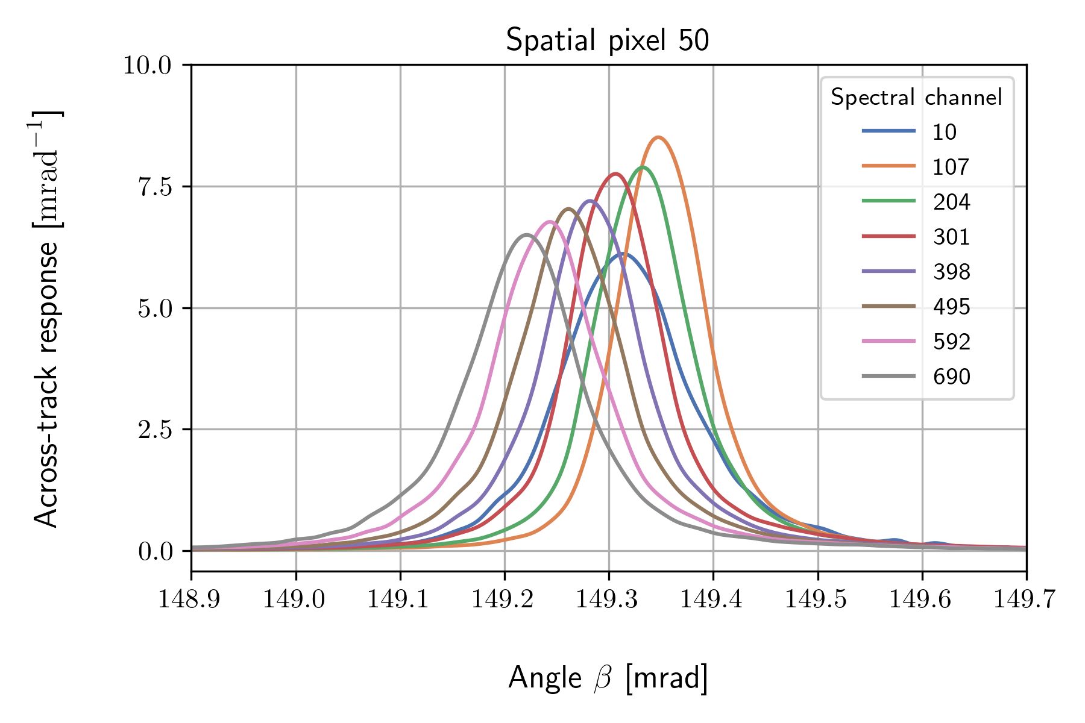
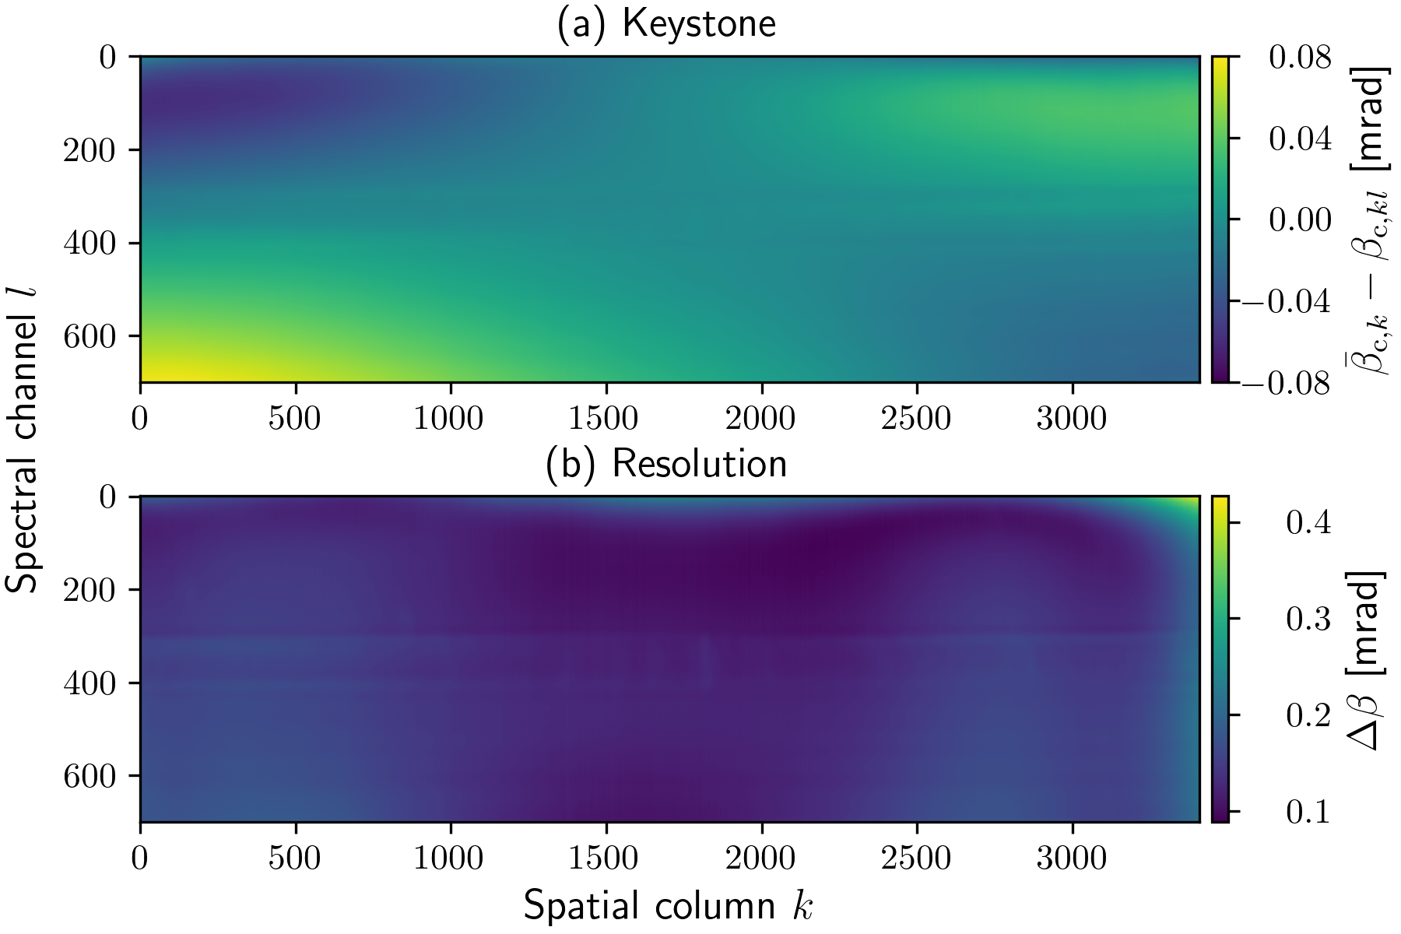
Geometric Calibration Results
Individual across-track response function (ARF) for each pixel
No analytical function: Cubic spline model

Slide 18
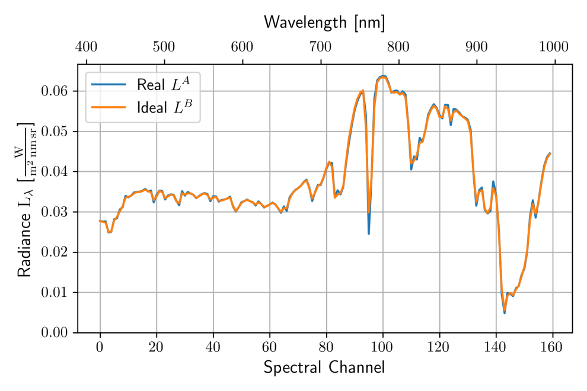
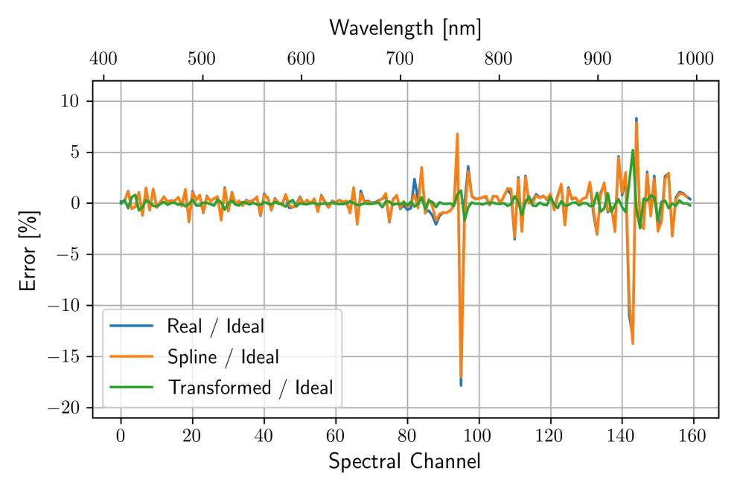
Simulation Results Undersampled Sensor
Sensor with ~1.4 Channels / FWHM
Larger errors compared to oversampled sensor
Smaller errors compared to conventional methods
Test Scene

Slide 19
Using Tikhonov regularization to stabilize ill-posed problem

