Slide 1
Mohammad H. Tahersima, Kurtis Thome, Brian N. Wenny, Mehran Yarahmadi, Derrick Lampkin, Norvik Voskanian, Sarah Eftekharzadeh Kay
Use of RadCalNet in Calibration and Validation of Hyperspectral Instruments [WICSIS-2024; ID 124 ]
Contact: mohammad.tahersima@nasa.gov
Notes:
•10:20am - 10:30am
one file (max 230MB) as 16:9. ppt – FILENAME: 124_Tahersima.pptx
Presentations will have to be uploaded via USB memory stick during the breaks and up to 30 minutes before the session starting time.

Slide 2
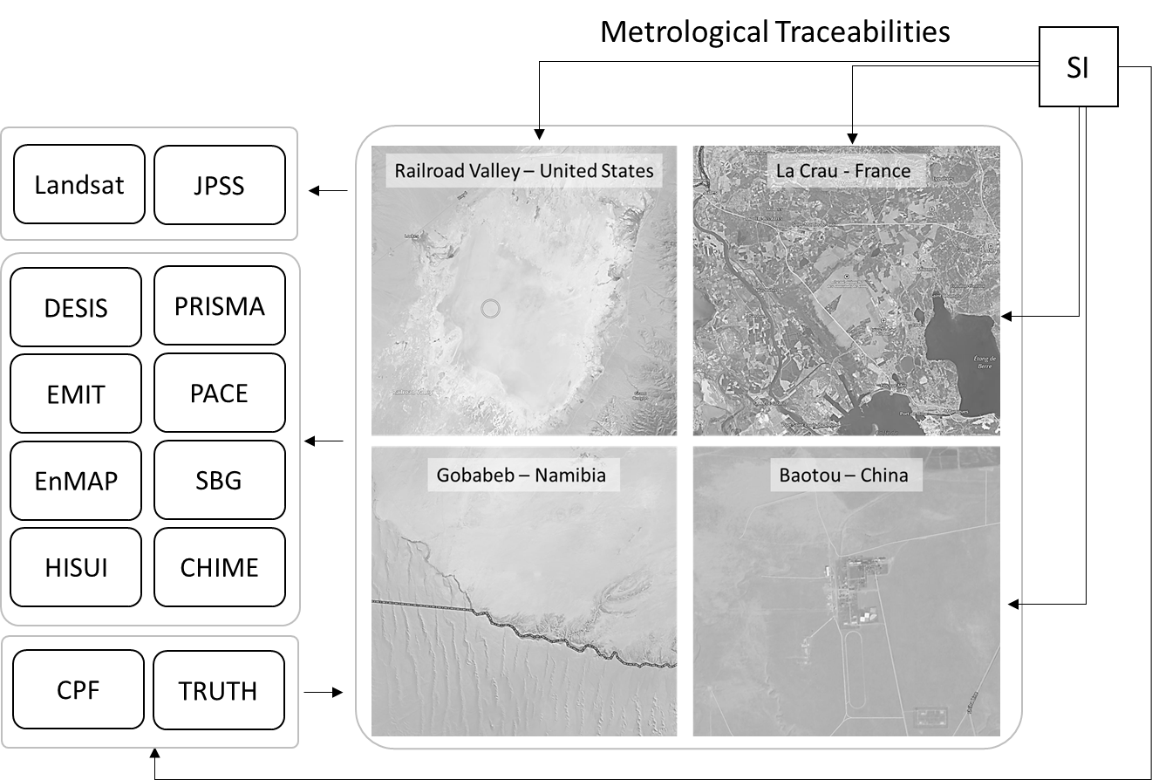
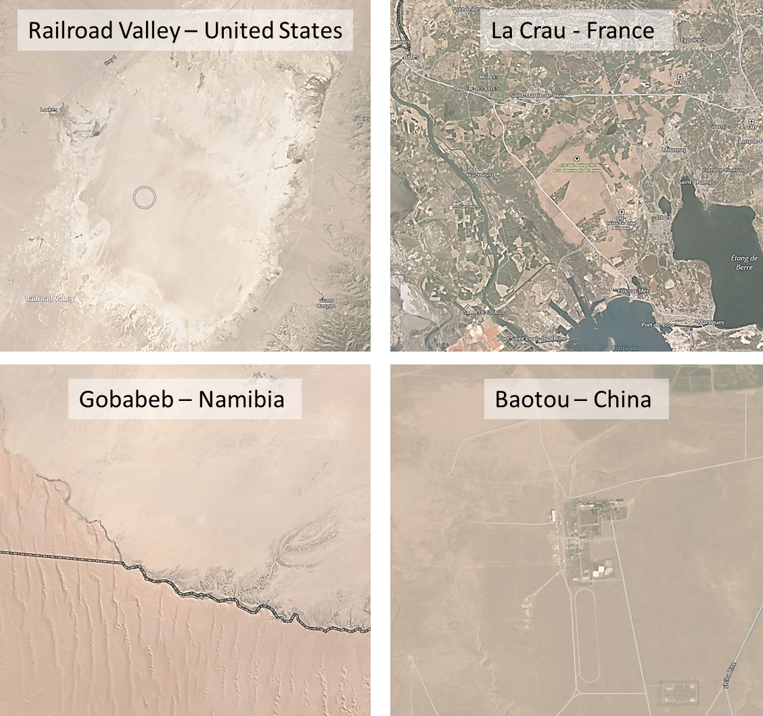
Radiometric Calibration Network (RadCalNet)
In-situ network of high-quality data
Independent site operators
Choice of method to generate spectral surface reflectance
Rules for surface reflectance data
Nadir surface reflectance at 10 nm intervals including 400- 1000nm
0900–1500 local standard time at 30 min intervals.
Area larger than 45mX45m.
Atmospheric data
Bouvet et al. “RadCalNet: A Radiometric Calibration Network for Earth Observing Imagers Operating in the Visible to Shortwave Infrared Spectral Range” [10.3390/rs11202401]
Wenny et al. “Look-up table approach for uncertainty determination for operational vicarious calibration of Earth imaging sensors” [10.1364/AO.442170]
Tahersima et al. “Intercomparison of Landsat OLI and JPSS VIIRS Using a Combination of RadCalNet Sites as a Common Reference” Remote Sens. 2023. [10.3390/rs15235562]
Voskanian et al. “Combining RadCalNet Sites for Radiometric Cross Calibration of Landsat 9 and Landsat 8 Operational Land Imagers” [10.3390/rs15245752]
Yarahmadi et al. “Intercomparison of Landsat Operational Land Imager and Terra Advanced Spaceborne Thermal Emission and Reflection Radiometer Using RadCalNet” [10.3390/rs16020400]

Slide 3
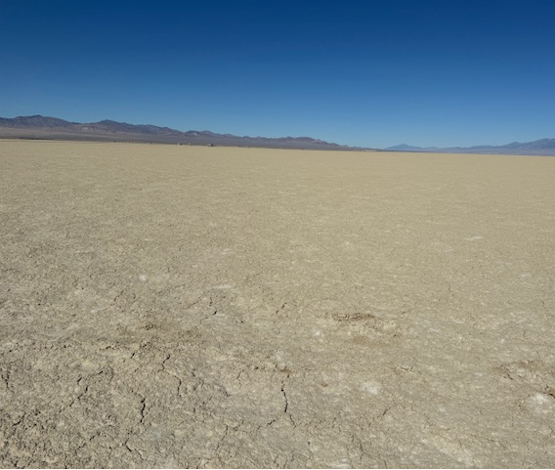
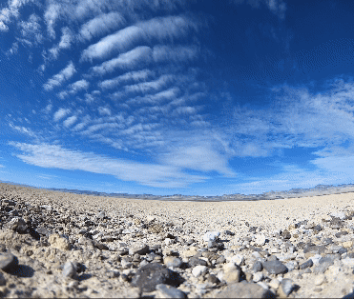
Uncertainty Budget
RadCaTS, October 2024
Radiometer
RadCalNet relies on process outlined in NPL’s Quality Assurance Framework for Earth Observation (QA4EO)
Uncertainties of surface effects dominate
Focus is on surface effects: temporal, spatial, and directionality dependence to illumination-observation
Uncertainty in TOA Reflectance
Radiance in Field
Atmospheric Input
Solar Irradiance
Surface Representativeness
Radiative Transfer Code
Surface BRDF
Atmosphere
Surface

Slide 4
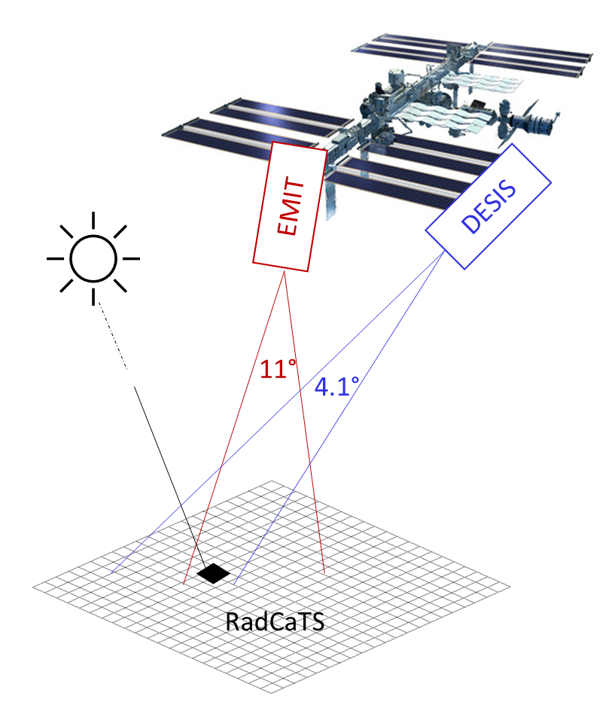
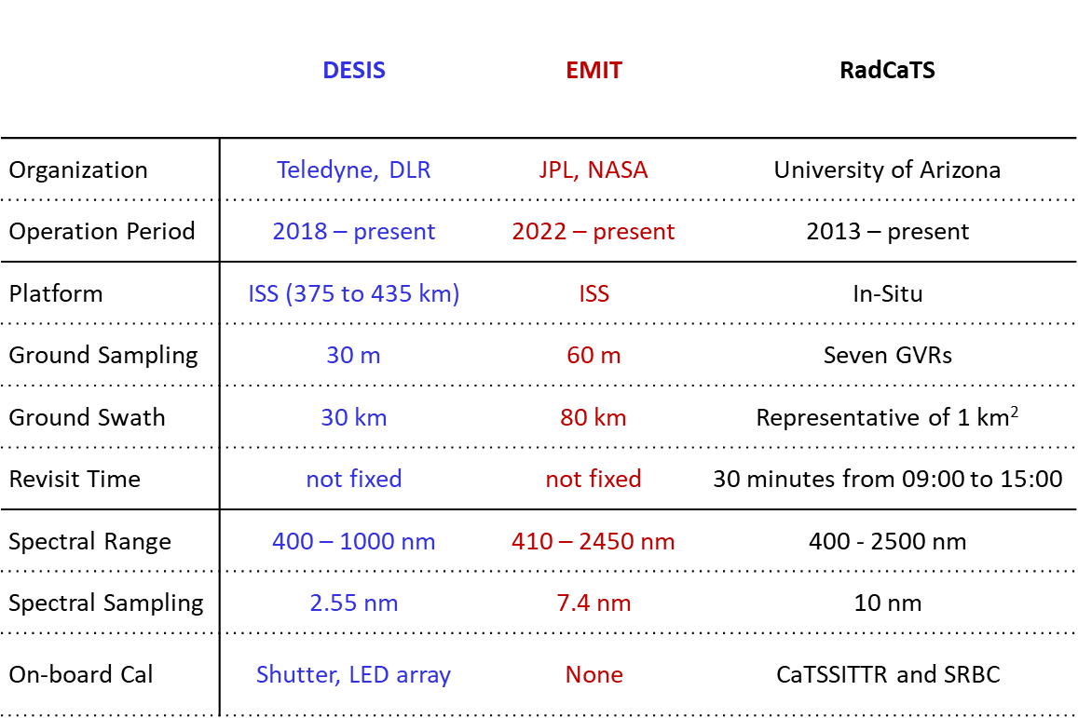
DESIS, EMIT, and RadCaTS (‘RVUS’)
ISS visits a range of overpass times along with the corresponding changes in sun illumination geometry

Slide 5
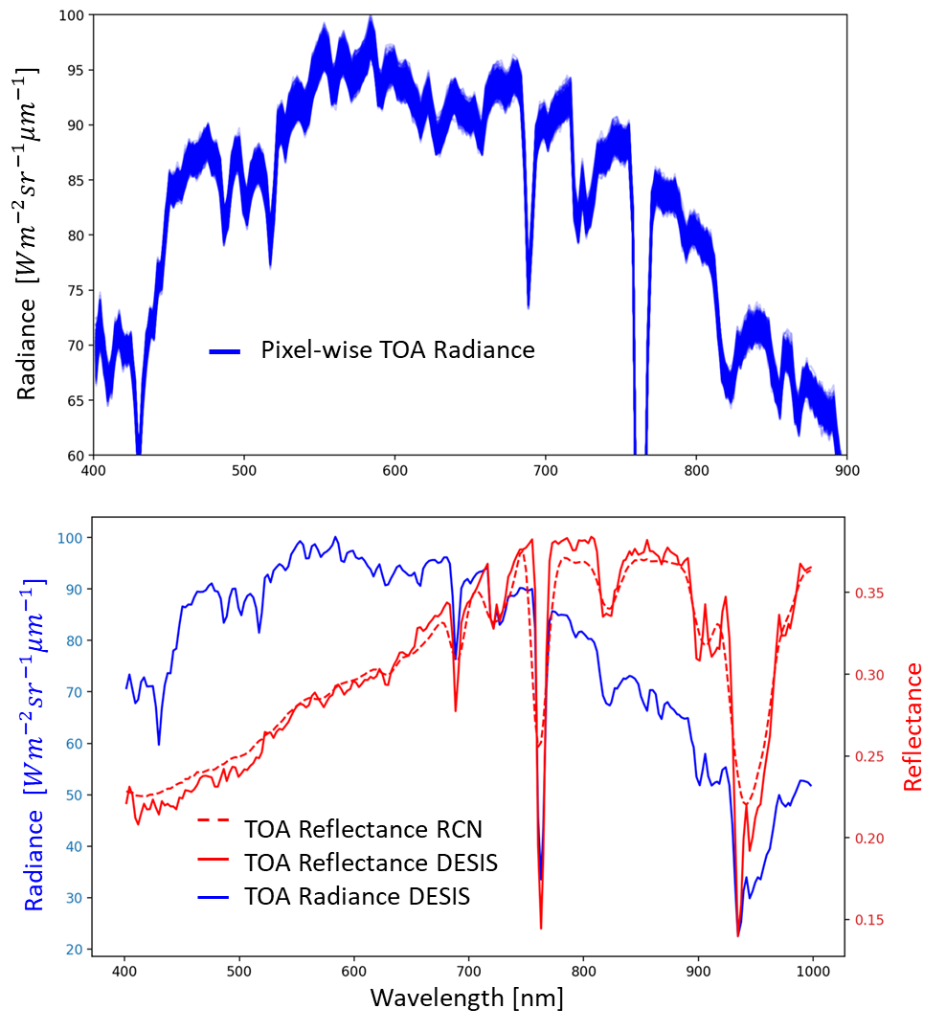
Preprocessing Steps of Each Image to compare with RadCalNet predicted TOA reflectance
Pixels from the 1 km² area are averaged
Radiance-based images of EMIT and DESIS are converted to reflectance
TSIS-1 HSRS spectral solar irradiance is used

Slide 6
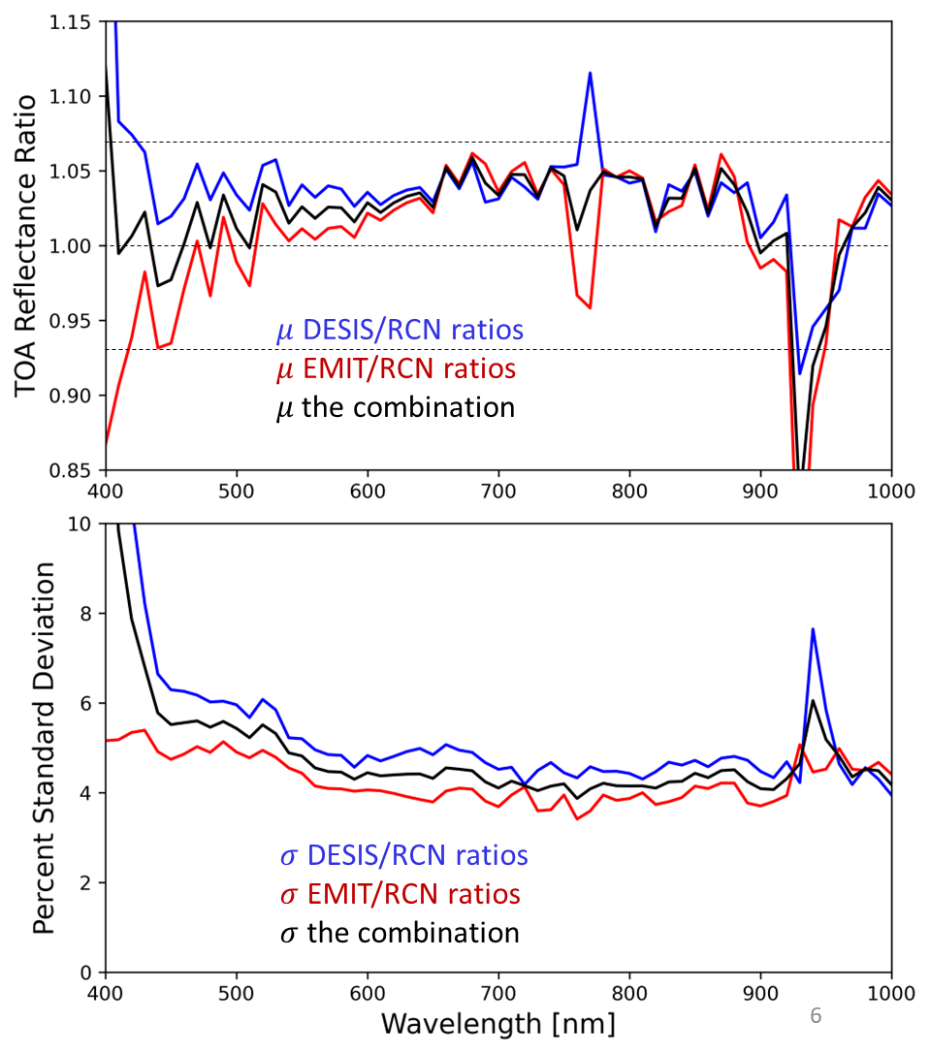
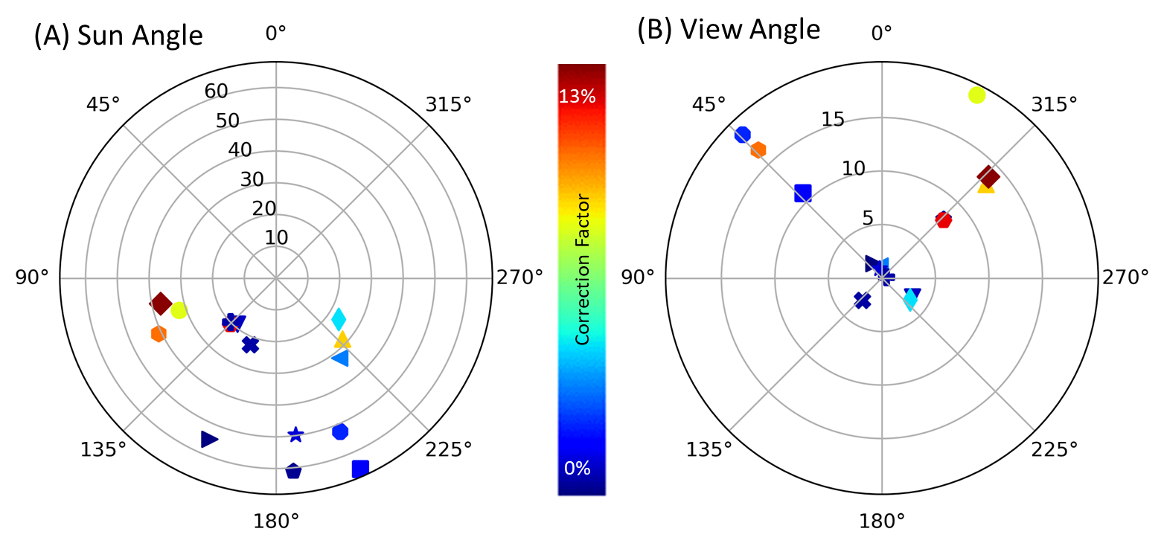
Absolute Intercomparisons Statistics of Ratios
19 coincident views of RVUS ($Δt<15$ min)
15 DESIS scenes and 4 EMIT scenes
Instruments agree within their combined uncertainty
Assumption: flat 5% uncertainty for each of DESIS and EMIT
Except $λ<$ 450 nm and at 760 nm and 940 nm absorption lines.
Larger spread of the DESIS/RCN ratio is expected
Better agreement with ground truth when observation is near-nadir and closer to solar-noon

Slide 7
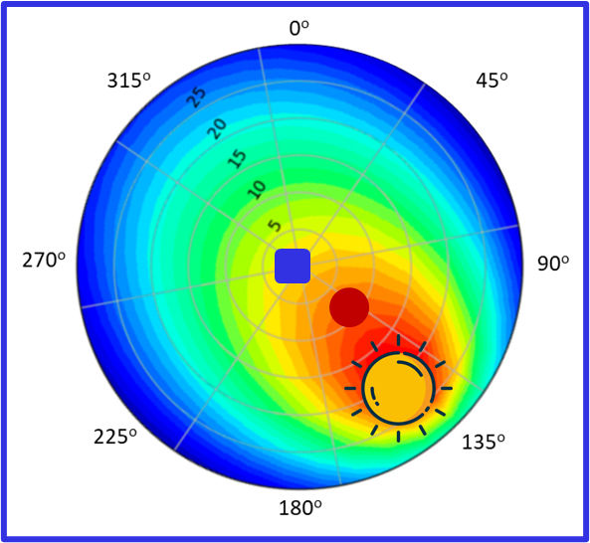
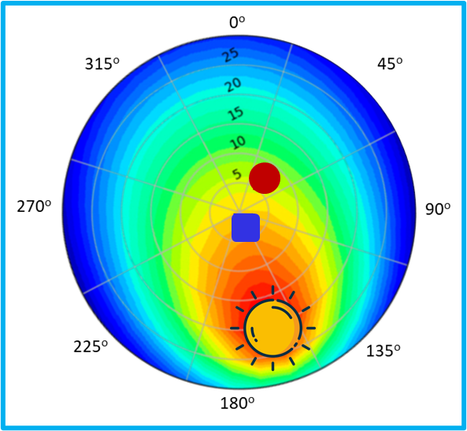
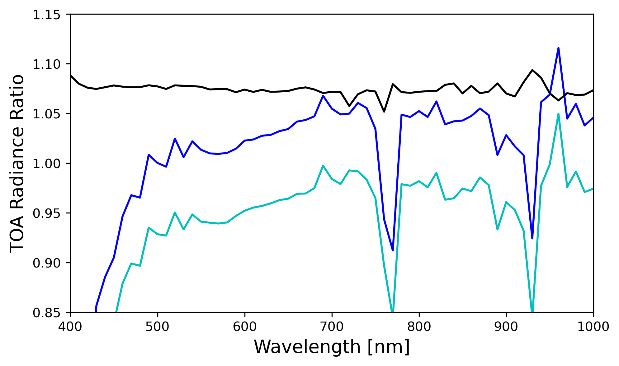
[BRDF model taken from Bruegge et al. 2019; 10.3390/rs11222601]
Relative EMIT/DESIS Study
Viewing the Same Source
At Different Angles
Scenes are captured in 2023, 6 weeks apart
Spectrally flat 7% BRDF factor for the ratio of the ratios of coincident views
Validates 2018 Goniometric measurements of the site [Bruegge et al. 2019]
June 23rd: Back-reflected light
Aug 4th: Forward-reflected light
Same Surface
Similar Atmospheres
Similar Time
Same ratio of Instruments
Different Angles
Tahersima et al. “Characterizing Vicarious Calibration Test Sites using Imaging Spectroscopy ”, SPIE 2024 [10.1117/12.3028315]

Slide 8
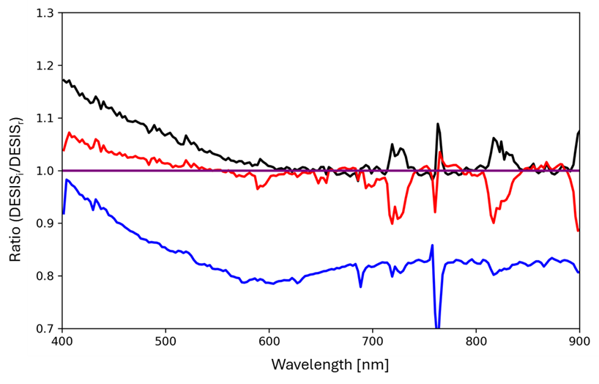
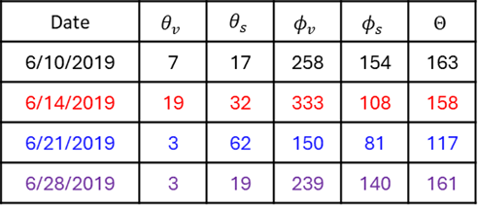
Relative Short-term Studies Not using ground truth
Short-term observations limits the changes in the sensor and the site conditions
Isolates BRDF effects
But also includes atmospheric effects
Large solar zenith angle results in the largest difference in this set
Consistent scatter angles with values close to 160 degrees show good agreement
Tahersima et al. “Characterization of the Railroad Valley Playa Test Site using DESIS Imaging Spectrometer from the Space Station Orbit” (In review)

Slide 9
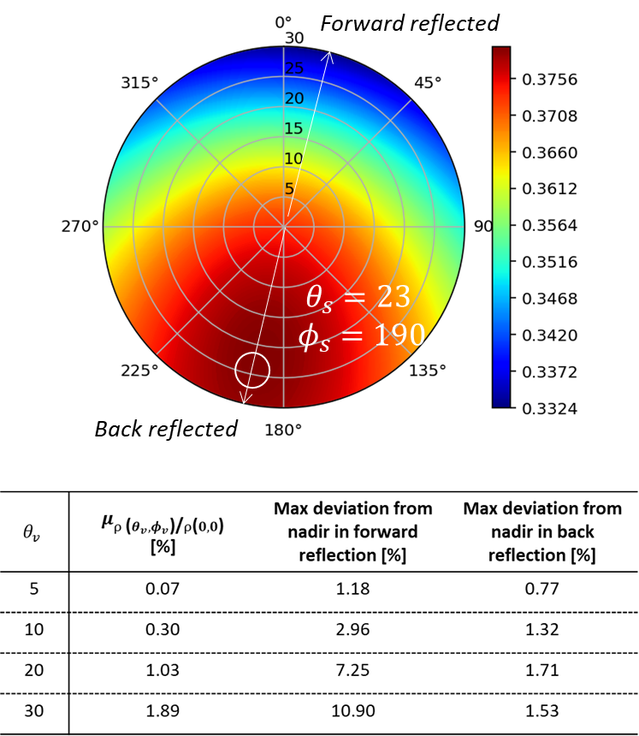
Conclusions
RadCalNet as a common reference for intercomparison of the radiometric scale of two hyperspectral sensors
DESIS and EMIT data was used to characterize BRDF effects of the site
BRDF model based on the on-orbit sensor data
2018 goniometric measurements of the site remain valid
Radiometric data is more sensitive in the forward reflection
Outlook
Directional UAV collection of RadCaTS site
In-situ validation using transect ASD collections
Add data from other imaging spectrometers (e.g., PACE, PRISMA, and EnMAP)
Similar approach for the radiometric scales of SBG and CHIME
Thanks to CSDA, JPL, Teledyne, and RadCalNet

Slide 10
1. How many vicarious calibration sites might be needed worldwide to ensure accurate characterization of the radiances and reflectances (L1B and L2 products) returned by spectral imaging missions? And what are the core measurements that should be made at these sites (and uncertainty/performance requirements)?
The trade-off is between number of sites and how quickly we can reach a desired accuracy. One month of data from four RadCalNet-like sites suffices to reach a 5% accuracy.
Spectral surface reflectance, AOD, Angstrom, WV column, Ozone column, Temperature, Pressure, and quality flag for surface/atmosphere conditions. Surface reflectance uncertainties close to 3% is desired.
2. What are the main challenges in harmonizing CAL/VAL approaches across different EO missions, sites, and campaigns, and how can these be addressed?
Challenge: differing levels of adherence to the critical principles like metrology, transparency, and openness.
Solution: Adherence to the FRM or an FRM-like framework.
3. What is currently missing to carry out holistic and all-encompassing CAL/VAL activities, and how, for example with which innovations, can this be supported?
Having one or more on-orbit metrological references ( SITSats) would enable that vision.
4. How can emerging technologies, such as artificial intelligence and machine learning, be leveraged to improve the accuracy and efficiency of calibration and validation processes?
Machine learning modelling could be beneficial for anomaly flagging of high temporal resolution calibration data. They could also be used to speed up atmospheric and/or terrestrial correction algorithms.

