Slide 1
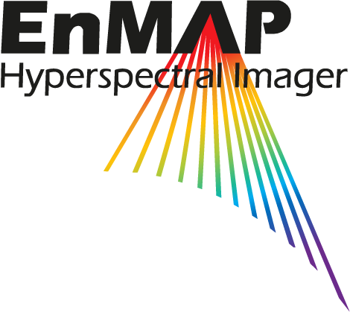
Evaluating the performance of machine learning methods for mineral mapping using different spaceborne hyperspectral satellite data
Saeid Asadzadeh
Anna Buczyńska
Raymond Kokaly
Sabine Chabrillat

Slide 2
MICA (Tetracorder) expert system
How machine learning methods compare to MICA for mineral mapping using spaceborne sensors?
2

Slide 3
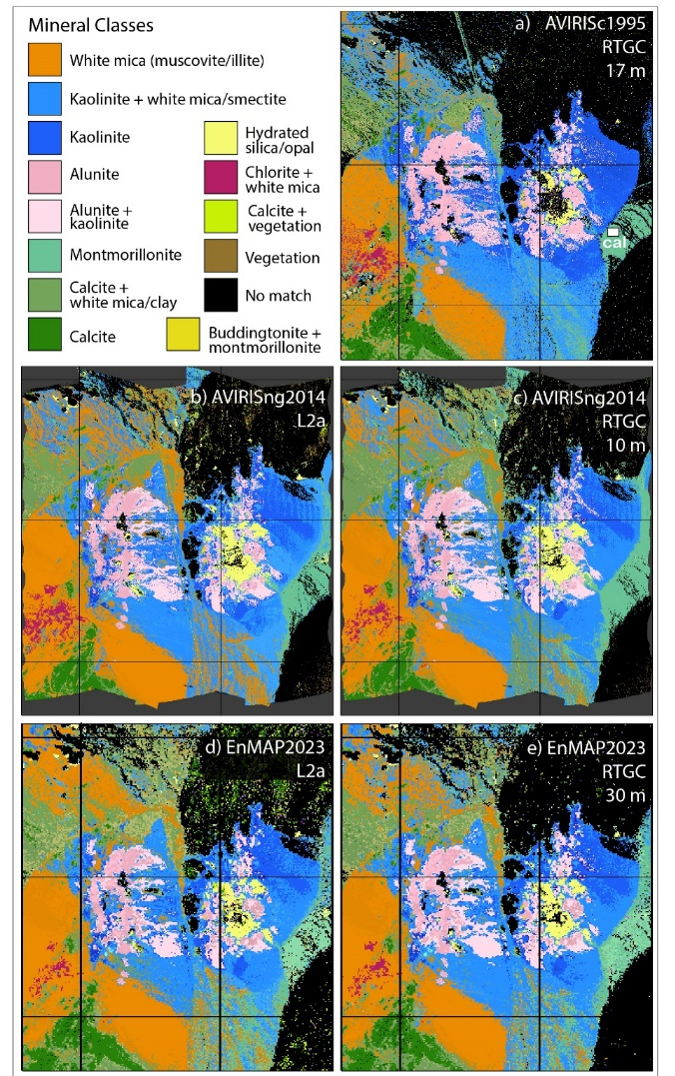
Back to Cuprite
The mineral mapping capability of spaceborne imaging spectroscopic data was compared against AVIRIS-c using MICA
AVIRIS-NG (airborne)
EnMAP
PRISMA
EMIT
HISUI
GaoFen-5
The sensors were compared from different aspects:
Classification accuracy
Image geometry
Spectral shape
Calibration (SNR, atmospheric correction…)
Ground data
Fig. 1 MICA mapping results
(Ray Kokaly et.al)
3

Slide 4
Mineral mapping using ML: VNIR (420-1320 nm)
Accuracy assessment of classification results
Classification method | VNIR
 | overall accuracy [%] | Kappa coefficient [%]
Random Forest | 83.46 | 75.42
SVM(RBF) | 82.80 | 74.21
SVM(Poly) | 96.25 | 94.30
K - Neighbours | 81.79 | 73.26
Extra Trees | 84.12 | 76.44
U – Net | 87.84 | 81.05
Radial basis function
4

Slide 5
Mineral mapping using ML: SWIR (1460– 2445 nm)
Accuracy assessment of classification results
Classification method | SWIR
 | overall accuracy [%] | Kappa coefficient [%]
Random Forest | 80.91 | 77.86
SVM(RBF) | 81.24 | 78.10
SVM(Poly) | 92.78 | 91.42
K - Neighbours | 78.65 | 81.36
Extra Trees | 81.36 | 78.38
U – Net | 87.10 | 84.73
5
Notes:
PGE: Platinum-group elements (PGE) include Iridium, Palladium, Platinum, Rhodium, Ruthenium, and Osmium.
Rare earth elements group comprises Cerium, Gadolinium, Lanthanum, Neodymium, Praseodymium, and Samarium.

Slide 6
Sensor-wised comparison
SVM(polynomial): VNIR
SVM(polynomial): SWIR
Sensor | Accuracy measure
 | overall accuracy [%] | Kappa coefficient [%]
EnMAP | 96.25 | 94.30
AVIRIS-NG | 95.59 | 93.85
EMIT | 90.99 | 87.11
PRISMA | 94.48 | 91.73
HISUI | 93.89 | 90.63
GaoFen-5 | 94.46 | 91.71
Sensor | Accuracy measure
 | overall accuracy [%] | Kappa coefficient [%]
EnMAP | 92.78 | 91.42
AVIRIS-NG | 93.13 | 92.03
EMIT | 86.64 | 84.53
PRISMA | 91.98 | 90.50
HISUI | 90.09 | 88.13
GaoFen-5 | 90.08 | 88.15
Best classification results for spaceborne sensors
Best classification results for spaceborne sensors
6
Notes:
PGE: Platinum-group elements (PGE) include Iridium, Palladium, Platinum, Rhodium, Ruthenium, and Osmium.
Rare earth elements group comprises Cerium, Gadolinium, Lanthanum, Neodymium, Praseodymium, and Samarium.

Slide 7
Classification results per mineral class: EnMAP
SVM(polynomial), EnMAP, VNIR
Mineral | Accuracy measure
 | user accuracy [%] | Producer accuracy [%]
alunite | 93.62 | 89.53
alunite + kaolinite | 80.81 | 82.90
buddingtonite | 100.00 | 80.00
calcite | 97.88 | 97.58
calcite + montmorillonite | 46.15 | 49.48
calcite + muscovite | 81.61 | 82.68
chlorite + muscovite | 100.00 | 76.36
hydrated silica | 96.71 | 99.32
Kaolinite + trace mica | 89.44 | 87.59
kaolinite/dickite | 95.35 | 96.80
montmorillonite | 93.81 | 89.33
muscovite | 84.22 | 94.27
nontronite | 90.48 | 59.38
pyrophyllite + kaolinite | 68.57 | 72.73
SVM(polynomial), EnMAP, VNIR
Mineral | Accuracy measure
 | user accuracy [%] | producer accuracy [%]
goethite | 86.56 | 95.08
chlorite + muscovite | 95.70 | 99.55
magnetite | 93.09 | 80.31
hematite | 100.00 | 95.02
jarosite | 99.26 | 86.45
epidote | 33.33 | 50.00
Best classified mineral class Worst classified mineral class
Best classified mineral class Worst classified mineral class
7
Notes:
PGE: Platinum-group elements (PGE) include Iridium, Palladium, Platinum, Rhodium, Ruthenium, and Osmium.
Rare earth elements group comprises Cerium, Gadolinium, Lanthanum, Neodymium, Praseodymium, and Samarium.

Slide 8
Sensitivity to training data: VNIR
Overall accuracy Kappa coefficient
8
Notes:
PGE: Platinum-group elements (PGE) include Iridium, Palladium, Platinum, Rhodium, Ruthenium, and Osmium.
Rare earth elements group comprises Cerium, Gadolinium, Lanthanum, Neodymium, Praseodymium, and Samarium.

Slide 9
Sensitivity to training data: SWIR
Overall accuracy Kappa coefficient
9
Notes:
PGE: Platinum-group elements (PGE) include Iridium, Palladium, Platinum, Rhodium, Ruthenium, and Osmium.
Rare earth elements group comprises Cerium, Gadolinium, Lanthanum, Neodymium, Praseodymium, and Samarium.

Slide 10
Reflectance refinement: VNIR
Sensor | Reflectance | RF |  | RBF SVM |  | Poly SVM
 |  | overall accuracy | Kappa coefficient | overall accuracy | Kappa coefficient | overall accuracy | Kappa coefficient
EnMAP | standard | 83.46 | 75.42 | 82.80 | 74.21 | 96.25 | 94.30
 | refined | 85.42 | 79.05 | 84.18 | 77.05 | 96.02 | 93.51
PRISMA | standard | 80.11 | 71.02 | 79.75 | 70.20 | 94.48 | 91.73
 | refined | 80.47 | 71.40 | 79.50 | 69.80 | 94.56 | 91.86
AVIRIS-NG | standard refined | 82.56 89.02 | 76.34 84.84 | 82.48 89.20 | 76.18 85.04 | 95.59 95.59 | 93.85 93.85
HISUI | standard refined | 75.34 83.24 | 64.07 74.89 | 75.43 82.63 | 63.88 73.71 | 93.89 94.43 | 90.63 91.46
GaoFen-5 | standard refined | 66.73 n/a | 54.40 n/a | 67.68 n/a | 55.22 n/a | 94.46 n/a | 91.71 n/a
EMIT | standard | 68.91 | 58.43 | 68.40 | 56.85 | 90.99 | 87.11
 | refined | 76.90 | 68.02 | 76.14 | 66.13 | 90.99 | 87.11
Best classification results for spaceborne sensors
10
Notes:
PGE: Platinum-group elements (PGE) include Iridium, Palladium, Platinum, Rhodium, Ruthenium, and Osmium.
Rare earth elements group comprises Cerium, Gadolinium, Lanthanum, Neodymium, Praseodymium, and Samarium.

Slide 11
Reflectance refinement: SWIR
Sensor | Reflectance | RF |  | RBF SVM |  | Poly SVM
 |  | overall accuracy | Kappa coefficient | overall accuracy | Kappa coefficient | overall accuracy | Kappa coefficient
EnMAP | standard | 80.91 | 77.86 | 81.24 | 78.10 | 92.78 | 91.42
 | refined | 80.98 | 77.98 | 81.15 | 77.87 | 92.19 | 90.57
PRISMA | standard | 62.41 | 57.82 | 62.48 | 57.74 | 91.98 | 90.50
 | refined | 80.22 | 76.97 | 80.47 | 77.16 | 91.94 | 90.47
AVIRIS-NG | standard refined | 87.67 87.11 | 85.85 85.22 | 88.57 88.48 | 86.71 86.60 | 93.13 93.13 | 92.03 92.03
HISUI | standard refined | 85.25 85.00 | 82.42 82.12 | 85.22 85.22 | 82.24 82.24 | 90.09 90.09 | 88.13 88.13
GaoFen-5 | standard refined | 83.09 n/a | 80.01 n/a | 82.86 n/a | 79.59 n/a | 90.08 n/a | 88.15 n/a
EMIT | standard | 74.02 | 70.51 | 66.88 | 61.98 | 86.64 | 84.53
 | refined | 78.05 | 74.84 | 70.71 | 66.04 | 86.45 | 84.30
Best classification results for spaceborne sensors
11
Notes:
PGE: Platinum-group elements (PGE) include Iridium, Palladium, Platinum, Rhodium, Ruthenium, and Osmium.
Rare earth elements group comprises Cerium, Gadolinium, Lanthanum, Neodymium, Praseodymium, and Samarium.

Slide 12
Conclusions
The SVM(polynomial)
Produces results closest to the MICA.
Not very sensitive to the quality of atmospheric correction
Could be trained with a small training set.
Mixed classes are challenging to classify.
1D CNN performs better that 3D CNN, yet it is not superior to SVM method!
12

Slide 13
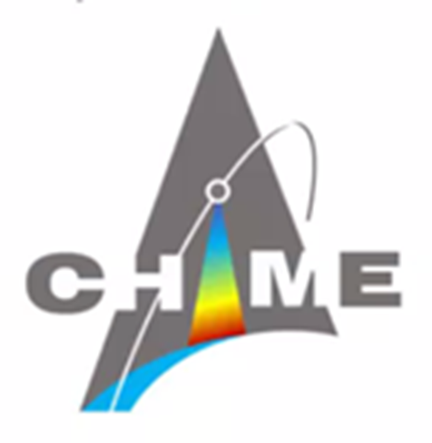
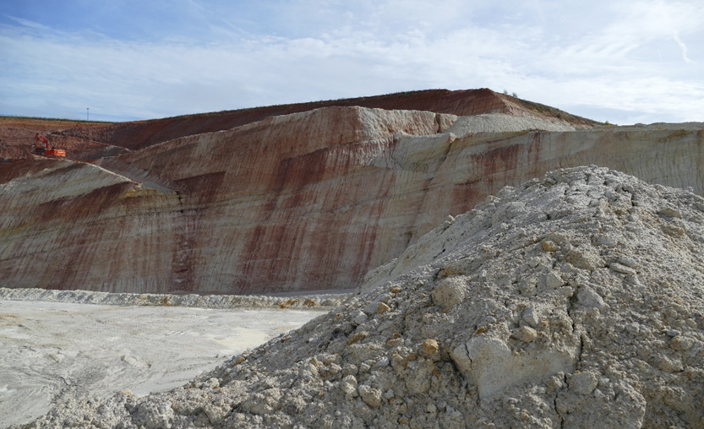
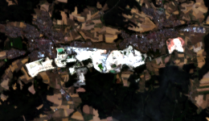
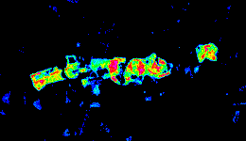
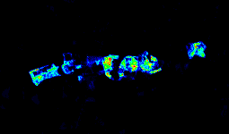
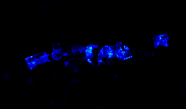
ESA CHIME CHEES & L2: Kaolinite Abundance
Development of the L2B mineral processor (V2)
Applies to CHIME L2A BOA reflectance
Pre-select kaolinite-bearing pixels via ANN
Areal abundance:
- Feature based regression model
- GPR
Volumetric abundance:
- locally fitted regression model
Hirschau, Germany
EnMAP RGB
Areal Abundance Uncertainty
Volumetric Abundance Uncertainty

