Slide 1
Calibration Insights from the DESIS Instrument: Lessons for Future Imaging Spectroscopy Missions
E. Carmona¹, M. Bachmann¹, R. de los Reyes¹, U. Heiden¹, K. Kühl¹, R. Müller¹
¹German Aerospace Center, Earth Observation Center, Münchener Str. 20, 82234 Weßling, Germany

Slide 2
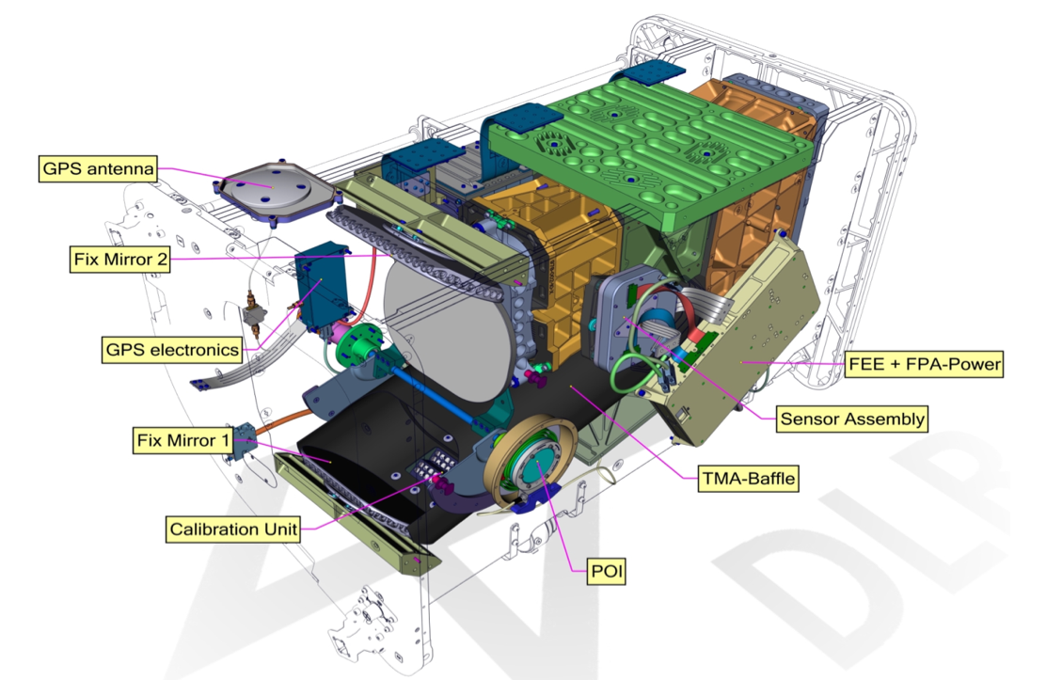
DESIS instrument
Hyperspectral instrument consisting of a Three-Mirror-Anastigmat (TMA) telescope combined with an Offner-type spectrometer
Mission Instrument | MUSES/DESIS
Target lifetime | 2018-2023
Off-nadir tilting (across-track, along-track) | -45° (backboard) to +5° (starboard), -40° to +40° (by MUSES and DESIS)
Spectral range | 400 nm to 1000 nm
Spectral Sampling (res., acc.,bands) | 2.55 nm, 0.5 nm, 235 bands. Binning: 118 , 79 , 60 bands
Spectral response | Gaussian shape, 3.5 nm FWHM
Software Binning (sampling distance, number bands) | Binning 2 (5.1 nm, 118 bands) Binning 3 (7.6 nm, 79 bands) Binning 4 (10.1 nm, 60 bands)
Radiometry (res., acc.) | 13 bits, ~10%
Spatial (res., swath) | 30 m, 30 km (@ 400 km)
SNR (signal-to-noise) | 195 (w/o bin.) / 386 (4 bin.) @ 550 nm
Instrument (mass) | 93 kg
Capacity (km, storage) | 2360 km per day, 225 GBit
FEE: Front End Electronic
FPA: Focal Plane Array
TMA: Three Mirror Anastigmat
POI: Pointing Unit
Sensors 2019, 19(7), 1622; https://doi.org/10.3390/s19071622

Slide 3
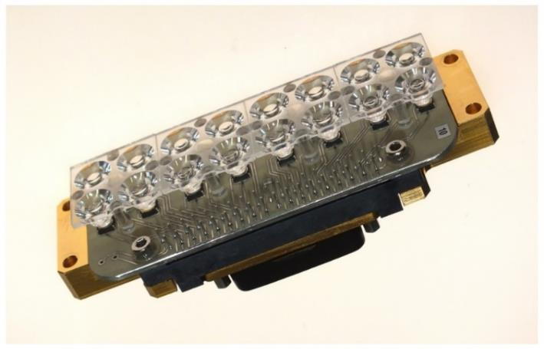
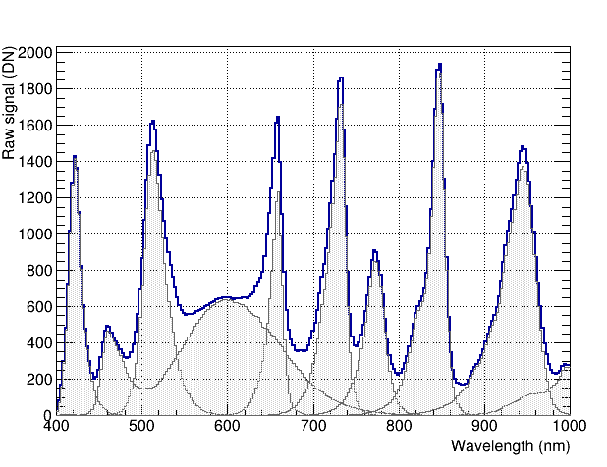
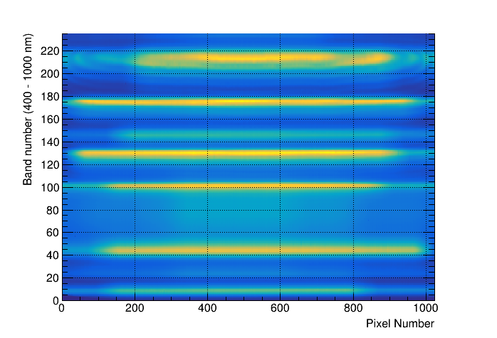
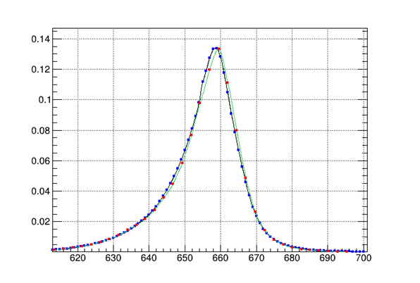
Calibration unit
Equipped with 9 different types of LEDs. It allows to measure signal with different LED types. Calibration measurement every week for >5 years
Non uniform illumination of the focal plane, but very precise for spectral calibration
Fit parameters
Normalization = 1.6495012
Spectral shift = -0.5160 (nm)
Vertical shift = 0.00016
Wavelength (nm)

Slide 4
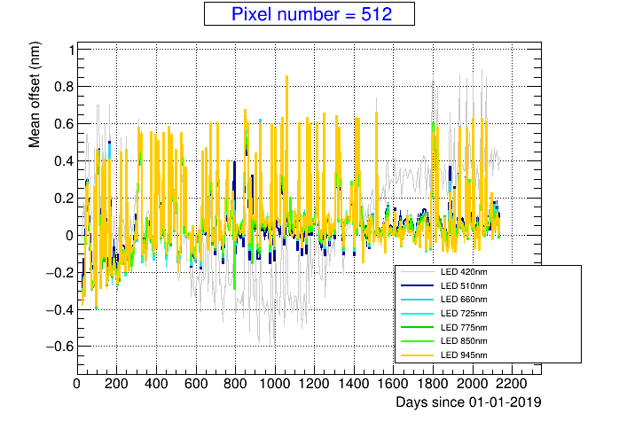
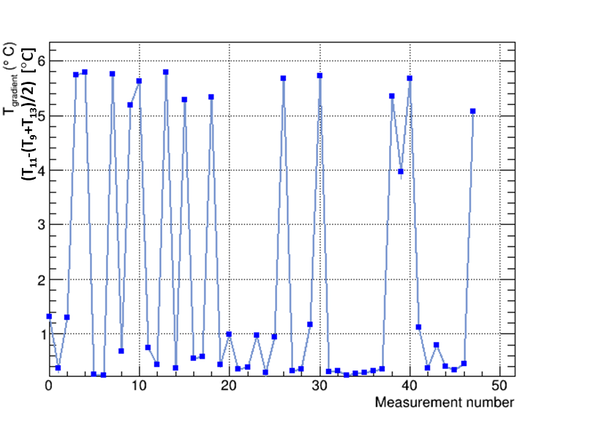
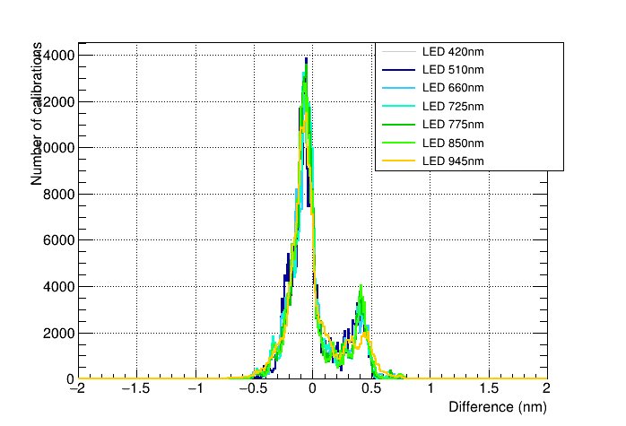
Spectral calibration results
Mostly obtained from on-board Spectral Calibration. Very precise measurement of LEDs profile provides accurate values
Observed simultaneous jumps of 0.5 nm in all LEDs and all pixels across-track. Correlated with different temperature gradients inside DESIS sensor. Two populations: low-temperature gradient (LTG) and high-temperature gradient (HTG)
Wavelength shifts
Temperature gradient
Offset (nm)
After stabilization, RMS ~0.1 nm for one of the two states

Slide 5
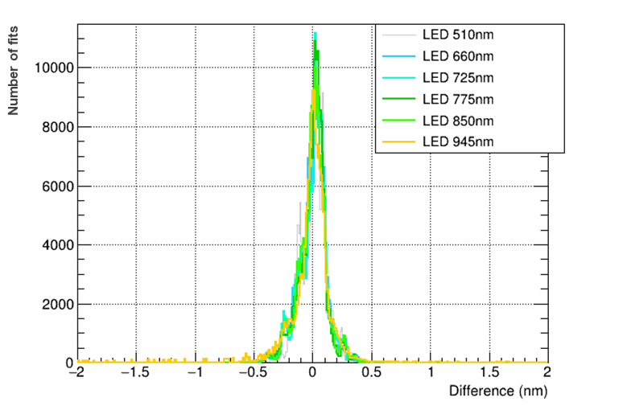
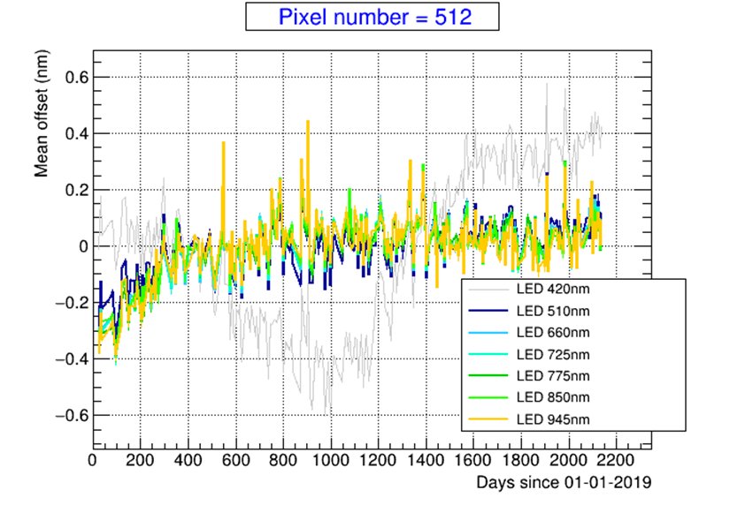
Spectral calibration results (low temperature gradient)
Global shift: based on LED calibration measurements, sensor experiments global shifts. Change of trend in September 2019. More stable since then.
Fine tuning with atmospheric features during vicarious calibration
Spectral stability: based on LED calibration, spectral stability 0.09 – 0.11 nm, within one mode
The 2 modes observed associated to temperature gradients (jump of 0.5 nm) corrected during smile correction step
Number of measurements

Slide 6
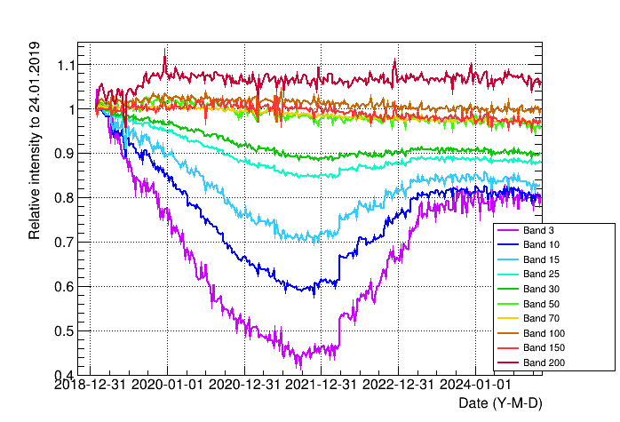
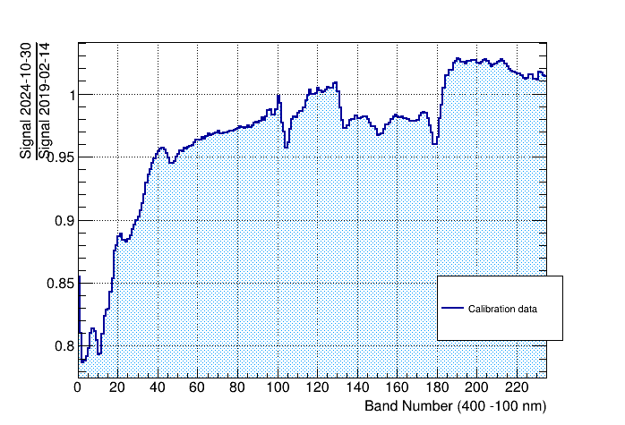
Calibration unit more results
Change of behavior below 500 nm observable during the mission lifetime. Different phases observed
Degradation from launch until August 2021
Rapid increase between April 2022 and April 2023. Very stable since then

Slide 7
Radiometric vicarious calibration
Use DESIS scenes. Data not evenly distributed in time
Particularly challenging to have abundant good quality Radcalnet (RCN) scenes
Calibration updates arrive several months after data acquisition
Period #1
Period #2
Period #3
Period #4
Period #5
Period #1
Period #2
Period #3
Period #4
Period #5
Notes:
And how do we calibrate DESIS? Well, using vicarious calibration. As input we use images over uniform areas (for instance CEOS PICS sites) that help us to adjust the relative response of the sensor elements in the spectral and spatial direction and we also use Radcalnet scenes to get the absolute calibration. One problem of this approach is that scenes are not evenly distributed in time and can make particularly challenging to have enough Radcalnet scenes in one period. Another problem is that calibration updates require months in order to get enough data and process them.
Until now we have defined 5 calibration periods (the last two being tested at the moment) with a typical separation of 7 months. These graphs show the temporal distribution of scenes used for calibration. The left one shows the distribution of uniform and radcalnet scenes while the right one you can see which RCN scenes are used for calibration in each period.

Slide 8
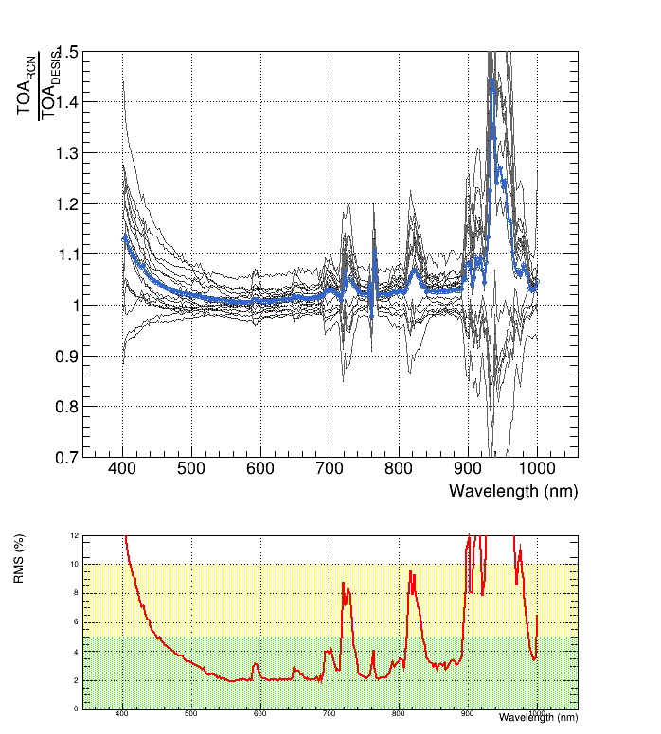
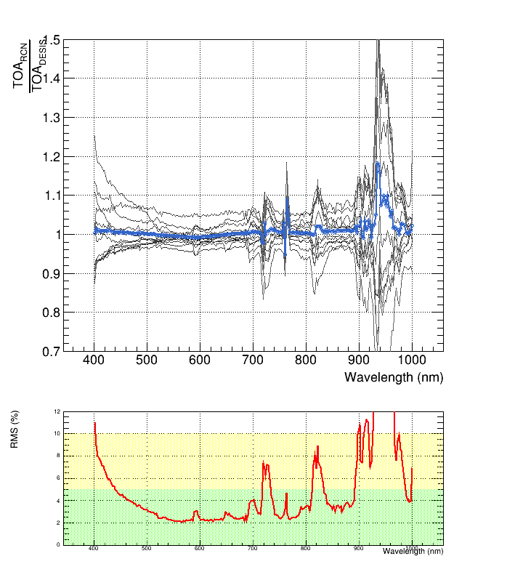
Calibration update with RCN data
Correction of the calibration bias
TOA reflectance from RCN BOA reflectance
Calibration update needed
TOA reflectance from RCN BOA reflectance
Period 4`
TOA reflectance from RCN BOA reflectance
Period 5

Slide 9
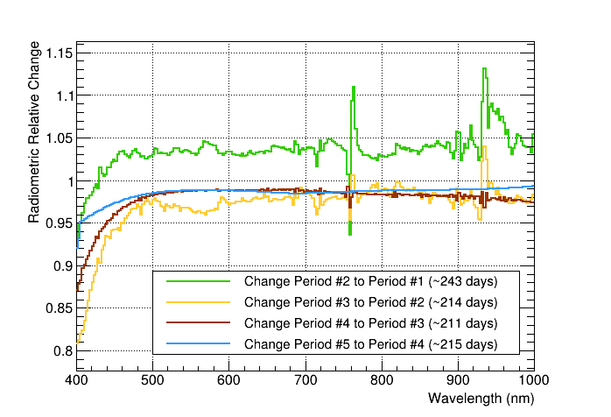
Radiometric update from vicarious calibration
The plot shows relative change of detector performance obtained from the vicarious calibration
Very similar to Calibration unit data
CAL data reproduces the fast decrease in performance below 500 nm
Main differences are:
CAL data shows a maximum decrease down to 40% from the initial values, while the Vicarious data shows a maximum decrease down to 60%
CAL data does not reproduce decrease of ~2% between periods above 500 nm
CAL decrease below 500 nm is constant until July 2021, but vicarious results show different intensities for different periods

Slide 10
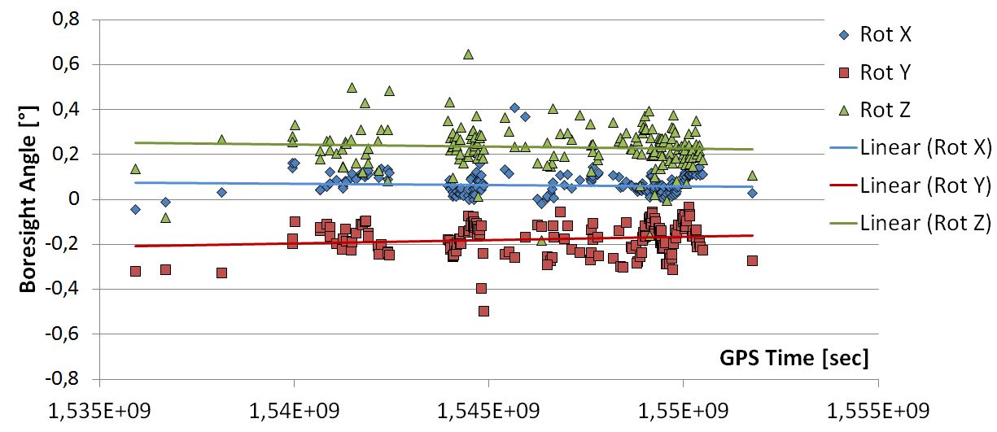
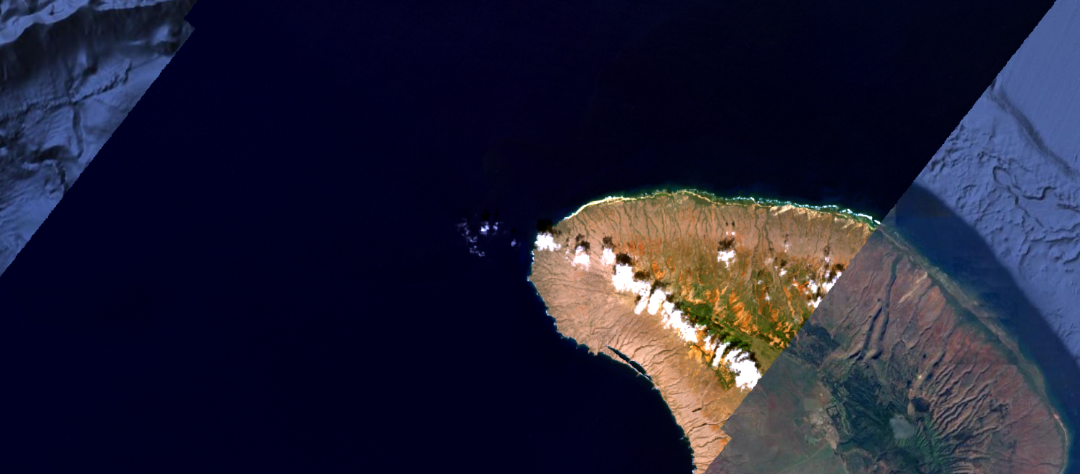
Geometric performance
Orthorectification is performed individually for each DESIS product. In case image matching works for a scene
RMSE (east) = 21.0 ± 5.9 m
RMSE (north) = 21.4 ± 6.0 m
In case of no-matching, geolocation relies on boresight calibration:
RMSE ~289 m (across); ~496 m (along), but with peak values up to 1 km
Latest update of boresight calibration with date 01.03.2023
Check matching information in metadata. When no GCPs “matchingMethod = none” (in addition orthoRMSE_x/y = -1 or numPointsGCP=0)

Slide 11
Lessons from DESIS for future sensors
Hyperspectral space instrument can be calibrated vicariously with not too big effort
Delay to have new calibrations in place. Challenging to keep users informed
On-board calibration is still very recommendable, in particular for spectral calibration
Use of DESIS calibration unit with LEDs for spectral calibration satisfactory. Not the case for radiometric calibration
Better use the complete datatake for estimation of geometric parameters. Relying in GCPs provides results which are not always consistent
Use of a rolling shutter sensor has not been identified as a problem

Slide 12
Seed questions
How many vicarious calibration sites might be needed worldwide to ensure accurate characterization of the radiances and reflectances (L1B and L2 products) returned by spectral imaging missions? And what are the core measurements that should be made at these sites (and uncertainty/performance requirements)?
Depends on goals and instrument. DESIS uses 3 RadCalNet sites, ToA and BOA reflectance .
What are the main challenges in harmonizing CAL/VAL approaches across different EO missions, sites, and campaigns, and how can these be addressed?
Not always uncertainty estimations and traceability of the measurements/results obtained
What is currently missing to carry out holistic and all-encompassing CAL/VAL activities, and how, for example with which innovations, can this be supported?
Systematic measurements, uncertainties, BRDF models, site with focus on spectral cal/val
How can emerging technologies, such as artificial intelligence and machine learning, be leveraged to improve the accuracy and efficiency of calibration and validation processes?
Personally I trust more simple model for calibration. Not really convinced that AI or ML are necessary for calibration
…but ML can handle large data volumes and complex and/or non-linear parametrizations. There are cases where it can be an advantage
12

Slide 13
EXTRA

Slide 14
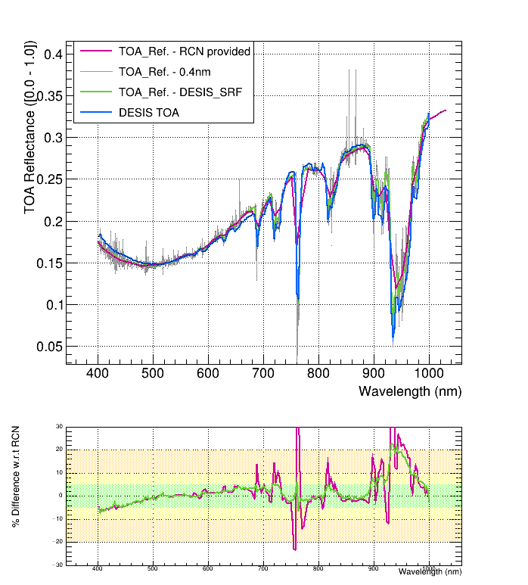
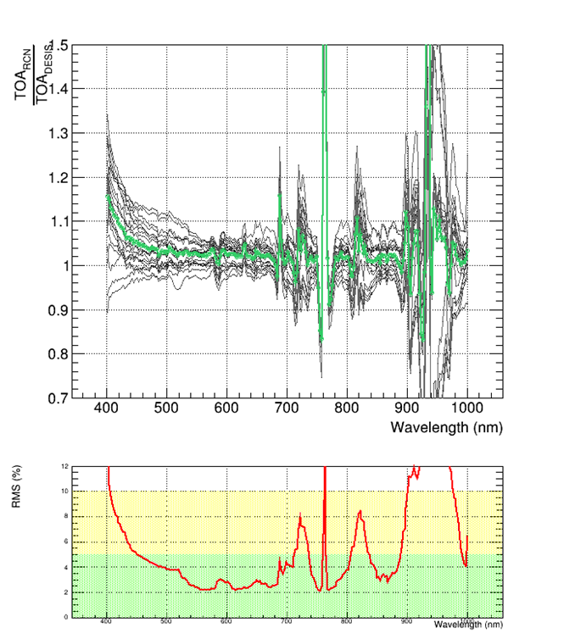
Vicarious Calibration
Use flat-fielding over uniform areas for pixel-to-pixel relative adjustment. Use RadCalNet sites for absolute calibration
10 nm SSD
2.5 nm SSD

Slide 15
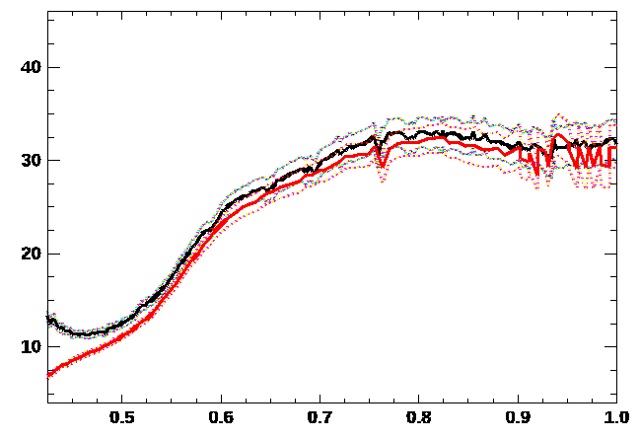
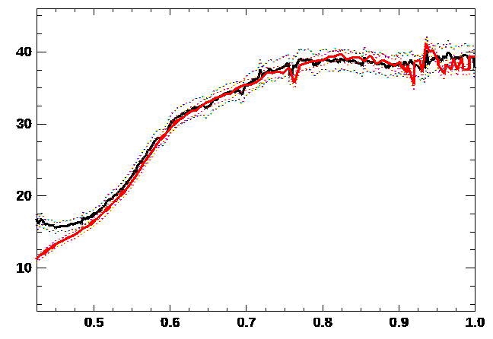
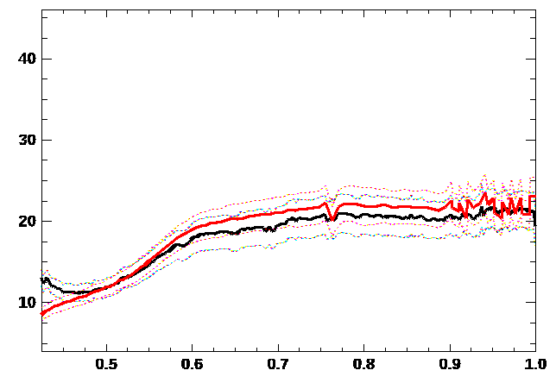
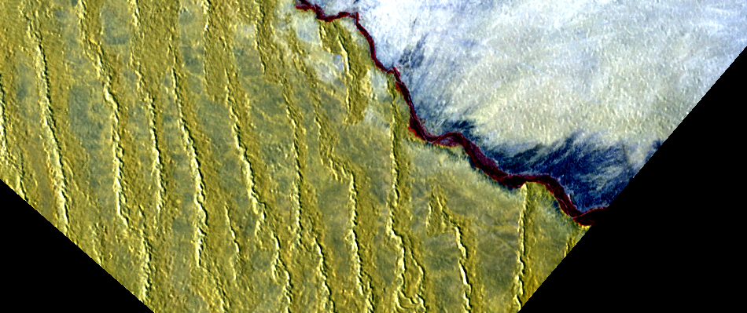
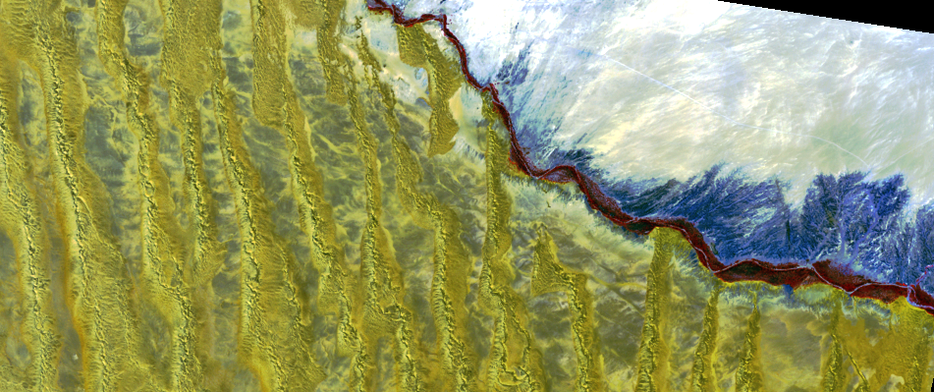
DESIS and EnMAP – L2A spectral comparison
DESIS
EnMAP
A
B
C
A
B
A
B
C
C
Gobabeb, Namibia; DESIS + EnMAP cal/val site,
DESIS: SAA 72°, SZA 47°, 02/10/2022, 07:52 (UTC)
DESIS
EnMAP
Notes:
Hot potato to Emiliano
L1 calibration issue of DESIS
Problem coming from TOA, not a problem with ATM correction – deviation from RADCALNET
Not systematic – other scenes does not have this effect
Unclear
Emiliano:
Below 480 not so much reliable – calibration difficult, previously it was degrading, that stopped
First 6 bands careful

Slide 16
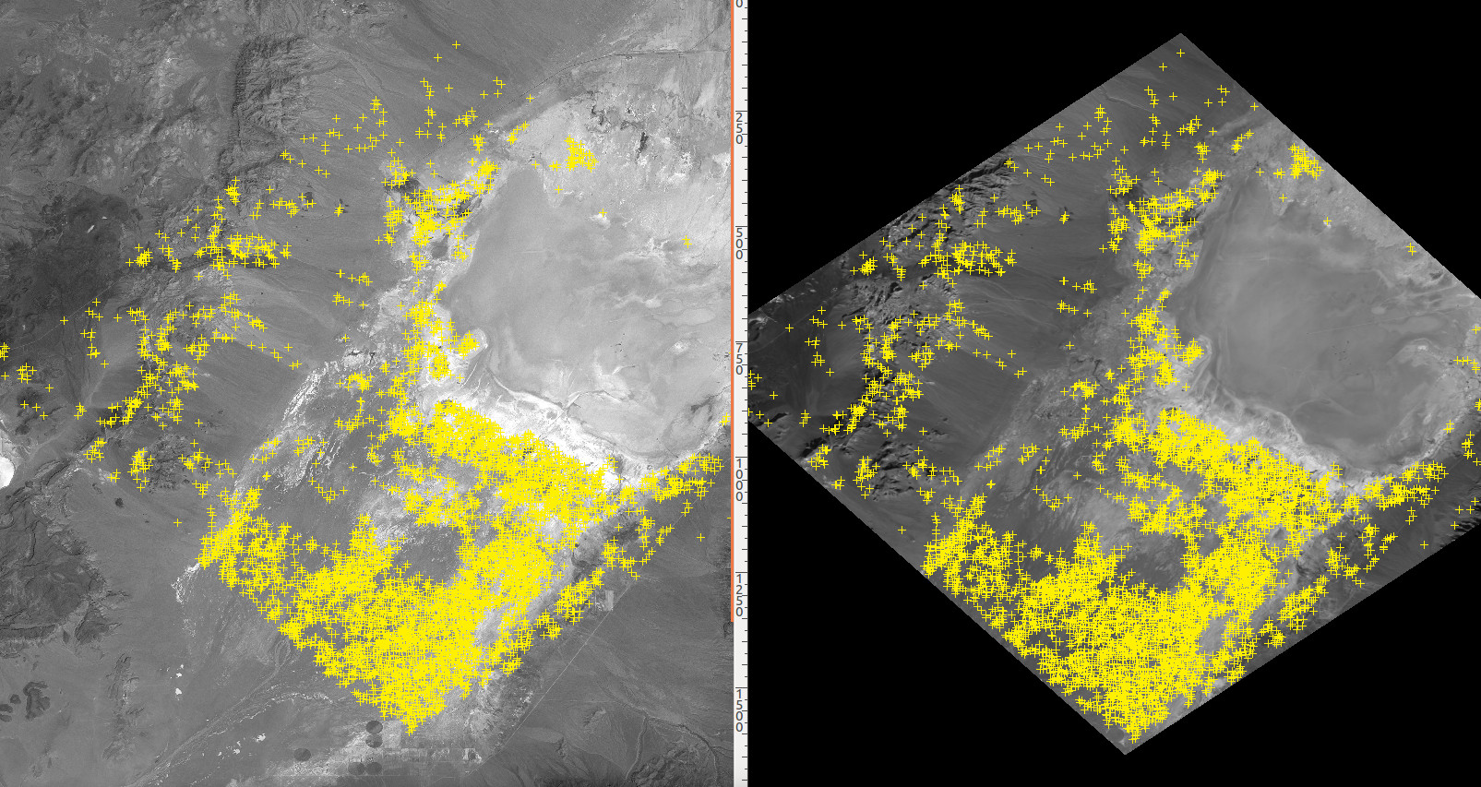
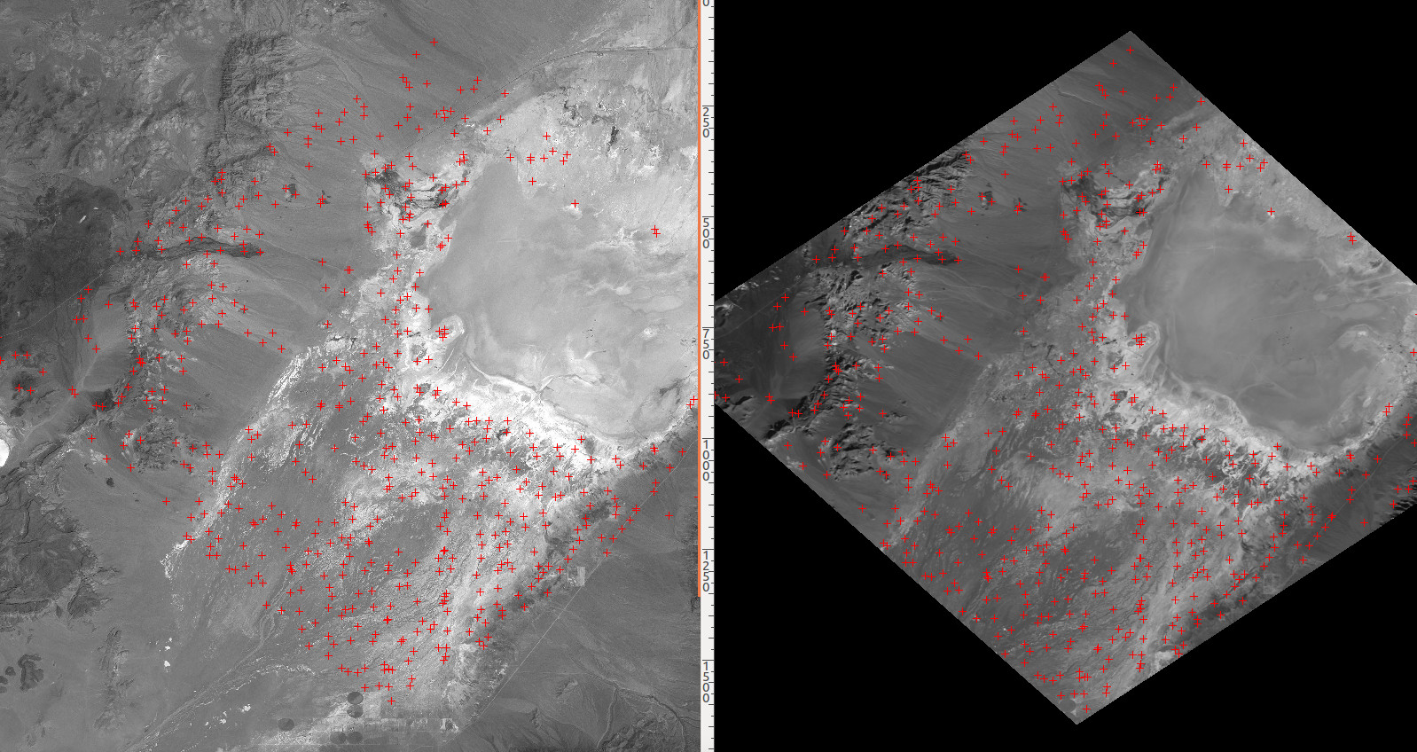
L1C Processing (and Calibration)
Reference Image (Landsat 8 Pan, ~18 m CE90)
DESIS Image (after coarse rectification)
Railroad Valley, USA
13-12-2018
18:23:11 UTC
38.4467°N 115.7512° W
Sun: 64.14°, 160.58°
Incident Angle: 0.8°
Selected GCP to improve DESIS sensor model (on-the-fly and for boresight calibration)
Others are used for Quality Assessment
Cascade of matching
BRISK (Binary Robust Invariant Scalable Keypoints)
LLSQ (Local Least Squares)
SIFT (Scale-Invariant Feature Transform)

Slide 17
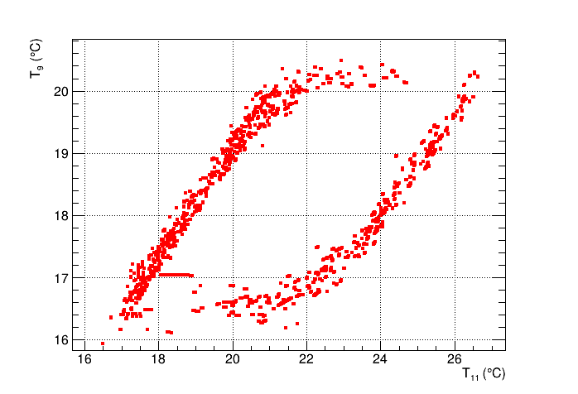
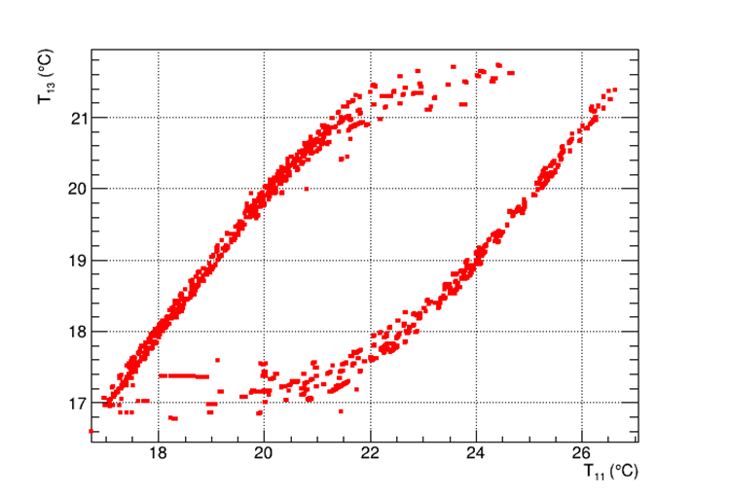
Temperature gradients
Relationship between temperature values used to compute temperature gradients for spectral correction

