Slide 1
Cal/Val Park: fostering innovation and international cooperation in the Cal/Val domain
Fabrizio Niro¹, Roberto Colombo², Sergio Cogliati², Lorenzo Genesio³, Franco Miglietta⁴, Antonio Petitti⁵, Béatrice Berthelot⁶, Sebastien Saunier⁷, Niall Origo⁸, Joel Kuusk⁹, Sultan Kocaman¹⁰, Noelle Cremer¹, Massimo Cardaci¹, Stefano Casadio¹, Marco Galli¹, Gabriele Brizzi¹, Leonardo De Laurentiis¹¹ and Valentina Boccia¹¹
1. Serco for ESA/ESRIN, Frascati, Italy
2. University of Milano Bicocca, UNIMIB, Milan, Italy
3. National Research Council, CNR-IBE, Florence, Italy
4. Fondazione Clima e Sostenibilità, FCS, Florence, Italy
5. National Research Council, CNR-STIMA, Bari, Italy
6. Magellium, Toulouse, France
7. Telespazio-FR, Toulouse, France
8. National Physical Laboratory, NPL, London, UK
9. University of Tartu, Tartu, Estonia
10. Hacettepe University, Ankara, Turkey
11. European Space Agency, ESA/ESRIN, Frascati, Italy

Slide 2

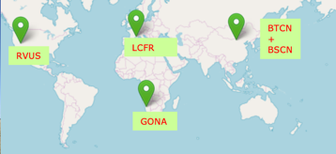
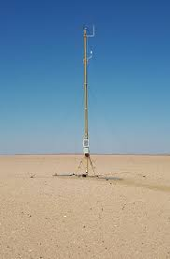
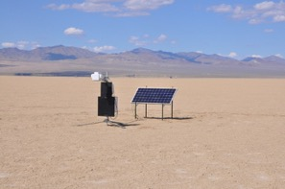
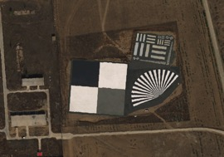

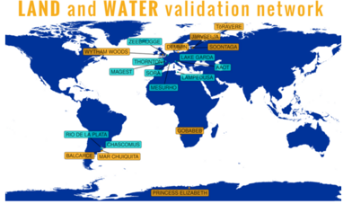
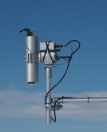
Background and Motivations
Proliferation of satellite EO data → How to harness the full potential of these heterogeneous data ? → Interoperability
Space Agencies (within CEOS-WGCV) successfully established common infrastructures (e.g., RadCalNet) and protocols to facilitate interoperability, yet limitations remain
Data gaps :
  Lack of dedicated targets for assessing geometric accuracy and image quality parameters, notably for HR/VHR sensors
  Scarcity of reference data for validating SR products, notably of hyperspectral measurements, HYPERNETS filling this gap
Methodological gaps :
  Synergies across networks and sites are seldom exploited
  Operational networks have limited flexibility and scalability
  Existing networks/sites do not strictly follow FRM guidelines

Slide 3
Objectives and Timeline
Objectives
  Supporting the Cal/Val needs of optical VNIR/SWIR, multi- and hyper-spectral mission with GSD ≤ 30 m
  Promoting adoption of metrological practices (FRM)
  Promoting research and innovation in methods and sensors
  Exploiting synergies within existing networks and sites
  Ensuring flexibility and scalability to accommodate needs of future sensors or instrument-type, e.g., HR TIR
  Fostering collaborations among Space Agencies and EO Commercial data providers
Timeline
  3 consecutive Phases (design, set-up, operations)
  Design Phase (supported by ESA) almost completed (Q2 2025)
  Currently preparing the ground for Phase 2 and Phase 3 aiming at a multi-agency effort
EO missions that can benefit from CVP data

Slide 4
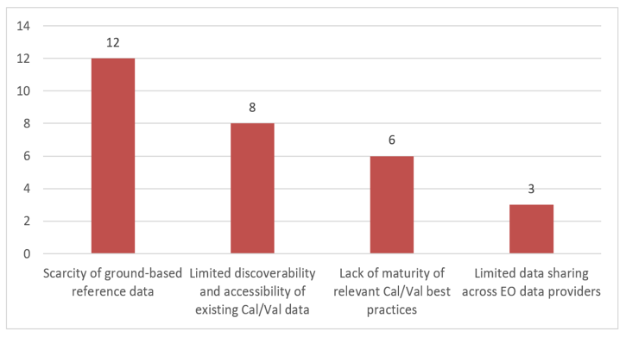
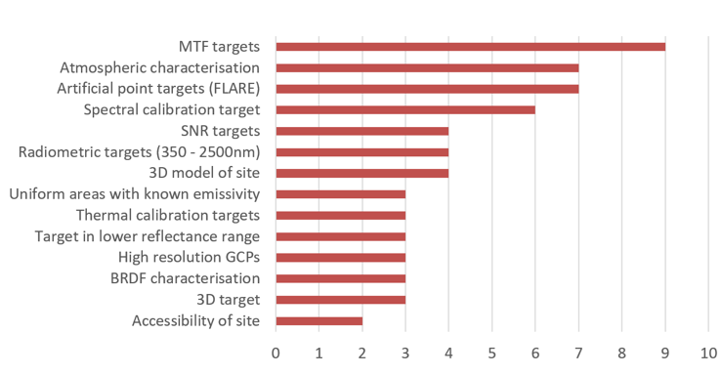
Cal/Val needs driven approach to design
Reaching out to Commercial and Institutional EO data providers and experts for gathering their needs:
  ESA, ASI, GFZ, VITO, CSIRO, Leonardo, OPT MPC
  Planet, Satellogic, Airbus, SSTL, OSK, Albedo, ConstelIr, Kuva, Aistech, Satellite Vu, BlackSky, Promethee, EnduroSat, AerospaceLab, Satlantis, Absolute Sensing
Questionnaire sent to each data provider and one-to-one meetings organised to review the answers
User Consultation WS organised on 2-3 Oct 2023 to further gathering Cal/Val needs
Summary Report issued, main takeaways:
  Scarcity and limited discoverability of Cal/Val data
  Lack of targets for Image Quality (IQ) parameters (e.g. MTF, SNR) notably for HR/VHR sensors
What is the main limitation to current post-launch Cal/Val capabilities ?
What is your recommended component of an ideal Cal/Val site ?

Slide 5
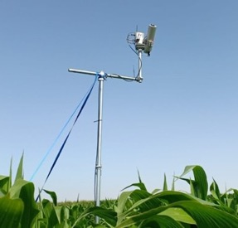
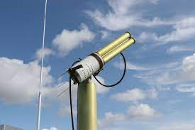
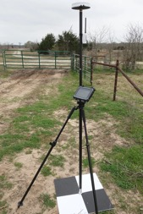
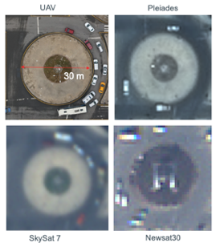
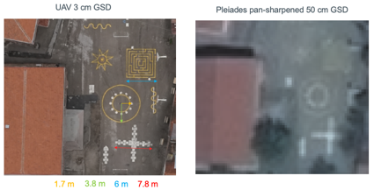
Measurable Cal/Val parameters
Radiometry (L1) – Spectra/atmospheric measurements + selected targets + RTM will allow reflectance-based approach for validation of hyperspectral radiance data (RadCalNet approach)
Surface reflectance (L2A) – Spectral measurements of selected targets for direct validation of SR products and assessment of AC algorithms
Atmospheric parameters (L2A) – Atmospheric measurements of AOT, TCWV (AERONET) + all-sky camera for cloud mask
Geometry (L1) – Use of GCPs in the CVP region to validate geolocation, band-to-band registration, calibration of geometric model
Image quality (L1) – Quantitative assessment of MTF with checkboard target + geometric patterns for image sharpness
Higher-level products (L2B) – Measurements of soil/vegetation biogeophysical parameters, e.g., LAI, fAPAR, SOC

Slide 6
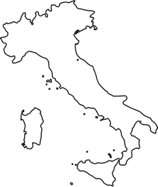
Cal/Val Park Area and Region
Candidate sites ranked based on scientific and practical criteria: availability long-term, flatness, cloud cover and aerosol, adjacency, constraints in land/flight use, legal issues
Best suited site identified in the Grosseto region: the Cal/Val Park Area
Additionally, we will exploit sites within the Cal/Val Park Region:
  Ancillary sites (water pond and managed vegetated site)
  Existing natural and man-made 1D and 3D Geo/IQ features for GCPs + IQ assessment
Components: A1 (Radiometry), A2 (Geo/IQ), A3 (Atmosphere), A4 (Lab), Extension Area (Playground for field campaigns)
Cal/Val Park Area
Cal/Val Park Region
Ancillary site (water)
Ancillary site (vegetation)
Geo/IQ features (n)

Slide 7
Baseline layout for A1 – Radiometry
Satellite data
Pixels involved in the convolution (e.g. satellite data @30m )
Robotic ground rover system equipped with ASD-like, white panel and RGB camera. Multiview sampling. Black circle is the sensor FOV and box for rover charging
L1 and L2A products
RadCalNet-like station and sensor FOV
Hypstar and NoX instruments and sensor FOV
Multispectral thermal instruments for LST
L2B products
Automatic fisheye RGB-like camera for vegetation parameters (LAI, Fc, fAPAR). Soil moisture instruments. Soil organic content, emissivity, soil textural and structural composition
Webcam stations

Slide 8
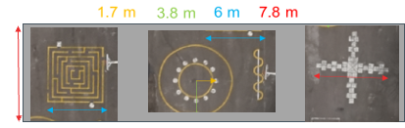
Baseline layout for A2 – Geometry and IQ
MTF Checkboard target for Image quality Parameter quantitative estimate:
  GSD < 5.0 m
  Fix orientation
  Material: Gravels
  Yearly Spectral characterization
  Regular check / Cleaning
  Background can be grass-covered type
7 Modules for quick qualitative assessment of Spatial Resolution
  GSD < 2.0 m
  Various Patterns depending on GSD.
  Colour Patterns (yellow, red, blue, white, green) with paving or painting or both
  Linear / Circular / Complex Forms
  Modular concept reduce footprint over soil.

Slide 9
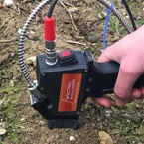
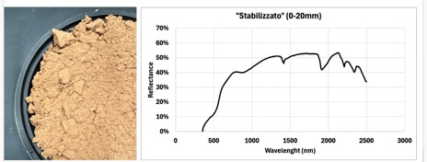
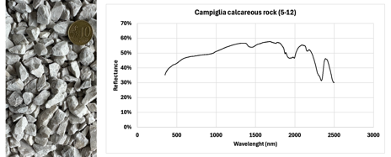
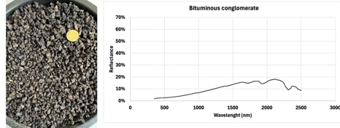
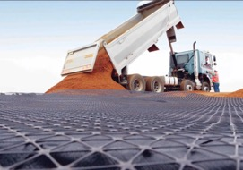
Selection and characterisation of materials
Set of candidate materials assessed, their reflectance properties measured in the lab
Selection of materials based on scientific and practical considerations:
  Cover a wide range of brightnesses
  Affordable price to cover large (>1ha) targets
  Available in the site proximity (transportation costs)
  Easily deployable, resistant and solid
The final selection for the 5 Rad targets:
  1 Bright and 1 black gravels (60% and 5-15%)
  1 Stabilised brown material (30-40%)
  2 natural: rotation grass and bare soil
This set of targets allows validation of radiances over wide range, L1, L2A and L2B products

Slide 10
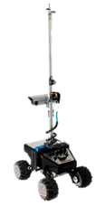
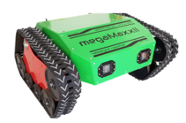
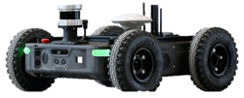
Sampling Approach
Temporal domain: fixed position HYPSTAR, RadCalNet and NOX sensors installed over masts operated according to network protocols
Spatial domain: mobile platform equipped with VNIR/SWIR spectrometer (ASD-like) covering the full spectral range (400 – 2500nm)
Conceptual framework to define the protocol considering target size, rover speed, sensing time, assuming normally-distributed variability
Best protocol for a given uncertainty requirement (→ # sampling points), minimizing traveling time while preserving spatial representativeness
Engineering design and technological solutions have been explored for the rover
Spatial Sampling protocol
Rover design and solutions

Slide 11
Conclusion and Outlook
The Cal/Val Park equipment, technologies, and methods have been defined to measure various radiometric and geometric parameters for the Cal/Val of L1, L2A, and L2B products.
Cal/Val Park is designed to support both high-spatial-resolution and hyperspectral missions, across institutional and commercial sectors, enhancing interoperability among sensors.
This infrastructure will be unique and represents the state of the art in Cal/Val activities. It will work in synergy with existing networks to provide high-quality, SI-traceable data.
The Cal/Val Park is anticipated to drive technological advancements, deliver scientific and societal benefits, support EO science training, and foster international collaborations.

Slide 12
Replies to seed questions
How many vicarious sites → Generally, “the more is better” to enhance match-up opportunities, ideally, the ensemble of sites/targets should allow validating the radiance and reflectance over its full dynamic range, including natural and artificial surfaces
Core measurements at the site → Ground-based surface hyperspectral measurements covering full range (400-2500nm) + atmospheric measurements (AOT, TCVW, CM) over a set of targets, with proper sampling and of the spatial and temporal variability of the target → Cal/Val Park layout
Challenges in harmonization across missions/sites and how to address them → International coordination across agencies and commercial partners, need to build consensus within the community on best practices (instrument/sensors, protocols, algorithms for both radiometry and geometry)
What is missing for holistic and all-encompassing Cal/Val → The Cal/Val Park ☺, meaning a super-site where many collocated and complementary measurements are made to ensure multi-missions, multi-purpose capabilities (optical L1, L2A, L2B + atmosphere + TIR), going forward we need a network of Cal/Val Parks

Slide 13
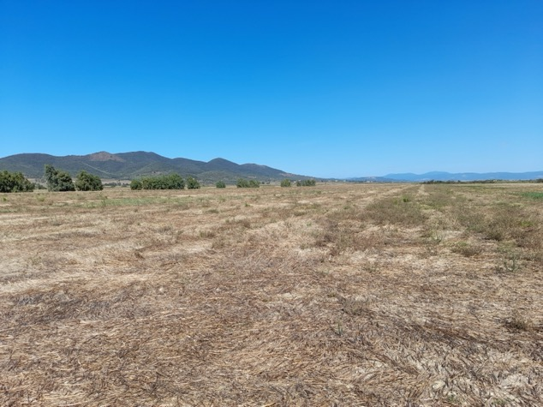
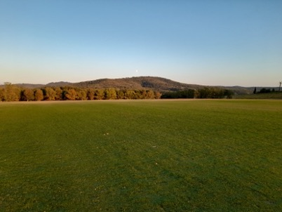
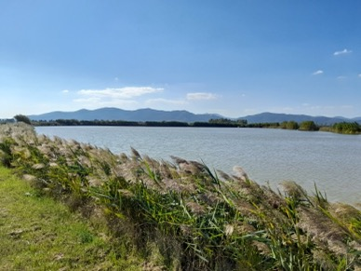
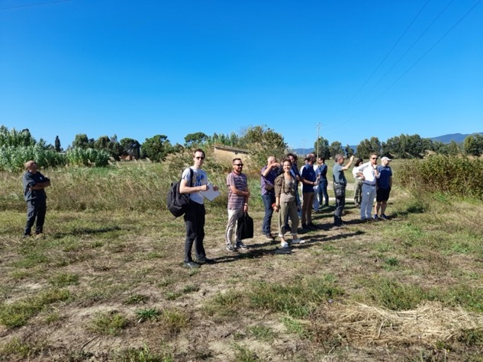
Thanks for your attention

