Slide 1
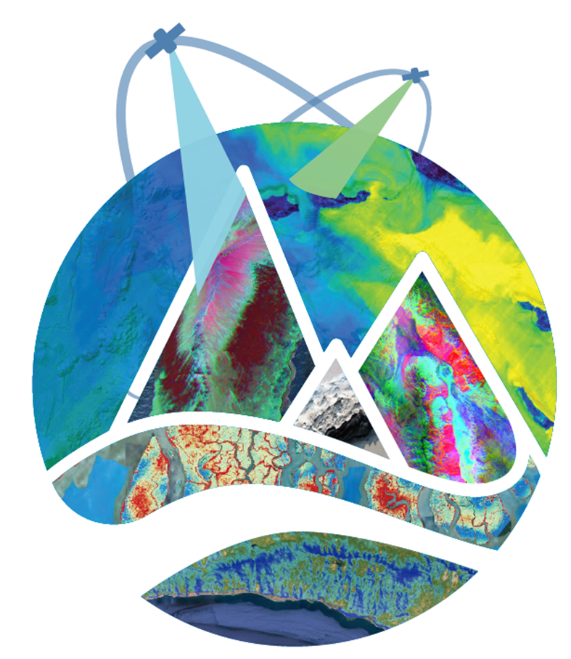
Jeff Dozier, Edward H. Bair, Niklas Bohn, Brent A. Wilder, Amy Braverman, Philip G. Brodrick, Robert O. Green, Maggie Johnson, Kimberley R. Miner, Noah Molotch, Ross Palomaki, Karl Rittger, David Schimel, David R. Thompson 13 November 2024 3rd Workshop on International Cooperation in Spaceborne Imaging Spectroscopy, ESA ESTEC
Retrieval of Snow Properties from Imaging Spectroscopy: The path towards SBG and CHIME
The research was carried out at the Jet Propulsion Laboratory, California Institute of Technology, under a contract with the National Aeronautics and Space Administration (80NM0018D0004).
Reference herein to any specific commercial product, process, or service by trade name, trademark, manufacturer, or otherwise, does not constitute or imply its endorsement by the United States Government or the
Jet Propulsion Laboratory, California Institute of Technology.

Slide 2
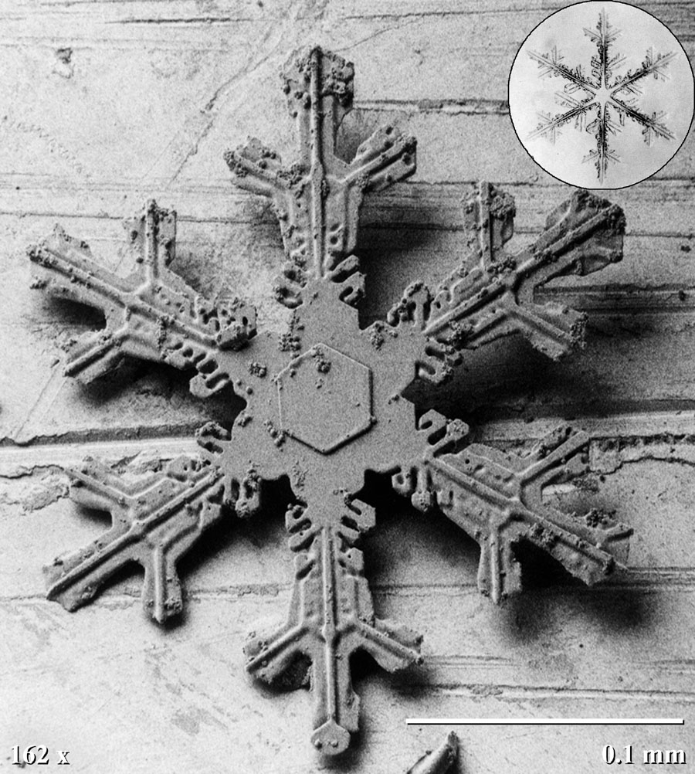
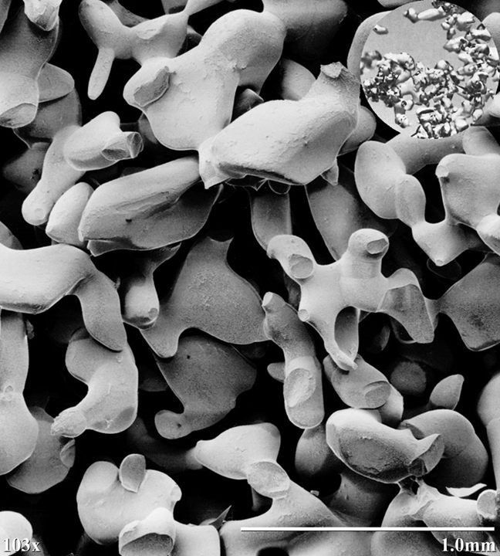
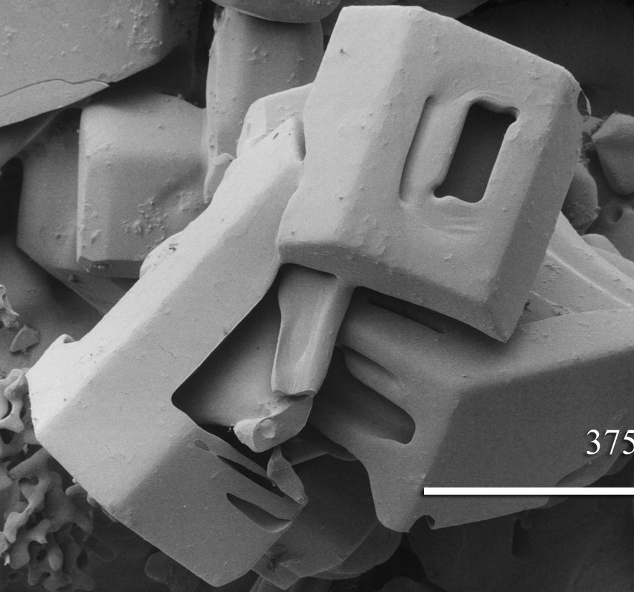
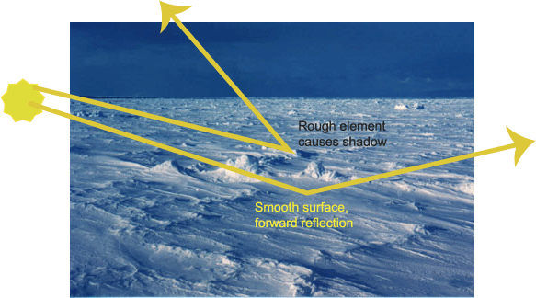
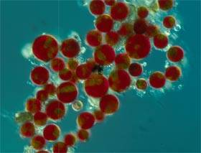
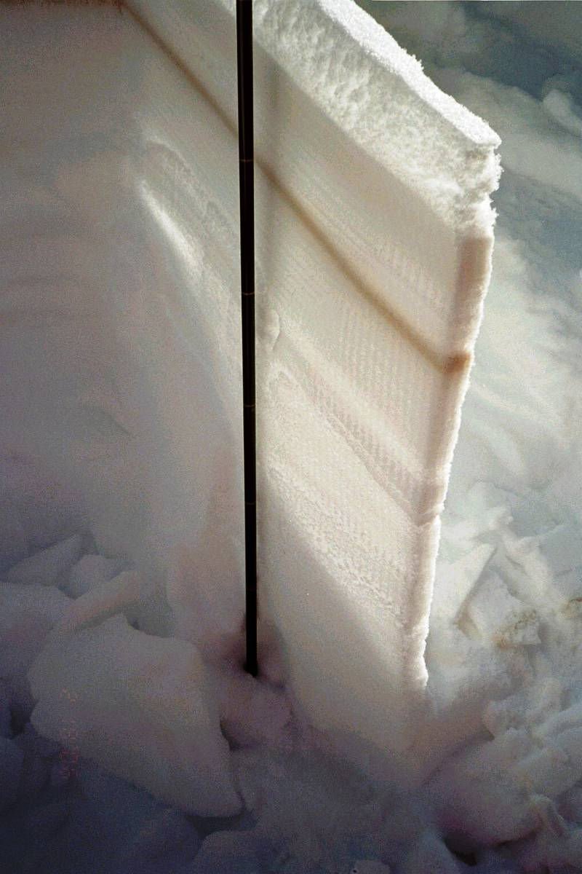
What is Snow?

Slide 3
Variety in Forward Modeling
Wiscombe & Warren (& Bair et al.)
δ-Eddington & Mie scattering
SNICAR similar
Painter et al. (& Bohn et al.)
Nonspherical snow grains & DISORT for angular reflectance
Kokhanovsky & Zege
Geometric optics & asymptotic radiative transfer
Kaempfer et al.
3D microstructure & photon tracking
(R. Perla: “snow a structure, not a grain collection”)

Slide 4
Decadal Survey Focus
DS Science/Application Objective | Priority | DS Suggested Biogeophysical Parameters | Geophysical Parameters (one-sigma uncertainty target) | Applications enabled
H-1c. Quantify rates of snow accumulation, snowmelt, ice melt, and sublimation from snow and ice worldwide at scales driven by topographic variability. | Most Important | Snow and glacier albedo and surface temperature. Spectral albedo of subpixel snow and glaciers at weekly intervals to an accuracy to estimate absorption of solar radiation to 10%. Ice/snow temperature to ± 1K. At spatial resolution of 30 to 100 m. | Snow and ice coverage fraction (coverage fraction +/- 7%) | EA1 Water resource management, EA2 Drought monitoring, EA3 Drought / flood prediction, EA4 Weather forecast, EA5 Climate modeling, EA6 Shipping / navigation around sea ice
 |  |  | Snow surface reflectance, 380-2500 nm
 |  |  | Snow grain size, used to calculate albedo (absorption +/- 7%)

Slide 5
Spectral Albedo
Darker when grains are larger, mainly in the near-infrared where ice itself is mildly absorptive
Darker when contaminated by light-absorbing particles (LAP), mainly in the visible
Darker in the visible when snow is shallow, snow water equivalent (SWE≤~500mm for larger grains)
Usually different than other surfaces like vegetation or soil

Slide 6
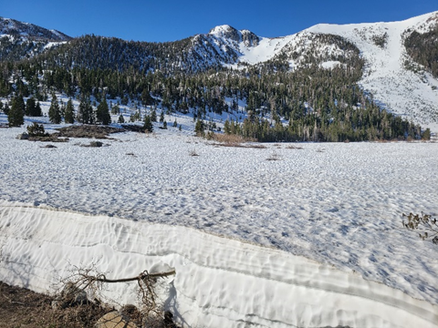
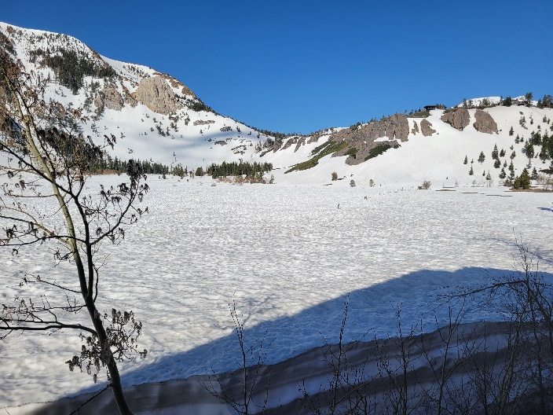
Roughness lowers Albedo and reduces Forward Scattering
The left image looks in the direction toward the Sun, whereas in the right image the Sun is behind me. Forward scattering, based on a model like DISORT, should cause the left image to be brighter than the right, but the opposite is the case.

Slide 7
Recommendations
The Science/Applications Traceability Matrices for SBG should:
Specify that the sensor, data processing, and algorithms retrieve square root of effective radius of snow grains to within 18% RMS error
And that the “darkening” of snow—the difference between estimated clean albedo and actual albedo integrated over wavelengths 400 to 900 nm—is retrieved to within 12% RMS error
(these thresholds to be explored under a range of illumination conditions and fractional snow-covered area)
Two problems to solve
Effect of surface roughness (rougher surfaces a little darker)
Atmospheric correction for bright surfaces (avoid spurious darkening)
SBG VSWIR Snow and Hydrology
14 August 2024
7

Slide 8
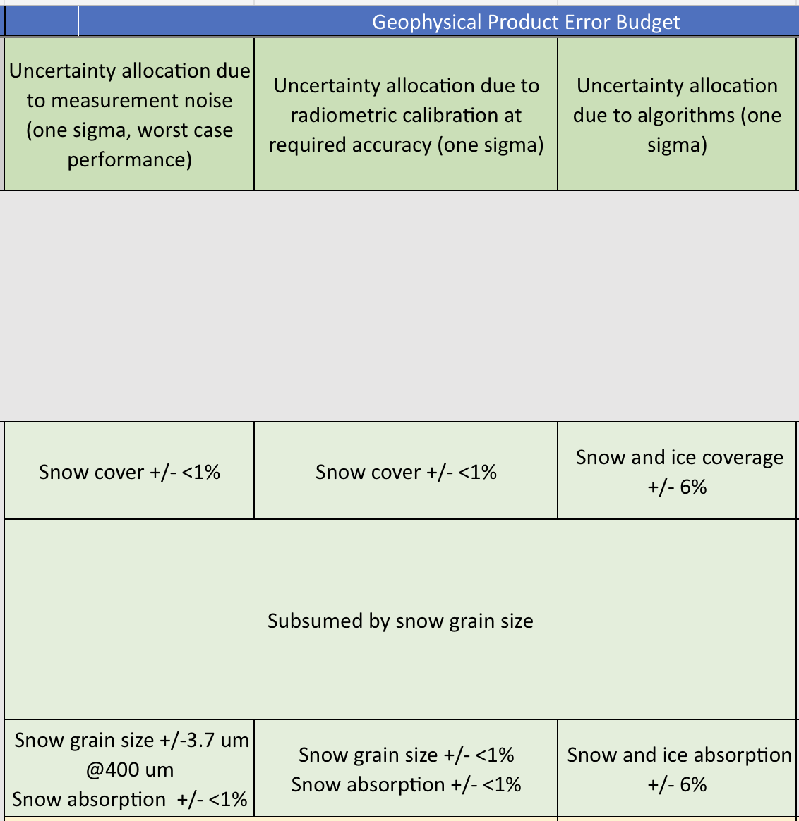
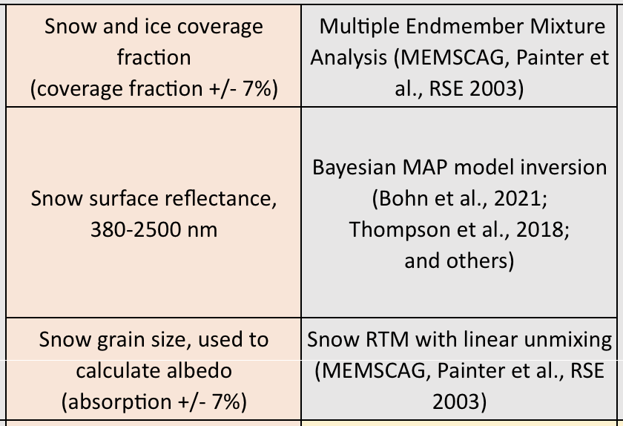
Product Error Budget
From albedo to absorption
From grain size to square-root of grain size
Radiative forcing: error budget for integrated difference between clean and dirty snow in VIS to NIR wavelengths

Slide 9
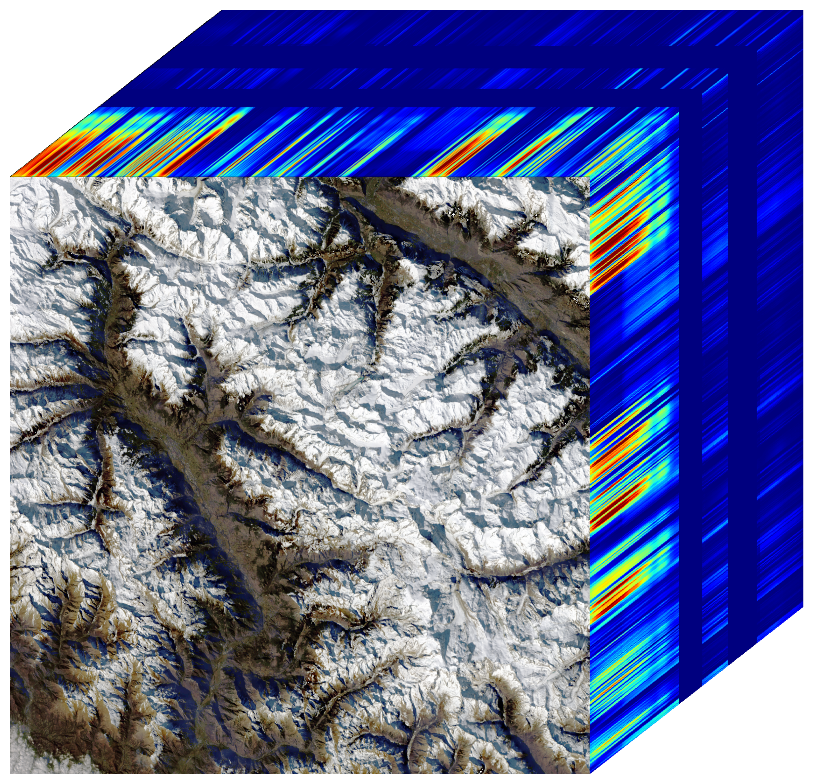
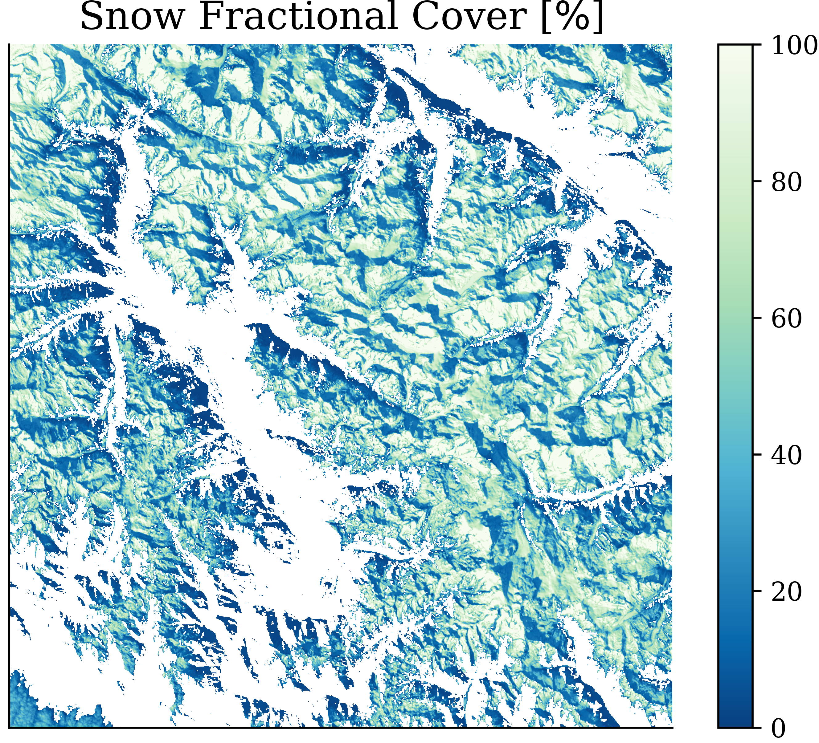
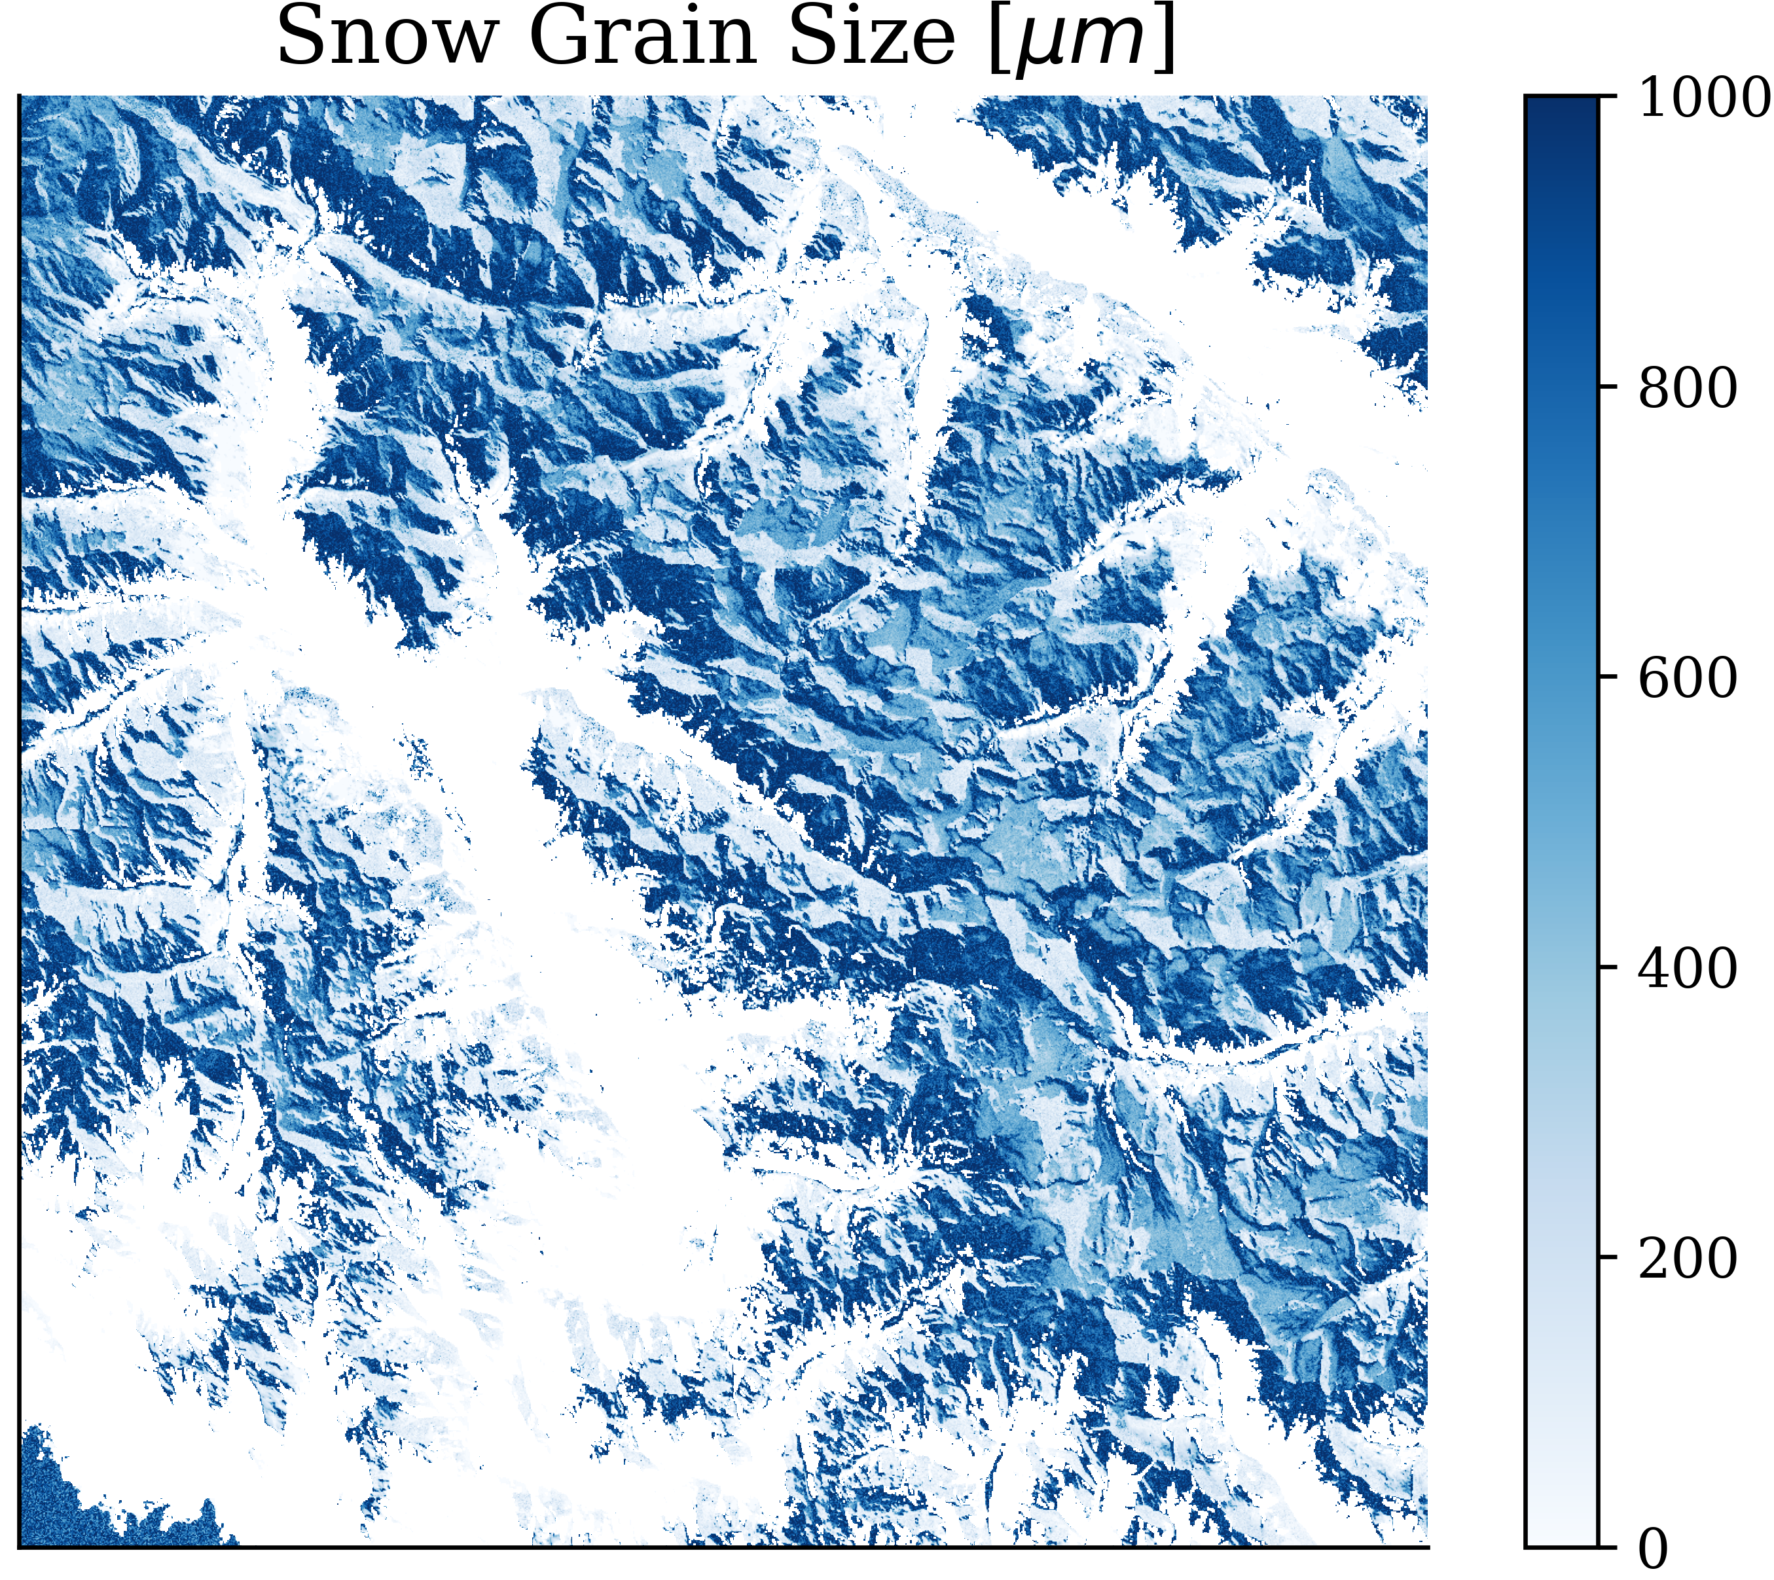
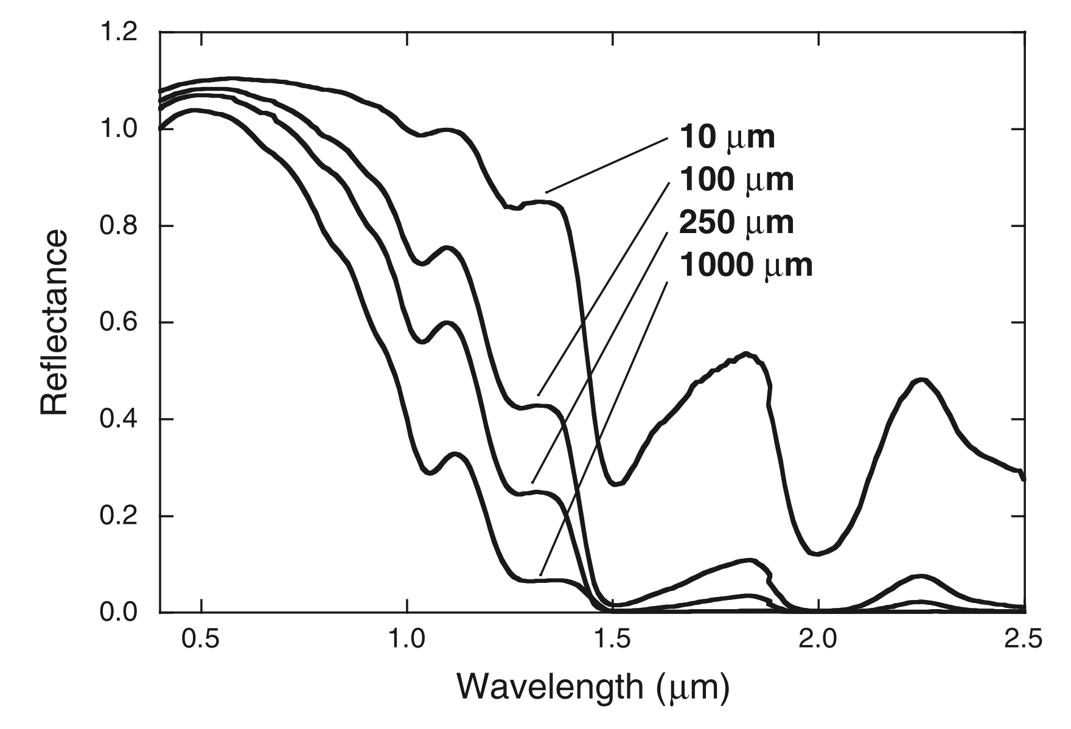
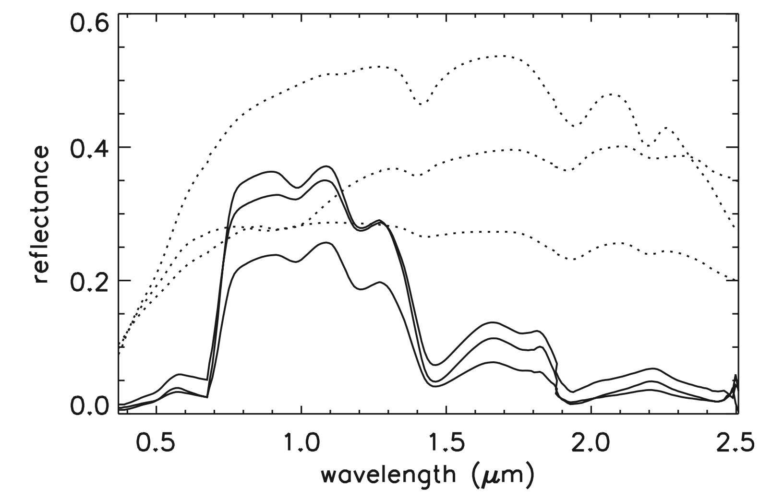
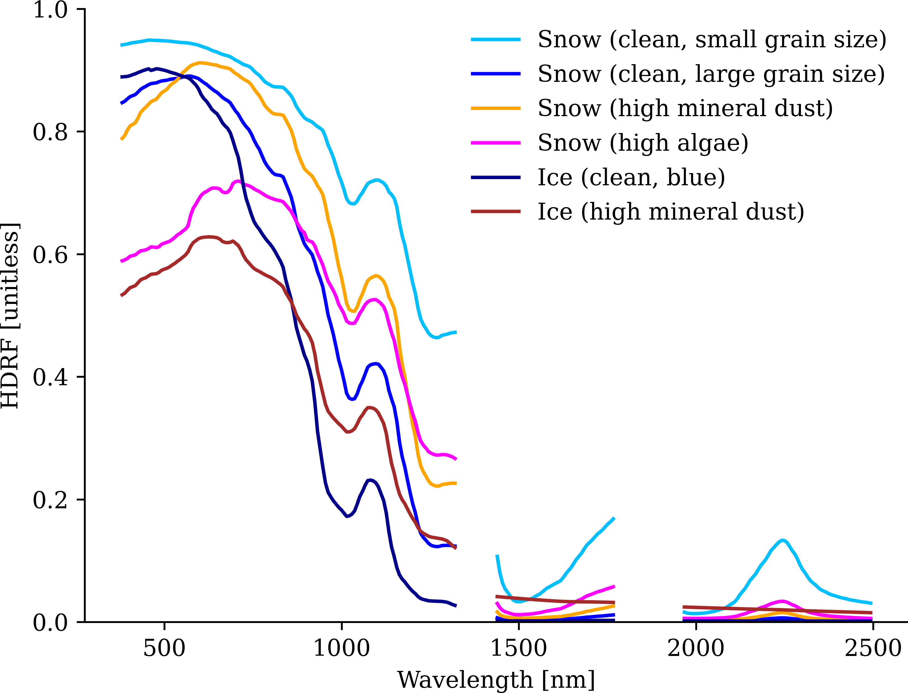
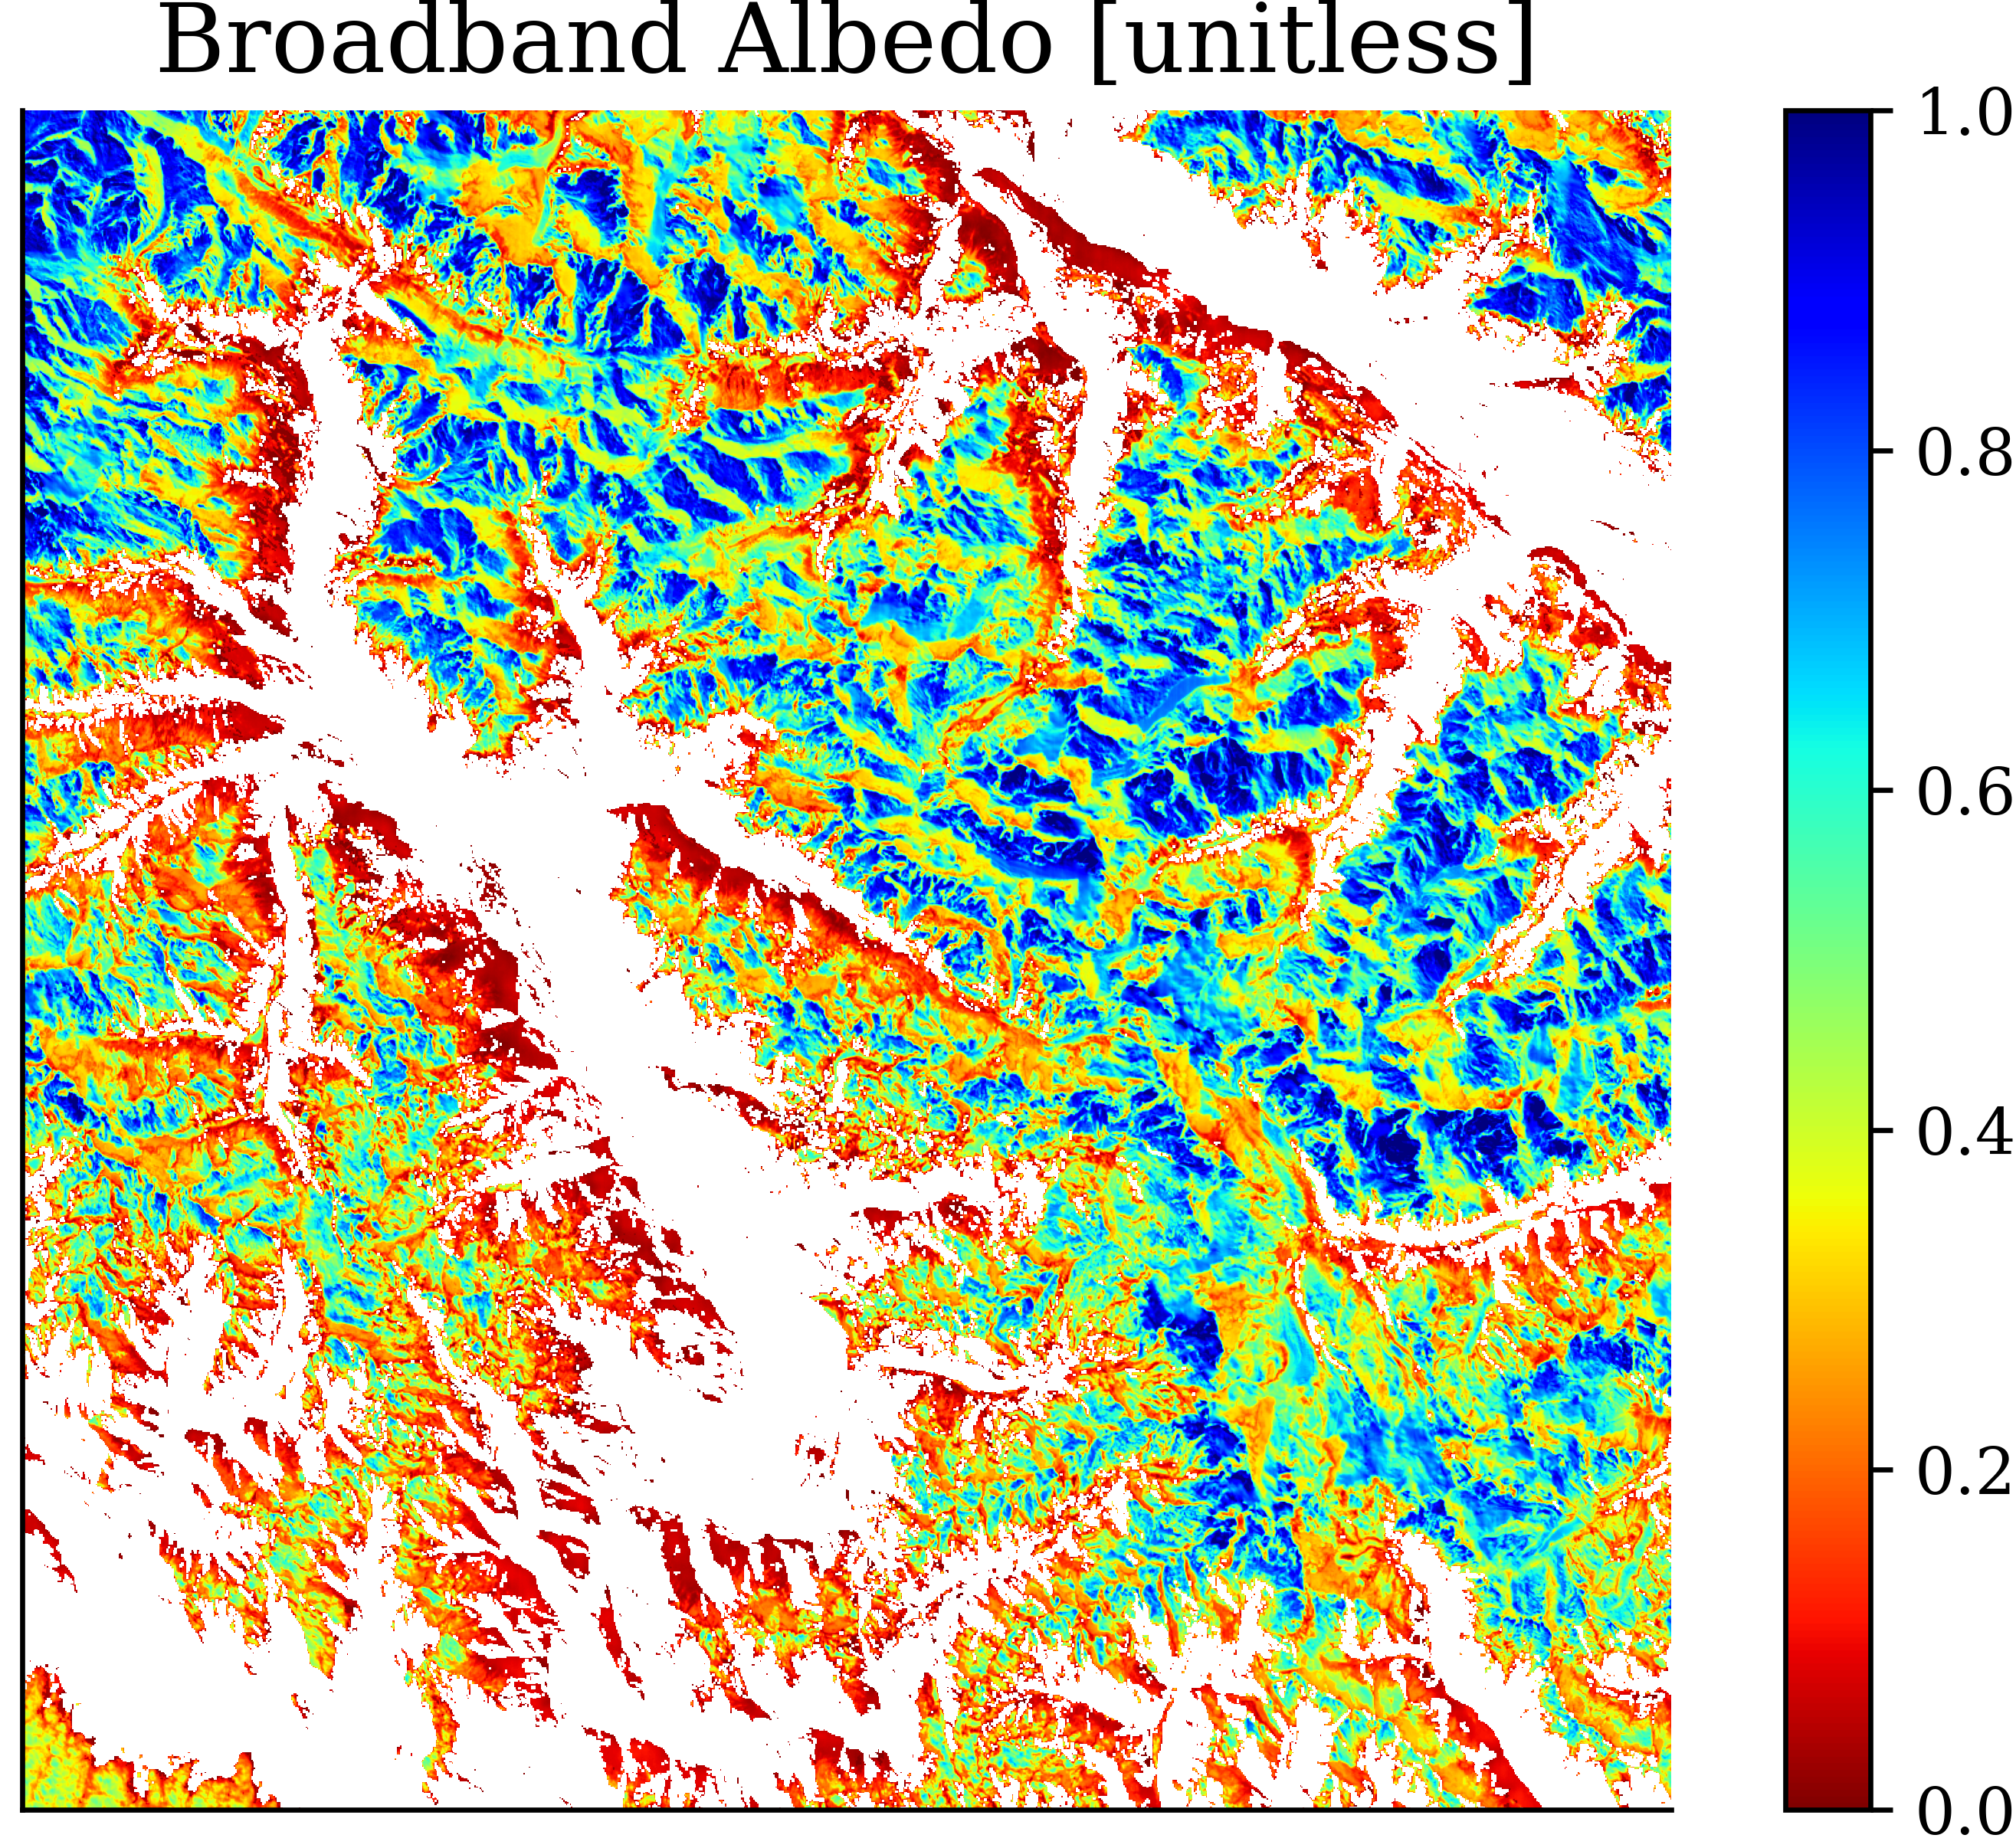
Example Products
Spectral Unmixing
(Painter et al. 2003)
Snow Fraction
Grain Size
Albedo
+ Uncertainty
HDRF
+ Uncertainty

Slide 10
Conclusions
Retrieving albedo (grain size & LAP characteristics) and f_{SCA} must be in concert
Modeling the effect of the terrain—illumination, sky view factor, and multiple re-reflection in topographic hollows—helps
but only if illumination angles and view factors are about correct
and many are badly incorrect, especially in globally available DEMs
so we must be careful about how we consider the terrain
and we must deal with roughness (sub-pixel topography)

Slide 11
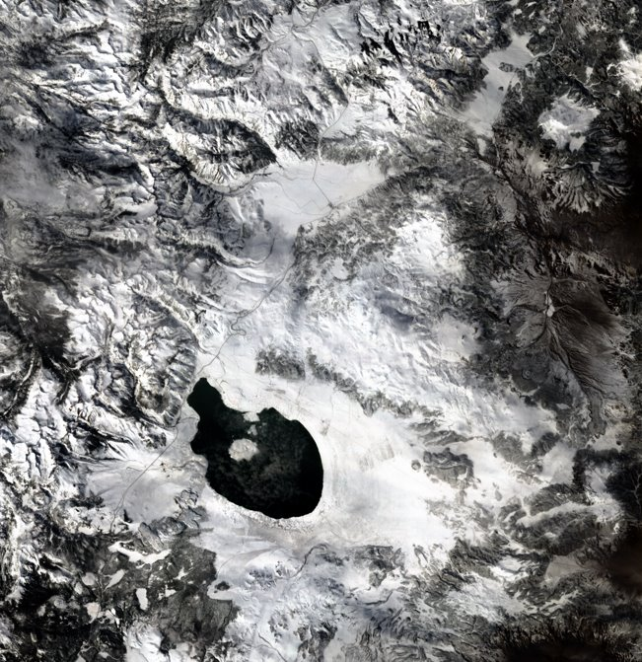
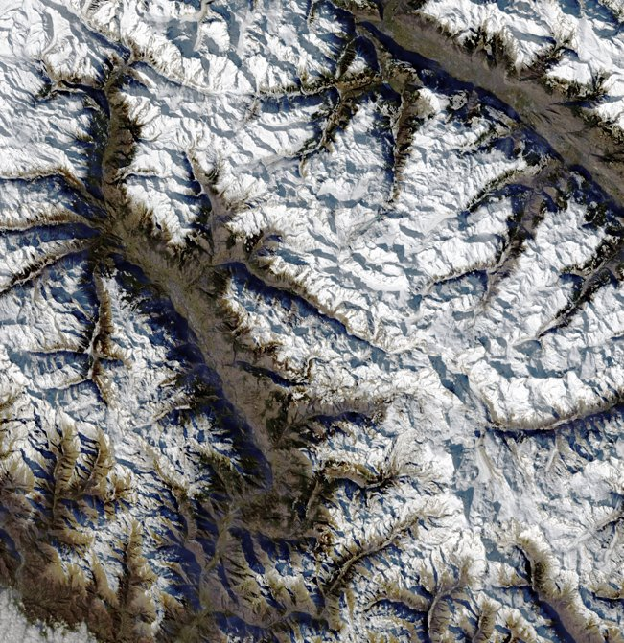
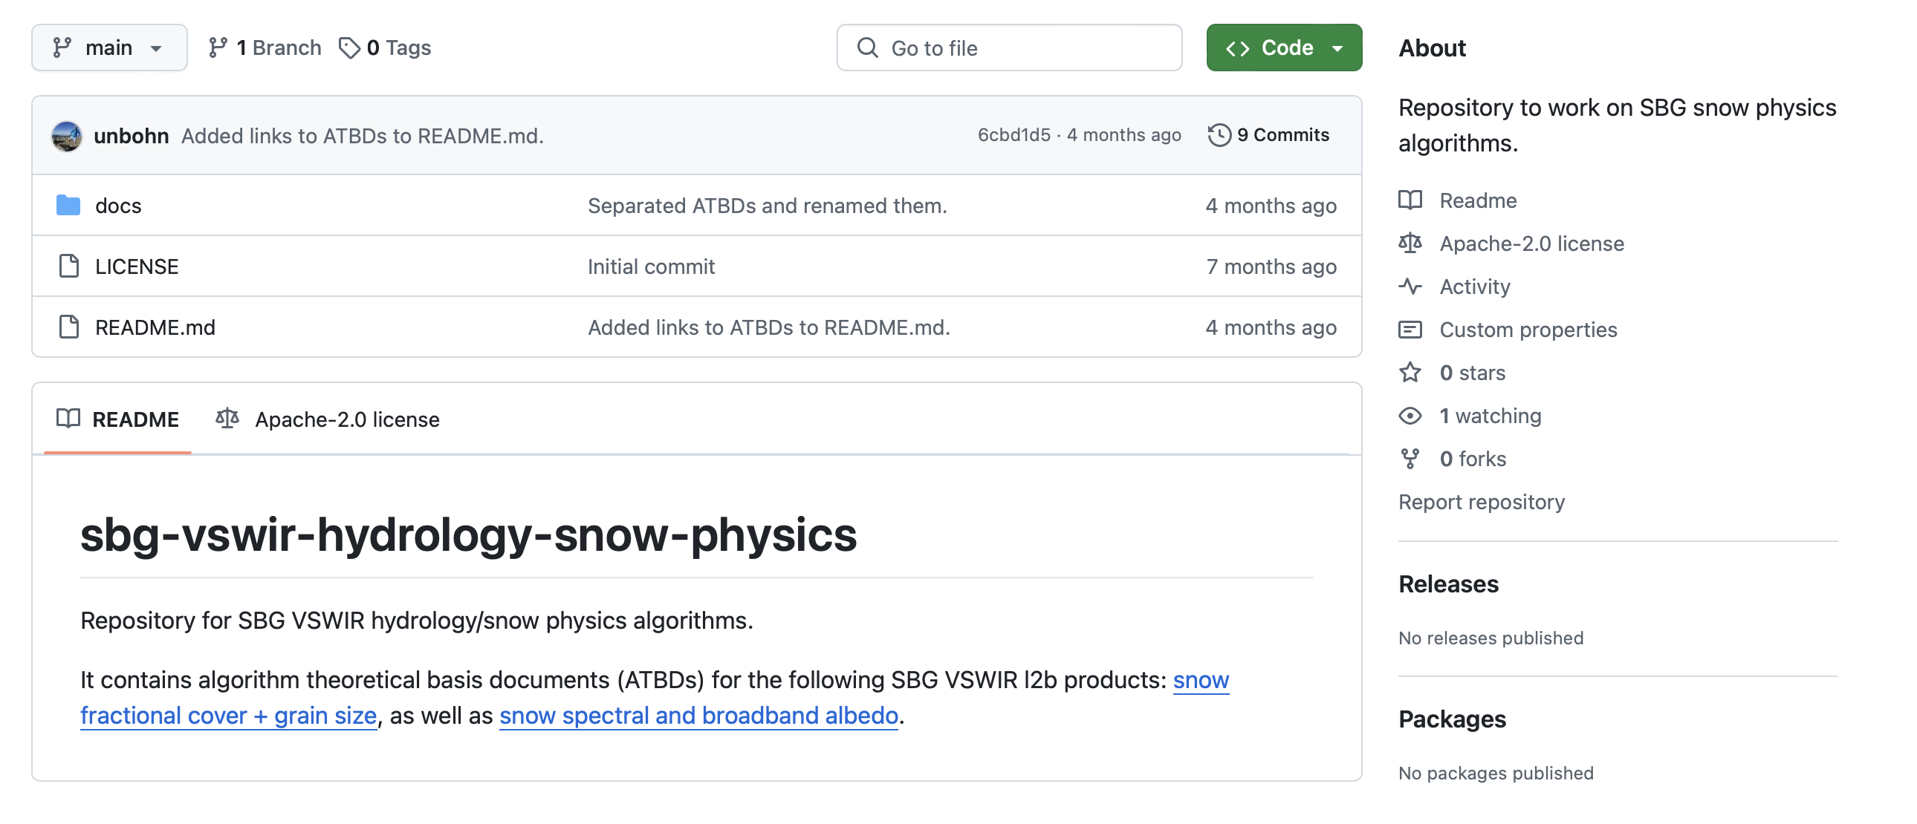
Next Steps
Develop open-source tools, including algorithms and ATBD repositories on GitHub
Work with SBG VSWIR calibration experts on strategy for snow calibration sites
Develop data fusion and UQ strategy
Strengthen connections to Earth Action & Applications
Foster input from community
Connection to NASA snow missions => LiDAR, InSAR technologies
Explore synergies between SBG VSWIR and TIR for snow applications
EMIT Candidate Scenes:
Aosta Valley, Alps (top),
Mono Lake, Sierra Nevada (bottom)

Slide 12
Thank you!
The research was carried out at the Jet Propulsion Laboratory, California Institute of Technology, under a contract with the National Aeronautics and Space Administration (80NM0018D0004).
Reference herein to any specific commercial product, process, or service by trade name, trademark, manufacturer, or otherwise, does not constitute or imply its endorsement by the United States Government or the
Jet Propulsion Laboratory, California Institute of Technology.

