Slide 1
Hyperspectral simulation with the Eradiate radiative transfer model
V. Leroy, S. Schunke, L. Franceschini*, N. Misk, M. Luffarelli, Y. Govaerts
Rayference, Brussels
* Now with OHB

Slide 2
Standard atmospheric profiles: Convenient but outdated
Now ~1900, ~420

Slide 3
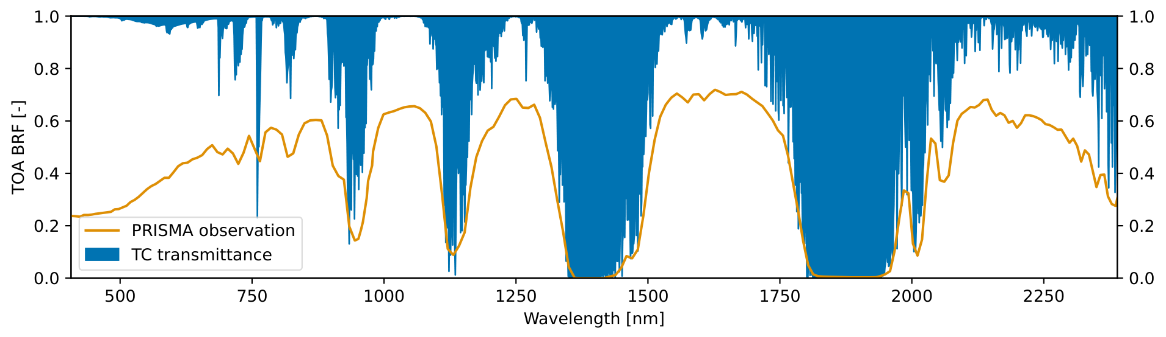
HIS spectral domain
Example of PRISMA observation acquired over CEOS Libya4 PICS on 20 March 2020 (orange) and molecular transmittance (blue) of the AFGL U.S. standard atmosphere
Transmittance [-]
How good are we outside atmospheric windows?

Slide 4
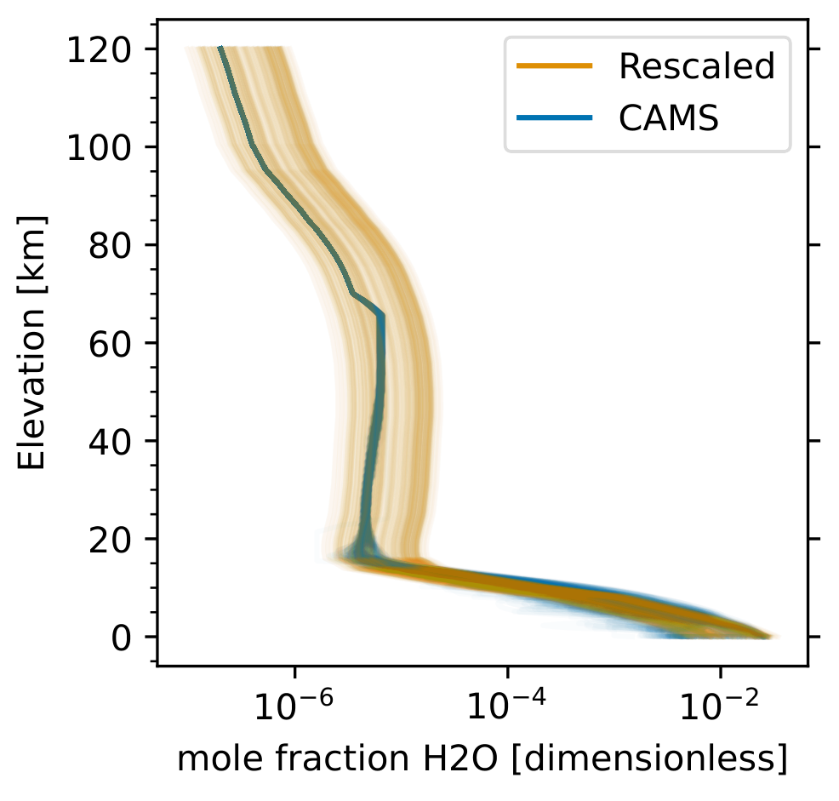
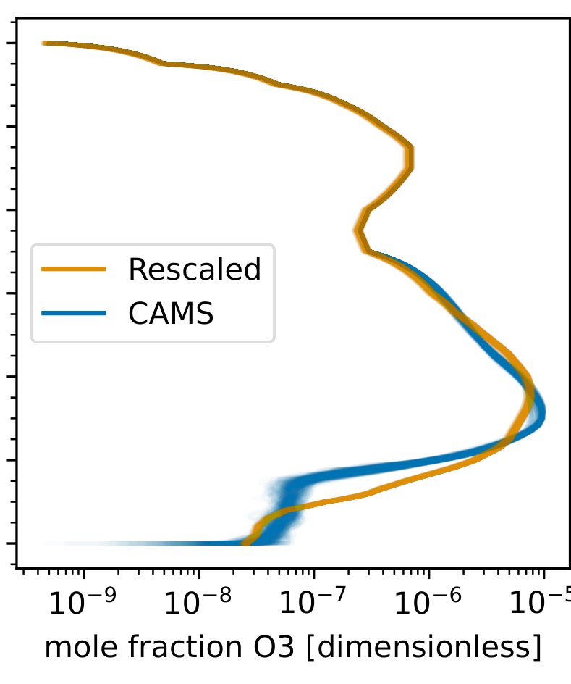
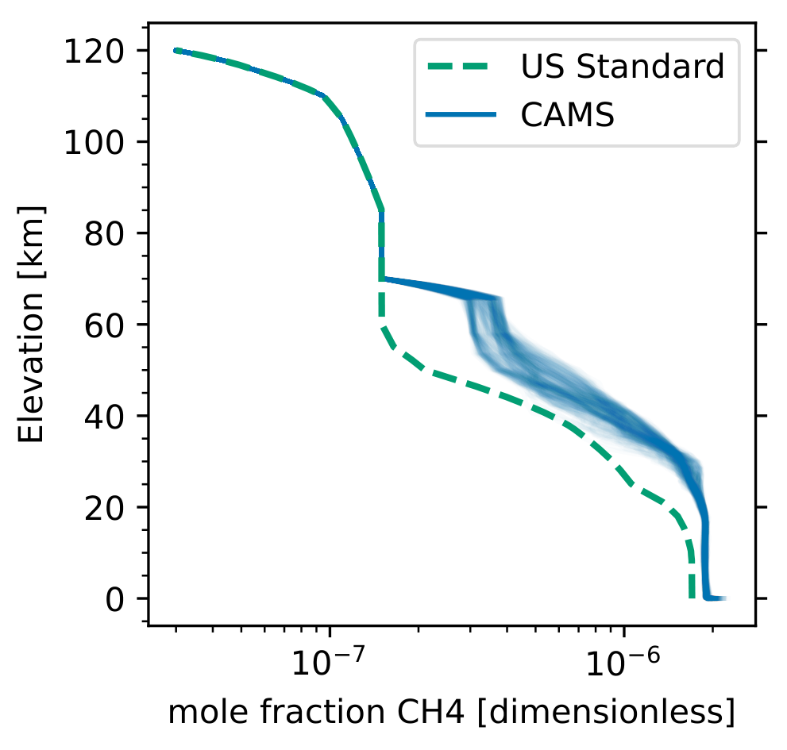
Two approaches to build atmospheric profiles
Conventional: use AFGL US standard profile, rescale total column concentration of H₂O and O₃
Realistic: generate custom profile at the place and time of observation using CAMS reanalysis data
(p, T, x[CO, NO₂, NO, O₃, H₂O, SO₂, N₂O, O₂, CH₄, CO₂])
WATER VAPOUR
OZONE
METHANE

Slide 5
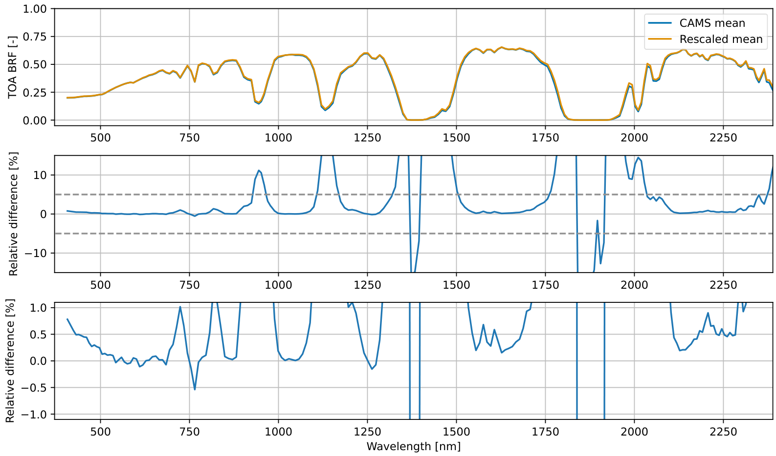
PRISMA observations over Libya-4
Mean value
27 simulations
Mean relative difference
TRUTHS-like uncertainty range

Slide 6
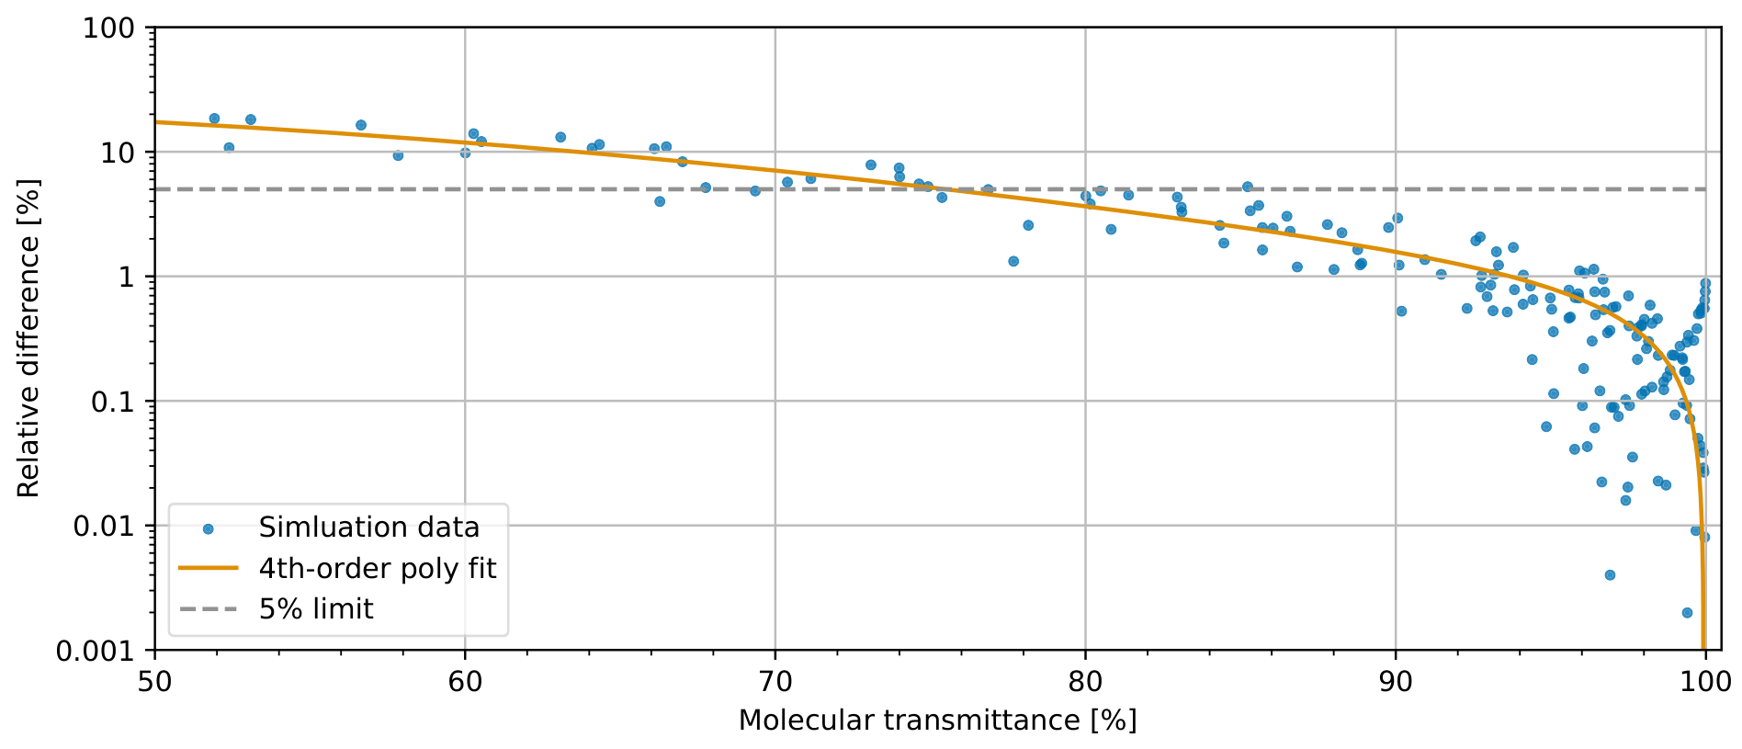
Relative difference versus molecular transmittance
5%
1%
75%
97%

Slide 7
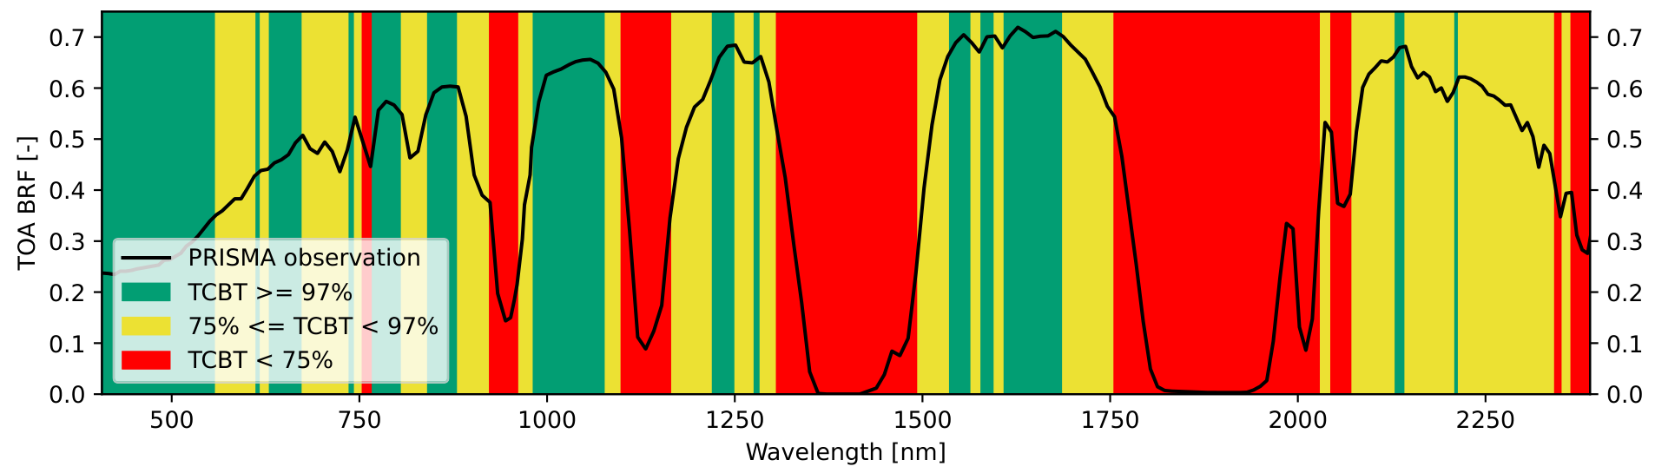
Simulation uncertainty
To secure 1% accuracy, use CAMS profile when total column molecular transmittance < 97%
More in Leroy et al. (2024)
10.1080/22797254.2024.2389798
Uncertainty | Transmittance
< 1% | > 97%
< 5% | [75%, 97%]
> 5% | < 75%
Mean PRISMA TOA BRF values from the 27 observations acquired over Libya-4

Slide 8

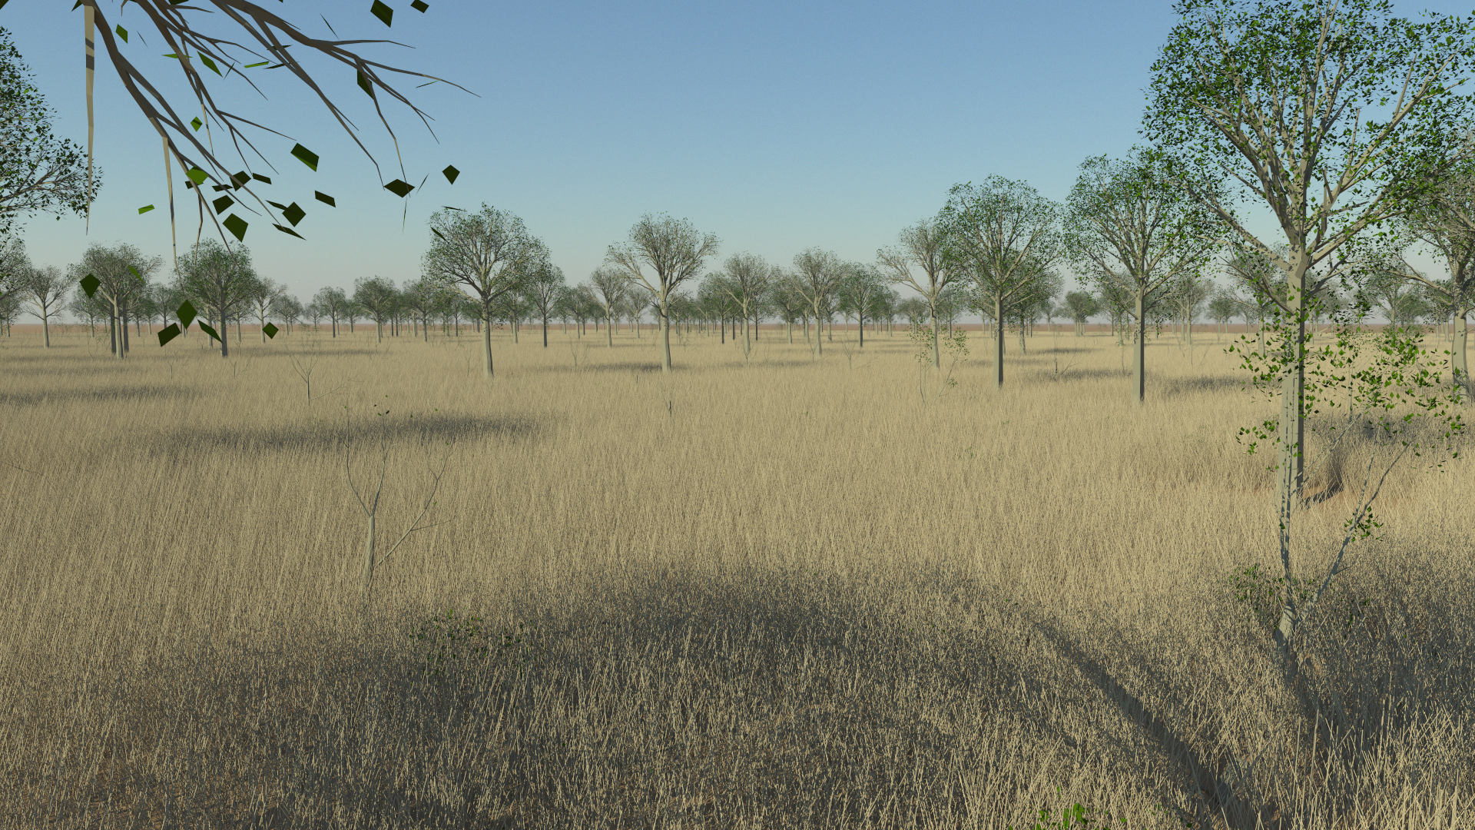
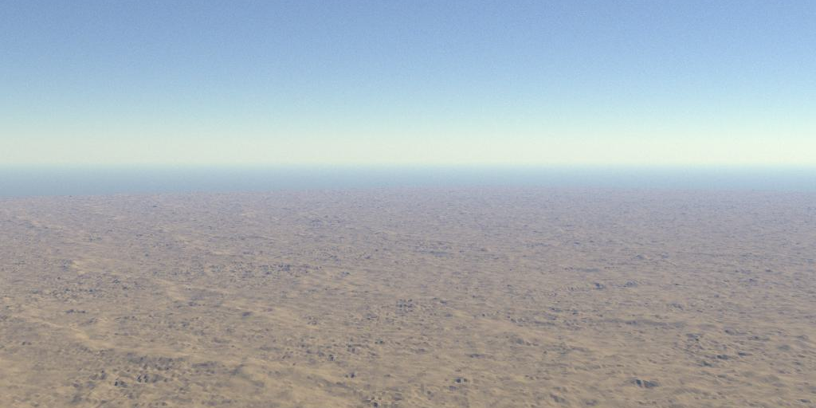
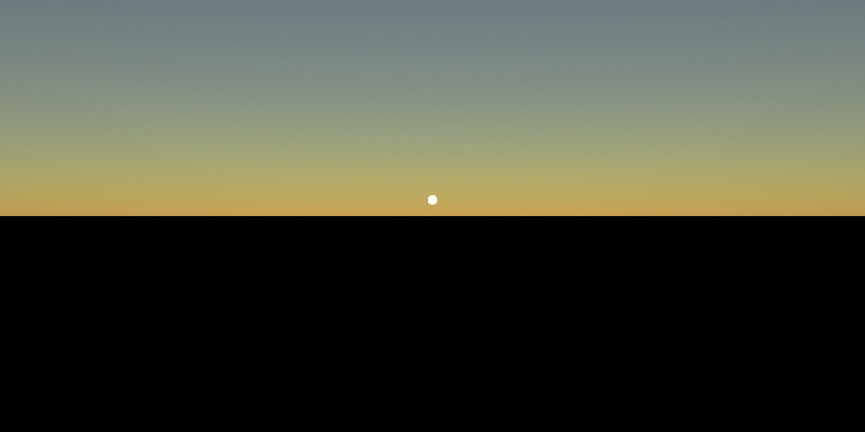
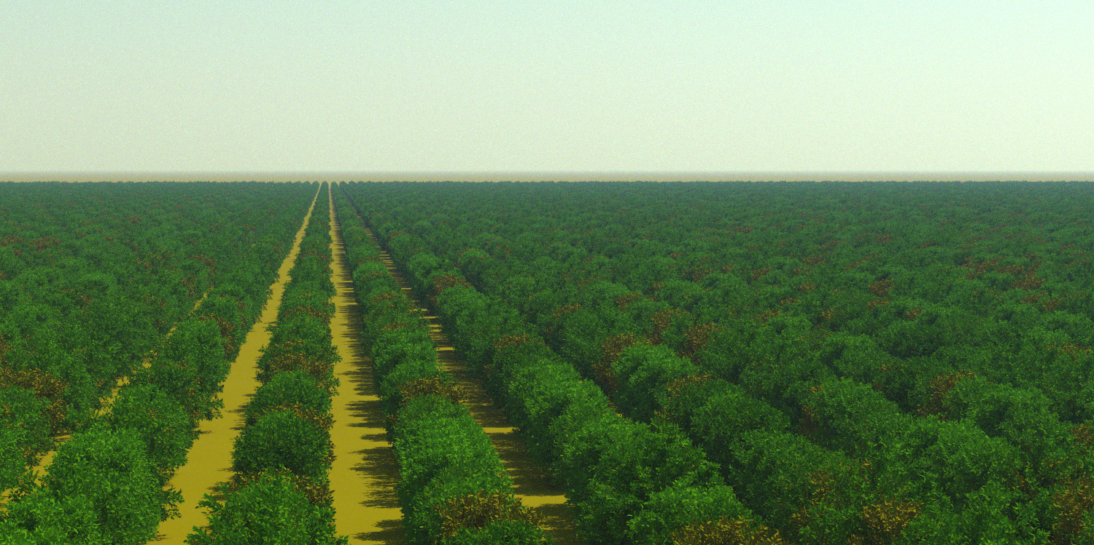
Satellite and in-situ observation simulation
State-of-the-art atmospheric model
Detailed surface modelling
Plane-parallel and spherical-shell geometries
Monte Carlo ray tracing
Designed for cal/val ⇒ highly accurate
Python interface & package
Detailed documentation
Free software (LGPL)
⇒ more on eradiate.eu

Slide 9
How close are different projects on implementing FAIR data? What aspect is the most difficult? What projects are implementing standardization?
—
What are challenges to open science in cal/val, algorithm development, and science and applications use spaces? What are potential improvements?
RTM maintenance and availability is an issue (either closed-source, hard to find, unguaranteed maintenance)

