Slide 1
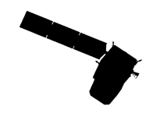


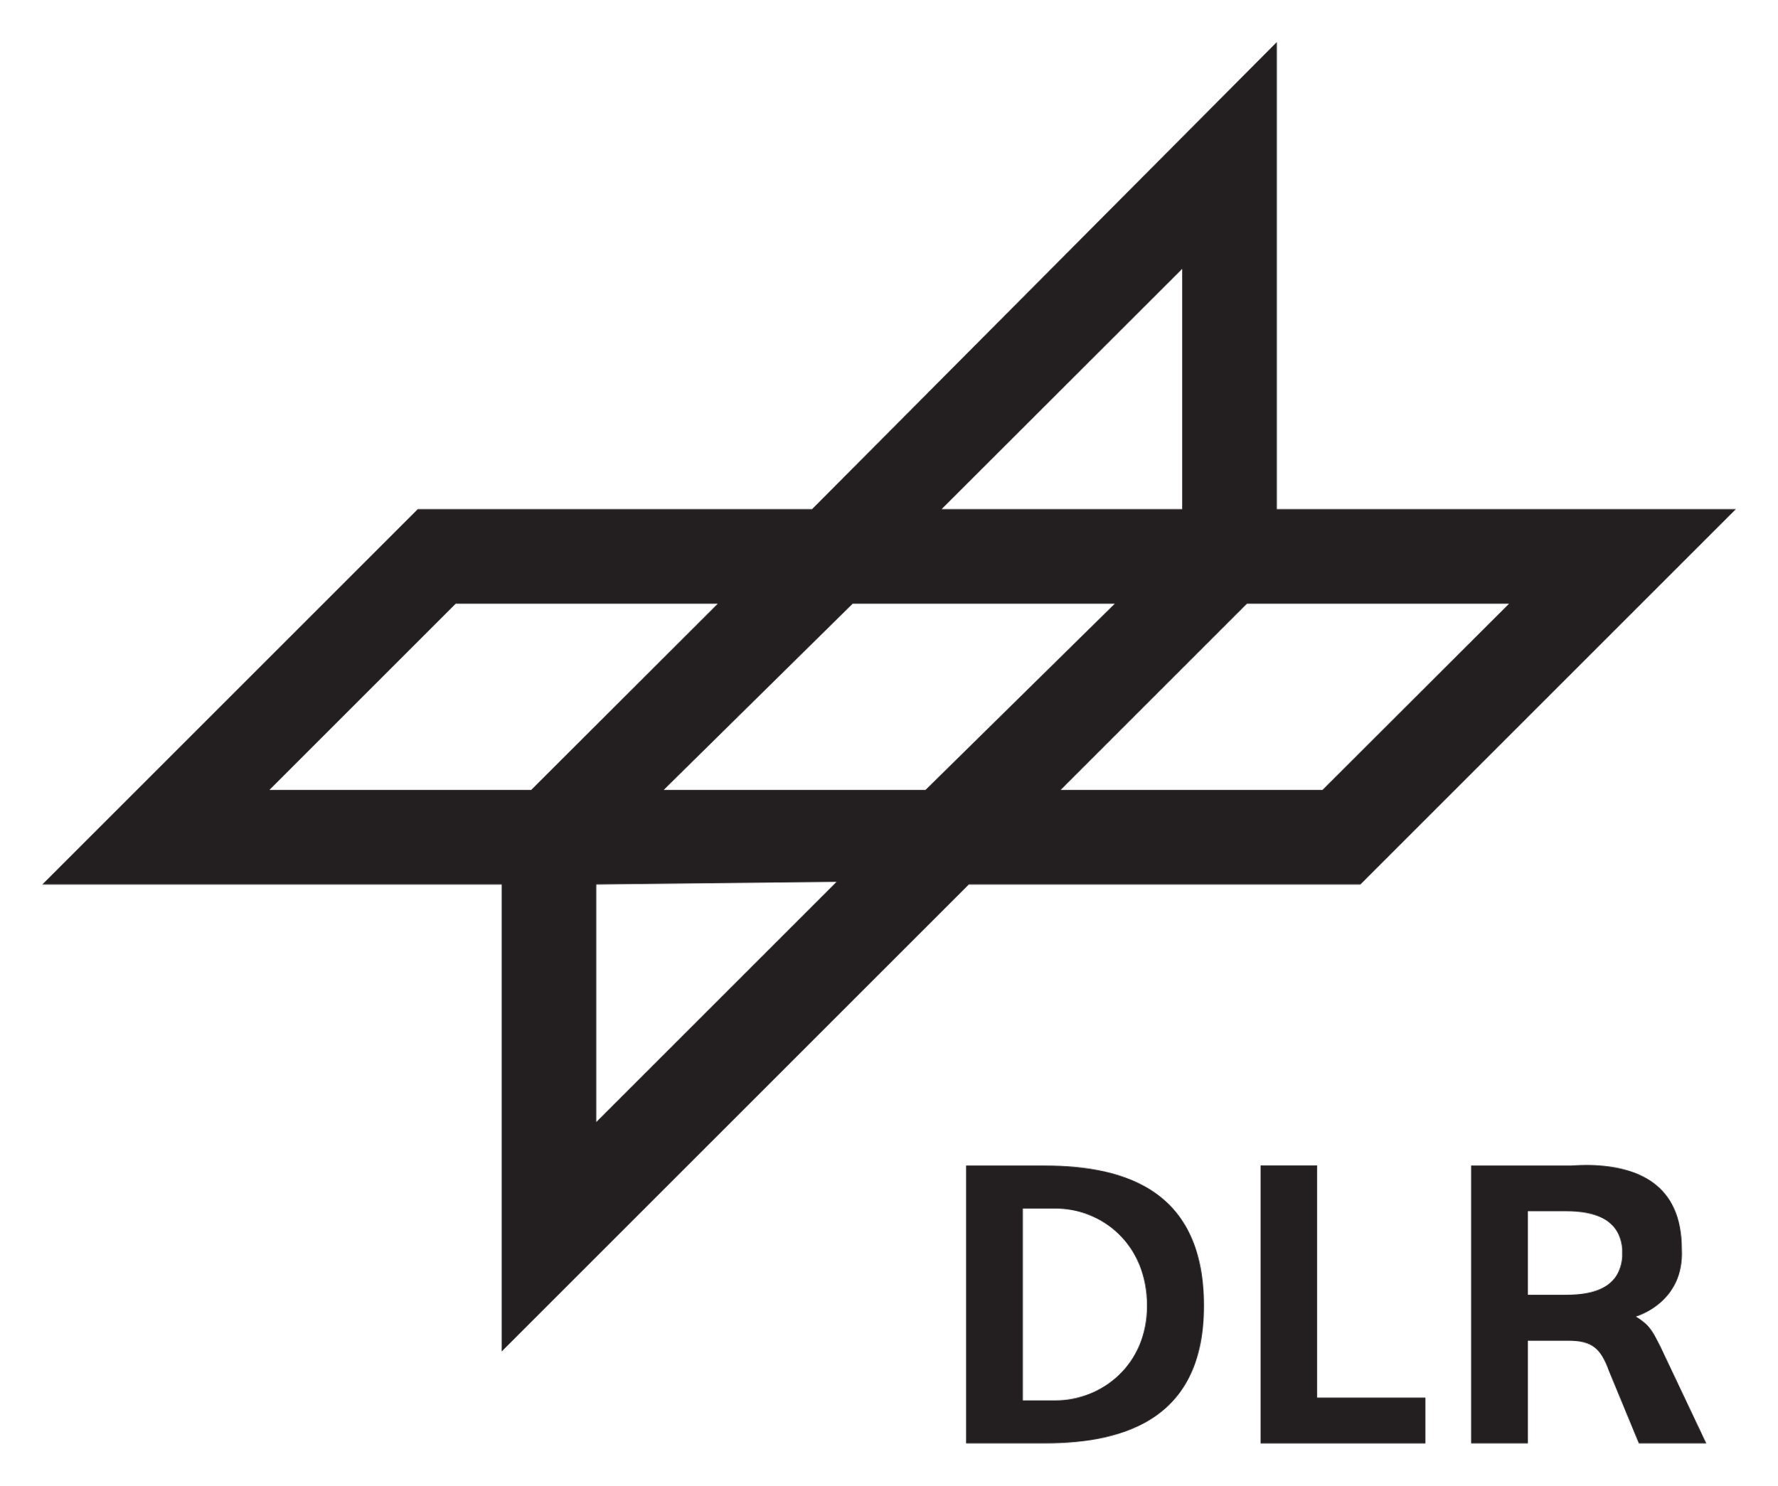


Coordinating Level-2 Reflectance Products Across Imaging Spectroscopy Missions
David R. Thompson¹, Valentina Boccia², Luigi Agrimano³, Kevin Alonso², Urs Niklas Bohn¹, Philip G. Brodrick¹, Marco Celesti², Raquel De Los Reyes⁴, Vito De Pasquale³, Regina Eckert¹, Ferran Gascon², Andreas Hüni⁵, Ray Kokaly⁶, Jerome Louis⁷, Francesca Santoro³, Kurtis Thome⁸, Philip Townsend⁹, Michael Werfeli⁵
¹ Jet Propulsion Laboratory, California Institute of Technology
² European Space Agency
³ Planetek Italia
⁴ DLR Earth Observation Center
⁵ University of Zurich
⁶ United States Geological Survey
⁷ Telespazio, France
⁸ NASA Goddard Space Flight Center
⁹ University of Wisconsin, Madison
Instrument
Scattering
Atmosphere
Absorption
Reflection
Surface
Notes:
SBG is good to go and address the next levels of detail. The team has developed have a feasible solution that would deploy state-of-the-art technology that is however, at TRL 6thanks to past NASA investments. The community had reviewed and concurs with the level of performance this system can provide, and is strongly behind the envisioned geophysical products. As you’ll see, some of this system’s deficiencies in revisit can be mitigated by NASA’s leadership in international data harmonization and sharing.

Slide 2
The challenge
Instrument
Scattering
Atmosphere
Absorption
Reflection
Surface

Slide 3
The importance of L2a harmonization
L2a is foundational: It is necessary for downstream processing attempting to measure Earth surface properties.
Harmonization is useful for CHIME/SBG-VSWIR: One can improve the sampling frequency by combining data from both missions.
There is no single gold standard solution: There are lots of reasonable options, so we must balance consistency with a need to experiment.
Results can be sensitive to changes: Different modeling assumptions can create differences far in excess of instrument noise.

Slide 4
State vector
Forward model
Measurement
4

Slide 5
Measurement
Inversion
Estimated state

Slide 6
Some guiding principles
Differences in product definition are to be avoided, as they prevent interoperability
Differences in forward modeling and/or inversion approaches are inevitable, and do not prevent interoperability with appropriate uncertainty accounting.

Slide 7
What do we mean by “surface reflectance?”
Is the reflectance of a virtual surface at ground height oriented parallel to the geoid, or
… a terrain facet relative to a Digital Elevation Model?
Is it the Hemispherical Directional Reflectance Factor defined at the observation geometry, or
… simulated for a different geometry?
Is it Remote Sensing Reflectance (Rrs.)?
What strategy is used for geolocalization?

Slide 8
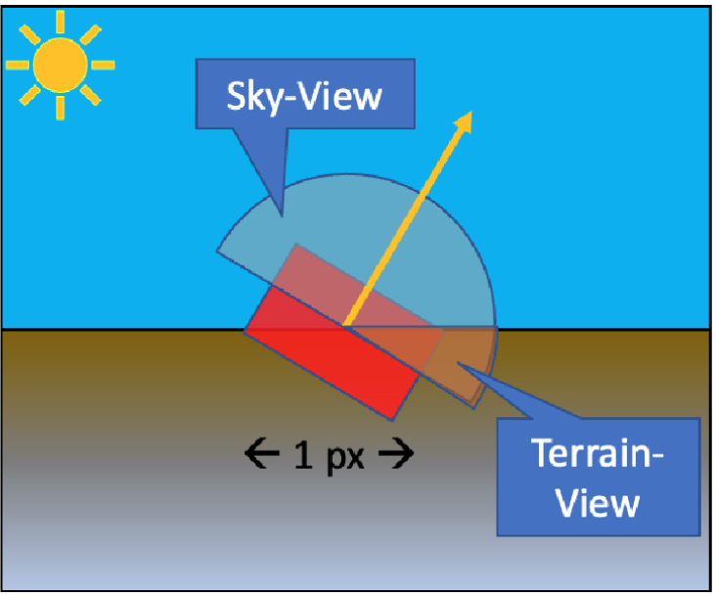
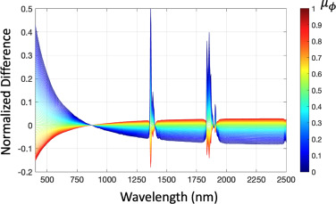
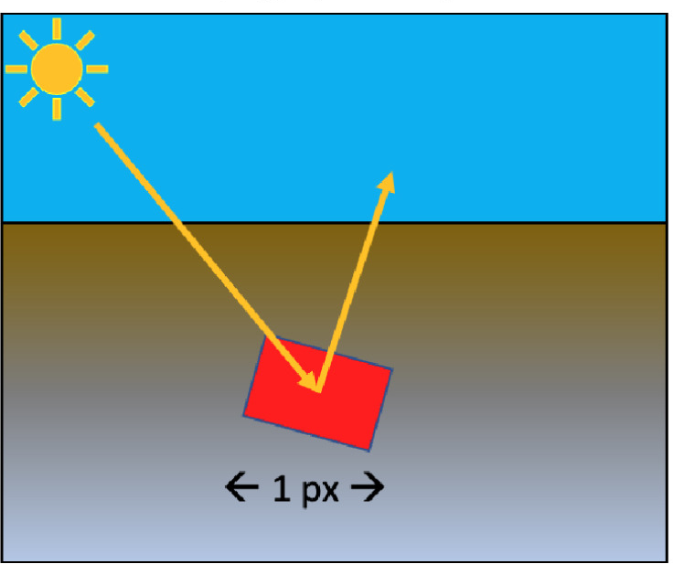
Topographic effects
Carmon et al., “Shape from Spectra”, RSE 2023

Slide 9
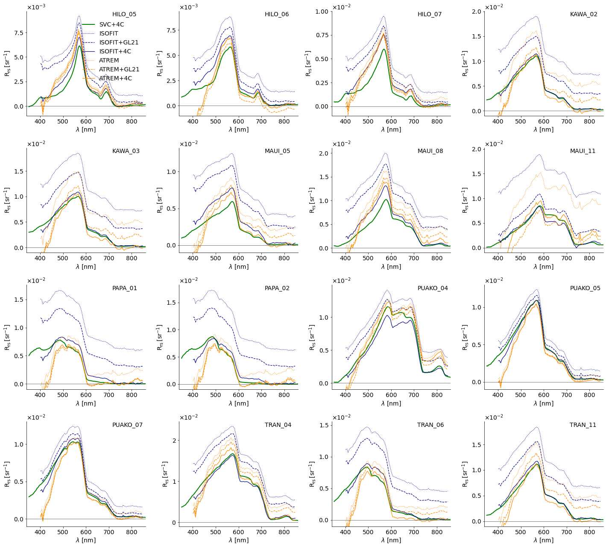
Glint removal is key for aquatic observations
Marcel König et al., in review
11/13/24

Slide 10
Provisional parameters for CHIME and SBG-VSWIR
Parameter | CHIME | SBG-VSWIR
Surface definition | Topography-relative | Topography-relative
Digital Elevation Model | Copernicus DEM* | Copernicus DEM*
Ortho basemap | Sentinel-2 GRI | Sentinel-2 GRI
BRDF Correction Applied | Capability will exist | In higher level (L2B+) products
Radiative Transfer Model | LibRadTran*, ERADIATE* | MODTRAN 6.0*, PCRTM, vSmartMOM, or sRTMNet
Glint model | Gege variant* | Gege variant*
Solar Irradiance Model | TSIS* | TSIS*
Aerosol Parameters | AOD, Angstrom Exponent* | AOD, Angstrom Exponent*
Masks | CEOS ARD & Sentinel-2 list | Water, Cloud, Cloud shadow, cloud adjacency. Snow, vegetation, soil, etc. at L2B+
Table 1: Table of reflectance algorithm parameters. Items in bold affect the definition of the target physical quantity being measured, making them the most important areas for coordination. Asterisks (*) indicate answers still to be confirmed.

Slide 11
Seed questions
How does your work contribute to improving harmonization? Aligning key product definitions, and to the extent possible forward model assumptions.
What aspect of harmonization can most benefit users? Definitions are critical. Rigorous uncertainty quantification is needed to combine multimission data products in a principled way.
At what level of processing is harmonization most necessary (L1B, L1C, L2A, L2B+, L3/L4)? Lower level products, but L2A may be the most challenging from a practical perspective because of the plurality of approaches and definitions.
What is more important, the harmonization on data formats or the harmonization on information content of the products? Information content is most important, since formatting is relatively easy to change on the user side.

Slide 12
Backup

Slide 13
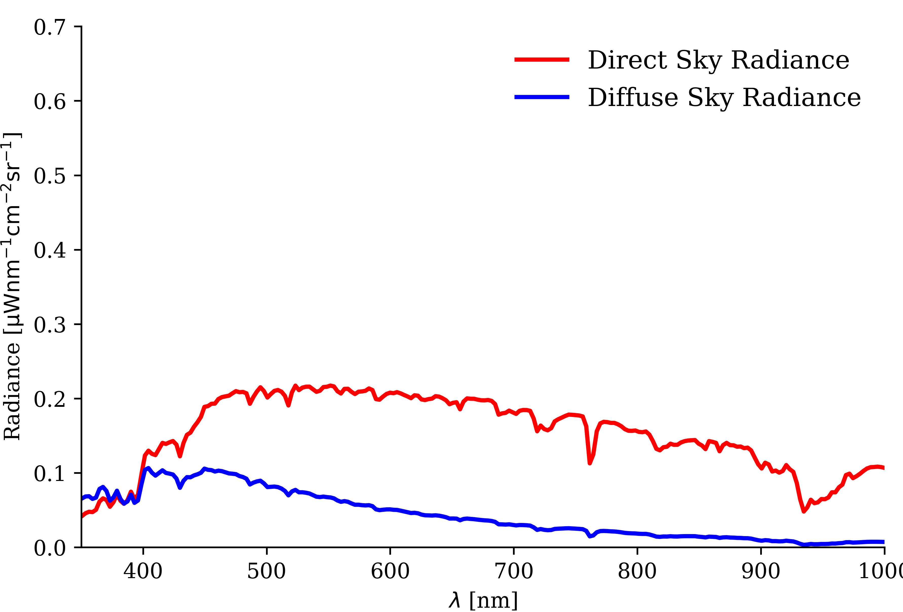
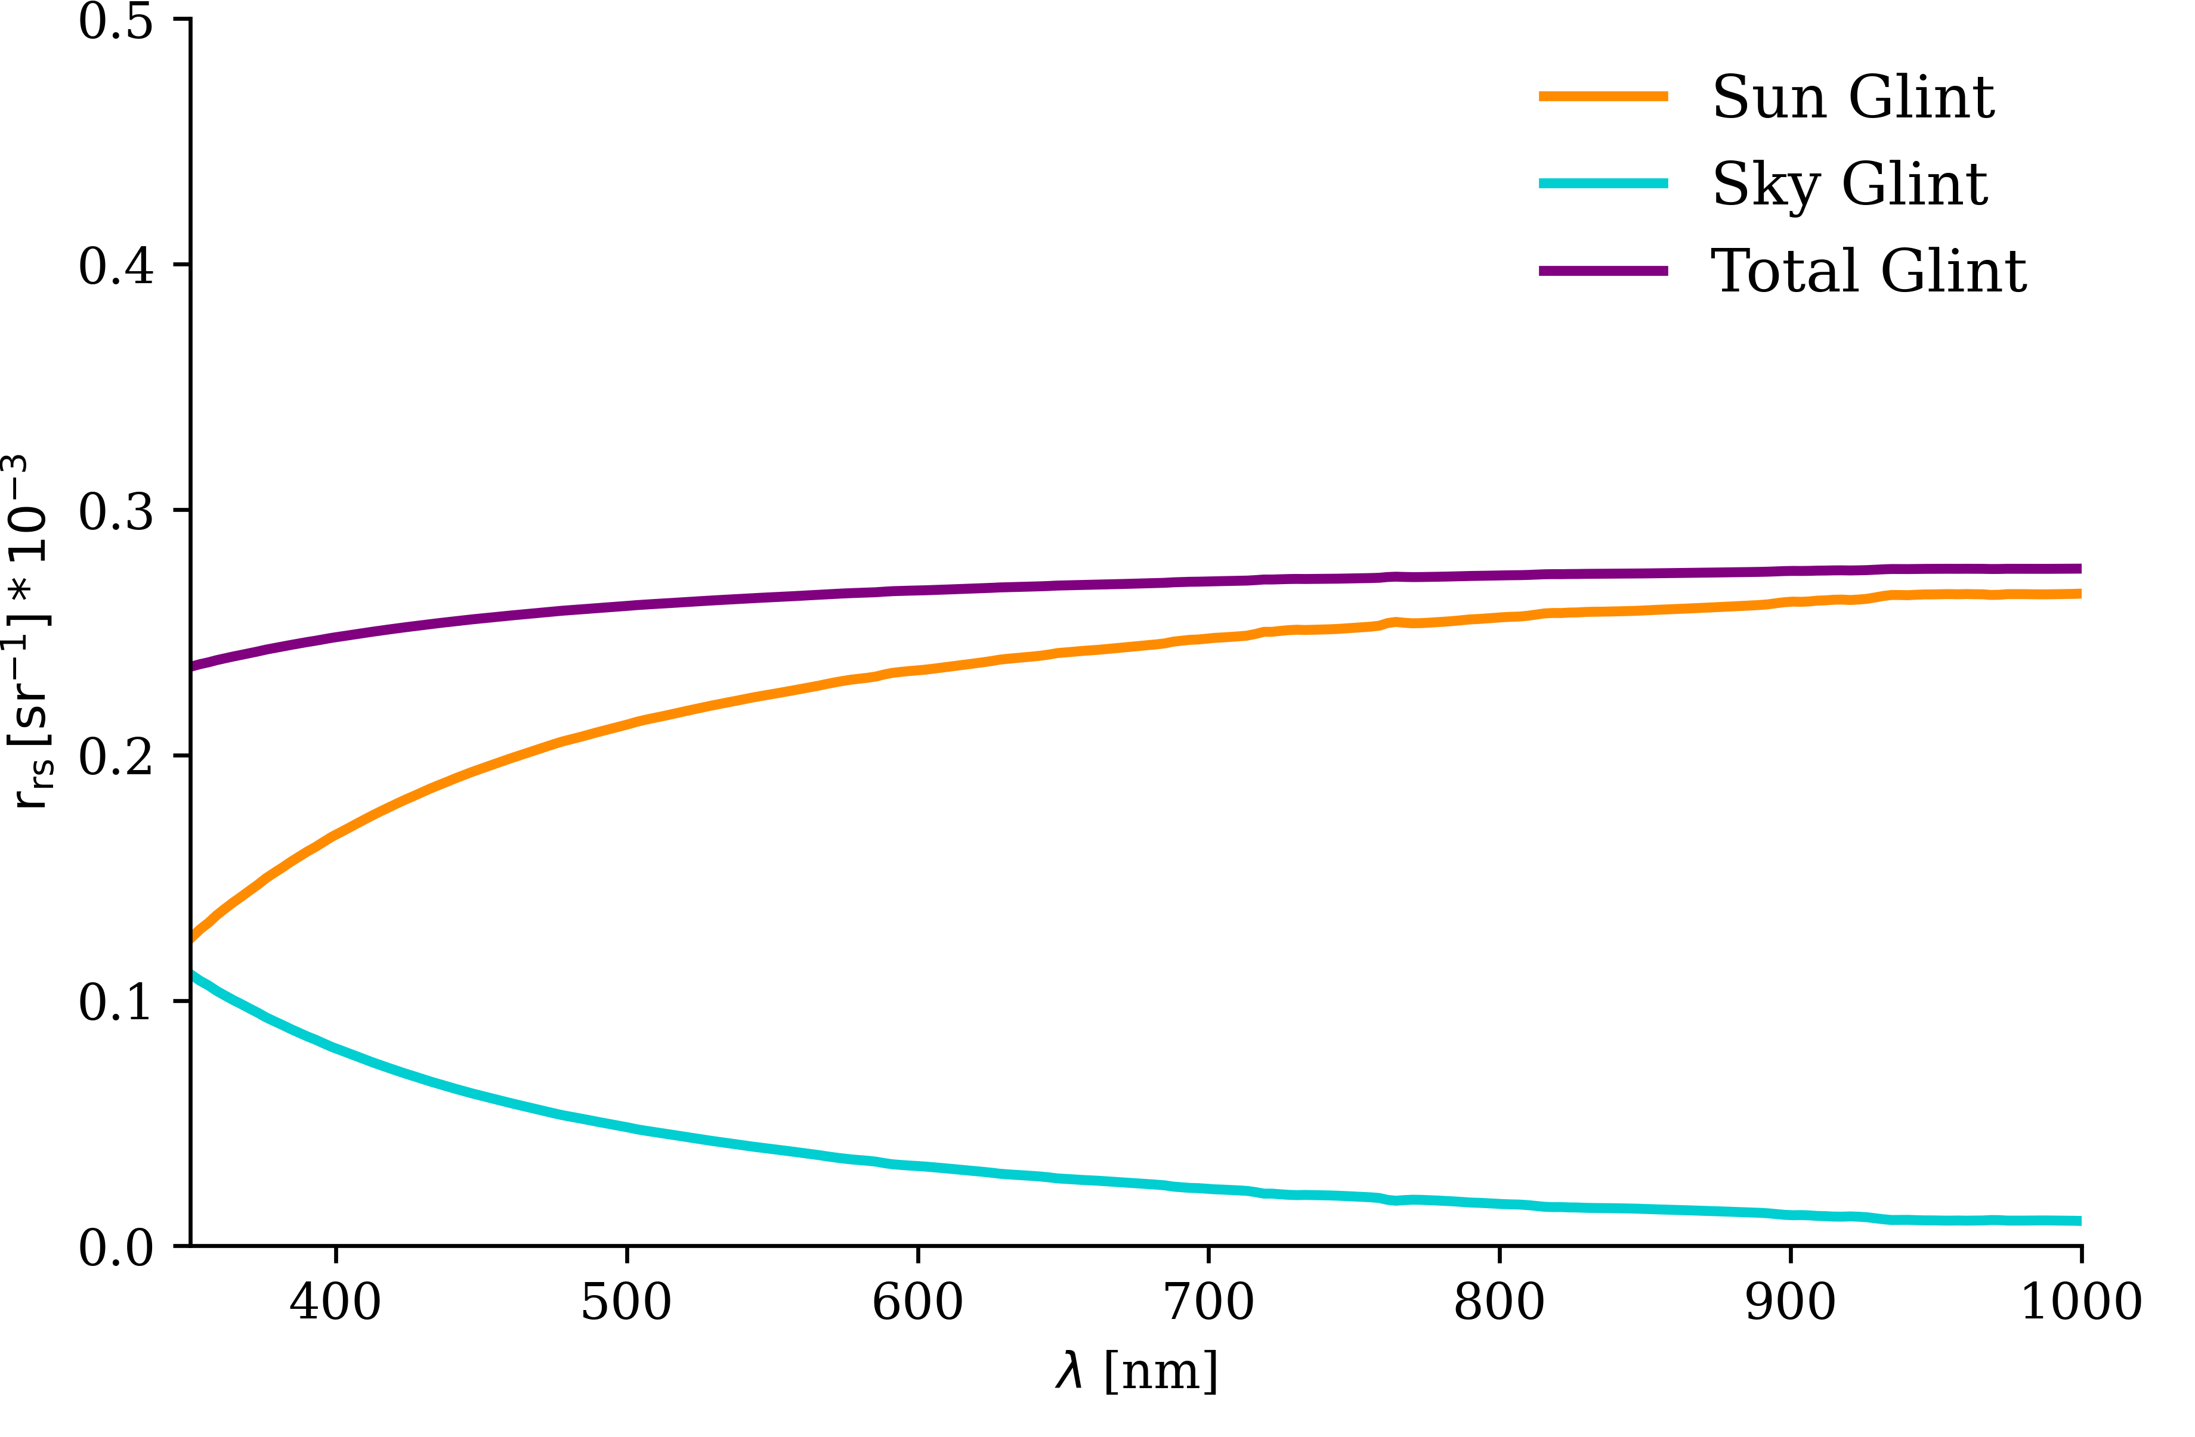
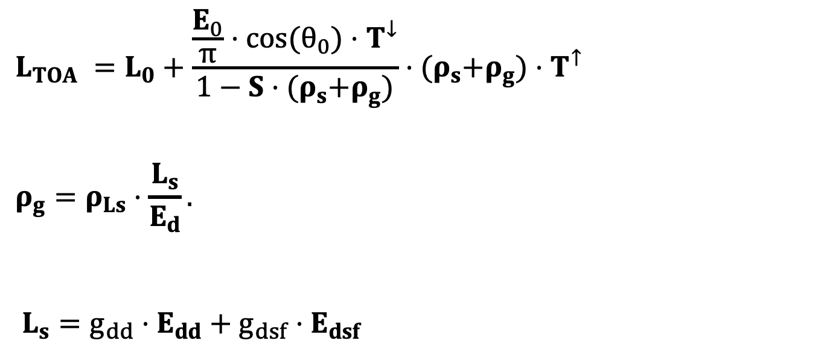
New sunglint & skyglint model
Courtesy Niklas Bohn, Marcel König, and others
$$L_{TOA} =L_{0}+\frac{\frac{E_{0}}{π}⋅cos(θ_{0})⋅T^{↓}}{1−S⋅{(ρ}_{s}+ρ_{g})}⋅{(ρ}_{s}+ρ_{g})⋅T^{↑}$$
$$ρ_{g}=ρ_{Ls}⋅\frac{L_{s}}{E_{d}}.$$
$$L_{s}=g_{dd}⋅E_{dd}+g_{dsf}⋅E_{dsf}$$

Slide 14
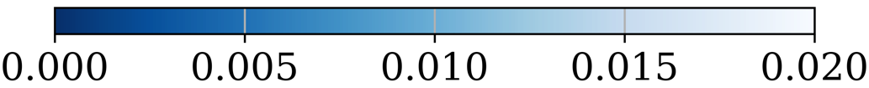
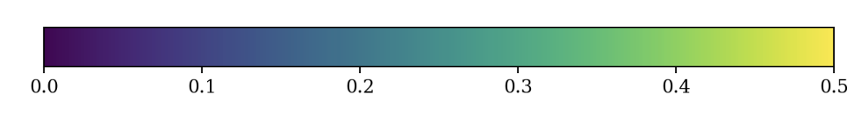
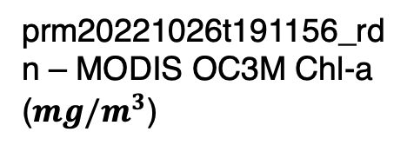
prm20221026t191156_rfl – NIR reflectance @ 801 nm (no glint correction)
prm20221026t191156_rfl – NIR reflectance @ 801 nm (glint correction)
prm20221026t191156_rdn – MODIS OC3M Chl-a ($mg/m^{3}$)

Slide 15
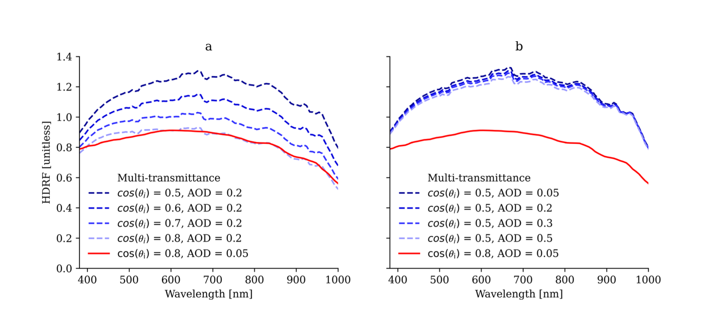
Impact of topography on snow observations
Bohn et al., in review

Slide 16
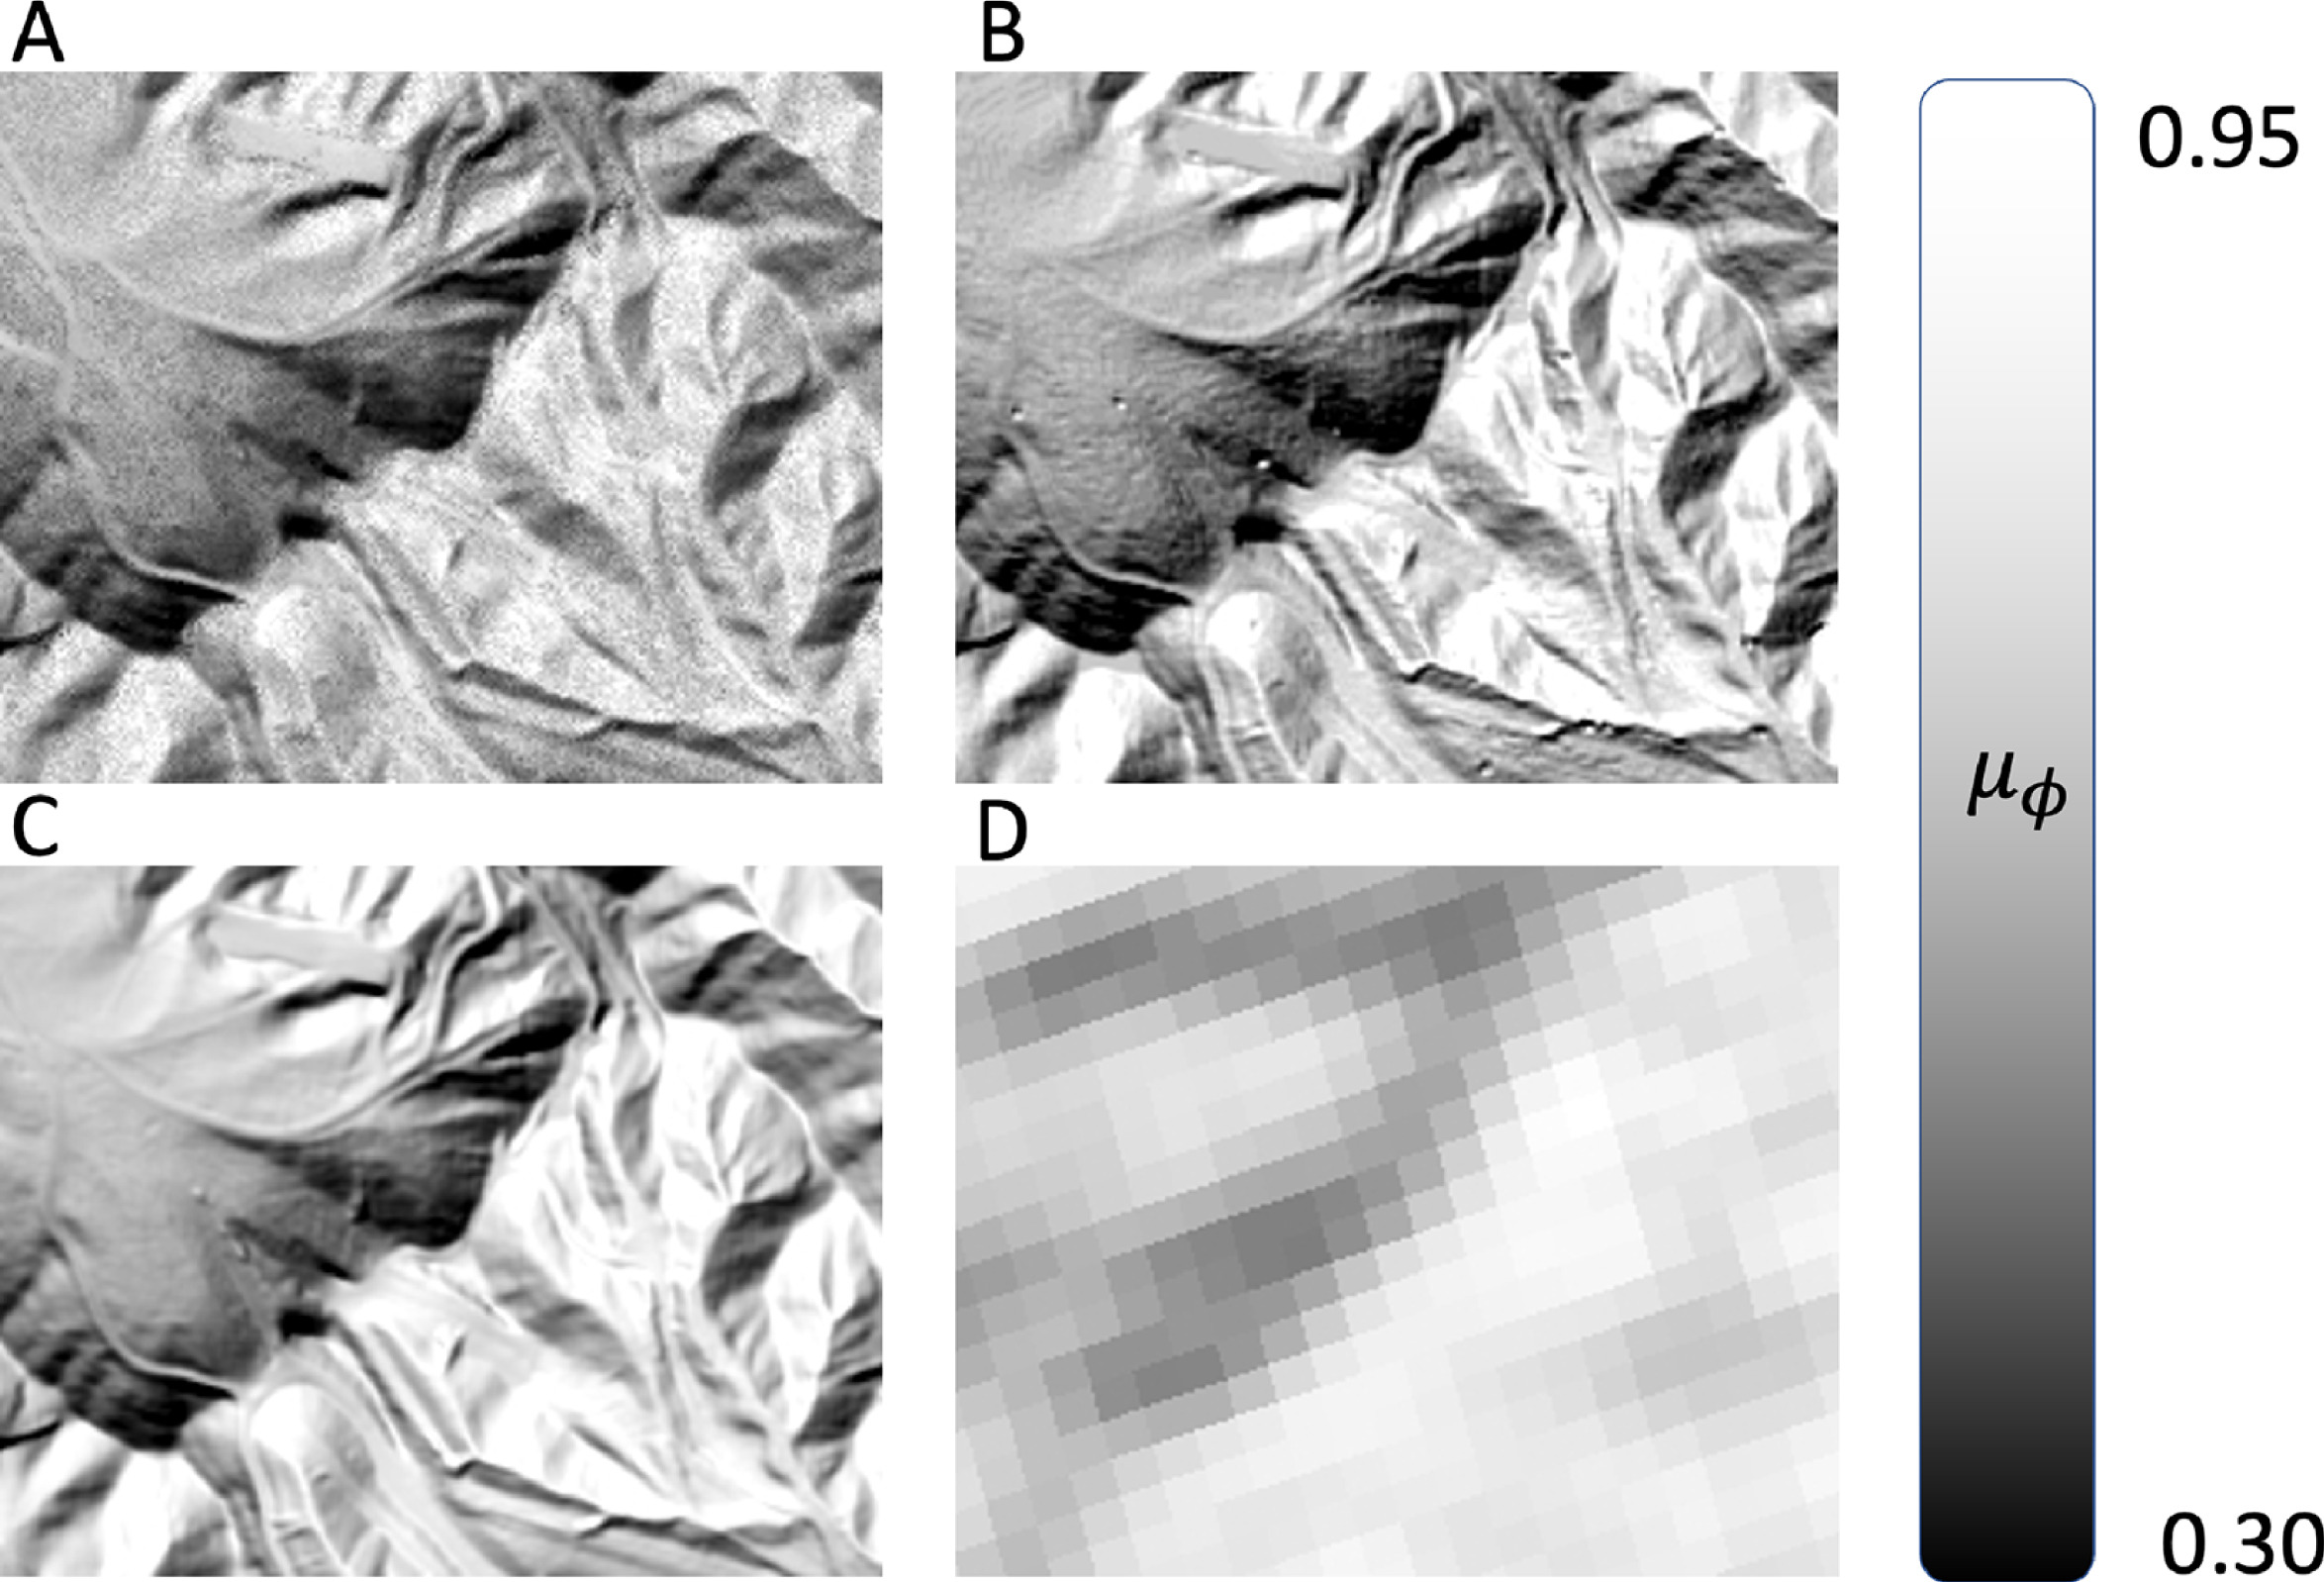
Retrieval of topography parameters
Radiance-derived
Lidar DSM
Carmon et al., RSE 2023
Lidar DEM
NASA DEM

Slide 17
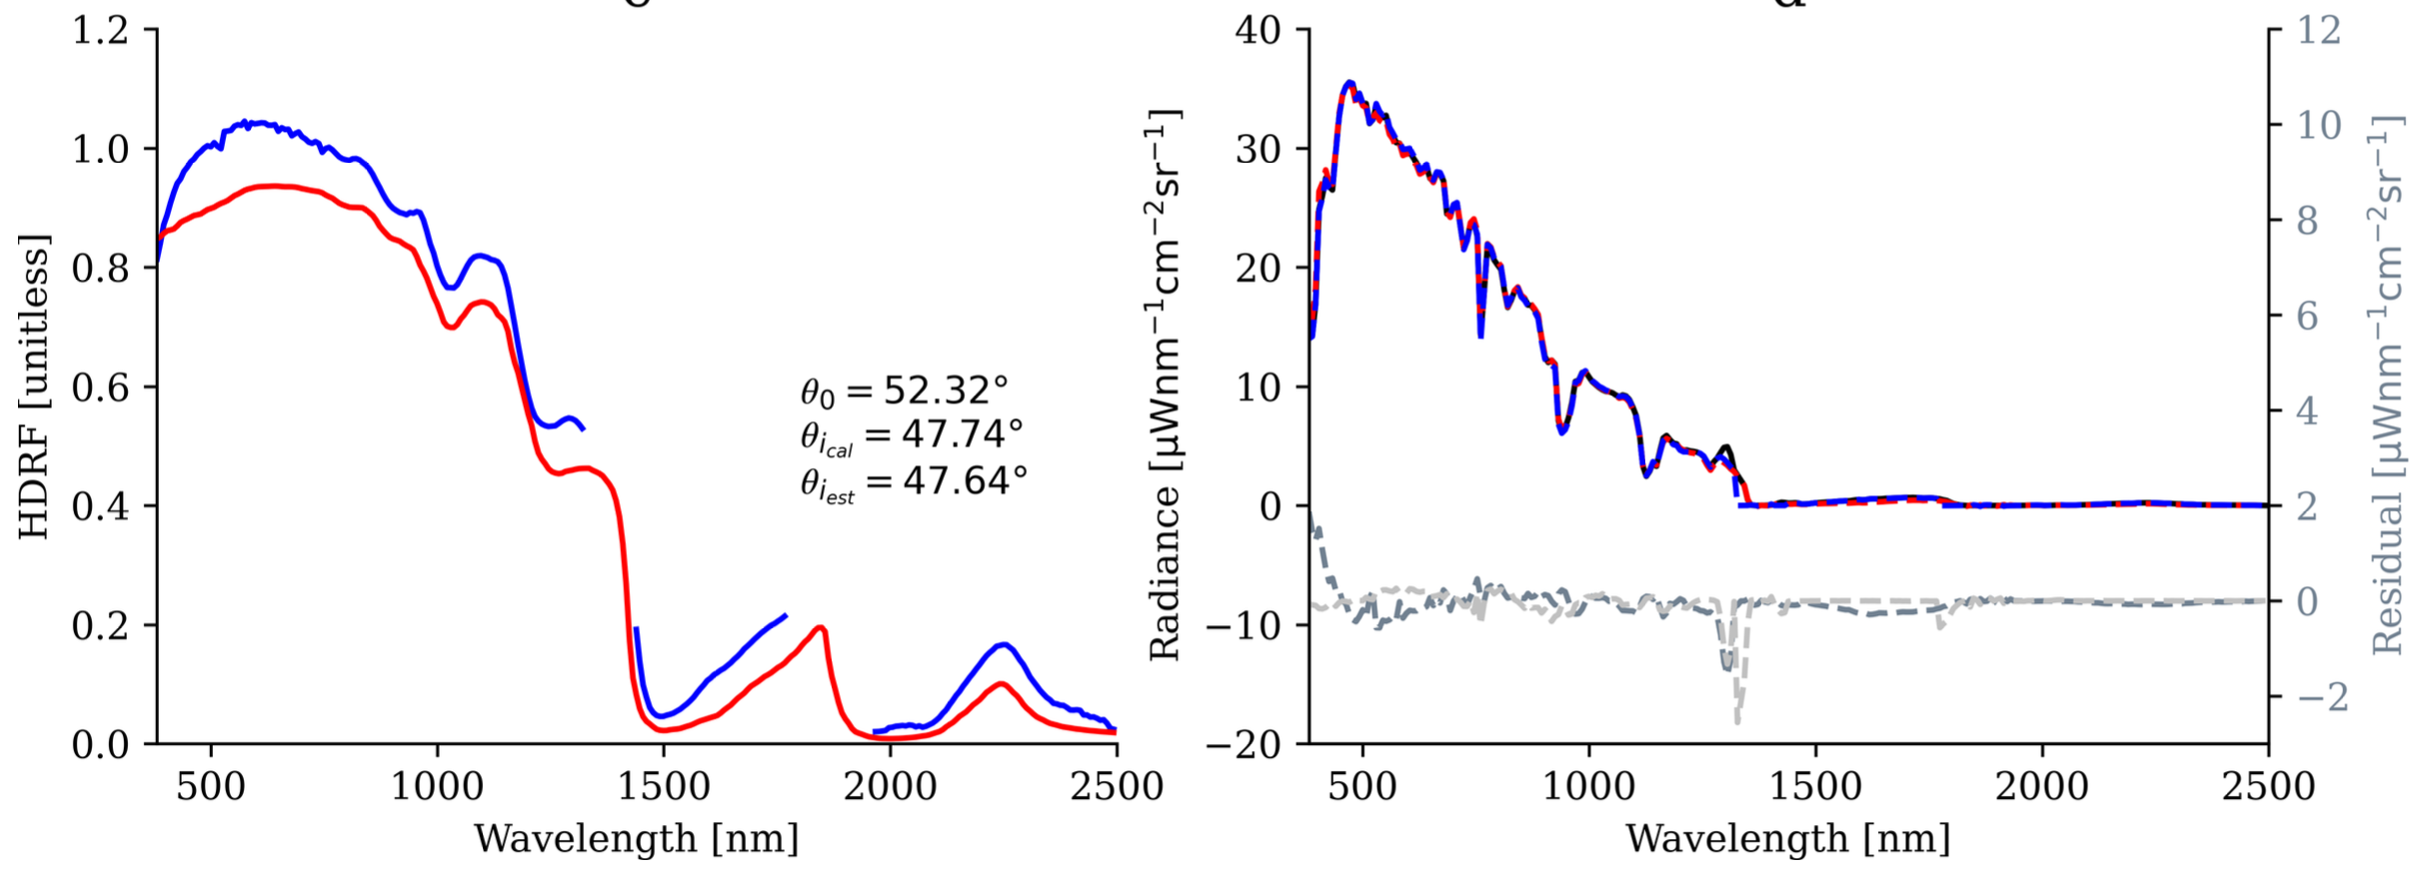
Topography aware snow retrievals
Bohn et al., in review

