Slide 1
CHIME Hypersense Campaign Data Harmonisation and Quality Assessment via Uncertainty Analysis
18. May 2024
ICSIS, Nordwijk
Mike Werfeli, Daria Larcher, Andy Hueni, Kimberley Mason, Cinzia Panigada, Giulia Tagliabue, Raquel De los Reyes, Jens Nieke, Michael Rast and Marco Celesti

Slide 2
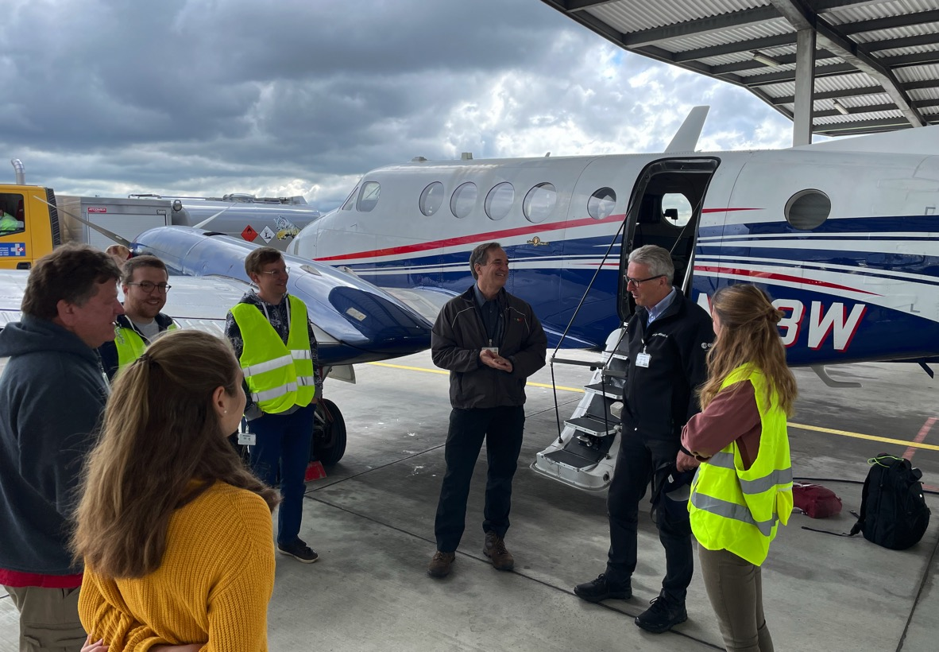

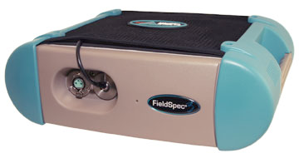
Main objectives
Hypersense CHIME-SBG airborne campaign 2021
Select multi-sensor matchups
Consistent atmospheric processing
Cross-Validation and uncertainty assessment

Slide 3
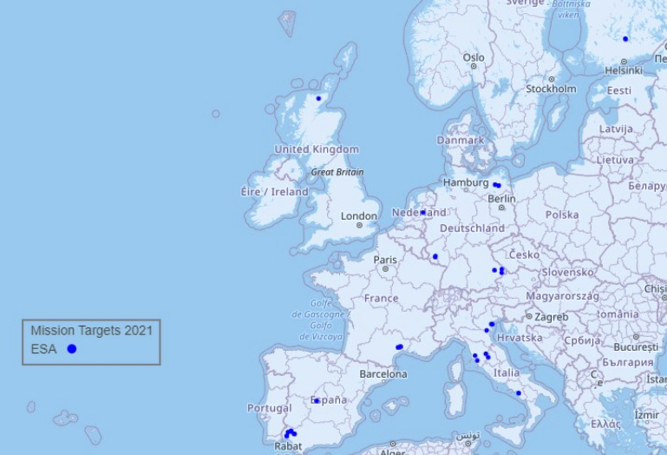

Geographical extent
Bavarian Forest National Park | Forest
Camarena | Soils
Demmin | Soil, N Climate
Jolanda | Agriculture, S Climate
Trasimeno | Limnology
Rio Tinto | Minerals
To be reprocessed

Slide 4
Data set selection (Time matchups)
X

Slide 5
Image reprocessing
ATCOR
ATCOR
PACO
AROSICS
AROSICS
AROSICS
MSDS

Slide 6
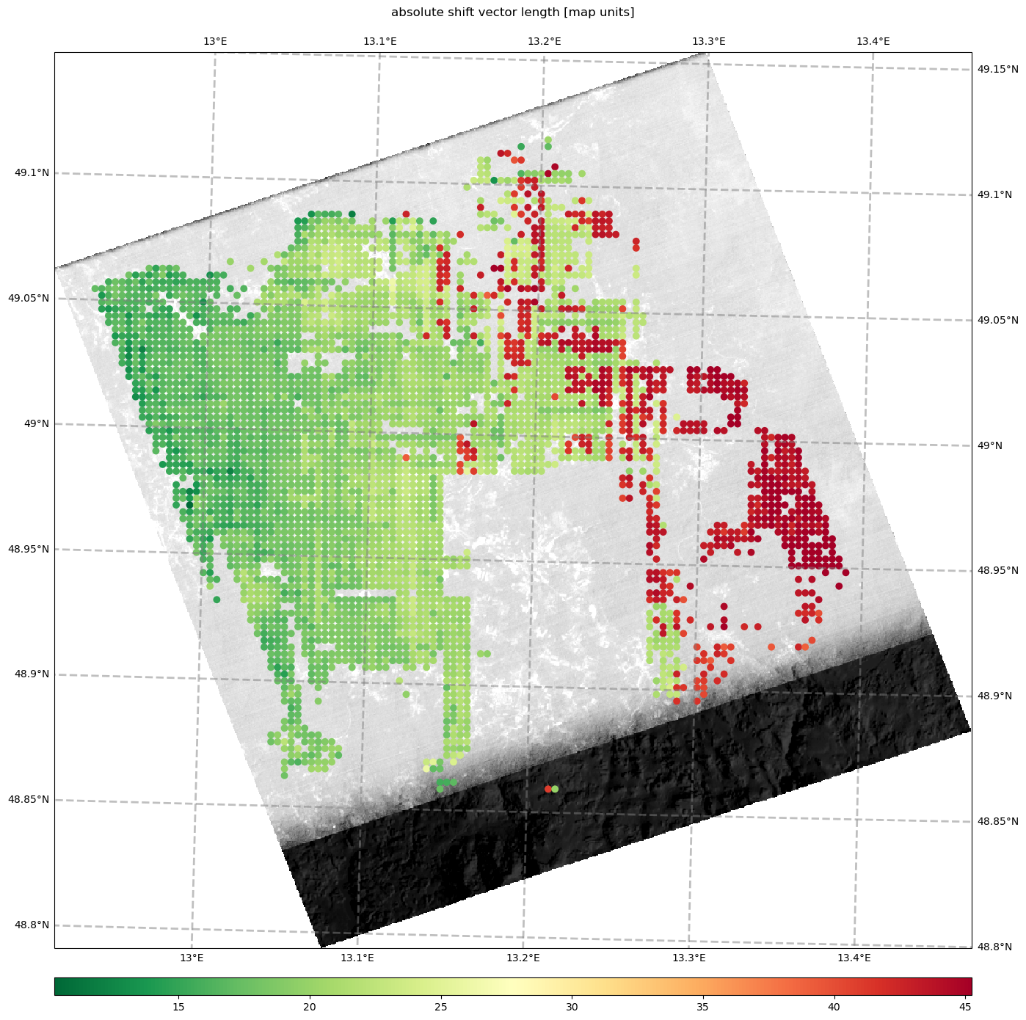
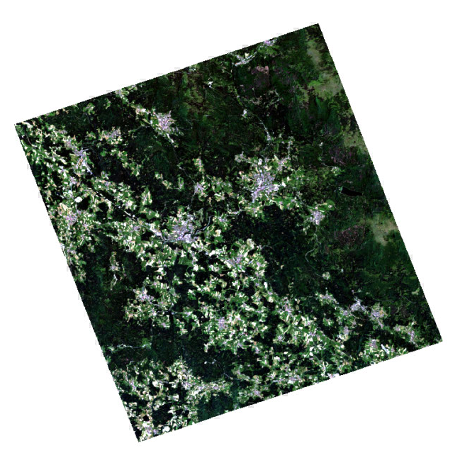
AROSICS reprojection
Reprojection to:
Sentinel-2 GRI
Pixel shifts after reprojection

Slide 7
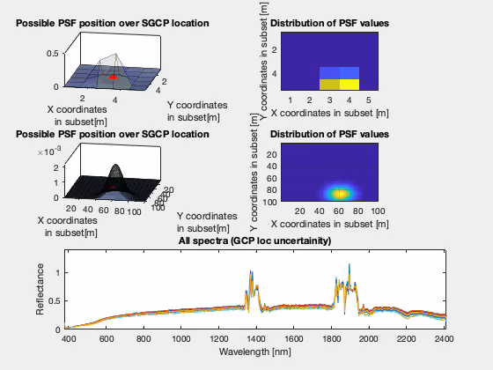

Uncertainty linked to geolocation
Added to field spectroradiometer measurement
$$u\left(c_{geo}\right)=sd({MC realisations}_{PSF})$$

Slide 8

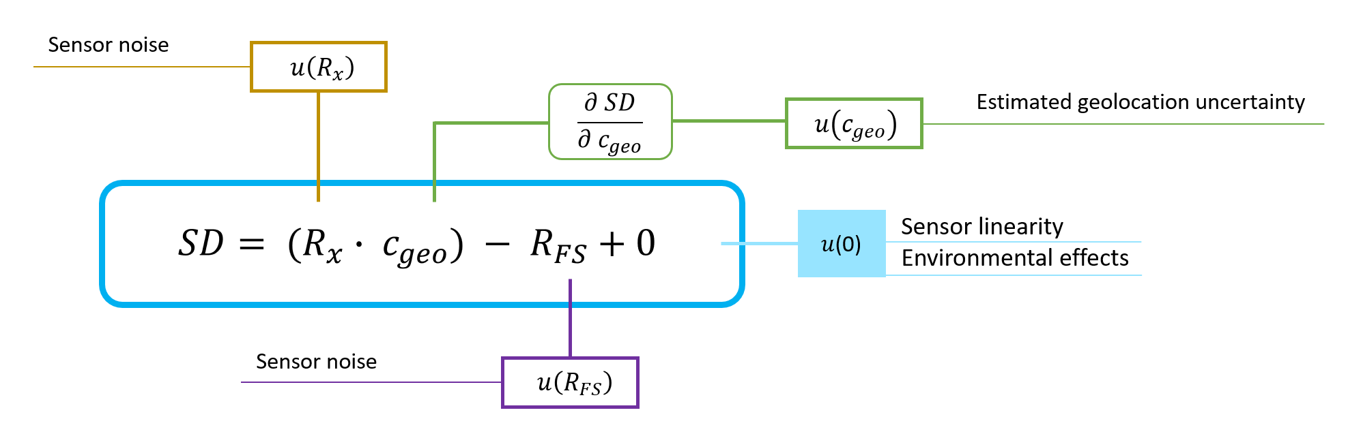
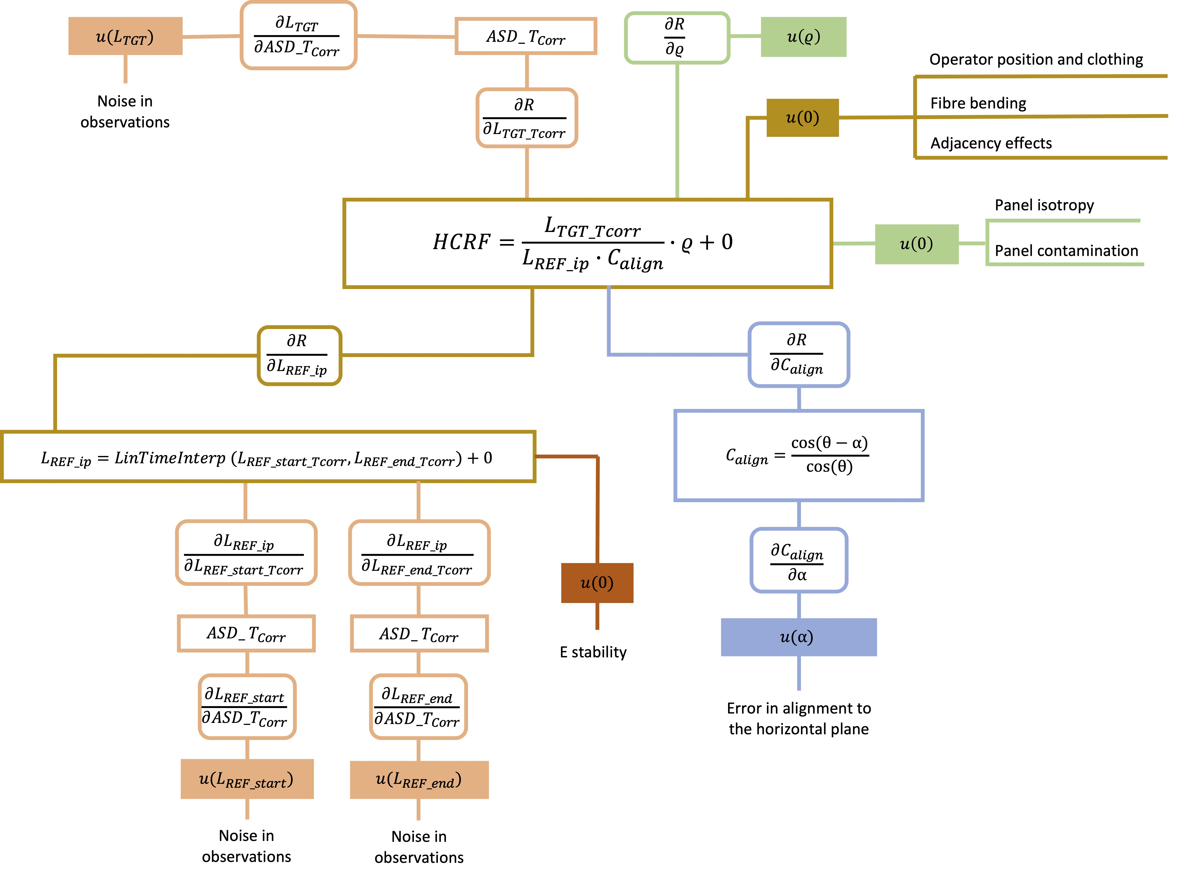
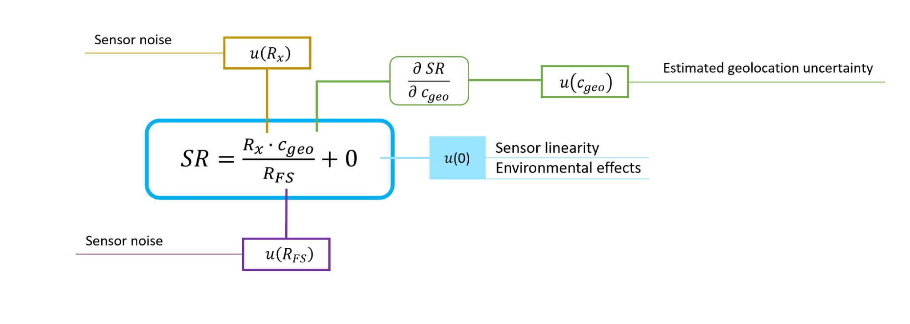
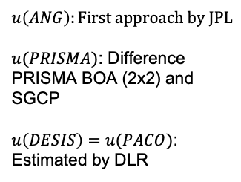
WP 2: Contribution from MetEOC 3 & 4 to CCN3 u(HDRF)
(A. Hueni et. al. 2023)
$$u\left(ANG\right):First approach by JPL$$
$u(PRISMA)$: Difference PRISMA BOA (2x2) and SGCP
$u\left(DESIS\right)=u(PACO)$: Estimated by DLR
A. Hueni, K. Mason and S. Trim, 2023. Uncertainty Support in the Spectral Information System SPECCHIO. IEEE Journal of Selected Topics in Applied Earth Observations and Remote Sensing 16, 2668-2680.

Slide 9
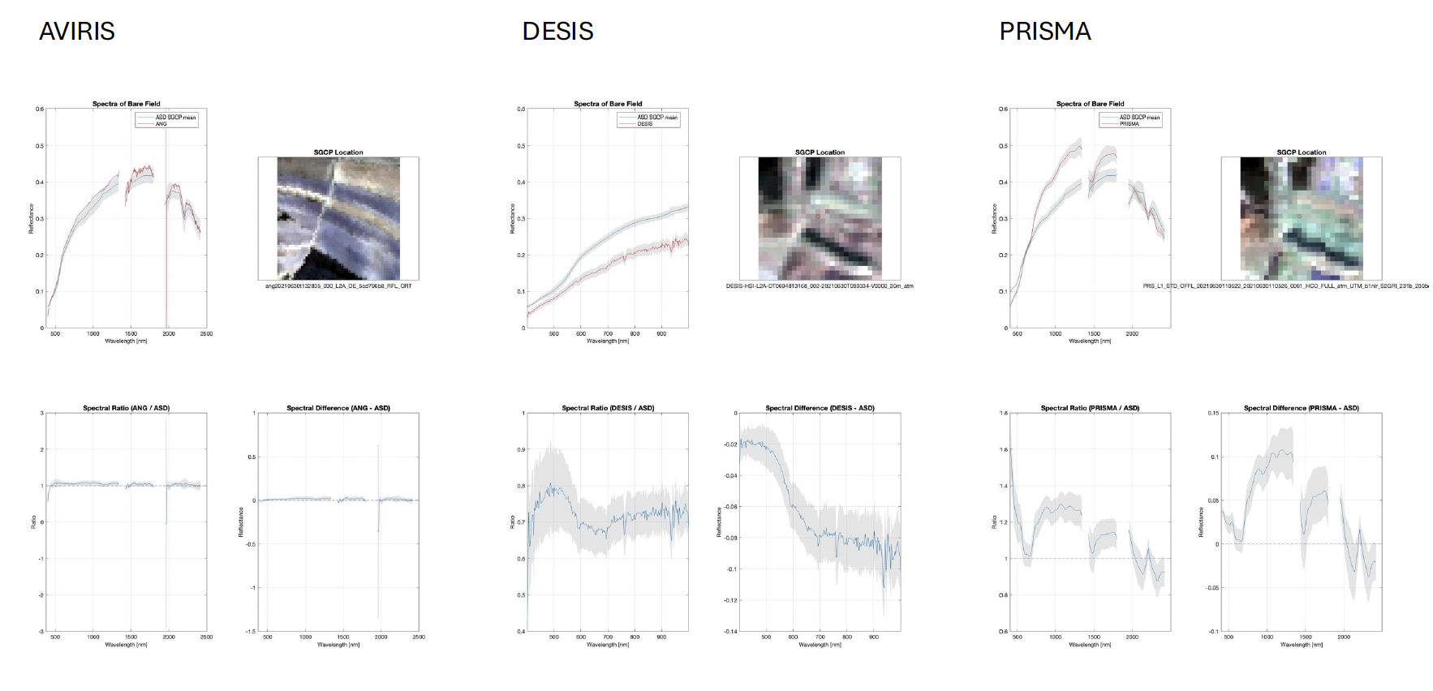
Vicarious Calibration and Validation at SGCP 1

Slide 10
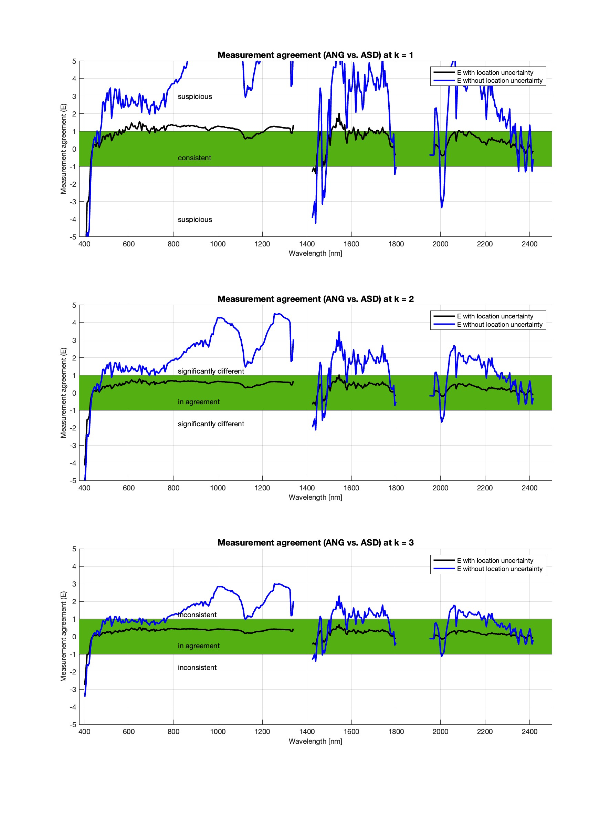
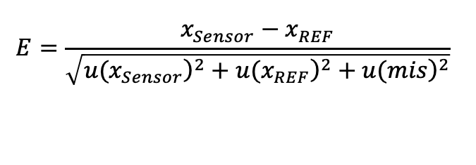
Data Quality: Measurement Agreement
$$E=\frac{x_{Sensor}−x_{REF}}{\sqrt{{\left.u(x_{Sensor}\right)}^{2}+{\left.u(x_{REF}\right)}^{2}+{\left.u(mis\right)}^{2}}}$$

Slide 11
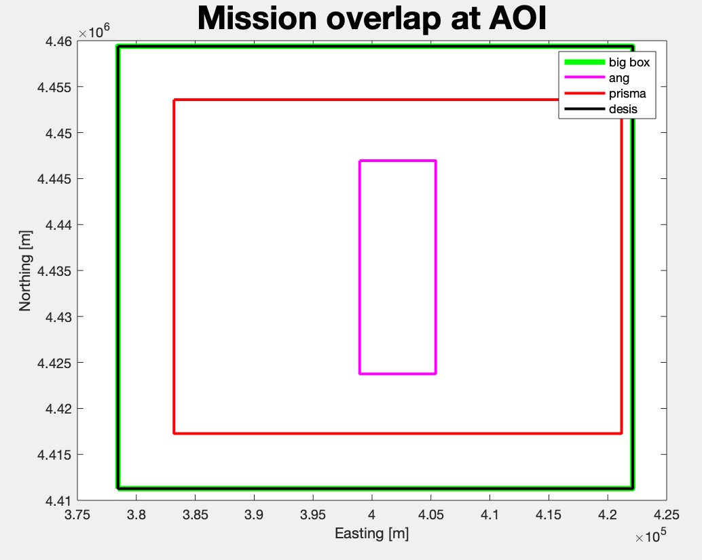
Intercomparison exercise
ANG resampled to 30m
  Spline interpolation
Compute virtual reference sensor
Comparison to virtual reference sensor
  Compute differences
  Compute measurement agreements
Notes:
Auto-comparison of all matching pixels
Additional analysis:
Aerosol related problems

Slide 12
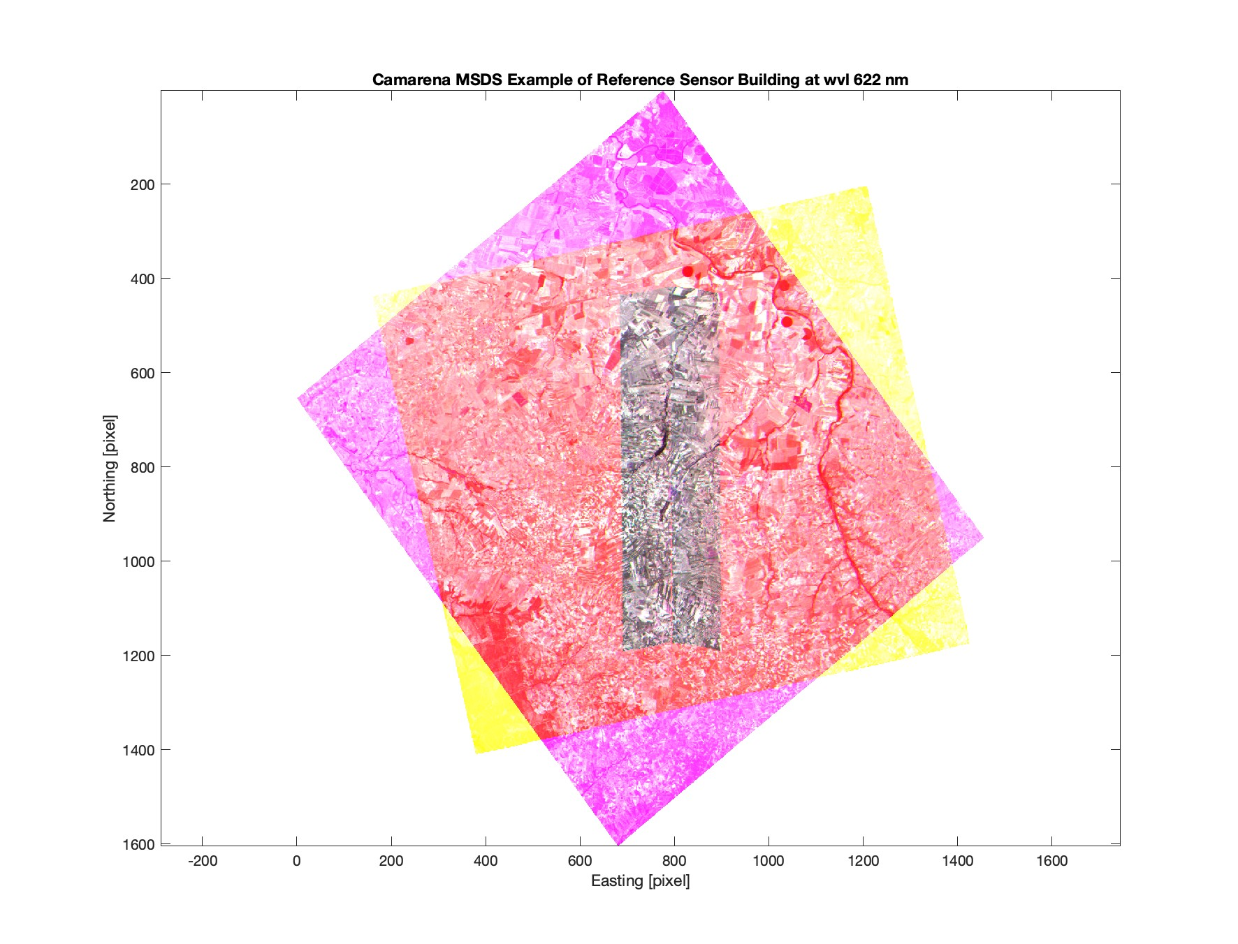
MSDS
Step 1
logical map
Step 2
get spectra of each img
Step 3
get uncertainty of each img
Step 4
compute reference sensor
Step 5
compute difference and ratio maps

Slide 13
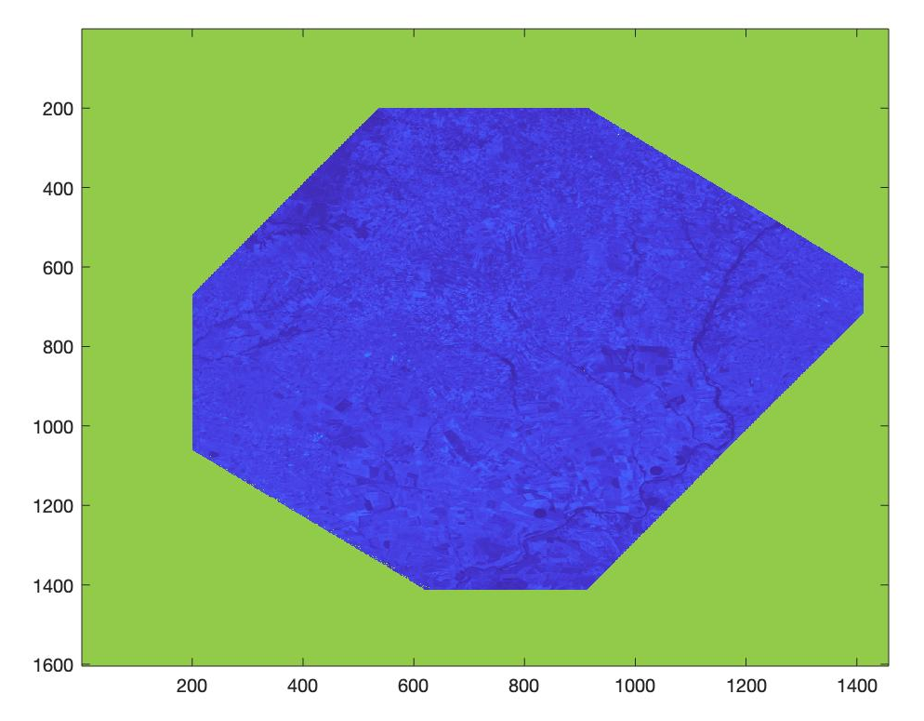
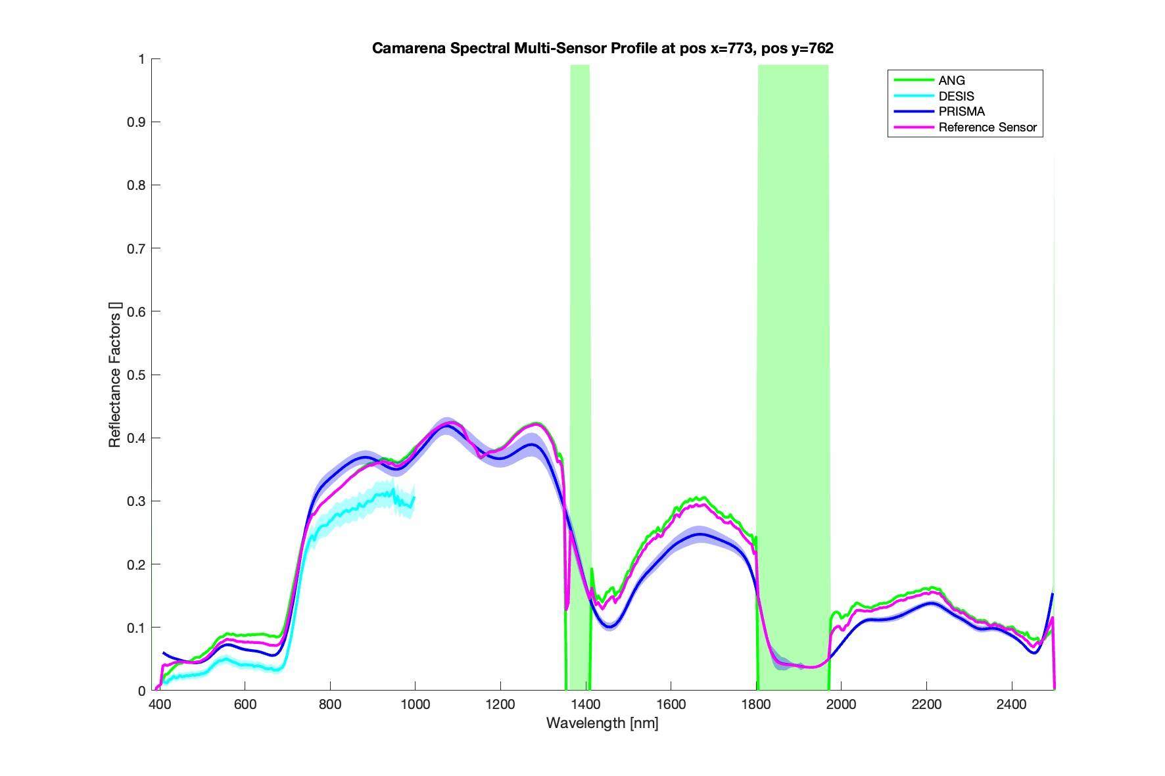
Reference Sensor
Reference sensor image
Pixel units
Pixel units

Slide 14
ISSI Forum on measurement disparities
Held in June 2024, in Bern, Switzerland
(White-) Paper on how to handle measurement disparities between different space-based EO products
Main findings:
  Estimate a full traceable uncertainty budget for every satellite mission
  If not available, use a common approach to estimate an uncertainty
  Make processing algorithm openly accessible for intercomparison (sources of uncertainty)

Slide 15
Questions?
Thank you for your attention

Slide 16
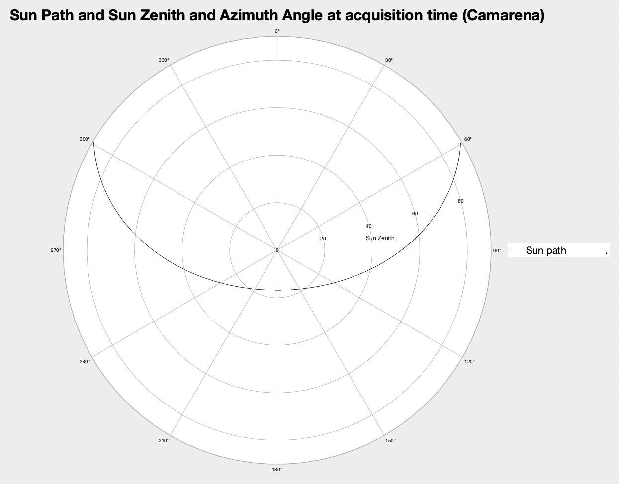
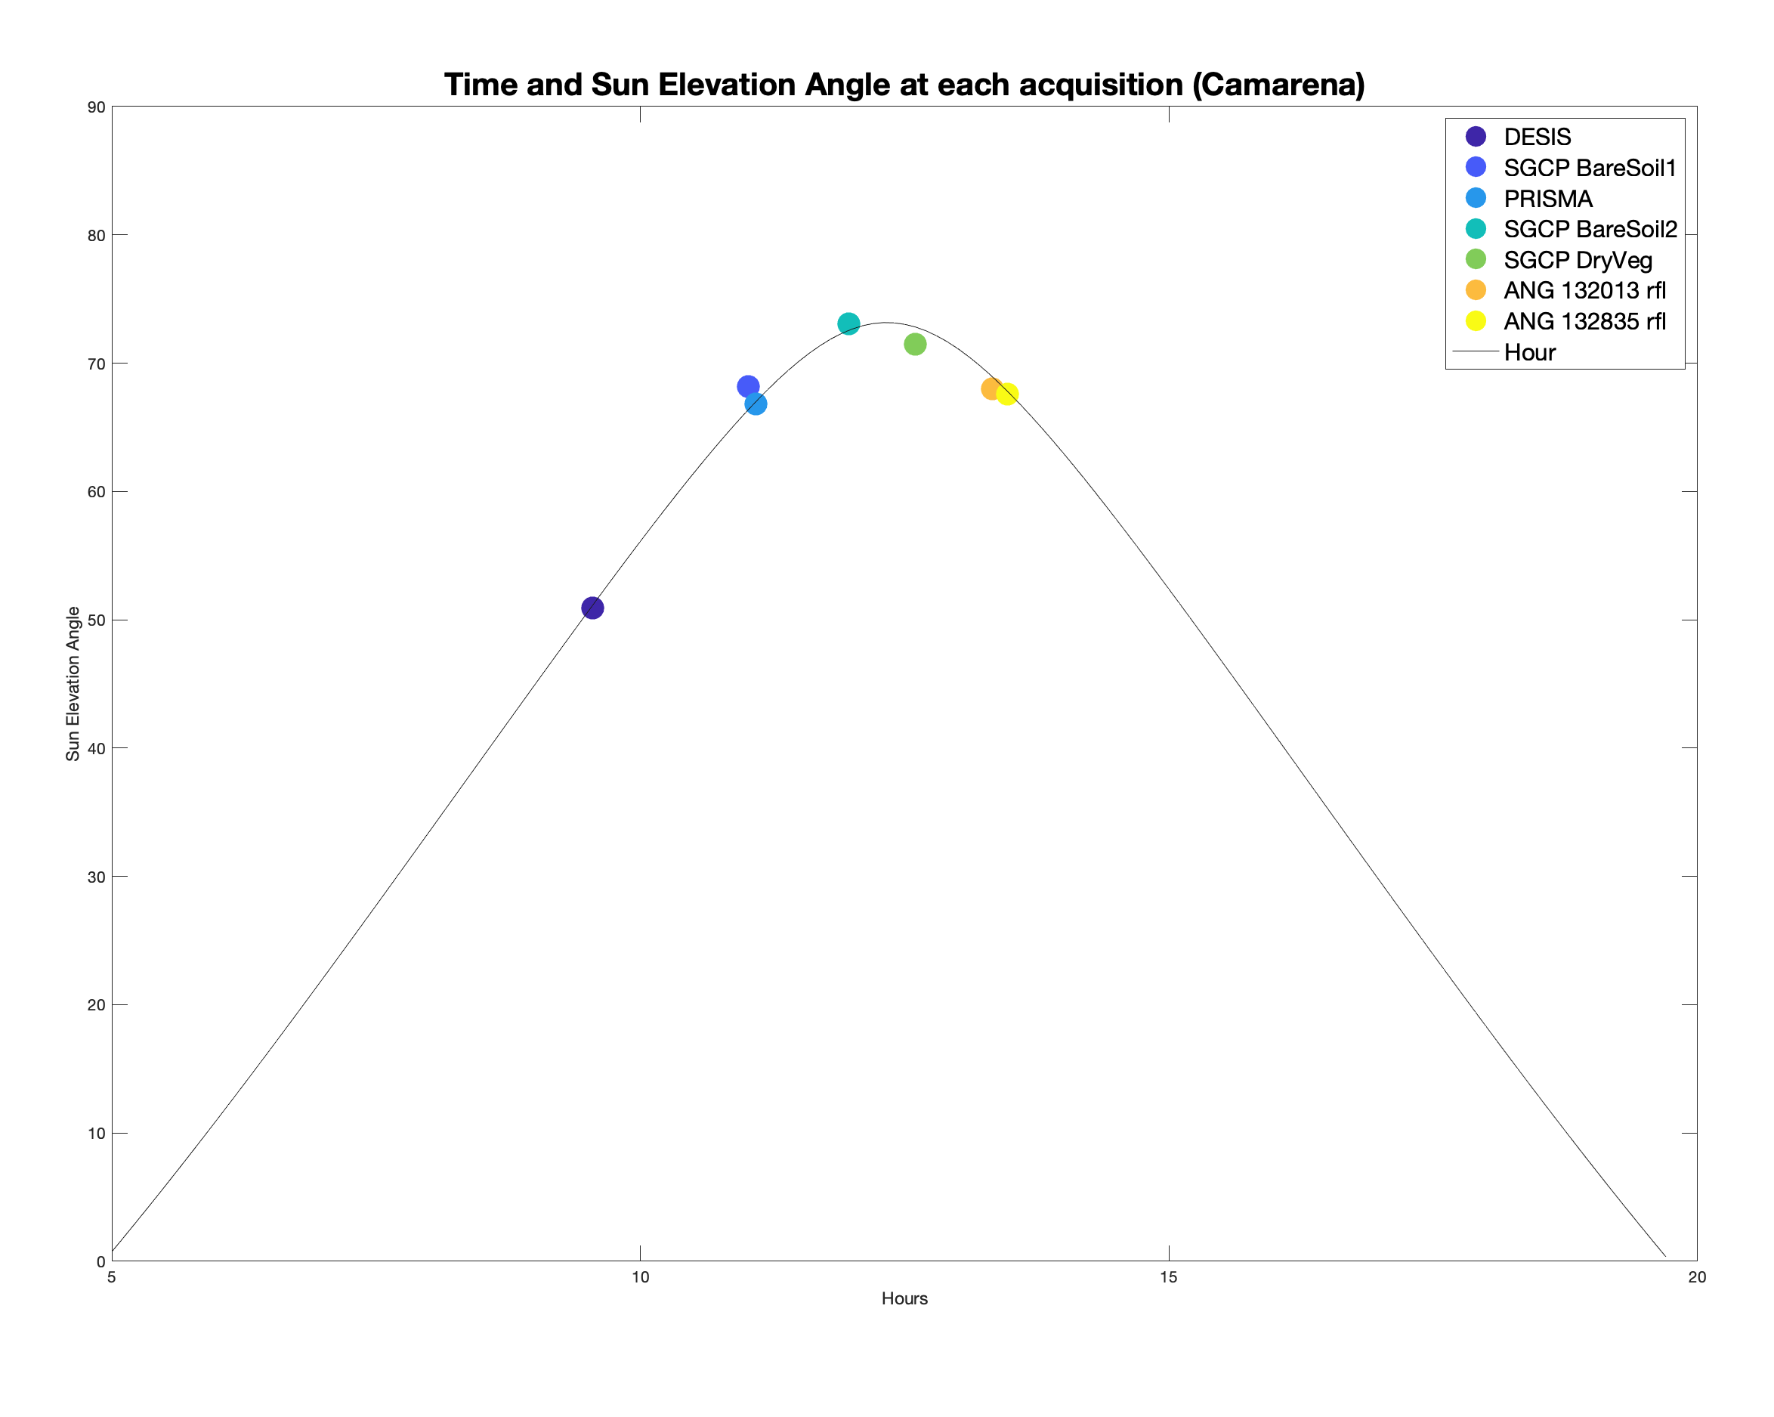
BRDF analysis - non-constant illumination angles

Slide 17
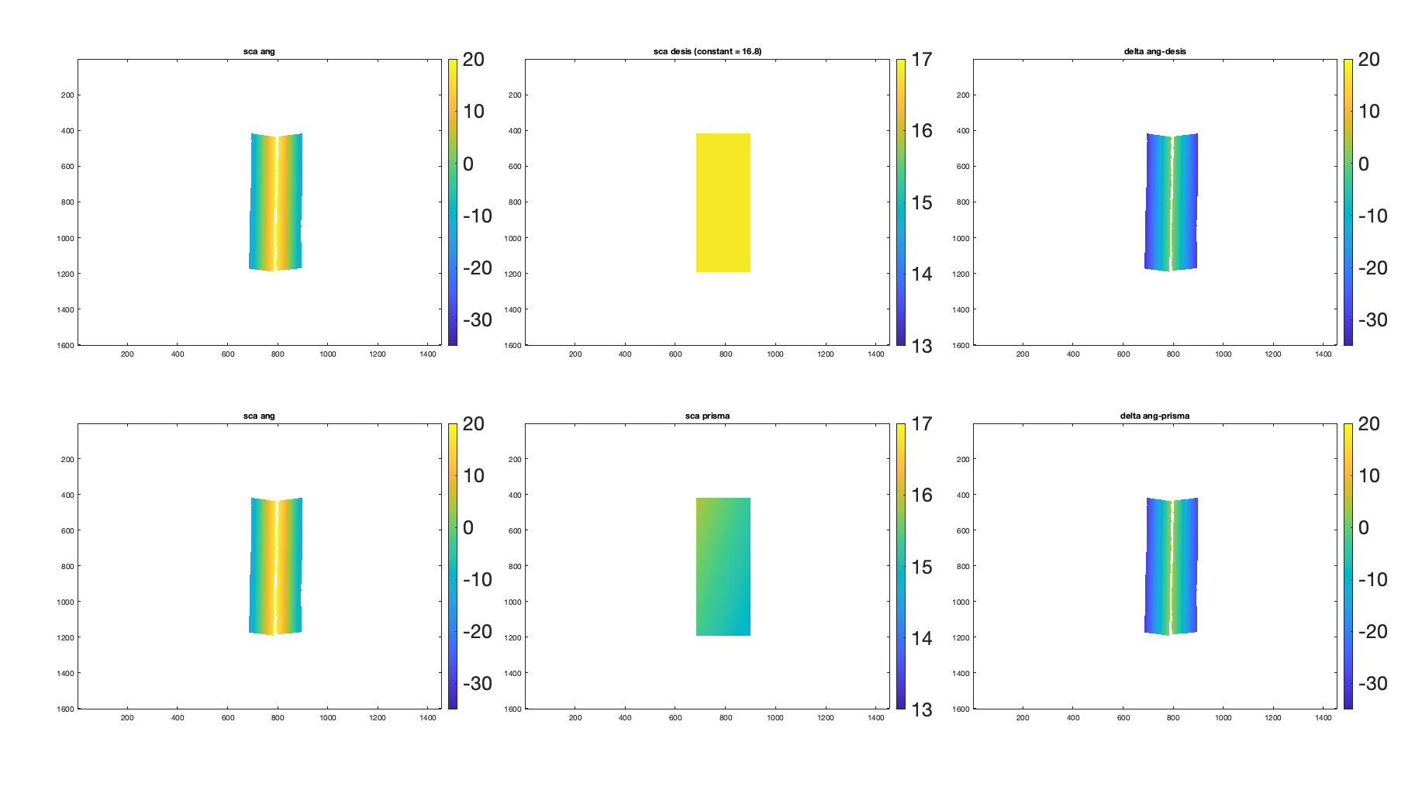
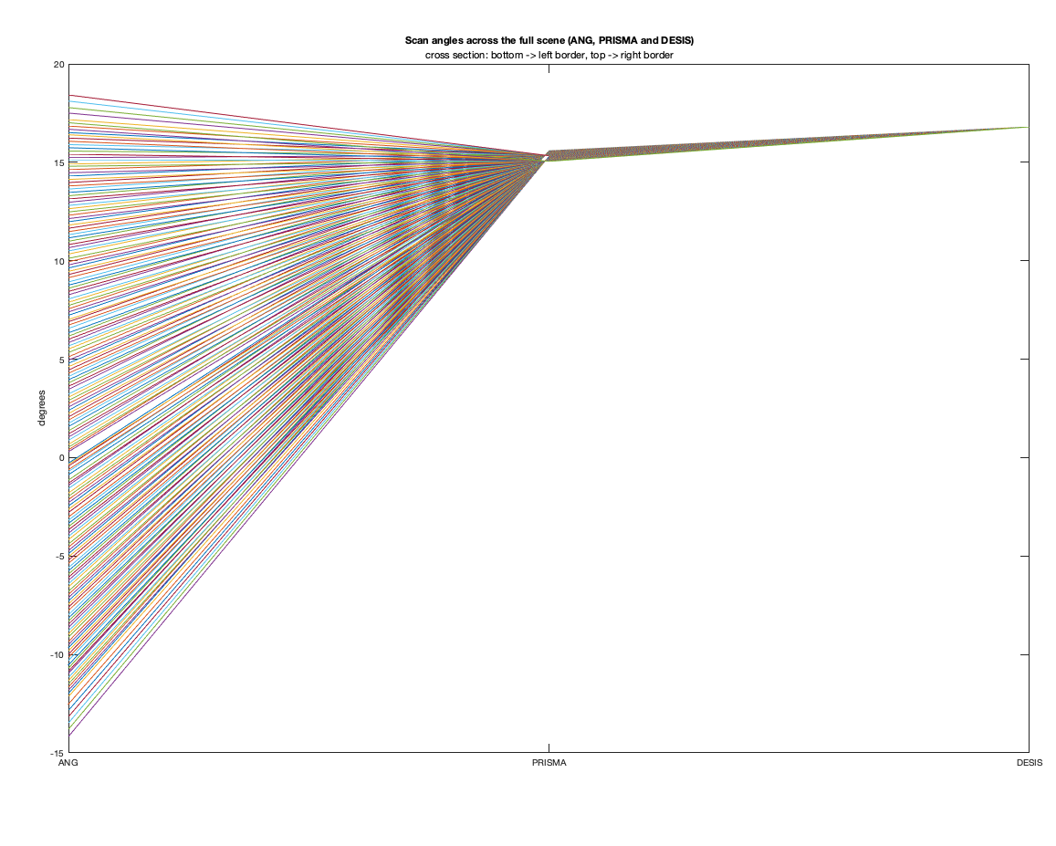
BRDF analysis - non-constant observation angles
DESIS
ANG
PRISMA

Slide 18
BRDF analysis – scan angle difference images
ANG
DESIS = 16.8°
difference image
Max difference in
obs. angle up to 32°
ANG
PRISMA
difference image

Slide 19
Backup Slides

Slide 20
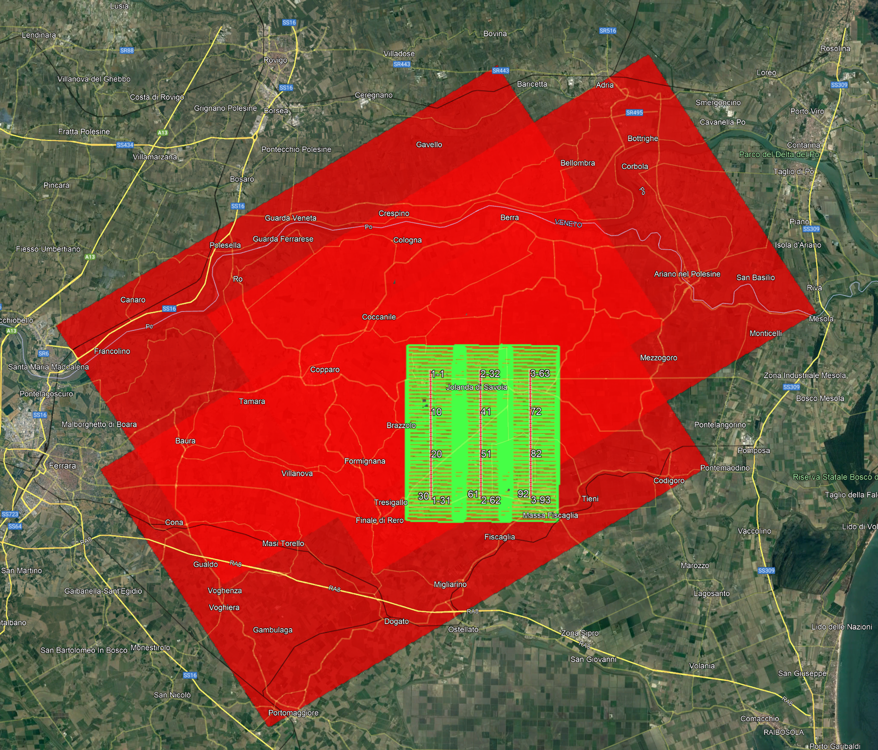
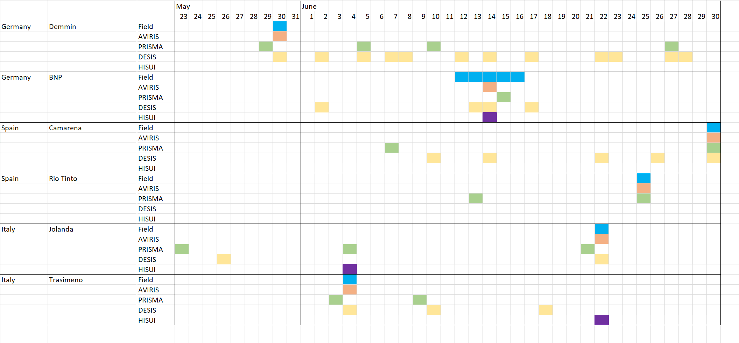
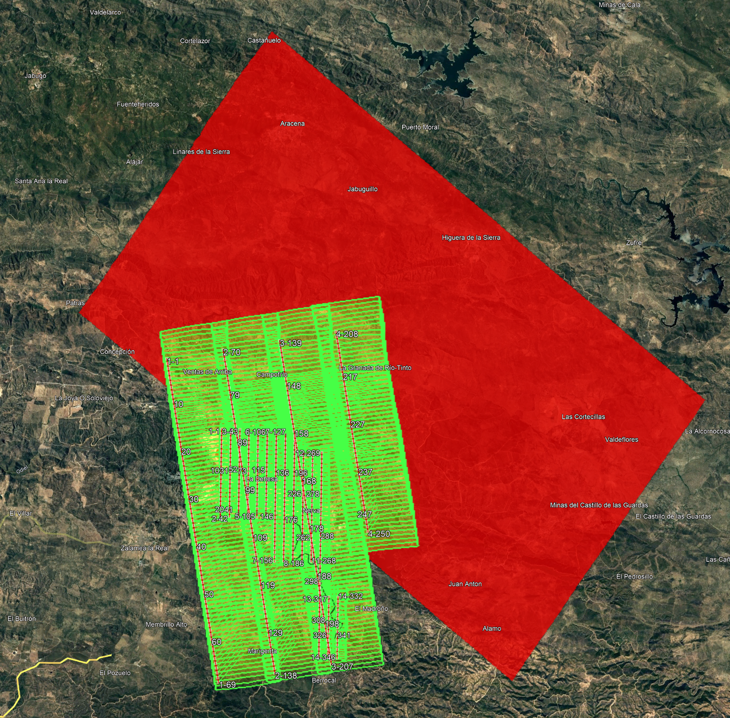
HISUI Information
Jolanda
Trasimeno

Slide 21
AI’s from MTR
Compare data flows between sensors (as part of the report): ANG, DESIS and PRISMA have slightly different processing data flows.
Decide which reference image to use (S2 scenes versus GRI) -> for the time being, we use S2 scenes used by PRISMA team. Bands in GRI are suboptimal (NIR matching works best for our scenes).
UZH: Check unit of JPL uncertainty (% or reflectance?)
UZH: Send draft of report to ESA
Double check 7th NOV as date for progress meeting 2 (RD will be on holidays at the time)
Arrange call with ESA + U of Tokio about HISUI. Then estimate effort on RSL side. -> superseded by todays meeting
MR and MW to liaison on ISSI workshop. -> ISSI workshop submitted and accepted.
✔︎
✔︎
✔︎
✔︎
✔︎
✔︎

