Slide 1
Status and updates on the hyperspectral image archive of DESIS
Hyperspectral 2024, ESA ESTEC, Noordwijk, NL 13-15 November 2024
Uta Heiden¹, Emiliano Carmona¹, Martin Bachmann¹, Daniele Cerra¹, Raquel de los Reyes¹, Felix Feckler¹, Uwe Knodt², David Krutz³, Heath Lester⁴, David Marshall¹, Rupert Müller¹, Johannes Roeder¹, Mirco Tegler⁵
¹ Earth Observation Center, DLR, 82234 Weßling, Germany
² Institute of Space Systems, DLR, 28359 Bremen, Germany
³ Institute of Optical Sensor Systems, DLR, 12489 Berlin, Germany
⁴ Teledyne Brown Engineering (TBE), 300 Sparkman Drive, Huntsville, AL 35805, USA
⁵ German Remote Sensing Data Center, DLR, 17235 Neustrelitz, Germany

Slide 2
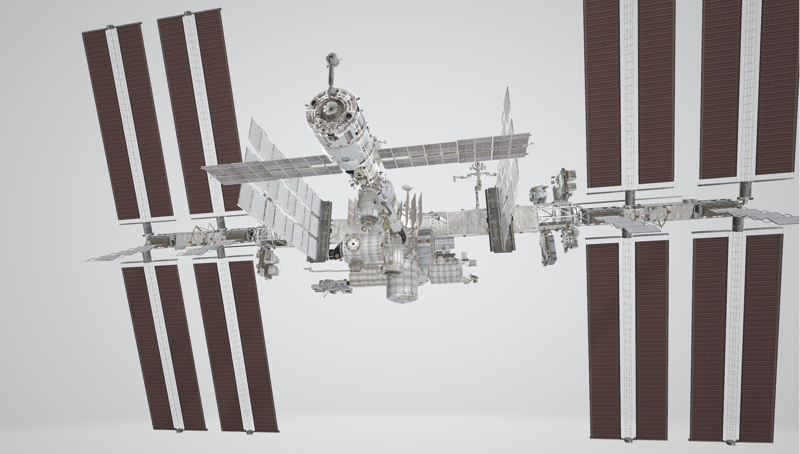
DLR.de • Chart 2
> Lecture > Author • Document > Date
Notes:
DESIS is an imaging spectrometer onboard the ISS
Mounted on the Express Logistics Carrier 4
DESIS mounted on the ExPRESS Logistics Carrier 4
EMIT ELC 1

Slide 3
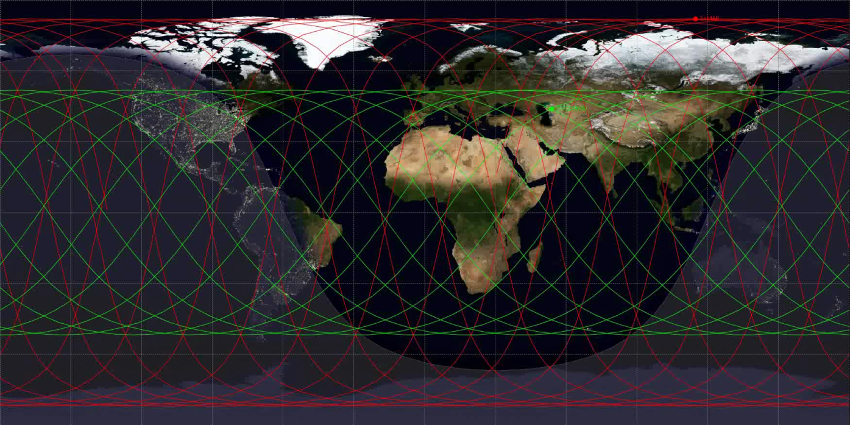
DESIS specification
ISS (~ 400km), non-sun-synchronous orbit
Covers 55° N to 52° S
Tilting options: -45° (backboard) to +5° (starboard),
-40° to +40° (along track)
> Lecture > Author • Document > Date
Mission Instrument | ISS/MUSES DESIS
Off-nadir tilting (across-track, along-track) | -45° (backboard) to +5° (starboard), -40° to +40° (by MUSES and DESIS)
Spectral range | 400 nm to 1000 nm
Spectral sampling, FWHM | 2.55 nm, 3.50 nm
Radiometry | 13 bits
Spatial (res., swath) | 30 m, 30 km (@ 400 km)
SNR (signal-to-noise) | 205 (no bin.)/406 (4 bin.) @ 550 nm
Instrument (mass) | 93 kg
Capacity (km, storage) | 2360 km per day, 225 GBit
Mission Instrument | ISS/MUSES DESIS
Target lifetime | 2018-2023 (nominal) …
Satellite (mass, dimension, usage) | 455 t, 109.0×97.9×27.5 m³ (multi-purpose)
Orbit (type, local time at equator, inclination, height, repeat cycle) | not Sun-synchronous, various, 51.6°, 320 km to 430 km, no repeat cycle
Coverage | 55° N to 52° S
Notes:
Green – ISS orbit – off nadir tilting for very Northern areas
Red – EnMAP orbit

Slide 4
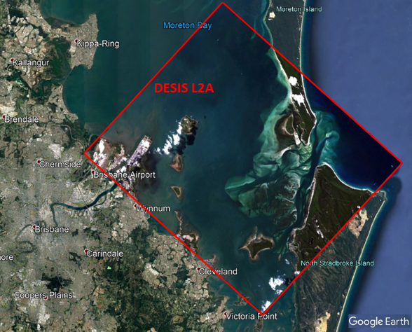
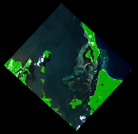
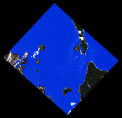
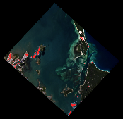
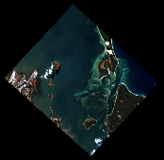
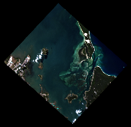
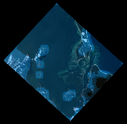
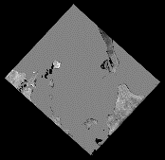
Introduction – Data products
Spectral calibration after smile correction is typically better than ~0.5 nm.
Archive
L1A Raw Data
(prepared for selection & ordering & processing)
Analysis Ready Data
L1B Top-Of-Atmosphere (TOA) Radiance
L1C Geocoded & Orthorectified
L2A Bottom-of-Atmosphere (BOA) Reflectance
Cloud Shadow
over land
Land Mask
Water Mask
Cloud Mask
Haze over land
Haze over water
AOT Map
WV Map

Slide 5
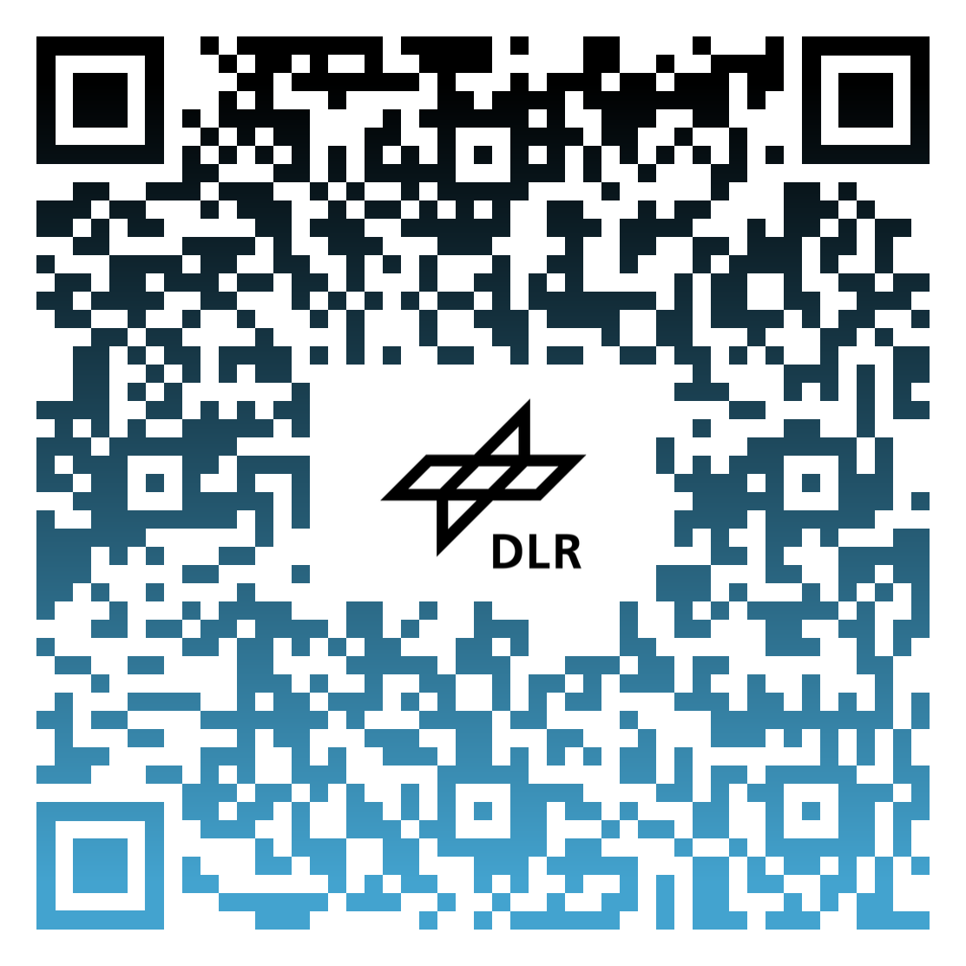
Data archive – Data access
DESIS archive @ DLR
(EOWEB Portal)
EOWEB Portal (DLR)
Searching,
Processing,
Download
DESIS archive @ TBE
(TCloud Portal)
DLR – Science Coordination
desis-scientific@dlr.de
Tasking new DESIS data
(TCloud Portal)
Science proposal

Slide 6
Data archive – Data access
Since 31/05/2024, Teledyne has stopped the DESIS tasking and archive services due to negotiations with NASA
DESIS archive @ DLR
(EOWEB Portal)
EOWEB Portal (DLR)
Searching,
Processing,
Download
DESIS archive @ TBE
(TCloud Portal)
DLR – Science Coordination
desis-scientific@dlr.de
Tasking new DESIS data
(TCloud Portal)
Science proposal

Slide 7
DESIS mission will continue …
Teledyne has been selected as NASA data provider, requires further negotiation about a concrete contract, kickoff started on 15th of October
The instrument DESIS and platform MUSES has been maintained in operations since the stop of data acquisition and archive service end of May, 2024
Instrument is alive and working, taking weekly calibration measurements
Teledyne now slowly reactivates a few standing order (first cloud free only)
Meanwhile IDIQ contract with NASA in preparation
Services at DLR (archive access + processing) is running nonstop!! – independent from the outcome of NASA negotiation

Slide 8
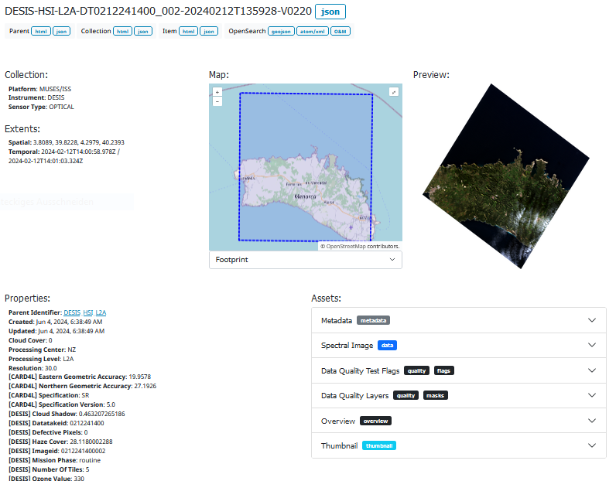
DESIS News – Improved download opportunity
DESIS via web services (WCS, WFS, WMS etc.)
Data format: COG (Cloud-Optimized GeoTIFF)
STAC Catalogue containing the metadata of the complete DESIS archive
L2A processed DESIS data (standard processing) will be made available
Bulk image download possible
Data product in line with CEOS ARD „Surface Reflectance“, currently under CEOS review
Notes:
We went some steps further, although a bit delayed …
Currently data is processed

Slide 9
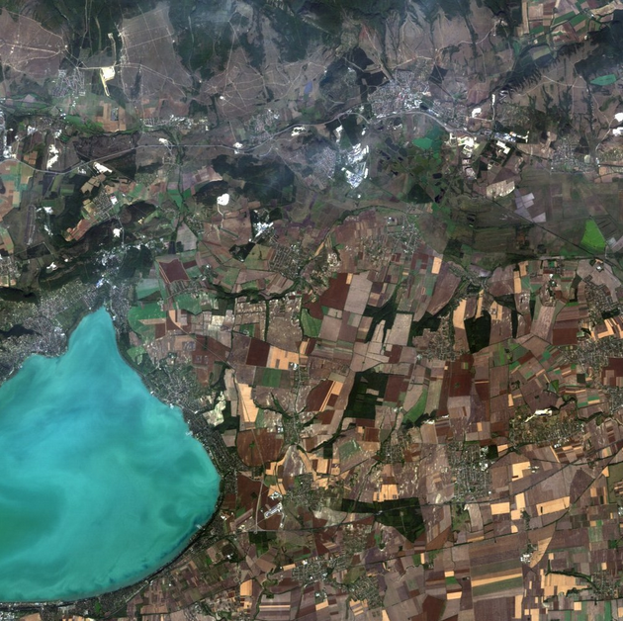
DESIS News – Special Issue
International Journal of Remote Sensing (Taylor & Francis)
“New research from the Spaceborne Imaging Spectrometer Mission DESIS”
Manuscript deadline extended: 30 December 2024
All topics invited – please contact us, if you are unsure
Uta Heiden (DLR), uta.heiden@dlr.de
Daniele Cerra (DLR), daniele.cerra@dlr.de
Rupert Müller (DLR), rupert.mueller@dlr.de
Mary Pagnutti (I2R), mpagnutti@i2rcorp.com
Example topics:
Applications in Environmental Monitoring
Ocean and Coastal Analysis
Innovative Applications
Data Fusion
Algorithm Development
Sensor Calibration and Validation
Notes:
We went some steps further, although a bit delayed …
Currently data is processed

Slide 10
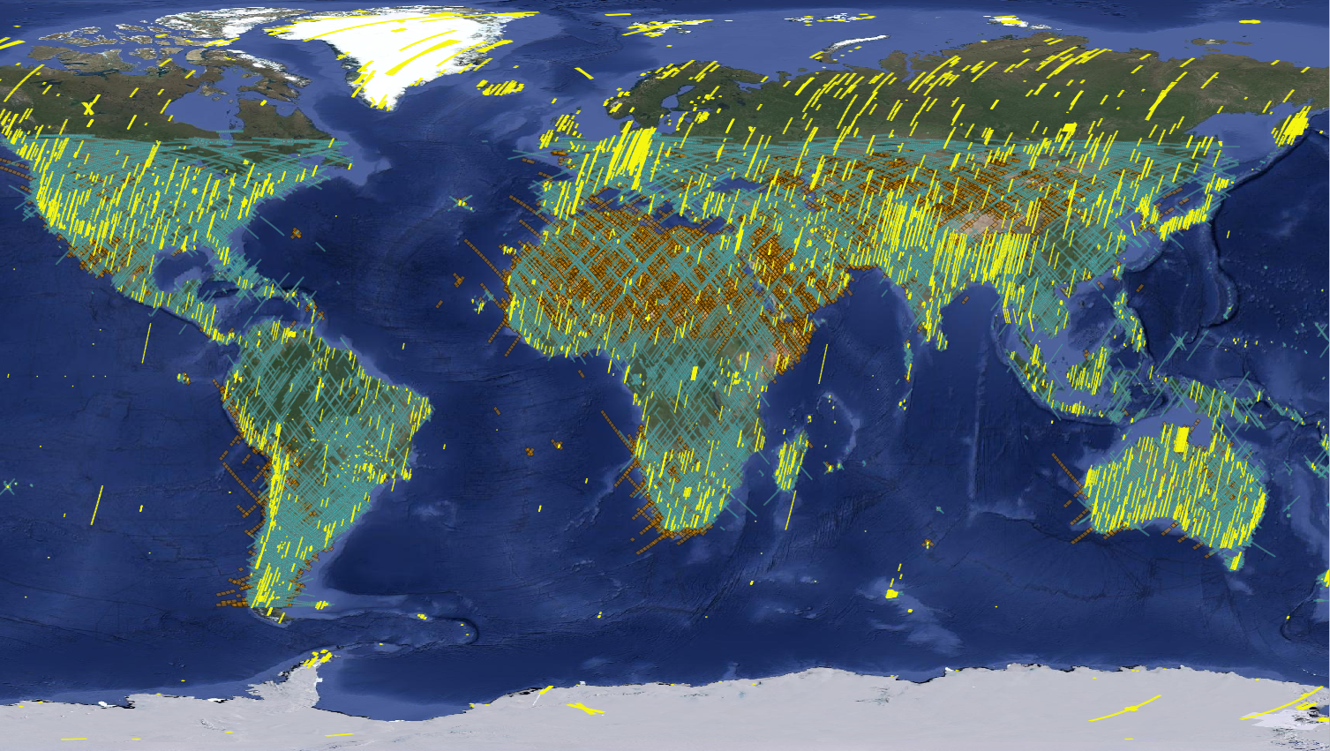
Thank you for your attention!
Points of contact:
Science: uta.heiden@dlr.de Commercial: TBE_MUSES_OPS@teledyne.com
DESIS, EMIT and
EnMAP matchups
(Status July 2023)
Notes:
We went some steps further, although a bit delayed …
Currently data is processed

Slide 11
Backup slides

Slide 12
Introduction – Operational processors
L0 Data
Products (* Delivery):
Level 0 (L0)
Raw data (Datatakes,
trajectory files, DC)
Level 1A (L1A)
Tiled images, browse image, metadata, quality flags <= archived
Level 1B (L1B)*
Top of Atmosphere (TOA) radiance (W·m⁻²·sr⁻¹·μm⁻¹)
Systematic and radiometric correction (rolling shutter, smile, …)
All metadata attached for further processing
Level 1C (L1C)*
Level 1B data ortho-rectified, re-sampled to a specified grid
Global DEM (SRTM, 1arcsec), sensor model refinement using global reference image (Landsat-8 PAN with acc. 18m CE90)
Level 2A (L2A)*
Ground surface reflectance (i.e. after atmospheric corrections)
With and w/o terrain correction

Slide 13
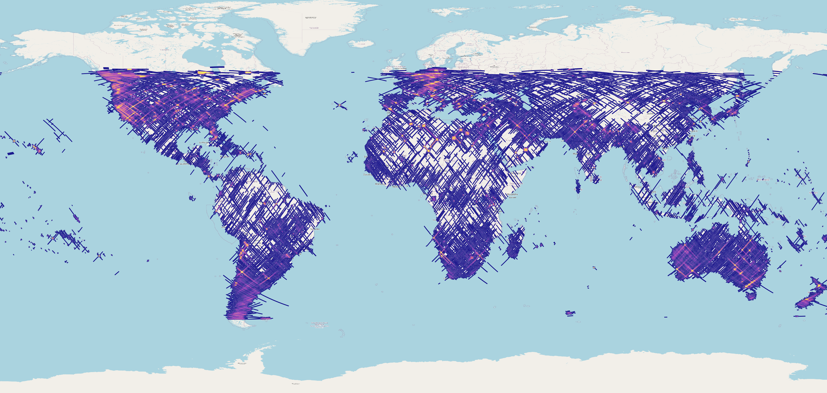
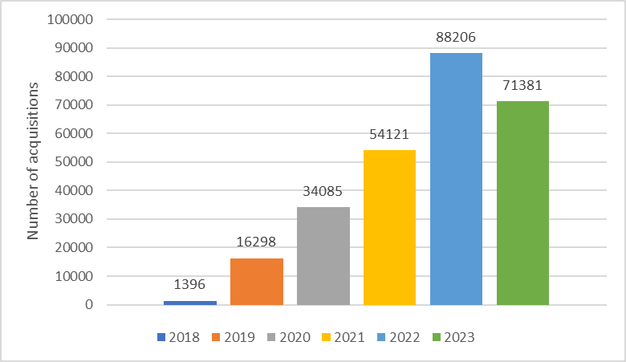
Data archive - World coverage with DESIS
No of available scenes
Status
October 2023
World
Feb 2023 – 204.839 scenes
Jul 2023 – 237.755 scenes (+ 16 %)
Oct 2023 – 265.499 scenes (+ 30 %)
July 2024 – > 300.000 scenes

Slide 14
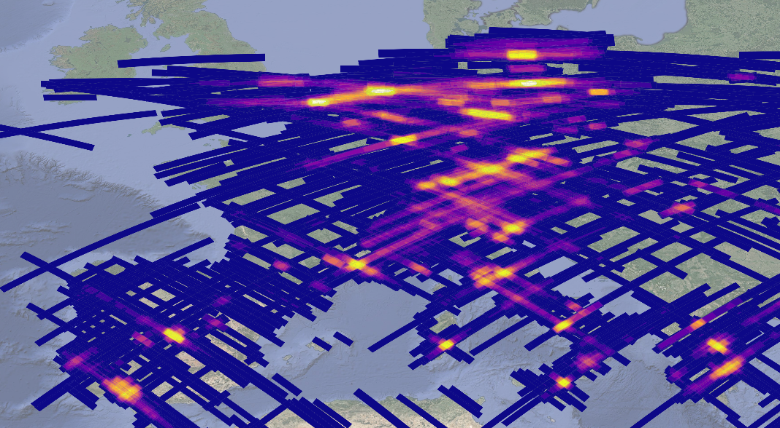
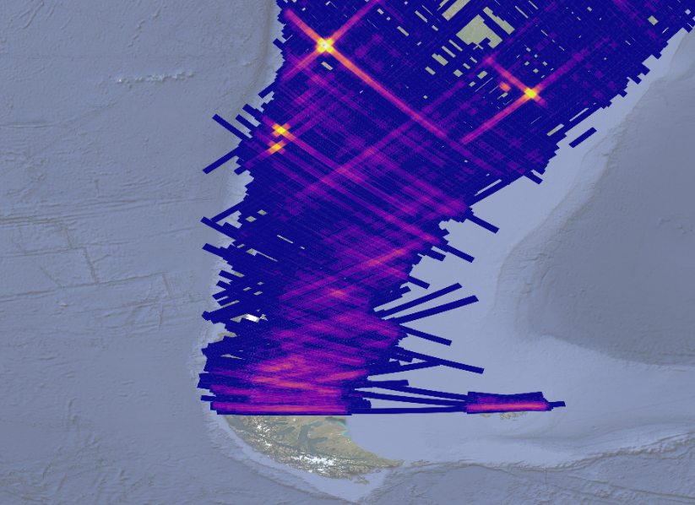
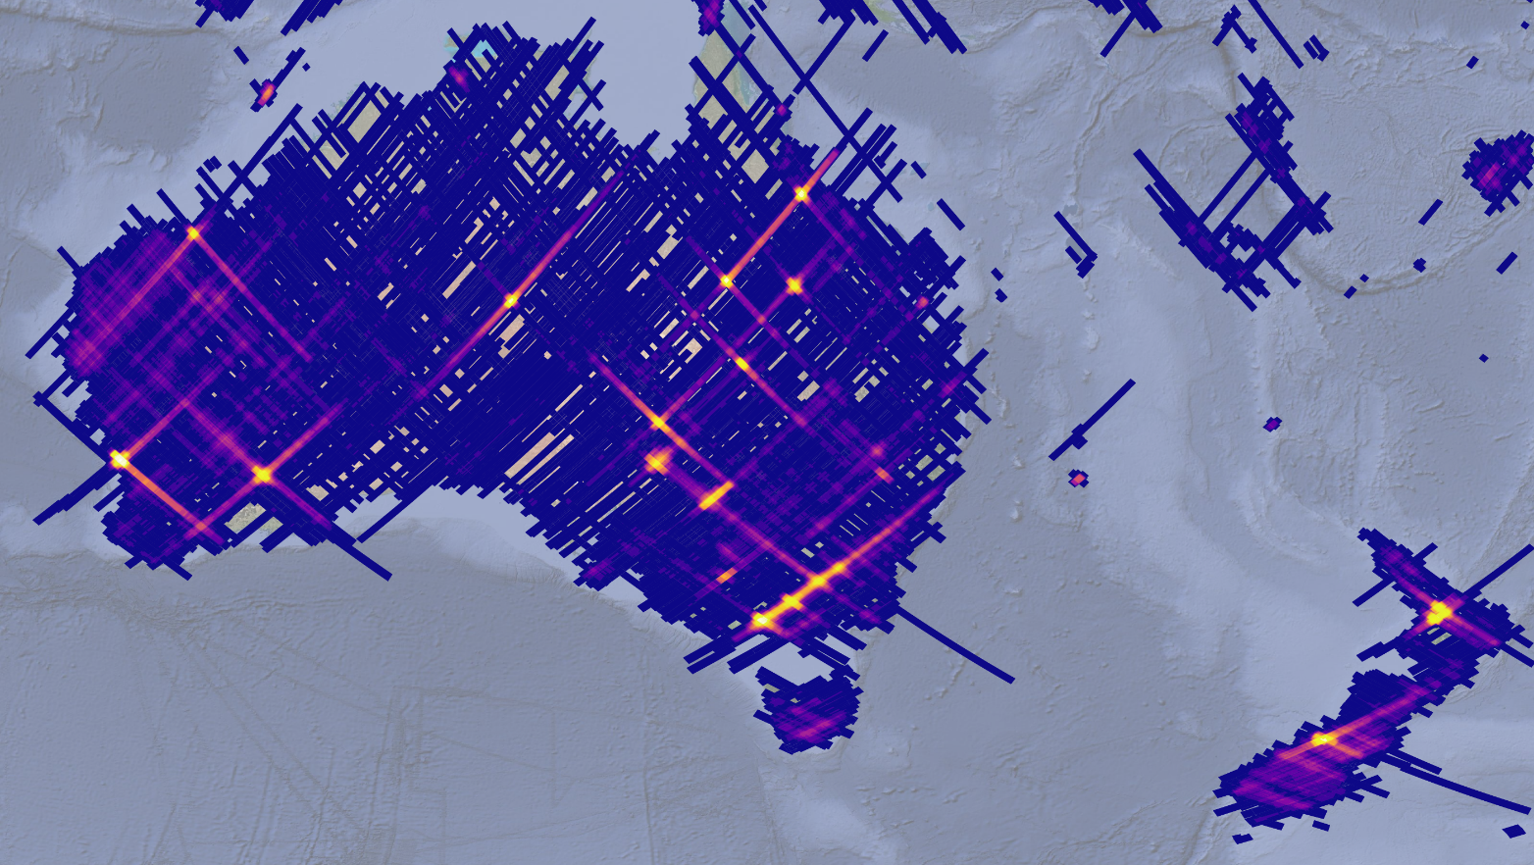
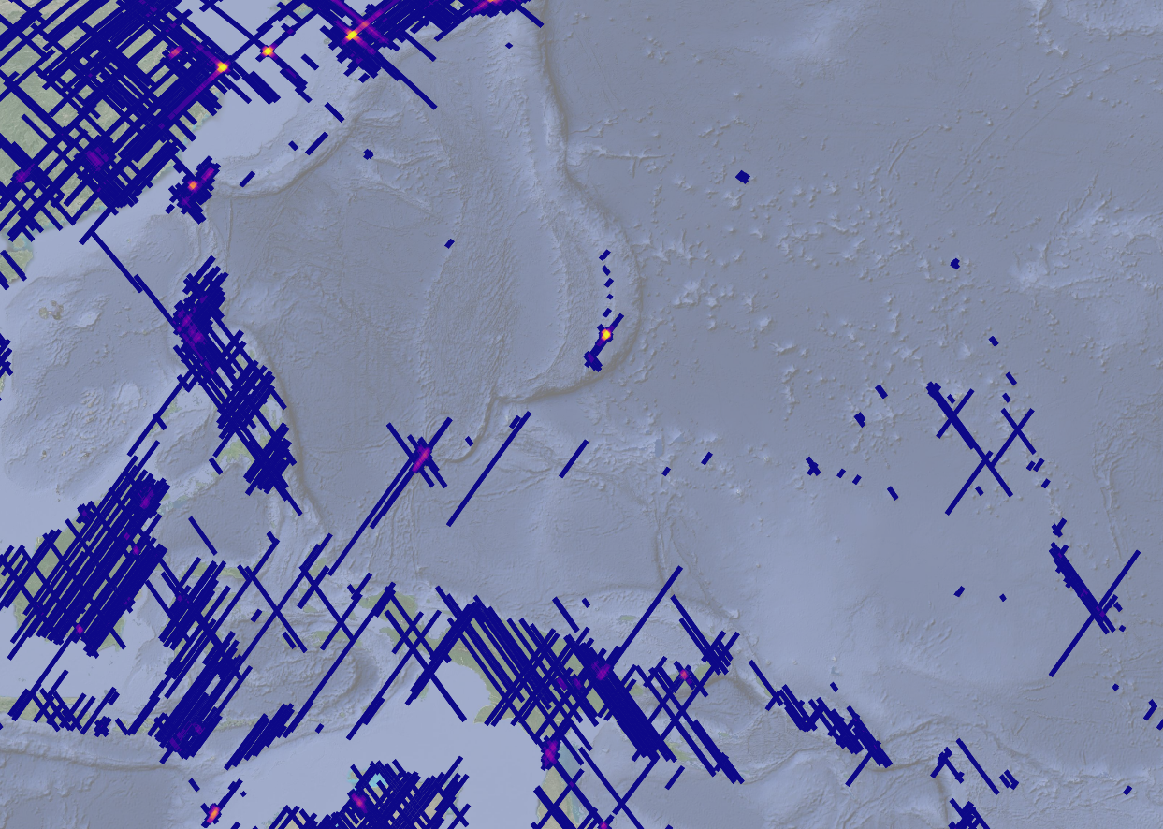
Data archive – Areal Mapping
No of available scenes
Europe – CHME sites
Pacific
Islands
Southern
America
Australia
New Zealand

Slide 15
DESIS specification
ISS (~ 400km), non-sun-synchronous orbit
Covers 55° N to 52° S
Tilting options: -45° (backboard) to +5° (starboard),
-40° to +40° (along track)
> Lecture > Author • Document > Date
Mission Instrument | ISS/MUSES DESIS
Off-nadir tilting (across-track, along-track) | -45° (backboard) to +5° (starboard), -40° to +40° (by MUSES and DESIS)
Spectral range | 400 nm to 1000 nm
Spectral sampling, FWHM | 2.55 nm, 3.50 nm
Radiometry | 13 bits
Spatial (res., swath) | 30 m, 30 km (@ 400 km)
SNR (signal-to-noise) | 205 (no bin.)/406 (4 bin.) @ 550 nm
Instrument (mass) | 93 kg
Capacity (km, storage) | 2360 km per day, 225 GBit
Mission Instrument | ISS/MUSES DESIS
Target lifetime | 2018-2023 (nominal) …
Satellite (mass, dimension, usage) | 455 t, 109.0×97.9×27.5 m³ (multi-purpose)
Orbit (type, local time at equator, inclination, height, repeat cycle) | not Sun-synchronous, various, 51.6°, 320 km to 430 km, no repeat cycle
Coverage | 55° N to 52° S
Notes:
Green – ISS orbit – off nadir tilting for very Northern areas
Red – EnMAP orbit

Slide 16
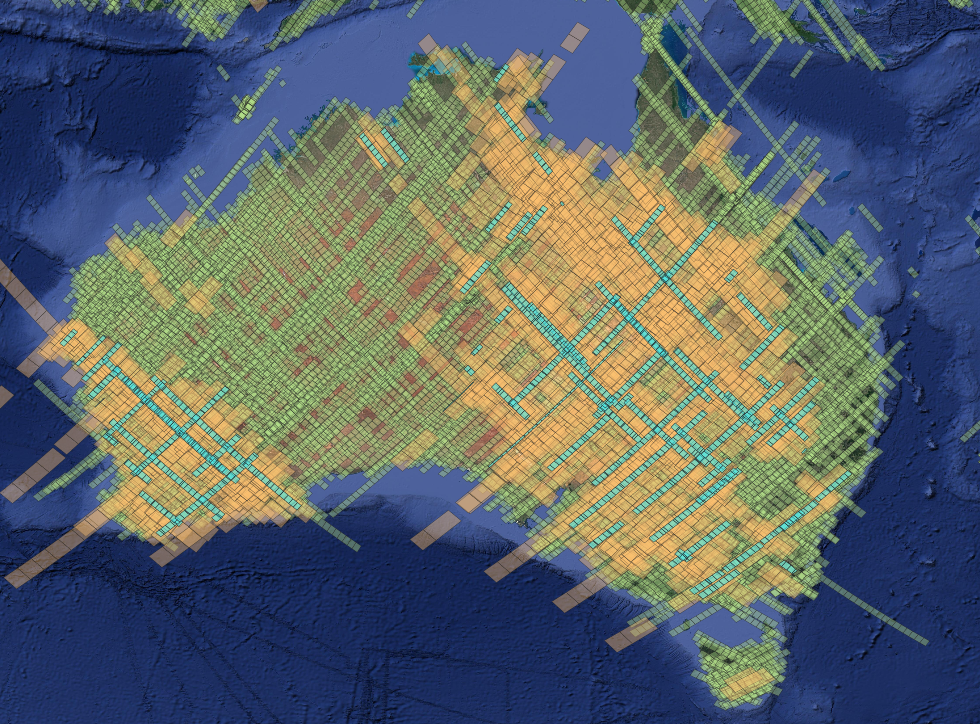
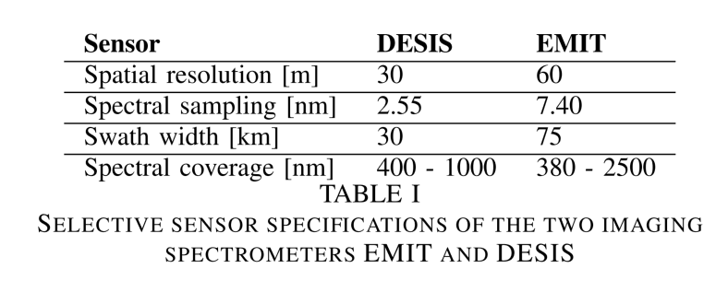
Synergies – DESIS/EMIT Acquisition overlap (within 60 min)
DESIS Footprints
EMIT Footprints
DESIS/EMIT Overlap
Status Oct 2023
Albury Forest
Notes:
Berechnet auf terrabyte (DLR Cooperation
with LRZ Supercomputing Center)

Slide 17
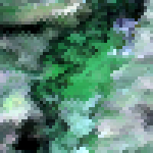
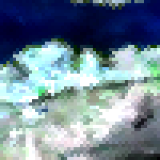
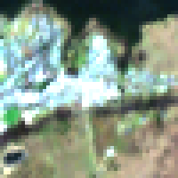
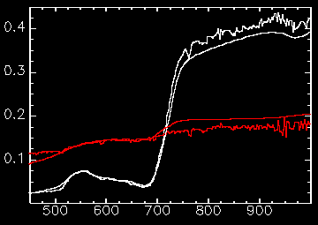
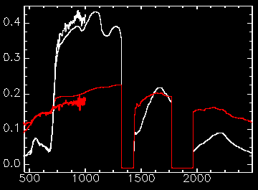
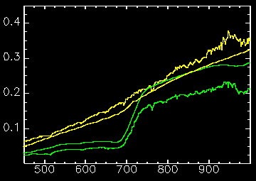
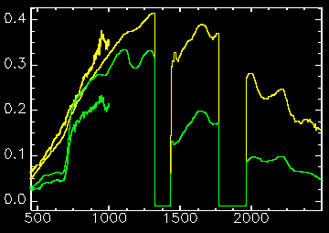
Synergies with EMIT – Albury Forest (16 / 03 / 2023, 04:50 GMT)
EMIT
EMIT | Sensor | DESIS
60 m | Spatial resolution | 30 m
7.40 nm | Spectral sampling | 2.55 nm
75 km | Swath width | 30 km
380 – 2500 nm | Spectral coverage | 400 – 1000 nm
EMIT
DESIS
DESIS
Reflectance factor
Reflectance factor
Wavelength [nm]
Wavelength [nm]

