Slide 1
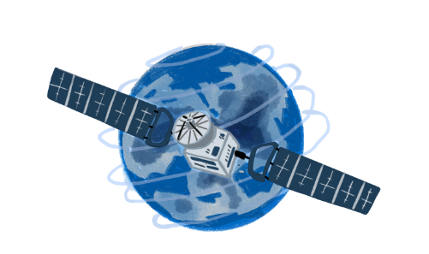

System for the Consolidation of L2 Products of the PRISMA-SG Mission
The COOL Project

Slide 2
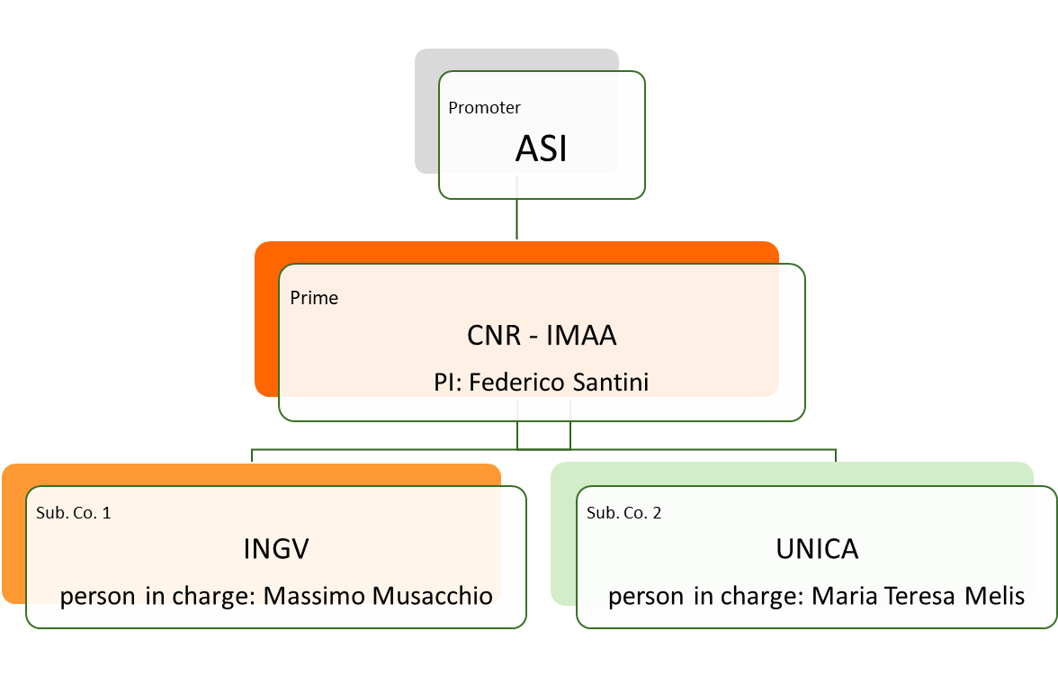
COOL Project
The Call ultimate goal: is to support the development of Earth Observation missions with a scientific program capable of fostering the growth of the skills within the national scientific and applicative community.
The ASI Call: aims to support an extensive and inclusive policy for the national scientific and applicative community of Earth Observation throughout all stages of development of national, European, and international programs.
Board
The COOL Project Objective: meets the objectives of the call by proposing the development of an advanced, modular and scalable system for the generation, validation, and consolidation of the SRL of the L2 products of PRISMA Second Generation (PRISMA-SG), considering the specific characteristics of the new sensor, with reference to the effects of off-nadir viewing.
This system will support the identification of the mission's limits and potential and will provide valuable assistance for managing industrial activities during the development and implementation phases of the mission.
Among the objectives of the project is the training of high qualification personnel.

Slide 3
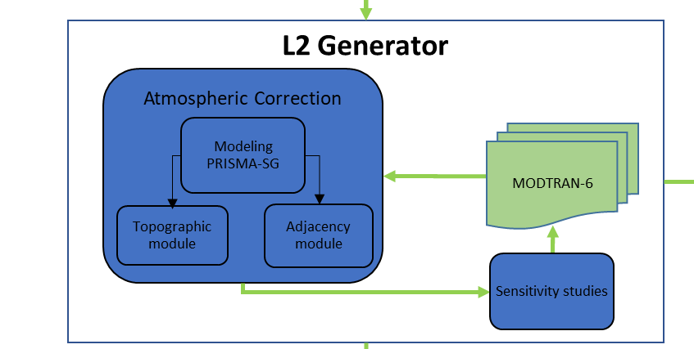
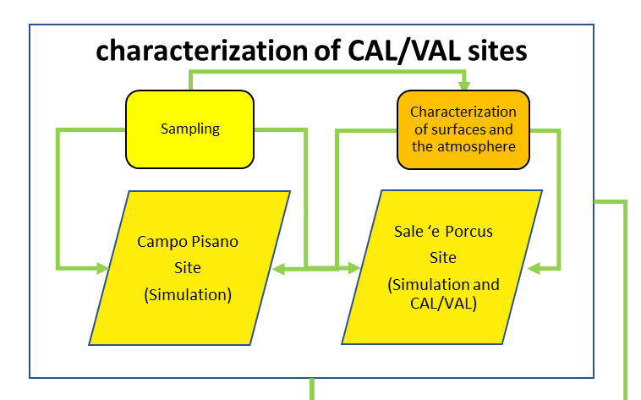
COOL Project: Logic Scheme
The COOL system is composed of two main subsystems
Development of procedures for the generation of L2 products, based on radiative transfer in the Earth/atmosphere system, specialized for the characteristics of PRISMA-SG;
Setup and characterization of two mineralogical/raw material sites.
Notes:
Objective:
Develop an advanced, modular and scalable system for the generation, validation, and consolidation of the SRL of the L2 products of PRISMA Second Generation (PRISMA-SG), considering the specific characteristics of the new sensor, with reference to the effects of off-nadir viewing. This system will support the identification of the mission's limits and potential and will provide valuable assistance for managing industrial activities during the development and implementation phases of the mission.
Main Activities:
Development of procedures for the generation of L2 products, based on radiative transfer in the Earth/atmosphere system, specialized for the characteristics of PRISMA-SG;
Development of procedures for the simulation of synthetic spectra at the sensor (TOA);
Setup and characterization of two mineralogical/raw material sites.
These systems are autonomous and respond to specific objectives, but they interact and complement each other through other subsystems, such as the demonstrator and the TOA reflectance simulators, in order to achieve all the objectives of the project

Slide 4
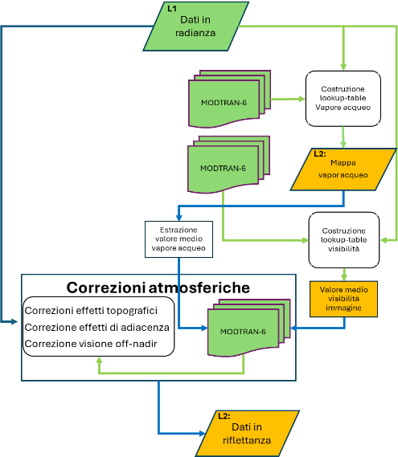
Atmospheric Correction
flow chart of the L2 generator
Main atmospheric correction steps
Parameterization of MODTRAN 6 considering the geographical coordinates of the image center and the acquisition and illumination geometry;
production of the water vapor map;
extraction of the average water vapor value over the image;
estimation of the average visibility value;
first run of the correction process, performed without introducing the correction for topographic and adjacency effects but considering off-nadir viewing;
computation of the point spread function (PSF);
estimation of the environmental function;
application of the environmental function to the reflectance image obtained from the application of the first atmospheric correction step (point 3);
second run of the correction process, including the correction for topographic and adjacency effects.

Slide 5
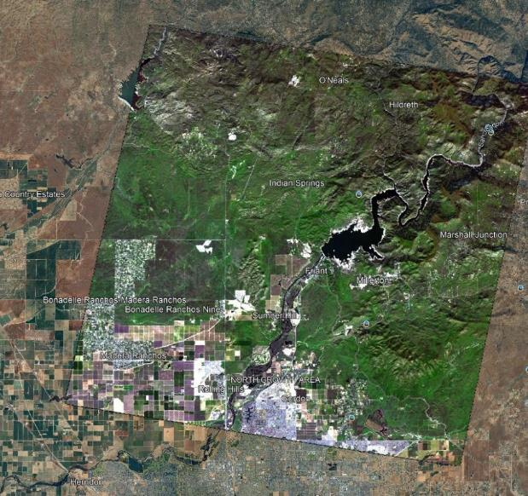
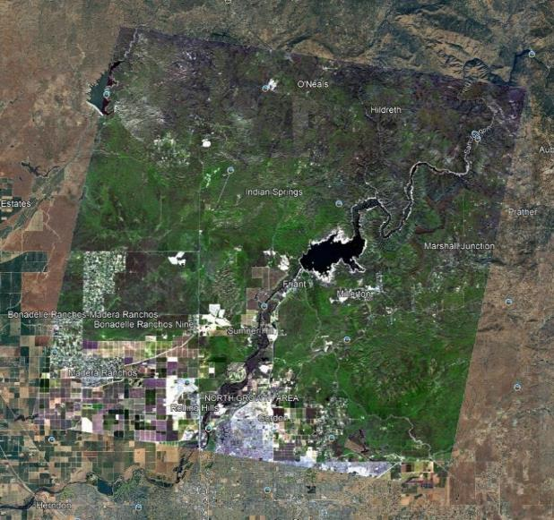
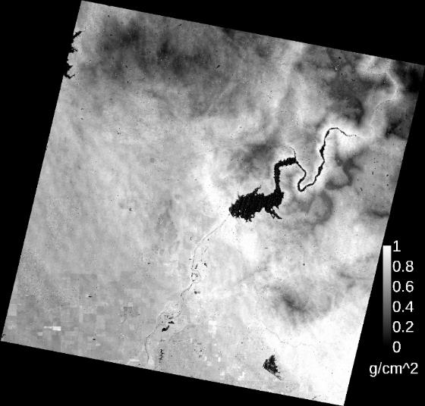
Atmospheric, Adjancy and Topographic Correction
EnMAP images acquired on February 18, 2023 - Fresno, California, USA
Water Vapour
Radiance
Reflectance – adjancy, topographic, off-nadir corr.
Results show a clear flattening after the application of simultaneous atmospheric, topographic, adjacency and off-nadir corrections
Notes:
Here are shown the results of applying atmospheric corrections, including corrections for adjacency effects, topographic effects, and off-nadir viewing, on a mountainous area in California, USA. The results demonstrate how the correction process effectively homogenizes the mountainous reliefs present in the scene

Slide 6
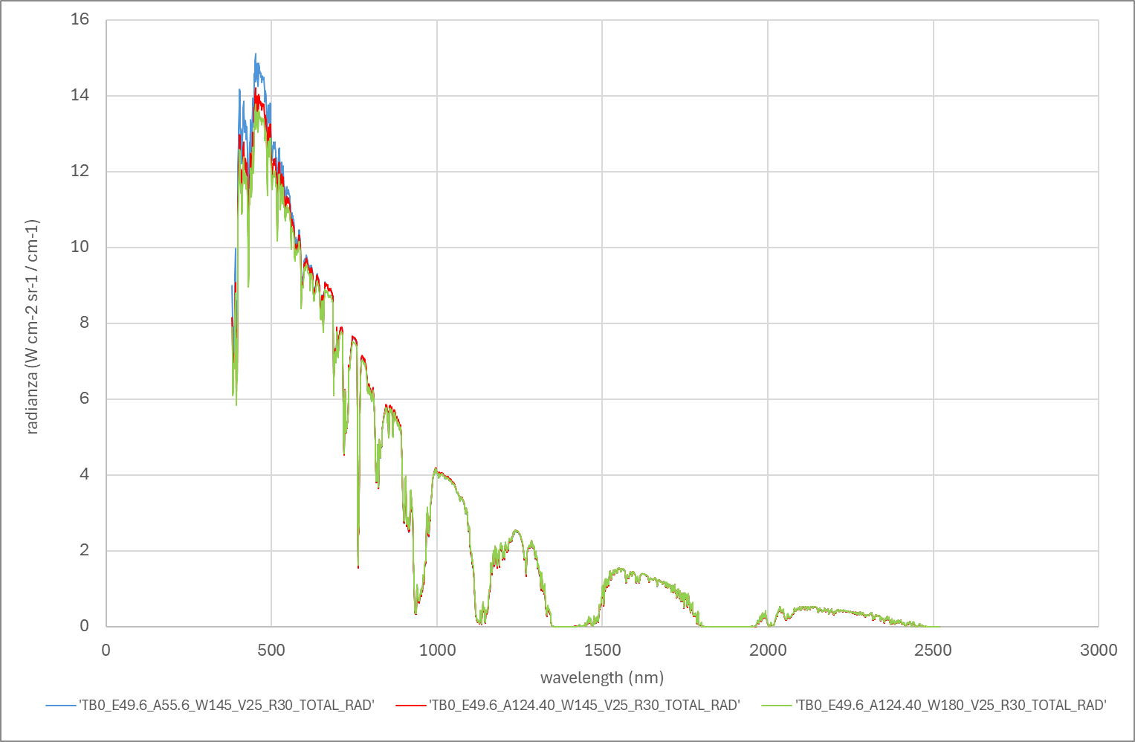
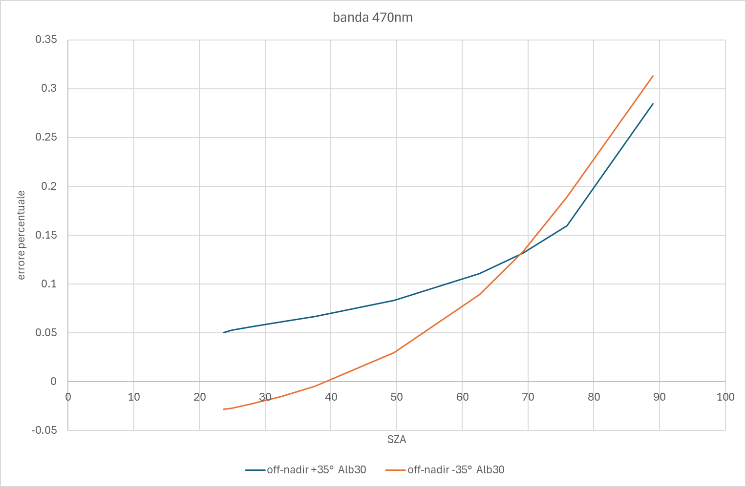
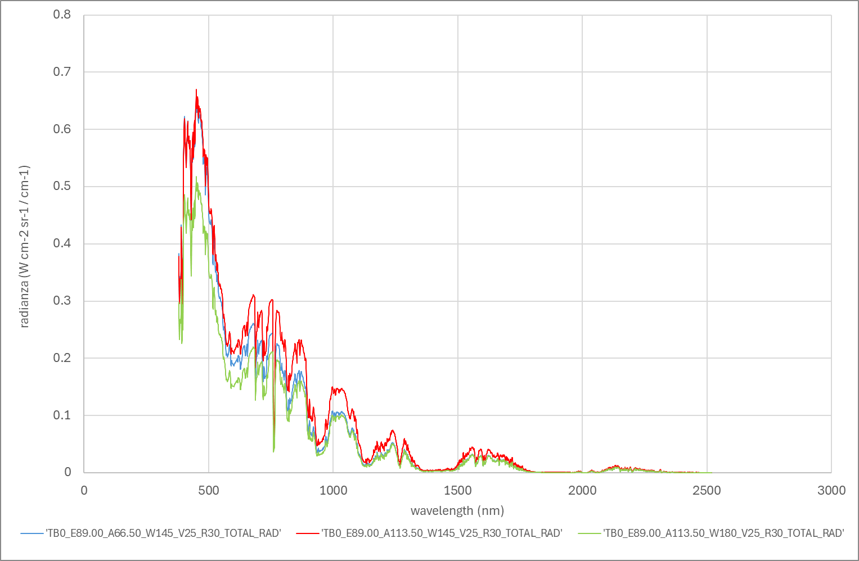
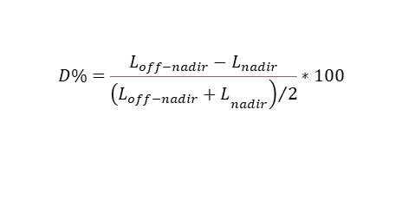
Sensitivity studies
A sensitivity study, based on the possible configurations (sun elevation vs relative azimuth) for a sun-synchronous satellite, was conducted to estimate the impact of high off-nadir angles possible with PRISMA-SG.
Mid latitude
$$D\%=\frac{L_{off−nadir}−L_{nadir}}{{\left.{\left(L_{off−nadir}+L\right.}_{nadir}\right)}/2}∗100$$
Off-nadir +35°,-35°, 0°
High latitude
Impact of off-nadir view vs sun elevation for an off-nadir of ±35° at 470nm
Notes:
The sensitivity study aims to verify the impact of off-nadir viewing on the signal recorded by the sensor, even in the presence of highly angled views such as those possible with PRISMA-SG. The graphs show that the deviation from nadir viewing increases with the SZA. The graph on the right shows that (for a 35° off-nadir ) this deviation exceeds 10% for SZA values greater than 60°.

Slide 7
The in-house atmospheric removal effect code :
ImaACor
The algorithms developed within the COOL project, including the correction for off-nadir viewing, are regularly integrated into the ImaACor atmospheric correction tool developed by CNR-IMAA
ImaACor Graphical °Interface
PRISMA Tool
ImaACor is participating in the ACIX-III Land Atmospheric Correction Inter-comparison eXercise
main screen

Slide 8
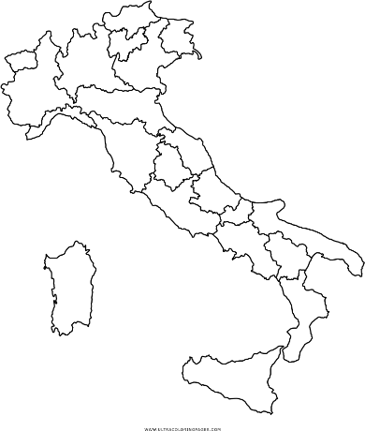
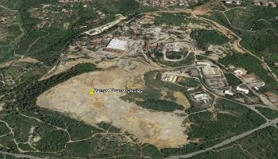
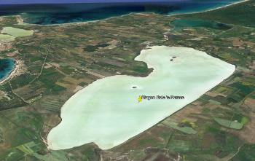
CAL/VAL site analysis
Site Characterization
Surface Spectroscopy; Roughness analysis
Mineralogy
Petrography
Atmospheric Characterization
Seasonal stability analysis
Reference missions: PRISMA, PRISMA–SG, ENMAP, SBG, SBG-TIR, CHIME
*
TOA generation
Ground
Atmosphere
Campo Pisano
1.0 km
0.2 km
From site characterization to TOA generation
Sale 'e Porcus
1.0 km
3.0 km
Notes:
The two proposed sites, located in southern and central Sardinia, are well known for their mineralogical characteristics and environmental conditions.
The first site is one of the main mining dumps in Sardinia, the mud basin of the “Campo Pisano” mine, (Iglesias). Extending over an area of ​​approximately 0.14 km2, it contains over 2 million m3 of tailings deriving from the treatment of minerals rich in lead and zinc sulphides from the mines of the Iglesiente district
The second proposed site is the “Sale 'e Porcus” pond, in the Oristano area, which occupies an area of ​​approximately 0.33 km2, characterized by seasonal variations in the state of surface moisture and total aridity in the summer.
The pond site is optimal for simulating the sensor signal at different acquisition angles. In the dry conditions, the site will be characterized by high albedos, determined by the presence of a homogeneous saline crust
The identified sites, known in great detail both for their spatial composition in mineralogical and spectral terms, show homogeneous behaviors with minimal lateral variations
An analysis will be carried out to specify which tools are necessary set up a CAL/VAL site; Also an analysis will be carried out in terms of medium / long-term maintenance cost

Slide 9
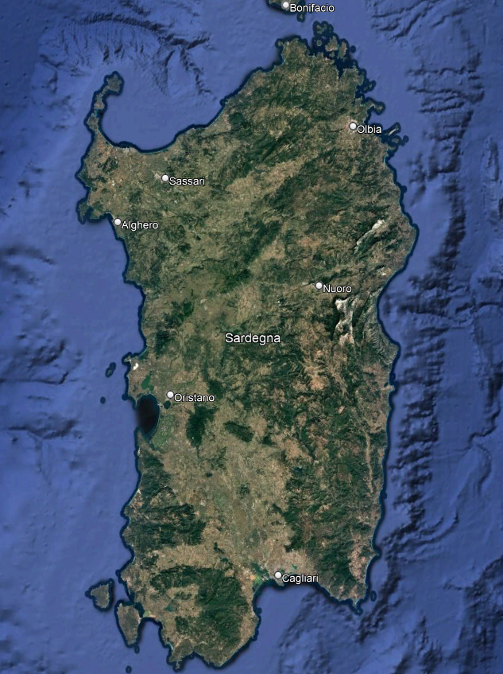
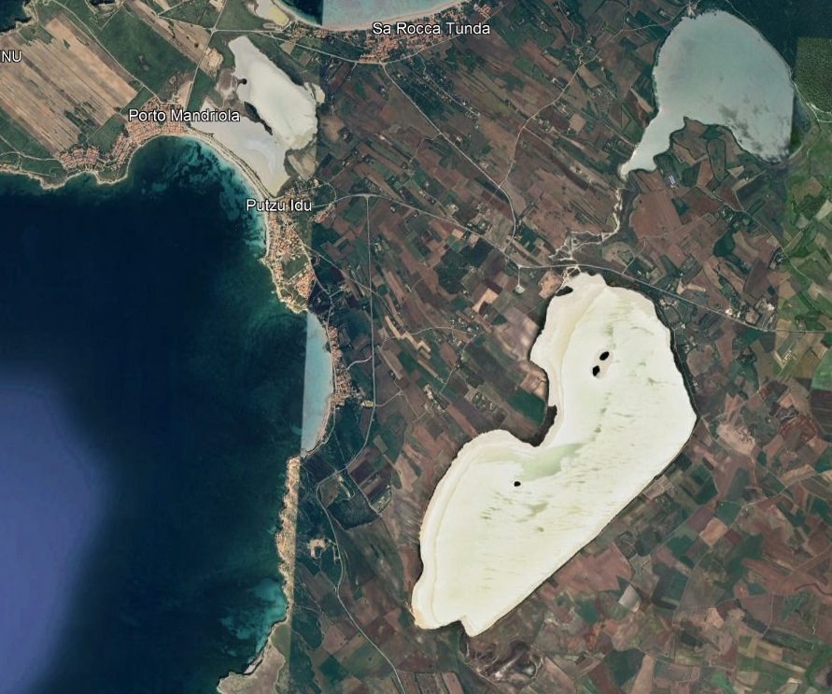
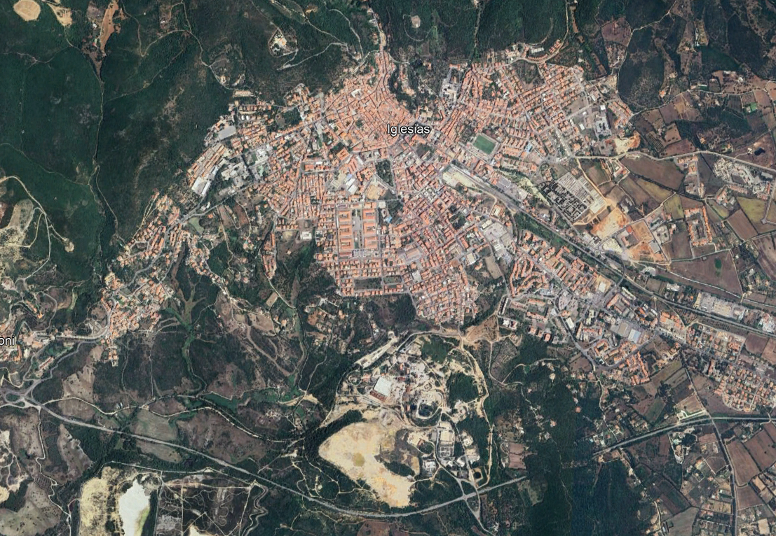
Surface characterization
Activities: Surface characterization:
  reflected solar radiation carried out with a portable spectroradiometer ASD Fieldspec; comparison of the spectral response of the different measurement points for each site by analyzing the spectral variability; analysis of seasonal variation and definition of the site.Surface Reflectance Measurements: measurements of

Slide 10
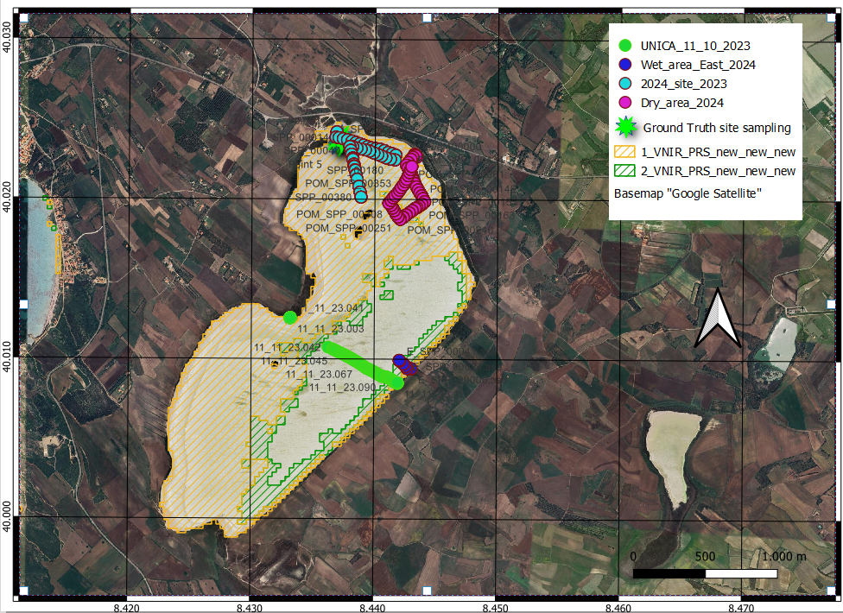
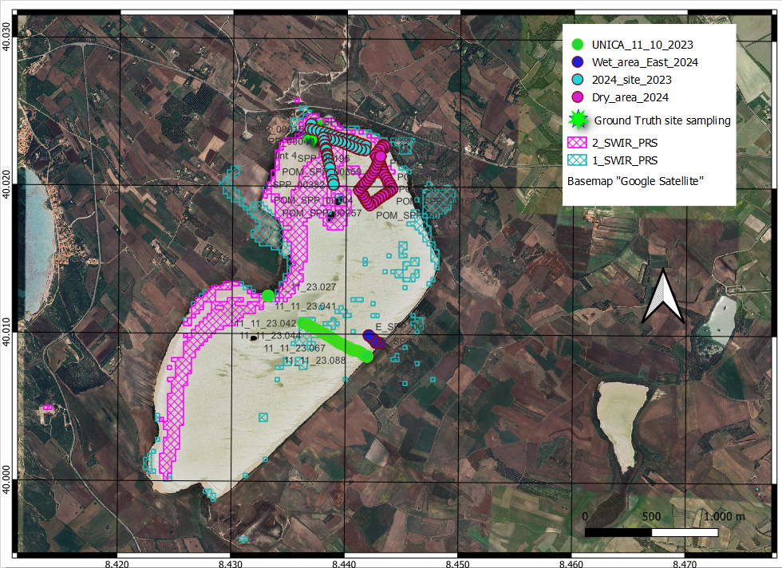
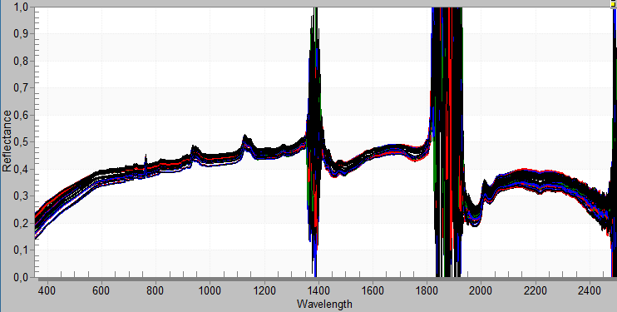
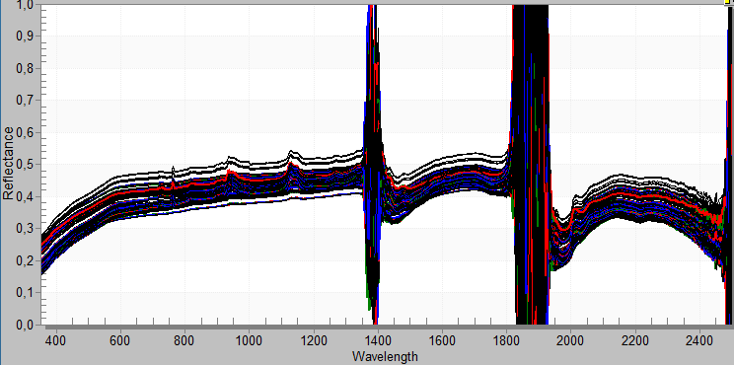
Sal’e Porcu Pond «Dirty Salt» pond

Slide 11
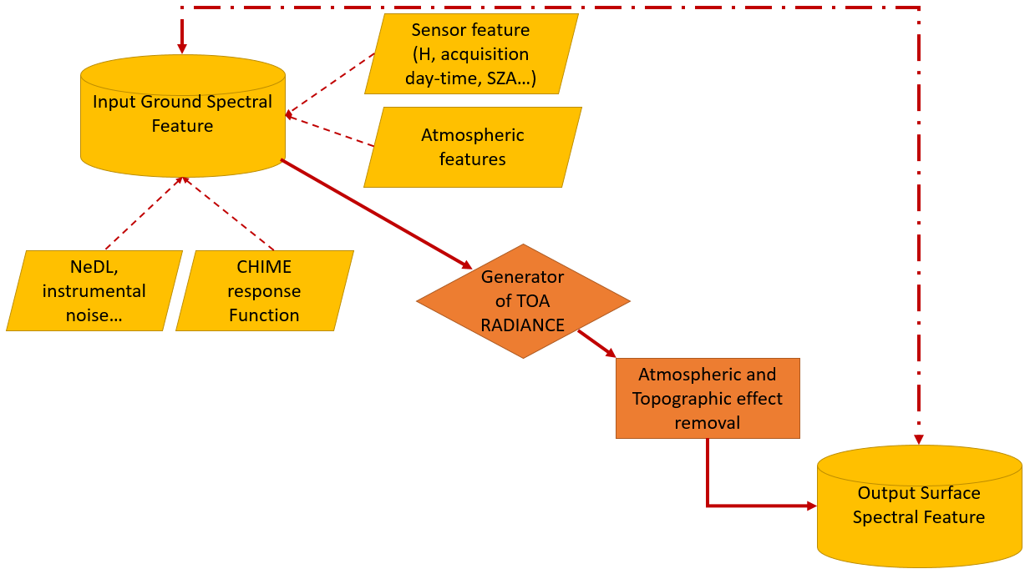
TOA reflectance generation
MODTRAN Radiative Transfer Model
Surface Spectral Characterization
Sensor Characterization
Sensor Spectral Response Function
P-SG

Slide 12
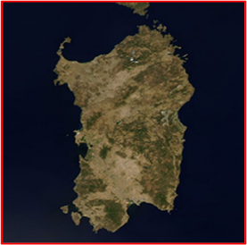
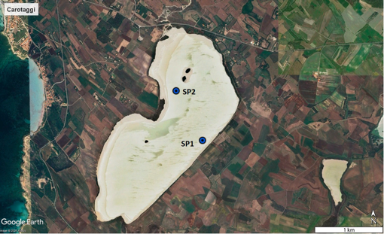
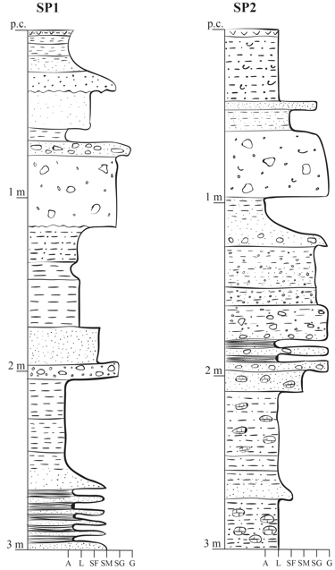
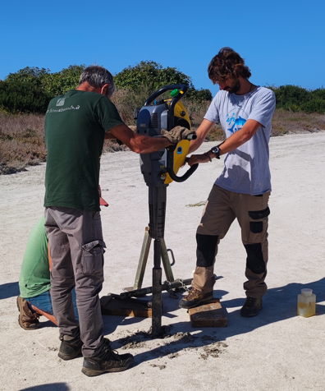
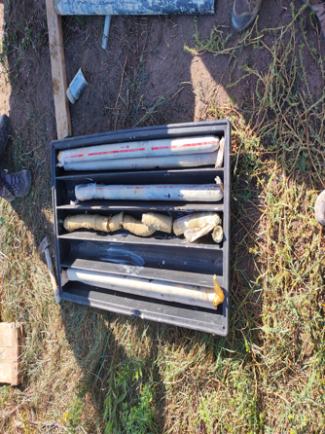
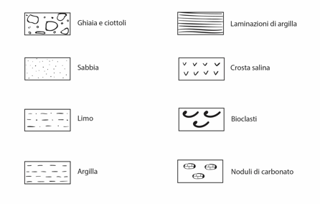
Site Characterization mineralogy and petrography
Sal ‘ e Porcus site
The points correspond to the core sampling points

Slide 13
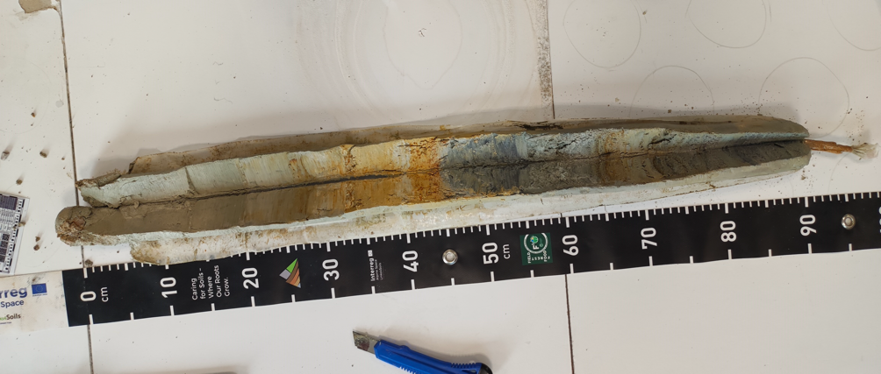
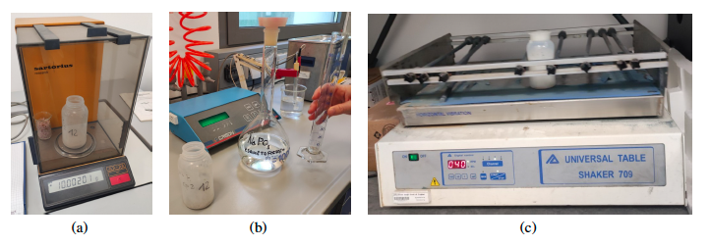
Site Characterization mineralogy and petrography
X’Pert Pro PANalytical diffractometer (Malvern Panalytical, Malvern, UK) with a copper X-ray tube (Cu-Kα1 λ = 1.54060 Å), nickel monochromator filter and X’Celerator detector.
Data were acquired at the following instrumental conditions: 40 kV and 40 mA, in the angular range of 5±70 ◦2θ. The interpretation software used was X'Pert3 HighScore Plus from PANalytical
Sedimentology analysis
Notes:
Da sinistra a destra: la bilancia usata per pesare i campioni; la misurazione di 10 ml
di esametafosfato di sodio da inserire nelle bottigliette; l’agitatore

Slide 14
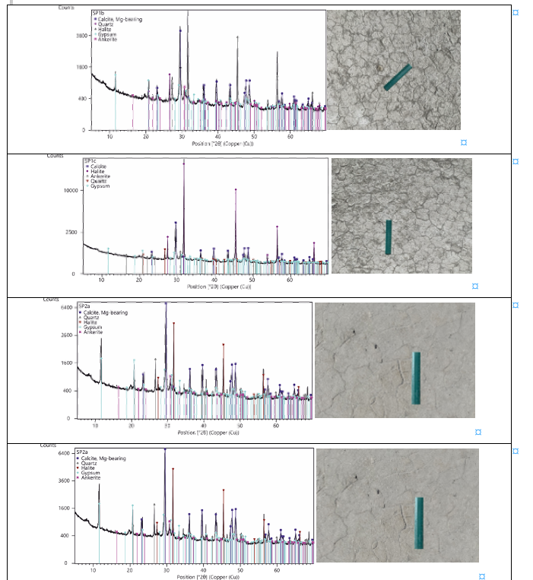
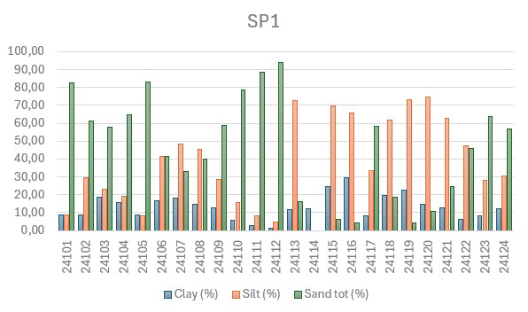
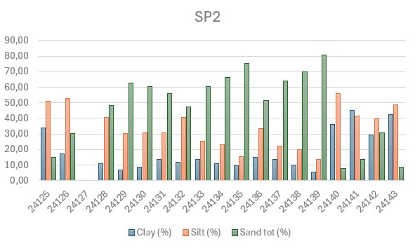
SP pond Site Characterization mineralogy and
petrography: Results
Sample | Mineralogy
SP1a | Cal, Qtz, Hl, Ank, Gp
SP1b | Cal, Qtz, Hl, Ank, Gp
SP1c | Cal, Qtz, Hl, Ank, Gp
SP2a | Cal, Qtz, Hl, Ank, Gp
SP2b | Cal, Qtz, Hl, Ank, Gp
SP2c | Cal, Qtz, Hl, Gp, Dol
SP3a | Cal, Qtz, Hl, Gp
SP3b | Cal, Qtz, Hl, Gp
SP3c | Cal, Qtz, Hl, Ank, Gp
SP4a | Cal, Qtz, Hl, Gp
SP4b | Cal, Hl, Ank, Gp
SP4c | Cal, Qtz, Hl, Ank, Gp
SP5a | Hl
SP5b | Cal, Qtz, Hl, Gp
SP5c | Cal, Qtz, Hl, Gp

Slide 15
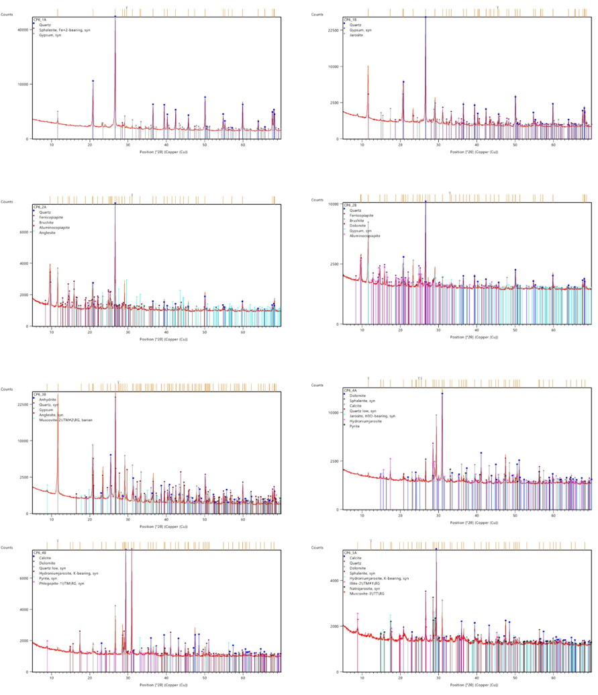
Campi Pisano Site Characterization mineralogy and
petrography : results
  minerals related to primary mineralizations mined in the past at the Campo Pisano mine and other mines in the Iglesias district - Sphalerite [ZnS], Pyrite [FeS2] and Galena [PbS], as sulphides; Anglesite [PbSO4], Smithsonite [ZnCO3] and Goethite [FeO(OH)], as secondary minerals of the mineralizations (sulphates, carbonates, hydroxides);
  minerals related to the rock encasing the mineralization - Dolomite [CaMg(CO3)2], Calcite [CaCO3], Quartz [SiO2];
  secondary minerals related to oxidation processes on the surface of the landfill: these phases are of particular interest, given their diffusion on the surface of the basin; their genesis is attributable to the environmental reactivity of the minerals originally present in the landfill with the atmosphere - Jarosite [KFe3(SO4)2(OH)6], Ferricopiapite [Fe3+2/3Fe3+4(SO4)6(OH)2 20(H2O)], Magnesiocopiapite [MgFe3+4(SO4)6(OH)2 20(H2O)] and Melanterite [FeSO4 7(H2O)], linked to the alteration of Pyrite in an oxidizing environment and with the production of acid mine drainage
Campo Pisano
XRF results

Slide 16
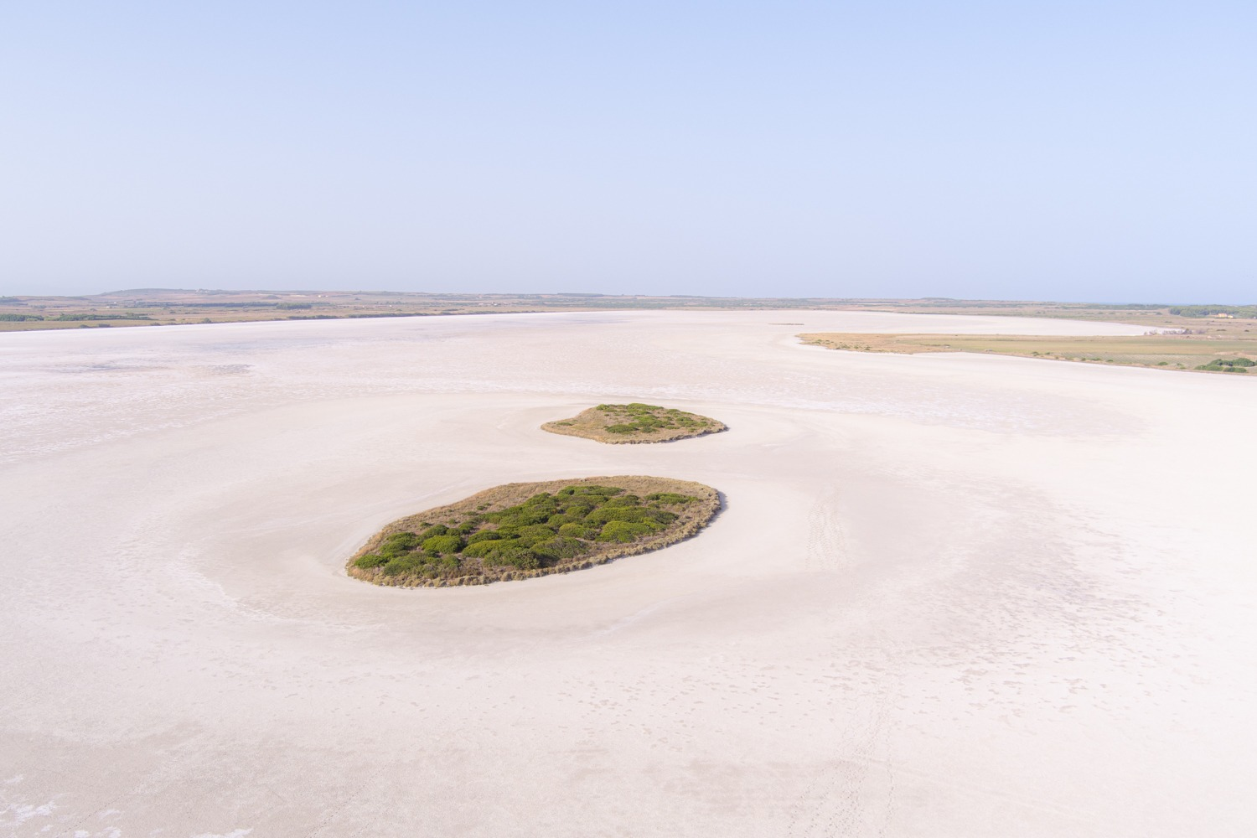
Key points
Mid of the project lifetime
Preliminary scientific results will be presented
during next AGU2024 fall meeting (search for us)
Considering the training of new/young colleagues as mandatory we also organize International Summer School on Remote Sensing (planned up to 2027)
Keep in touch
Thank You

