Slide 1
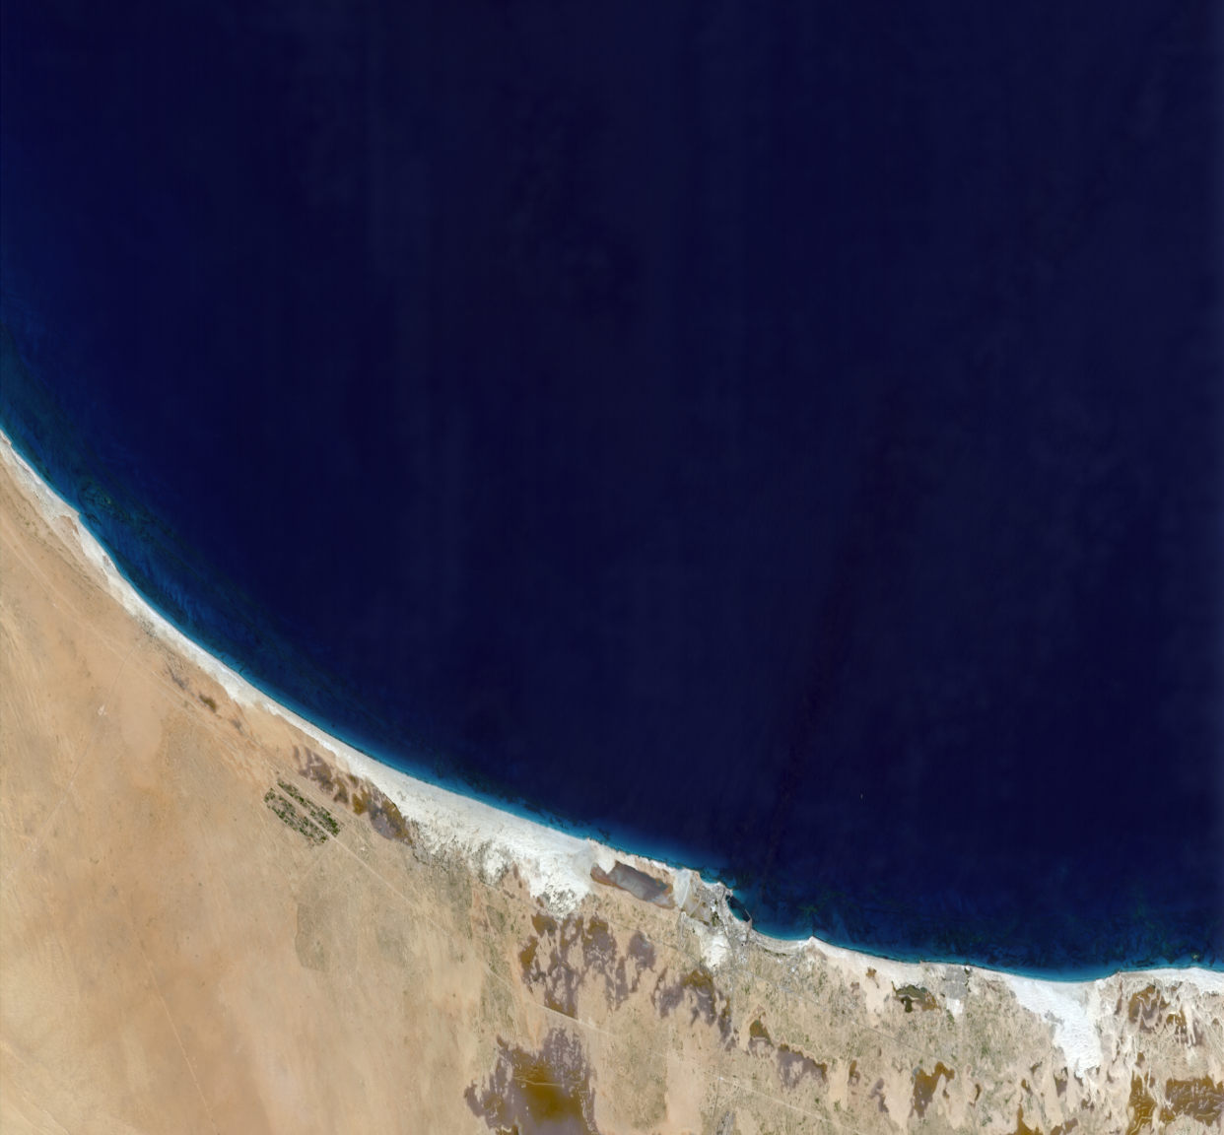
Nonlinearity Calibration for SBG-VSWIR and Related Imaging Spectrometers
Regina Eckert
Peter Sullivan, David R. Thompson, Byron Van Gorp, Lori Moore, Carl Bruce, Diana Blaney, Robert O. Green
November 14, 2024

Slide 2
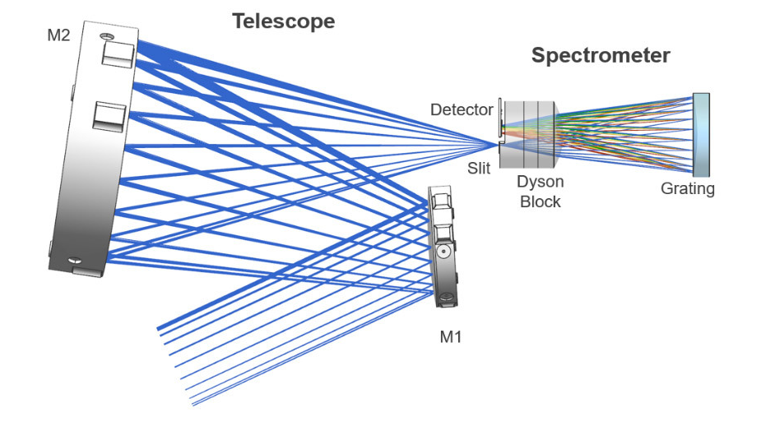
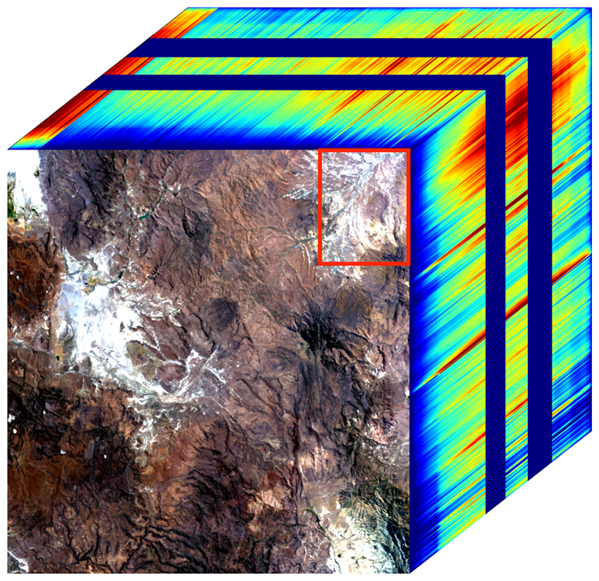
Pushbroom imaging spectrometer with Dyson block design
Detector Image
Spatial
Spectral
Spatial (Direction of Flight)
Incoming light

Slide 3
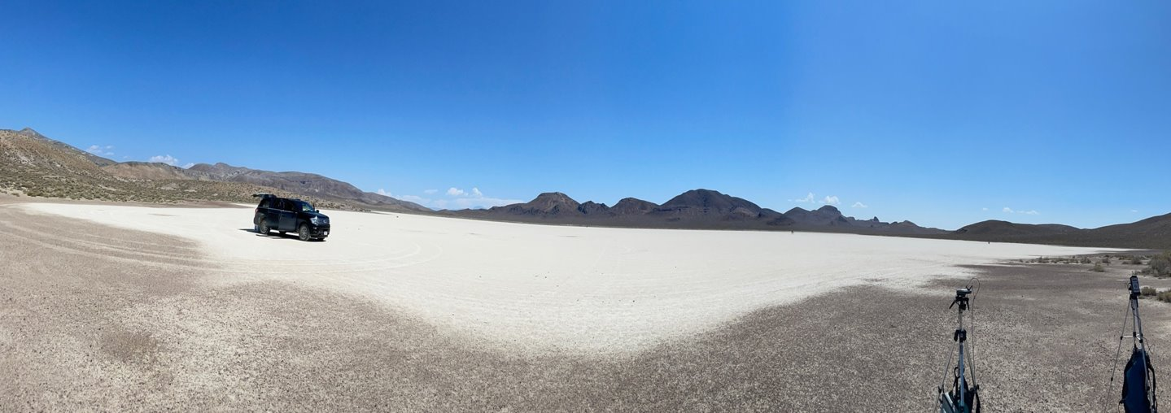
Earth as on-board calibrator, star tracker, flatfield, and shutter
Blackrock Playa - Image courtesy Ray Kokaly, USGS

Slide 4
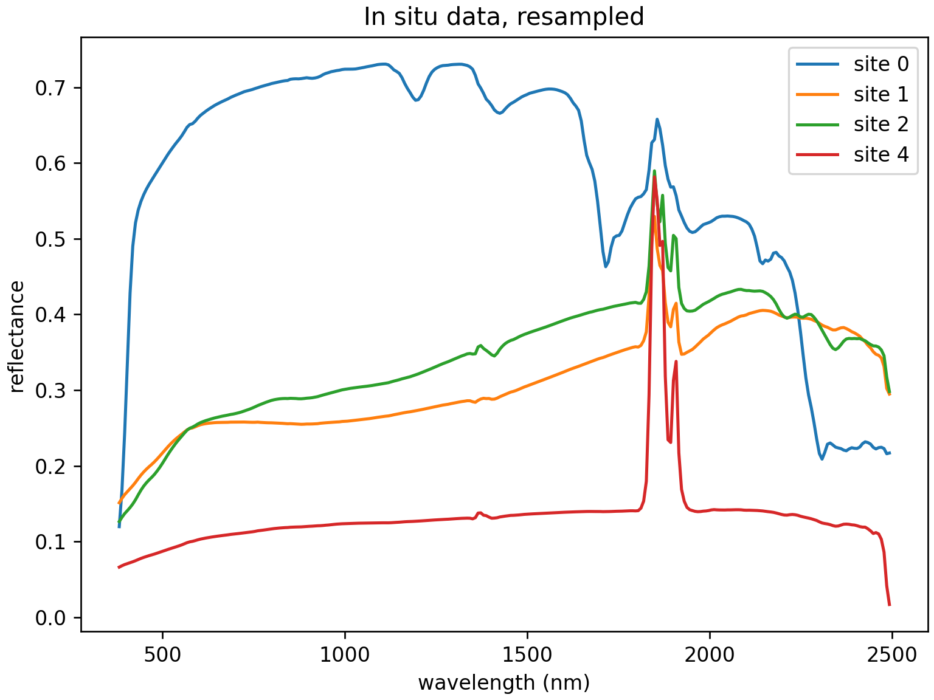
Vicarious calibration method
In Situ Measurements
0: White roof, 1: Concrete, 2: Dirt, 4: Asphalt
Radiometric Update Factors
Three flightlines at different altitudes
AVIRIS-3
Factors interpolated through atmospheric features
Forward simulated with retrieved atmospheric parameters from original radiance
Divide by original radiance for multiplicative update factors

Slide 5
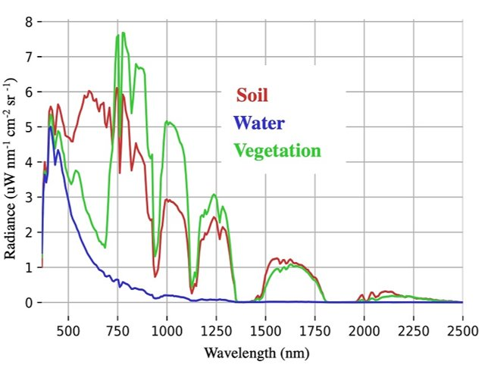
Bright playas in desert areas – but what about dark surfaces and high water vapor?
Example radiance spectra
How do we know the instrument has a linear response for low light levels?

Slide 6
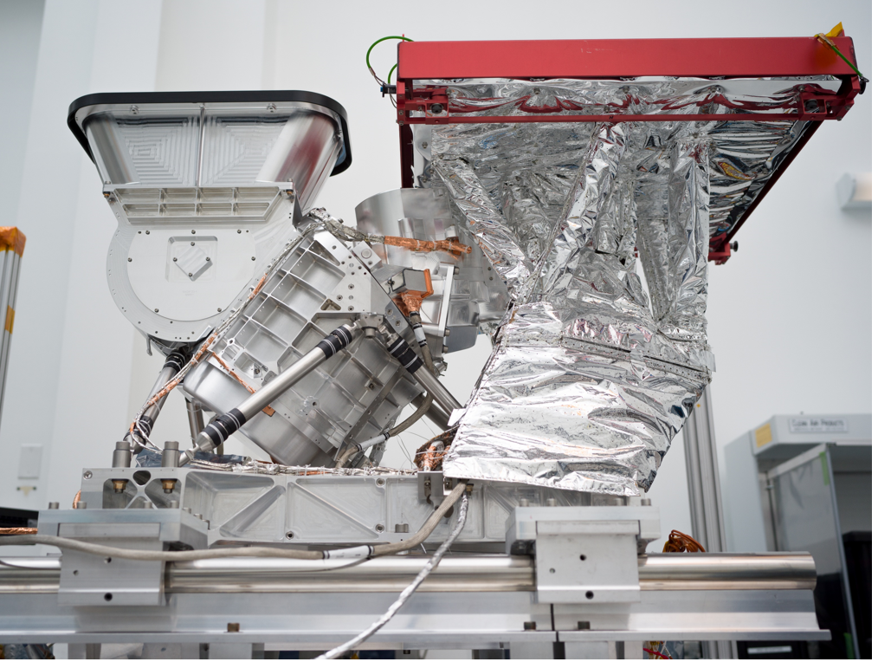
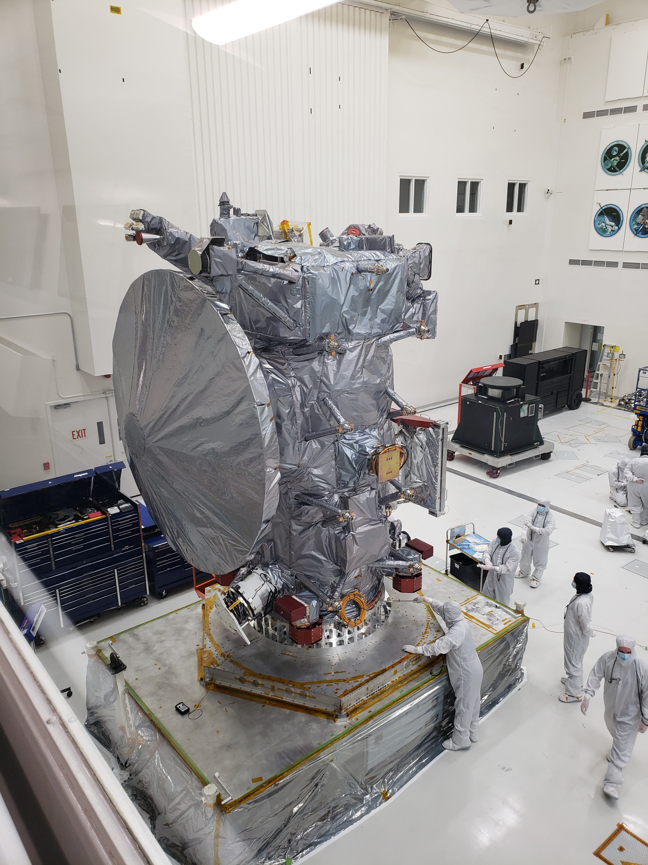
Mapping Imaging Spectrometer for Europa (MISE)
Imaging spectrometer from 800 nm – 5000 nm, 10 nm spectral sampling
Part of NASA’s Europa Clipper mission to Jupiter’s icy moon, Europa
Will map Europa’s surface composition (organics, hydrates, salts, ices, and other materials)

Slide 7
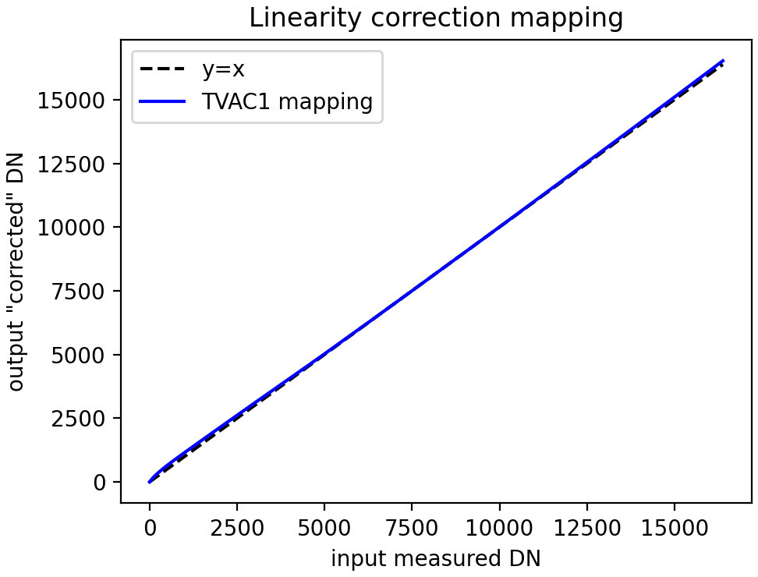
Nonlinear detector response
Input light B
MISE linearity correction mapping
Instrument
Input light A
Integrating sphere
A by itself: 1000 DN
B by itself: 30 DN
Expected A + B: 1030 DN
Measured A + B: 1020 DN

Slide 8
Must rely on other source of linearity to characterize detector nonlinearity
Another instrument
Illumination source with variable intensity
Integration time
Integrating sphere
(Linear addition of multiple sources)
Pulsed laser
SBG
Engineering Model FPA
EMIT
MISE
(Planned for SBG)
Unreliable method

Slide 9
Detectors across instruments
EMIT, AVIRIS-NG, AVIRIS-3, AVIRIS-5
MISE
SBG-VSWIR
Low-power design CHROMA-A detector
Analog-out
CHROMA-A detector
Analog-out
CHROMA-D detector
Digital-out

Slide 10
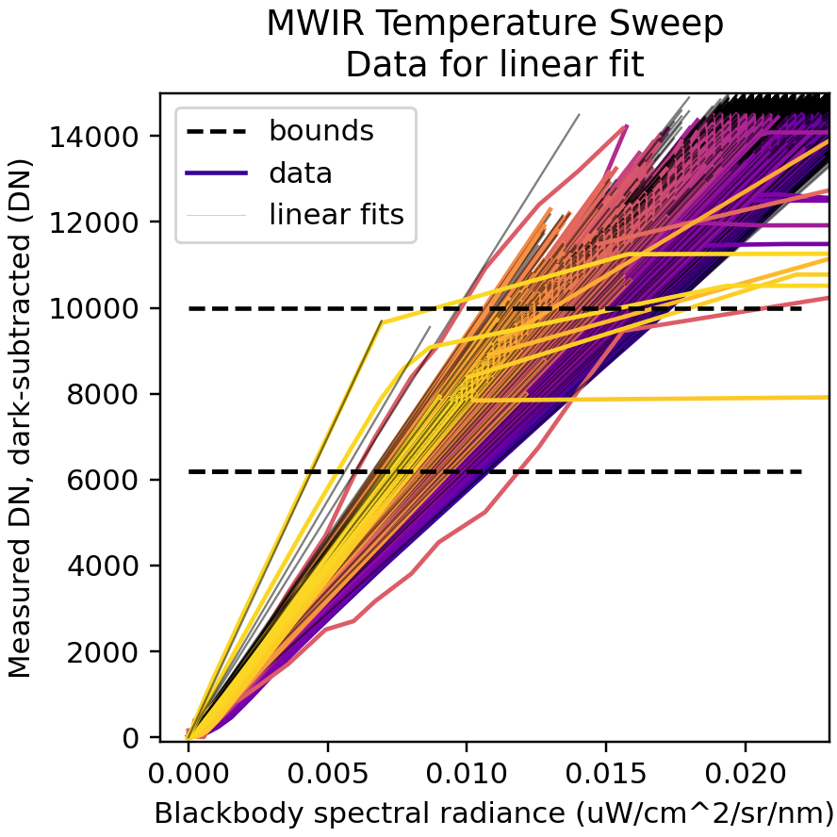
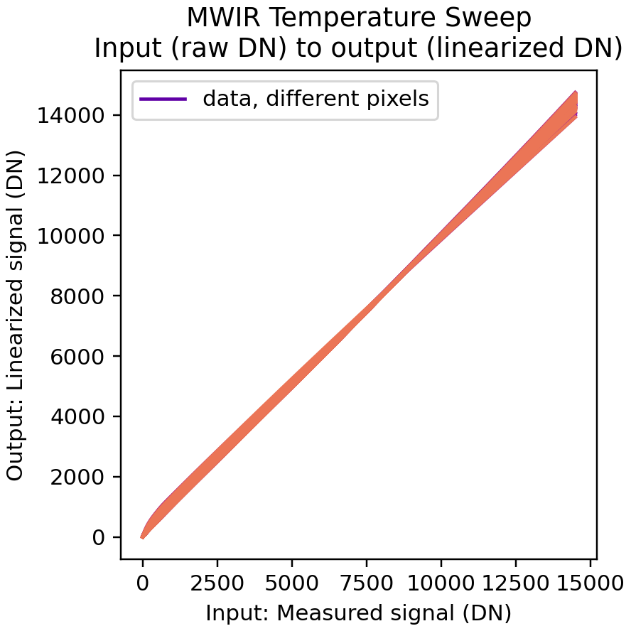
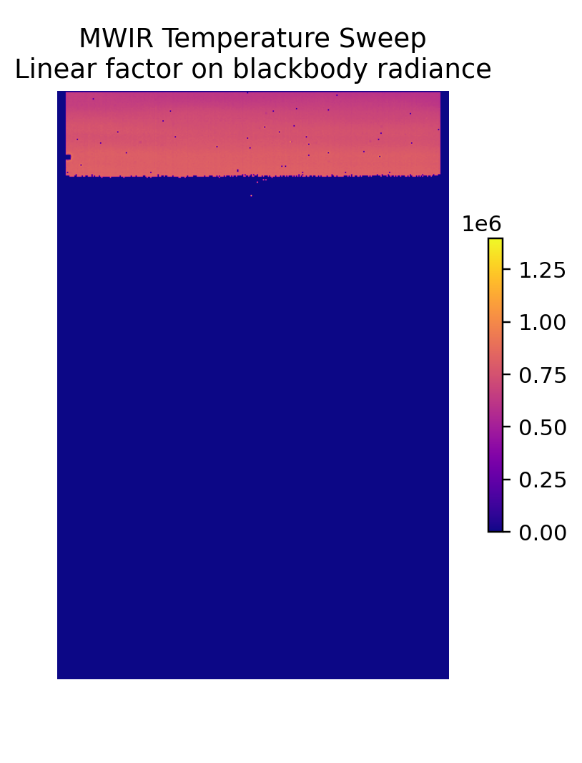
MISE linearity correction derivation
Transpose of x, y axes
$$s$$
$$αB$$
time
Blackbody Temperature Sweep
$$α$$
$$B$$
$$s$$
Fit multiplicative factor, $α,$between blackbody radiance, $B,$ and measured, dark-corrected signal (DN), $s$
2. Define relationship between measured, dark-corrected signal (DN) and output linearized signal
$$s= αB$$

Slide 11
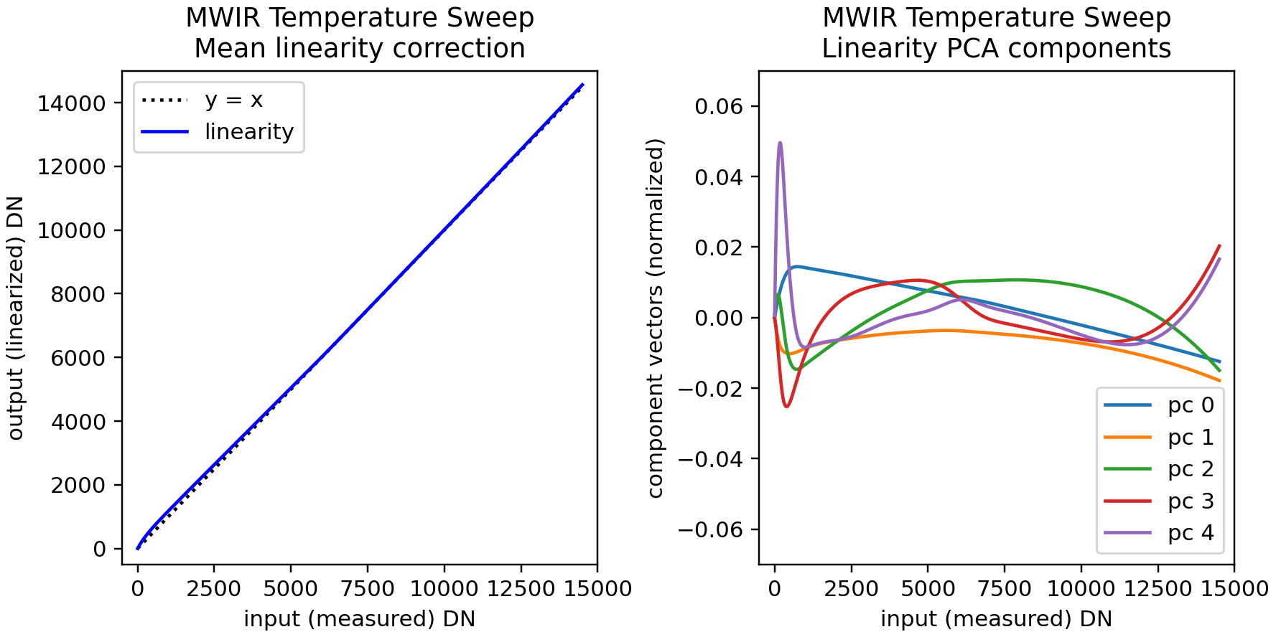
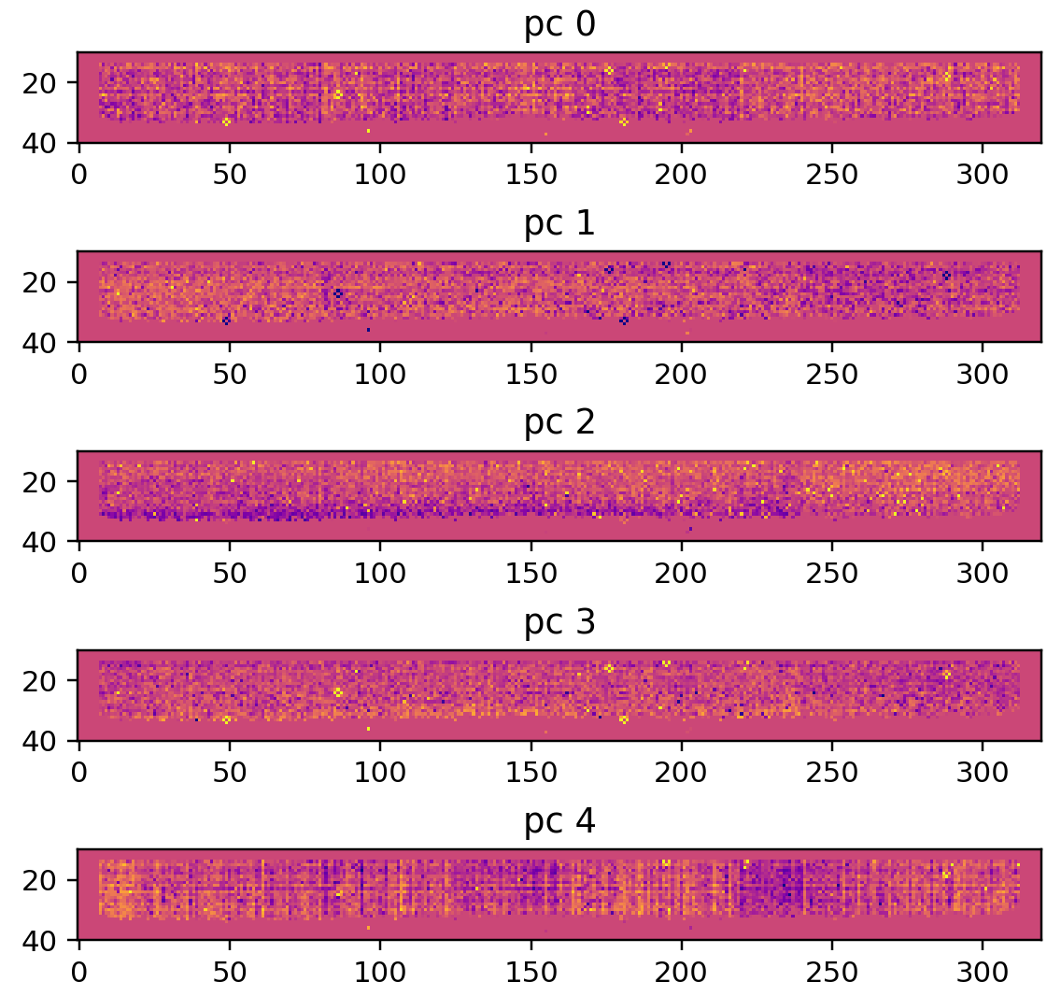
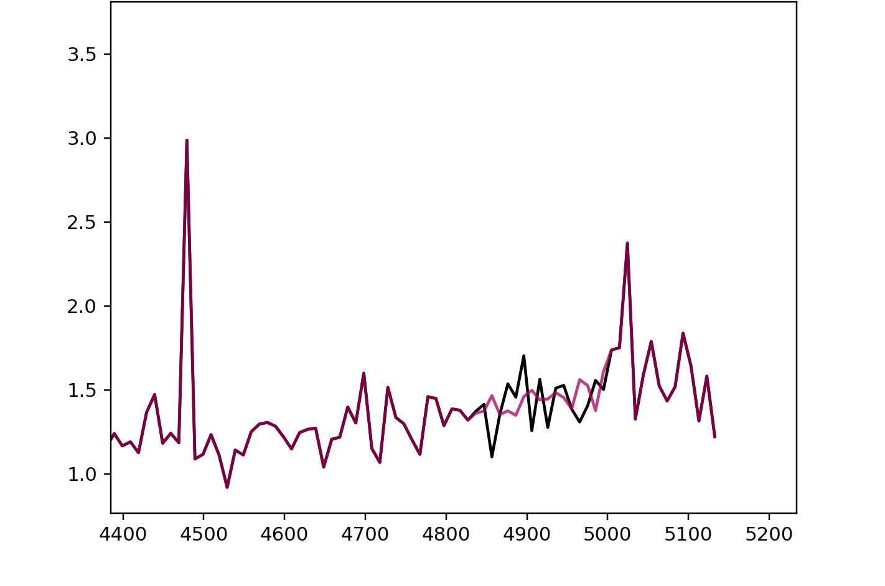
MISE pixelized linearity correction
Current pixelized pixel region
Normalized principal components weights
+3
-3
MISE RCC’s with linearity correction
Bulk linearity correction
Pixelized linearity correction
RCCs (uW/cm^2/nm/sr/DN)
wavelength (nm)

Slide 12
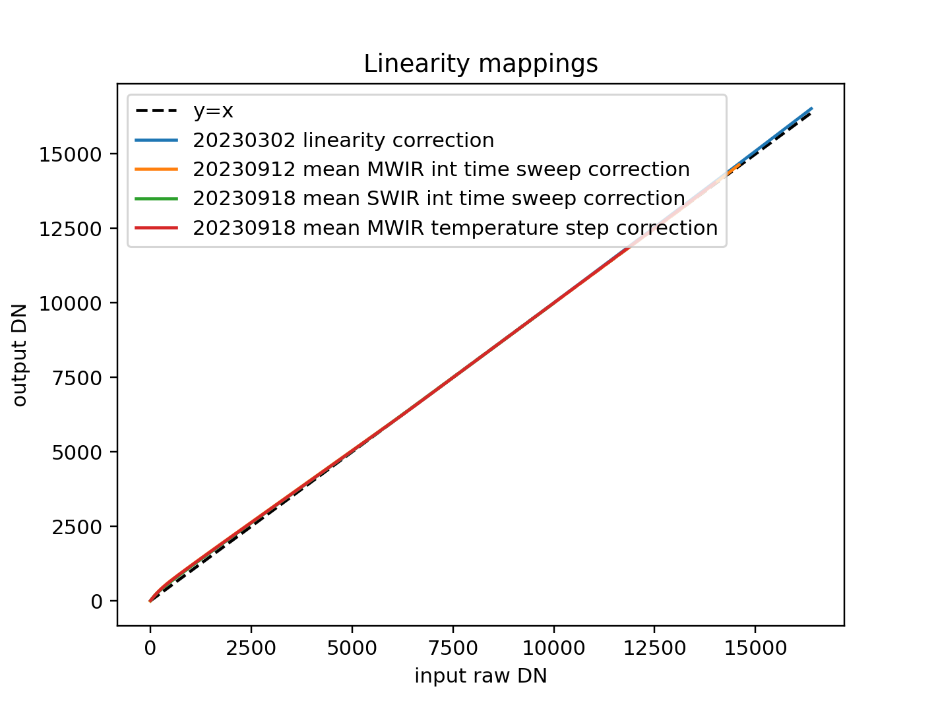
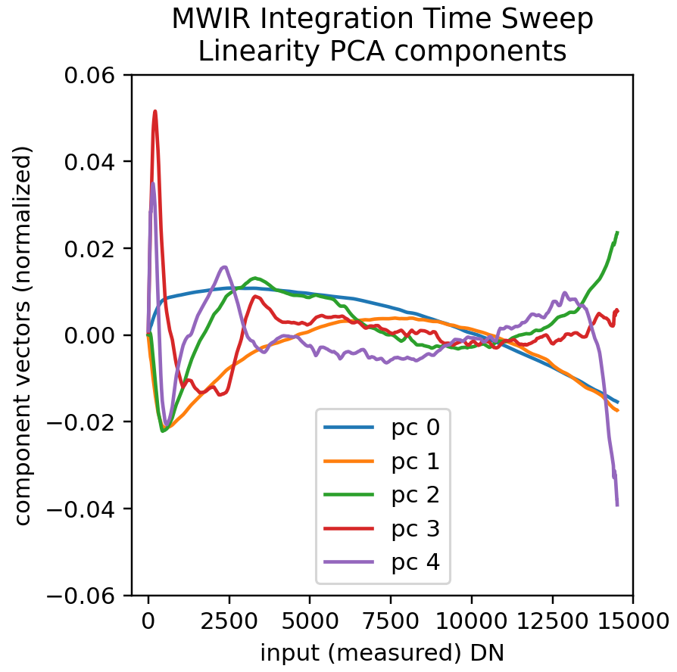
Linearity concurrence across measurements
For signal levels up to 4400 DN or so, the MISE detector reads out a lower value than expected
Different linearity measurements from TVAC1 and TVAC2 agree on the correction
Principle components also show similar features from different measurements

Slide 13
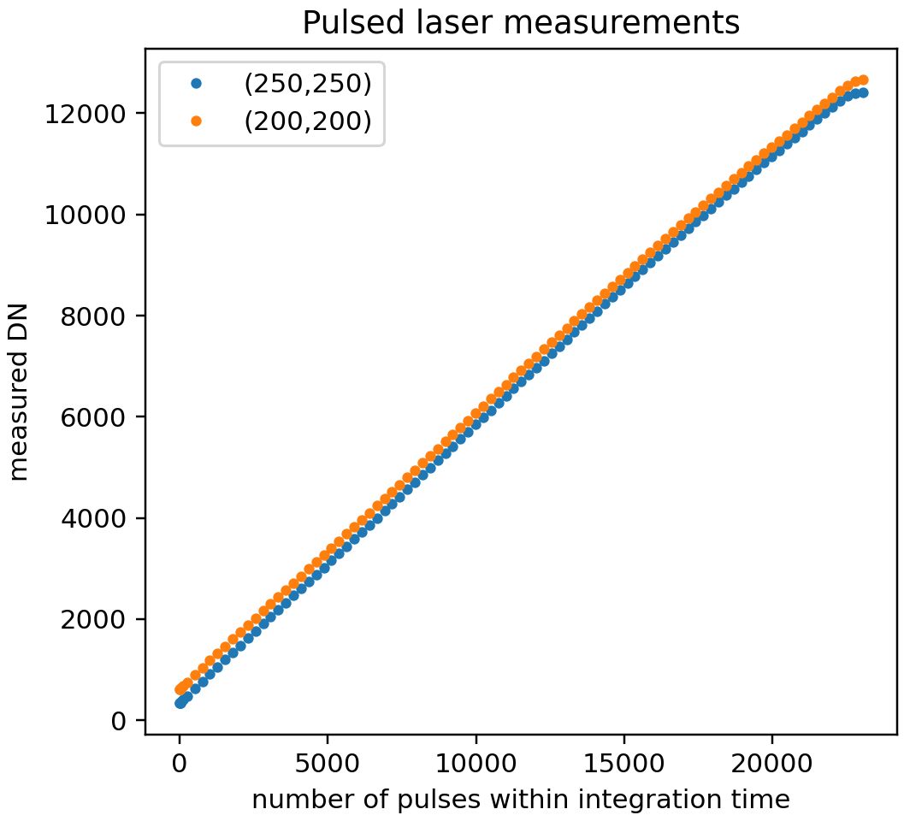
CHROMA-D linearity calibration with pulsed laser
Pulsed laser

Slide 14
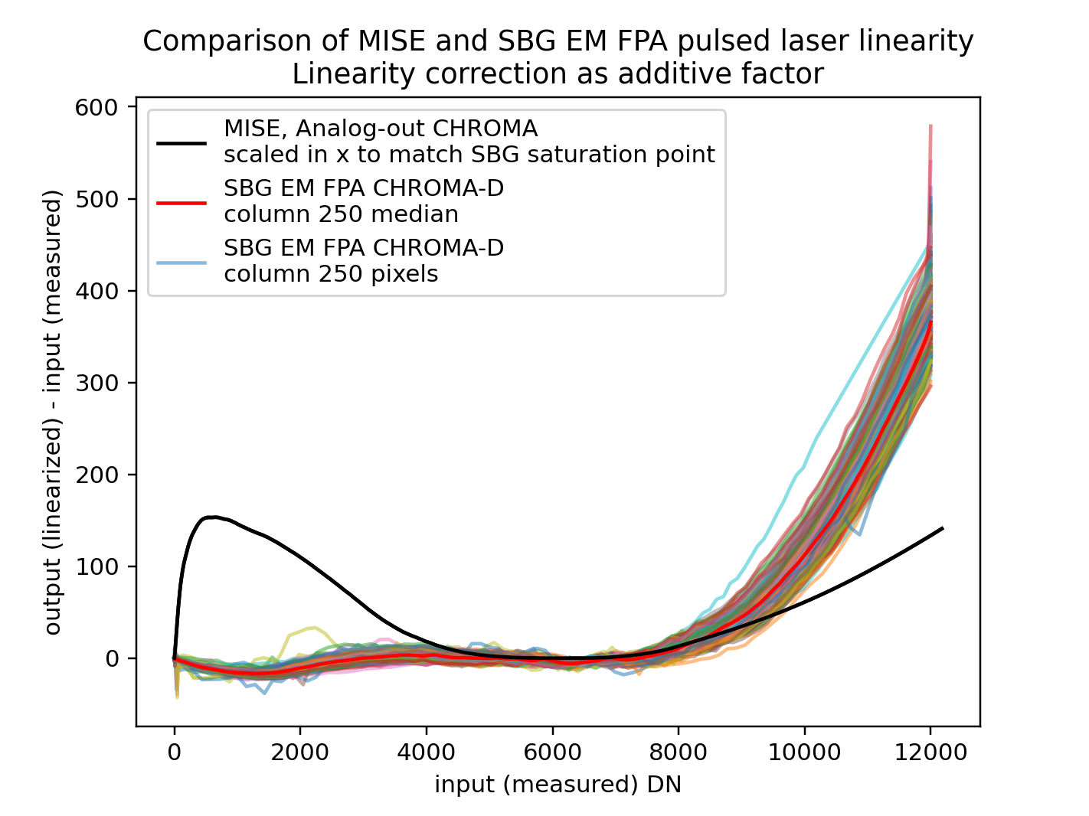
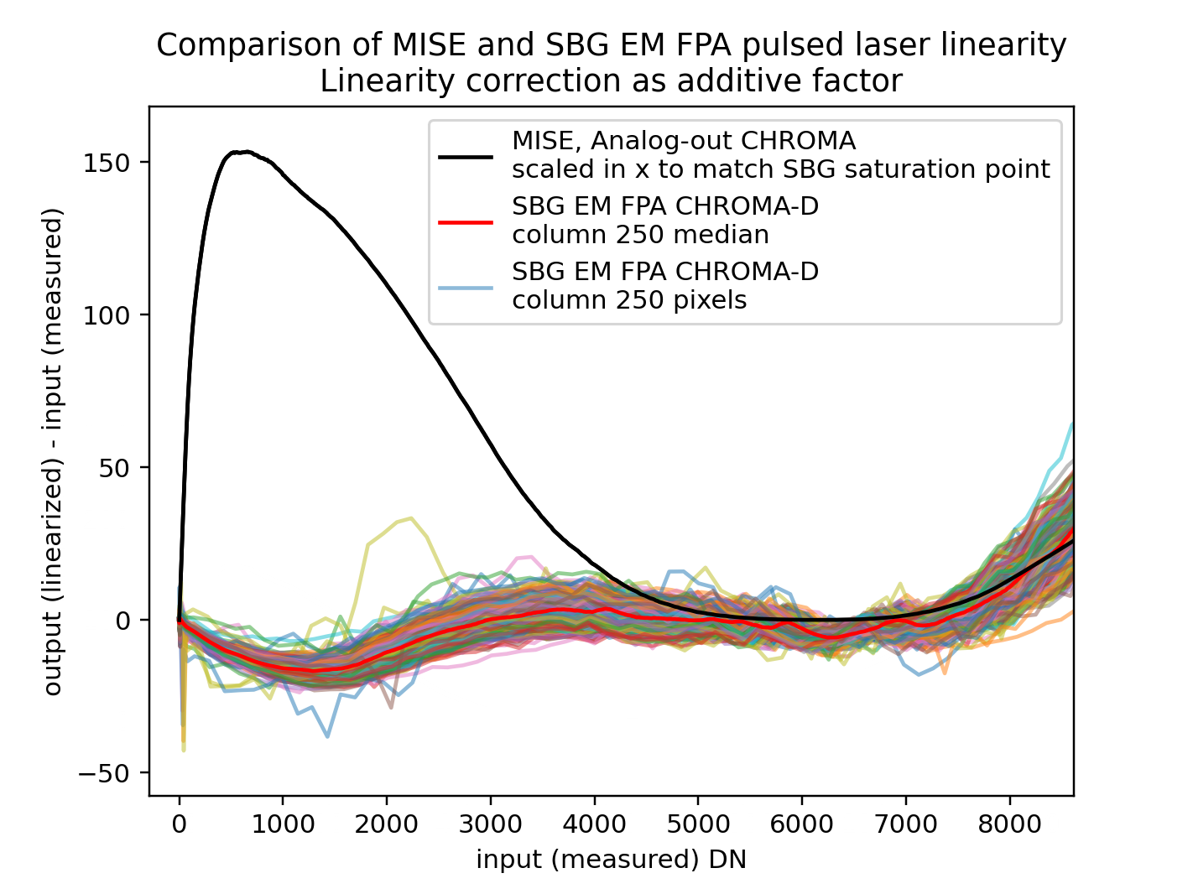
Pulsed laser linearity measurements of CHROMA-D
Full ADC ramp for CHROMA-D
Likely in-flight ADC range of use

Slide 15
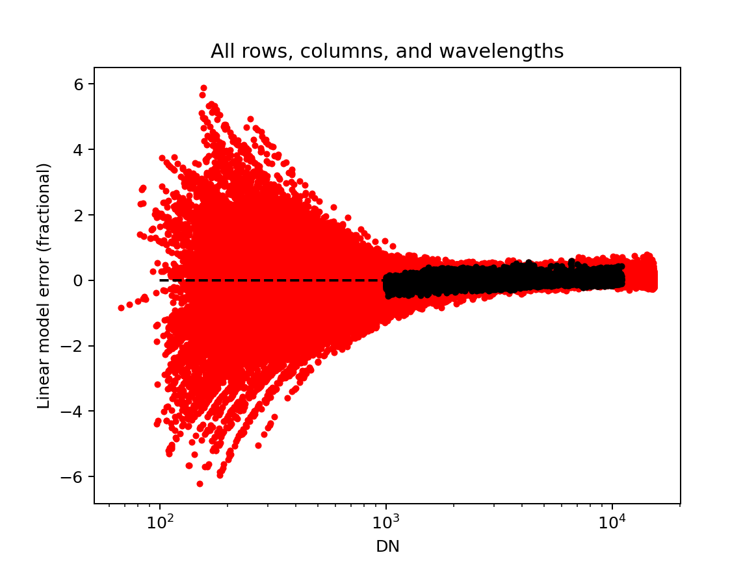
Plans for AVIRIS-5 and SBG-VSWIR
Residual from linear model
Illumination source with variable intensity
Integration time
Integrating sphere
(Linear addition of multiple sources)
Pulsed laser
Pixels used for linear fit
All pixels
In-flight calibration

Slide 16
Seed questions
How many vicarious calibration sites are needed? What core measurements?
Important to have both bright and dark targets, under different atmospheric conditions. Aquatic sites also very useful.
Surface reflectance + uncertainty/standard deviation of measurement needed; atmospheric condition also useful.
What are the main challenges in harmonizing CAL/VAL approaches?
Lack of comparable set of calibration files/characterization across instruments
Lack of overlapping targets between instruments for intercomparison
What is currently missing to carry out holistic and all-encompassing CAL/VAL activities?
Availability/access of in situ data and standardized collection techniques, especially for higher level products
How can emerging technologies, such as artificial intelligence and machine learning, be leveraged?
Identification of pseudo-invariant sites that are not measured in situ; stability of surface over time could be used for relative calibration updates
Formulating calibration as an optimization problem over instrument conditions

Slide 18
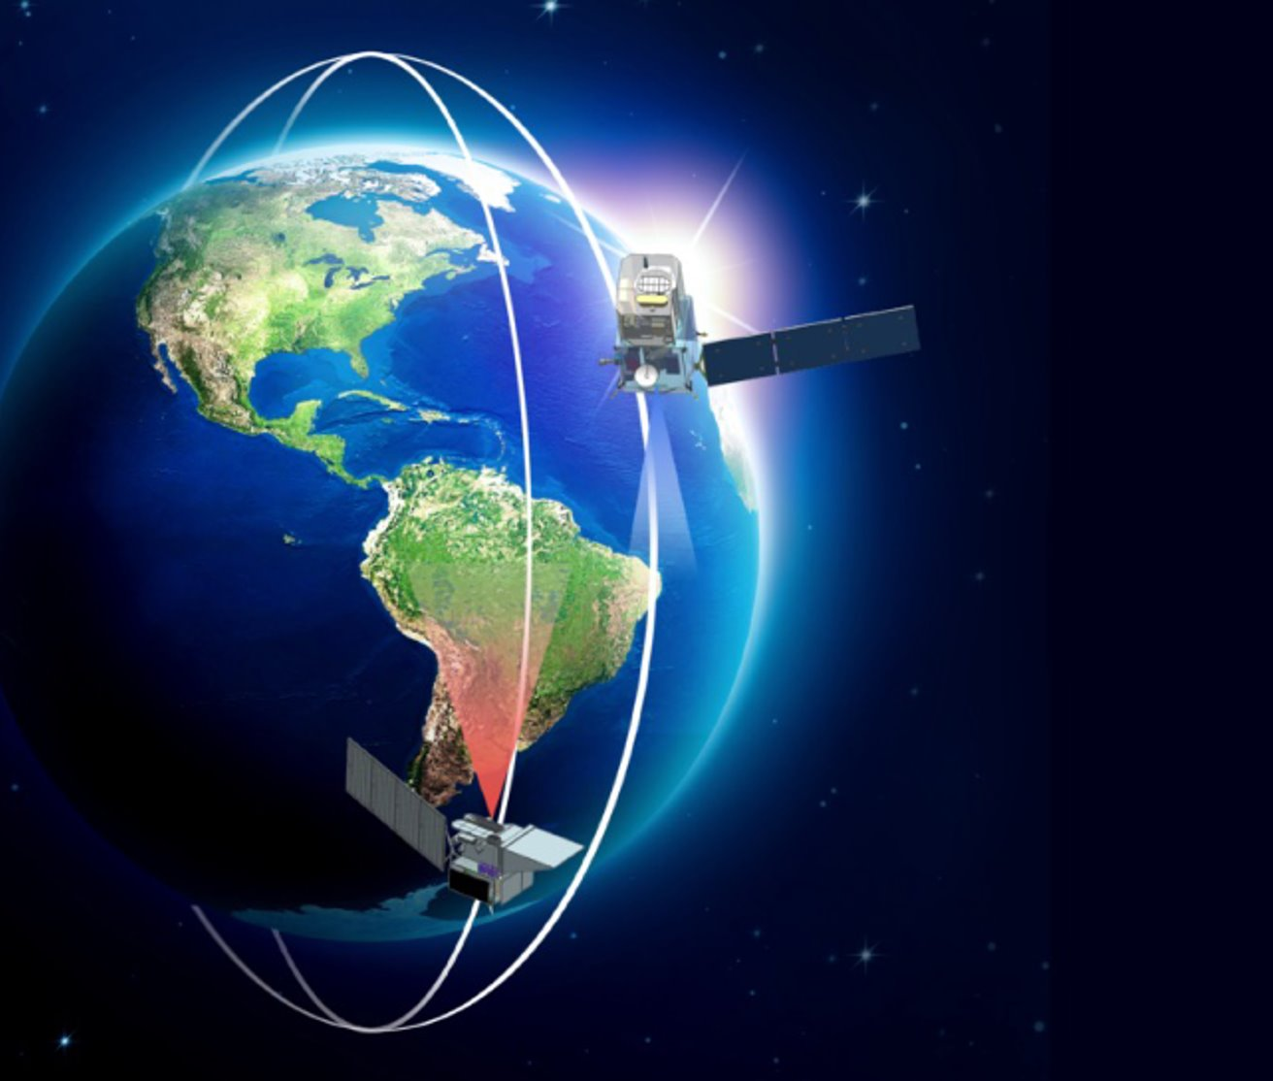
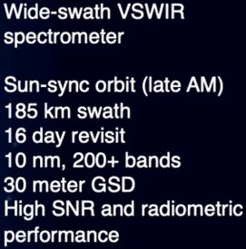
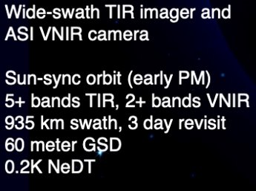
SBG-VSWIR
Surface Biology & Geology
(SBG)
SBG-TIR

Slide 19
Laboratory and in-flight calibration plans
Calibration File | Description | Relevant Calibration Tests | Laboratory Test Details | Relevant In-Flight Calibration
Radiometric Calibration Coefficients | Maps digital numbers (DN) to radiance | NIST lamp + spectralon panel | NIST lamp mounted 0.5 m from NIST spectralon panel, at 45 deg angle to light path into instrument | Vicarious calibration sites (aquatic and terrestrial), modeled through atmosphere to radiometry. (EMIT)
Radiometric Flat Field | Per-detector element correction of radiometric coefficient. | Flatfield scan of integrating sphere with OGSE periscope mirrors. | Broadband source with high signal across spectral range through integrating sphere, scanned spatially with OGSE periscope mirrors to cover the whole FOV. | Low spatial frequency updates over homogenous areas. Destriping via median most recent ~500 frames to get a flat input (statistically random) (EMIT)
Radiometric Dark Level | From unilluminated portion of orbit and masked detector elements. | Best way to take darks in lab measurements needs to be determined, given lack of shutter |  | Acquire frames in the dark mask on unilluminated side of the Earth. (EMIT)
Linearity Basis File & Linearity Map | Linearity function to correct detector nonlinearity | Tests prior to integration of FPAs with spectrometer: pulsed laser test, integration time sweep TVAC tests: integration time sweep, dual source test | Pulsed laser: Collect frames with different numbers of input laser pulses with bare FPA. Integration time sweep: Collect at least 100 integration time steps (short to long) with uniform illumination on bare FPA, and with aligned spectrometer. Dual source test: Two sources (A, B) injected into integrating sphere with variable aperture on A and internal beam blocks for both sources.
Bad Pixel Mask | From laboratory calibration measurements. Updated as needed. | FF scan of integrating sphere with OGSE periscope mirrors | Uses flatfield and RCC datasets, and any other available datasets. (See above.) | Algorithm to detect changes in bad pixel mask currently in play for EMIT.

Slide 20
Laboratory and in-flight calibration plans
Calibration File | Description | Relevant Calibration Tests | Laboratory Test Details | Relevant In-Flight Calibration
Spectral Calibration (Average and Array) | Spectral calibration and uncertainty (nanometers) | Laser Sphere and Spectral Response Function (SRF) | Lasers injected through integrating sphere and scanned spatially. Monochromator scanned in wavelength across full spectral range, at five different spatial fields. | Use atmospheric features to track spectral changes (EMIT)
Spectral & Spatial Stray Light Factors | Brings response functions towards Gaussian | Monochromator and spatially narrow source scanned at multiple integration times. | Monochromator scanned in wavelength across full spectral range, at five different spatial fields. Captured at various integration times.
Ghost Location Matrix | Maps correction for optical ghosting of Dyson spectrometer design. | Stray Light with Monochromator at multiple integration times; Measurement of 20+ broadband filters with distinct spectral profiles | Measurement of 20+ broadband filters with distinct spectral profiles to disentangle overlapping ghost responses at different wavelengths.
Spatial Cross-Track & Along-Track Response Functions | Describes the convolution of the cross-track and along-track signals in the spectrum | CRF, ARF | Spatially narrow broadband source scanned in the cross-track and along-track spatial directions.
Spatial Camera model | In concert with postion, attitude, and scan mirror data, the cameral model allows projection of the measured spectra on to the surface target. | CRF, ARF | Analysis of CRF and ARF datasets (see above). | Image tie points to Landsat& Sentinel ortho-base updates camera pointing & geolocation for each orbit. (EMIT)

Slide 21
Potentially: Use linearity of glint over aquatic targets
Residual from linear model
Near-infrared bands over ocean
Pixels used for linear fit
All pixels

