Slide 1
ENMAP PRODUCT VALIDATION AND
IN-ORBIT MISSION CROSS-VALIDATION
WICSIS 2024
Maximilian Brell ^{(1, 2)},
L. Guanter ⁽³⁾, D. Scheffler ⁽¹⁾, K. Segl ⁽¹⁾, S. Chabrillat ⁽¹⁾,
M. Bachmann ⁽⁴⁾, R. Reyes ⁽⁴⁾, M. Pato ⁽⁴⁾,
E. Carmona ⁽⁴⁾, V. Krieger ⁽⁵⁾, M. Bock ⁽⁵⁾, L. La Porta ⁽⁵⁾
and the EnMAP validation team and supporters
Helmholtz Center Potsdam, GFZ German Research Center for Geosciences, Potsdam, Germany
NEO HySpex (Norskk Elektro Optikk AS), Oslo, Norway
(3) Universitat Politècnica de València, Valencia, Spain
(4) Earth Observation Center (EOC), German Aerospace Center (DLR), Weßling, Germany
(5) Space Agency, German Aerospace Center (DLR), Bonn, Germany

Slide 2
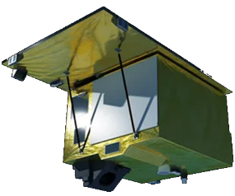
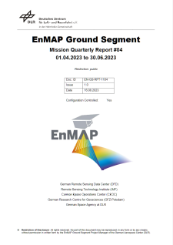
EnVAL: validation of EnMAP products
Image based
Data product | Field-, Image-, Model based validation
 | Radiance | Reflectance | Geometry | Quality
L1B | Vicarious: Inter. Sites RadCalNet Stability: PICS (Moon) SNR Scene based: Dead/bad Striping |  | Keystone MTF | SRF/Smile Anomalies
L1C | Cross-Validation (PRISMA, S2, EMIT, …) |  | Absolute Band-to-Band VNIR-to-SWIR | Anomalies
L2A |  | Ground & Water Quality mask Aerosol & WV |  | Anomalies
Mission
Quarterly
Report
In-situ based
In-situ/
Reference data

Slide 3
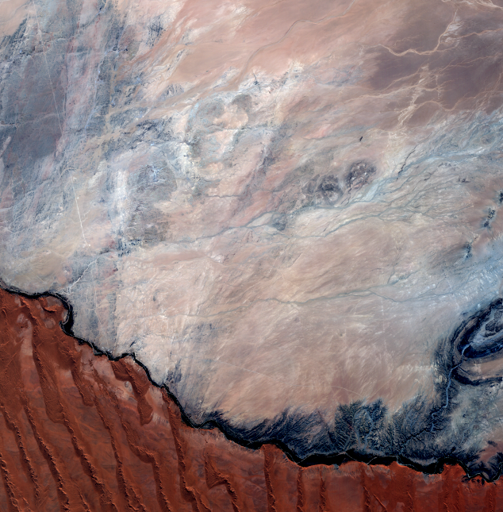
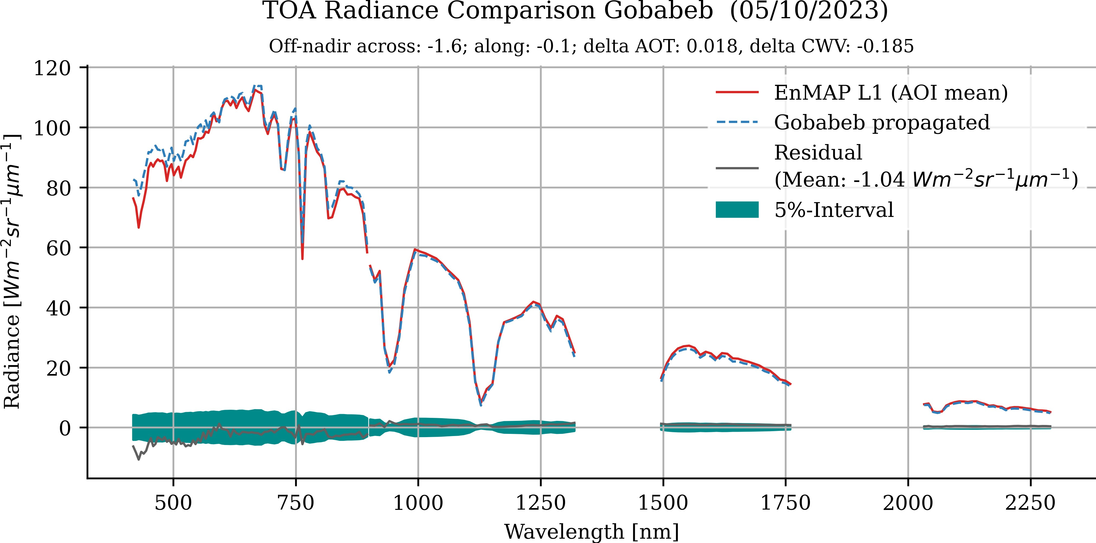
L1B TOA validation
Corresponding AOI/pixel; homogeneity check
+ HR georeference
+ Geolayer
Propagation → (TOA RAD)
(Spectral; temporal;
view & illum.;
AOT & WV
adjustment)
BOA REF
RadCalNet / Hypernets
In-situ spectra
AOT & WV

Slide 4
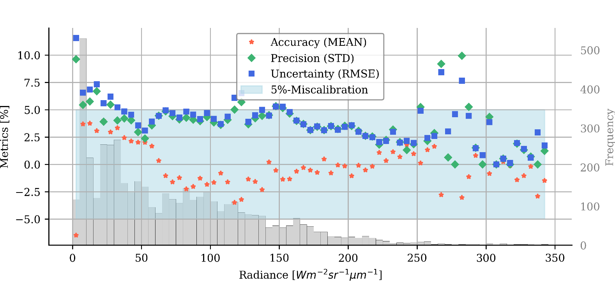
L1B TOA RAD validation
Complete in-orbit period
36 valid matchups
(Railroad Valley, Gobabeb, Pinnacles, Amiaz Plain, Makhtesh Ramon, Playa Zero…)

Slide 5
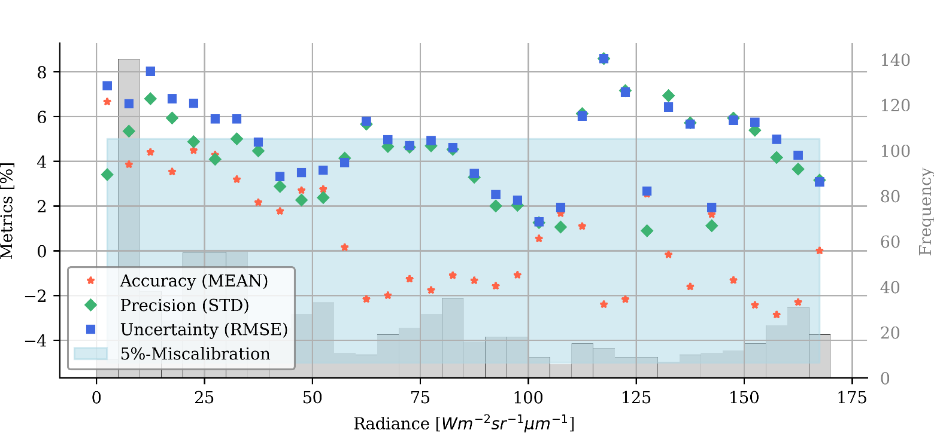
L1B TOA RAD validation
3rd year OP
Only 6 valid matchups
(lack of EnMap acquisitions during field campaigns)
(Railroad Valley, Gobabeb)

Slide 6
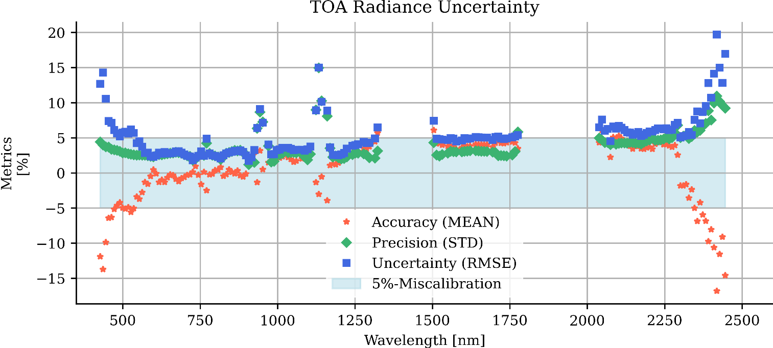
L1B TOA validation
Complete in-orbit period
36 valid matchups
(Railroad Valley, Gobabeb, Pinnacles, Amiaz Plain, Makhtesh Ramon, Playa Zero…)
Notes:
SNR, Atmosphere, AOT retrieval, field instruments less accurate at the borders wavelength. SWIR to high. More matchups needed.

Slide 7
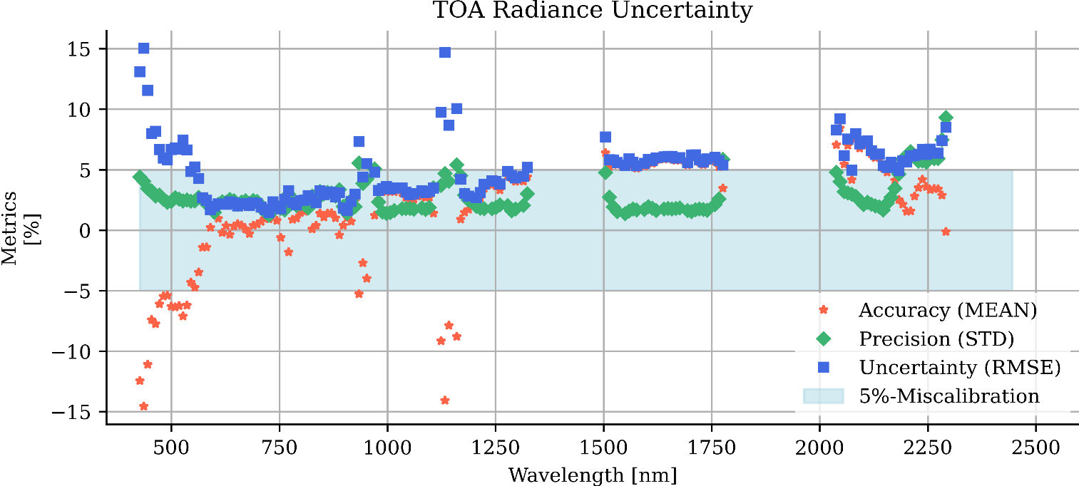
L1B TOA validation
3rd year OP
6 valid matchups
(Railroad Valley, Gobabeb)

Slide 8
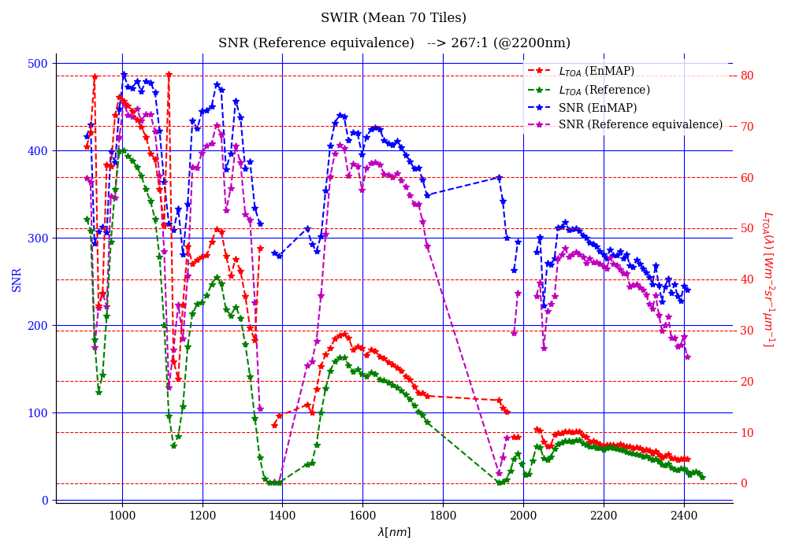
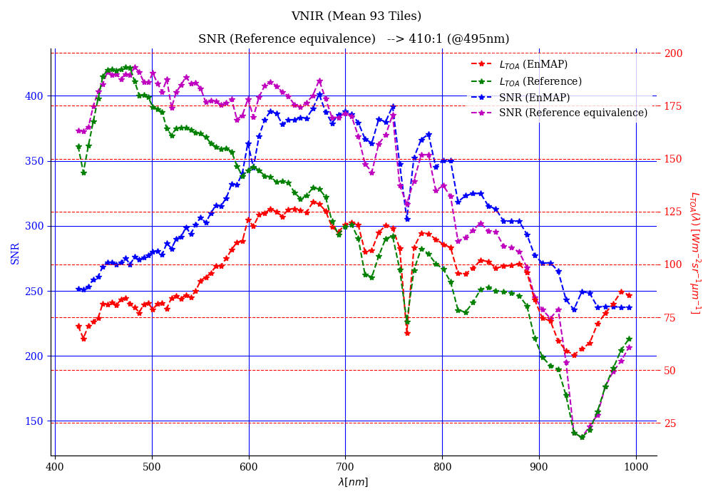
L1B SNR
Complete in-orbit period
Mean SNR calculated on the basis of 93 tiles
Criteria: VNIR > 343:1 (@495 nm & SSD 4.7 nm) SWIR > 137:1 (@2200 nm & SSD 8.4 nm)

Slide 9
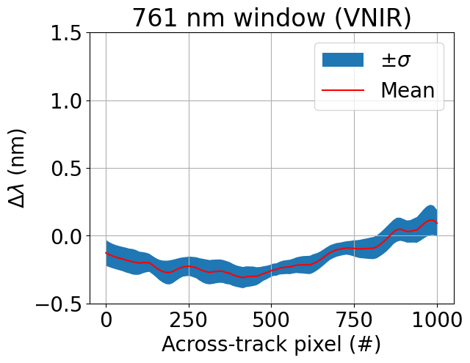
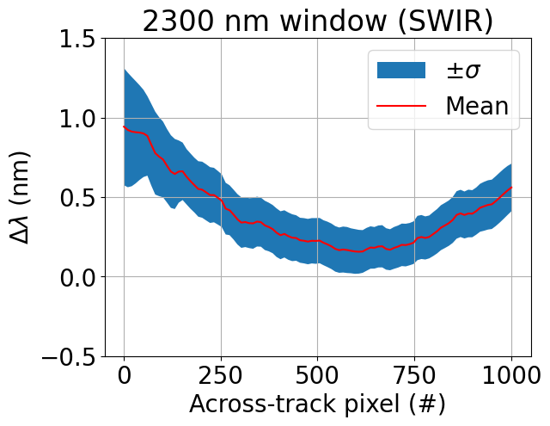
Validation performed by
L. Guanter (UPV)
L1B spectral validation
Results from 8 tiles (PV01.04.02/AV01.04.02) acquired under different atmospheric and angular conditions
VNIR: -0.16 nm offset, ~0.35 nm peak to peak
SWIR: 0.4 nm offset, ~0.6 nm peak-to-peak
Criteria: < 20 % linear displacement of a detector element fulfilled

Slide 10
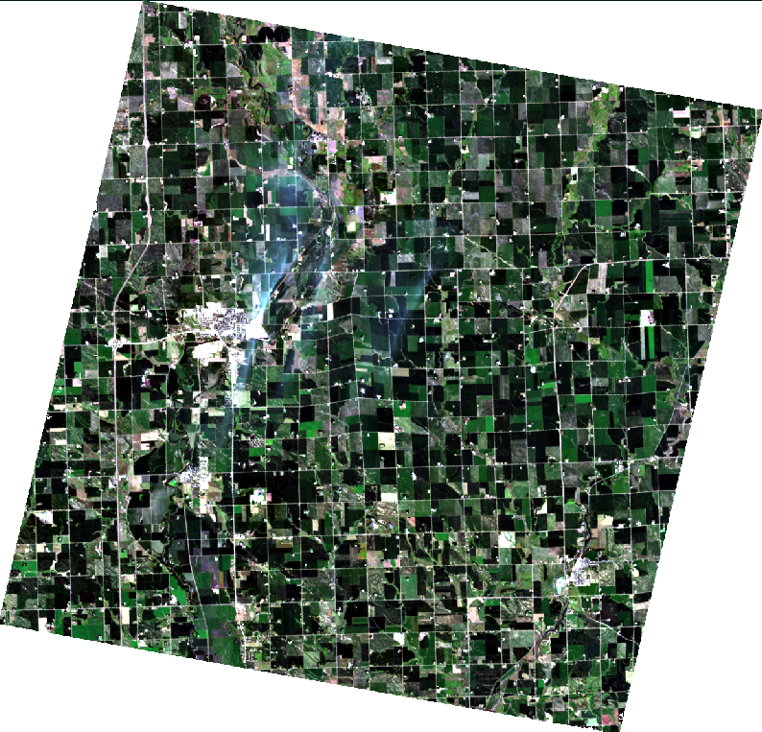
L1C absolute geometric &
VNIR-SWIR co-registration validation
EnMAP L1C
Absolute geometry:
Spatial mis-registra-tion
(AROSICS)
METRIC | VALUE [m]
RMSE_X | 10.2
RMSE_Y | 12.6
VNIR-SWIR co-registration:
METRIC | VALUE [m]
RMSE_X | 5.8
RMSE_Y | 6.8
HR Georeference
Great improvement! → Use up-to-date PV and AV

Slide 11
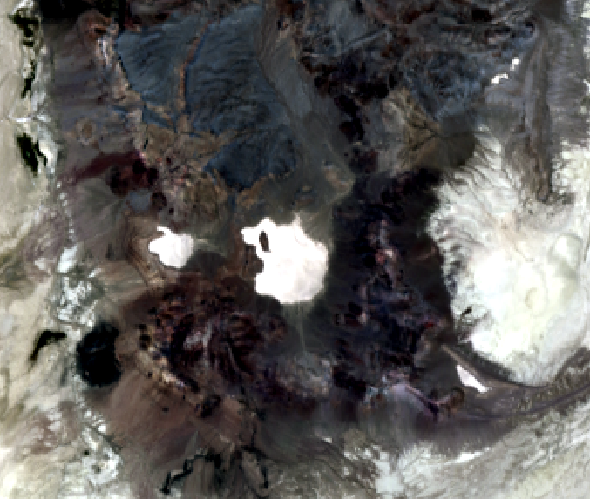
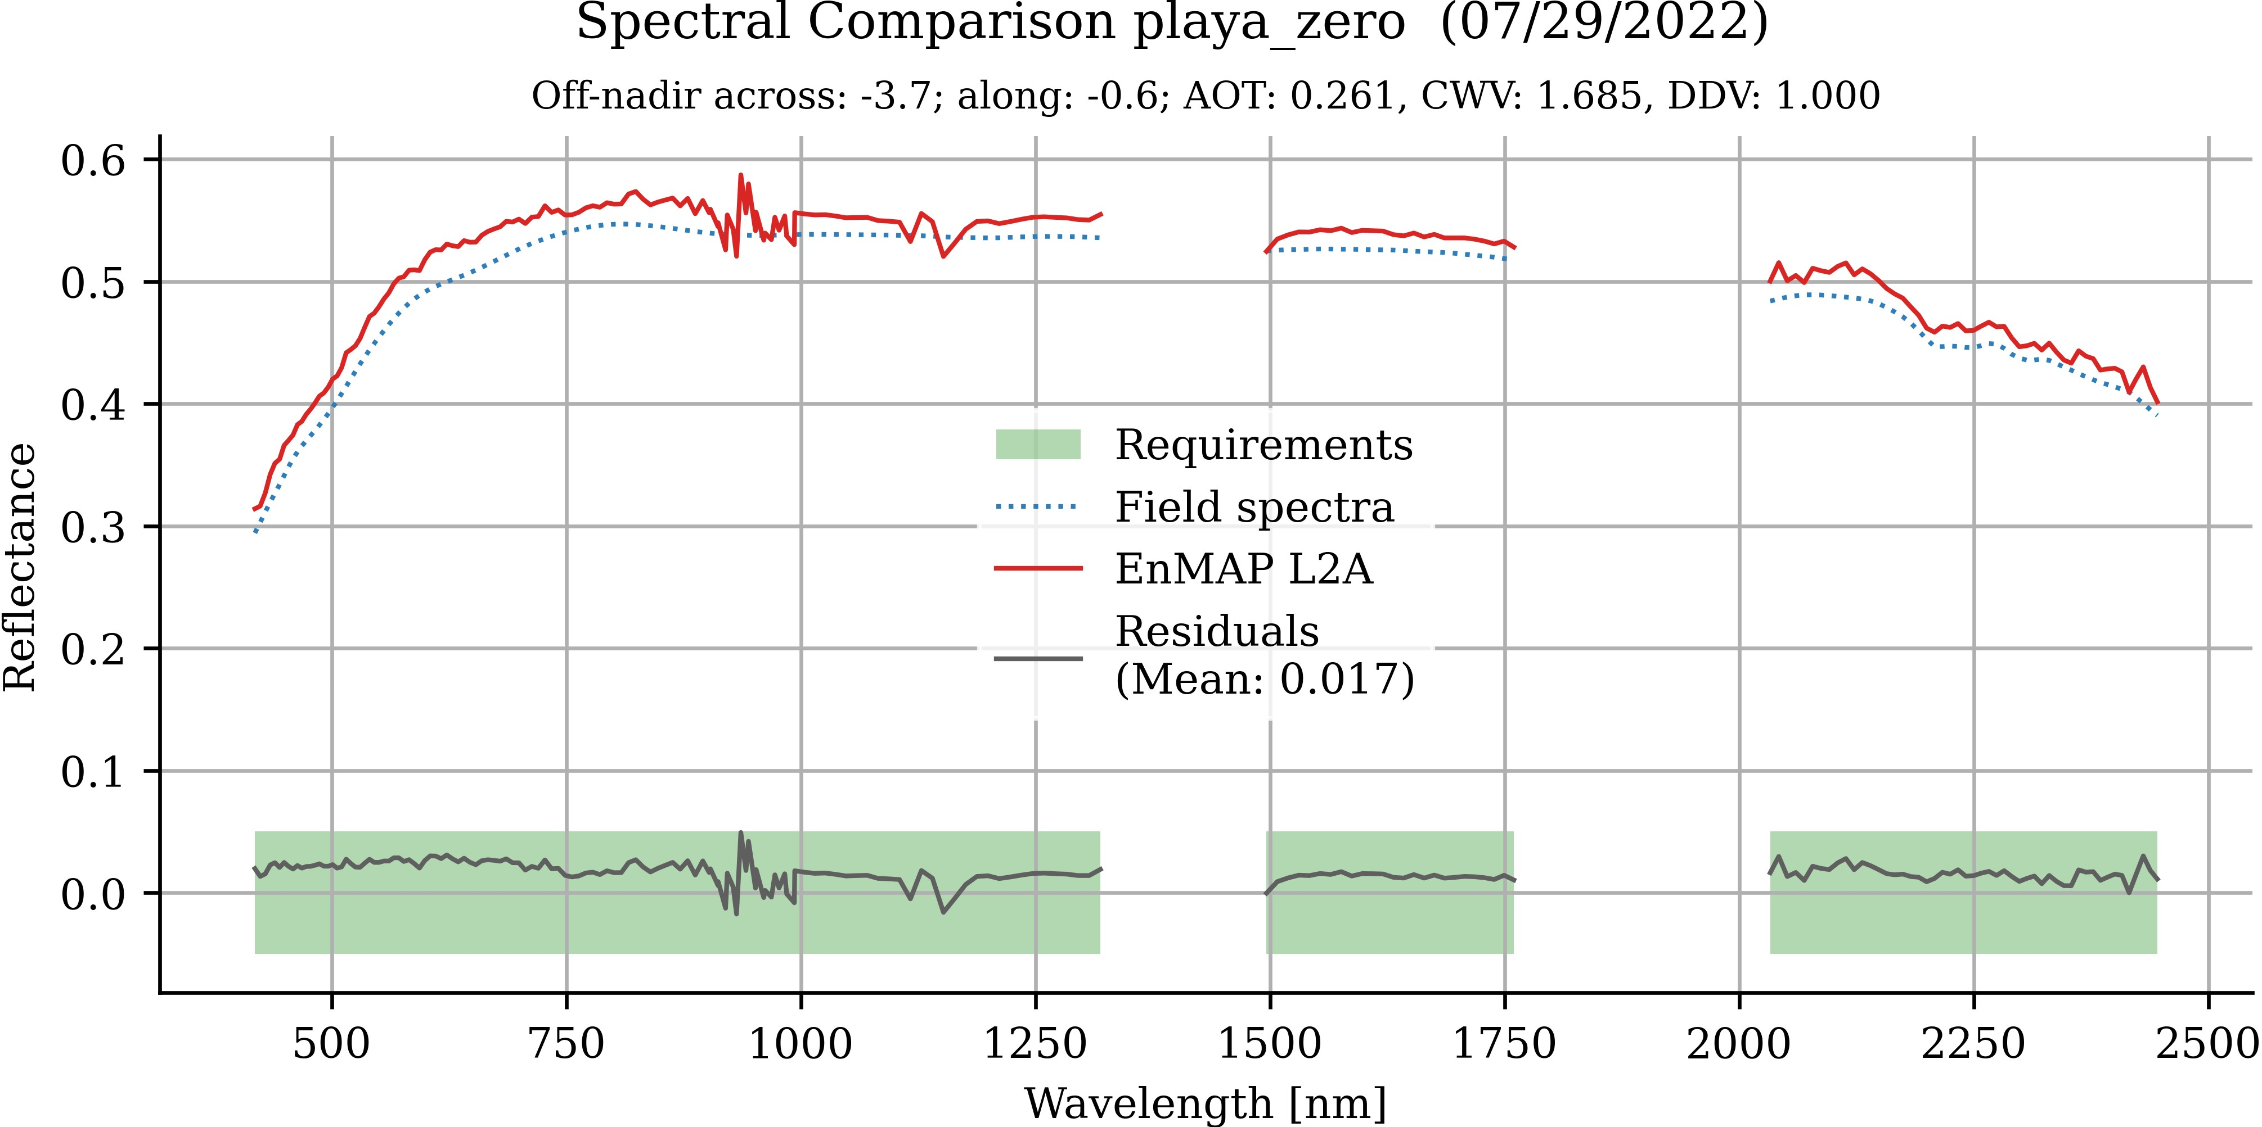
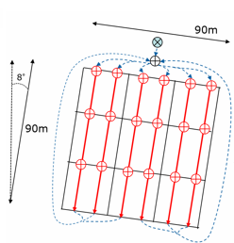
L2A BOA validation (land)
Consistency; homogeneity & location
In-situ data provided by R. Kokaly (USGS)
mean spectra
ASD measurement + GPS

Slide 12
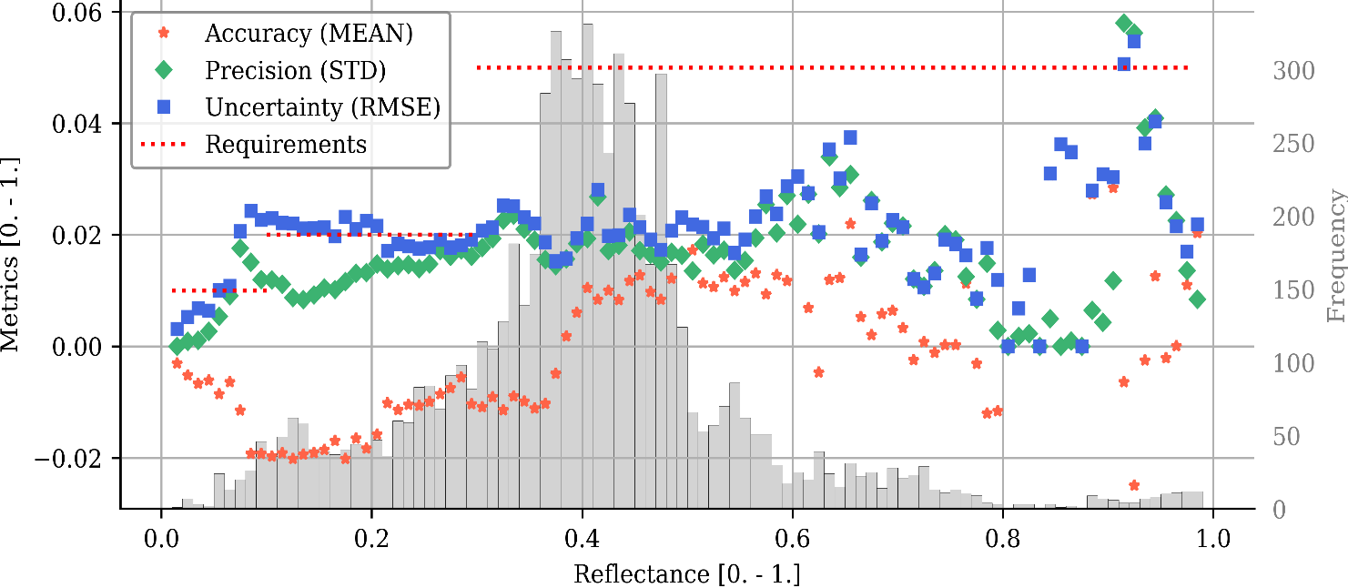
L2A BOA validation (land)
Complete in-orbit period
47 valid matchups
(Pinnacles, Amiaz Plain, Barrax, Munich-North-Isar, Makhtesh Ramon, Camarena, EROS, TXL, Playa Zero, La Crau, Gobabeb, Railroad Valley, Nansen Ice Shelf)
Requirements: Uncertainty (RMSE)
< 0.01 for ρ < 0.1 and
< 0.02 for 0.1 ≤ ρ < 0.3 and
< 0.05 for 0.3 ≤ ρ ≤ 0.6

Slide 13
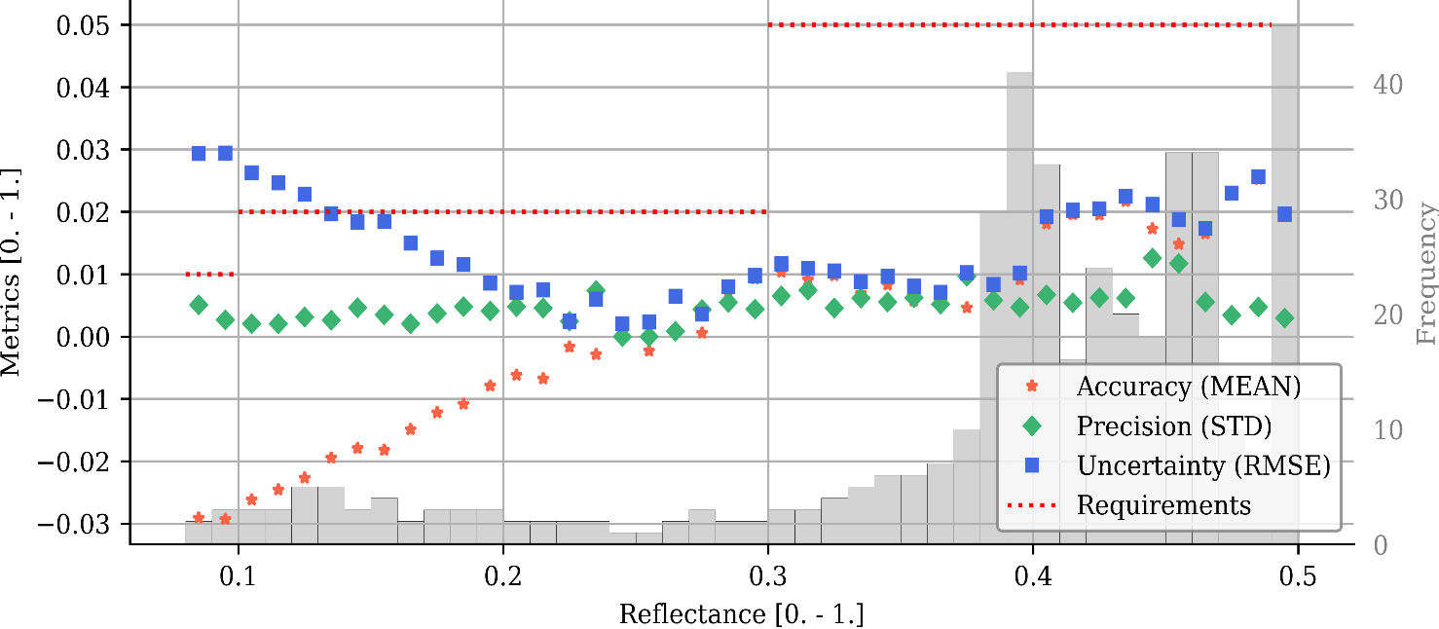
L2A BOA validation (land)
3rd year OP
3 valid matchups
(Gobabeb)
Requirements: Uncertainty (RMSE)
< 0.01 for ρ < 0.1 and
< 0.02 for 0.1 ≤ ρ < 0.3 and
< 0.05 for 0.3 ≤ ρ ≤ 0.6

Slide 14
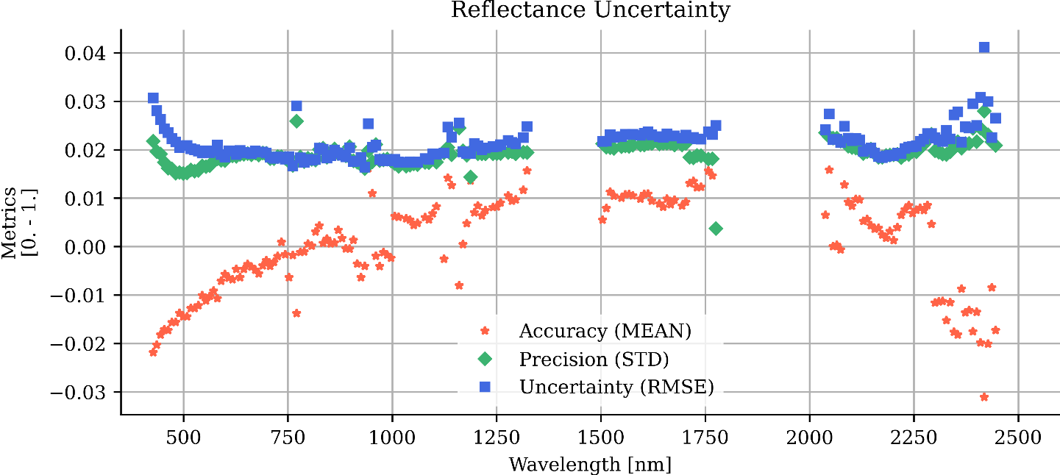
L2A BOA validation (land)
Complete in-orbit period
47 valid matchups
(Pinnacles, Amiaz Plain, Barrax, Munich-North-Isar, Makhtesh Ramon, Camarena, EROS, TXL, Playa Zero, La Crau, Gobabeb, Railroad Valley, Nansen Ice Shelf)
Requirements: Uncertainty (RMSE)
< 0.01 for ρ < 0.1 and
< 0.02 for 0.1 ≤ ρ < 0.3 and
< 0.05 for 0.3 ≤ ρ ≤ 0.6

Slide 15
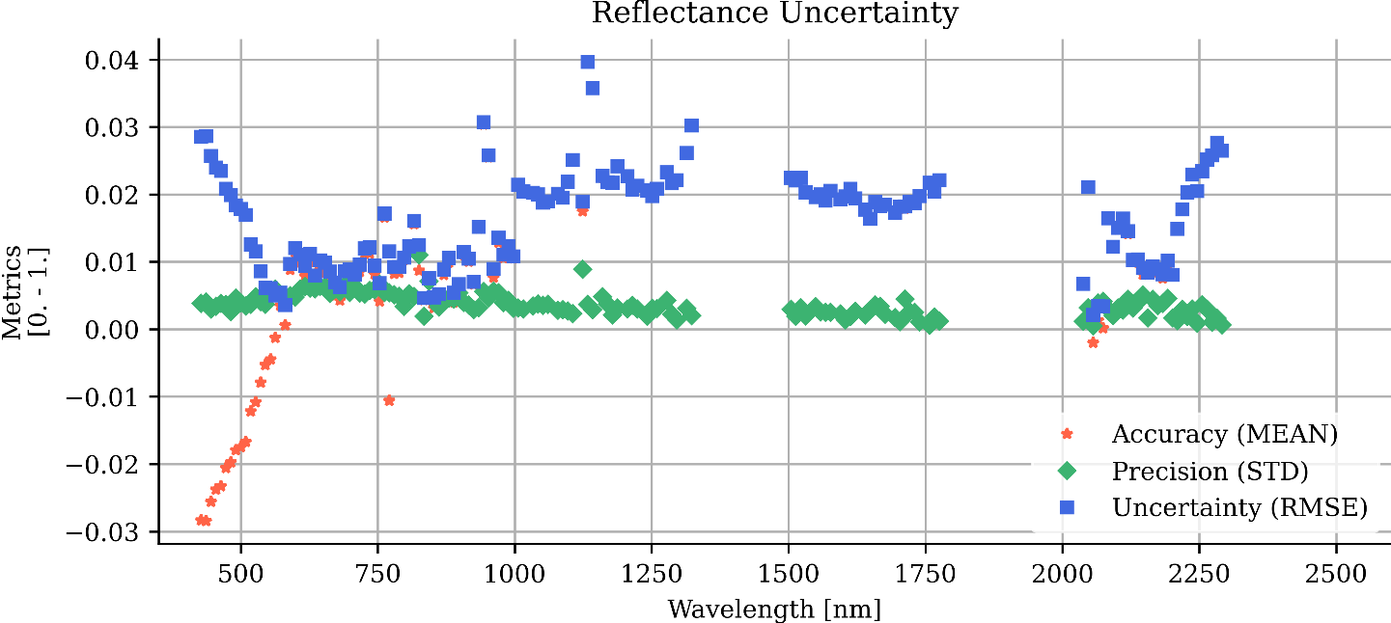
L2A BOA validation (land)
3rd year OP
3 valid matchups
(Gobabeb)
Requirements: Uncertainty (RMSE)
< 0.01 for ρ < 0.1 and
< 0.02 for 0.1 ≤ ρ < 0.3 and
< 0.05 for 0.3 ≤ ρ ≤ 0.6

Slide 16
EnVAL conclusions:
Image based
Data product | Field-, Image-, Model based validation
 | Radiance | Reflectance | Geometry | Quality
L1B | Vicarious: Inter. Sites RadCalNet Stability: PICS Moon SNR Scene based: Dead/bad Striping |  | Keystone MTF | SRF/Smile Anomalies
L1C | Cross-Validation (PRISMA, S2, EMIT, …) |  | Absolute Band-to-Band VNIR-to-SWIR | Anomalies
L2A |  | Ground & Water Quality mask Aerosol & WV |  | Anomalies
Mission
Quarterly
Report
In-situ based
In-situ/
Reference data

Slide 17
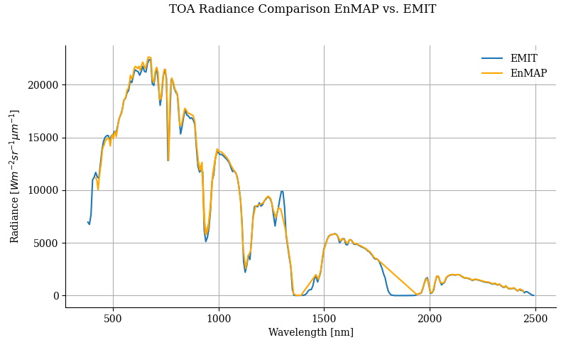
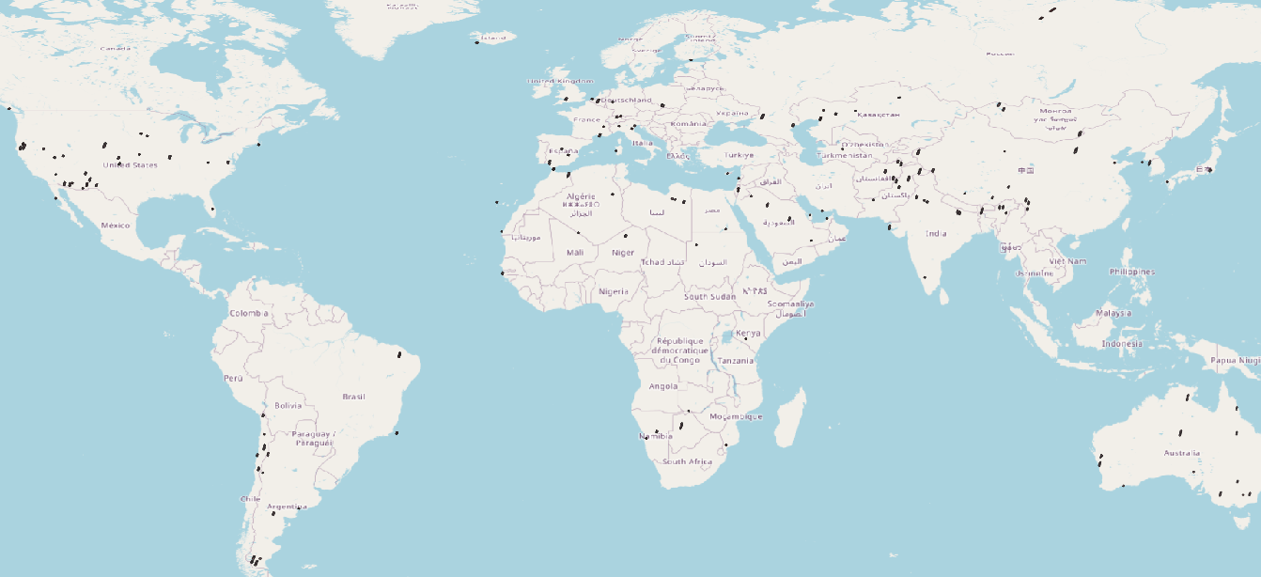
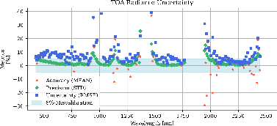
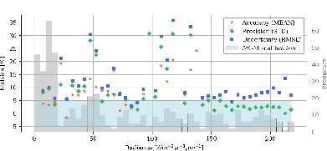
L1B & L2A cross-validation
Segmental comparison
EnMAP
Masking
Geometric matching
Segmenting
Filtering
Cloud detection
SZA/SAA
VZA/VAA
TOA Reflectance
Solar models
PRISMA
EMIT
Global statistics
In-situ data

Slide 18
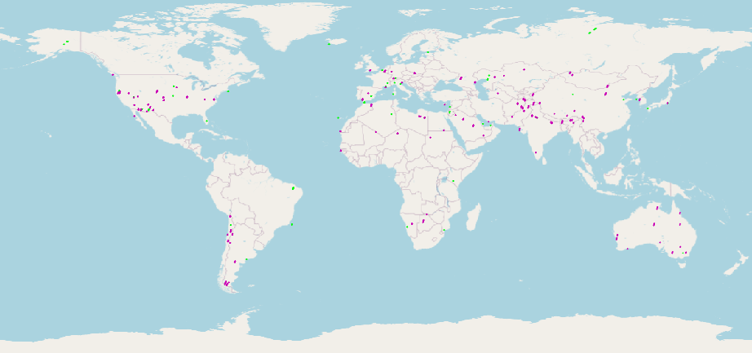
L1B & L2A cross-validation
EnMAP
Matchups with:
EMIT
PRISMA
Filtered matchups with EnMAP:
< 24 h timely offset
> 1/3 off an EnMAP tile
Cloudiness < 40%
No off-nadir criteria

Slide 19
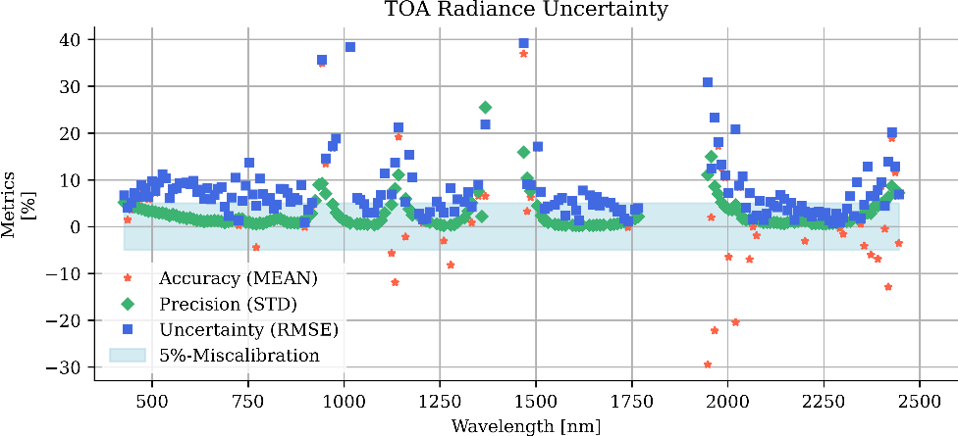
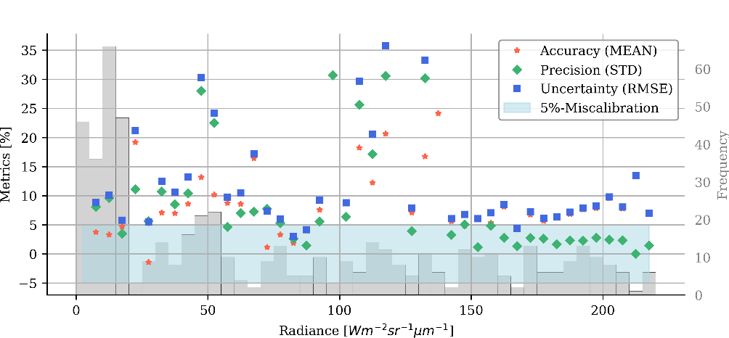
L1B cross-validation
EnMAP
PRISMA
Initial results!
7 Matchups
41 Segments

Slide 20
L1B & L2A cross-validation
Initiative to fill the
PRISMA and EnMAP
archives with spatiotemporal nadir matches
cross-validation
Transferfunctions e.g. for time-series densification
EnMAP
Matchups with:
EMIT
PRISMA
Filtered matchups with EnMAP:
< 24 h timely offset
> 1/3 off an EnMAP tile
Cloudiness < 40%
No off-nadir criteria
Notes:
Work in progress:
At the moment we are working hard on the cross-validation between EnMAP EMIT, PRISMA and S2
Intersecting the missions, Masking, filtering. Everithing is segment-wise…
The goal is to generate matchups and include also in-situ data and build up a global statistik…

Slide 21
EnVAL conclusions seed questions:
Image based
Data product | Field-, Image-, Model based validation
 | Radiance | Reflectance | Geometry | Quality
L1B | Vicarious: Inter. Sites RadCalNet Stability: PICS Moon SNR Scene based: Dead/bad Striping |  | Keystone MTF | SRF/Smile Anomalies
L1C | Cross-Validation (PRISMA, S2, EMIT, …) |  | Absolute Band-to-Band VNIR-to-SWIR | Anomalies
L2A |  | Ground & Water Quality mask Aerosol & WV |  | Anomalies
Independent validation is crucial for the data quality
The more matches, the better.
It is essential to represent the entire range of parameters (balancing)
Coordination of cross-matchups, including in-situ
AI for cross- CAL/VAL and harmonization
Mission
Quarterly
Report
Field based
In-situ/
Reference data

Slide 22
Behind the validation numbers:
Brell et al. 2024:
Assessment of EnMAP Data Quality Trough Global Product Validation Activities
Major revision RSE
Preprint available online
In-Situ collaborators:
R. Kokaly (USGS)
B. Di Mauro (CNR)
R. Colombo (UNIMIB)
E. Ben-Dor & D. Heller (TAU)
C. Anderson (USGS)
C. Ong (CSIRO)
R. O. Green (JPL)
B. Brede (GFZ)
Niall Origo (NPL)
R. Milewski (GFZ)
Great community success!
Ongoing support needed
A. Bialek (NPL)
C. Giardino (CNR- IREA)
M. Saberioon (GFZ)
V. Brando (CNR)
T. Schröder (CSIRO)
G. Kereszturi (Massey)
T. Painter (UCLA)
A. Kokhanovsky (GFZ)
F. Buongiorno (ASI)
…

Slide 23
ENMAP PRODUCT VALIDATION AND
IN-ORBIT MISSION CROSS-VALIDATION
WICSIS 2024
Maximilian Brell ^{(1, 2)},
L. Guanter ⁽³⁾, D. Scheffler ⁽¹⁾, K. Segl ⁽¹⁾, S. Chabrillat ⁽¹⁾,
M. Bachmann ⁽⁴⁾, R. Reyes ⁽⁴⁾, M. Pato ⁽⁴⁾,
E. Carmona ⁽⁴⁾, V. Krieger ⁽⁵⁾, M. Bock ⁽⁵⁾, L. La Porta ⁽⁵⁾
and the EnMAP validation team and supporters
Helmholtz Center Potsdam, GFZ German Research Center for Geosciences, Potsdam, Germany
NEO HySpex (Norskk Elektro Optikk AS), Oslo, Norway
(3) Universitat Politècnica de València, Valencia, Spain
(4) Earth Observation Center (EOC), German Aerospace Center (DLR), Weßling, Germany
(5) Space Agency, German Aerospace Center (DLR), Bonn, Germany

