Slide 1

L1 & L2 uncertainty propagation and distribution for upcoming hyperspectral missions
Pieter De Vis¹, Samuel E. Hunt¹, Astrid Zimmermann¹, Agnieszka Bialek¹, Andreas Hueni², Carmen Meiller², Mike Werfeli²
¹ National Physical Laboratory, Teddington, UK
² Remote Sensing Laboratories, University of Zurich, Zurich, Switzerland

Slide 2
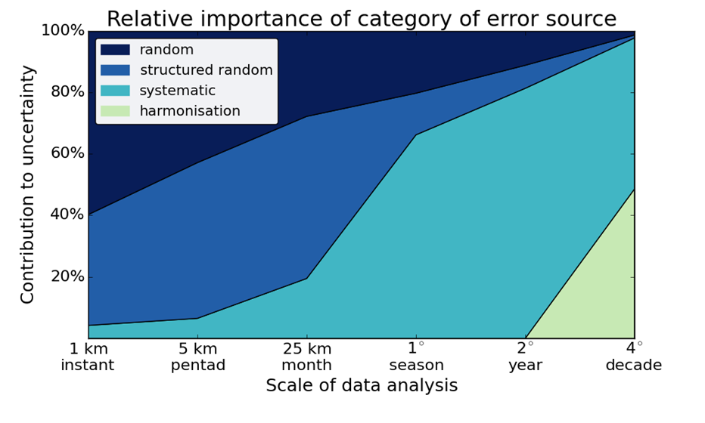
Uncertainties are important but can be complex
measured value
EO data need uncertainties for credible and reliable interpretation
Data is often affected by multiple uncertainty components. For some of these, the errors are correlated
Understanding error-covariances in the data is key to combine observations
error
uncertainty
true value
measurand
Image credit: http://dx.doi.org/10.6084/m9.figshare.1483409

Slide 3






Dealing with uncertainties
Approaches from metrology can assist EO community to develop quantitative characterisation of uncertainty
NPL has been involved in various metrological framework projects for EO
The CEOS-endorsed QA4EO framework, based on the principles of metrology, provides guidelines to enable the EO community to develop metrologically-rigorous data products
The CoMet Toolkit (“Community Metrology Toolkit”) has been developed to enable easy handling and processing of dataset error-covariance information
FDR4ALT
FDR4ATMOS

Slide 4
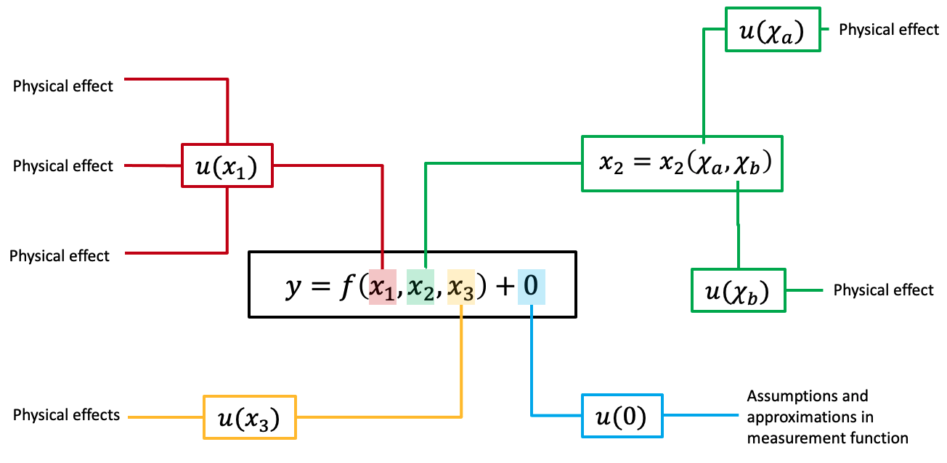
QA4EO Uncertainty tree diagram

Slide 5
QA4EO Effects Tables
 |  | Comments
Name of effect |  | A unique name
Affected term in measurement function |  | Name and standard symbol
Instruments in the series affected |  | List names
Correlation type and form | Pixel-to-pixel [pixels] | From a set of defined correlation forms
 | from scanline to scanline [scanlines]
 | between images [images]
 | Between orbits [orbit]
 | Over time [time]
Correlation scale | Pixel-to-pixel [pixels] | As needed to define type
 | from scanline to scanline [scanlines]
 | between images [images]
 | Between orbits [orbit]
 | Over time [time]
Channels/bands | List of channels / bands affected | Channel names
 | Error correlation coefficient matrix | A matrix
Uncertainty | PDF shape | Functional form
 | units | Units
 | magnitude
Sensitivity coefficient |  | Value, equation or parameterisation of sensitivity of measurand to term

Slide 6
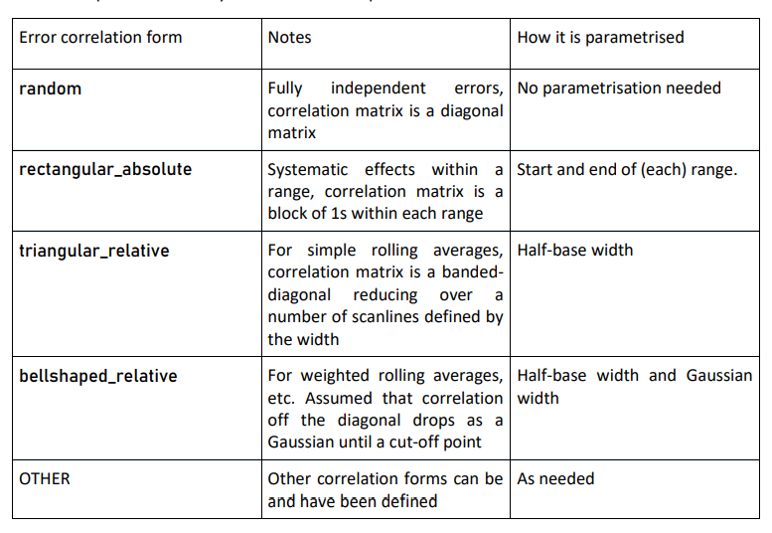
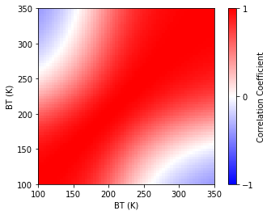
QA4EO Parameterised error-correlation forms
Custom error-correlation matrix Parameterised error-correlation information
https://qa4eo.org/documents/

Slide 7
Challenges for hyperspectral data
Hyperspectral imaging datasets have large data volumes and processing times
This leads to challenges to propagate and store the uncertainties because:
  Every stored uncertainty component will typically take up as much space as data variable
  (e.g. data with 300 spectral * 1000 spatial * 1000 spatial * 32 bit = 1.2 Gb)
  Storing error-correlation information from every pixel (spectral/spatial) to every other pixel becomes impossible
  (e.g. complete error-correlation of every pixel to every other pixel for above data = 360 Pb)
  Propagating uncertainties becomes more time consuming
  Full characterisation of sensors from industry often not available

Slide 8
Approaches for storing and propagating uncertainties for hyperspectral sensors
To mitigate these challenges, the following small compromises can be made:
Uncertainties and error correlation can be stored with fewer bits.
  E.g. 8-bit for error correlation matrix results in 0.01 accuracy in error-correlation coefficients
In most cases, error correlation matrices can be stored per dimension.
  E.g. for data with 300 spectral * 1000 spatial * 1000 spatial, three error correlation matrices will be stored with sizes 300*300, 1000*1000 and 1000*1000 in 8 bit = 2.1 Mb .
In some cases, error correlation can be assumed to be constant, and provided in separate file or described in ATBD or QA4EO effects table

Slide 9
Approaches for storing and propagating uncertainties for hyperspectral sensors
Beyond this, some choices need to be made for:
Storing uncertainty and error-correlation
Splitting uncertainties into components
  Useful when error correlation of these component is constant, but relative contribution of components varies
Storing uncertainty with error-correlation
  Error-correlation matrices stored in each file (for each dimension separately if possible)
Uncertainty propagation method
Monte Carlo (MC)
  Depending on number of iterations, can be very time consuming
Law of propagation of uncertainty (LPU)
  Calculation of Jacobian time consuming
  Large error correlation matrices can lead to slow matrix multiplication

Slide 10
Examples
For the following upcoming hyperspectral missions, the following approaches are being considered:
All of these are still under development and subject to change
Mission | Splitting uncertainties into components | Storing uncertainty with error-correlation per dimension | MC | LPU | Comments
FLEX | For L1B? | For L2 |  | ✔
CHIME |  | For L2 | ✔ |  | Robust MC results could be used to develop faster approach later
TRUTHS | ✔ | ✔ | ✔ |  | - Robust MC results planned to be used to develop faster approach using LUT later - Simple & Full output

Slide 11

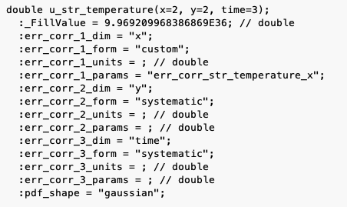
Tools overview
CoMet toolkit: Community Metrology toolkit
obsarray: Tool for storing and handling
uncertainty and covariance in NetCDF files
obsarray.readthedocs.io/en/latest/
punpy: Propagation UNcertainties in Python
punpy.readthedocs.io/en/latest/
comet_maths: Comet mathematical
algorithms and interpolation tools
comet-maths.readthedocs.io/en/latest/
V1.0.0 available on pypi and github
  www.comet-toolkit.org
training material available on www.comet-toolkit.org/examples

Slide 12
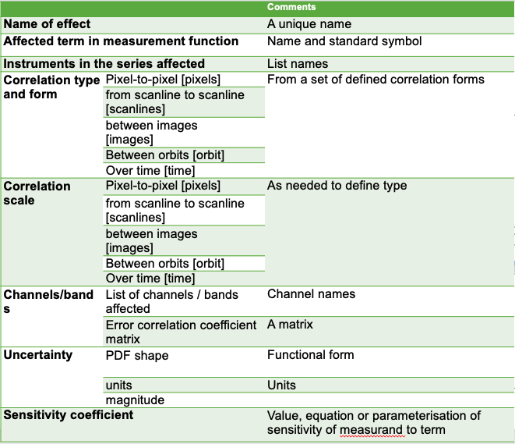
Standardised Error-Covariance Metadata: Digital Effects Tables
Effects Table
Digital Effects Table

Slide 13
Conclusions
Storing and propagating uncertainties is important but challenging for hyperspectral data
It is critical to understand the error correlation information, but it is typically sufficient to store parameterised information per dimension
Both the law of propagation of uncertainties and Monte Carlo methods are useful and have advantages and disadvantages
The CoMet toolkit can be very useful in practically implementing the above

Slide 14
Seed questions
How much “instrument agnostic” are the current state of the art algorithms? What is the level of customization/tuning/auxiliary data required to be able to run them on a different instrument?
  Regarding uncertainties, the core information needing to be stored is the same, though if and how they can be parametrised will vary from instrument to instrument.
  The CoMet toolkit has been designed to be completely instrument or algorithm agnostic. However, the uncertainty propagation for different sensors is implemented somewhat differently, working within the constraints of the already implemented atmospheric correction algorithms.
Can the AI based approaches really become instrument agnostic? If new training dataset are required and slightly different models are obtained, is it not one-model-one-sensor situation?
  Generally, I believe the approaches themselves can be quite instrument agnostic, though will likely need to be trained on datasets specifically generated for a specific instrument.
  For uncertainties, one idea being considered is to first generate robust uncertainties using MC for an initial sample of training data, and then use machine learning to speed up generation of further MC samples, as opposed to always running the processing chain itself.

