Slide 1
COMBINED USE OF PRISMA AND ENMAP MULTITEMPORAL ACQUISITIONS FOR TOPSOIL PROPERTIES MAPPING.
Raffaele Casa, Saham Mirzaei, Alessia Tricomi, Simone Pascucci, Stefano Pignatti, Francesco Rossi

Slide 2
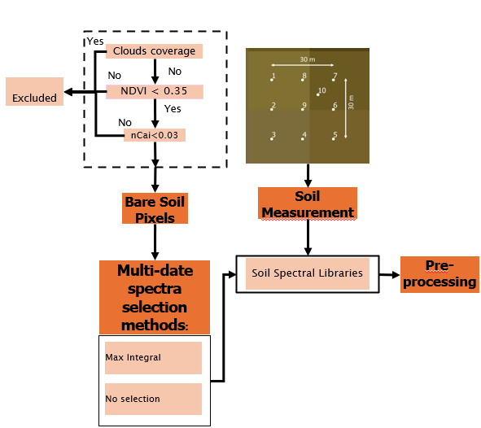
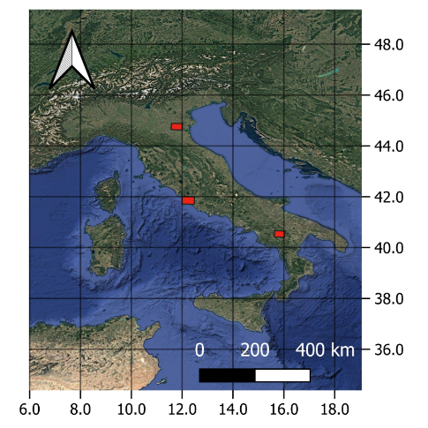
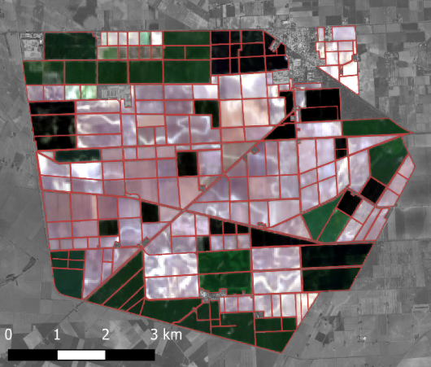
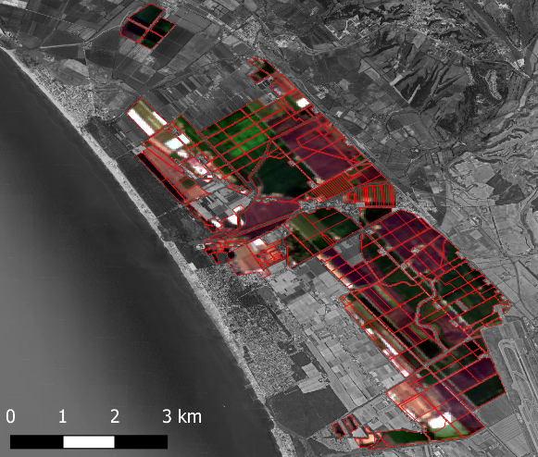
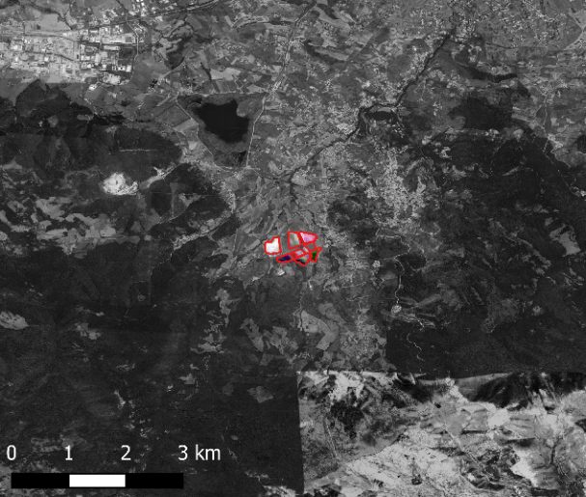
PRISMA time series
Bare soil selection procedure
Soil samples from a total of 95 ESU :
43 from Maccarese
33 from Jolanda
18 from Pignola
PRISMA IMAGES TIME SERIES
- ONLY -
Jolanda RGB 07/04/2023
Maccarese RGB 21/03/2023
Pignola RGB 24/02/2022

Slide 3
PRISMA time series
Case 1
Case 2
Case 3
Wet/Wet
Dry(72)/Wet(233)
Wet/Dry
Pre-processing | Algorithms | RMSE | R2 | RPD
SG1abso | SVR | 1.01 | 0.47 | 1.37
SG1abso | GPR | 1.02 | 0.45 | 1.35
DER | SVR | 1.03 | 0.44 | 1.34
SG1abso | RF | 1.04 | 0.43 | 1.32
Pre-processing | Algorithms | RMSE | R2 | RPD
snvabs | GPR | 0.73 | 0.74 | 1.97
snvrefl | GPR | 0.74 | 0.73 | 1.94
snvabs | SVR | 0.75 | 0.73 | 1.93
snvrefl | SVR | 0.75 | 0.73 | 1.92
Pre-processing | Algorithms | RMSE | R2 | RPD
DER | GPR | 1.22 | 0.64 | 1.67
SG1abso | GPR | 1.22 | 0.64 | 1.66
SG2abso | GPR | 1.23 | 0.63 | 1.65
SG2abso | RF | 1.38 | 0.53 | 1.46
SOC %
Pre-processing | Algorithms | RMSE | R2 | RPD
DER | GPR | 12.46 | 0.65 | 1.69
SG1abso | GPR | 12.74 | 0.63 | 1.66
snv_SG1_abs | GPR | 12.81 | 0.63 | 1.65
zangf_br | GPR | 13.11 | 0.61 | 1.61
Pre-processing | Algorithms | RMSE | R2 | RPD
snvrefl | PLSR | 10.38 | 0.76 | 2.06
SG1abso | GPR | 11.33 | 0.72 | 1.89
snvabs | GPR | 11.71 | 0.70 | 1.83
snvrefl | GPR | 11.76 | 0.70 | 1.82
Pre-processing | Algorithms | RMSE | R2 | RPD
snvabs | GPR | 12.77 | 0.68 | 1.77
snvrefl | GPR | 12.79 | 0.68 | 1.77
snvabs | PLSR | 13.02 | 0.67 | 1.74
snvrefl | PLSR | 13.38 | 0.65 | 1.69
Clay %
Pre-processing | Algorithms | RMSE | R2 | RPD
SG1abso | GPR | 9.37 | 0.76 | 2.06
DER | GPR | 9.58 | 0.75 | 2.02
SG1abso | PLSR | 10.91 | 0.68 | 1.77
DER | PLSR | 11.10 | 0.67 | 1.74
Pre-processing | Algorithms | RMSE | R2 | RPD
SG1abso | GPR | 9.02 | 0.75 | 2.02
DW | PLSR | 9.06 | 0.75 | 2.01
original | PLSR | 9.06 | 0.75 | 2.01
snvrefl | PLSR | 9.07 | 0.75 | 2.01
Pre-processing | Algorithms | RMSE | R2 | RPD
SG0 | PLSR | 7.84 | 0.72 | 1.88
SG2abso | PLSR | 8.34 | 0.68 | 1.77
zangf_br | PLSR | 8.36 | 0.68 | 1.76
SG1abso | GPR | 8.36 | 0.68 | 1.76
Silt %
Pre-processing | Algorithms | RMSE | R2 | RPD
SG1abso | GPR | 14.77 | 0.80 | 2.26
DER | GPR | 14.82 | 0.80 | 2.25
DER | PLSR | 17.27 | 0.73 | 1.93
SG1abso | PLSR | 17.33 | 0.73 | 1.92
Pre-processing | Algorithms | RMSE | R2 | RPD
det_bas_Spline | GPR | 14.56 | 0.79 | 2.20
SG0_det_bas | GPR | 14.59 | 0.79 | 2.20
zangf_br | PLSR | 14.75 | 0.79 | 2.17
Spline | GPR | 14.89 | 0.78 | 2.15
Pre-processing | Algorithms | RMSE | R2 | RPD
Spline | GPR | 14.19 | 0.79 | 2.16
MF | GPR | 14.29 | 0.78 | 2.14
zangf_br | PLSR | 14.48 | 0.78 | 2.12
Abso | GPR | 14.63 | 0.77 | 2.10
Sand %

Slide 4
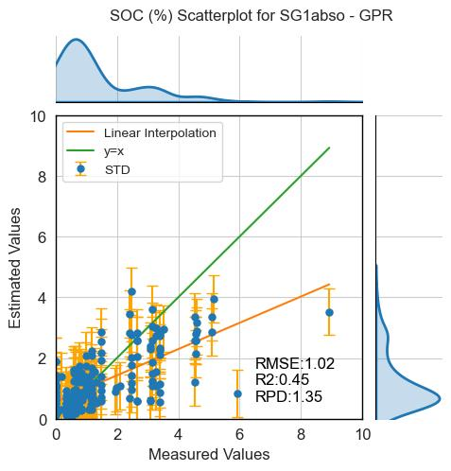
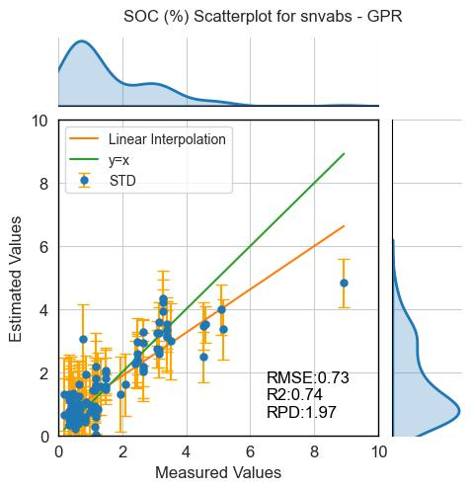
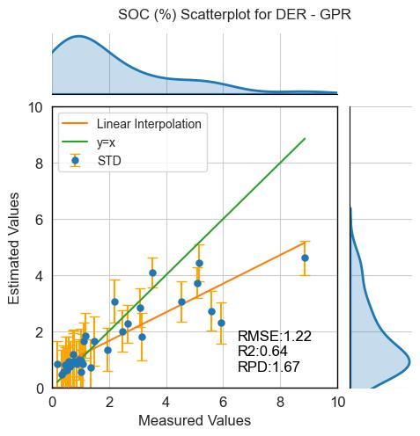
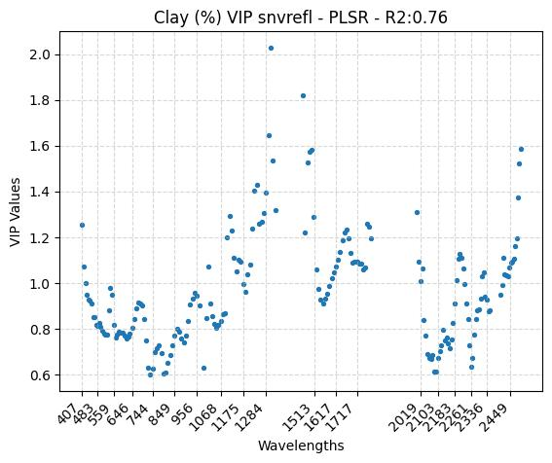
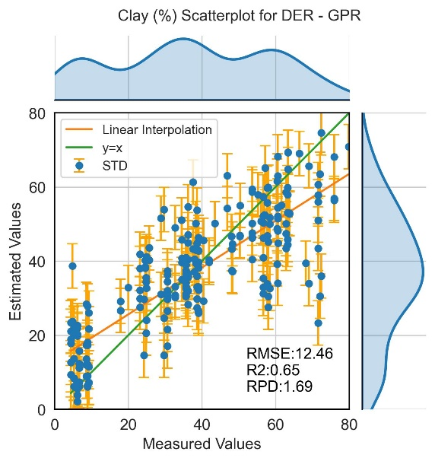
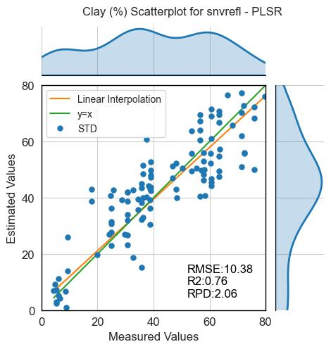
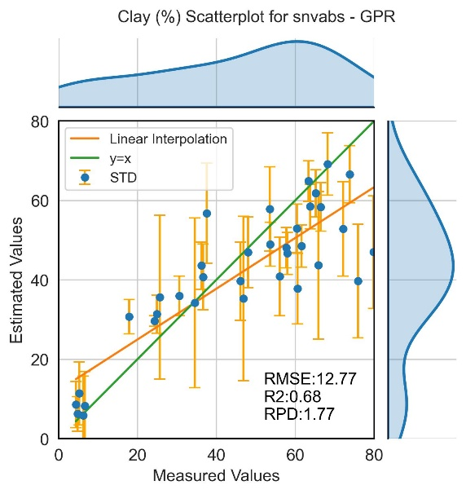
PRISMA time series
Case 1
Wet/Wet
Case 2
Dry/Wet
Case 3
Wet/Dry
SOC
Case 2
Dry/Wet
Clay

Slide 5
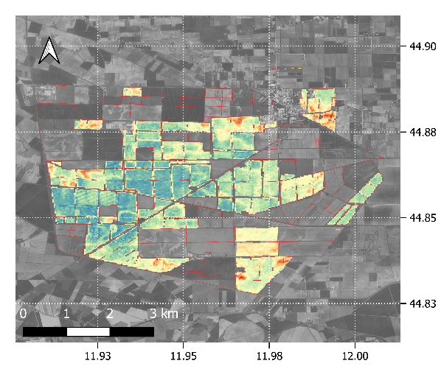
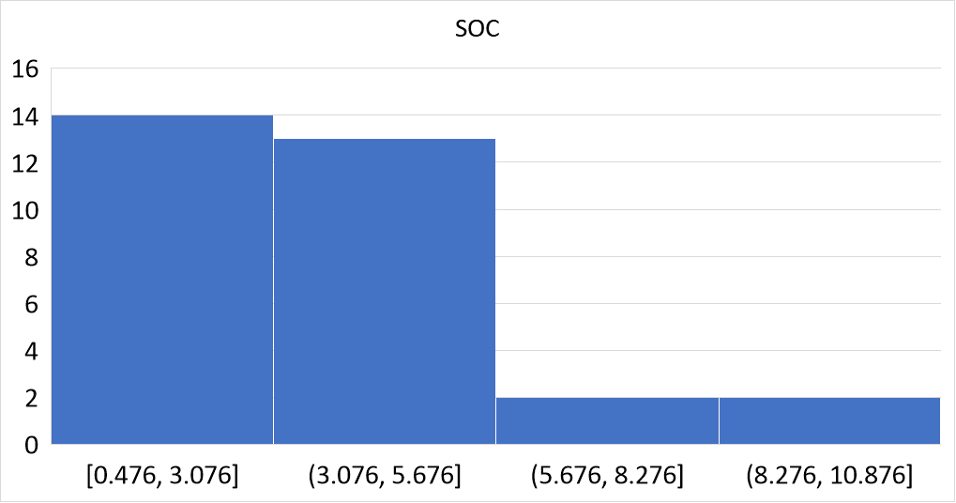
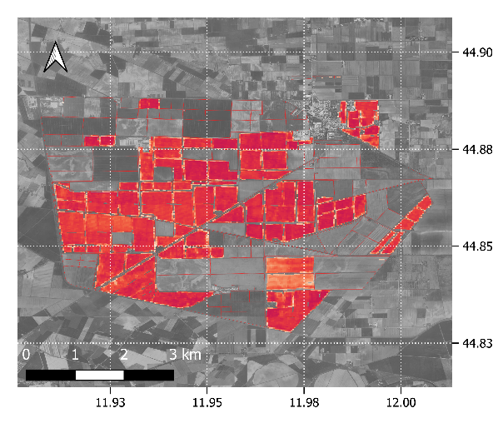
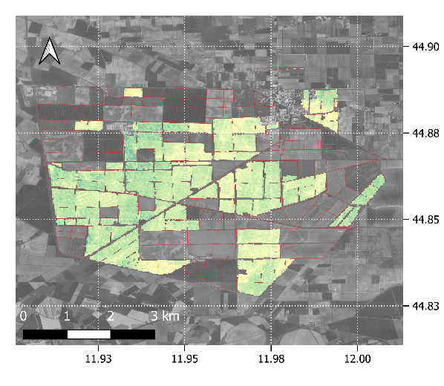
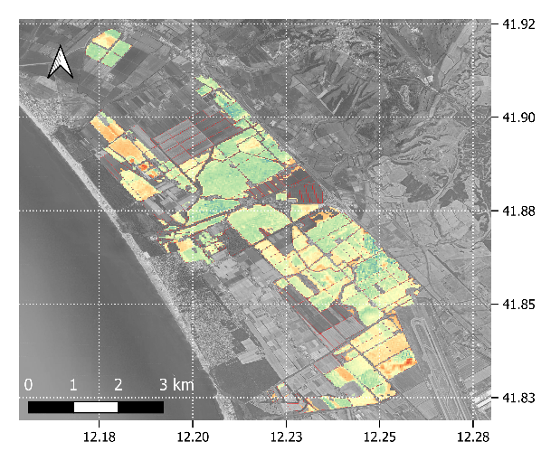
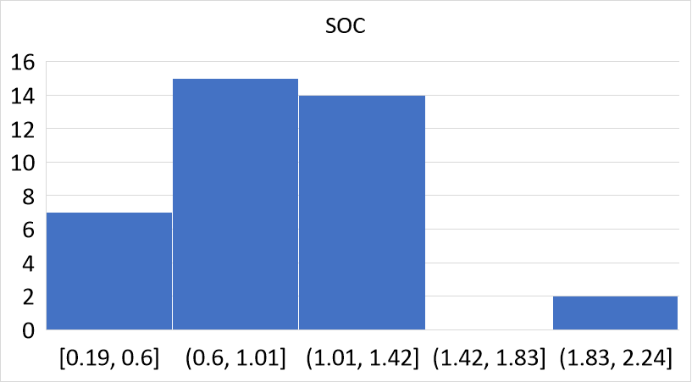
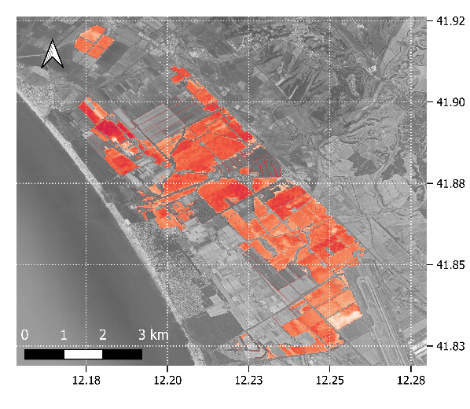
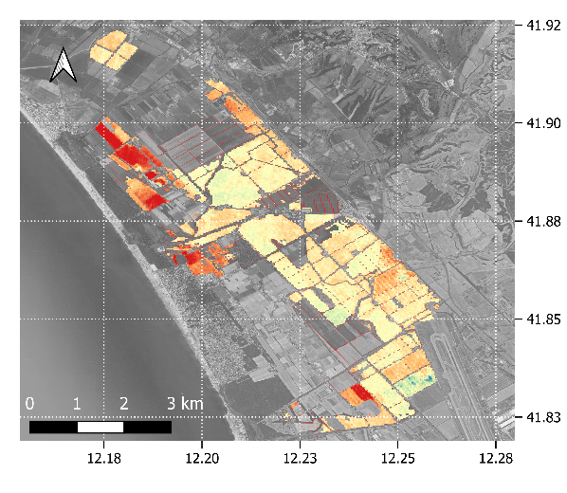
PRISMA time series
Estimation maps under conditions similar to those in Case 2 (dry/wet).
SOC (%) SNV-absorbance GPR
Clay (%) SNV-reflectance PLSR
Estimated
std
Jolanda 24/04/2021
21 bare soil samples
Maccarese 04/09/2021 20 bare soil samples

Slide 6
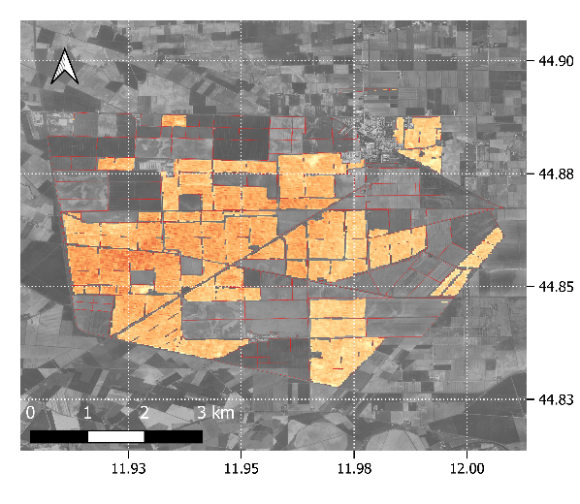
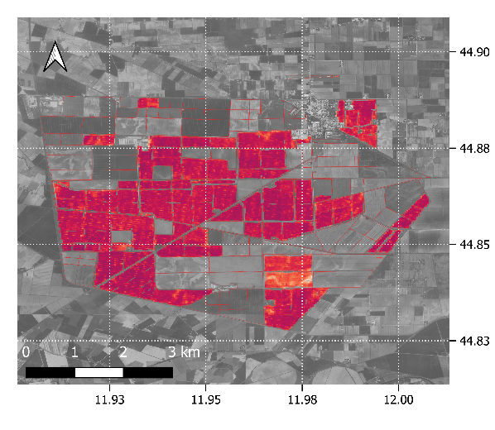
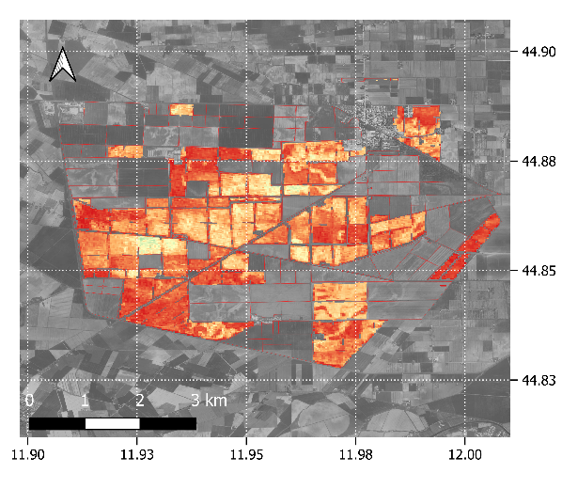
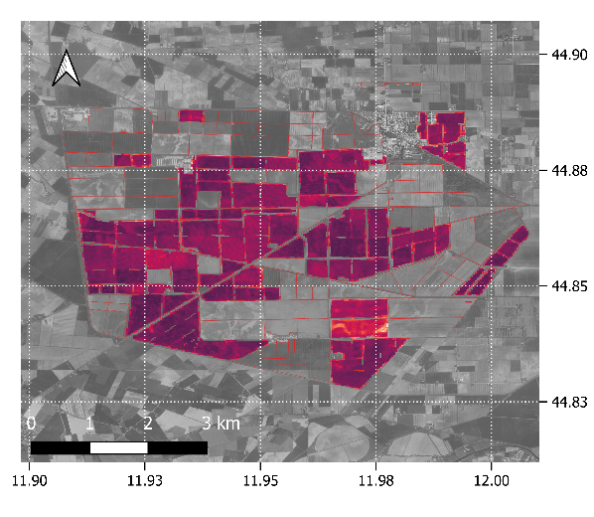
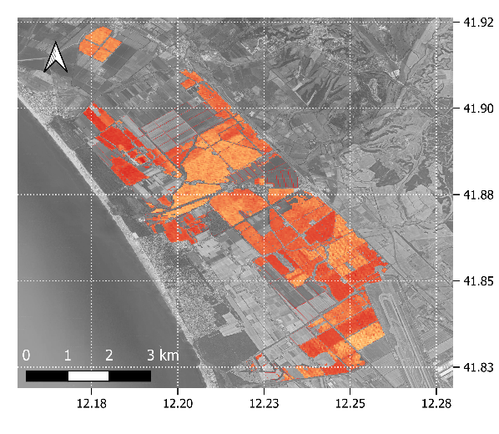
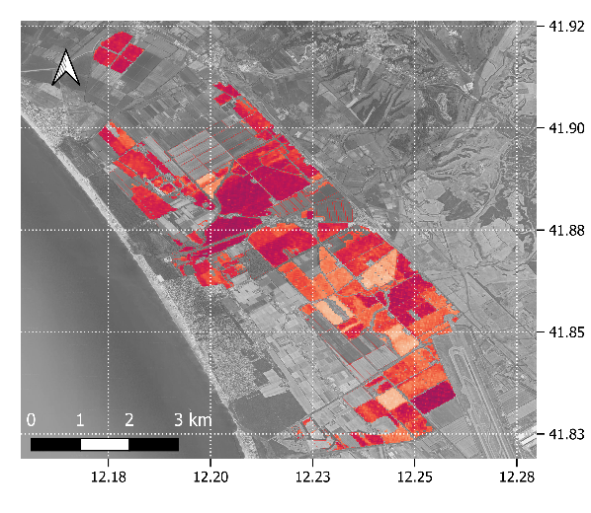
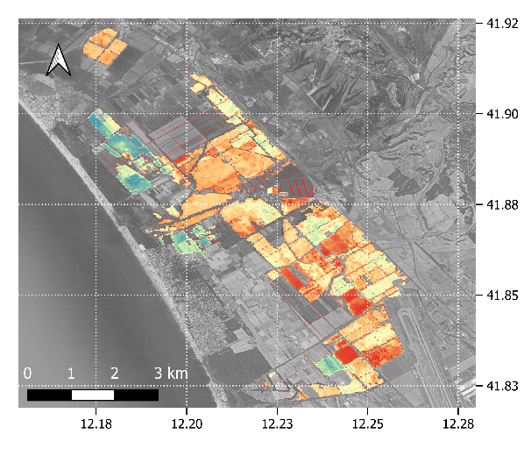
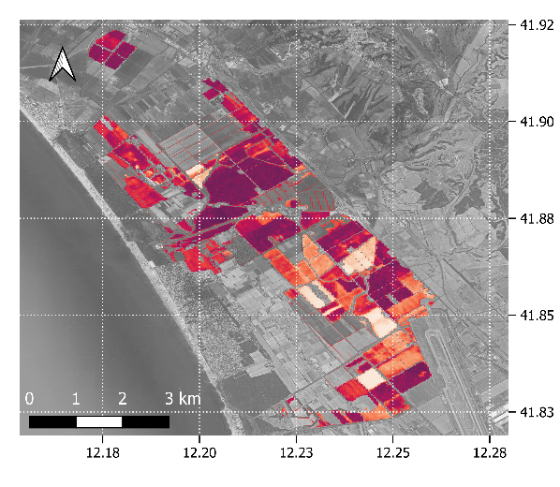
PRISMA time series
Silt (%) SG1-absorbance GPR
Sand (%) detrending baseline-spline GPR
estimated
std
estimated
std
Jolanda 24/04/2021
Maccarese 04/09/2021

Slide 7
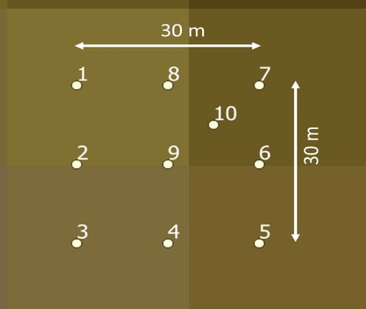
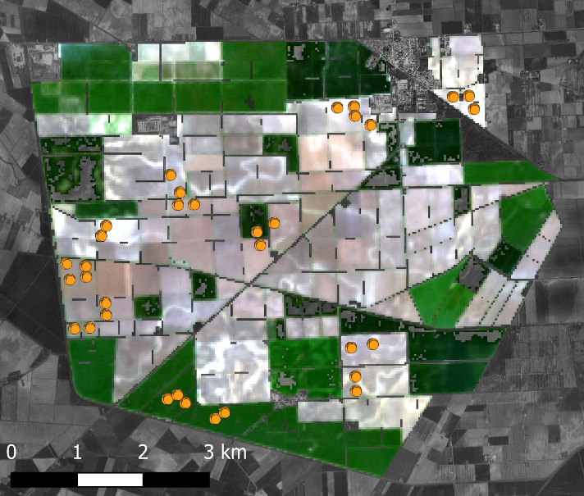
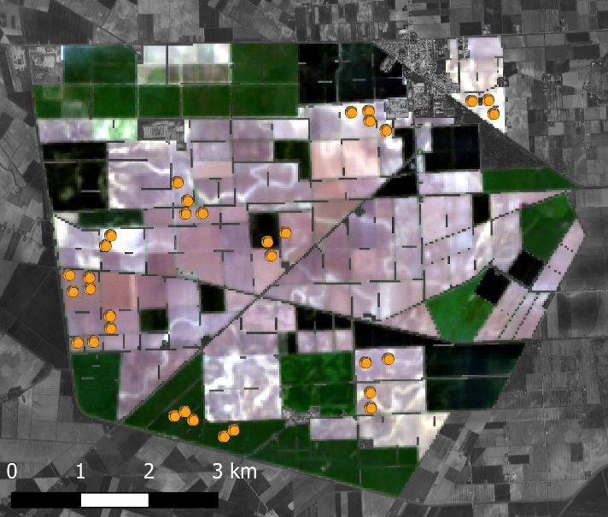
PRISMA and EnMAP time series
Bare soil selection procedure
Multi-date spectra selection methods:
Elemental Sampling Unit
Jolanda
Max Integral
Thres NDRE
EnMAP 04/04/2023
PRISMA 07/04/2023
Min S2WI
Soil Measurement
Max NSMI
Soil Spectral Libraries
Pre-processing
Original sensors spectra
PRISMA - EnMAP

Slide 8
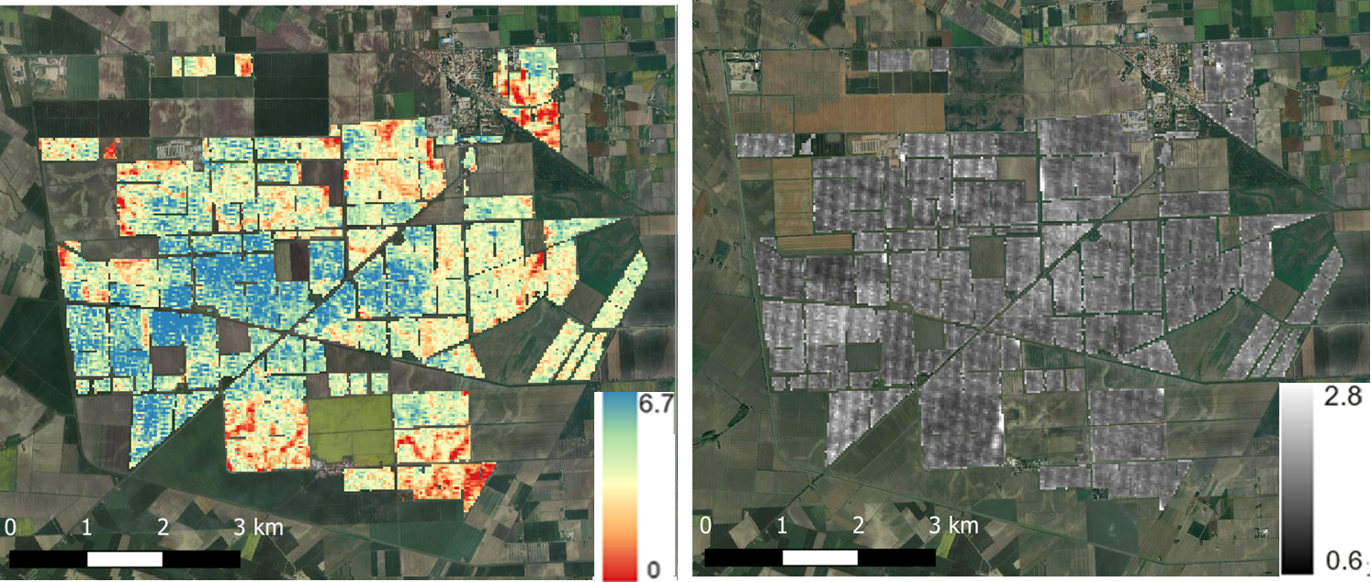
PRISMA and EnMAP time series
GPR trained on absorbance on the whole PRISMA and EnMAP timeseries, applied to single PRISMA image. 10-fold CV
Jolanda PRISMA 07/04/2023
Standard deviation
SOC
The models trained with a dataset of reflectance derived from PRISMA/ENMAP data (16/6 images over Jolanda) show a decrease in terms of performance, demonstrating the difficulty of the model transferability

Slide 9
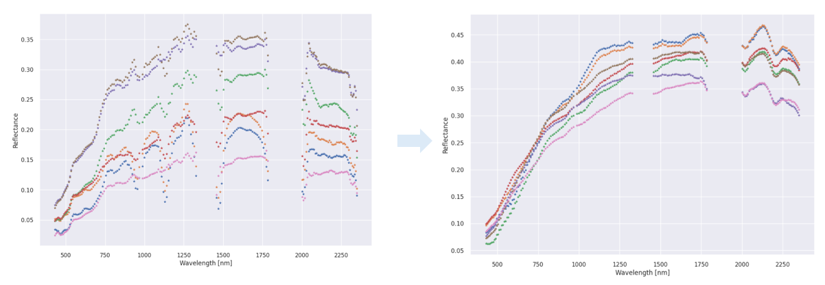
Autoencoder to dry up
Preprocessing using autoencoder of PRISMA reflectance corresponding to the same sample measured at different dates.
Open issues:
Additional external factors that are not modelled and are “disturbing” for the autoencoder
Satellite hyperspectral data noise (e.g., coherent noise)
When the autoencoder is used, there is a slight loss of distinctive features possibly due to a “smoothing” effect

Slide 10
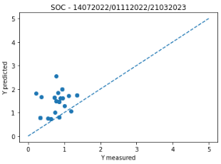
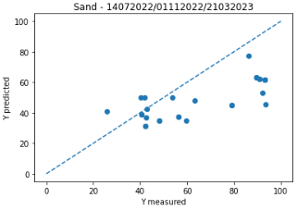
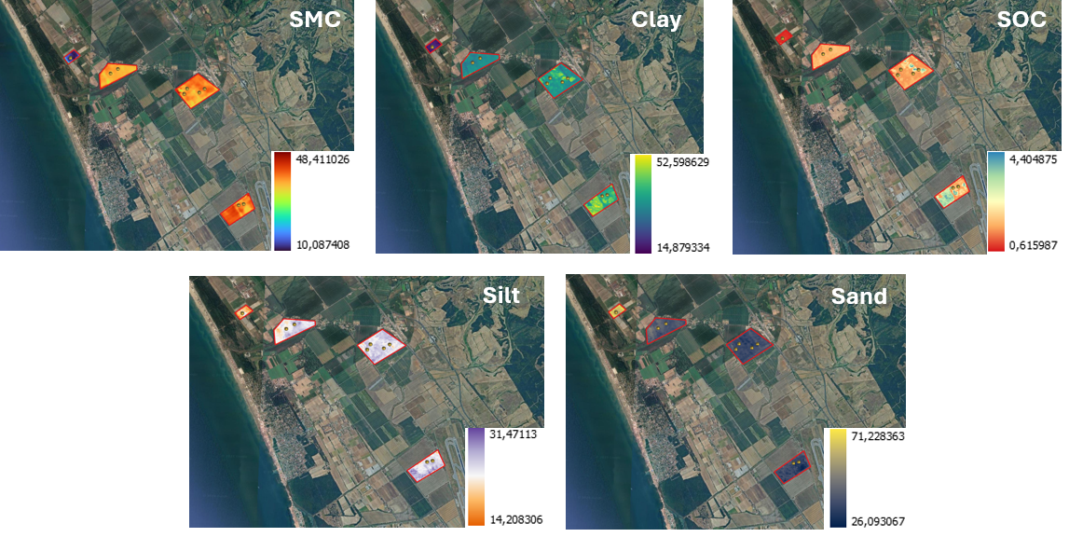
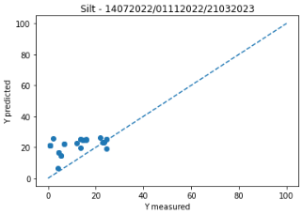
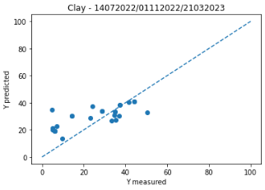
Regressor Chain and Soil Moisture classes
RMSE = 0,77
RMSE = 23
RMSE = 12,29
RMSE = 11,91

Slide 11
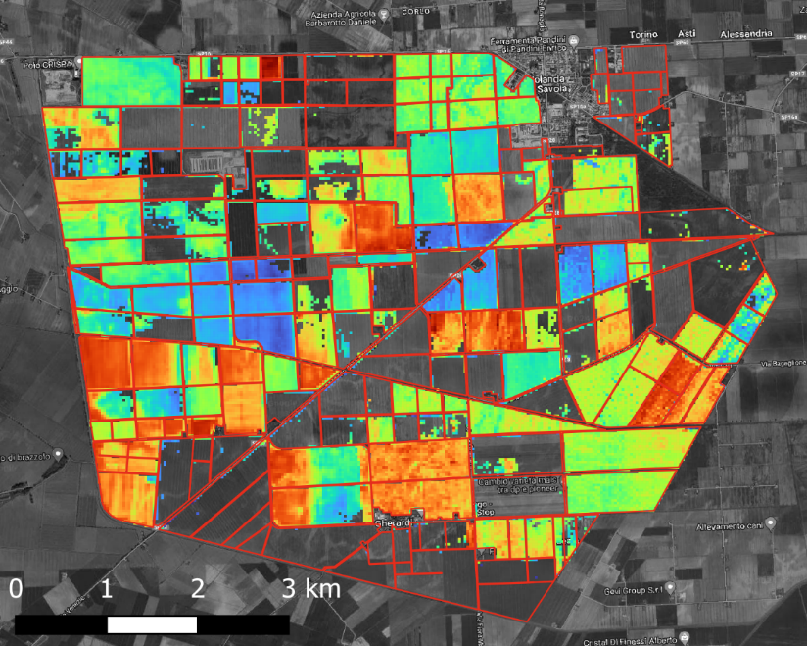
SBG/SBG-TIR like data (PRISMA and HyTES)
PRISMA
Bare Soil Masking
HyTES
Bare Soil Masking
Clouds coverage
Yes
No
NDVI < 0.35
No
Resampled @SBG-TIR
Yes
NDVI < 0.35
Excluded
Bare soil selection procedure
Yes
No
No
nCai<0.03
LST > 310 K
Jolanda HyTES LST 22/06/2023
Yes
No
Yes
Bare Soil Pixels
Soil sampling method
Bare Soil Pixels
Multi-date spectra selection methods:
Soil Spectral Libraries
Max Integral
Thres NDRE
Min S2WI
Max NSMI
Soil Measurement
Original sensors spectra

Slide 12
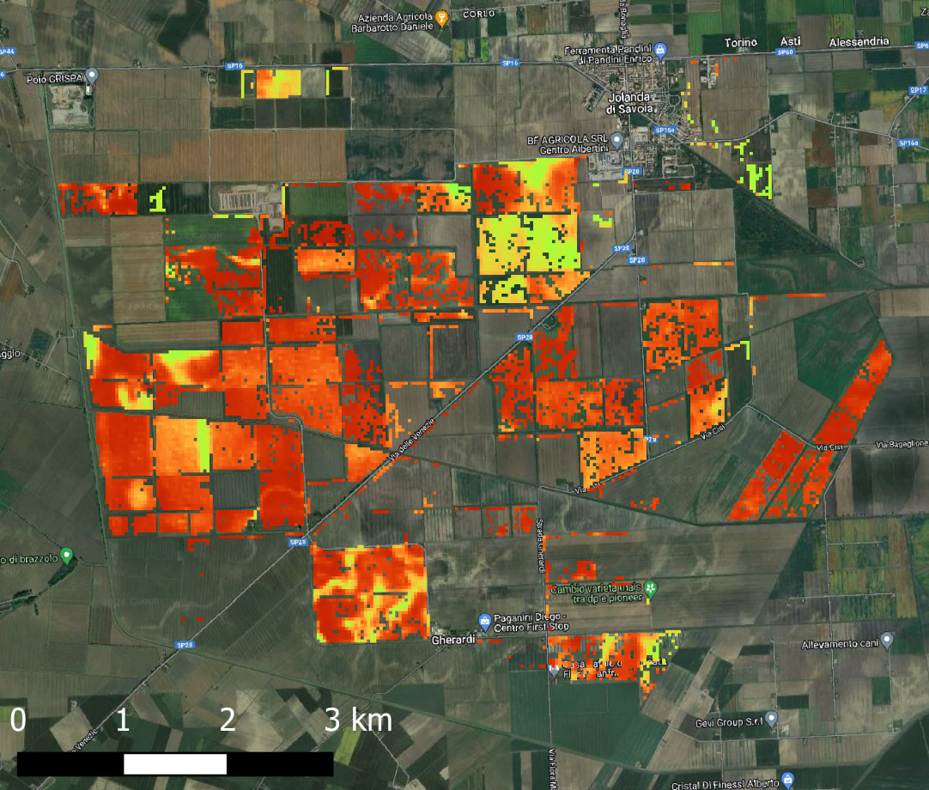
SBG / SBG-TIR like (PRISMA and HyTES)
Silt + Sand
PLSR trained on a detrended PRISMA + LWIR SBG-TIR (resampling HYTES) image. 10-fold CV
PRISMA + SBG-TIR (resampled HYTES)

Slide 13
Conclusion
The potential of hyperspectral time series has not yet been fully explored for topsoil.
Data harmonization / homogenization has a severe impact on results.
The GPR algorithm trained on dry data sets performs also well when applied to dry/wet time series. The dryness of the soil spectra is an ongoing issue.
The LWIR spectral range (i.e. SBG-TIR, LSTM and THRISNA) is very promising for fine and coarse soils (quartz)
Soil cannot only be considered just as an opportunity topic in campaigns designed for different topics (e.g. vegetation). In this regard, the attention of ESA and the National Agencies is welcome.

