Slide 1
Lessons learned from the EMIT mission
David R. Thompson, Robert O. Green, Philip G. Brodrick, K. Dana Chadwick, and the EMIT team
Jet Propulsion Laboratory, California Institute of Technology
Copyright 2024 California Insittute of Technology. All rights reserved; US Government Support Acknowedged.
Cover image caption and credit: Picture taken by Astronaut Jessica Watkins

Slide 2
The Earth surface Mineral dust source InvesTigation (EMIT)

Slide 3
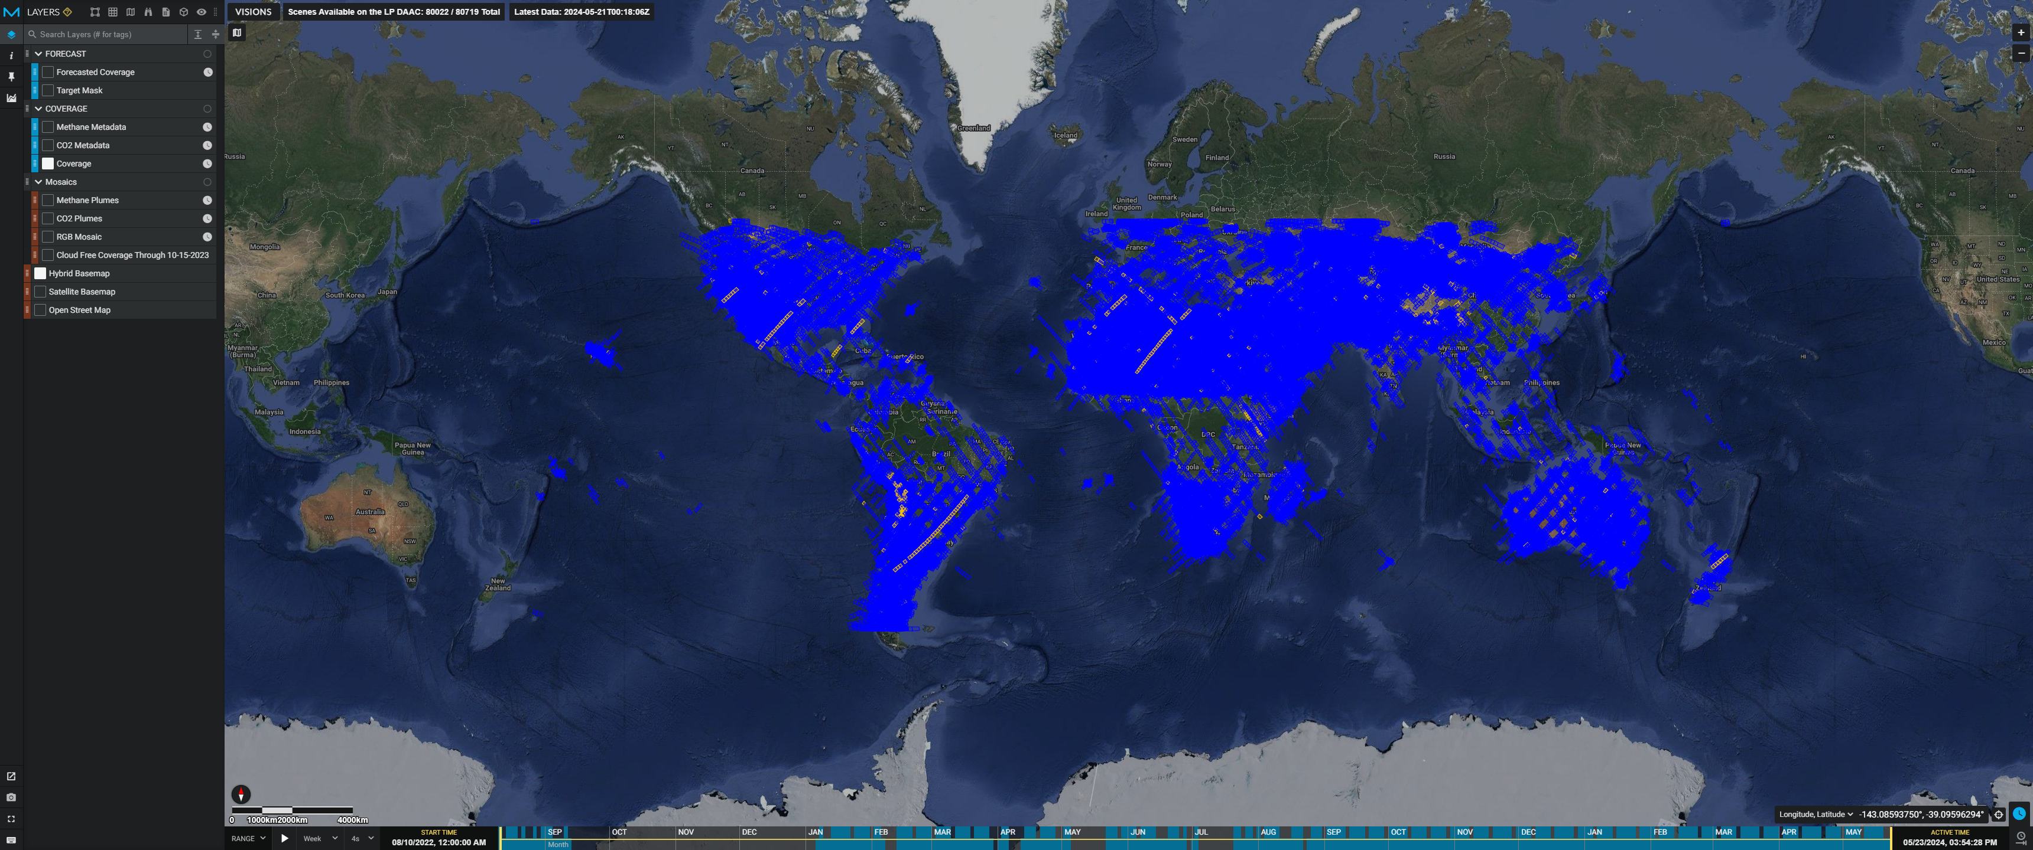
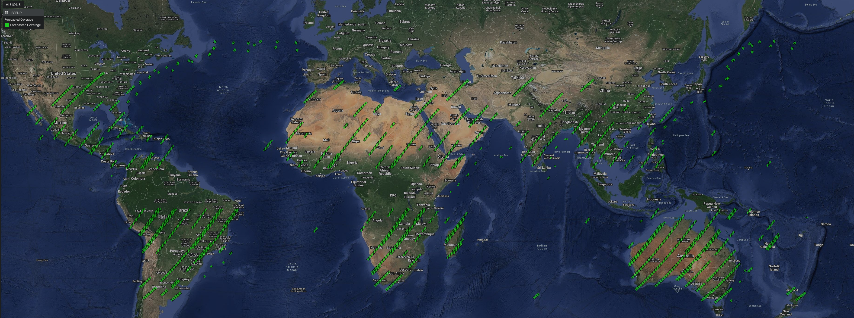
Global coverage
EMIT Coverage
EMIT Forecast

Slide 4
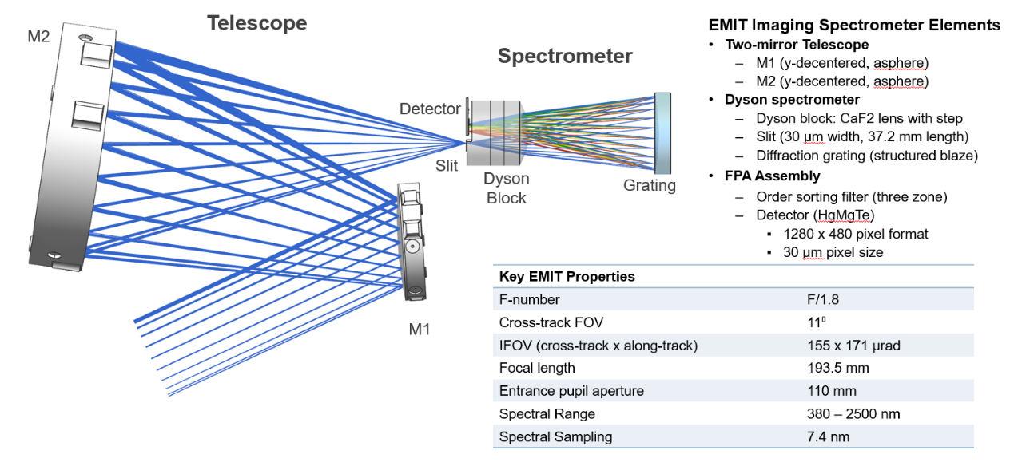
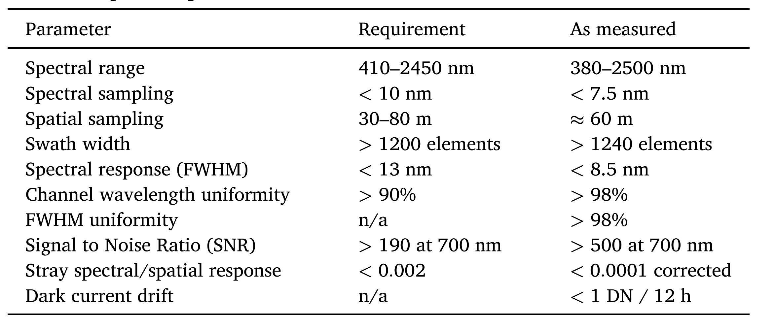
Lesson 1: Feasibility of the Dyson design
Thompson et al., Remote Sensing of Environment 2024

Slide 5
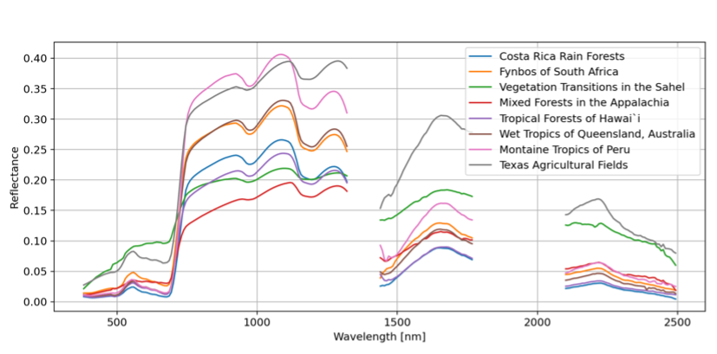
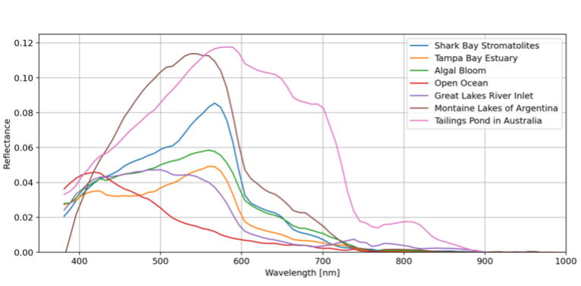
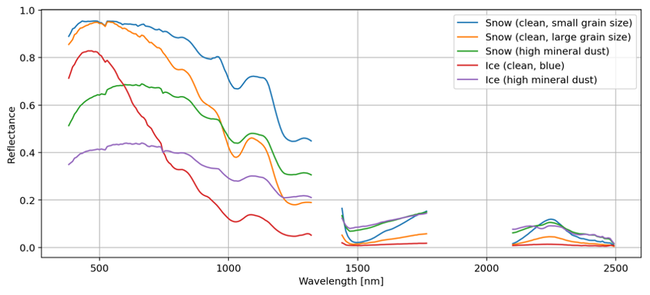
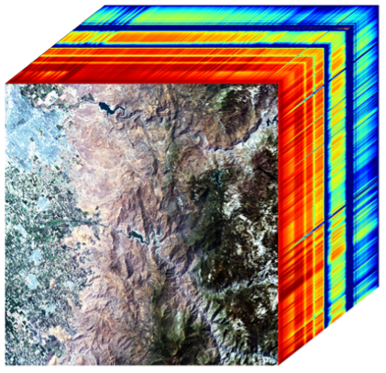
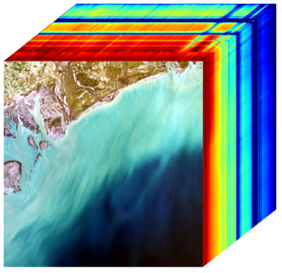
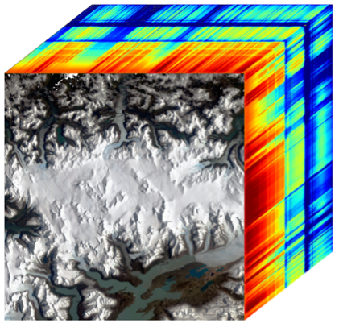
Lesson 2: Advances in spectral fidelity

Slide 6
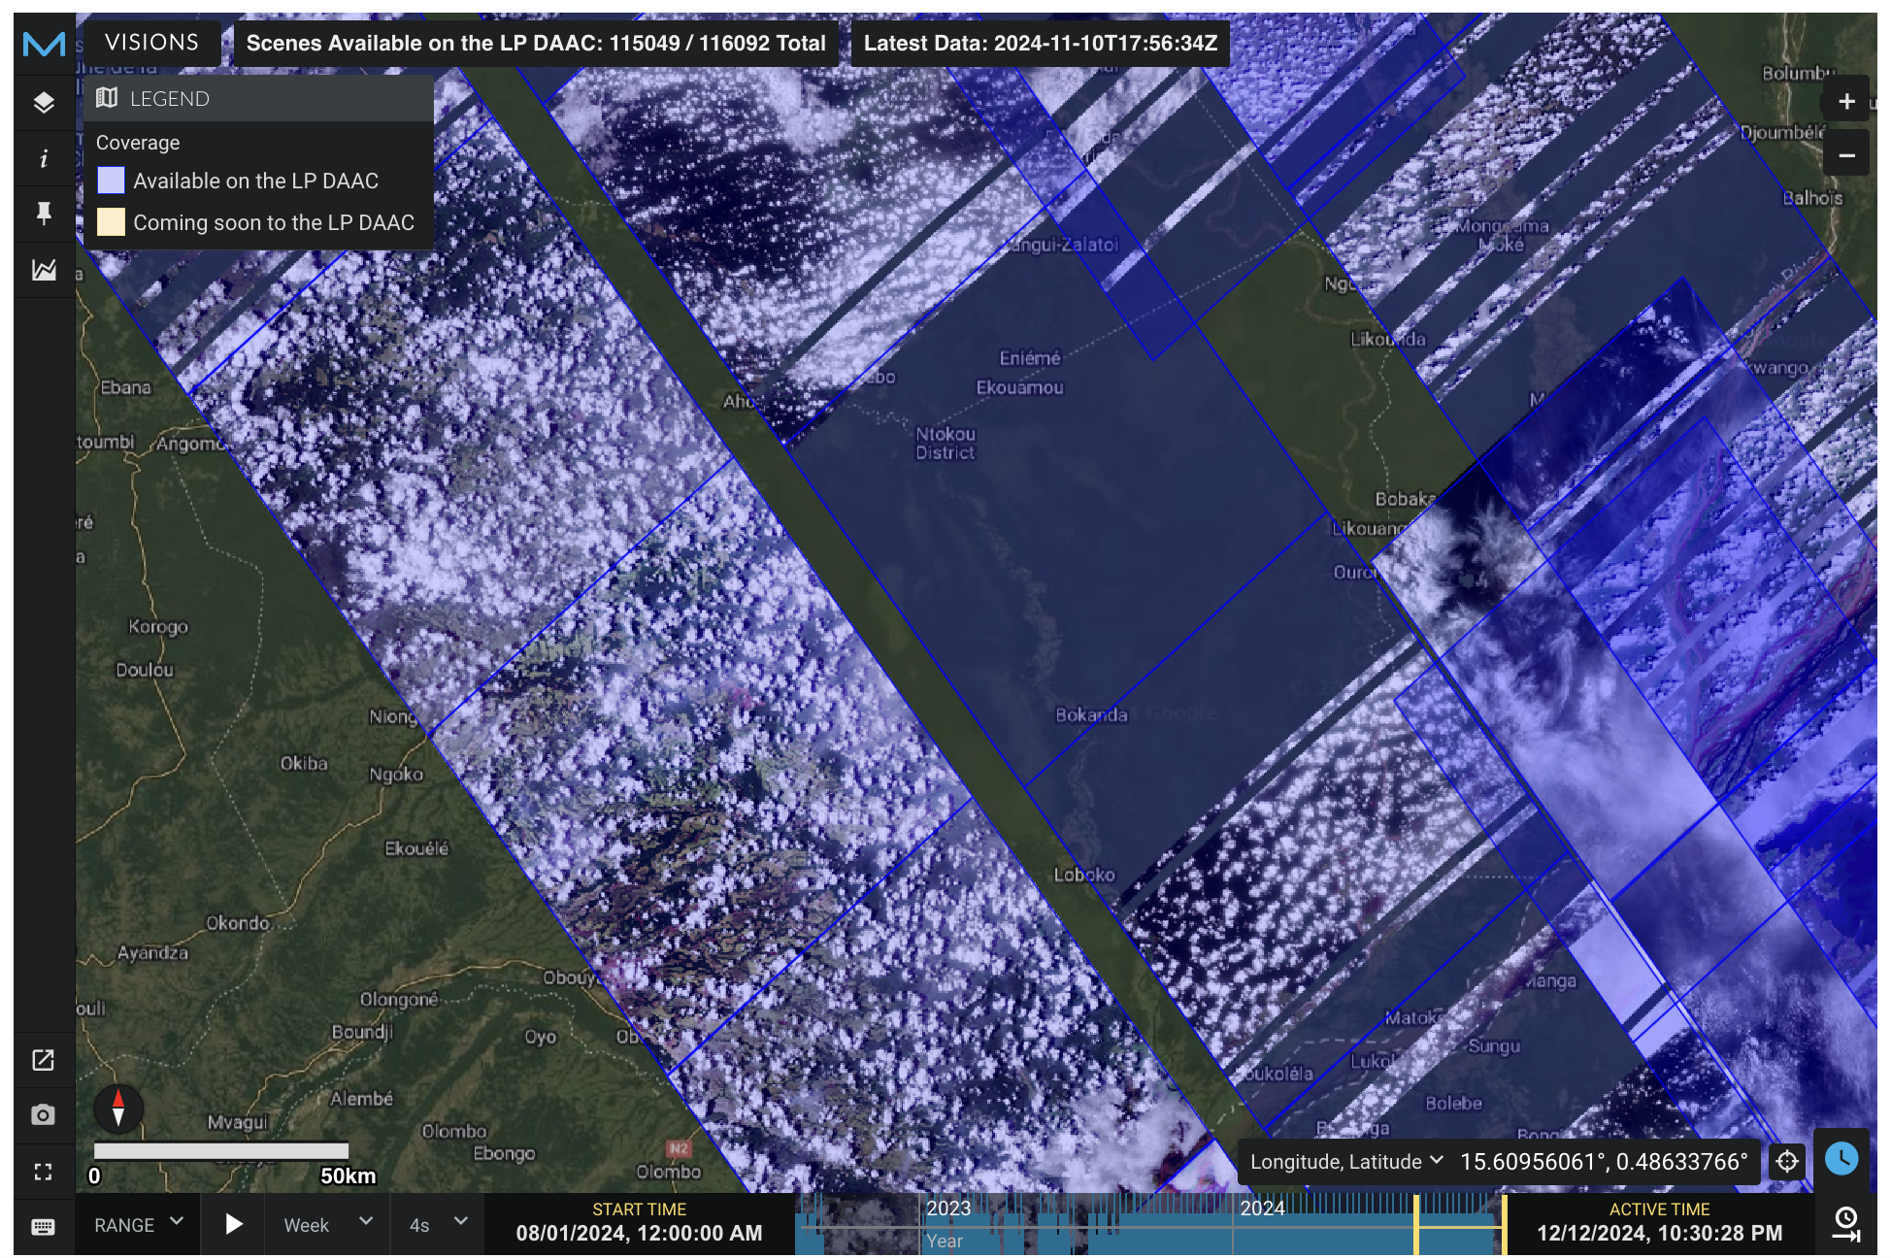
Lesson 3: Onboard cloud screening helps, but needs some work

Slide 7
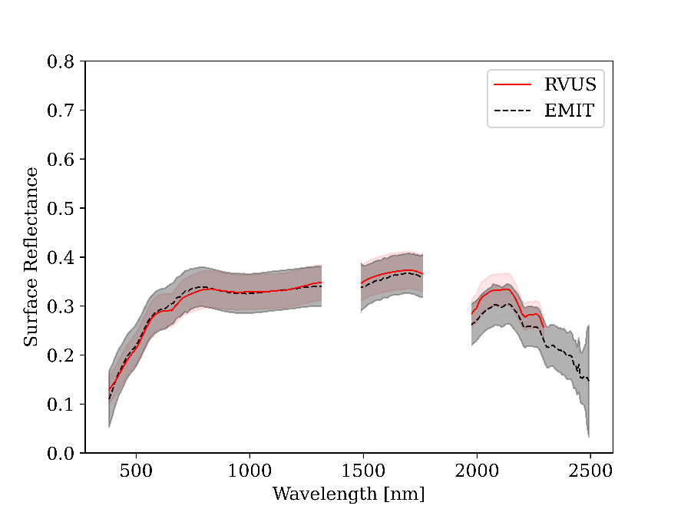
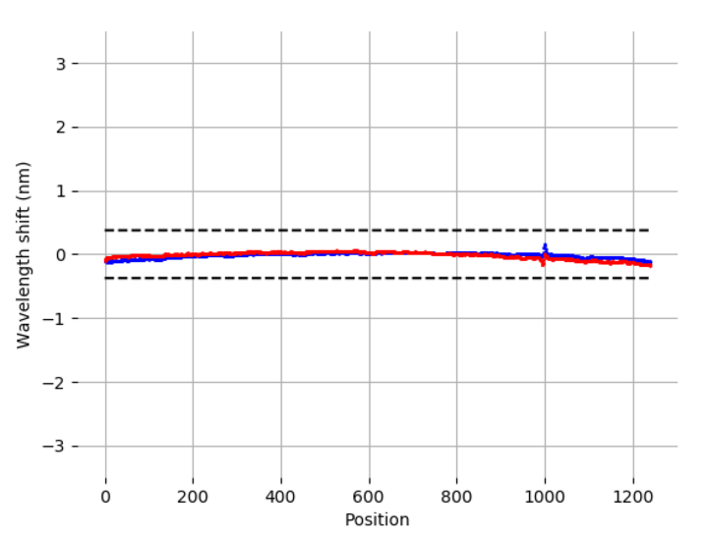
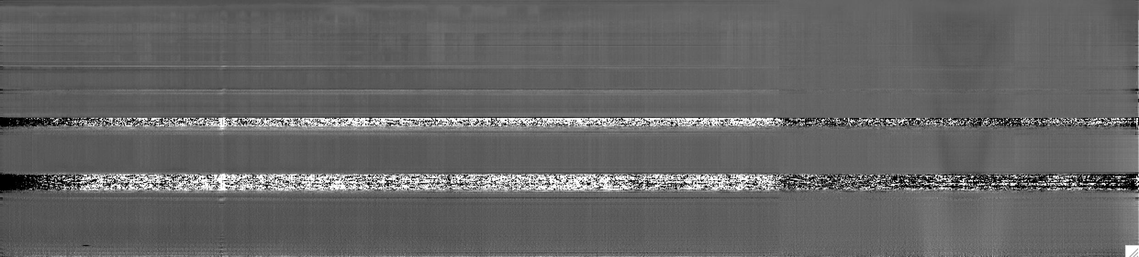
Lesson 4: The Earth is a calibration object
FWHM uniformity
Radiometric Calibration
Wavelength Calibration, Uniformity
Thompson et al., RSE 2024
Coleman et al., RSE (in press)
Thompson et al., RSE 2024
Flat Field
Dark State

Slide 8
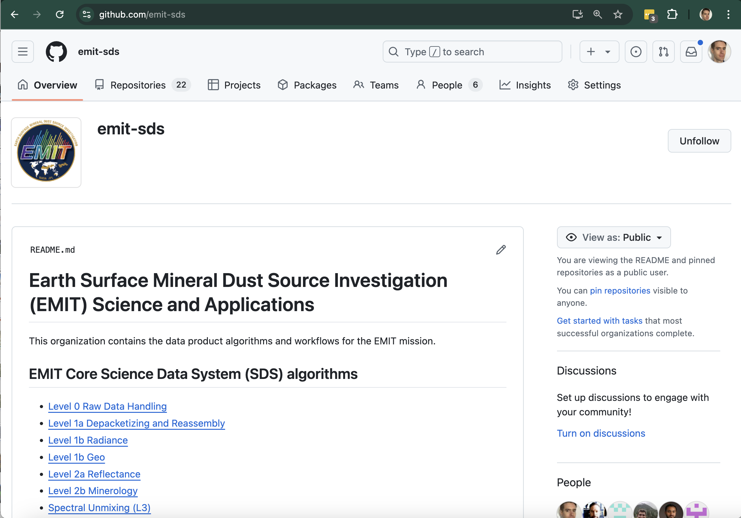

Lesson 5:
Open source development benefited the mission

Slide 9
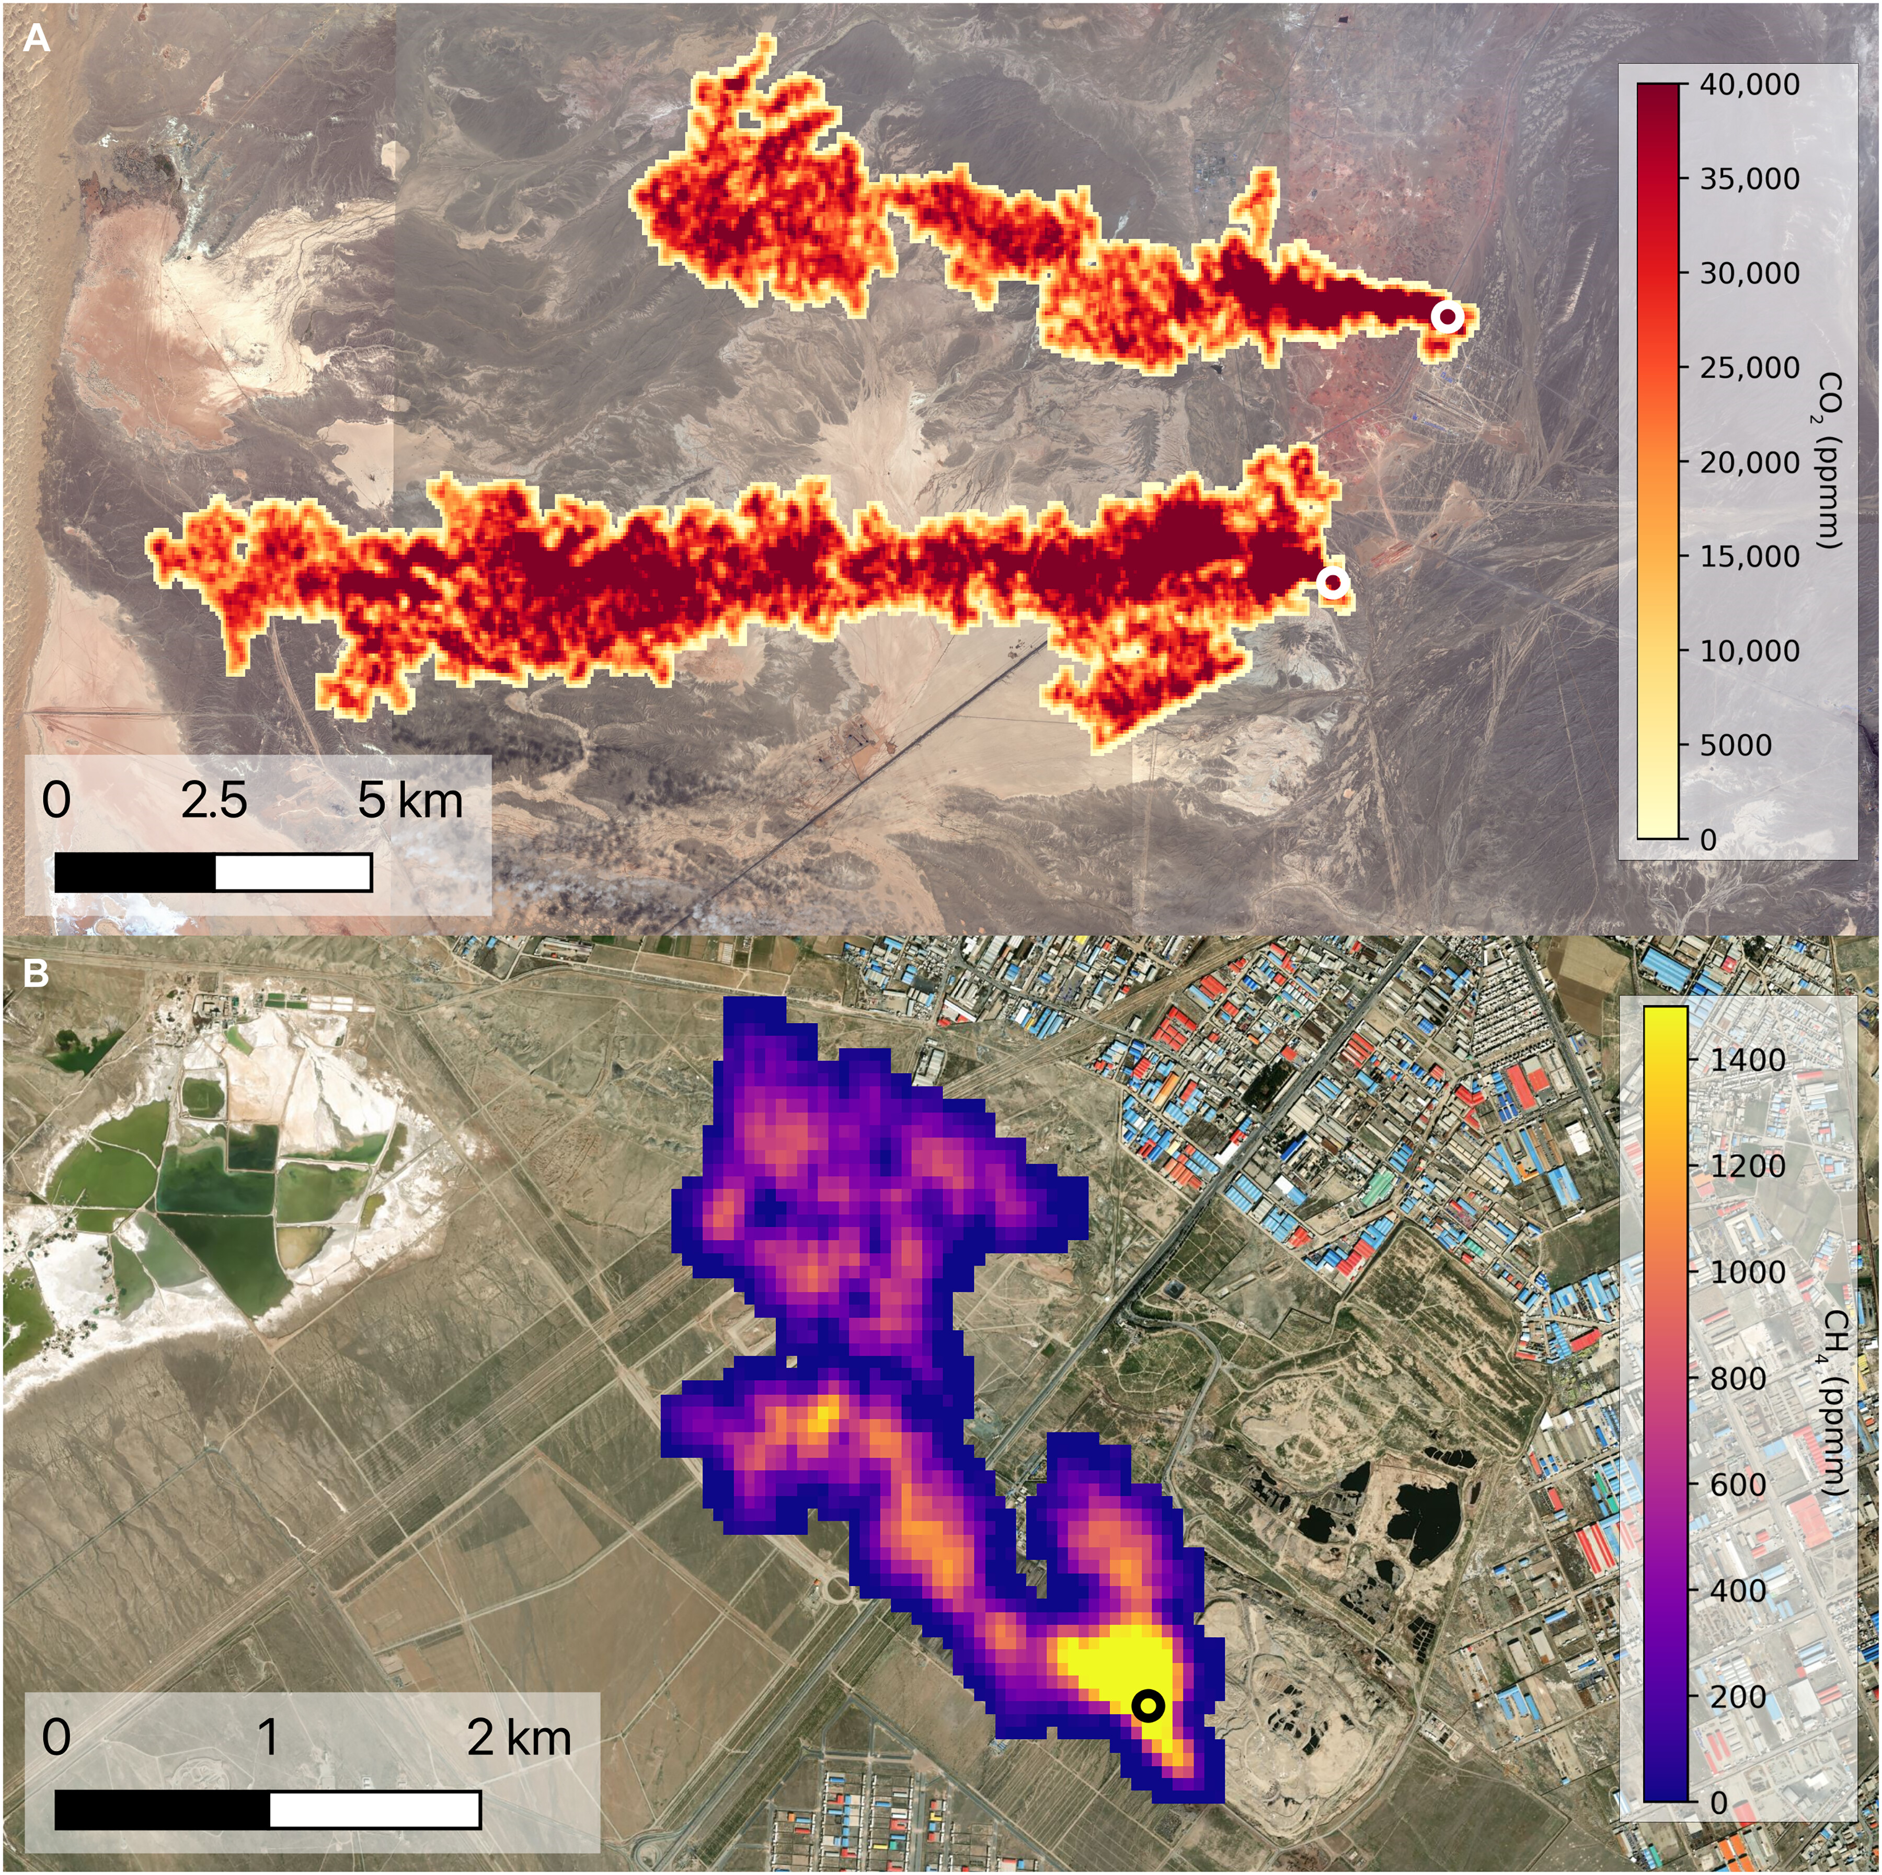
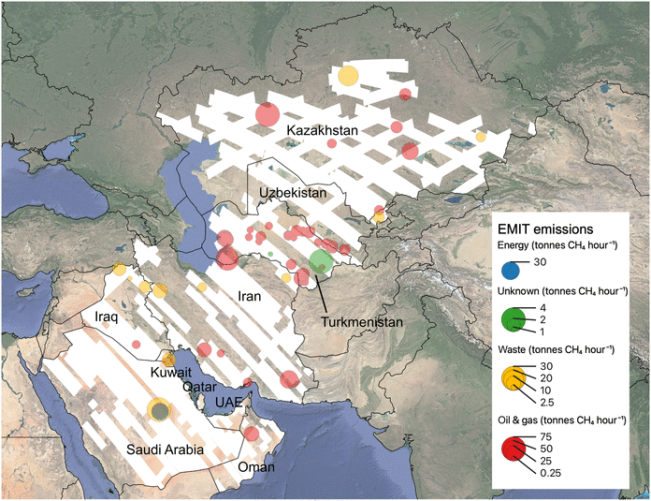
Lesson 6: Global greenhouse gas superemitters
Thorpe et al., Science Advances, 2023

Slide 10
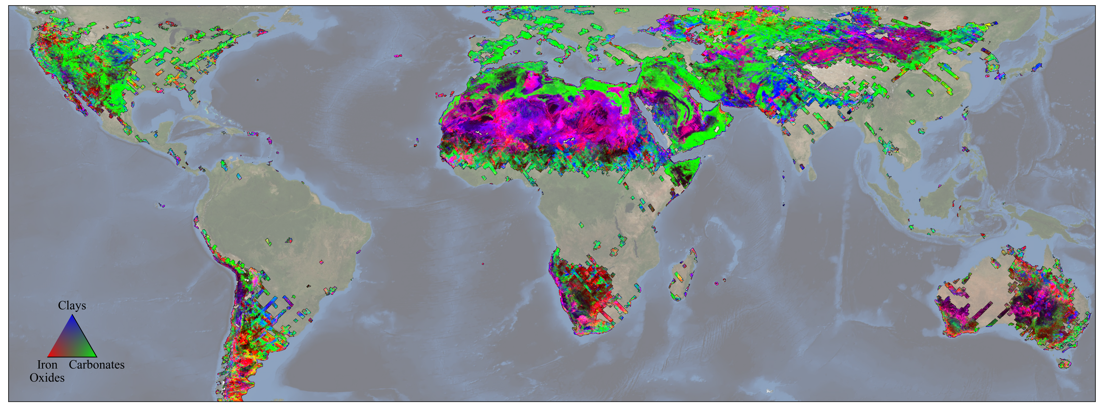
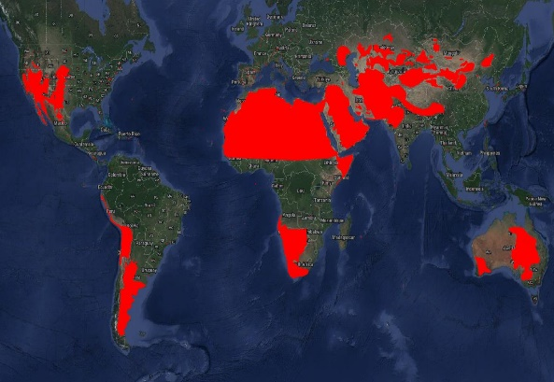
Lesson 7: Continental-scale mineral maps
Dust source and adjacent lands target mask

Slide 11
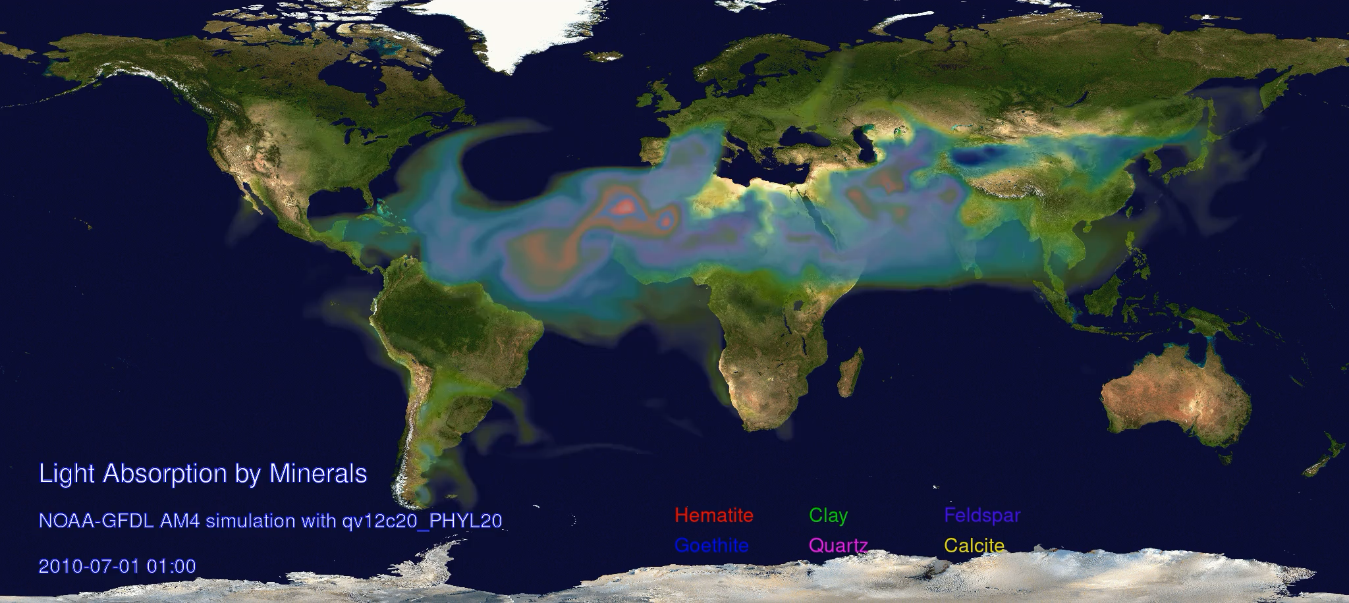
Lesson 8: Mineral dust radiative forcing
Shortwave Direct Radiative
Effect (W m⁻²)
EMIT
Pre-EMIT
Longlei Li & Natalie Mahowald, Cornell
Paul Ginoux, NOAA

Slide 12
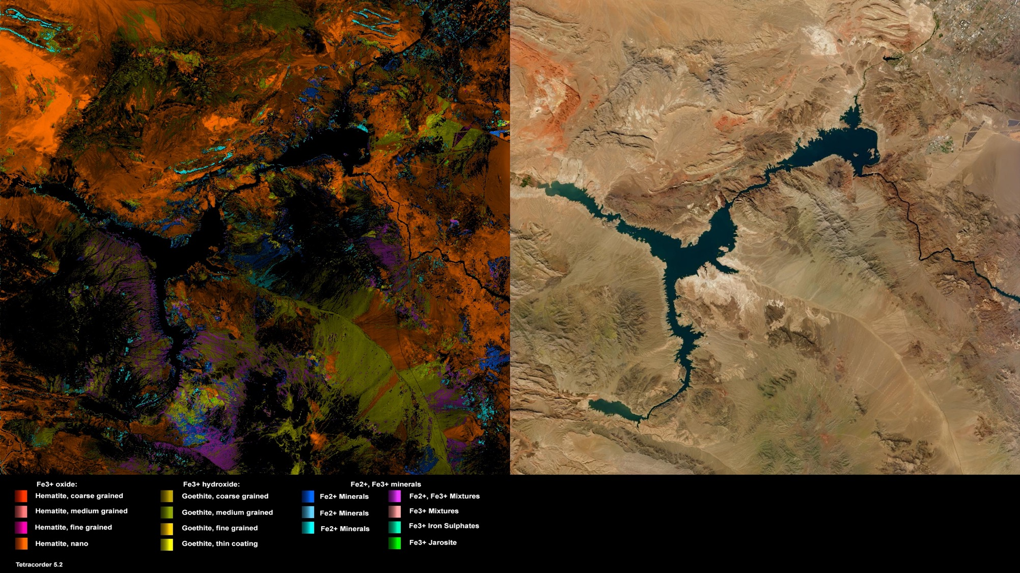
Lesson 9: Spectroscopy is beautiful

Slide 13
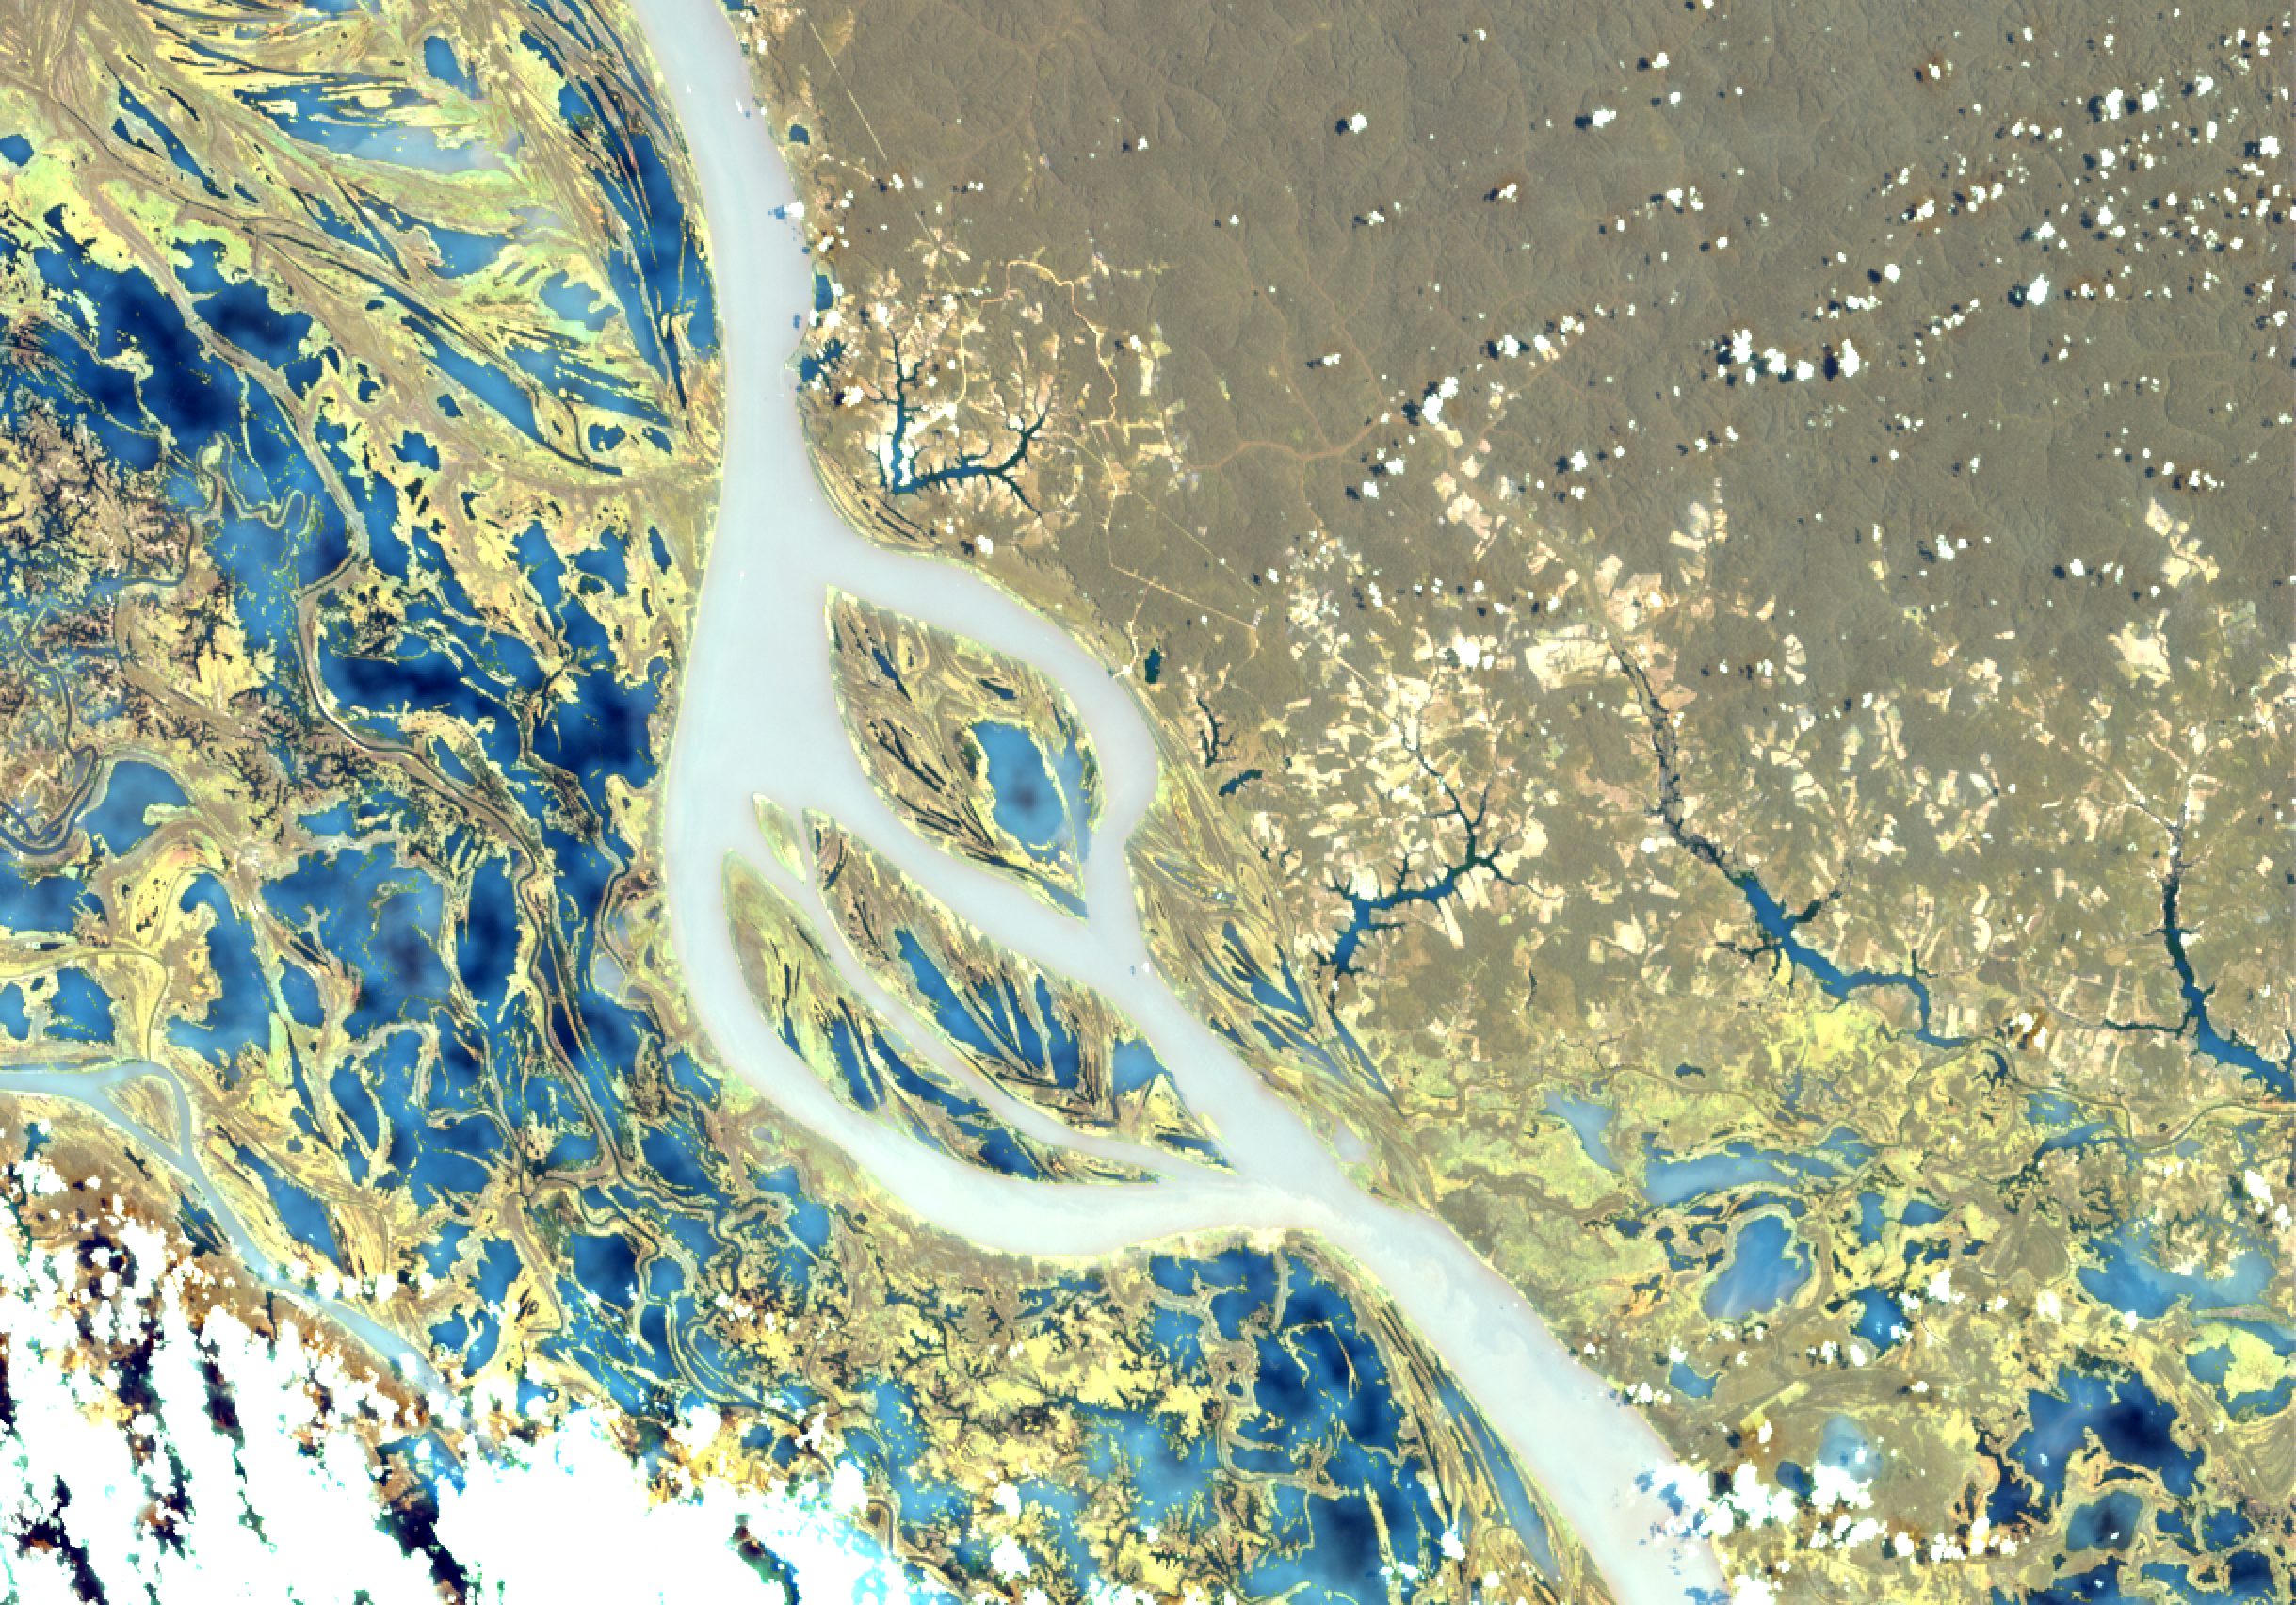
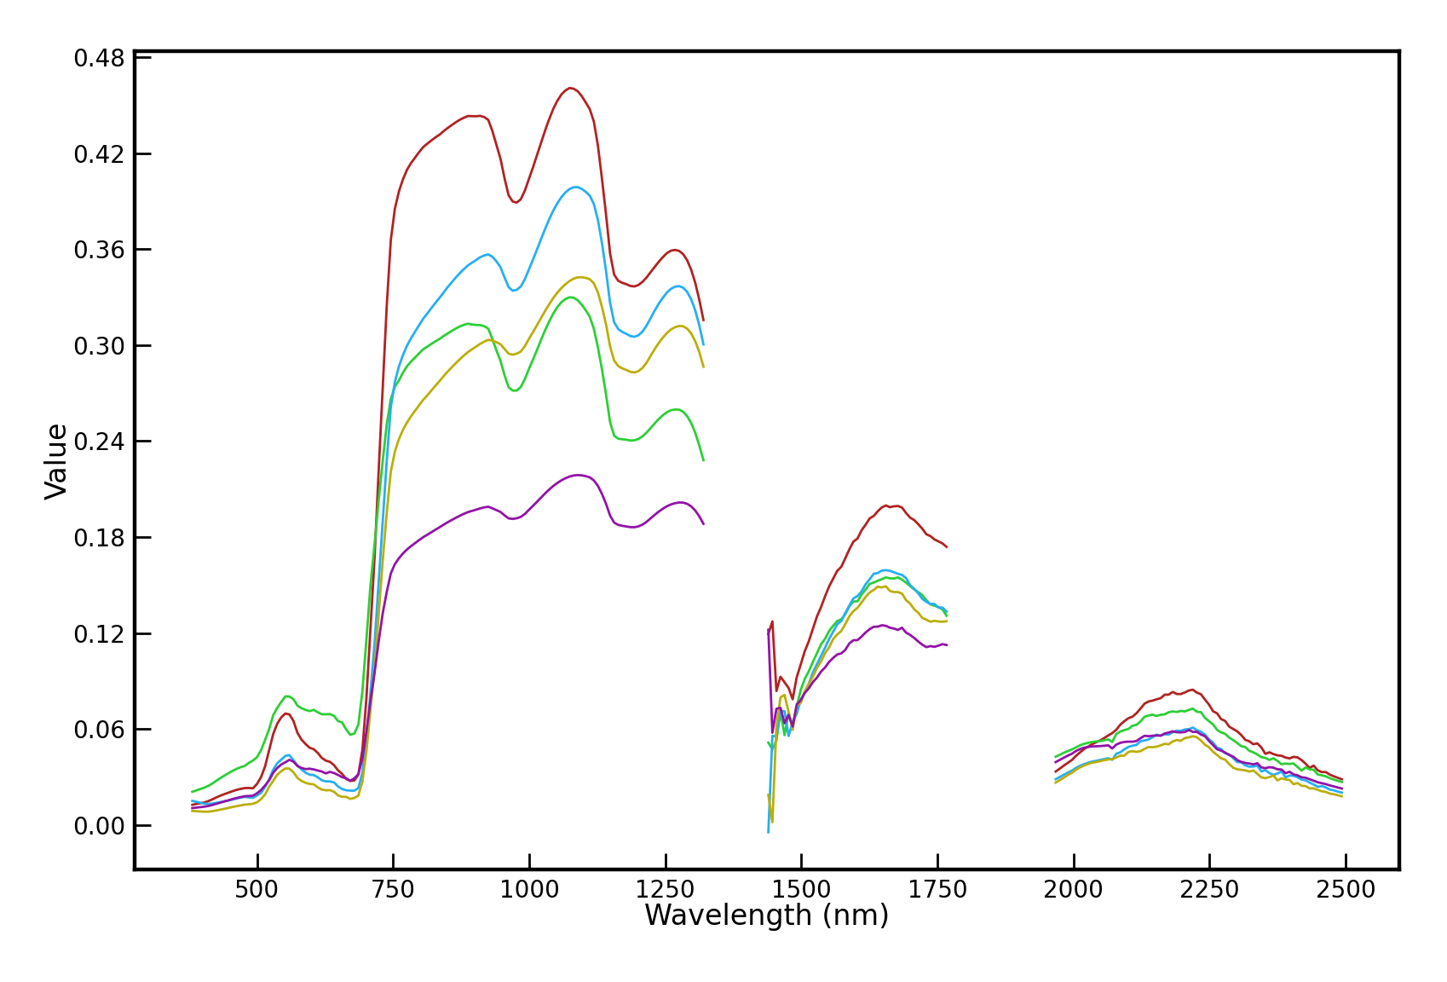
B
C
A
A
D
B
C
D
E
E

Slide 14
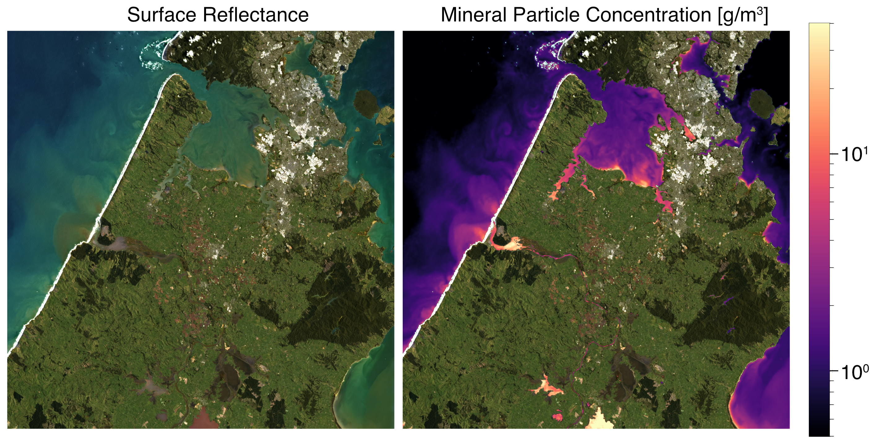
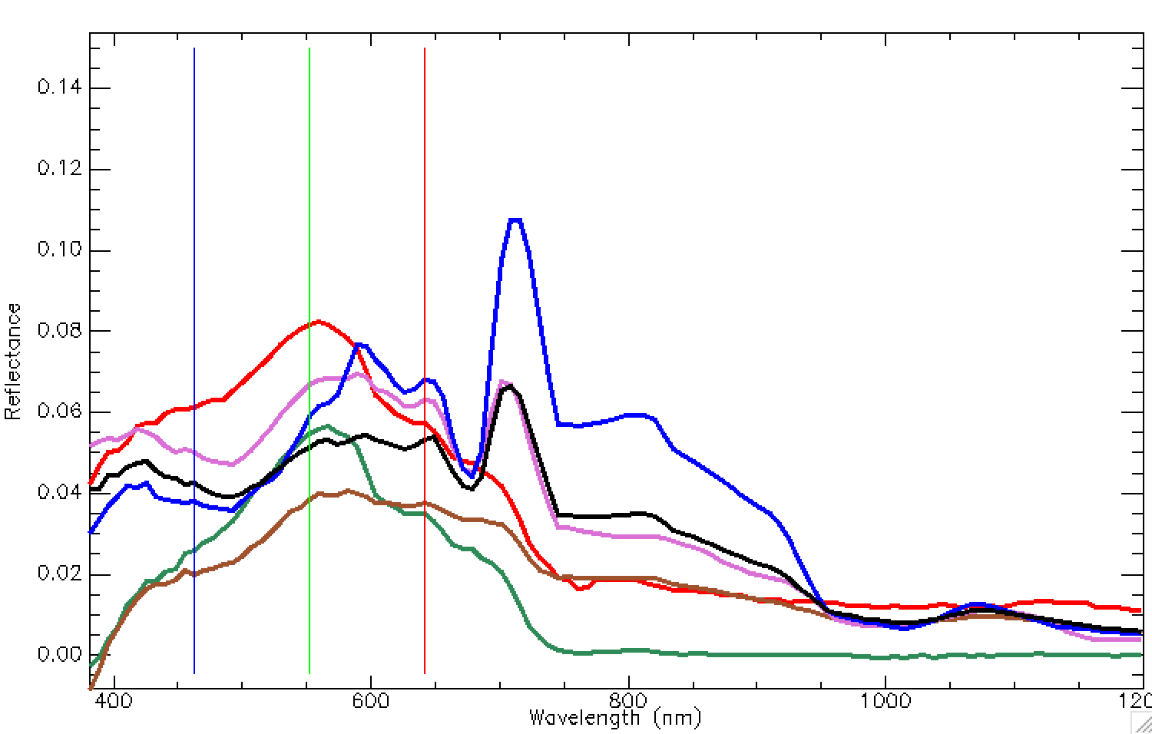
Courtesy Evan Greenberg, JPL

Slide 15
Thanks!
Cover image caption and credit: Picture taken by Astronaut Jessica Watkins

