Slide 1
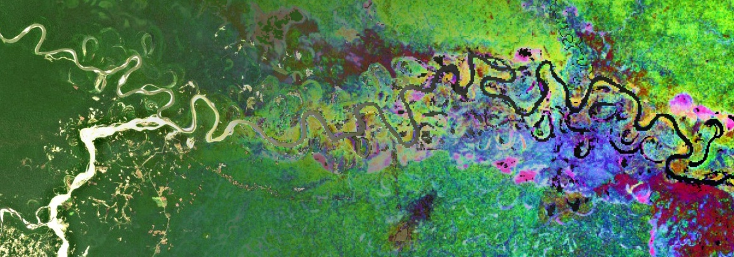
‘The tree that hides the cloud that reveals the forest’ Preparing access and use of global imaging spectroscopy data through cloud-based systems for forest monitoring Jean-Baptiste Féret, Rémi Cresson, Florian de Boissieu, Mona Bonnier, Mairi Souza Oliveira & Sandra Luque TETIS lab, INRAE, Montpellier, France (jb.feret@teledetection.fr)
3rd Workshop on international cooperation in spaceborne imaging spectroscopy – ESA-ESTEC – Nov 14, 2024

Slide 2
The tree that hides the cloud that reveals the forest
Introduction / Context
Toolbox
First results
Conclusions & perspectives

Slide 3
Introduction / context
How to efficiently map and monitor ecosystem extent & biodiversity using satellite EO ?
CEOS Ecosystem Extent Task Team: development of demonstrators based on various sensors & datacubes
→ Demonstrator for Tropical Forest monitoring: mapping forest types over Costa Rica
Understand the conservation potential of secondary forests in human-modified tropical landscapes
Compare intact and disturbed old-growth forests for conservation potential
Challenges for operational ecosystem extent & biodiversity mapping include:
Accessibility of Earth Observation time series
Cloud resources (HPC & storage) for optimal access and processing capacity at region / country scale
Free and open softwares, methods & data for reproducibility and dissemination
→ Harmonization of data format and information
Broader objectives :
Collaborative EO data processing, reproducibility, benchmark analyses, products validation
Effortless transition from research & prototype to operational application & production
Easier integration of multi-sensor analysis
Prepare for future satellite missions
Save time and money for public data providers, method developers and users

Slide 4
Costa Rica: Study area & context of analysis
Why focusing on Costa Rica?
Ecological transition since the 1990s: From being a pioneer in deforestation during the 1970s-1980s to becoming a leader in reforestation starting in the 2000s (Redo et al., 2012).
Current forest cover: 52% of the country’s total area, with 36% consisting of secondary forests (Stan and Sanchez-Azofeifa, 2019).
Significant topographic and climatic gradients: Presence of tropical dry and tropical wet biomes.
Biodiversity hotspot: The country hosts approximately 5% of the world's biodiversity on only 0.03% of the Earth's surface (MINAE et al., 2018).
Isolation of protected areas:
A fragmented landscape, predominantly composed of agricultural areas, pastures, and secondary forests.
Biological corridors connecting protected areas lack formal protection status and face significant anthropogenic pressure (Morera Beita et al., 2021).
Vulnerability of secondary forests: Especially pronounced during early regeneration stages, particularly outside protected areas (Reid et al., 2019, 2017; Shebitz et al., 2023).
Ground information available from partners SINAC (National System of Conservation Areas) & CATIE (Tropical Agricultural Research and Higher Education Center)

Slide 5
The tree that hides the cloud that reveals the forest
Introduction / Context
Toolbox
First results
Conclusions & perspectives

Slide 6
Toolbox
Data infrastructure :
Fully open source solutions
Open standards (OGC): STAC / COG
Cloud-native architecture (S3 object storage)
Current provider : Microsoft Planetary STAC catalog

Slide 7
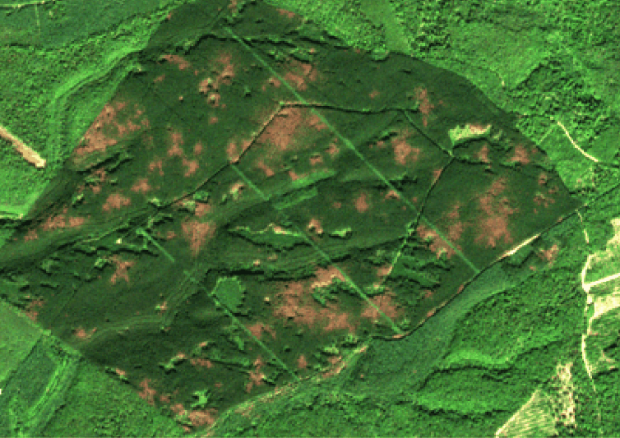
Toolbox
Data infrastructure :
Fully open source solutions
Open standards (OGC): STAC / COG
Cloud-native architecture (S3 object storage)
Current provider : Microsoft Planetary STAC catalog
Earth observation algorithms developed by TETIS team
biodivMapR, an R package for α- and β-diversity mapping using remotely-sensed images
FORDEAD, a python package to monitor FORest DEcline And Dieback
https://jbferet.github.io/biodivMapR/index.html
https://fordead.gitlab.io/fordead_package/

Slide 8
The tree that hides the cloud that reveals the forest
Introduction / Context
Toolbox
First results
Conclusions & perspectives

Slide 9
First results: Forest diversity mapping over Costa Rica using Sentinel-2 time series
SITS analysis and processing : production of cloudless spectral indices
Application of biodivMapR to map α- and β- spectral diversity
Comparison between spectral diversity and forest diversity
Map of forest types (information provided by SINAC & CATIE)
Plot inventories: validation in preparation to relate to floristic composition
Old-Growth Forest
Secondary Forest
Old-Growth Deciduous Forest
Secondary deciduous forest
Palm forest
Mangrove
α-spectral diversity
Costa Rica
β-spectral diversity
Map of forest types

Slide 10
The tree that hides the cloud that reveals the forest
Introduction / Context
Toolbox
First results
Conclusions & perspectives

Slide 11
Conclusions & perspectives
A cloud-based infrastructure was developed to run EO applications with S2 data
Standard data format + free & open softwares = efficient method development & upscaling
Geospatial standards will enhance capacity to integrate data from CHIME & SBG
Challenges remain to provide fully functional analysis ready data
Illustration: effect of geometry of acquisition on S2 data after cloud removal (NDWI1, French Guiana)
100 km
100 km
Before correction
After correction

Slide 12
Conclusions & perspectives
How close are different projects on implementing FAIR data?
Provide imaging spectroscopy data access through STAC API for enhanced use (alone or in combination)
What aspect is the most difficult?
Data policy of space agencies, agreement on different processing levels, STAC friendly software development to allow harmonization from lower to higher data levels
Copernicus Data Space Ecosystem is currently limited and cannot compete with Microsoft Planetary
What projects are implementing standardization?
→ DLR STAC collections for DESIS & EnMAP (https://geoservice.dlr.de/eoc/ogc/stac/v1/collections/)
What are challenges to open science in cal/val, algorithm development, and science and applications use spaces?
Adopt standards for ground data access
What are potential improvements?
→ Towards ARD: Accounting for directional effects on vegetation and sensor artifacts (e.g. spectral response non uniformity)

Slide 13
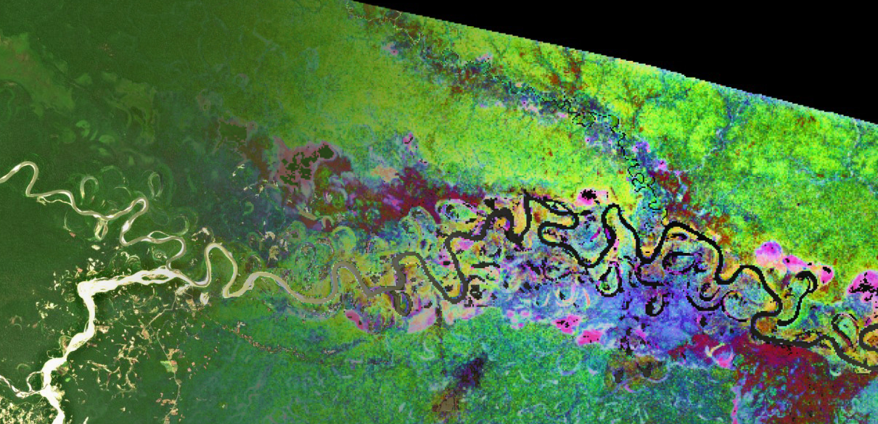
Thank you !
Research funded by
Association Nationale pour la Recherche (ANR JCJC BIOCOP ANR-17-CE32-0001)
CNES
Costa Rica partners:
Centro Agronómico Tropical de Investigación y Enseñanza
National System of Conservation Areas
©I. Biagiotti@THEIA

