Slide 1
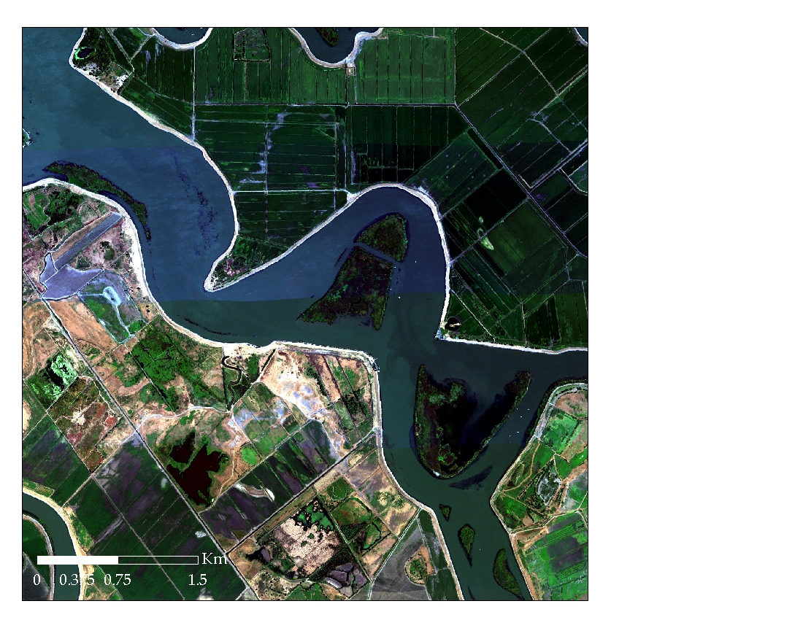


Understanding functional trait syndromes in an inland delta using time series of airborne imaging spectroscopy
Maria J. Santos, Shruti Khanna and Susan L. Ustin

Slide 2
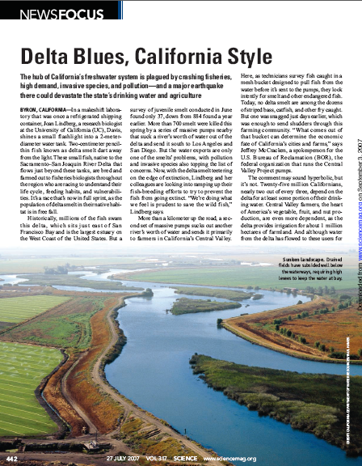
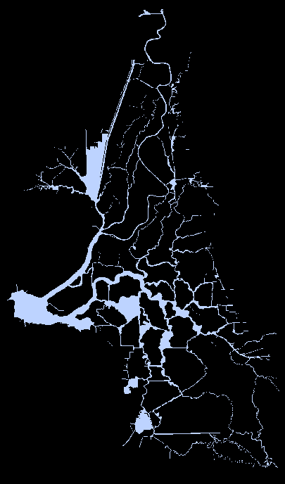
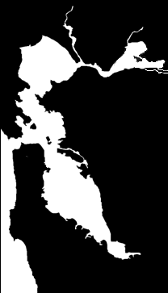
3rd Largest Tidal Estuary in the US &
Largest on the Pacific Coast
~ 2 000 km waterways
Drains 40% of state rivers
Drinking water >23 M people
Water for $39billion agricultural industry
  Aging levee system at risk of failure
Near Ecological Collapse
Sacramento
San Francisco
Pacific Ocean

Slide 3
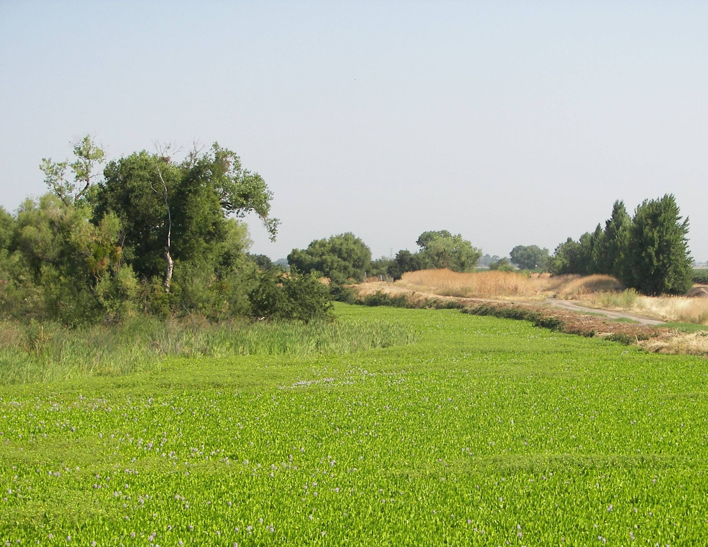
Water Hyacinth (Eichhornia crassipes)

Slide 4
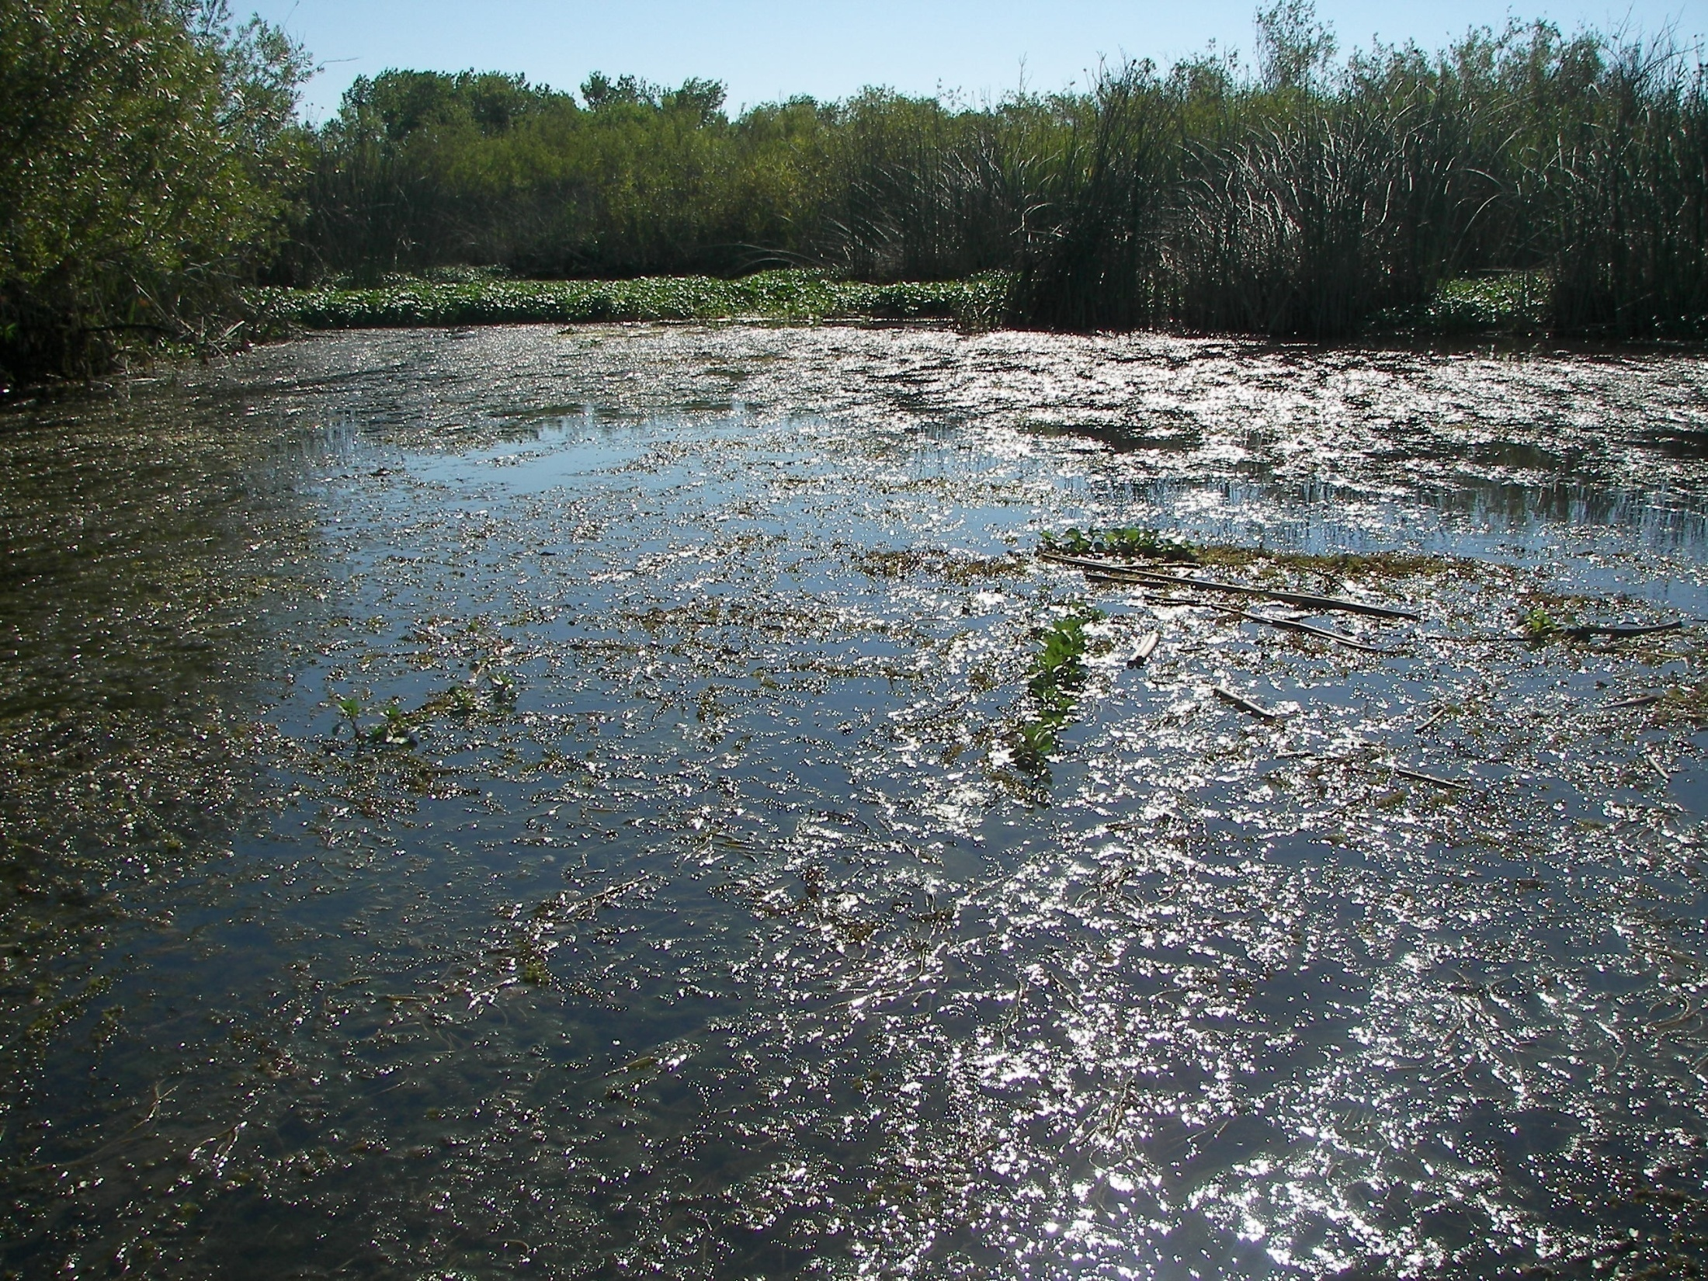
Brazilian Waterweed (Egeria densa)

Slide 5
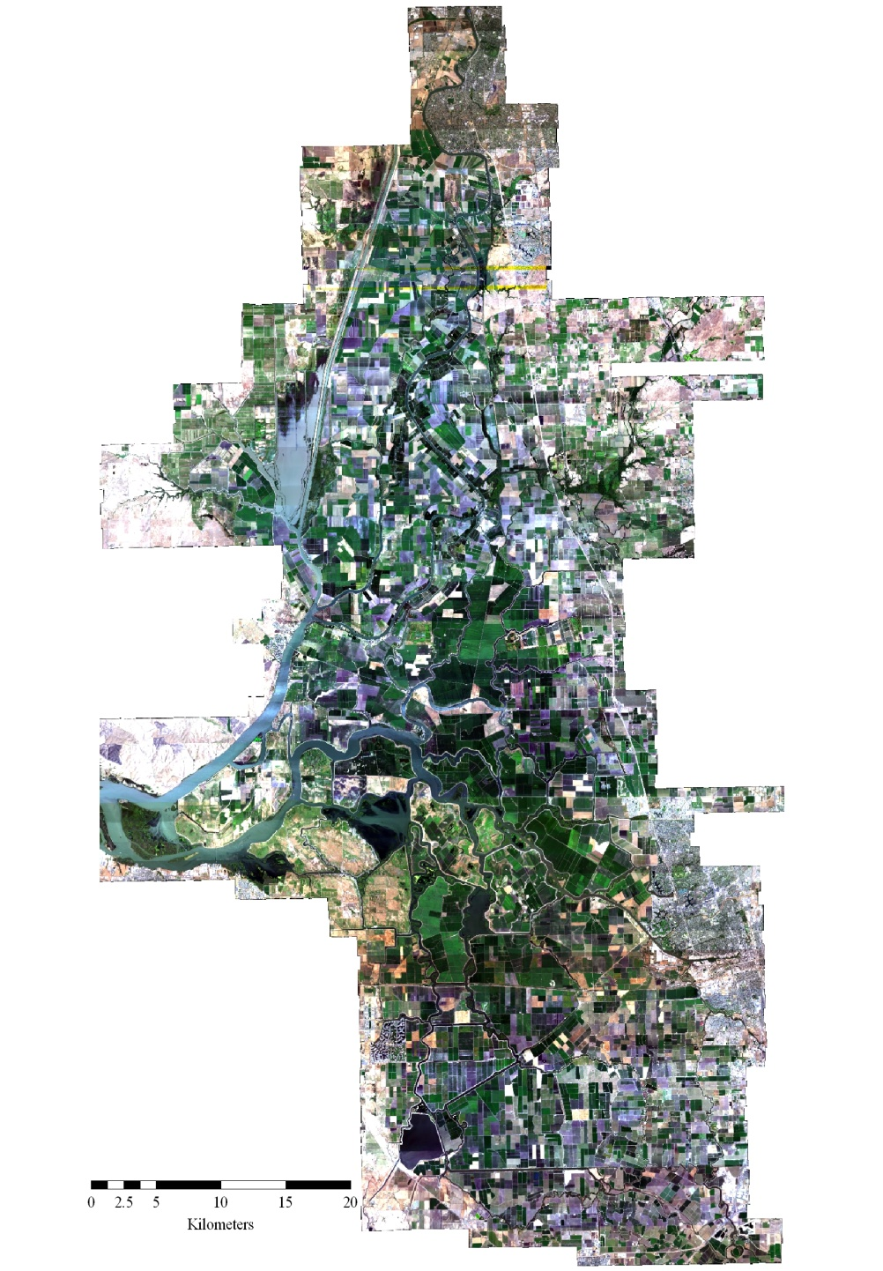
Imaging the delta
Year | Image acquisition | # of Flightlines | Sensor | Pixel size | Data size (GB) | Image extent
2003 | Jul 1 | 10+3 | HyMap | 3.0m |  | Central Delta (narrow) + Suisun (only Grizzly Island)
2004 | Jun 25 - Jul 7 | 64 | HyMap | 3.0m | 113 | Full Delta
2005 | Jun 22 - Jul 8 | 64 | HyMap | 3.0m | 144 | Full Delta
2006 | Jun 21 - 26 | 64 | HyMap | 3.0m | 121 | Full Delta
2007 | Jun 19 - 21 | 64 | HyMap | 3.0m | 118 | Full Delta
2008 | Jun 29 - Jul 07 | 48 | HyMap | 3.0m | 89 | Liberty island to S. Delta
2014 | Nov 14-25 | 61 | AVIRIS-ng | 2.5m | 894 | Full Delta
2015 | Sep 17-21 | 61 | AVIRIS-ng | 2.5m | 894 | Full Delta
2016 | Oct 8-9 | 22 | AVIRIS-ng | 2.5m | 369 | Liberty island, central Delta
2017 | Nov 1 | 22 | AVIRIS-ng | 2.5m | 346 | Liberty island, central Delta
2018 | Oct 6-9 | 28+18 | HyMap | 1.7m | 167 | Liberty island to Lost slough, central Delta, Suisun
2019 | Apr 9-12 | 28+18 | HyMap | 1.7m | 374 | Liberty island to Lost slough, central Delta, Suisun
2019 | Sep 23-28 | 71 | HyMap | 1.7m |  | Full Delta
2020 | Jul 15-18 | 58 | Fenix | 2.0m | 701 | Full Delta
2021 | Jul 8-28; Aug 11 | 58 | Fenix | 2.0m | 677 | Full Delta + Suisun
2022 | Jul 14-18 | 57 | Fenix | 2.0m | 1610 | Full Delta + Suisun
2023 | Sep 12-14 | 47 | AVIRIS-3 | 2.4m | 906 | Full Delta + Suisun
2024 | Jul 19-22; Aug 20 | 50 | AVIRIS-3 | 2.6m | 788 | Full Delta + Suisun

Slide 6
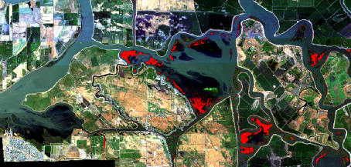
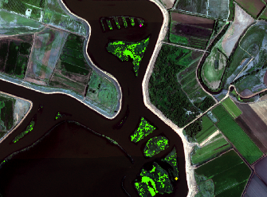
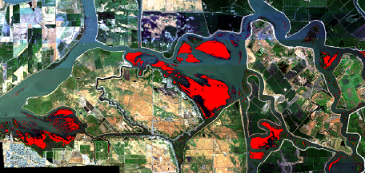
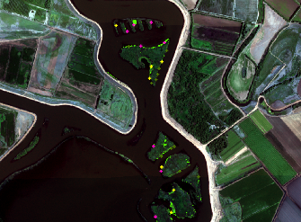
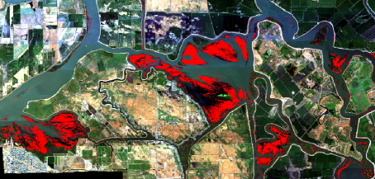
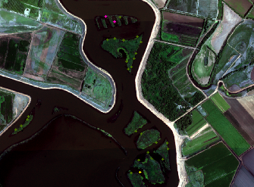
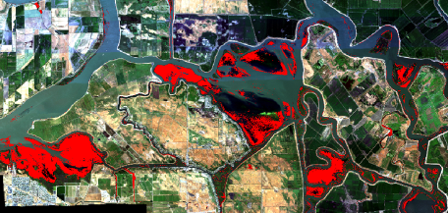
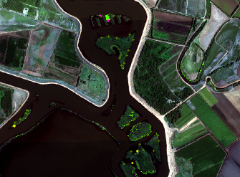

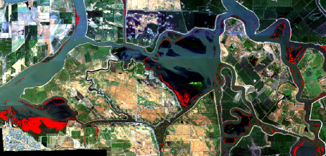
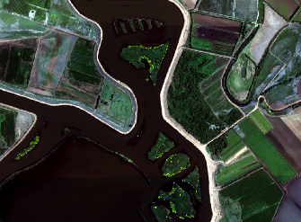
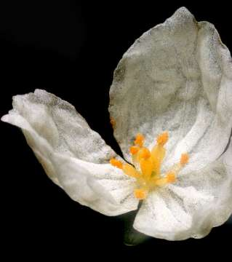
2004
2004
2005
2005
2006
2006
2007
2007
2008
2008
500m

Slide 7
Functional trait syndromes
Functional traits: morpho-physio-phenological attributes that impact fitness, i.e. individual performance (Violle et al., 2007).
The functioning contribution any one trait is coordinated with other traits, creating functional strategies (Reich et al., 2003; Sanchez-Martinez et al., 2020; Wright et al., 2004).
Trait syndrome: a combination of functional trait values that occur in a given taxonomic unit (e.g. a species) and that can be shared with others (e.g. a group of species, which may or may not be closely related).
Variability in functional syndromes can be represented as trait axes or trait spectra, and affected by species composition
[Sanchez-Martinez et al. 2024. https://doi.org/10.1111/2041-210X.14304]

Slide 8
Traits measured with vegetation indices:
30 indices for chlorophyll and other pigments
20 indices for leaf area
9 indices leaf water content
29 indices lignin, cellulose and salinity
2004-2008
2014-2019
Emergent and riparian vegetation

Slide 9

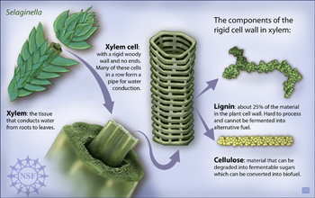

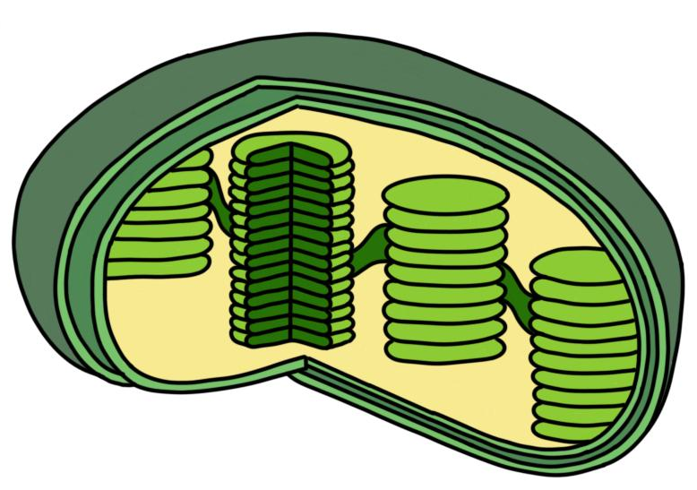

Consistency across vegetation indices
Consistent direction of response across decades
Different responses by the different plant communities
Chlorophyll
and other pigments
Leaf Water Content
Lignin, Cellulose and Salinity
Leaf area
Emergent – decreased and Red edge increased
Riparian – (almost) all increased
Emergent – decreased and Red edge increased
Riparian – decreased but Red edge increased
Emergent – majority increased
Riparian – majority decreased
Emergent – lignin decreased and salinity increased
Riparian – lignin decreased and salinity increased

Slide 10
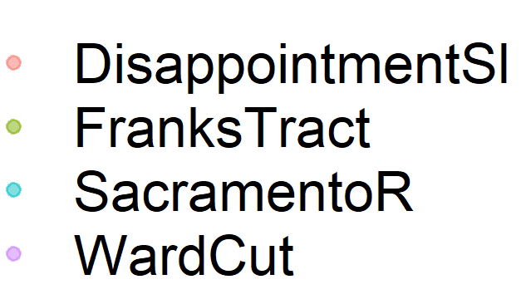

Trait syndromes changed between decades
Loadings
Loadings
PC1
~
>>
>>
PC1
>>
~
>>
~
>>
PC2
PC2

Slide 11
Trait syndromes changed between decades
Loadings
Loadings
>>
>>
PC1
PC1
~
~
>>
>>
~
>>
PC2
PC2

Slide 12

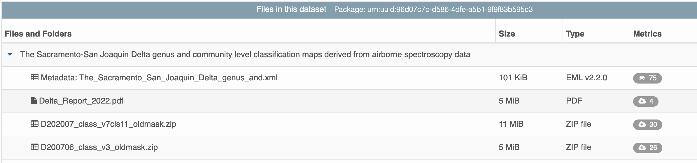
https://doi.org/10.5063/f1hh6hjx

Slide 13

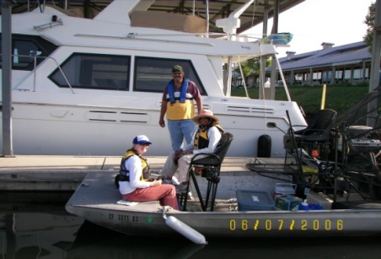
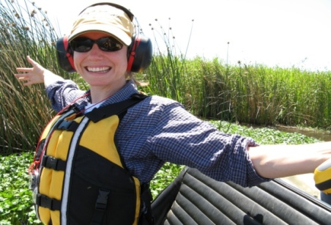

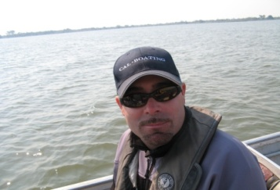

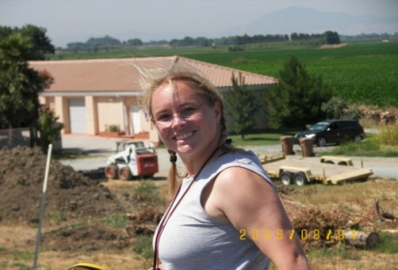

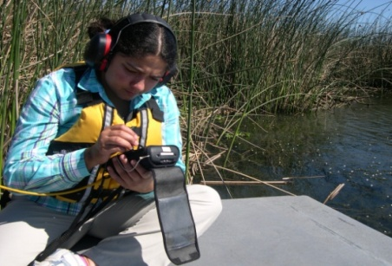
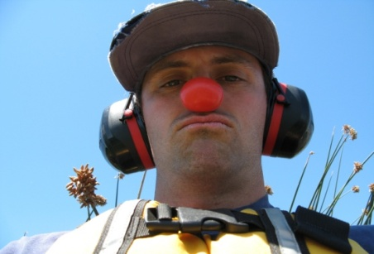
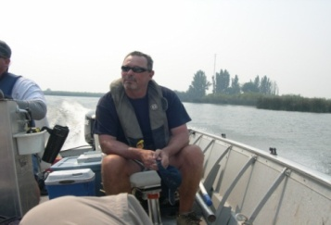
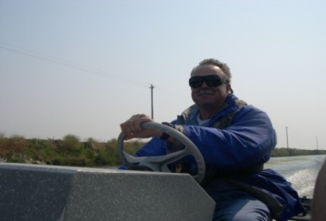


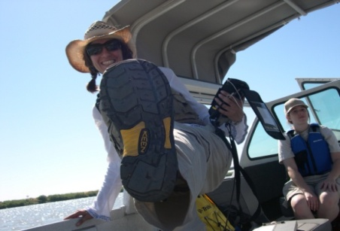
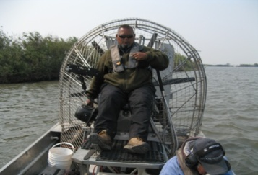
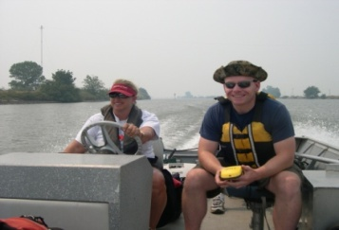
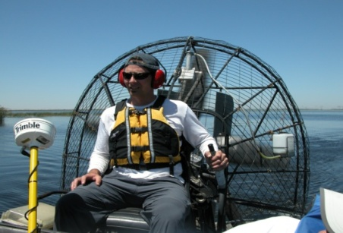
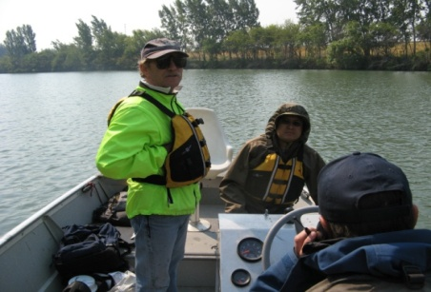
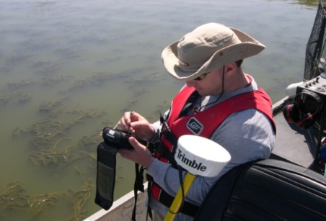
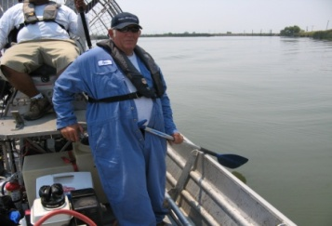
Thank you for your attention!

Slide 14
Open challenges
What are the main L3/L4 products that should be available from spaceborne hyperspectral images and how do these products contribute to a better understanding of Earth system processes?
  Plant traits: photosynthetic, hydraulic and
Are our algorithms ready for large scale L3/L4 product generation and their frequently repeated production in order to assess Earth system processes?
  Not yet
Do we have suitable uncertainty values per L3/L4 product and if yes, which processes can we measure and which not (e.g. soil organic carbon changes, vegetation productivity, snow and ice conditions, etc.)?
  Not yet.
Will the coverage and frequency of the upcoming hyperspectral missions suitable for process monitoring e.g. biodiversity, vegetation and soil health.
  It depends on the process to be understood. Biodiversity processes can have different ‘tempos’. Earth system processes go from <hourly to decades+
Which global user communities shall be better informed about the availability and usefulness of the upcoming new L3/L4 products?
  Researchers, managers and policy makers, data providers, businesses

Slide 15
Challenges
1. Target ecosystem(s)
Terrestrial, and aquatic targets, some submerged
Moving species
Phenology
2. Environmental variability
Tides: 2x tides daily
Seasonality
3. Screening
Light penetration in the water column
Water surface characteristics (sunglint and wind)
Mixing within pixels
4. Pre-processing
  Atmospheric correction over large water bodies
  Rotation
  Geocorrection
  Georegistration
5. Analysis
Relative indicators
Model type
Transferability: general versus yearly models
Accuracy

Slide 16
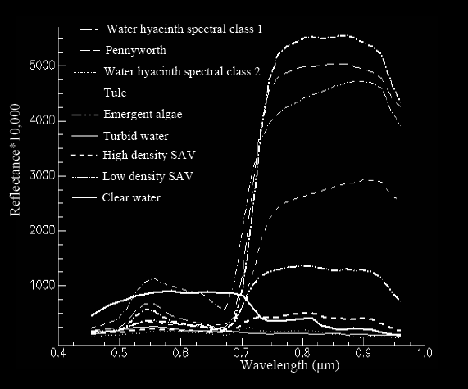
Semi-pragmatic decisions
Field Spectroscopy measurements
Stratified random sample across the range of variability of species and environmental conditions
Correct for tides and growing degree days for phenology
>70% cover SAV
Test atmospheric parameters
Correction to DOQQs/NAIP
Co-registered to earlier years
Test different types of models
Yearly models for management (herbicide loads), multi year models for research
Communicate, communicate, communicate:
accuracy and model development

