Slide 1
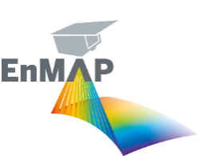
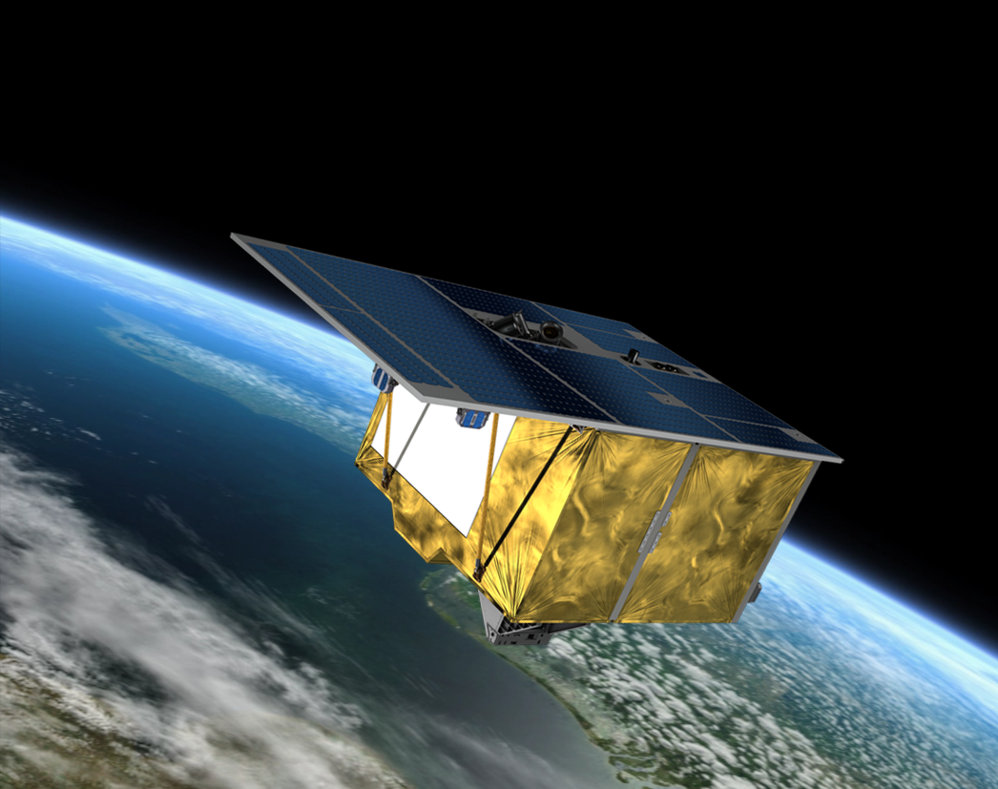
EnMAP hyperspectral mission: Developments and demonstration for spaceborne imaging spectroscopy open science
S Chabrillat^{1,2}, M Brell¹, K Segl¹, A Okujeni¹, R Milewski¹, D Scheffler¹, S Asadzadeh¹, K Ward¹, A Khokanovsky¹, A Brosinsky¹, K Koch¹, D Angelopoulo¹, B Jakimow³, A Janz³, A Bracher⁴, T Hank⁵, V Krieger⁶, M Bock⁶, L La Porta⁶
1. GFZ German Research Center for Geosciences, Potsdam
2. LUH Leibniz University Hannover, soil science, Hannover
3. HUB Humboldt University Berlin
4. AWI Alfred-Wegener-Institute, Bremerhaven
5. LMU Ludwig Maximilian University, Munchen
6. DLR German Space Agency, Bonn, Germany
3d Workshop Int. Coop. Spaceborne IS, ESA-ESTEC Noordwijk, 13-15.11.2024
Notes:
Within EnMAP scientific exploitation and support program in the operational phase, priority is placed on the development of demonstration of scientific achievements for various cutting-edge and environmental applications of benefit to society today, and on new developments in open source algorithms and educational tools to support the increased use of the EnMAP and in general of imaging spectroscopy spaceborne missions through developing free and open-source data processing tools and an education program to foster an expert user community. In this presentation, we will focus on showing selected examples of new geo- and bio- EnMAP products, and new achievements and plans to integrate science algorithms and to release new resources within EnMAP-Box toolbox and HYPERedu education program. Further, these advances shall support the establishment of synergies and collaboration with concordant missions (e.g. PRISMA, EMIT), and support the development of open test bench datasets and algorithms as key long-term objectives, which can serve as precursor for future missions like CHIME and SBG.

Slide 2
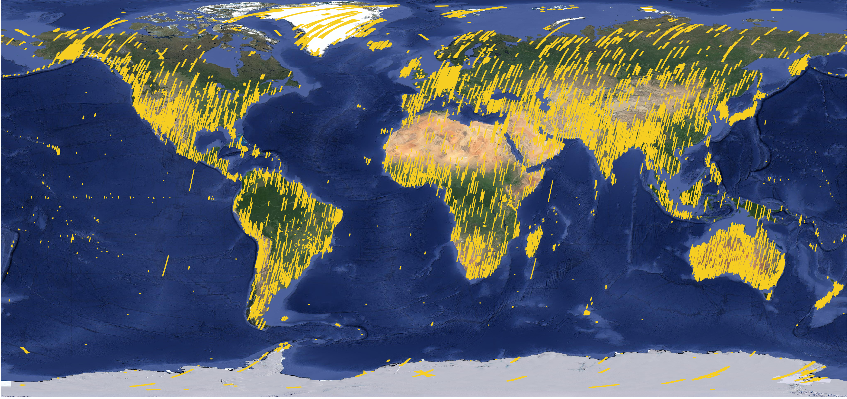
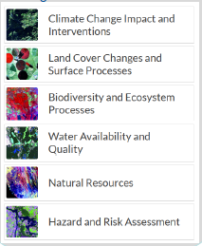
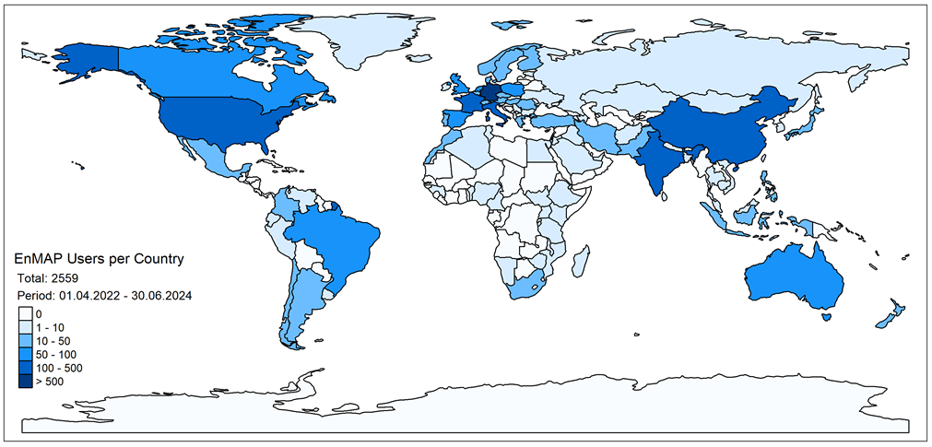
EnMAP – Environmental Mapping and Analysis Program (DLR/ GFZ/ OHB)
Data acquisition since 1. April 2022
Target mission based on user requests, completed with background and foreground mission
Well-calibrated data with high data quality, performances well beyond mission requirements
Strong demand for EnMAP data. In areas of high demand, user requests exceed mission capacities
Large user community and extensive science program
EnMAP science plan
Core themes
E. Carmona
Chabrillat et al., 2022
www.enmap.org
Notes:
EnMAP mission status after 2 years in orbit
>64200 products acquired and archived. Each product is an image 30 x 30 km wide, with 30m pixel size and >240 spectral channels 5-10 nm wide. Observations are based on user request and on the internal background and foreground mission (defined by the science segment following EnMAP science goals)
EnMAP goals
Core science themes: Environmental changes, ecosystem responses to human activities, management of natural resources
Core parameters: Global coverage, 30m pixel size, 242 spectral channels 400-2500 nm, revisit 27 days nadir, 4 days with off-nadir tilting, max 5000 km acquisitions/day, scientific mission
Measurements of key biophysical and geochemical parameters
Highly calibrated imaging spectroscopy data, Co-existence with Sentinel-2 & Landsat-8
EnMAP management
DLR Space Agency in Bonn is responsible for the overall project management
Core funding from the German Federal Ministry of Economic Affairs and Climate Actions (BMWK)
GFZ science PI: Extensive Scientific Exploitation preparation and mission support program

Slide 3
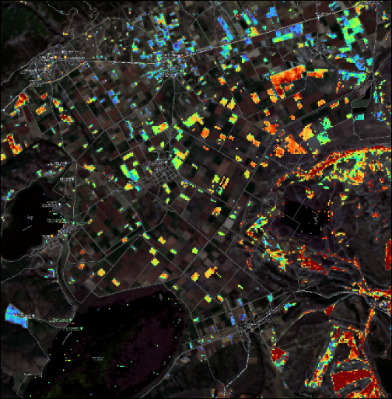
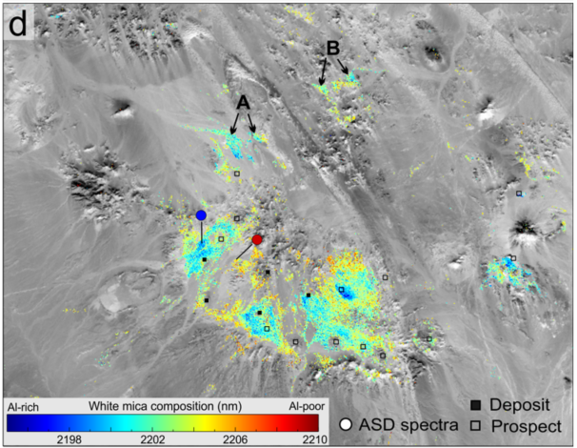
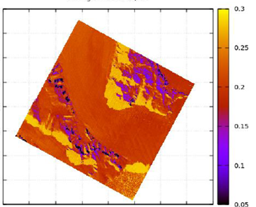
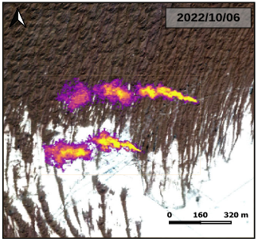
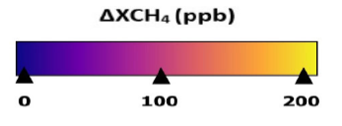
EnMAP application results: Provision of new geo-bio-atm products Contribution to EU policies and Copernicus services
Soil carbon
White mica composition
Snow grain diameter (mm)
High resolution
methane mapping
CH4 retrieval (ppb)
0
OM [%]
7
Vast alteration footprint
Locating the core of the system with EnMAP
Soil Organic Matter mapping
Aviator glacier, Antarctica
Kokhanovsky et al., 2024
Agricultural test site, northern Greece
Chabrillat et al., 2024
Rekodiq porphyry Cu–Au deposit, Pakistan
Asadzadeh et al., 2024
Turkmenistan oil & gas field
Roger et al., 2023
Notes:
Application results from the EnMAP science accompanying program/here GFZ science team
Soil is the largest terrestrial carbon storage. EnMAP allows to quantify top-soils carbon content. Few free soils are exposed since the image was acquired June 2023
Ch4 retrieval: EnMAP allows with its high signal-to-noise ratio in the longer wavelength (~2300 nm) to detect and quantify large methane emitters in much higher spatial resolution than methane missions –> EnMAP used to monitor large Methane sources around the world (IMEO/MARS program)
Raw materials: EnMAP can be used to map the variations in the composition of white mica (color from center wavelength 2190 to 2210 nm): The lower wavelengths (blue color) are associated with high aluminum contents in the structure of white mica, providing a vector towards the more promising part of the system where orebody (here copper-gold mineralization) is located → blue= closer to the mineralization (metal-bearing) centers, associated with most promising zones for exploration
Snow & ice: development of new snow transmission model, allowing to retrieve the snow grain size and assessment of the snowpack vertical inhomogeneity

Slide 4
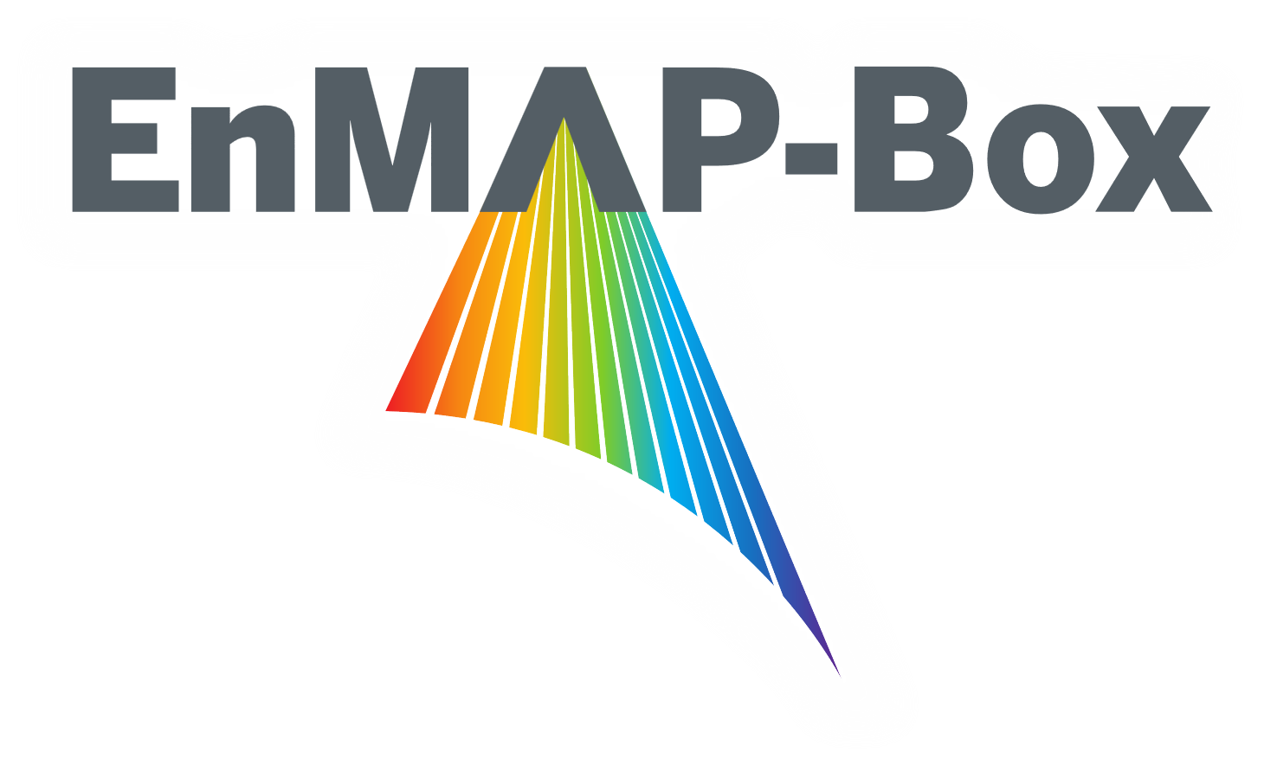
EnMAP science program after 1st year of mission
Maintained in a reduced version
Focus
Mission support: Science/Technical recommendations to the mission board (data quality, acquisition strategy), review of users proposals, background and foreground mission
External validation: EnMAP data quality monitoring, international campaigns, cross-mission collaborations
Science & Application:
Demonstration of scientific achievements for various cutting-edge and environmental applications of benefit to society today
Maintenance and developments in open source algorithms and educational tools to support the increased use of the EnMAP and in general of imaging spectroscopy spaceborne missions → release of new resources EnMAP Box and HYPERedu
Work packages:
WP1 – WP2: Validation/data quality and campaigns
WP3 – WP5: EnMAP Box, algorithm consolidation and validation
WP6 – WP8: Standards & benchmark data, training and workshops, HYPERedu, outreach
WP9 - International collaboration, coordination
Partners:
Lead GFZ Potsdam (HYPERedu, soil, minerals) with HU Berlin (EnMAP Box)
Partners: LMU München (agriculture), AWI Bremerhaven (water)
Funding:
DLR Space Agency with resources from the BMWK

Slide 5
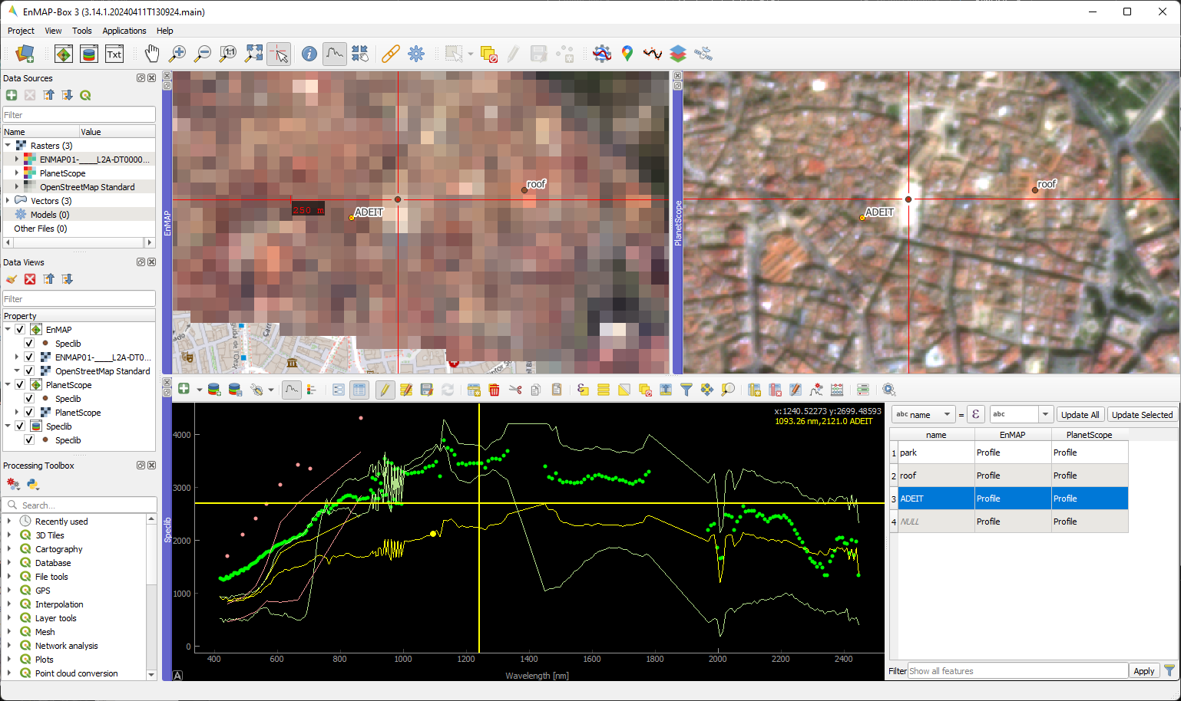
EnMAP Box
Visualization & analyzes of imaging spectroscopy data & spectral libraries
Python plugin for QGIS, free- and open source (GPL-3)
EnMAP, EMIT, DESIS, PRISMA, … (not-only EnMAP)
latest release: EnMAP-Box 3.15
See Poster EnMAP Box
Jakimow et al. 2023. EnMAP-Box: Imaging spectroscopy in QGIS. SoftwareX, 101507. https://doi.org/10.1016/j.softx.2023.101507
Notes:
Aim: ease visualizazion and analyzis of IS data and the use of spectral libraries
Plugin for QGIS Geoinformation System, free- and open source to provide easy access,
runs on multiple platforms -> windows, linux, macOS
not only for EnMAP data -> support EMIT, DESIS, PRISMA data as well and generally optical raster data
if it can be read by QGIS / GDAL, you can display it within the EnMAP-Box
Poster Session Wednessday
HyperEDU

Slide 6
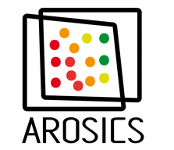
Open Source Applications: Progress and plans
Vegetation / Agriculture
Plant Water Retrieval (PWR, Wocher 2018)
Analyze Spectral Integral (ASI, Wocher 2020)
Vegetation Processor (Danner 2021)
Interactive Visualization of Vegetation Reflectance Models (IVVRM, Danner 2018)
Interactive Red-Edge Inflection Point (iREIP, Hank 2021)
Vegetation Index Toolbox and Spectral Index Creator (Hank 2021)
EnMAP Hybrid Retrieval Workflow (Steinhauser 2024) NEW
Soil & Geology
EnMAP Soil Mapper (EnSoMap, Chabrillat 2016) NEW features
EnMAP Geological Mapper (EnGeoMap, Mielke 2016)
EnMAP Mineralogy Mapper (EnMinMap, Asadzadeh 2026) NEW
Snow & ice
EnMAP Snow&ice Mapper (EnFrost, Khokanovsky/Scheffler 2025) NEW
Preprocessing
EnMAP Preprocessing Tools (EnPT, Scheffler 2023) NEW features
Water:
OLCI Neural Network Swarm (ONNS, Hieronymi 2017)
OC-PFT (Alvarado 2022)
Time Series:
EO Time Series Viewer (Jakimow 2020)
GEE Time Series Explorer (Rufin 2021)
Generic:
Regression-based unmixing (Okujeni 2017)
Scatter Plots
Image Cube, Raster Math
Classification & Regression Workflows
Interactive Sankey Plots
[soon] SpecDeepMap Sematic Segmentation NEW
See Poster
ISOFIT
See Poster
6
Notes:
The core functionality of the EnMAP-Box is enhanced by various EnMAP-Box applications
that provide access to research- and domain-specific uses
agriculture, soil & geology, pre-processing of EnMAP data or the analysis of Time Series

Slide 7
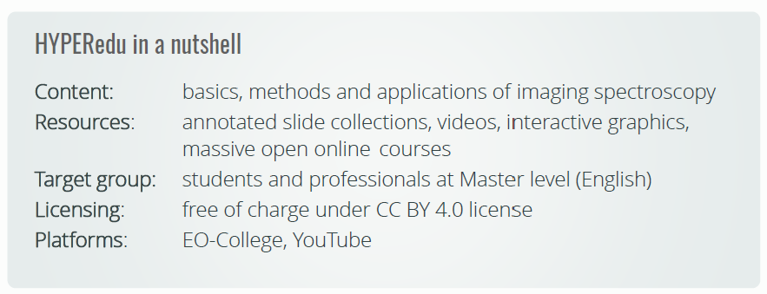
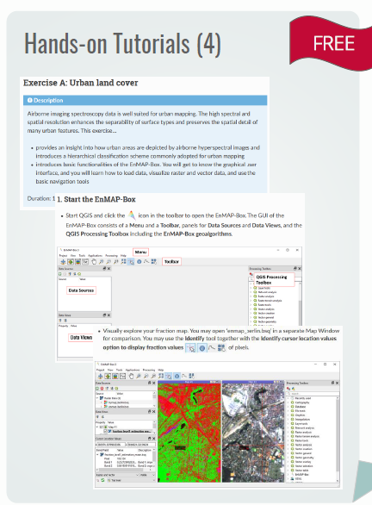
Online education tool HYPERedu
See Poster HYPERedu
Training course and educational resources on IS are still scarce
HYPERedu: online learning initiative conceptualized and implemented since 2019
Large community effort
Huge success: HYPERedu participants
EO-College: >3600 course participants
YouTube: >900 subscribers
Most popular videos >1000 views EACH (5900 views for the basic MOOC Trailer)
Foerster et al. 2024. Hyperedu online learning program for hyperspectral remote sensing: Concept, implementation, and lessons learnt, JAG
https://doi.org/10.1016/j.jag.2024.103983

Slide 8
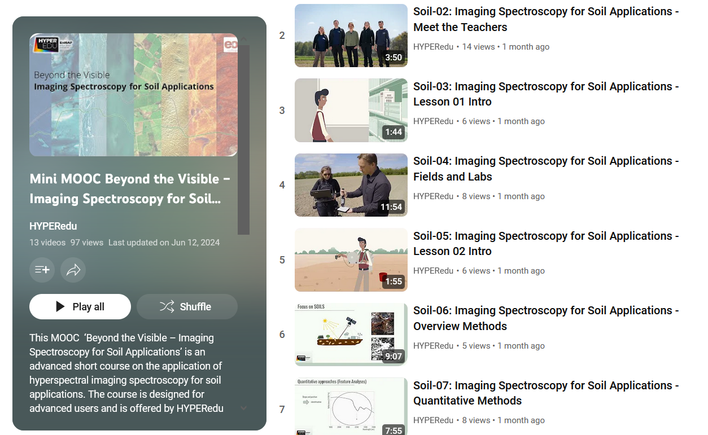
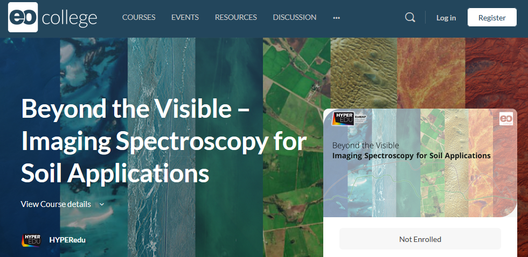
MOOCs: Progress and plans
MOOCs=Massive Open Online Courses
Include interactive videos, quizzes, tutorials, certificate, offline version
Basic MOOC: >2600 participants!
Focus on maintenance, update, and development new MOOCs
https://eo-college.org/courses/beyond-the-visible-imaging-spectroscopy-for-soil-applications/

Slide 9
Outlook: Lessons learnt from EnMAP
Open science
Open source and open science developments benefit to the mission
Benefit to the whole spaceborne IS community
Support synergies and collaboration within missions
Support provision of test bench datasets and algorithms
Support key long-term objectives, precursors for future missions
FAIR principles
EnMAP-Box and applications fulfill the FAIR demands (except few applications e.g. EnPT)
HYPERedu incl. publications of slides, tutorials, datasets (IS+insitu), education videos, screenshots
Benchmark data following standards & protocols
Challenges
“There is no glory in documentation”: Proper documentation and maintenance of software requires time
Open science takes (more) time: Dedicated science programs & funding schemes are needed + long-term
PR: Very strong user demand! → How do you keep up with the demand
Continuity: Spaceborne IS is a very rapidly evoluting field! → How to maintain and keep up-to-date
Common guidelines, Common platforms
Benchmark datasets: Bottleneck for sharing in-situ data
Thank you for your attention
EnMAP PI project: Scientific preparation and support of the EnMAP satellite mission (50EE1529, 50EE2401)

Slide 10
Seed questions
How close are different projects on implementing FAIR data? What aspect is the most difficult? What projects are implementing standardization?
What are challenges to open science in cal/val, algorithm development, and science and applications use spaces? What are potential improvements?
Thank you for your attention!
Notes:
> How close are different projects on implementing FAIR data?
The EnMAP-Box and their applications, provided by LMU, GFZ, AwI etc., fulfill the FAIR demands (Examples below). Sure, some details could be supported better, e.g. the scope and the timeliness of the documentation. Nevertheless I think that the basic intend of the FAIR principles is already met.
> What aspect is the most difficult?
"There is no glory in documentation". Proper documentation and maintenance of software requires time. This time is then lacking to develop new features (which are usually part of or fix bugs. It would be good if funding institutions would communicate more that they honor a good documentation and attempts to improve code quality, even without developing new features.
Greeting,
Benjamin
F: Software, and its associated metadata, is easy for both humans and machines to find.
- the source code public available and documented well, e.g. on https://enmap-box.readthedocs.io.
A: Software, and its metadata, is retrievable via standardised protocols.
- our code is hosted in public git repositories, i.e. an "industry" standard to describe source-code and its changes
I: Software interoperates with other software by exchanging data and/or metadata, and/or through interaction via application programming interfaces (APIs), described through standards.
- the EnMAP-Box heavily relies on GDAL and QGIS. Both have shown to implement support for data interfaces very fast, e.g. to support OGC serviced and a wide range of vector and raster data formats
R: Software is both usable (can be executed) and reusable (can be understood, modified, built upon, or incorporated into other software).
- the EnMAP-Box is released under an open-source license (GNU GPL-3) and makes use of other free- and open-source libraries only.
- can be used on different platforms (linux, windows, macOS)

Slide 11
Benchmark datasets
support the establishment of synergies and collaboration with concordant missions, and support the development of open test bench datasets and algorithms as key long-term objectives, which can serve as precursor for future missions like CHIME and SBG
Provision of EnMAP imagery linked with biogeochemical in-situ data sets for software development and validation (2026)
Soil
Mineralogy
Snow
Agriculture
Water quality
Following established standards & protocols (field/lab acquisition and processing)
Preparation for next missions:

Slide 12
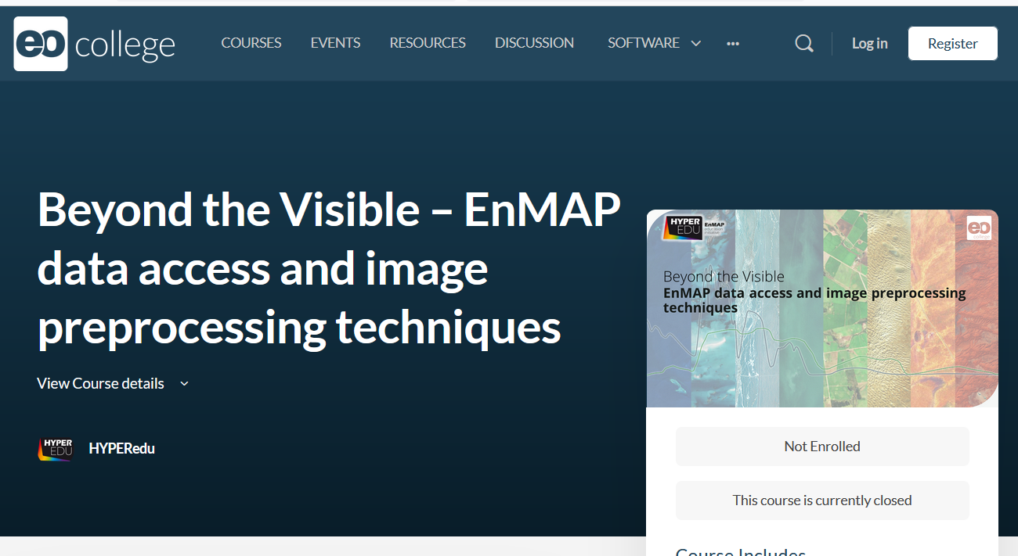
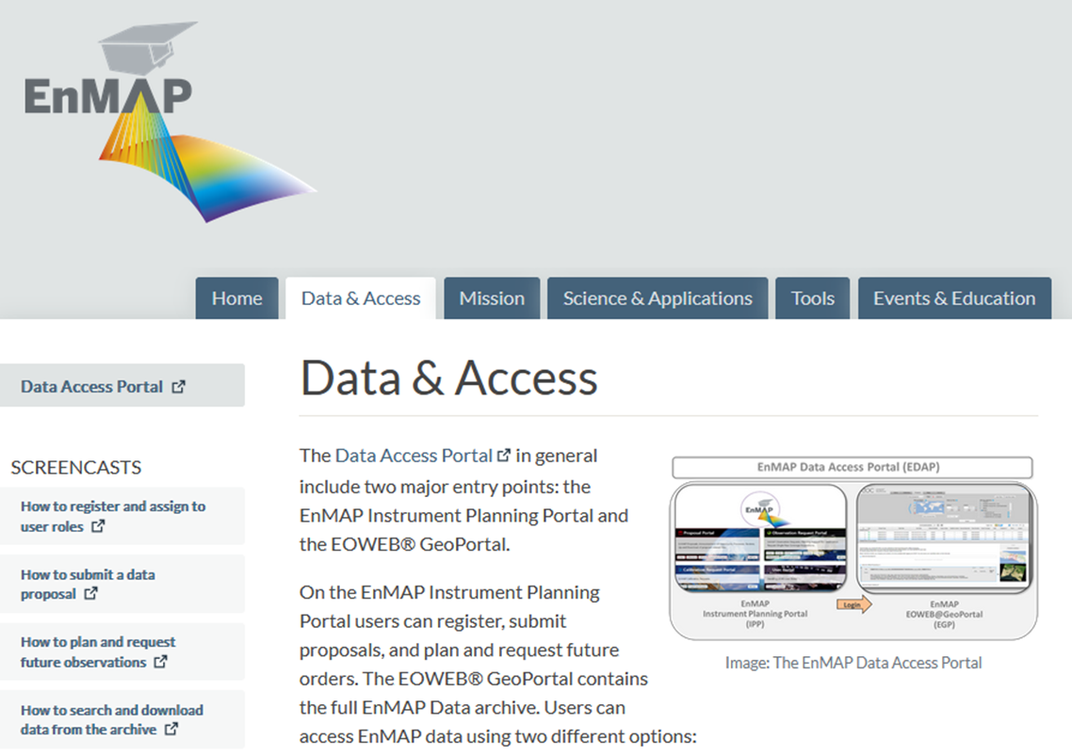
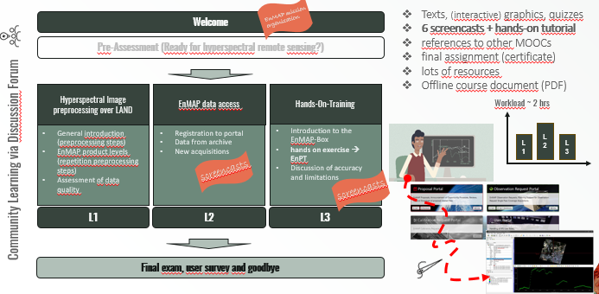
Community support: Online education tool HYPERedu
New Mini-MOOC Data access and image preprocessing techniques (released July 2023)

Slide 13
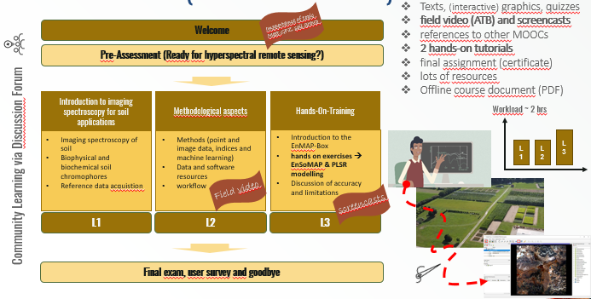
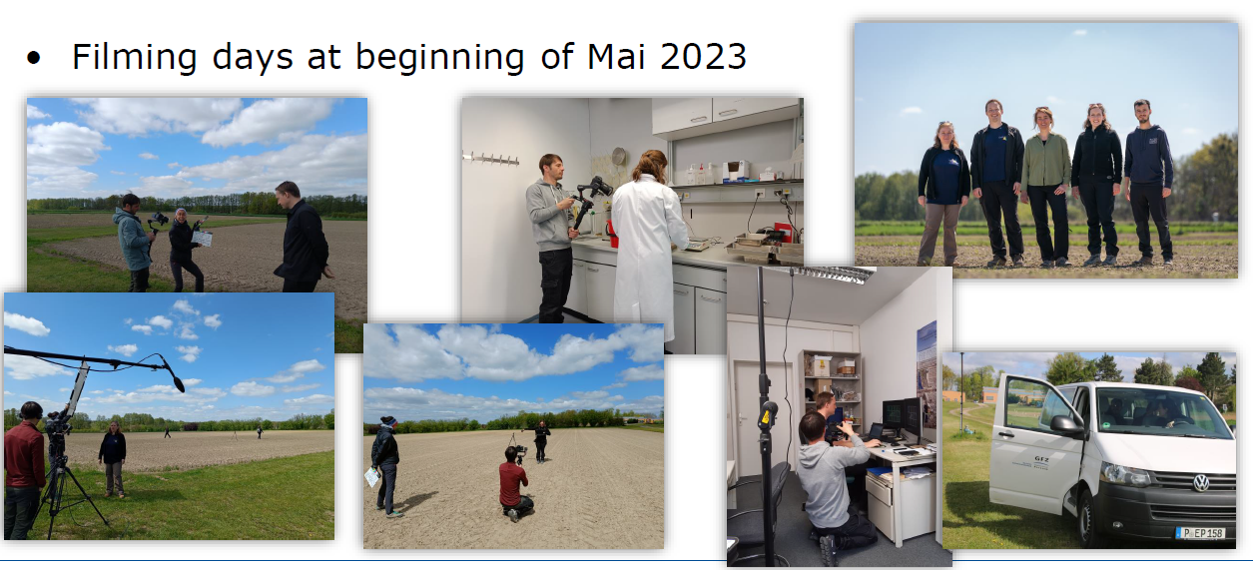
Community support: Online education tool HYPERedu
New Mini-MOOC Soil
Texts, (interactive) graphics, quizzes
Field video and screencasts
Reference to other MOOCs
2 hands-on tutorials
Final assignment (certificate)
Lots of resources
Offline course document (PDF)
https://eo-college.org/courses/beyond-the-visible-imaging-spectroscopy-for-soil-applications/ → Course trailer online, full course release Mai 2024

Slide 14
Graphical User Interface
14
14
Notes:
[Animation, the entire slide may be skipped] → Animation does not work here, only in original slide
left: EnMAP scene showing the city of Valencia
right: PlanetScope dataset with higher spatial detail
Raster Layer Styling Panel is used to change the displayerd band combinations very fast
as the EnMAP-Box is aware of band wavelenght, it often can select the required bands automatically
[later in the video] we can select pixel profiles and display them in a spectral library

Slide 15
Graphical User Interface
Notes:
[Animation, the entire slide may be skipped]
left: EnMAP scene showing the city of Valencia
right: PlanetScope dataset with higher spatial detail
Raster Layer Styling Panel is used to change the displayerd band combinations very fast
as the EnMAP-Box is aware of band wavelenght, it often can select the required bands automatically
[later in the video] we can select pixel profiles and display them in a spectral library

Slide 16
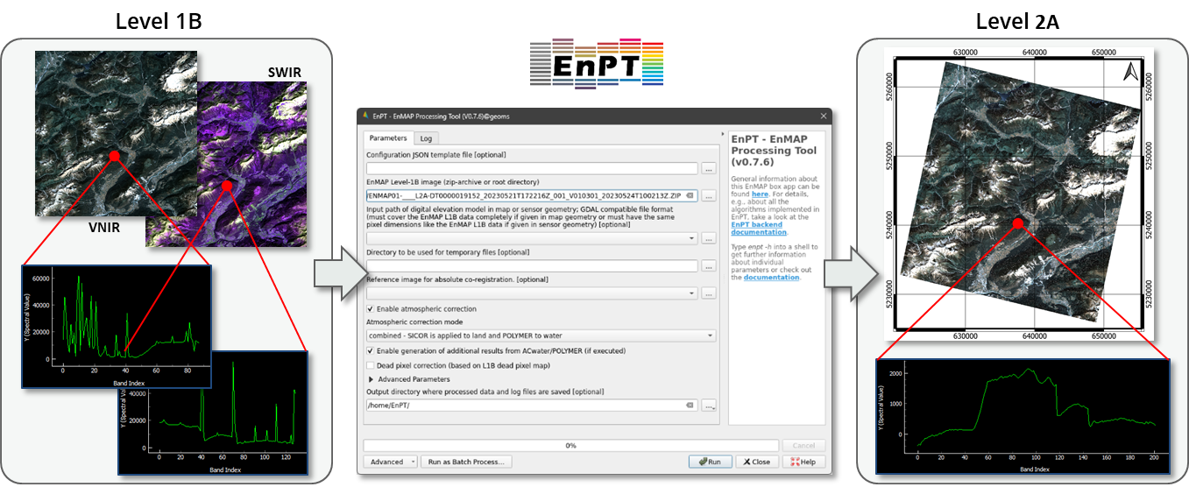
Software toolboxes: EnMAP Preprocessing Tool (EnPT) Alternative “do-it-yourself”
Scheffler D., Bohn N., Guillaso S., Segl K. (2021). EnPT - EnMAP Processing Tool (Version v0.18.2). Zenodo. http://doi.org/10.5281/zenodo.4977250
Bohn, N., Scheffler, D., Brell, M., Segl, K.(2022). SICOR - Sensor Independent Atmospheric Correction, Zenodo. http://doi.org/10.5281/zenodo.5973187
Notes:
Addtional water products implemented by AWI (2022) are:
- Chlorophyll concentration
- Particle scattering factor fb in Park & Ruddick (2005)
- Reflectance of the sun glint predicted from ECMWF wind speed
- TOA reflectance at 865 nm corrected for Rayleigh scattering
- Quality flags as generated by Polymer AC

Slide 17
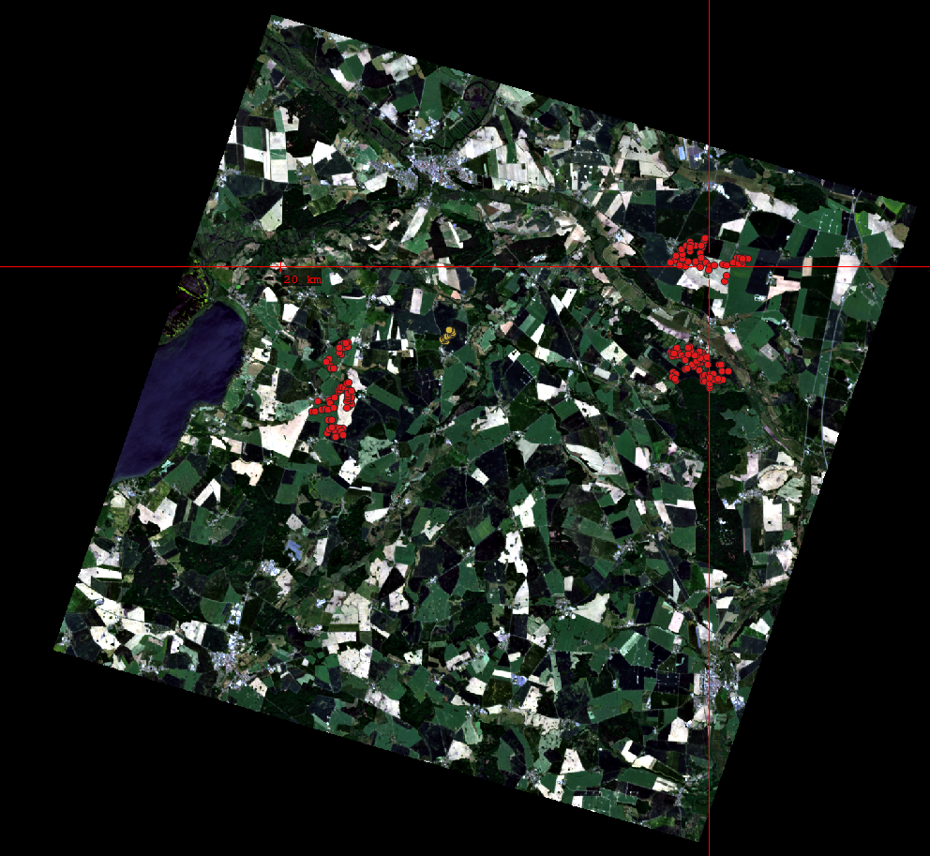
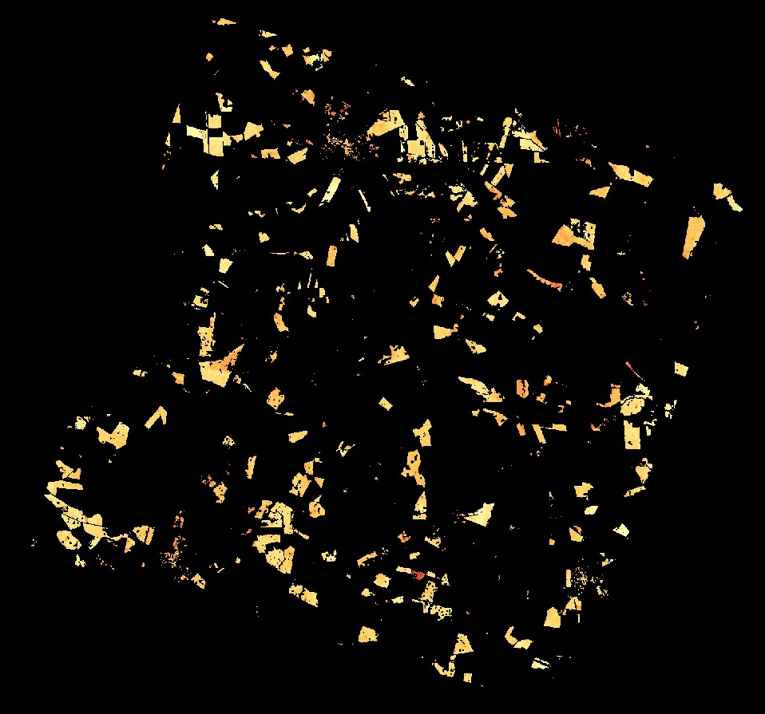
Soil carbon and soil health
Soil degradation is a serious concern in Europe and worldwide
Implications for food security and climate change
Soil Carbon is one of GEOSS Essential Climate Variables (ECVs)
Soil is largest terrestrial carbon storage
SDGs: SOC as most relevant soil property regarding climate regulations → monitoring status should be improved
EnMAP allows to quantify top-soils carbon content
EnMAP high SNR in the SWIR (>2000 nm) is critical
to discriminate and quantify NPV from soil
to quantify other soil quantities (clay or carbonates abundance), important for soil fertility and soil health characterisation
Demmin image recorded by EnMAP on 02.06.2023
SOC mapping (g/kg)
Slide courtesy K. Ward@ GFZ

Slide 18
Soil carbon
Soil degradation is a serious concern in Europe and worldwide
Implications for food security and climate change
e.g. reduction of soil organic carbon (SOC) content
Soil Carbon is one of GEOSS Essential Climate Variables (ECVs)
SOC important for e.g. soil fertility and water retention
Soil is largest terrestrial carbon storage
SDGs: SOC as most relevant soil property regarding climate regulations → monitoring status should be improved
EnMAP allows to quantify top-soils carbon content
Demmin image recorded by EnMAP on 02.06.2023
SOC mapping (g/kg)
Slide courtesy K. Ward@ GFZ

Slide 19
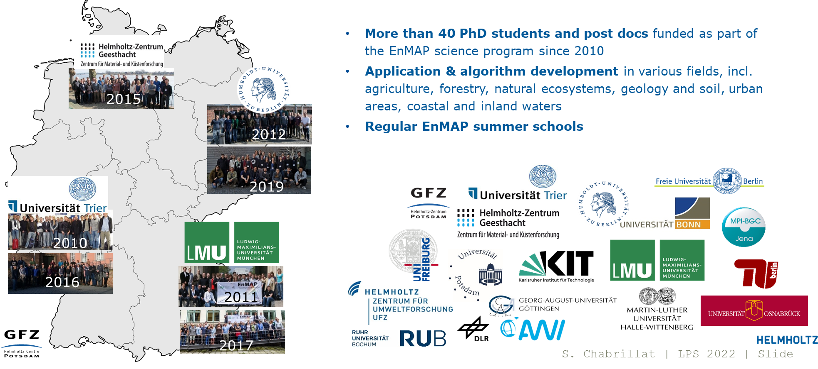
EnMAP scientific preparatory activities: Science and education program

