Slide 1






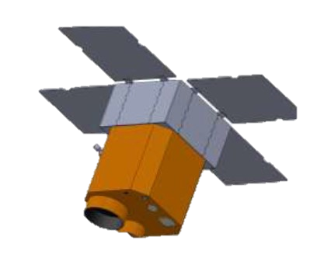




Japanese spaceborne hyperspectral sensor constellation project
Takahiro Kawashima¹, Akira Iwasaki¹,
Takayoshi Fukuyo², Ryo Suzumoto², Ryo Ui²,
Keita Ito³, Takashi Sukegawa⁴, Haosheng Lin⁵, Hirofumi Kasahara⁶
¹The University of Tokyo,
²ArkEdge Space Inc., ³Space BD Inc.,
⁴CANON Inc., ⁵HI-Spectral LLC, ⁶MUFG Bank Ltd.

Slide 2
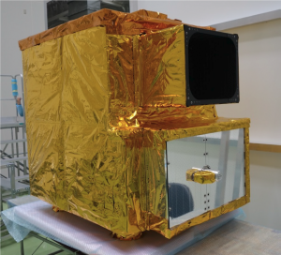

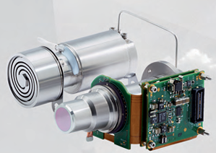
Overview
2
The Small Hyperspectral Sensor Satellite Project is being newly developed under the Small Business Innovation Research (SBIR) program, led by Japanese Ministry of Economy, Trade, and Industry (METI) and scheduled for launch in 2027
While the observation specifications are similar to those of the ISS-borne HISUI, it aims to reduce both mass and cost to about 1/10th of the HISUI.
<Main Specification>
Mineral
Vegetation
Type | Hyperspectral sensor (grating type)
Scan method | Push-broom scan
Wavelength region | 400 - 2500 nm
Spectral sampling | 10 nm
GSD | 30m
Swath | 19km
SNR | ~250
Size and mass (allocated for payload) | 200 x 200 x400mm (12U), 20~25kg
  Heritage of conventional sensors
Green-house gas
HISUI
https://www.hisui.go.jp/sensors/index.html
  Mission
  Requirement
System optimization
  Miniaturization
New technology
SBIR
Small sat
Monolithic spectrograph
eSWIR detector

Slide 3
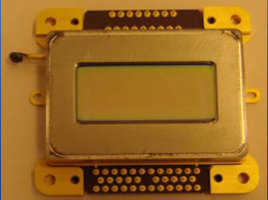
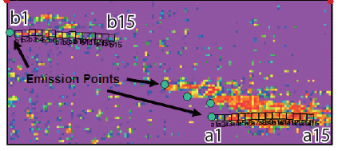

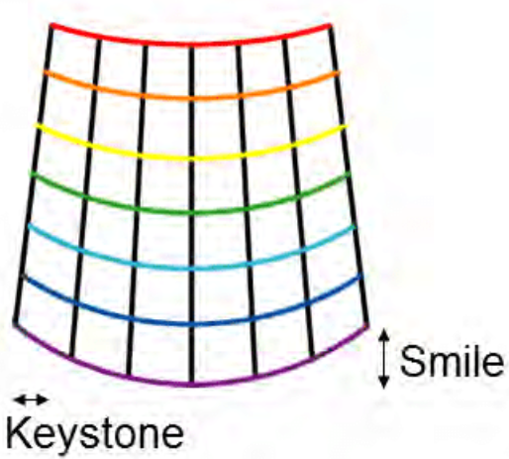
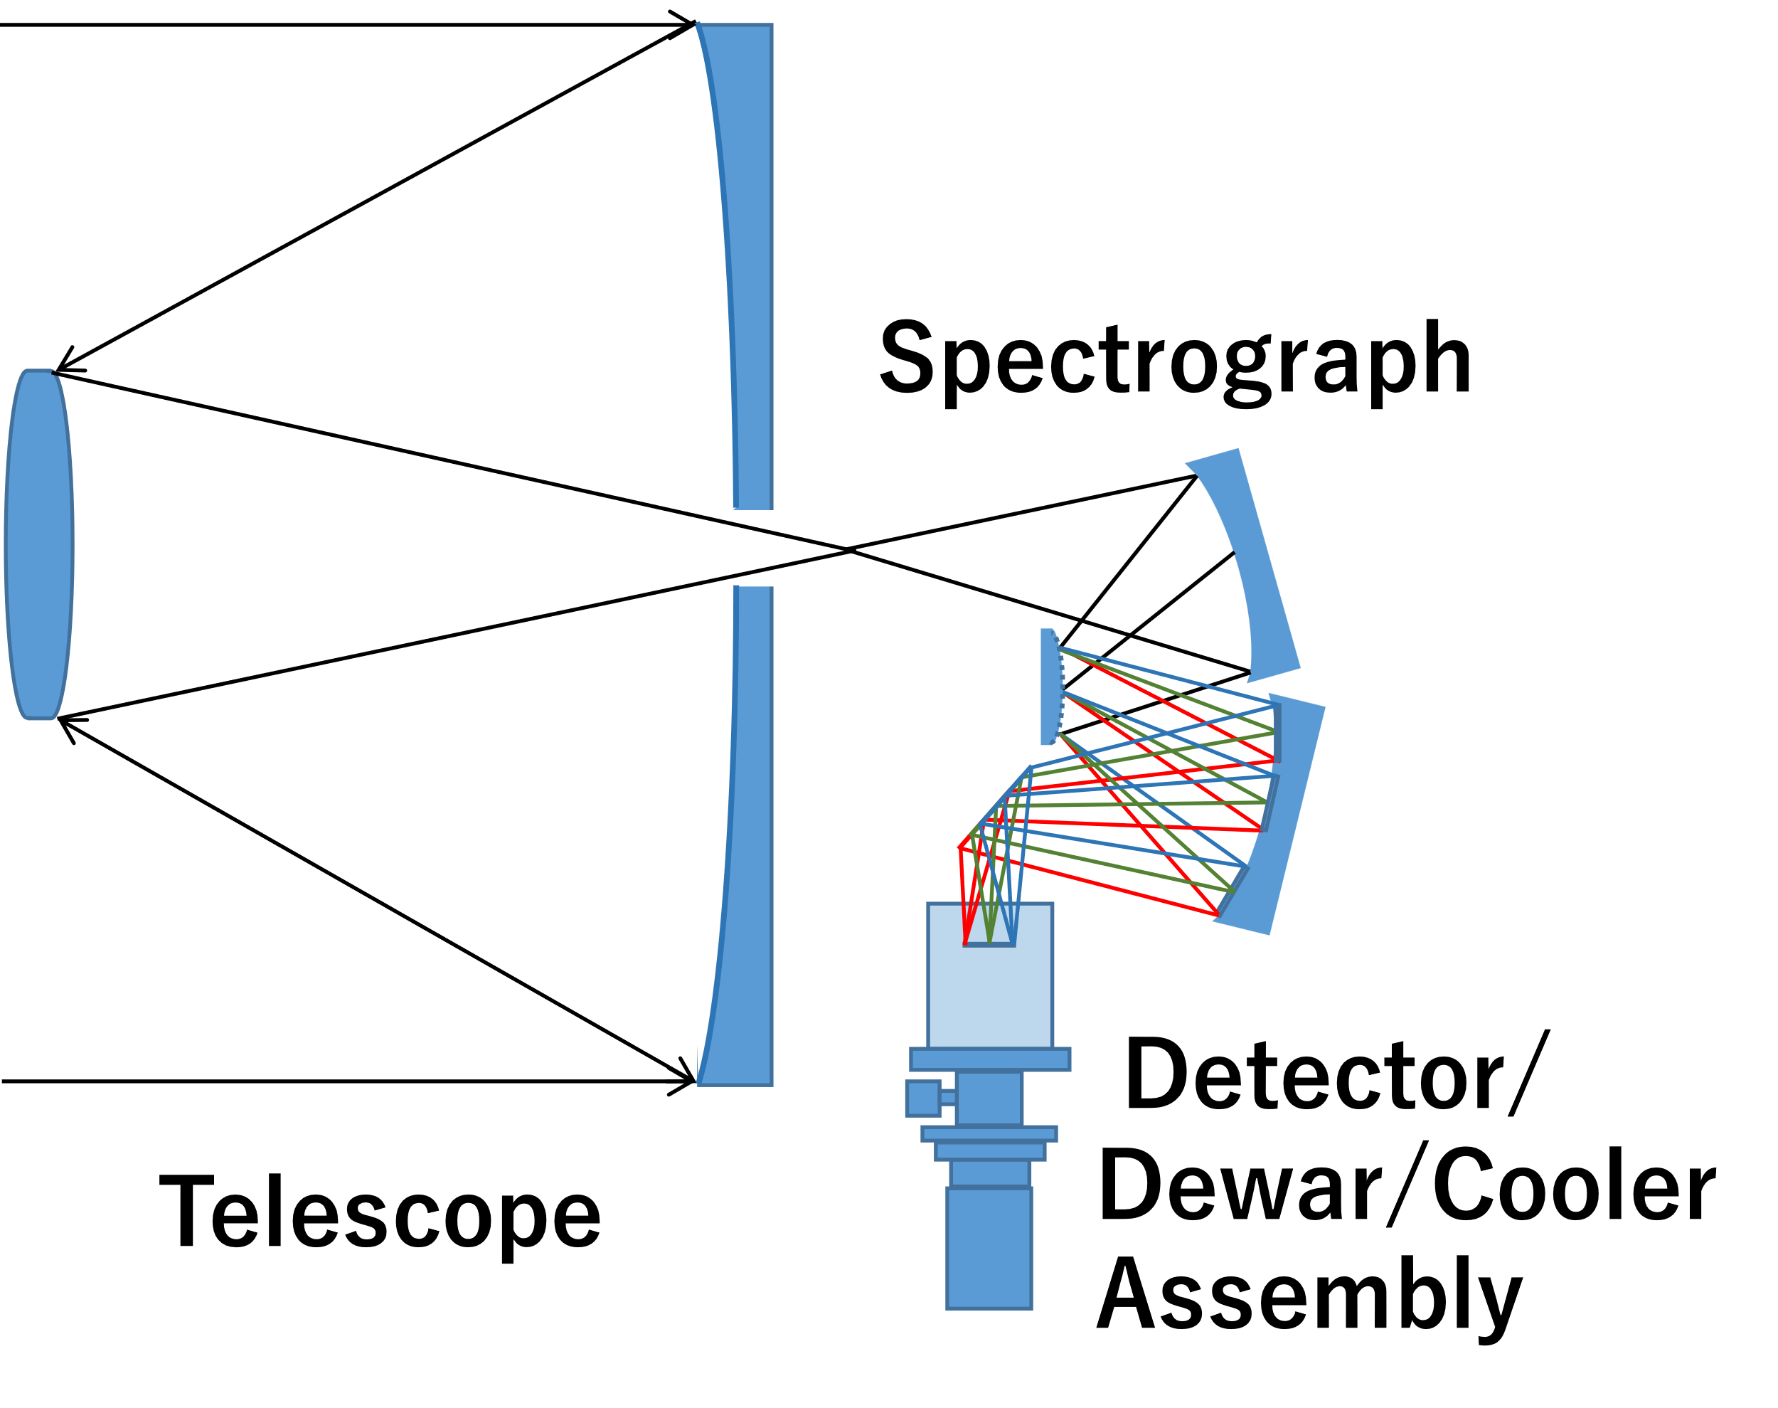
Miniaturization from HISUI to SBIR hyperspectral sensor
3
Target
Satellite
Scanning
method
Telescope
Spectrometer
Detector
Signal processor
https://www.hisui.go.jp/sensors/index.html
Wavelength region:
400 - 2500nm
Spectral sampling :
10nm (VNIR), 12.5nm (SWIR)
Custom-made detectors for VNIR&SWIR each Pixel pitch : 30μm
Data compression
Binning
Radiometric correction
Smile correction
SPG
Mineral
DET
Swath
=20 km
Slit
Telescope
HISUI (2019)
190kg (instrument
only)
*Borne on ISS
Cross Track
Coast
Aperture:
300mm
HgCdTe for SWIR
(120K)
※sample image
GSD=30m
Along Track
2 spectrometers
Agriculture
Vegetation
etc..
Wavelength region:
400- 2500nm
Spectral sampling:
10nm
Commercial detector
(VNIR/SWIR integrated)
Pixel pitch : 15μm
*Additional for data reduction
Cloud removal
SPG
DET
Swath
=19 km
Slit
Telescope
1 spectrometer
Monolithic&
Demagnification
optics
SBIR sat ( 2027)
～25kg (instrument
only)
~100kg (Bus +
Panchromatic
senor)
Cross Track
Aperture:
170mm
Green
House gas
HgCdTe for SWIR
(180K)
⇒miniature cooler
※sample image
GSD=30m
Along Track

Slide 4
Development plan
4
Engineering and flight models will be manufactured over the next two years.
To shorten the development term, an EFM method, i.e. an EM compatible with the FM, will be manufactured, tested and evaluated, and then refurbished into the FM.
An end-to-end simulator is developed, and correlation with hardware to increase the accuracy of performance simulation, accelerate design evaluation, and reduce rework due to defects to realize short term delivery of a total of two years.

