Slide 1

K. Dana Chadwick, Robert O. Green, David R. Thompson, Regina Eckert, Philip G. Brodrick, Kelly Luis, Niklas Bohn, Christiana Ade, and Colleagues
November 14, 2024
Jet Propulsion Laboratory, California Institute of Technology and The Community
NASA SBG VSWIR – Overview of planned L3 measurements and products
(with a vegetation focus)
The research was carried out at the Jet Propulsion Laboratory, California Institute of Technology, under a contract with the National and Space Administration (80NM0018AeronauticsD0004)
Reference herein to any specific commercial product, process, or service by trade name, trademark, manufacturer, or otherwise, does not constitute or imply its endorsement by the United States Government or the
Jet Propulsion Laboratory, California Institute of Technology

Slide 2
SBG VSWIR Observation Requirements from Decadal Survey Substantiated and Refined with Studies and Analysis
The SBG Research and Applications Traceability Matrix (SATM) follows the National Academies 2017 decadal survey directions for desired capabilities. Key performance parameter ranges for the VSWIR instrument, derived from the SATM are shown below.
Spectral Range: 380-2500 nm
Spectral Bands: Between 8 to 12 nm with continuous spectral coverage
Radiometric and Signal to noise (SNR) performance: SNR ≥400 VNIR and SNR ≥250 SWIR at 25% reflectance, <5% absolute radiometric uncertainty with high uniformity, low stray-light, and low polarization sensitivity needed to meet key RA objectives
Ground Sampling Distance (GSD) at nadir: 31 to 35 m
Revisit Period: ≤16 days at the equator
Coverage: All global land, inland waters, and coastal oceans
Local Time for Acquisition: Between 10:30 to 11:30 AM
Stability and duration: Measurements must be able to detect changes for addressing dynamics of the Earth System over the prime mission lifetime of 3 years with possible extensions
Consistent with notional DS Observable from page B-17: Primary Observable: Chemical properties of vegetation and aquatic biomass, and Soils Land, inland aquatic, coastal zone, and shallow coral reef: Spectral radiance (10 nm; 380-2500nm); GSD = 30-45 m; Revisit = ~15 days; SNR = 400:1 VNIR/250:1 SWIR @ 25% reflectance; IT of ~5 ms. High-fidelity imaging spectrometer (150-200 km swath from sun-sync LEO).

Slide 3
SBG-VSWIR Project Data Products
SBG-VSWIR Project Data Product | Units | Coverage
Raw Data (L0) | Digital Numbers (DN) | Global
Radiance at Sensor (L1b) | Spectral radiance (uW/nm/cm^2/sr) | Global
Surface Reflectance (L2a) | Hemispherical Directional Reflectance Factors (unitless) | Global
Cloud Mask (L2b) | Binary classification map (unitless) | Global
Fractional Cover (Photosynthetic Vegetation, Nonphotosynthetic Vegetation, Soil, Snow+Ice, Water, Char) (L2b) | Fraction (unitless) | Global
Snow and Ice fractional cover (L3) | Fraction (unitless) | Polar regions, land with snow & ice fraction > threshold
Snow broadband albedo (L3) | Fraction (unitless) | Polar regions, land with snow & ice fraction > threshold
Snow grain size (L3) | um | Polar regions, land with snow & ice fraction > threshold
Minerals Identification (large number of encoded classes) (L3) | Categorical classification (unitless) | Land with rock or soil fraction > threshold
Mineral Spectral Abundance (Phyllosilicates, Iron-bearing minerals, Carbonates, Chlorites, Sulfates, Hydrated Silicates, Hydroxides, Amphiboles, Evaporites) (L3) | Fraction (unitless) | Land with rock or soil fraction > threshold
Top of Canopy Leaf water content (L3) | Fraction (g water / g fresh leaf mass) | Land with PV or NPV fraction > threshold
Equivalent water thickness (L3) | cm | Land with PV or NPV fraction > threshold
Top of Canopy nitrogen (L3) | Fraction (g N / g dry mass) | Land with PV or NPV fraction > threshold
Top of Canopy leaf mass per area (L3) | g/m^2 | Land with PV or NPV fraction > threshold
Aquatic Chlorophyll a (L3) | ug/L | Ocean, coasts, inland water with water fraction > threshold
Phytoplankton Absorption Coefficients (L3) | 1/m | Ocean, coasts, inland water with water fraction > threshold
Benthic Fractional Cover (L3) | Fraction (unitless) | Ocean, coasts, inland water with water fraction > threshold
What are the main L3/L4 products that should be available from spaceborne hyperspectral images and how does these products contribute to a better understanding of Earth system processes?

Slide 4

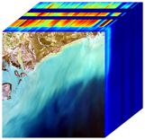
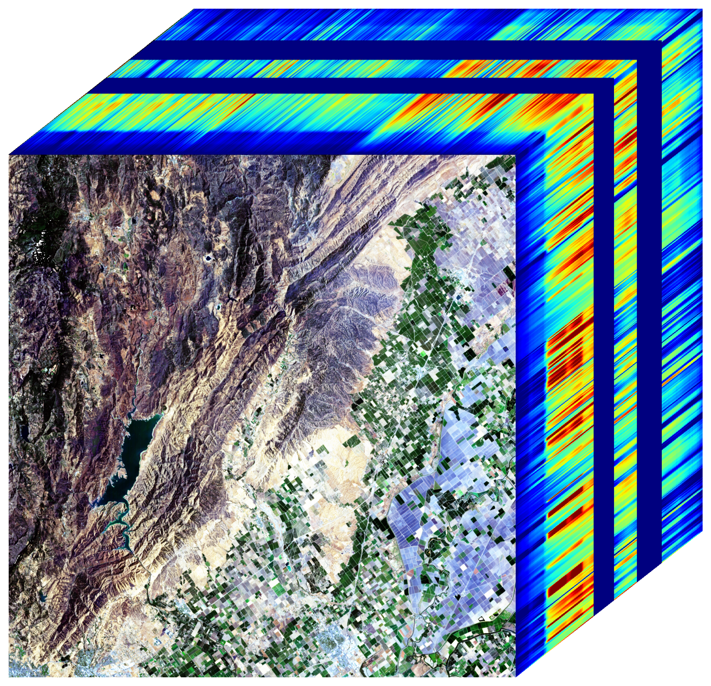
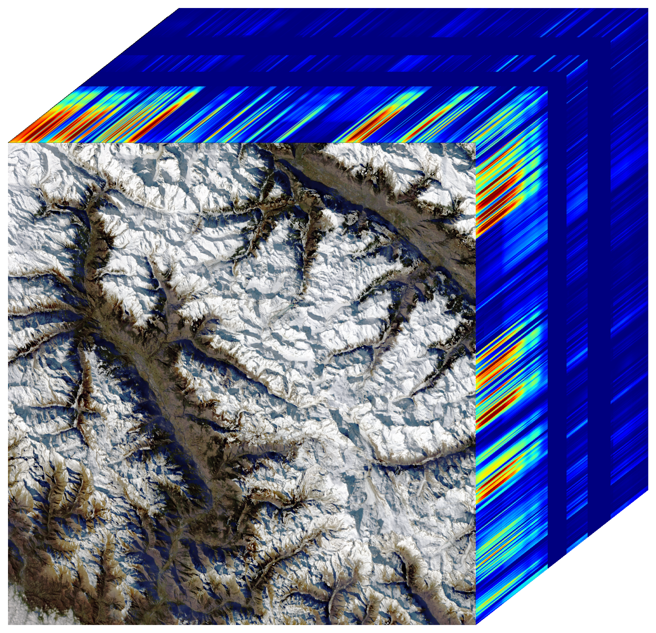
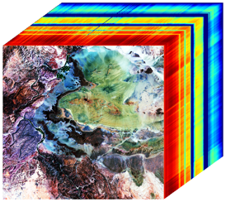
SBG VSWIR Imaging Spectroscopy L3 Products Contribute to Understanding Earth System Processes
ECOSYSTEMS AND NATURAL RESOURCES
E-1. What are the structure, function, and biodiversity of Earth’s ecosystems, and how and why are they changing in time and space?
E-2. What are the fluxes of carbon, water, nutrients, and energy between ecosystems and the atmosphere, the ocean, and the solid Earth, and how and why are they changing?
E-3. Fluxes within ecosystems. What are the fluxes within ecosystems, and how and why are they changing?
SOLID EARTH
S-1. How can large-scale geological hazards be accurately forecast in a socially relevant time frame?
S-2. How do geological disasters directly impact the Earth system and society following an event?
HYDROLOGY
H-1. How is the water cycle changing?
H-2. How do anthropogenic changes in climate, land use, water use, and water storage, interact and modify the water and energy cycles locally, regionally and globally.
H-4. Hazards, extremes, and sea level rise. How does the water cycle interact with other Earth system processes to change the predictability and impacts of hazardous events.
CLIMATE
C-3. How large are the variations in the global carbon cycle and what are the associated climate and ecosystem impacts?
WEATHER
W-3. How do spatial variations in surface characteristics (influencing ocean and atmospheric dynamics, thermal inertia and water) modify transfer between domains?
Coastal and Aquatic Ecosystems
Terrestrial Ecosystems
Hydrology Snow and Water
Geology and Minerals

Slide 5
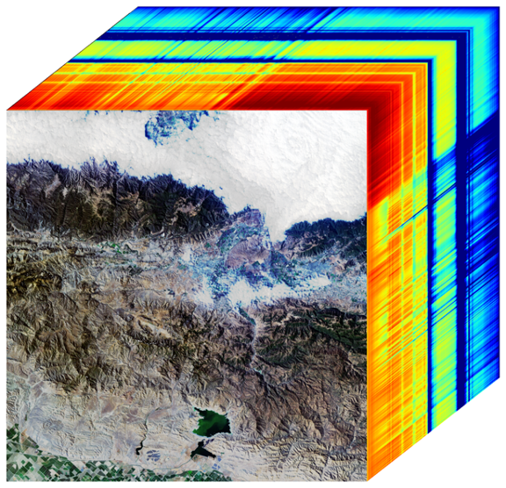
Aquatic Products Objectives
DS Science/Application Objective | Priority | DS Suggested Biogeophysical Parameters | Geophysical Parameters (one-sigma uncertainty target) | Applications enabled
E-1a. Quantify the distribution of the functional traits, functional types, and composition of vegetation and marine biomass spatially and over time. | Very Important | Primary Observable: Chemical properties of aquatic biomass (Inland, Coastal, Shallow): Spectral radiance (10nm; 380-2500nm); GSD = 30-45m; Revisit = ~15 days; SNR = 400:1 VNIR/250:1 SWIR @ 25% reflectance; IT of ~5 ms. | Remote Sensing Reflectance (380-1050 nm) | EA27 Fisheries management EA28 Harmful Algal Blooms EA 29 Oil Spill Recovery EA 43 Water resource management
 |  |  | Pigment Concentrations (chlorophyll 25% via AWG)
E-1c. Quantify the physiological dynamics of terrestrial and aquatic primary producers. | Most important |  | Benthic composition - proportional cover of algae, coral, sand, seagrass (coral fraction 20% at 5m depth, from AWG) | EA25 Mitigation of invasive species EA26 Marine conservation EA43 Coastal habitat monitoring
Notes:
(“Structure” is the spatial distribution of plants and their components on land, and of aquatic biomass. “Function” is the physiology and underpinning of biophysical and biogeochemical properties of terrestrial vegetation and shallow aquatic vegetation.)

Slide 6
Snow Physics Products Objectives
DS Science/Application Objective | Priority | DS Suggested Biogeophysical Parameters | Geophysical Parameters (one-sigma uncertainty target) | Applications enabled
H-1c. Quantify rates of snow accumulation, snowmelt, ice melt, and sublimation from snow and ice worldwide at scales driven by topographic variability. | Most Important | Snow and glacier albedo and surface temperature. Spectral albedo of subpixel snow and glaciers at weekly intervals to an accuracy to estimate absorption of solar radiation to 10%. Ice/snow temperature to ± 1K. At spatial resolution of 30 to 100 m. | Snow and ice coverage fraction (coverage fraction +/- 7%) | EA1 Water resource management, EA2 Drought monitoring, EA3 Drought / flood prediction, EA4 Weather forecast, EA5 Climate modeling, EA6 Shipping / navigation around sea ice
 |  |  | Snow surface reflectance, 380-2500 nm
 |  |  | Snow grain size, used to calculate albedo (absorption +/- 7%)

Slide 7
Geology & Soils Products Objectives
DS Science/Application Objective | Priority | DS Suggested Biogeophysical Parameters | Geophysical Parameters (one-sigma uncertainty target) | Applications enabled
E-1c. Quantify the physiological dynamics of terrestrial and aquatic primary producers. | Most Important | Primary Observable: Chemical properties of vegetation, aquatic biomass, and soils (Land, inland aquatic, coastal zone, and shallow coral reef): Spectral radiance (10nm; 380-2500nm); GSD = 30-45m; Revisit = ~15 days; SNR = 400:1 VNIR/250:1 SWIR @ 25% reflectance; IT of ~5 ms. | Soil Surface Chemistry iron oxides, carbonates, and types of clay minerals, e.g., montmorillonite, illite, and kaolinite, p371, (Kaolinite spectral abundance +/-10%) | EA15 Post-fire severity assessment and recovery, EA18 Forest and Agricultural Yield, EA20 Rangeland management, EA33 Land carbon accounting EA40 Improving landslide models and predictions
S-1a. Measure the pre-, syn-, and posteruption surface deformation and products of Earth’s entire active land volcano inventory with a time scale of days to weeks. | Most Important | Ground-surface composition and changes over time. Hyperspectral VNIR/SWIR (at the ~ 30 m spatial scale) and TIR data (at the ~ 60 m spatial scale) with 1-2 week revisit time, acquiring continuously for periods of weeks to months prior to an eruption to detect trends and change | Bare surface mineral composition (Mineral spectral abundance +/-10%) | EA10 Wildfire fuel mapping, EA36 Volcanic eruption forecast, EA38 Lava flow prediction, EA39 Crater lake hazard prediction
S-1c. Forecast and monitor landslides, especially those near population centers. | Very Important | High spatial resolution time series of distribution of vegetation and rock/soil composition. Hyperspectral VNIR/SWIR and TIR data at 30-45 m spatial resolution and ~ weekly temporal resolution | Surface composition and cover (Soil coverage fraction +/- 10%) | EA8 Urban heat islands, EA9 Vector-borne diseases, EA14 Land energy fluxes, EA31 Wildfire emissions forecast, EA34 Land use GHG accounting, EA35 Peatland mapping, EA40 Landslide modeling, EA41 Landslide risk forecasting, EA42 Post-landslide assessment and recovery
S-2b. Assess surface deformation (<10 mm), extent of surface change (<100 m spatial resolution) and atmospheric contamination, and the composition and temperature of volcanic products following a volcanic eruption (hourly to daily temporal sampling) | Very Important | Volume, composition and temperature of all eruptive products and measure their changes over time. Hyperspectral VNIR/SWIR and TIR data at 30-45 m spatial resolution and ~weekly temporal resolution.
Notes:
(“Structure” is the spatial distribution of plants and their components on land, and of aquatic biomass. “Function” is the physiology and underpinning of biophysical and biogeochemical properties of terrestrial vegetation and shallow aquatic vegetation.)

Slide 8
Terrestrial Vegetation Products Objectives
DS Science/Application Objective | Priority | DS Suggested Biogeophysical Parameters | Geophysical Parameters (one-sigma uncertainty target) | Applications enabled
E-1a. Quantify the global distribution of the functional traits, functional types, and composition of vegetation spatially and over time. | Very Important | Primary Observable: Chemical properties of aquatic biomass (Inland, Coastal, Shallow): Spectral radiance (10nm; 380-2500nm); GSD = 30-45m; Revisit = ~15 days; SNR = 400:1 VNIR/250:1 SWIR @ 25% reflectance; IT of ~5 ms. | Surface reflectance 380-2500 nm Enables Competed Science Team leadership to support further DS named goals, including: carbon concentrations, nutrients, other biochemicals, Jmax, Vcmax, plant functional types, tree species diversity | EA15 Post-fire assessment and recovery, EA16 Wildlife conservation management, EA17 Invasive species management, EA18 Forest and Agricultural Yield, EA19 Monitor vegetation health, EA20 Rangeland management, EA21 Map endangered species habitat, EA22 Biodiversity conservation, EA24 Habitat restoration, EA45 Agricultural diseases, EA46 Agricultural practices for wildlife habitat
 |  |  | Canopy nitrogen (N % +/- 25% via AWG)
 |  |  | Leaf Water Content (LWC % +/- 10%: p362, uncertainties via AWG)
E-1c. Quantify the physiological dynamics of terrestrial and aquatic primary producers. | Most Important |  | Leaf Mass per Area - TBC (LMA g/m2 +/- 30%) | EA10 Wildfire fuel mapping, EA15 Post-fire assessment and recovery, EA17 Invasive species management, EA18 Forest and Agricultural Yield, EA19 Monitor vegetation health, EA20 Rangeland management, EA24 Habitat restoration, EA31 Wildfire emissions forecast, EA33 Land carbon accounting, EA34 Land cover GHG accounting, EA45 Agricultural diseases, EA46 Agricultural practices for wildlife habitat
 |  |  | Fractional cover: p371 (Live foliage (PV), plant residue (NPV) fraction +/- 10%)
 |  |  | Equivalent water thickness (mm) p371 (EWT/CWC +/- 10% via AWG)
 |  |  | Surface Reflectance 380-2500 nm Enables Competed Science Team leadership to support further DS named goals, including: xanthophyll pigments, cellulose, lignin
E-2a. Quantify the fluxes of CO2 and CH4 globally at spatial scales of 100-500 km and monthly temporal resolution with uncertainty < 25% between land ecosystems and atmosphere and between ocean ecosystems and atmosphere. | Most important | GPP, respiration, and decomposition, and biomass burning. Global, daily, 30 m / 300 m | Non-photosynthetic vegetation (coverage fraction +/- 10%) | EA10 Fuel mapping for wildfire management, EA44 Improvement of agricultural practices
E-3a. Quantify the flows of energy, carbon, water, nutrients, and so on sustaining the life cycle of terrestrial and marine ecosystems and partitioning into functional types. | Most Important | GPP, respiration, litterfall and decomposition, non-PS vegetation, functional types. Global, daily, 30 m / 300 m. | Non-photosynthetic vegetation (coverage fraction +/- 10%) | EA10 Fuel mapping for wildfire management, EA44 Improvement of agricultural practices
E-1: What are the structure, function, and biodiversity of Earth’s ecosystems, and how and why are they changing in time and space?
(“Structure” is the spatial distribution of plants and their components on land, and of aquatic biomass. “Function” is the physiology and underpinning of biophysical and biogeochemical properties of terrestrial vegetation and shallow aquatic vegetation.)
E-1a. Quantify the global distribution of the functional traits, functional types, and composition of vegetation spatially and over time. (Very Important)
E-1c. Quantify the physiological dynamics of terrestrial and aquatic primary producers. (Most Important)

Slide 9
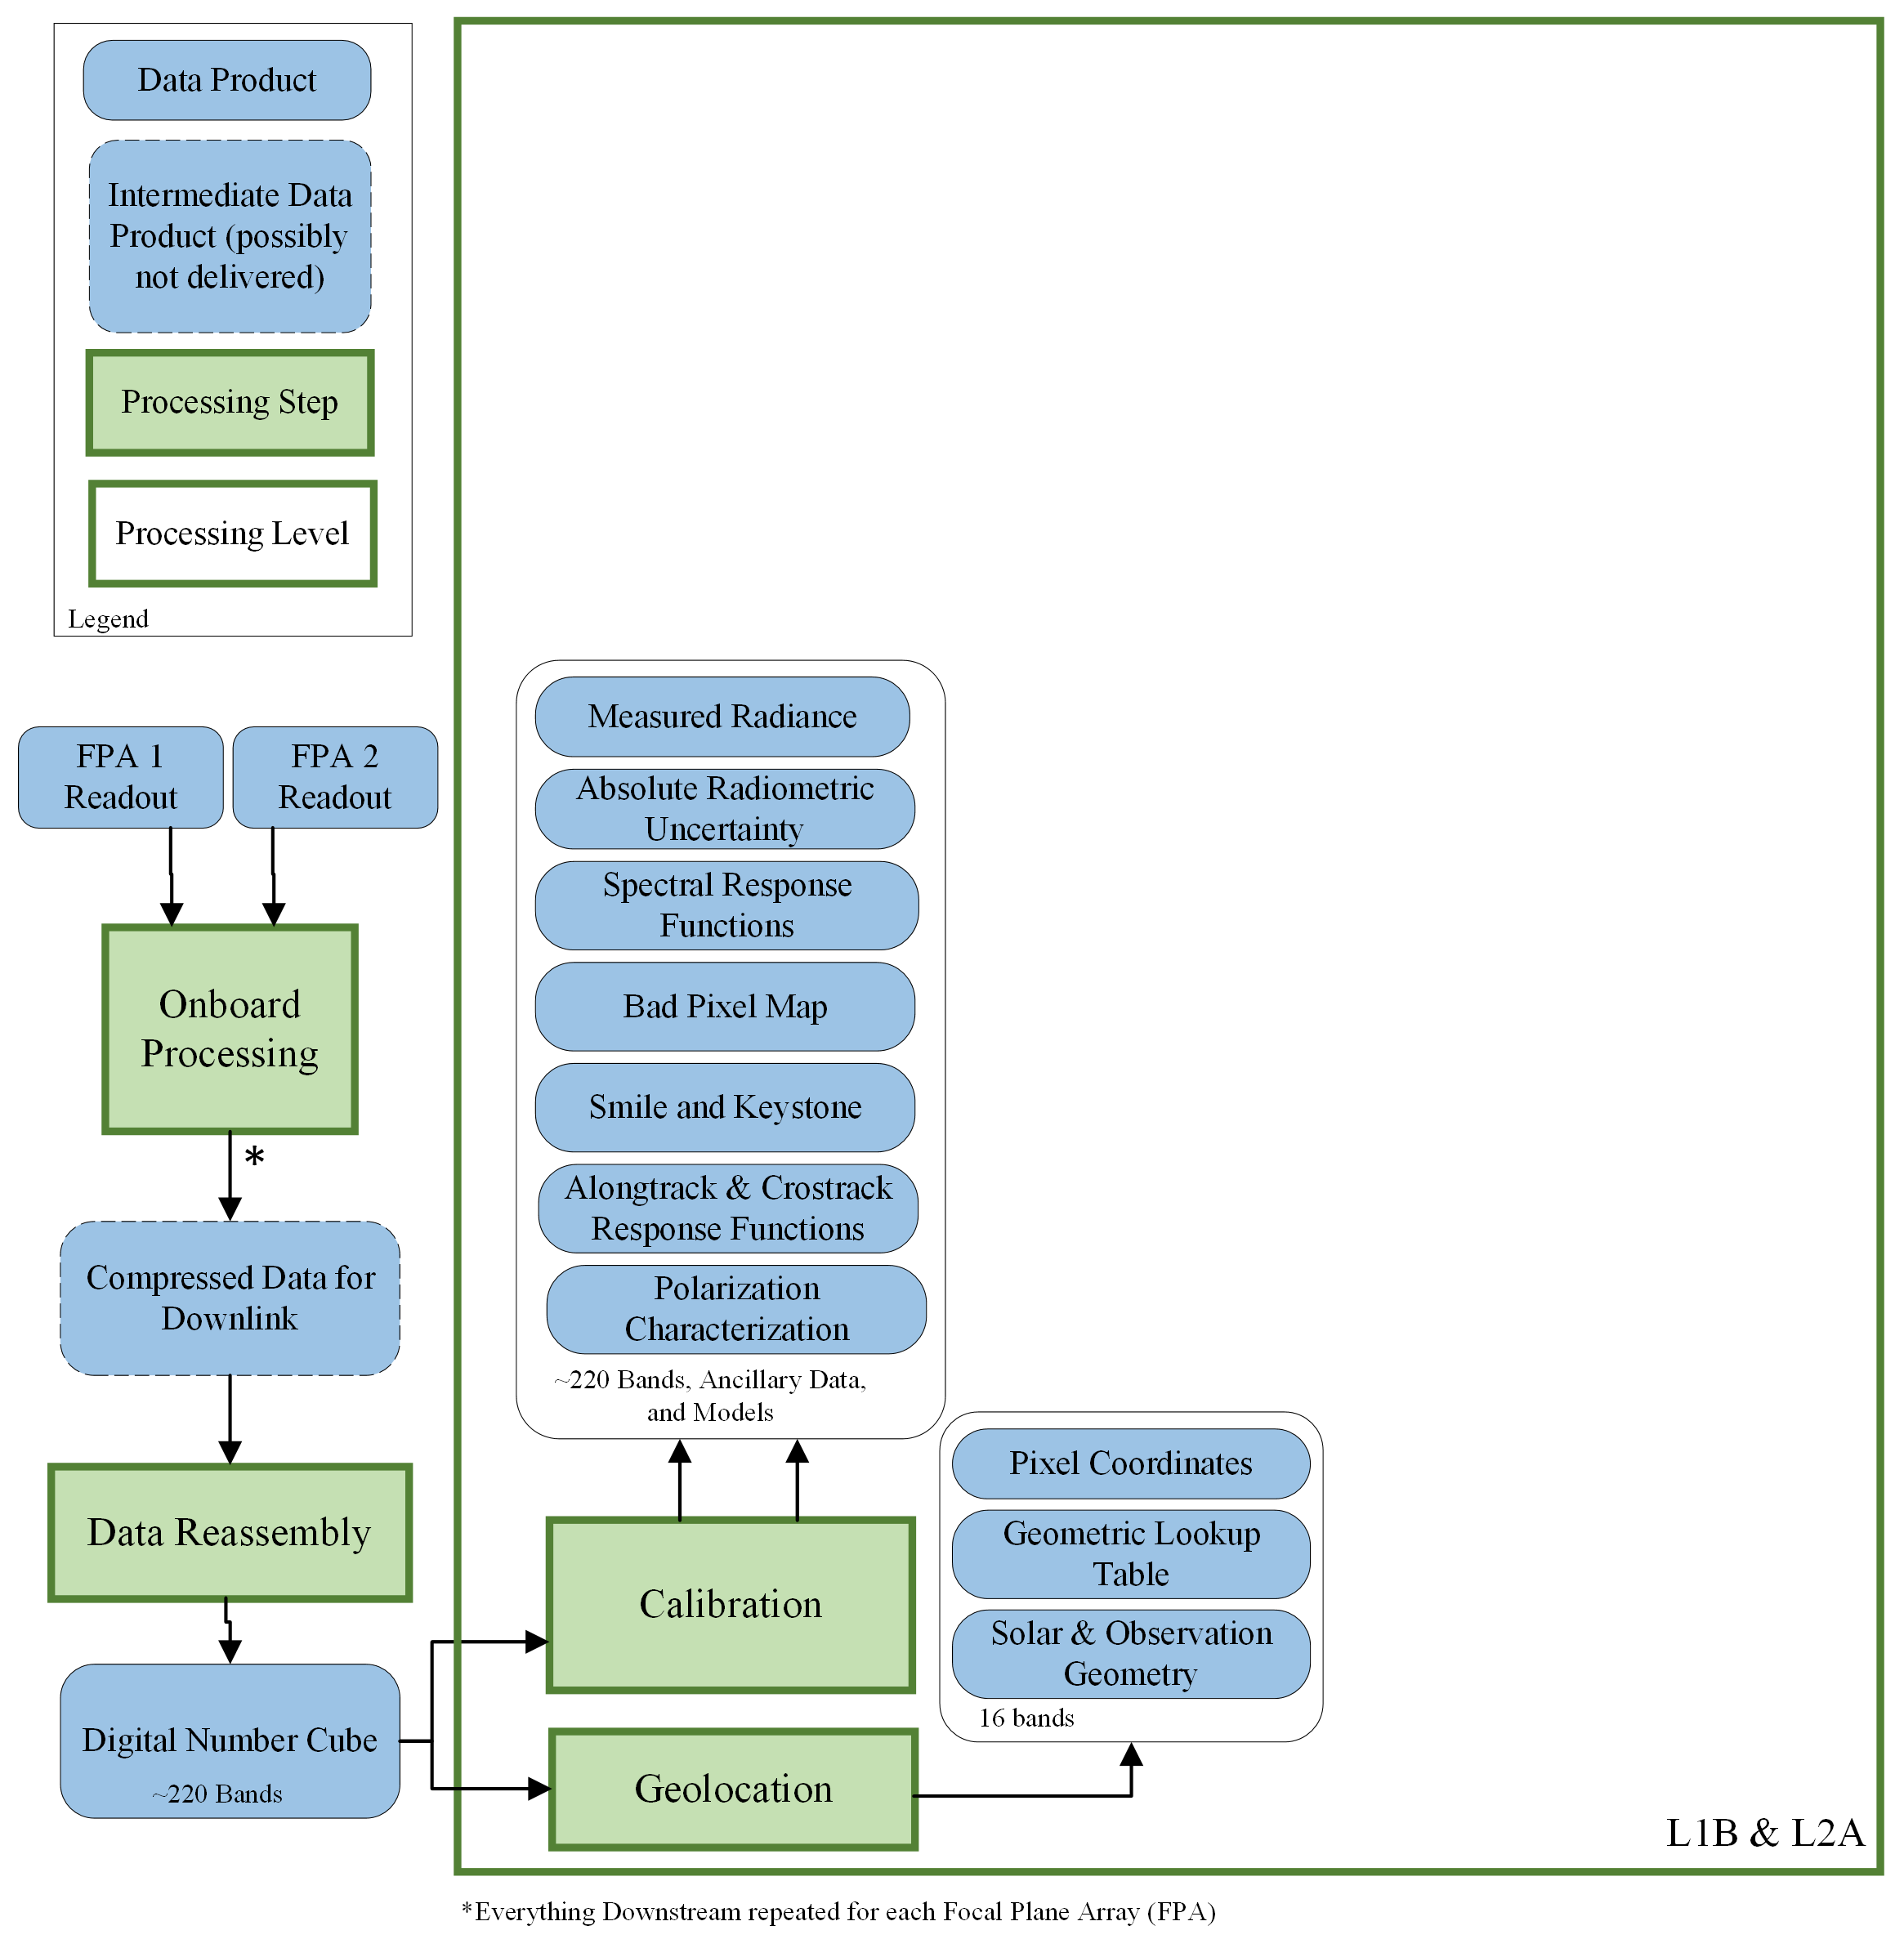
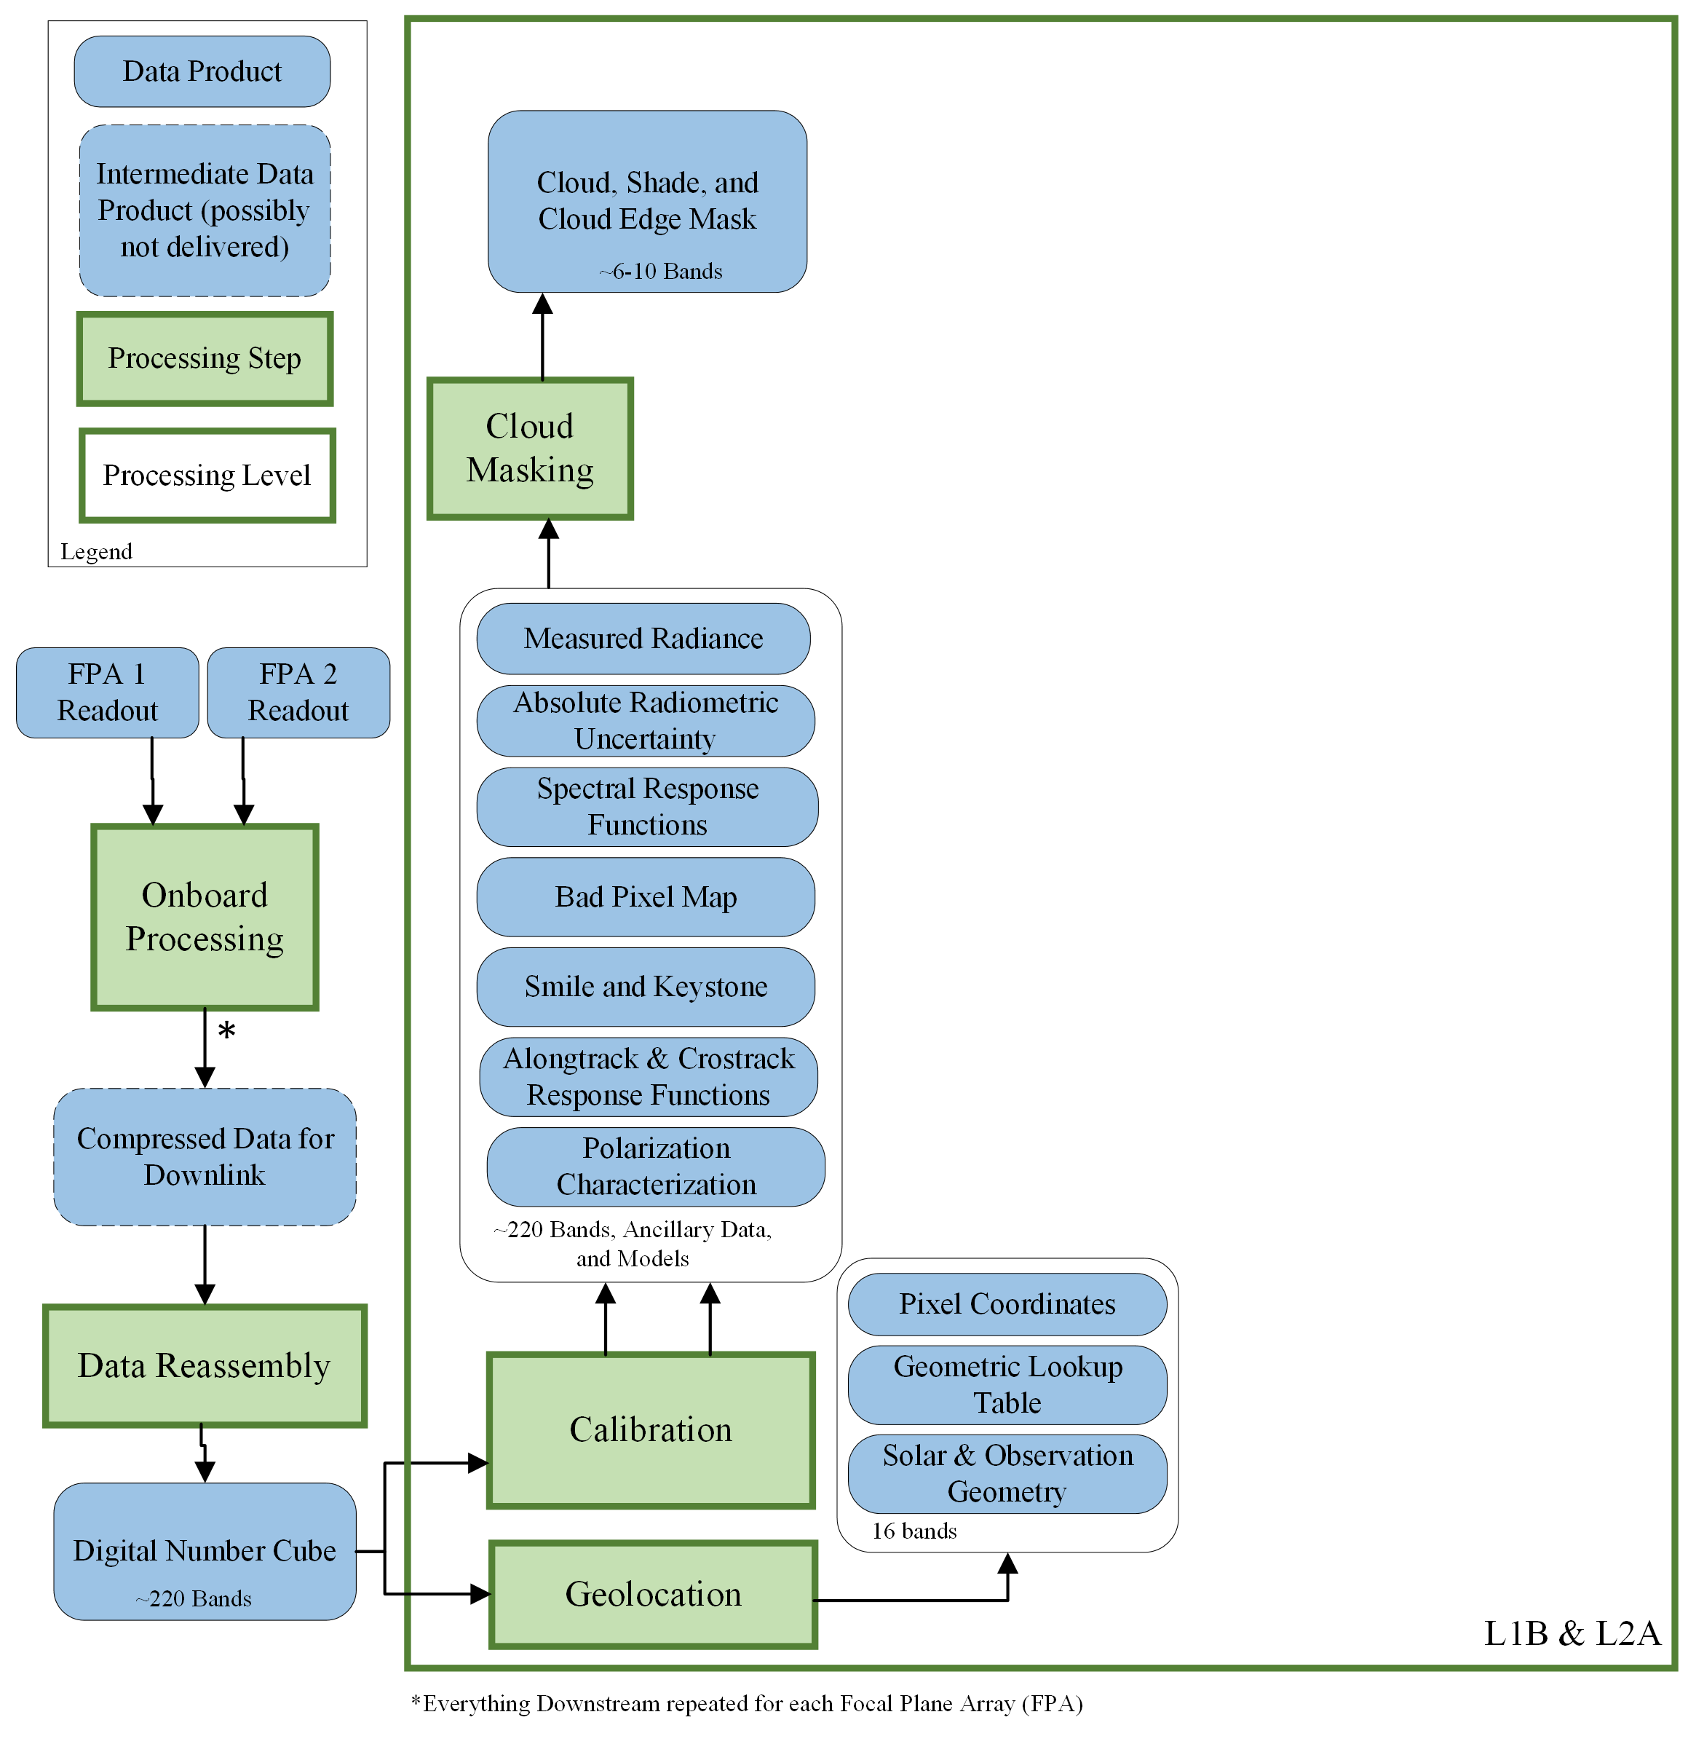
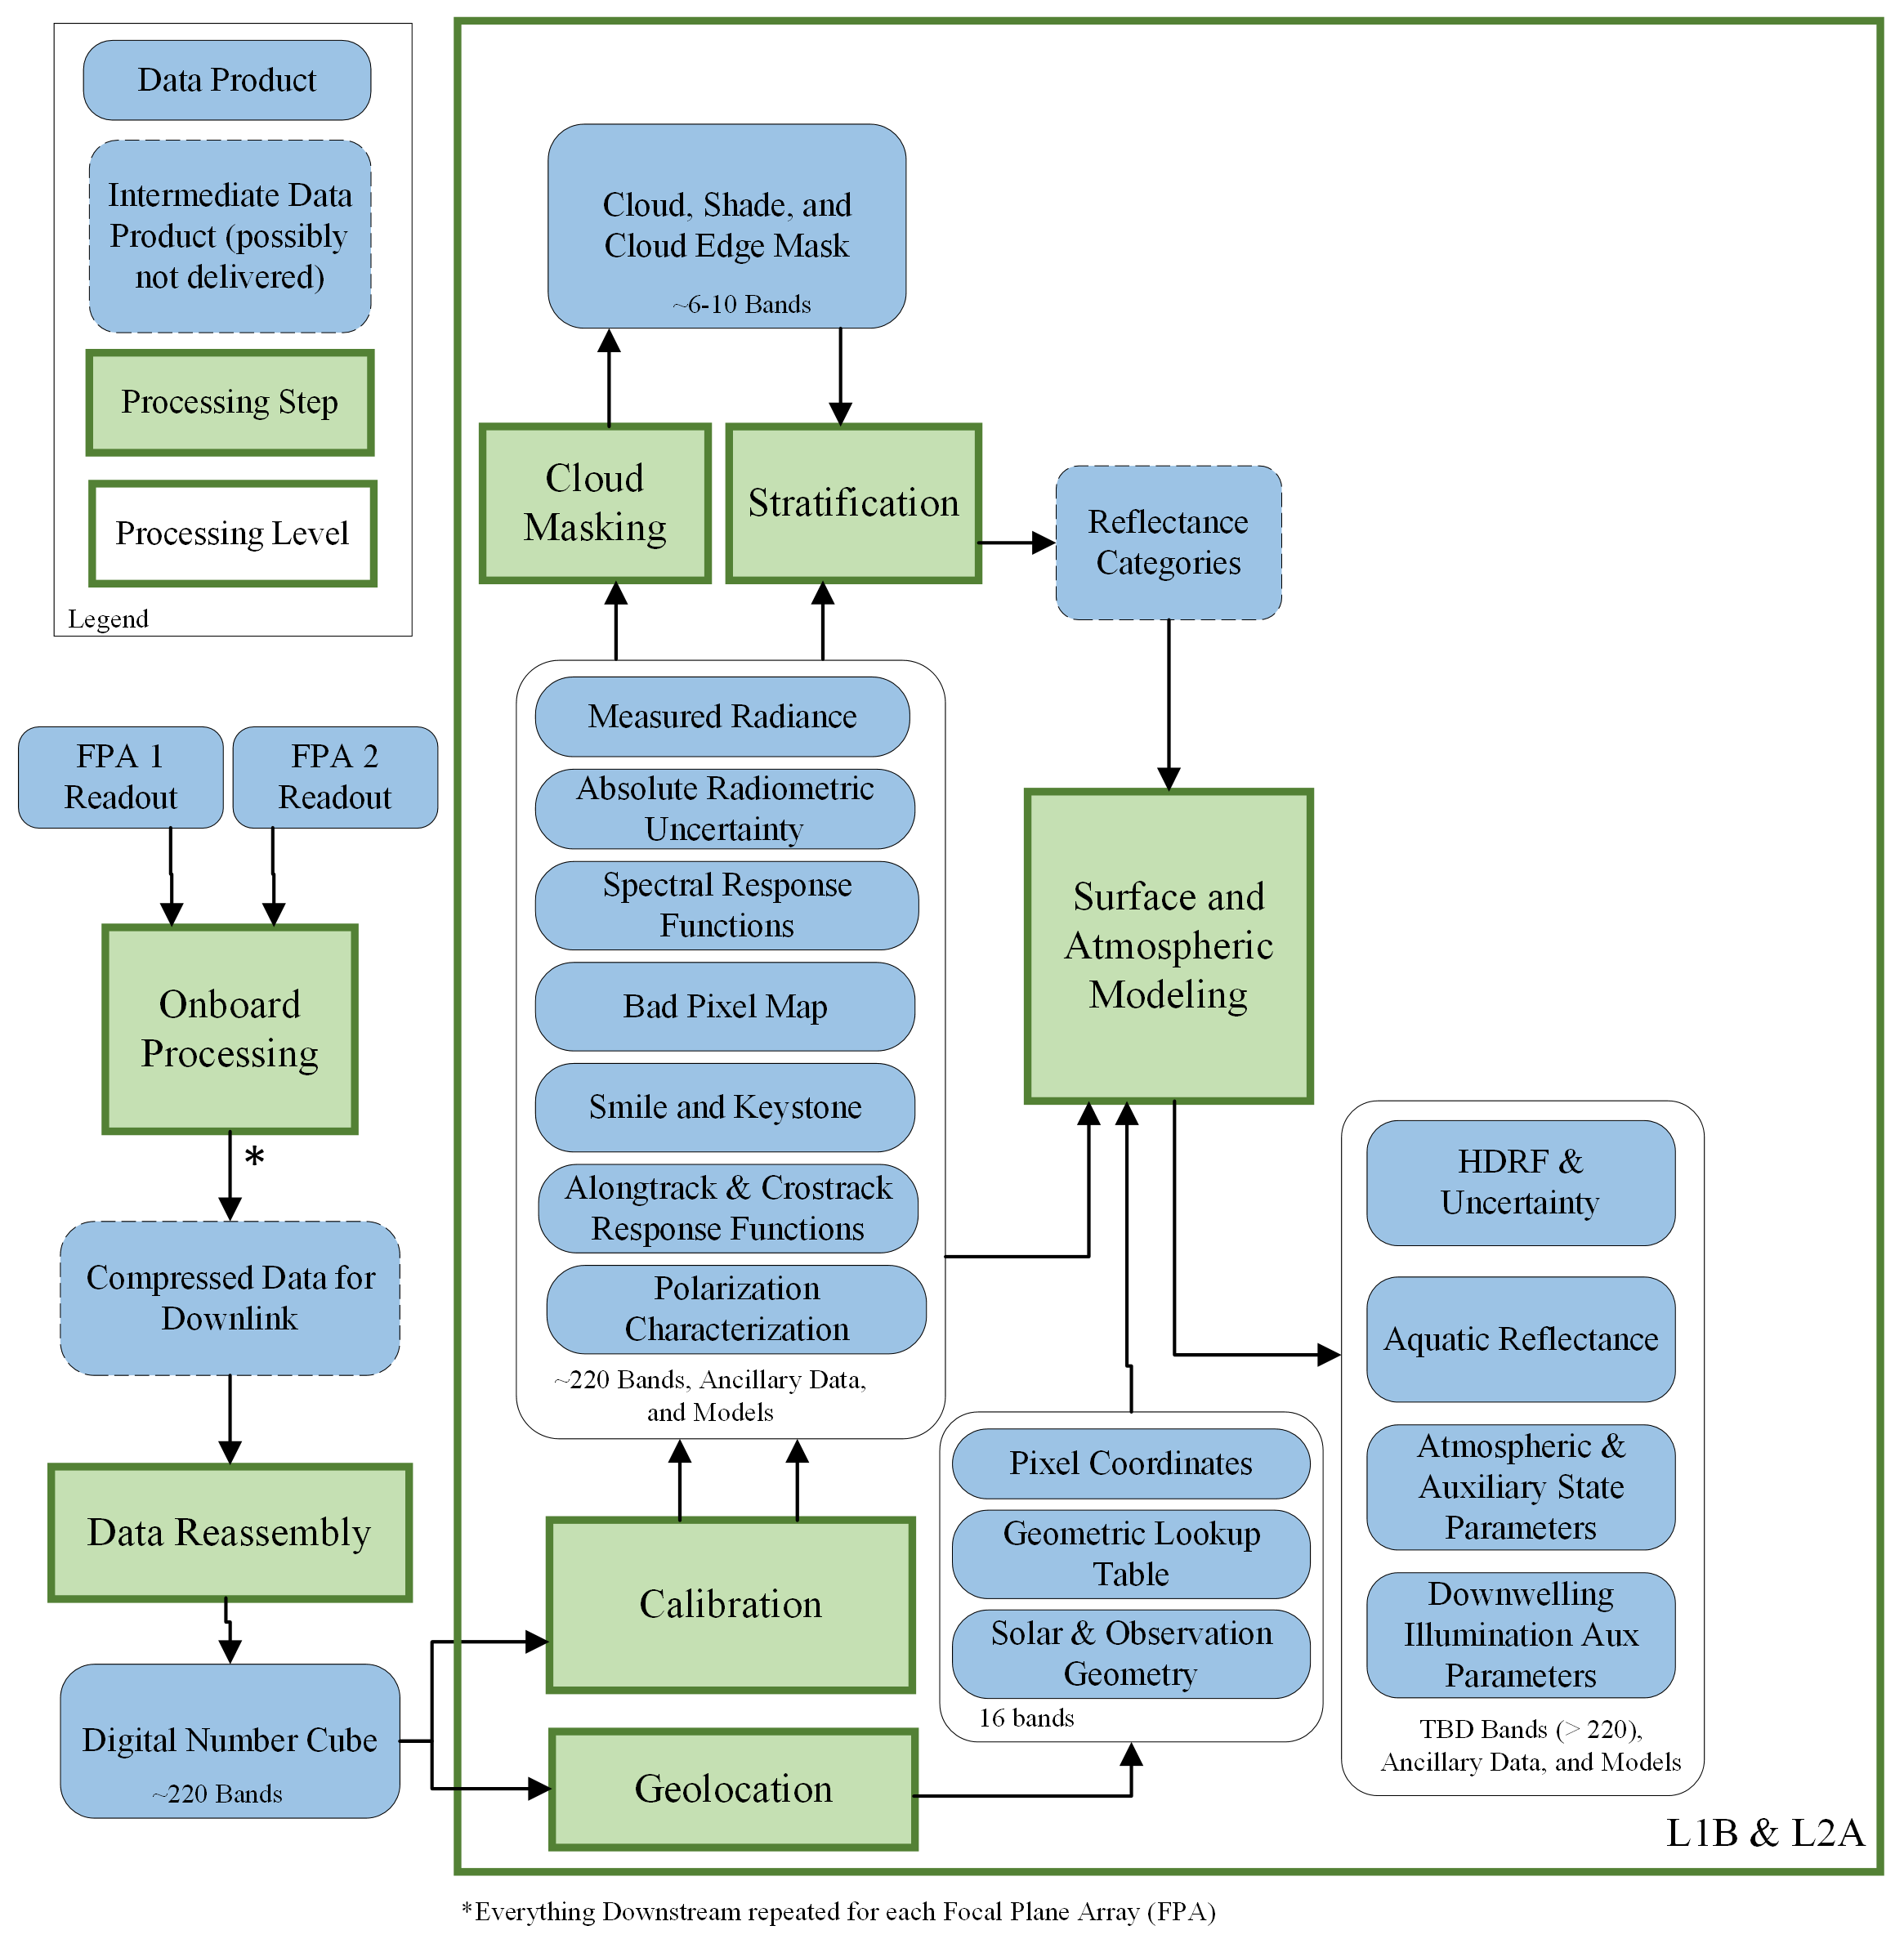
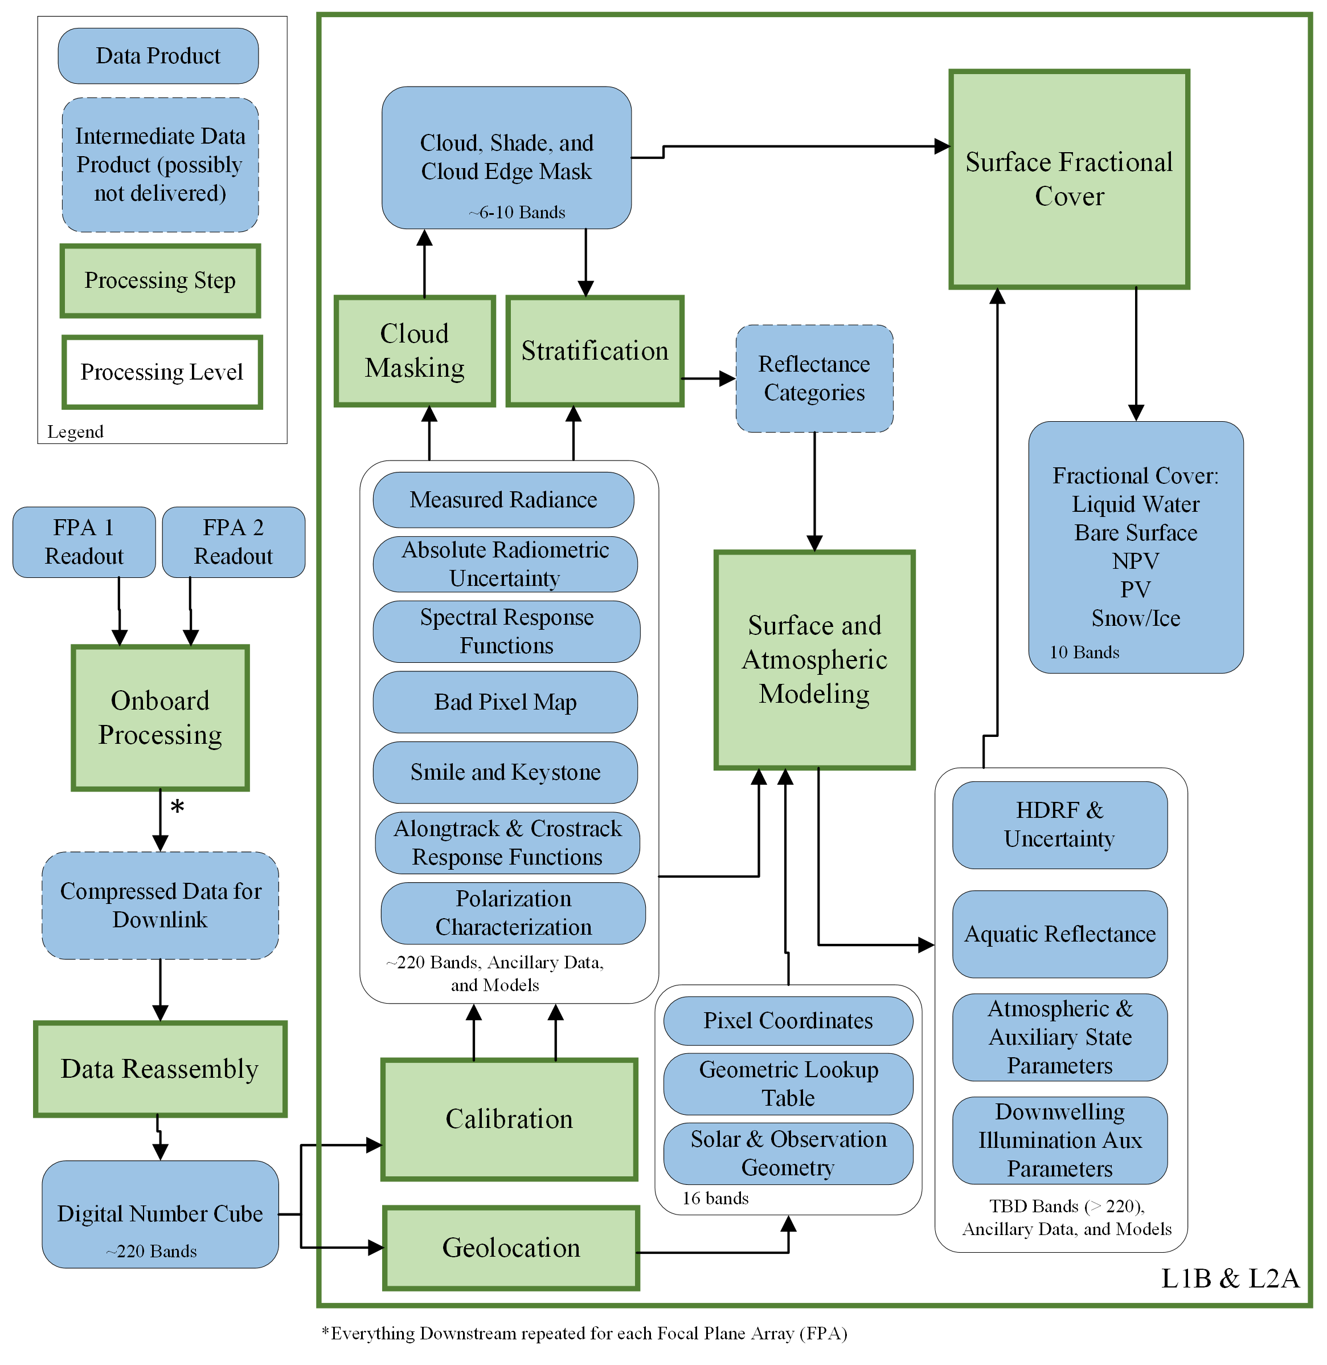
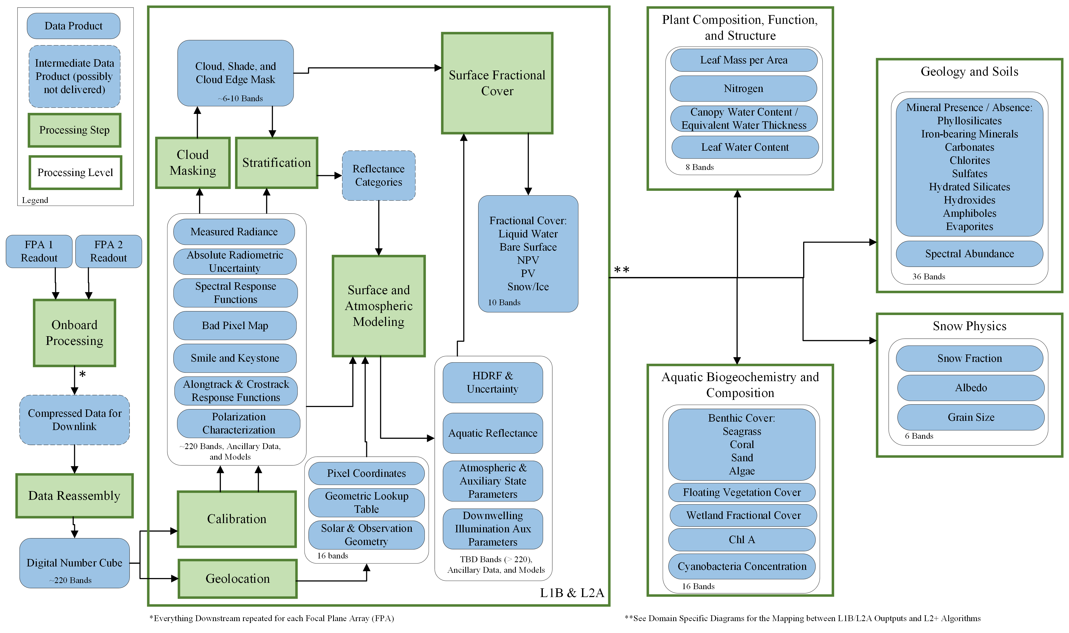
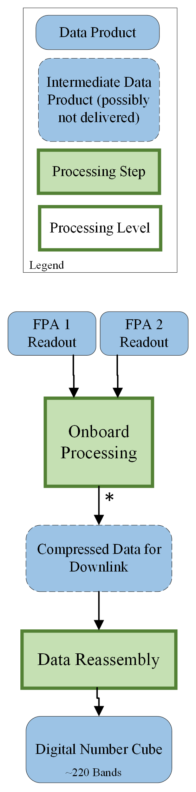
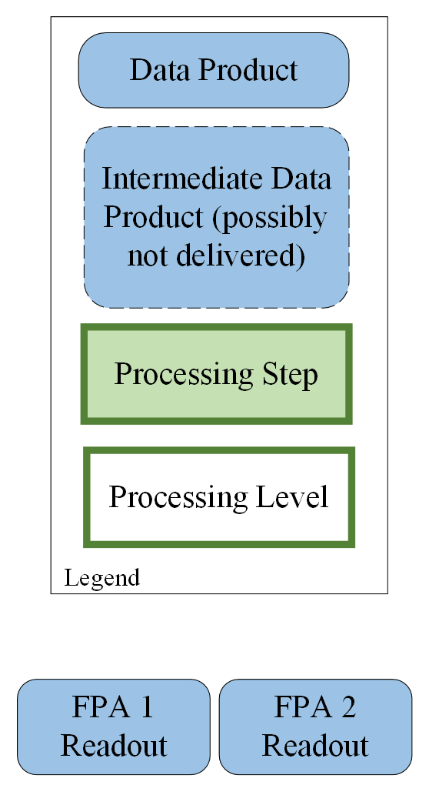
Core Algorithm Product Workflow

Slide 10
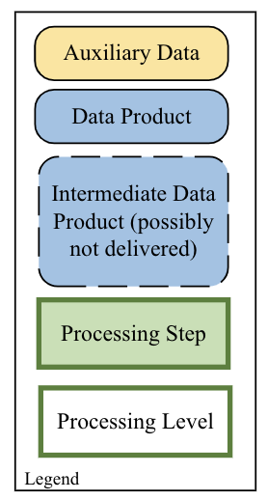
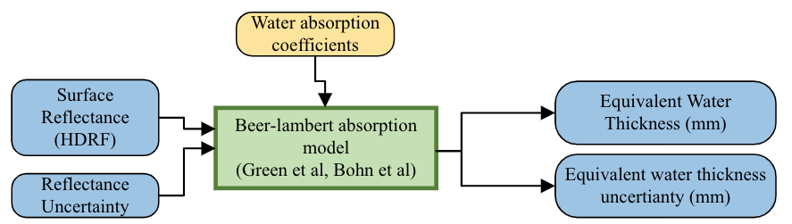
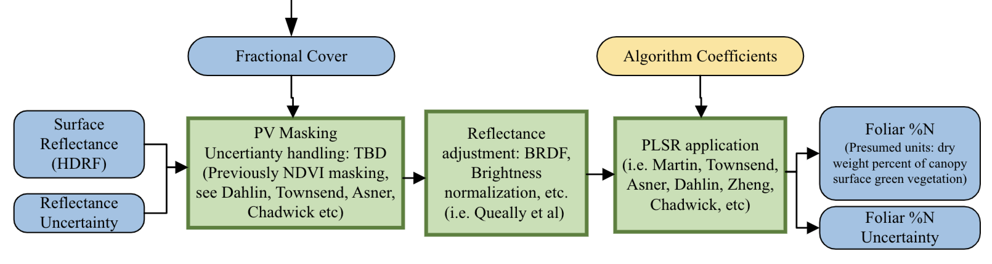
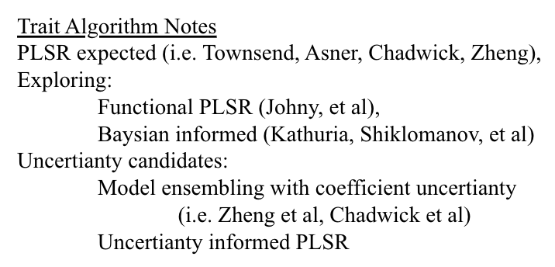
Terrestrial Vegetation – Candidate Algorithms
Are our algorithms ready for large scale L3/L4 product generation and their frequently repeated production in order to assess Earth system processes?
Equivalent Water Thickness
Foliar Traits (%N as example)

Slide 11
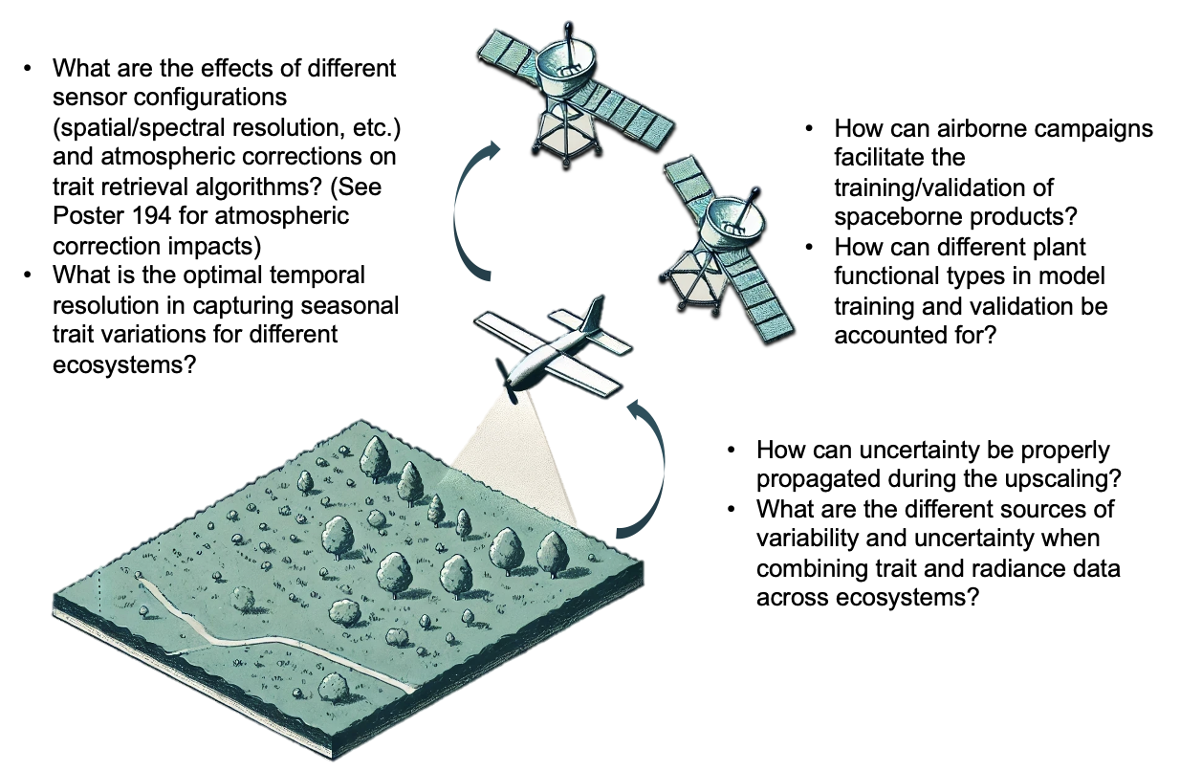
We are not ready
Products have been successfully generated in many locations and at many scales, BUT:
We need to do this:
Globally
Sub-seasonally
In mixed pixel and complicated canopy environments
Ideally utilizing methods that support intercomparison of products across missions
And:
We need a strategy for leveraging different data collection activities
We need to do better error propagation
We need to be able to utilize airborne training data from different sensor platforms that have different atmospheric correction algorithms
There are many questions that we can be answering right now leveraging existing paired airborne and field collections!

Slide 12


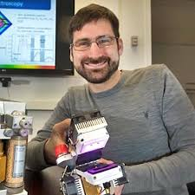



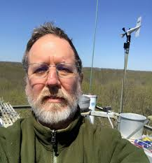








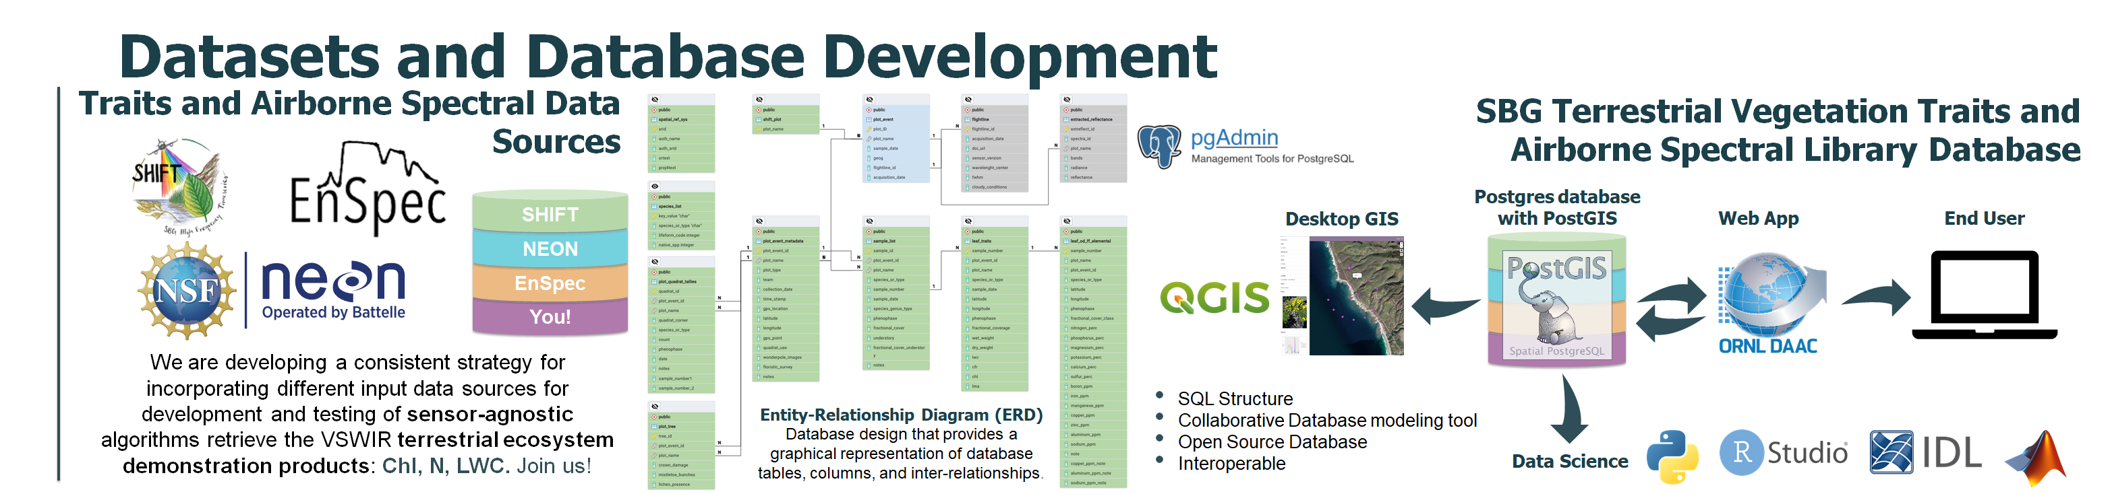
Terrestrial Vegetation: database development
PLSR algorithm development requires testing database that can support updates to atmospheric correction algorithms and inputs from various campaigns/programs.
Small team working on developing database structure that will support algorithm testing for airborne <> field collection model methods
Once draft established, we will release to the community for comment, collaboration, and use

Slide 13
Terrestrial Vegetation: database development
SBG Plant Traits and Spectral (PLANTS) database
SBG PLANTS will facilitate the modelling of sensor-agnostic algorithms to retrieve the
SBG VSWIR terrestrial ecosystem
demonstration products, such as
canopy water content (EWT), leaf mass per area (g/m2), canopy surface nitrogen (% dry weight), and leaf water content (%).
Deployed on Amazon Relational Database Services (AWS-RDS) supporting storage, indexing, and querying of spatial data.
Flexible and can be redesigned under a version control system to incorporate other dataset structures from the SBG community and partners (e.g., EnSpec, NEON, Your data!) in an open platform that enables findable, accessible, interoperable, and reusable data.
+ Obs!

Slide 14
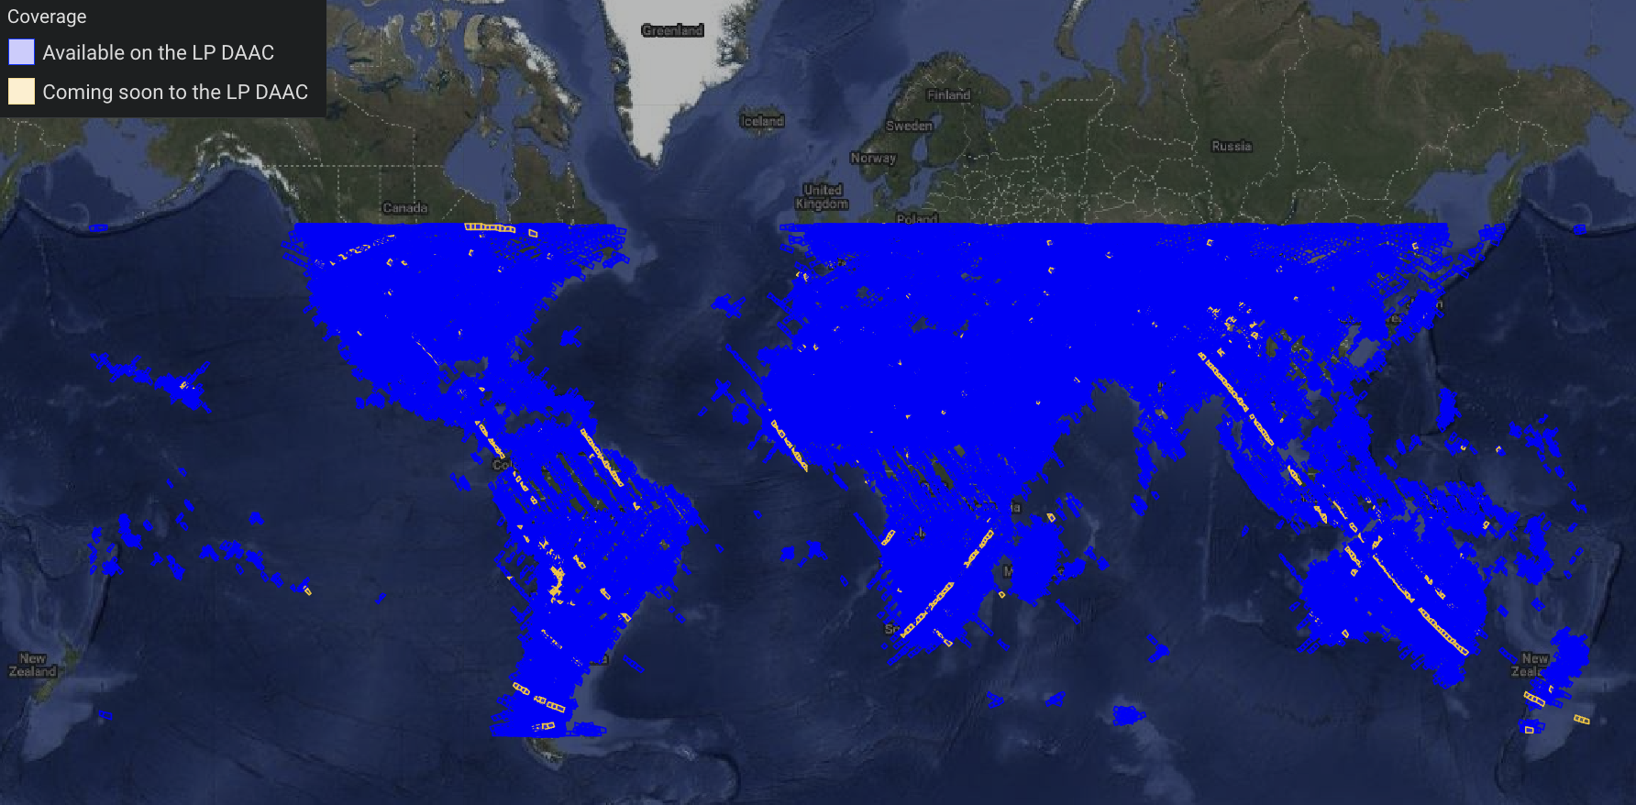









We are not ready… but we will be.
SBG Plant Traits and Spectral (PLANTS) database
Paired field collections
Increasingly global coverage from spaceborne sensors
And more!

Slide 15
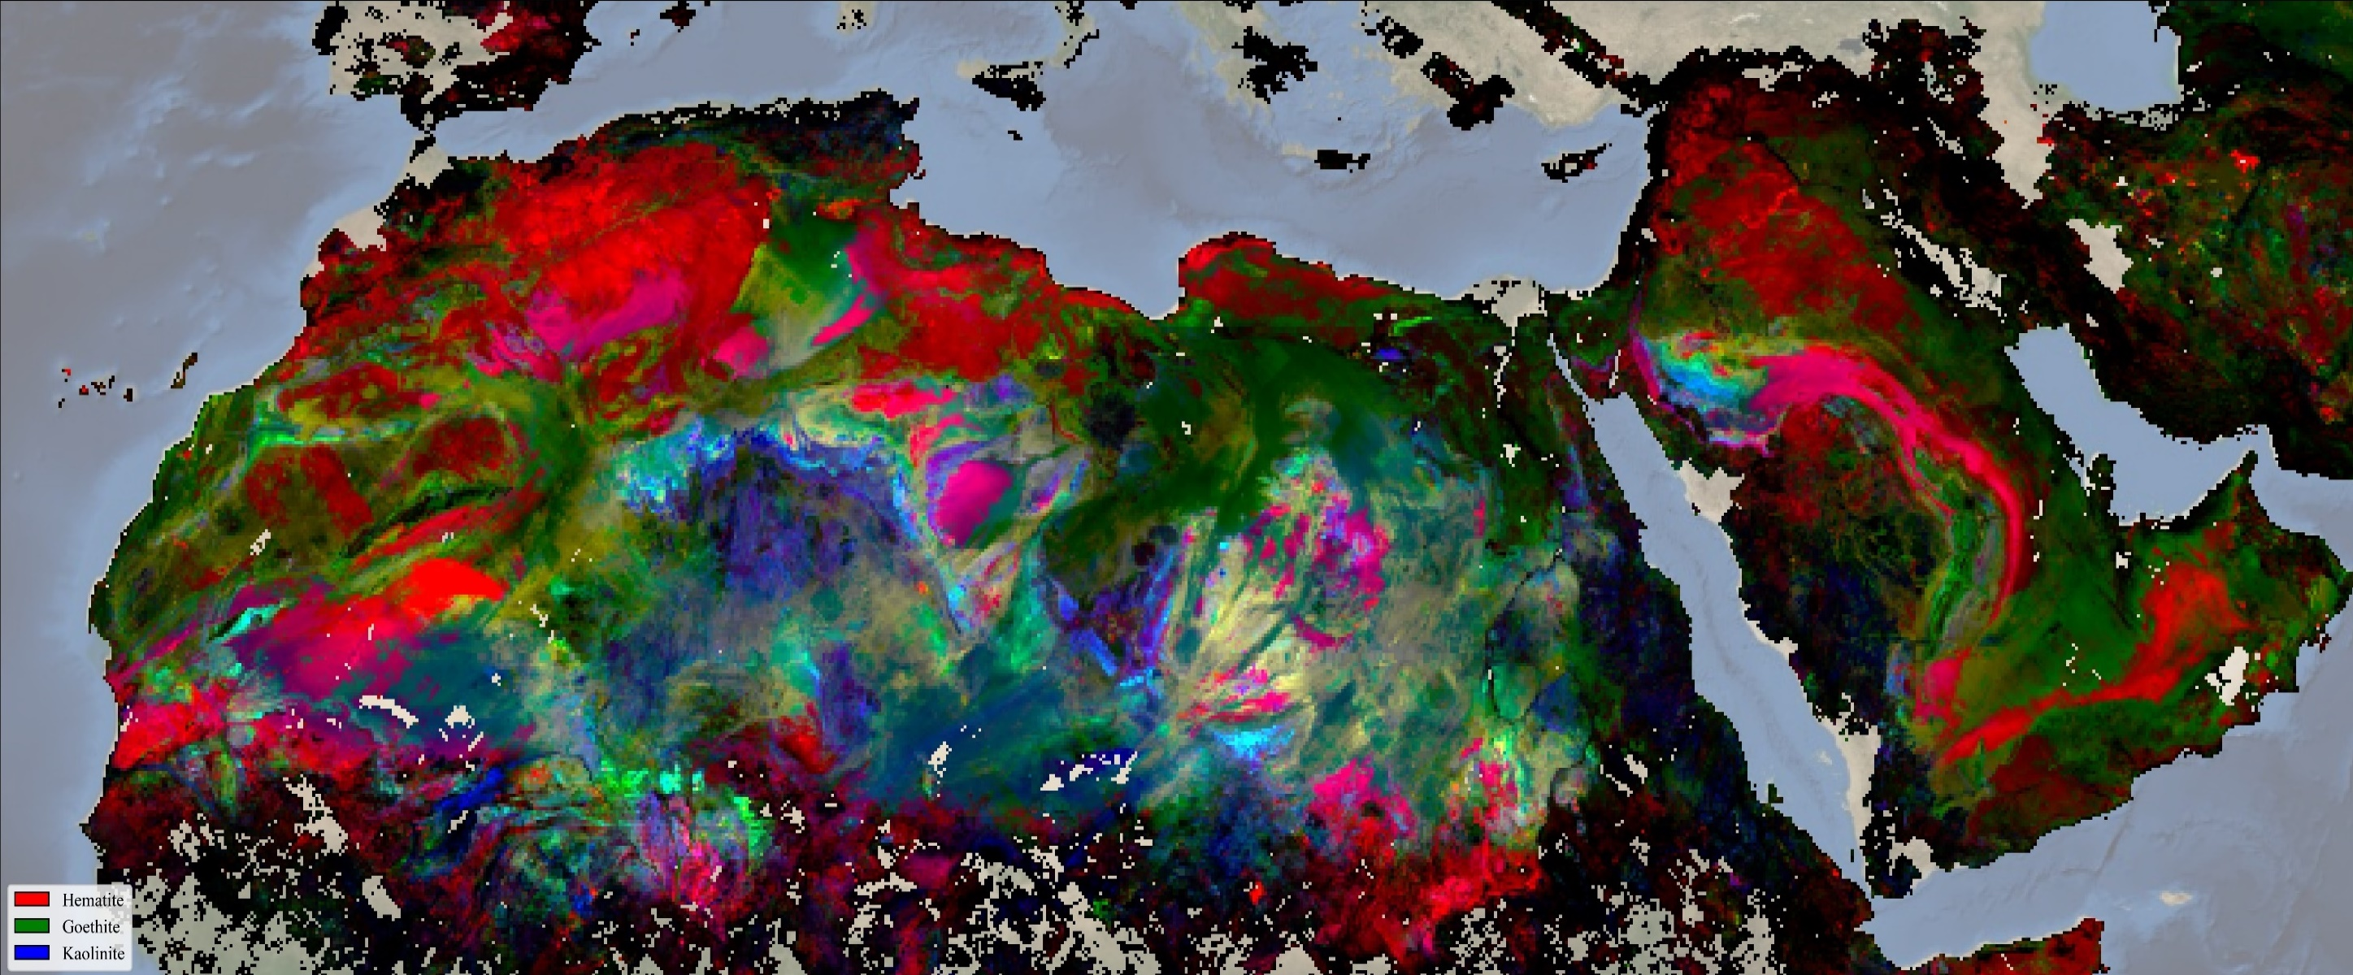
We learn by doing

