Slide 1
Centro di Geodesia Spaziale “Giuseppe Colombo”, Matera, Italy
Status of the PRISMA mission (at the turn of 5 years in orbit)
Sara VENAFRA, Ettore LOPINTO, Patrizia SACCO
Agenzia Spaziale Italiana

Slide 2
Presentation highlights
The mission in brief
Mission statistics
Users
Archived data
Catalogue

Slide 3
Mission Overview
Italian EO hyperspectral Mission fully funded by ASI and realized by Italian Industries Consortium led by OHB Italia, Leonardo and Telespazio, conceived as a pre-operational demonstrator
Launched on March 22, 2019, ended his 5.25 years nominal lifetime on June 19, 2024
Access to Users opened on May 21, 2020 https://prisma.asi.it/
Sensor with 240 total bands in VNIR (#66 , 400–1010 nm) & SWIR (#174, 920–2505 nm), partial spectral overlap
High spectral Resolution (better of 14 nm)
Medium spatial resolution (30m) and swath (30km)
PAN camera (400–700 nm) offers added capability with fine (5m) spatial resolution
Primary mode – Service On Demand user requests, subject to quota and a priority level (depends by the user type)
Secondary mode – Background mission to fill-up resources still available after planning of users requests + systematic acquisitions
Products are in HDF5-EOS format and include HYP data cube + PAN image + metadata
Level 1: Top-of-Atmosphere Radiance radiometrically corrected and calibrated in physical units (incl. Cloud mask; Sun-glint Mask; Classification Mask; Calibration and characterization data)
Level 2B: Geolocated at Bottom-of-Atmosphere Radiance
Level 2C: Geolocated at Bottom-of-Atmosphere Reflectance (incl. Aerosol Characterization Product (VNIR); Water Vapour Map Product (HYP); Cloud Characterization)
Level 2D: Geocoded version of the level 2C products Geocoded Bottom-of-Atmosphere Reflectance
Absolute HYP radiometric accuracy better than 5% (TOA or BOA)
Quasi-open data policy, products are given free of charge for commercial exploitation too (allowed since mid 2024)
MISSION STATUS: completed his nominal lifetime but is still in fully operational conditions.

Slide 4
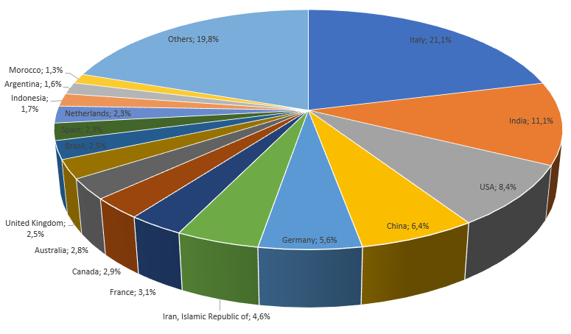
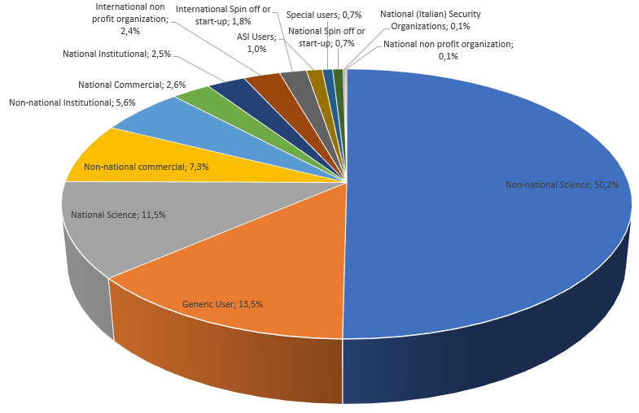
All Statistics @16/09/2024 - Users
2862 Licenses activated with 5149 total users (1.8 users per license)
61.7% of the licenses are scientists (50.2% belongs to non-Italian Science and is the largest category)
Institutional (8.2%) and commercial (9.8%) represent 18% of licenses
Foreign commercial (7.3%) is 2.8 times the Italian commercial (2.6%)
5 nations covers 52.7% of the Licenses
the Italian users represent the 21.1%
India, USA, China and Germany together account the 31.6%
The remaining 96 nations cover the 47.3%

Slide 5
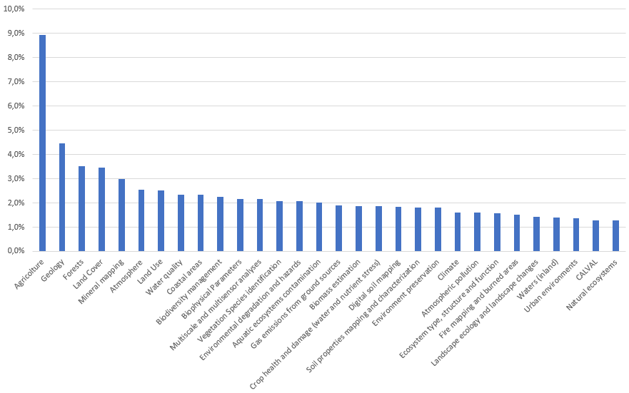
Exploitation domains
The 70% of the thematic exploitation areas which have been declared at registration time, covers in an almost uniform way 30 domains ranging from Geology to Mineral Composition, but few themes stands out
Agricolture (8.9%)
Land use+Land cover (6%)
Forest (3.5%)
Mineral mapping (3,0%)

Slide 6
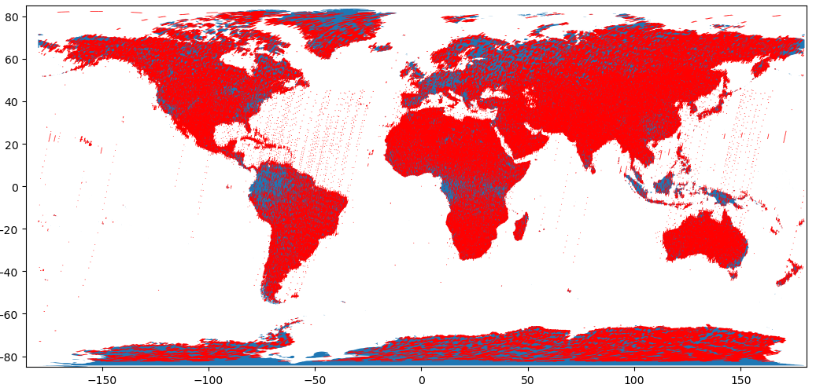
Archive
Archive contains 346774 images

Slide 7
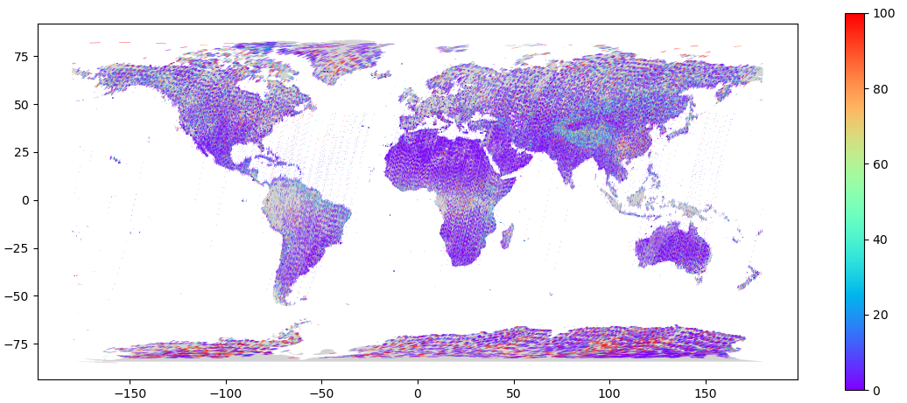
Archive quality (cloudiness)
Cloudiness Level | Percentage of Products
0%-1% | 49,7%
1%-20% | 25,7%
20%-30% | 4,8%
30%-40% | 3,5%
40%-50% | 2,8%
50%-60% | 2,3%
60%-70% | 2,0%
70%-80% | 2,0%
80%-90% | 2,1%
90%-100% | 5,0%
49.7% of the entire content of the archive has a cloudiness < 1%
13.4% of the entire content of the archive has a cloudiness >50%

Slide 8
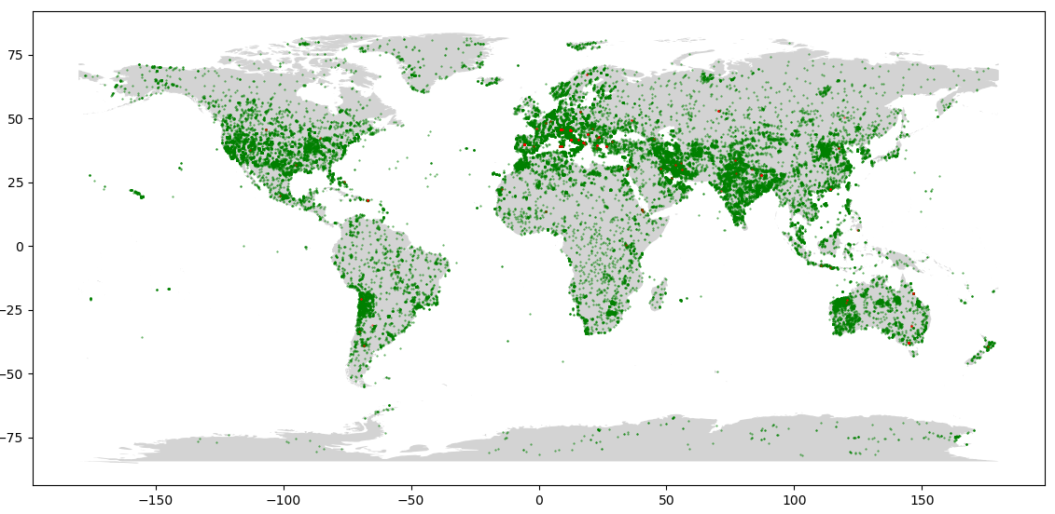
Orders from catalogue
Largest part of user orders is based on requesting production from the catalogue (i.e. historical data acquisitions), thanks to the archive good coverage and low cloudiness.

Slide 9
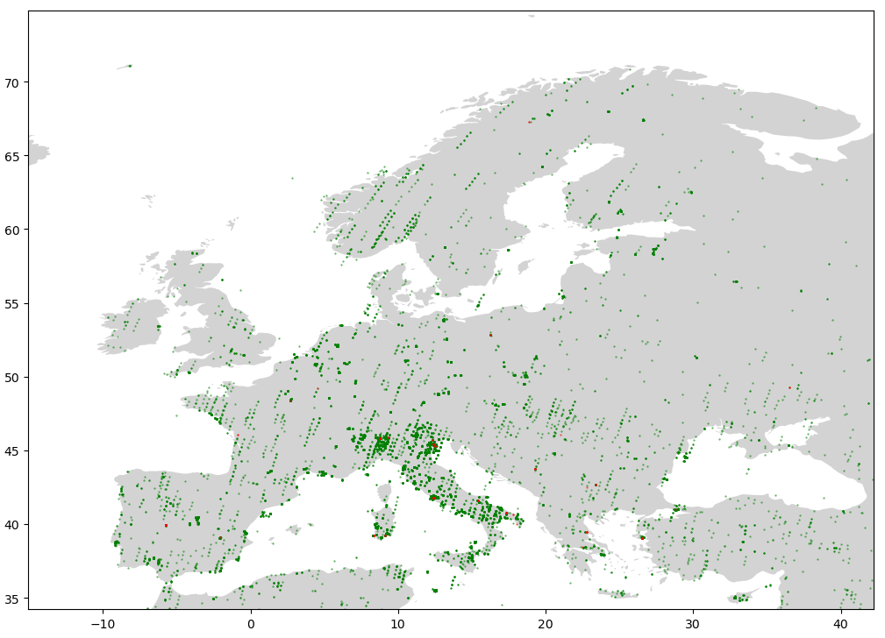
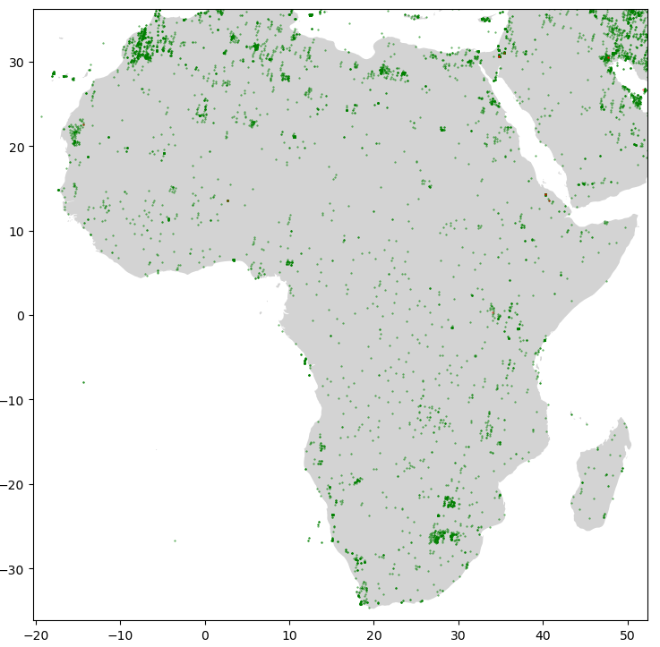
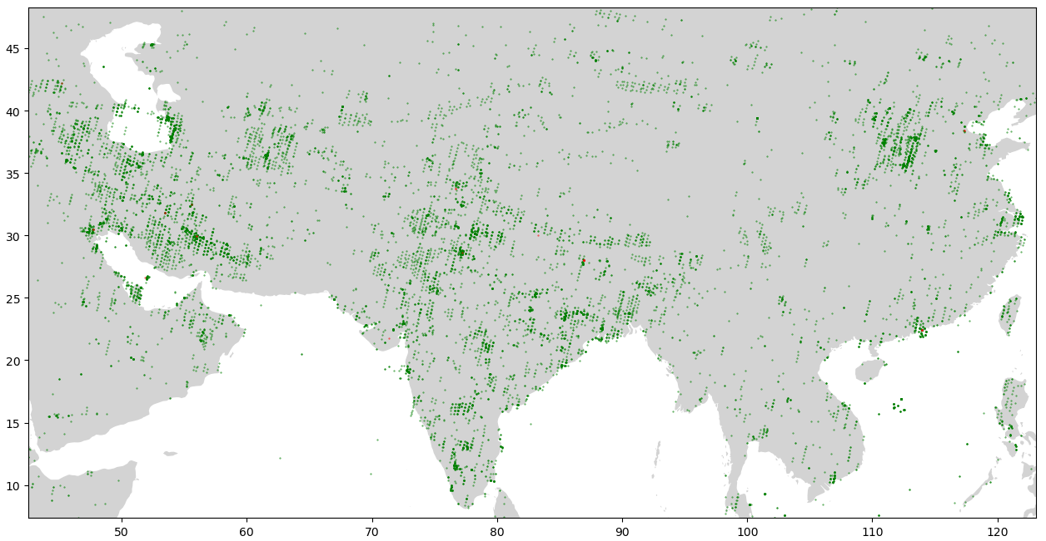
Orders from catalogue
Hydrocarburs exploration (Kuwait)
ASI PRISMA Scienza projects

Slide 10
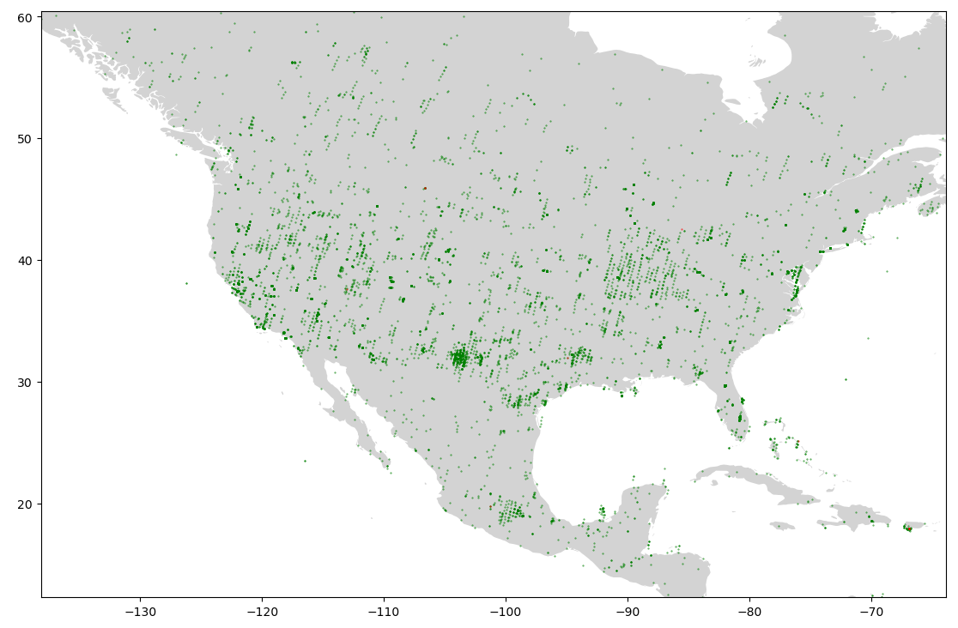
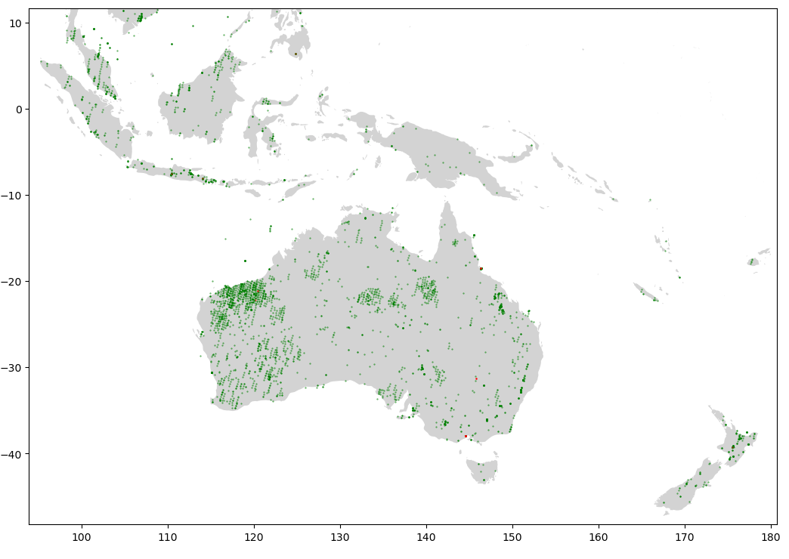
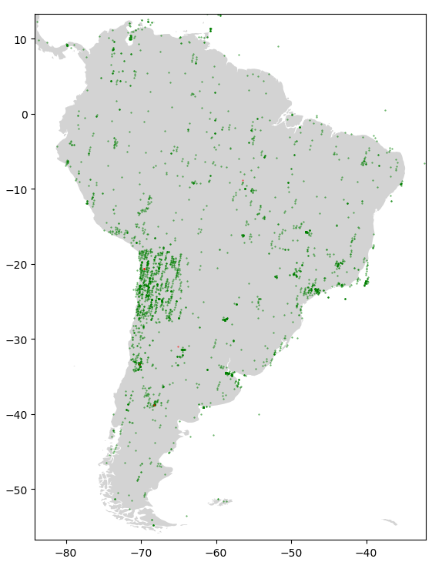
Orders from catalogue
Methane detection exp. (Texas)
CSIRO mineral mapping demonstration over Australia
Remote sensing projects (Chile)

Slide 11
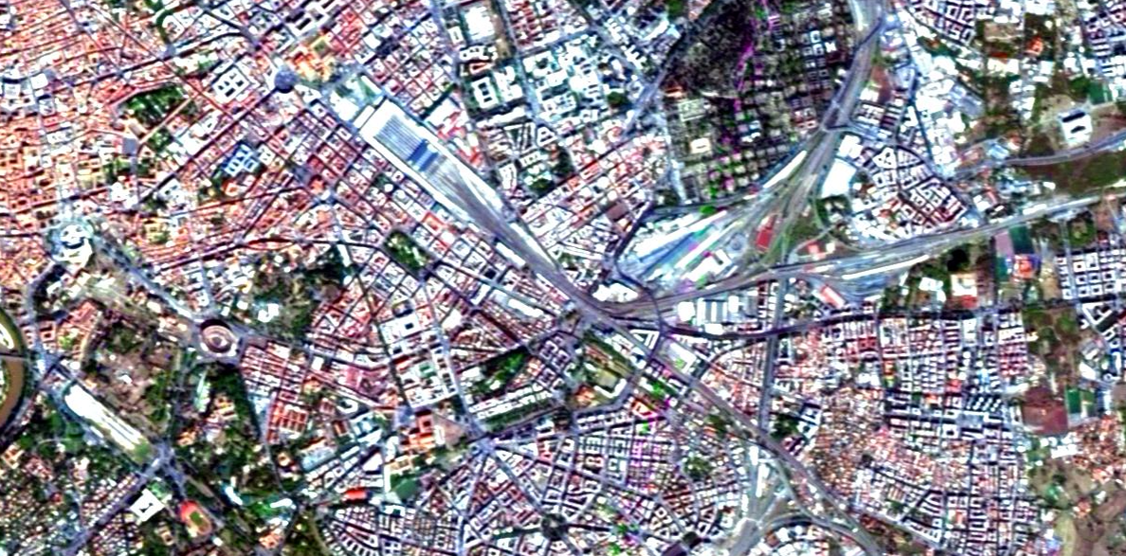
Image of Rome, acquired on 10 Sept 2024, pansharpened
(crop)
portal:
https://prisma.asi.it
Info, contacts, inquiries:
prisma_missionmanagement@asi.it

Slide 12
Thank You
Agenzia Spaziale Italiana
Centro di Geodesia Spaziale “Giuseppe Colombo”
Matera, Italy

