Slide 1
FLEX Mission Status
Marco Celesti, Ralf Bock, Matthias Drusch, Jose Moreno
On behalf of the FLEX team

Slide 2
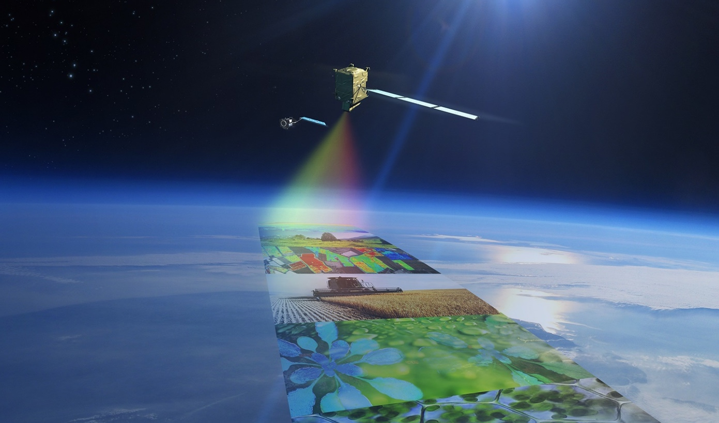
FLuorescence EXplorer (FLEX) Mission
Mission Objective
By retrieval of full-spectrum vegetation fluorescence and NPQ-related products, FLEX is aimed at
quantifying actual photosynthetic activity of terrestrial ecosystems
providing physiological indicators for vegetation health status

Slide 3
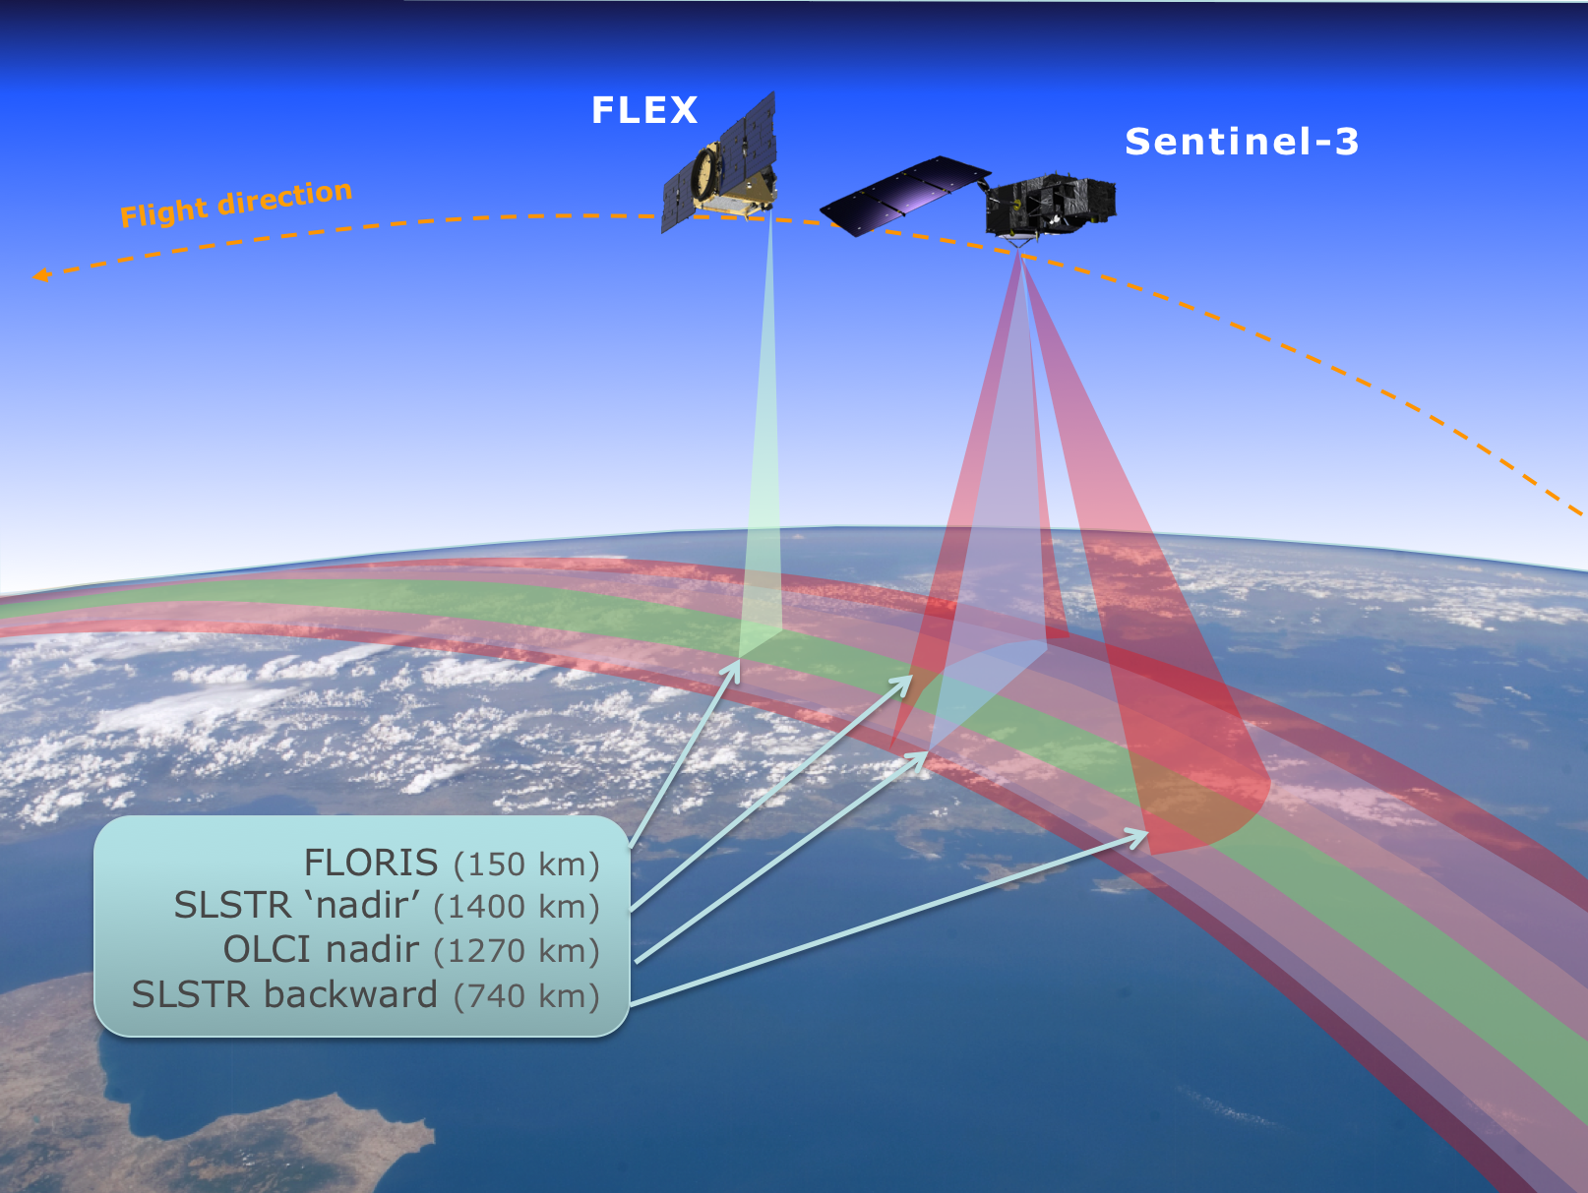
FLEX – Sentinel 3 Tandem Flight
FLEX will fly in tandem with Sentinel-3 for characterisation of the atmospheric state (cloudiness, aerosols, and atmospheric water vapour) and land surface characteristics (land cover type, biophysical parameters and surface temperature)
Large uncertainties due to moving clouds and changes in the atmospheric state ➔ temporal co-registration within 6s to 15s is required.
Status:
Orbit Control Startegy defined with ESTEC and ESOC experts.
Analyses and simulations confirm a passive-safe convoy flight.

Slide 4
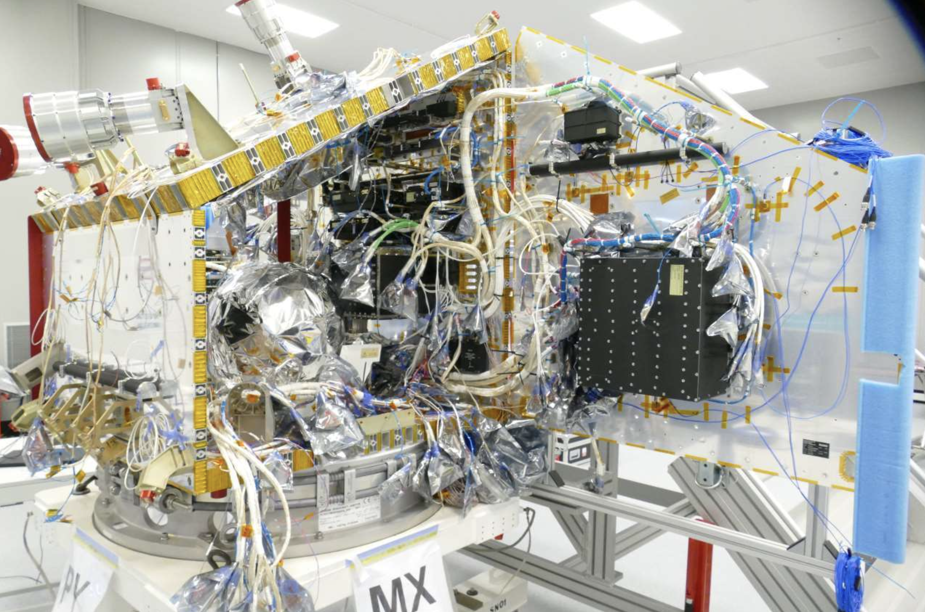
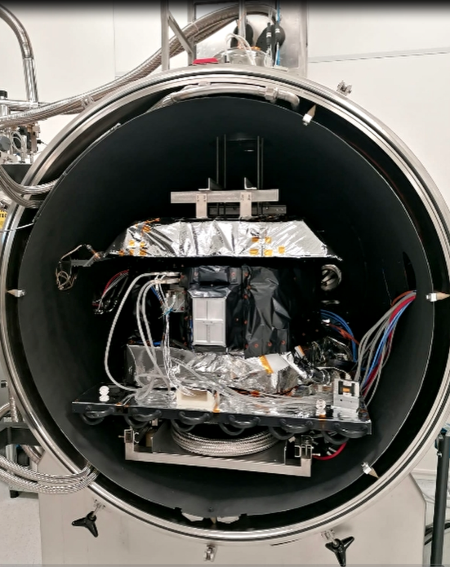
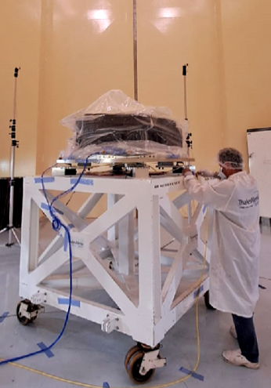
FLEX Mission Status
Platform Integration completed and in storage at TAS Belfast.
Ready to receive FLORIS integration and start Satellite Assembly.
FLORIS flight model assembly completed in May 2024.
Calibration Campaign February-April 2025.
Shipment to TAS for Satellite Integration in May 2025.
Data Innovation and Science Cluster (DISC) activities are ongoing (Level-2 products development and implementation, cal/val preparation, etc.)
Official launch slot has moved to 2027, but with the satellite and GS ready by mid-2026 there could be an opportunity to launch still in 2026.

Slide 5
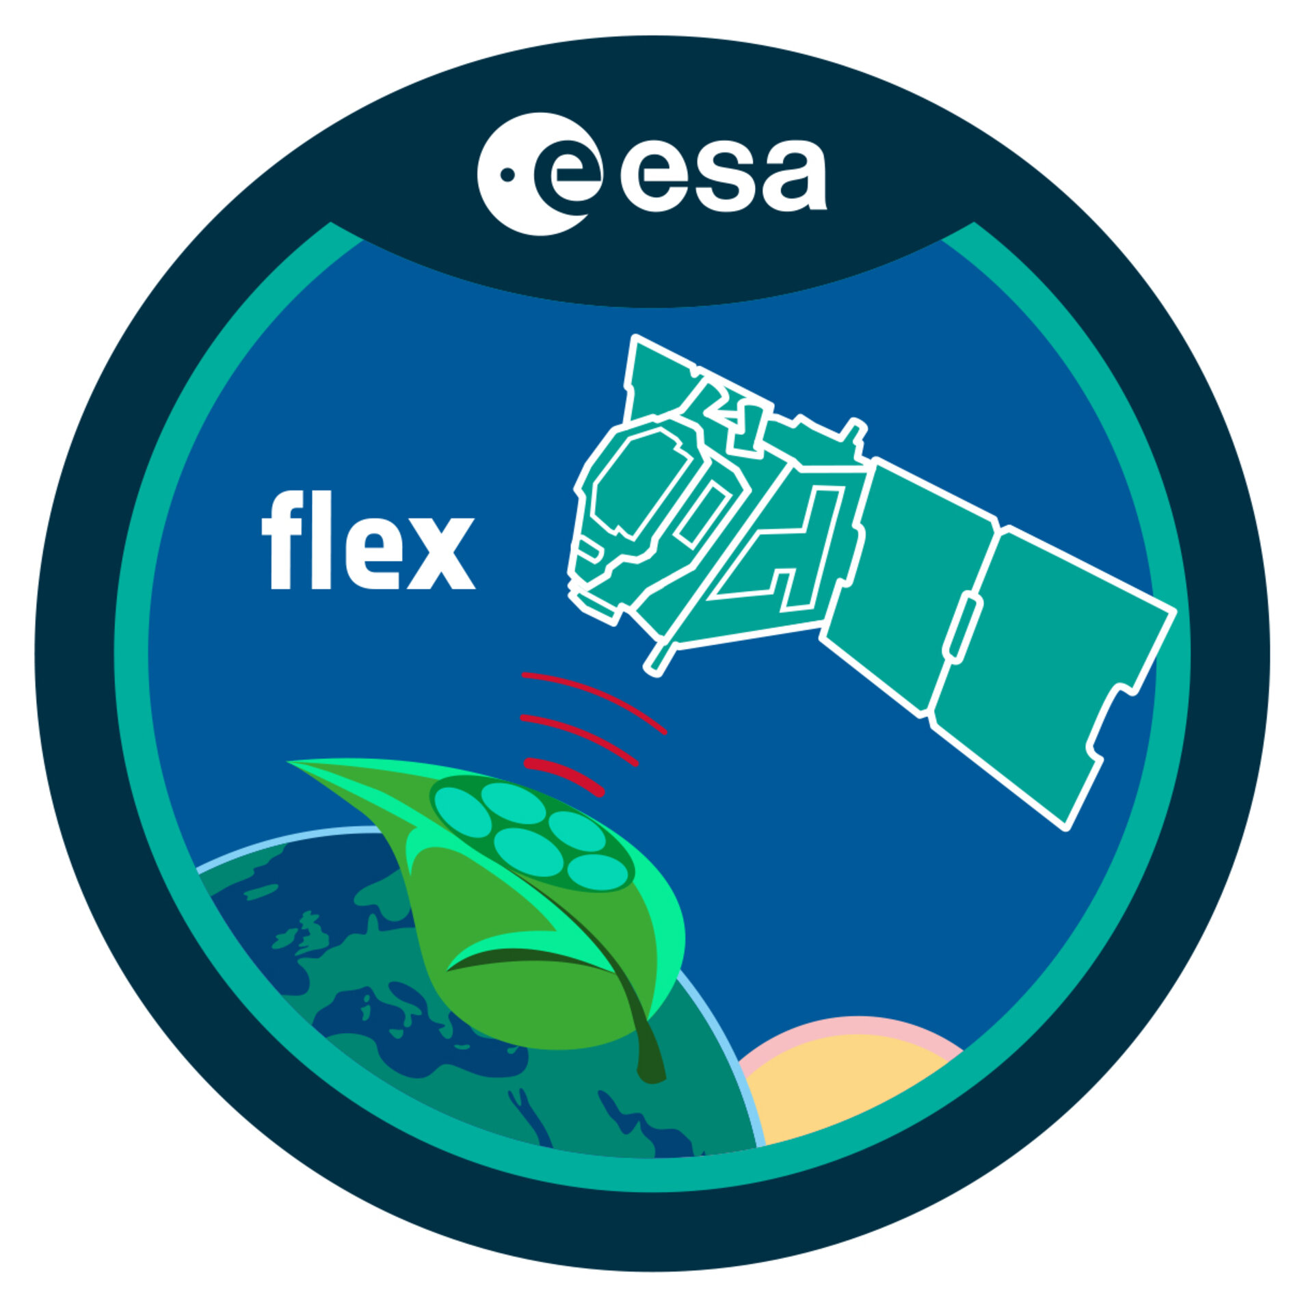


Thank you for your attention !
https://www.esa.int/Applications/Observing_the_Earth/FutureEO/FLEX

Slide 6
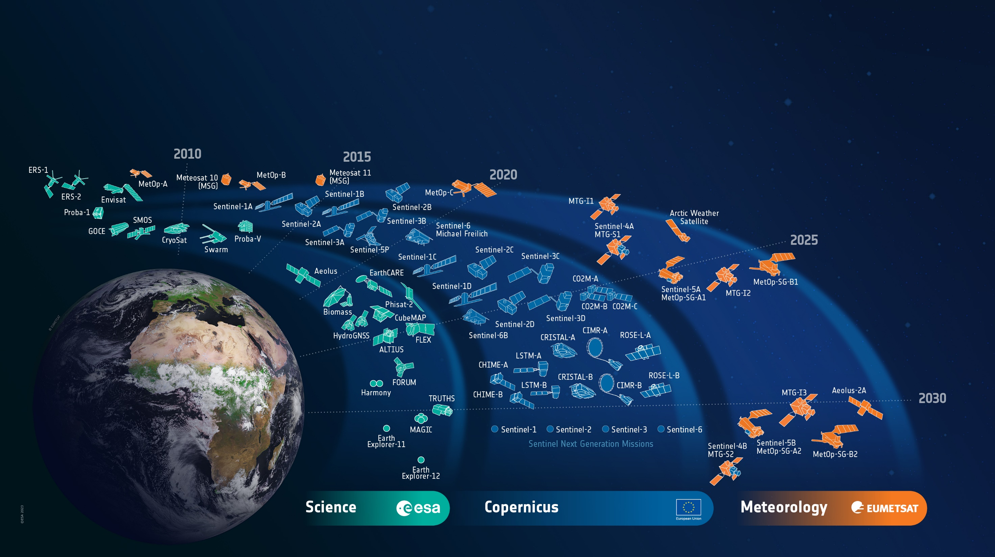
ESA’s Earth Observation Missions
Notes:
D/EOP has three main lines of activities: Earth Science – Copernicus – Meteorology
Meteorology => focussed on meteorological operational observation. In cooperation with Eumetsat. MeteoSat (TG) and MetOP (SG)
Copernicus is the largest producer of EO data in the world. Providing data for several operational services: Land, Atmosphere, Ocean, Climate, Disaster, Security. Copernicus Evolution with 6 new missions. Sentinel Next Generation.
Earth Science => Science driven programme. Explore new measurement techniques. Addressing specific scientific aspects that might become operational missions later on.
FLEX will fly in tandem with one of the Sentinel-3 satellites. As it looks now this will be S3C which will be launched few months prior to FLEX.

Slide 7

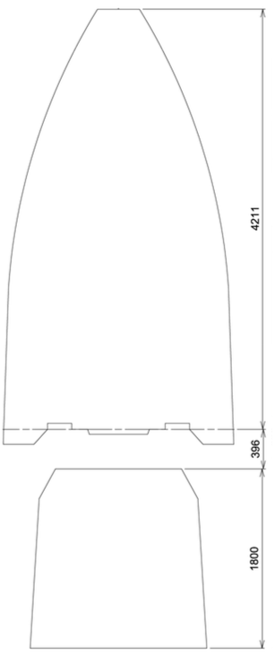
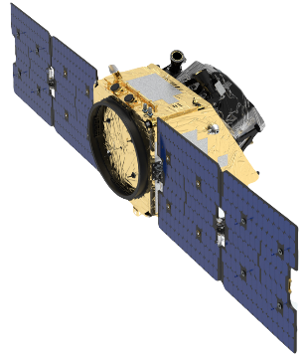
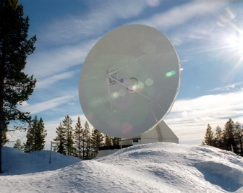
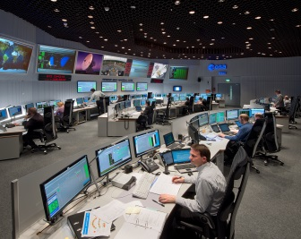
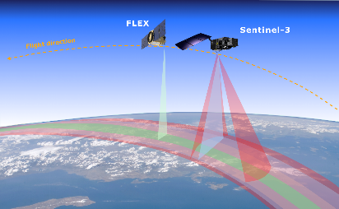
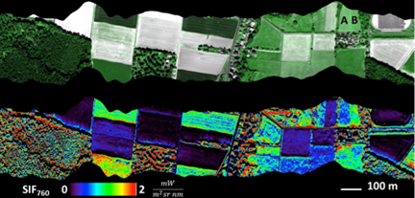
FLEX Mission Architecture
Space segment
Ground segment
Launcher
Spacecraft
Flight Operations Segment
Recurring platform
Instrument: imaging spectrometer
Lifetime: 3,5 (5) years
TT&C S-band station
(Kiruna)
ESOC
Vega-C, VESPA+/SSMS
Payload Data Ground Segment
Orbit
Sun-synchronous at 815 km
LTDN 10:00, in convoy and
6-15 seconds ahead of Sentinel-3
27 days repeat cycle
Coverage: 56°S to 75°N
X-band science data acquisition station (eg. Svalbard)
Processing and archiving element (ESRIN)
User segment
Chlorophyll fluorescence products for scientists, research centres and environmental services to study variations of actual photosynthesis, vegetation health status, and carbon uptake
Auxiliary data:
OLCI and SLSTR data (Sentinel-3)
ECMWF, DEM sources…

Slide 8
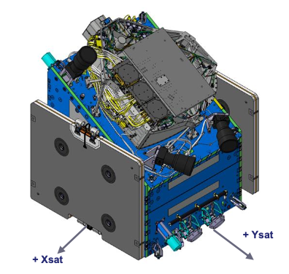
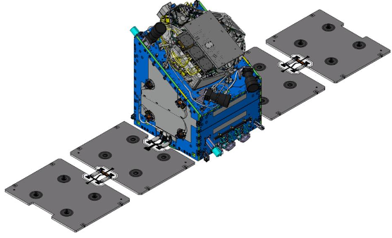
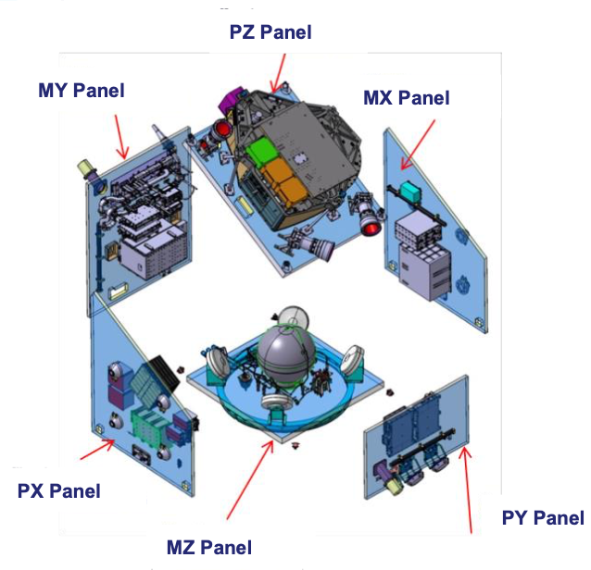
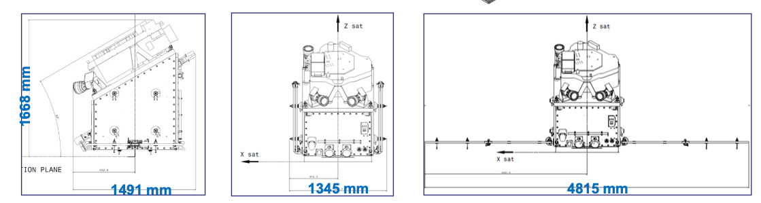
FLEX Satelite Overview
FLORIS Instrument
Satellite Platform
Stowed and deployed configuration

Slide 9
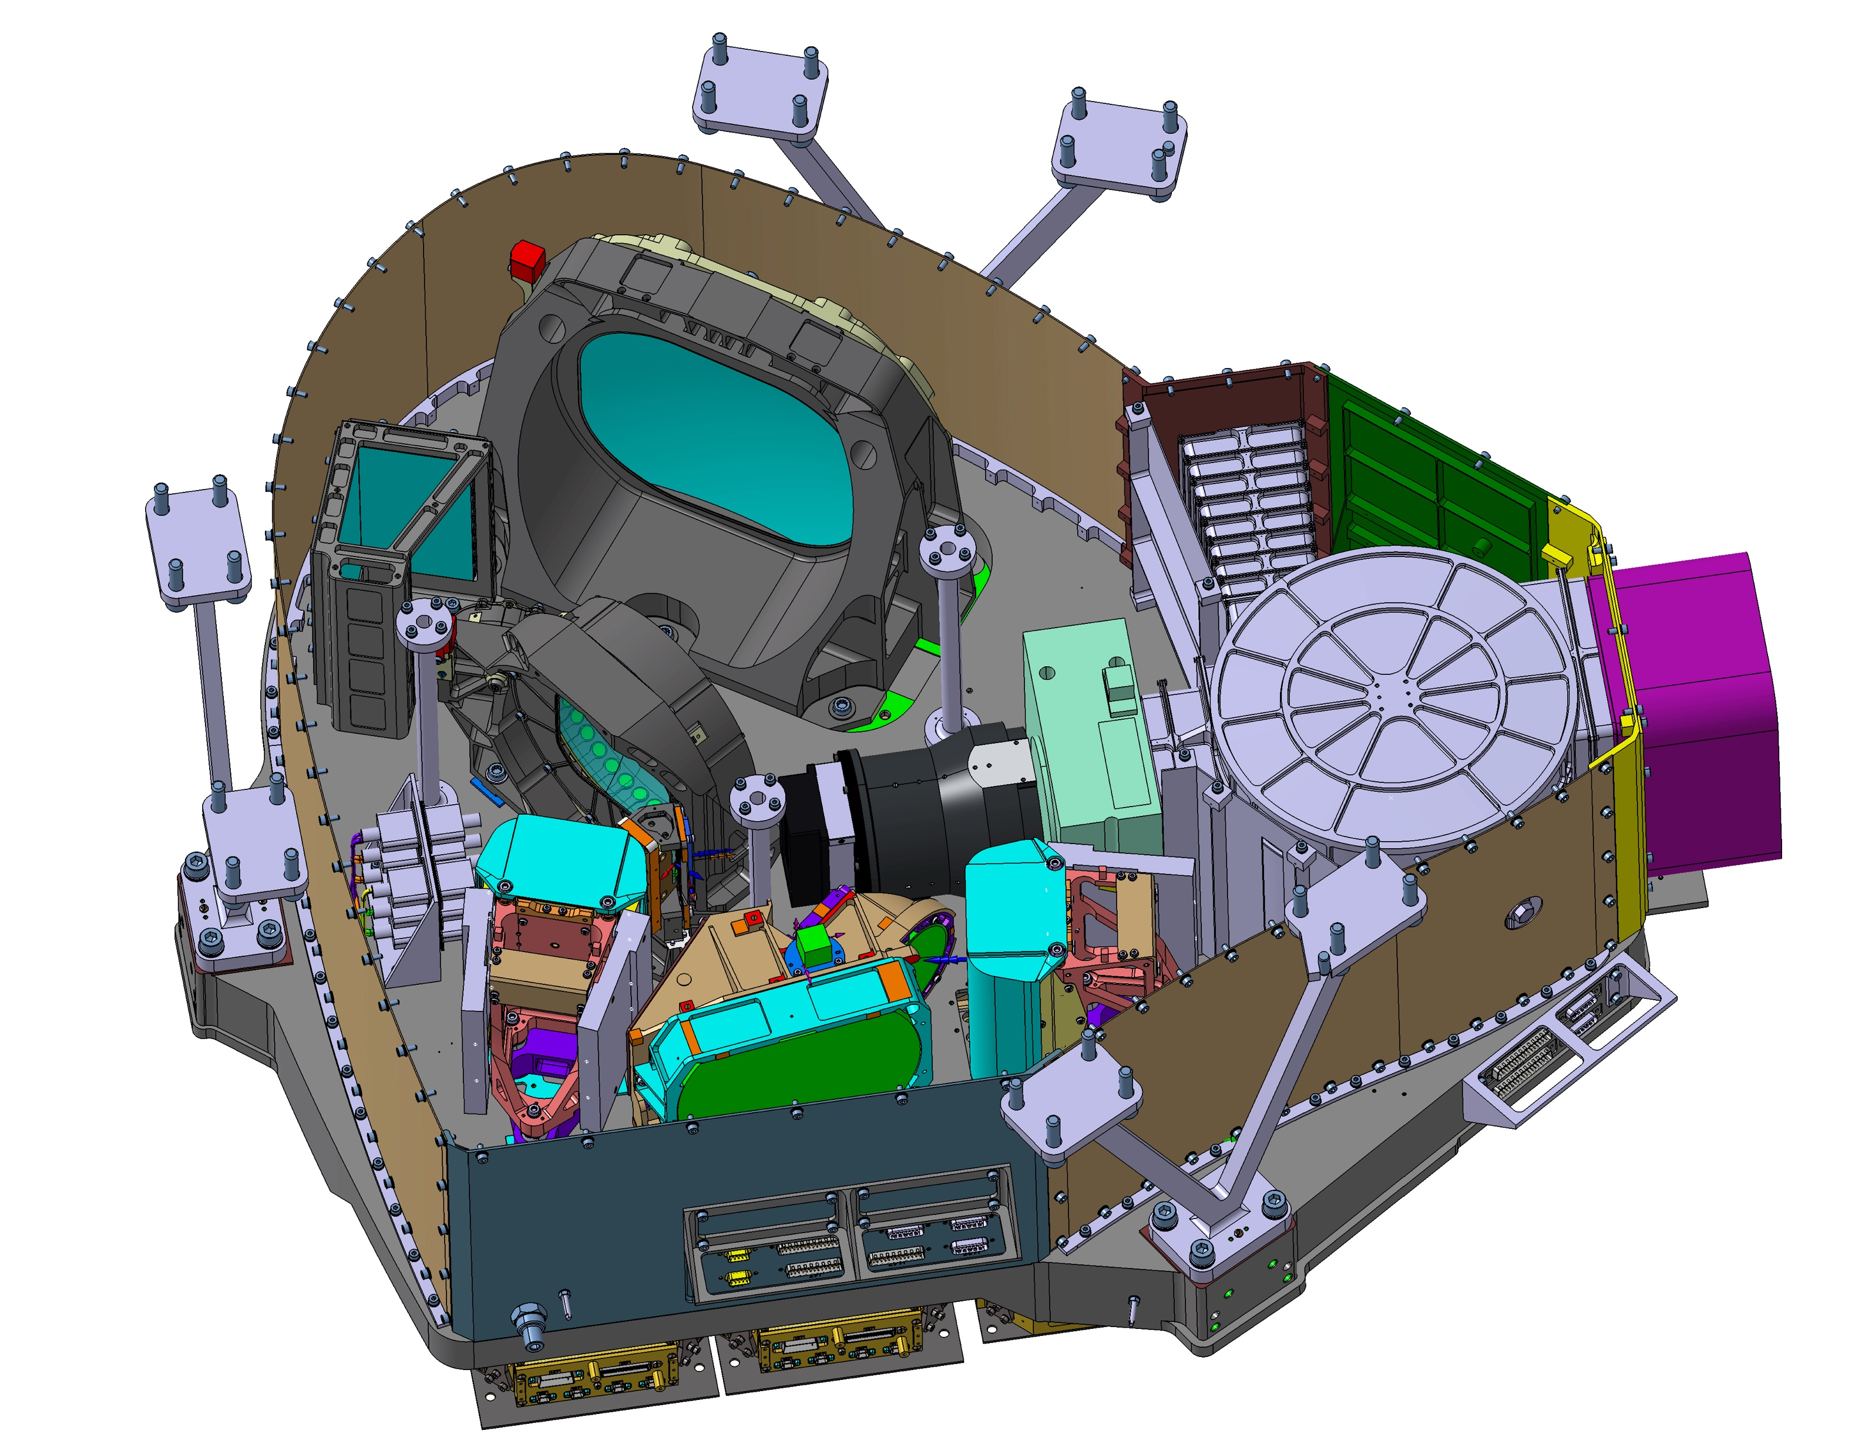


FLORIS Instrument Subsystems Overview
HR Spectrometer Mirror
Bipods to mount on platform structure
Light Trap
Sun port / baffle
HR Spectrometer Lens
& Grating
Calibration Unit
Earth Nadir Port / baffle
Slit Assembly
Focal Plane System (HR)
Polarisation Scrambler
Low Resolution Spectrometer
Telescope
Focal Plane System (LR)
Video Acquisition Units
Instrument Optical Module structure / optical bench
= integrated on optical bench (status Sept. 2023)

Slide 10
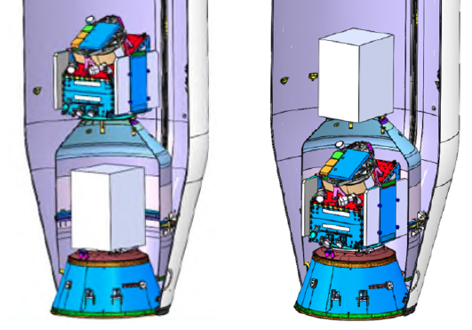
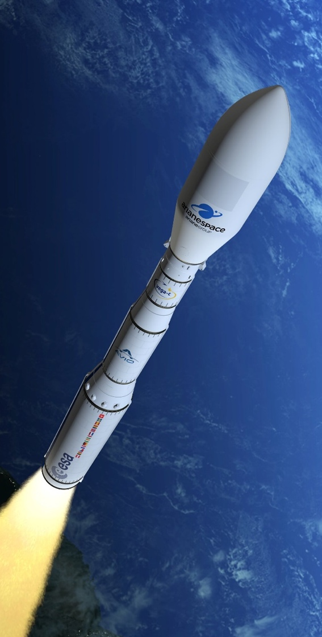
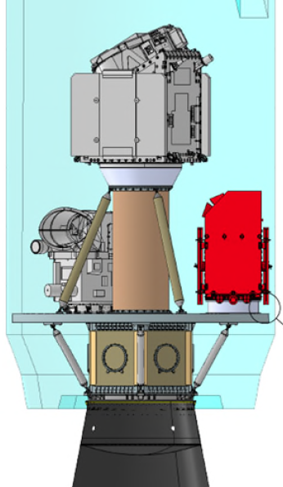
Launcher status
FLEX has been designed to be compatible with a Vega-C launcher
A feasibility study has been performed,
showing compatibility with Vega-C and VESPA+
FLEX fits inside or on top of VESPA+ adapter
Feasibility study to launch on SSMS adapter is ongoing
  Launch Service Contract with Arianespace signed for a dual Launch FLEX + Altius
  Vega-C launch slot for FLEX is summer 2026; TBC pending failure recovery and return to flight.
  VESPA = VEga Secondary Passenger Adapter
  SSMS = Small Spacecraft Mission Service
FLEX
Altius

Slide 11
Milestones and Outlook
Major Project Development Milestones
Satellite Activties Outlook
FLORIS Instrument Development Kick-Off Sept-2016
Mission System Requirements Review (M-SRR) Nov-2016
Instrument Requirements Review (IRR) May-2017
Instrument Preliminary Design Review (PDR) Sept 2018
Start of Instrument C/D phase & S/C Prime Dec-2018
Satellite Preliminary Design Review (PDR) Dec-2019
Instrument and Satellite Critical Design Review (CDR) Mar-2022
Science Readiness Assessment (SRA) April-2023
Start of Platform Assembly, Integration & Test Oct-2023
Mission Critical Design Review (M-CDR) June-2024
Instrument delivery for satellite assembly Jan-2025
Satellite Qualification and Acceptance Review (QAR) Nov-2025
Launch mid-2026 TBC
2024
Instrument testing and calibration campaign
Platform integration and testing completed
Conduct Launcher Review
Start DISC activity
FLEX4WaterApplications
Announcement of Opportunity for Cal/Val
2025
Mount FLORIS on satellite platform
Satellite qualification test campaign
Rehearsal Campaign
FLEX Space Segment ready for launch in 2026

Slide 12
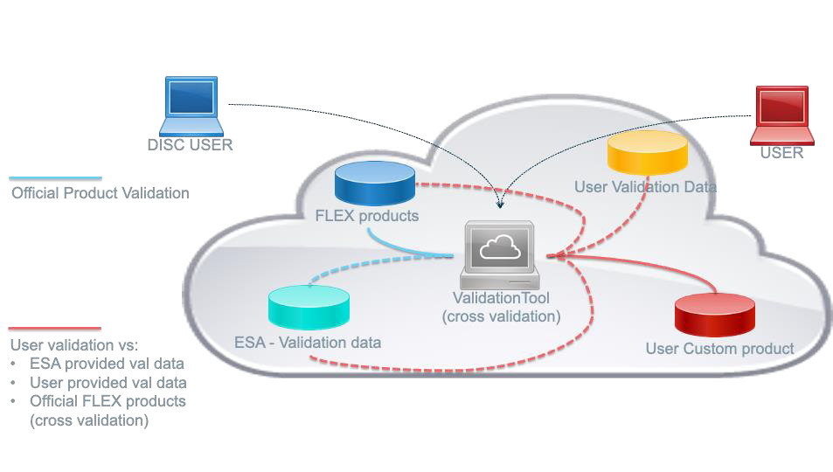
DISC
The mission data quality manager will be supported by a team of external experts in a contractual framework: the Data Innovation and Science Cluster (DISC).
The FLEX DISC will implement the ground segment activities related to:
Instrument calibration and performance monitoring
Scientific processors facility (development, integration,
and maintenance of the L2 processing facility, maintenance
of the L1B processing facility, processors evolution, etc.)
Calibration/validation activities
Development and generation of experimental L2 and L3
(or beyond) products

Slide 13
Data Products (= Geophys. Parameters) …
22 L1C products (7 products suggested)
16 L2A products (14 products suggested)
11 L2B products (11 products suggested)
18 L2C products (TBC)
TOTAL:
59 internal products generated in FLORIS HR focal-plane geometry
50 final products generated in UTM ground projection
NOTE: uncertainty layers to be added

Slide 14
Suggested list of products (by the MAG)
L1C
L2A
L2C
L2B

