Slide 1
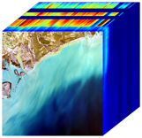
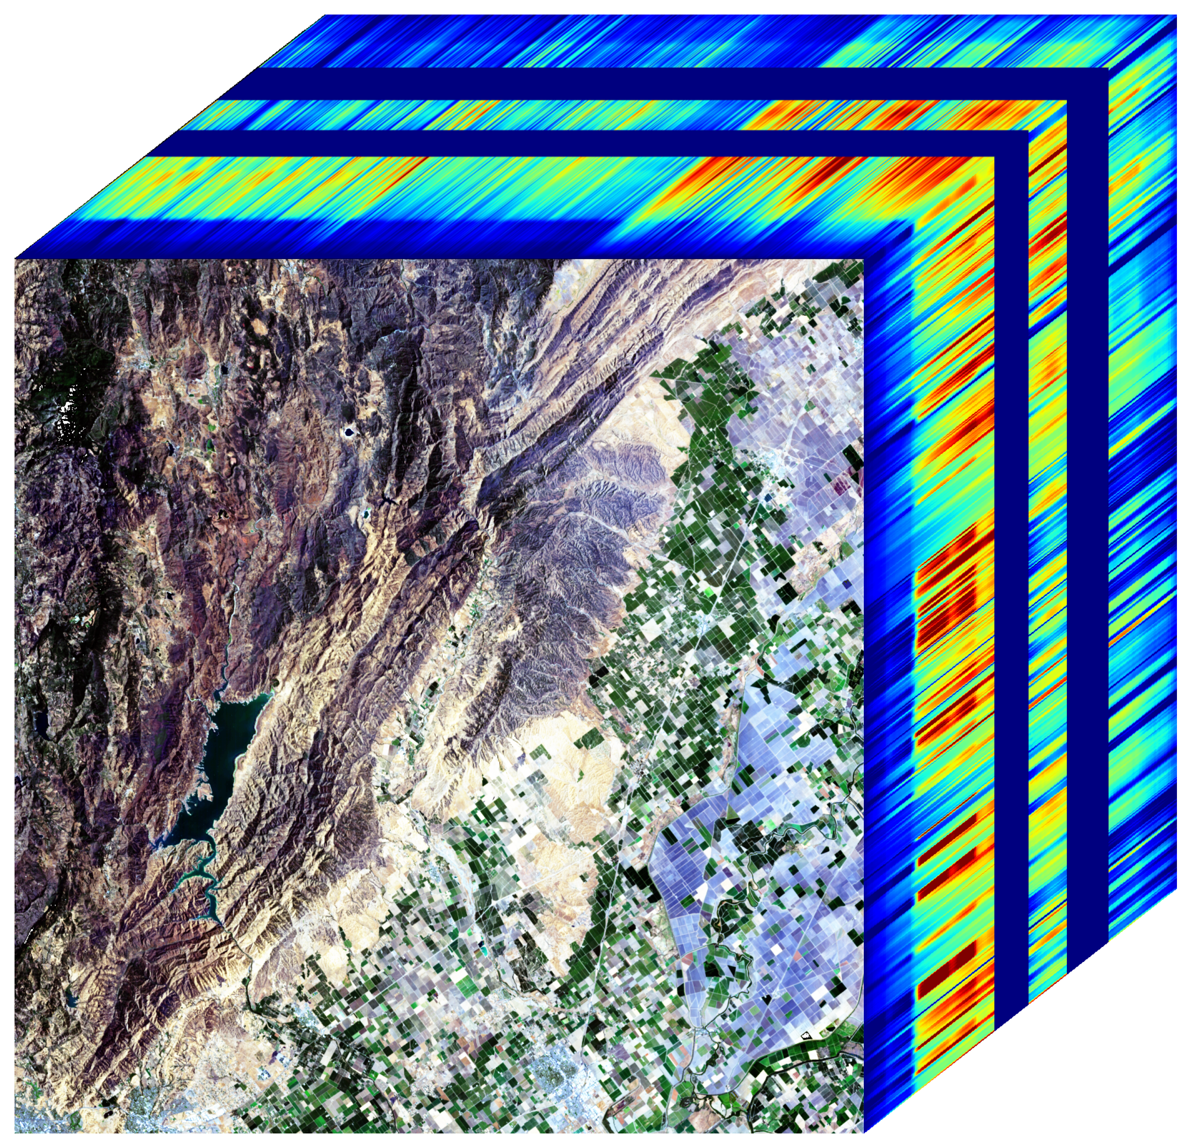
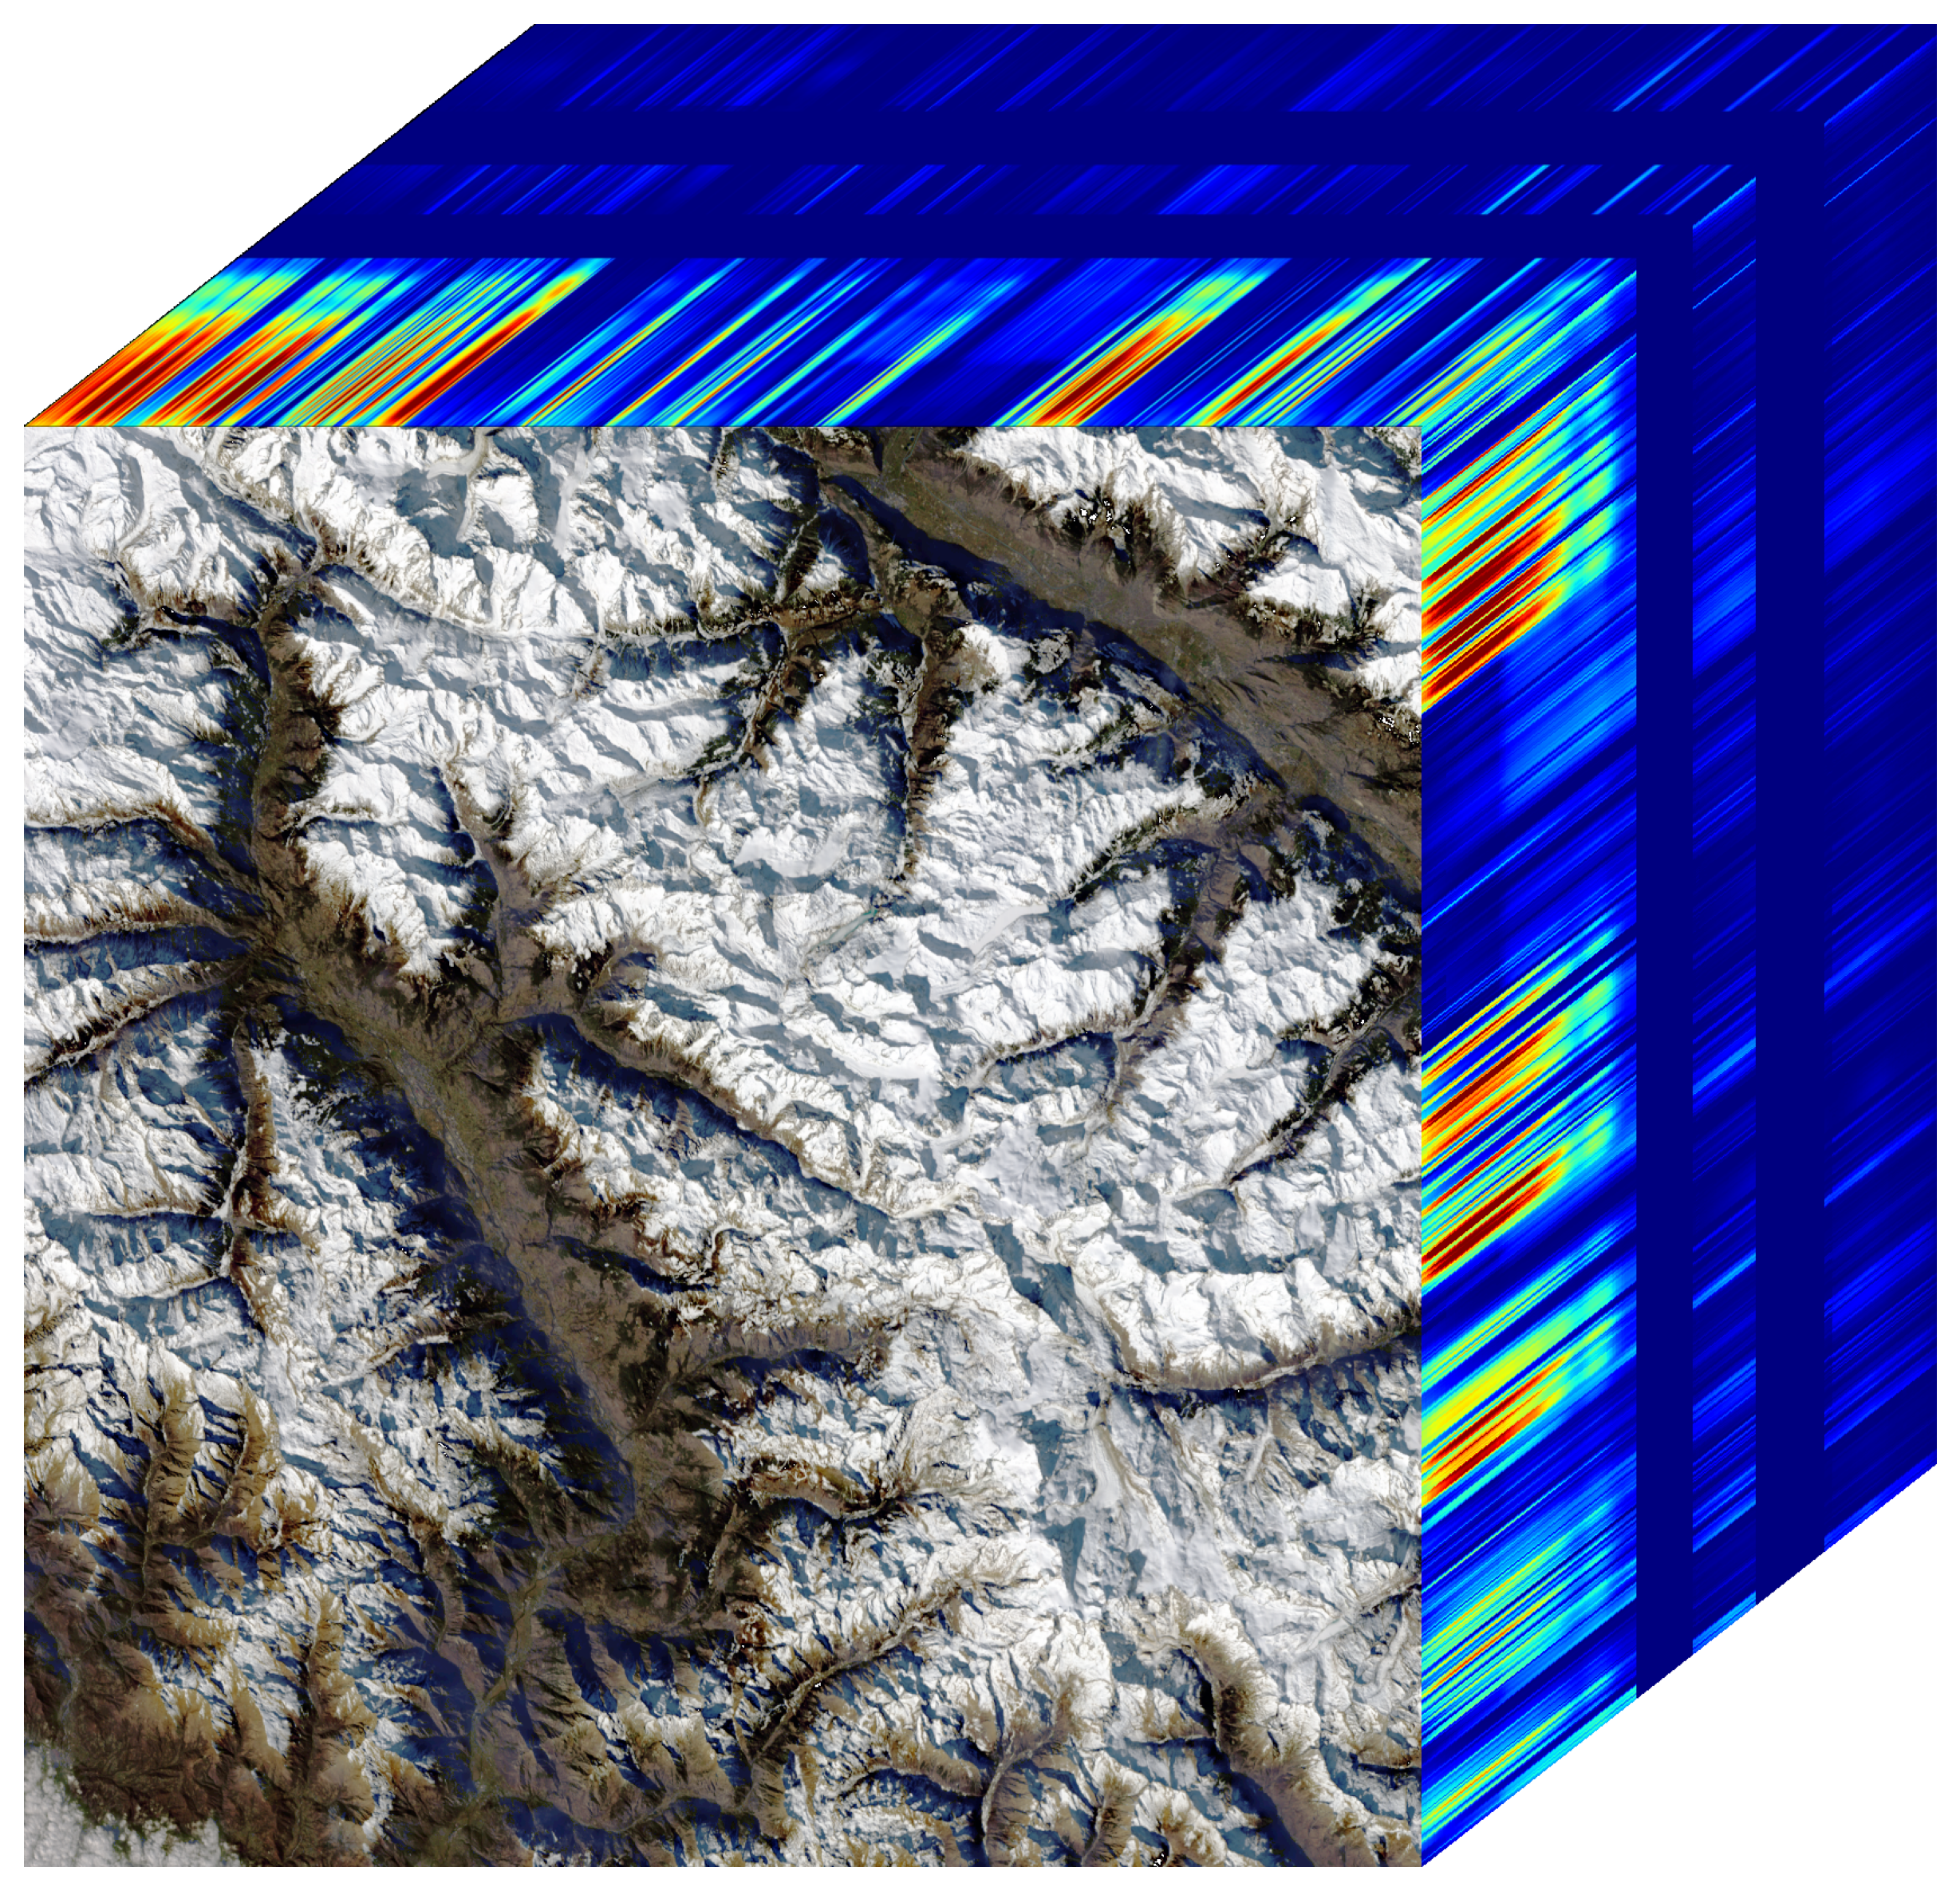
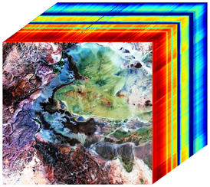
SBG VSWIR Imaging Spectroscopy Addresses Key Identified Decadal Survey Objectives
ECOSYSTEMS AND NATURAL RESOURCES
E-1. What are the structure, function, and biodiversity of Earth’s ecosystems, and how and why are they changing in time and space?
E-2. What are the fluxes of carbon, water, nutrients, and energy between ecosystems and the atmosphere, the ocean, and the solid Earth, and how and why are they changing?
E-3. Fluxes within ecosystems. What are the fluxes within ecosystems, and how and why are they changing?
SOLID EARTH
S-1. How can large-scale geological hazards be accurately forecast in a socially relevant time frame?
S-2. How do geological disasters directly impact the Earth system and society following an event?
HYDROLOGY
H-1. How is the water cycle changing?
H-2. How do anthropogenic changes in climate, land use, water use, and water storage, interact and modify the water and energy cycles locally, regionally and globally.
H-4. Hazards, extremes, and sea level rise. How does the water cycle interact with other Earth system processes to change the predictability and impacts of hazardous events.
CLIMATE
C-3. How large are the variations in the global carbon cycle and what are the associated climate and ecosystem impacts?
WEATHER
W-3. How do spatial variations in surface characteristics (influencing ocean and atmospheric dynamics, thermal inertia and water) modify transfer between domains?
Coastal and Aquatic Ecosystems
Terrestrial Ecosystems
Hydrology Snow and Water
Geology and Minerals

Slide 2
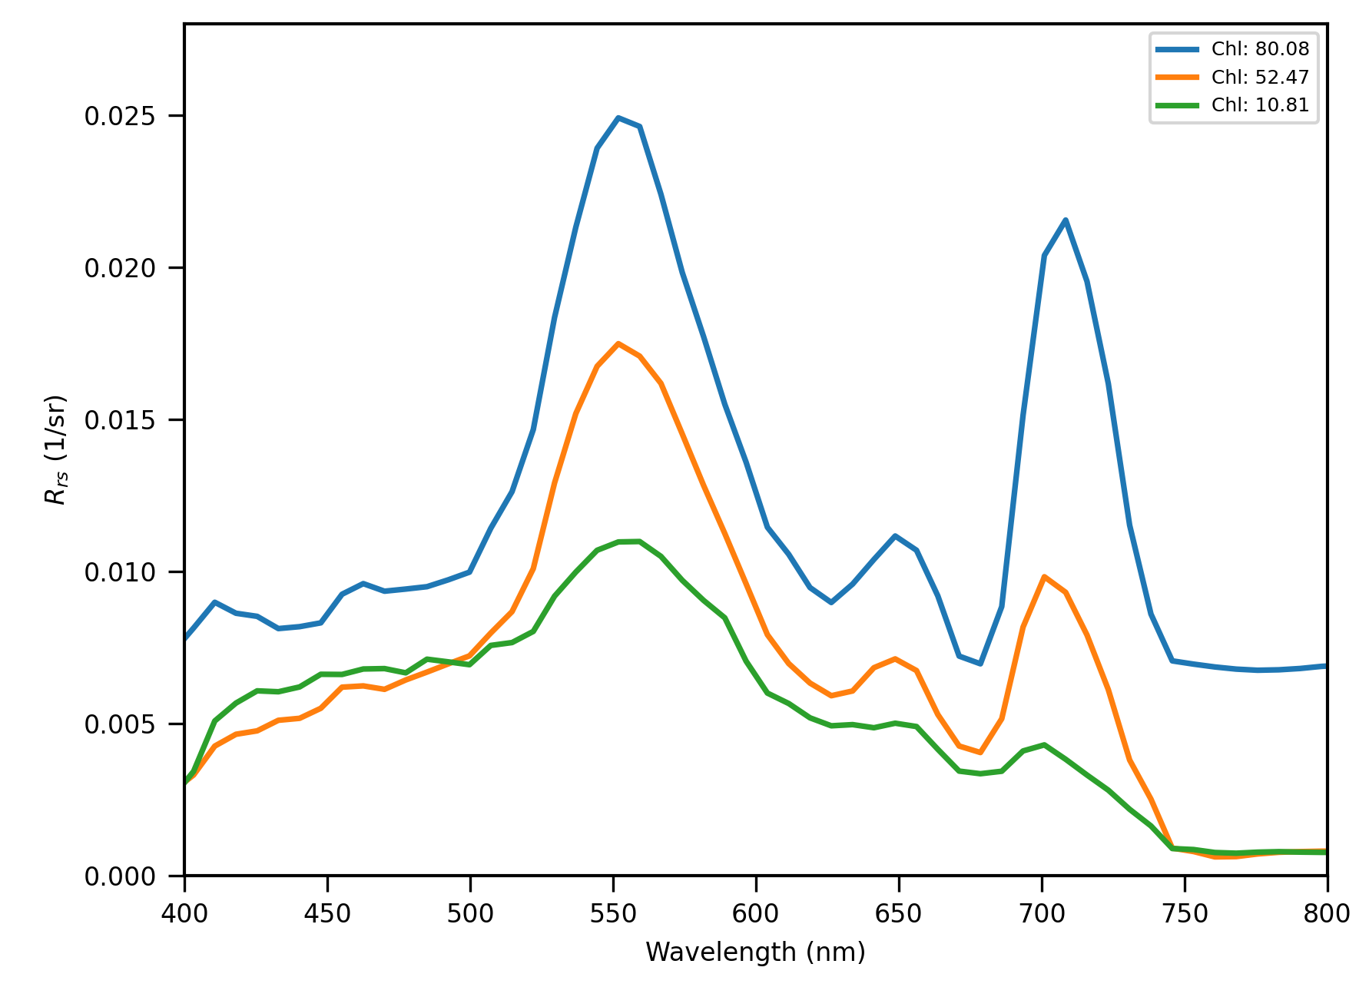
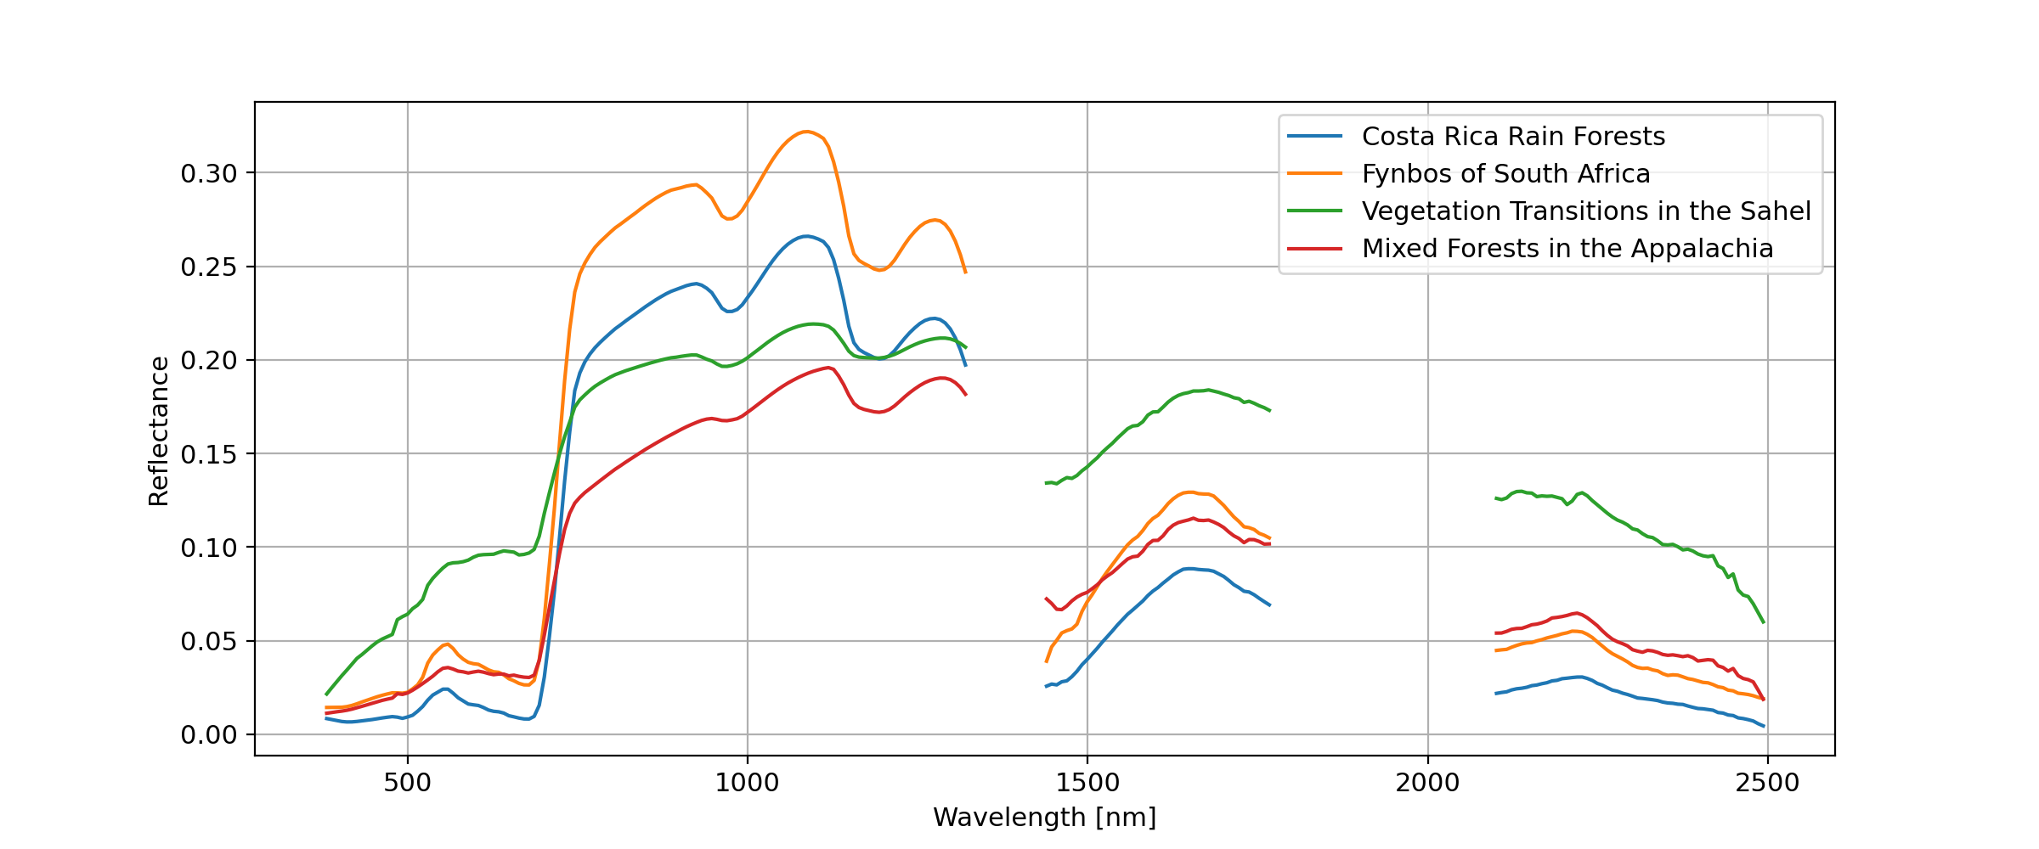
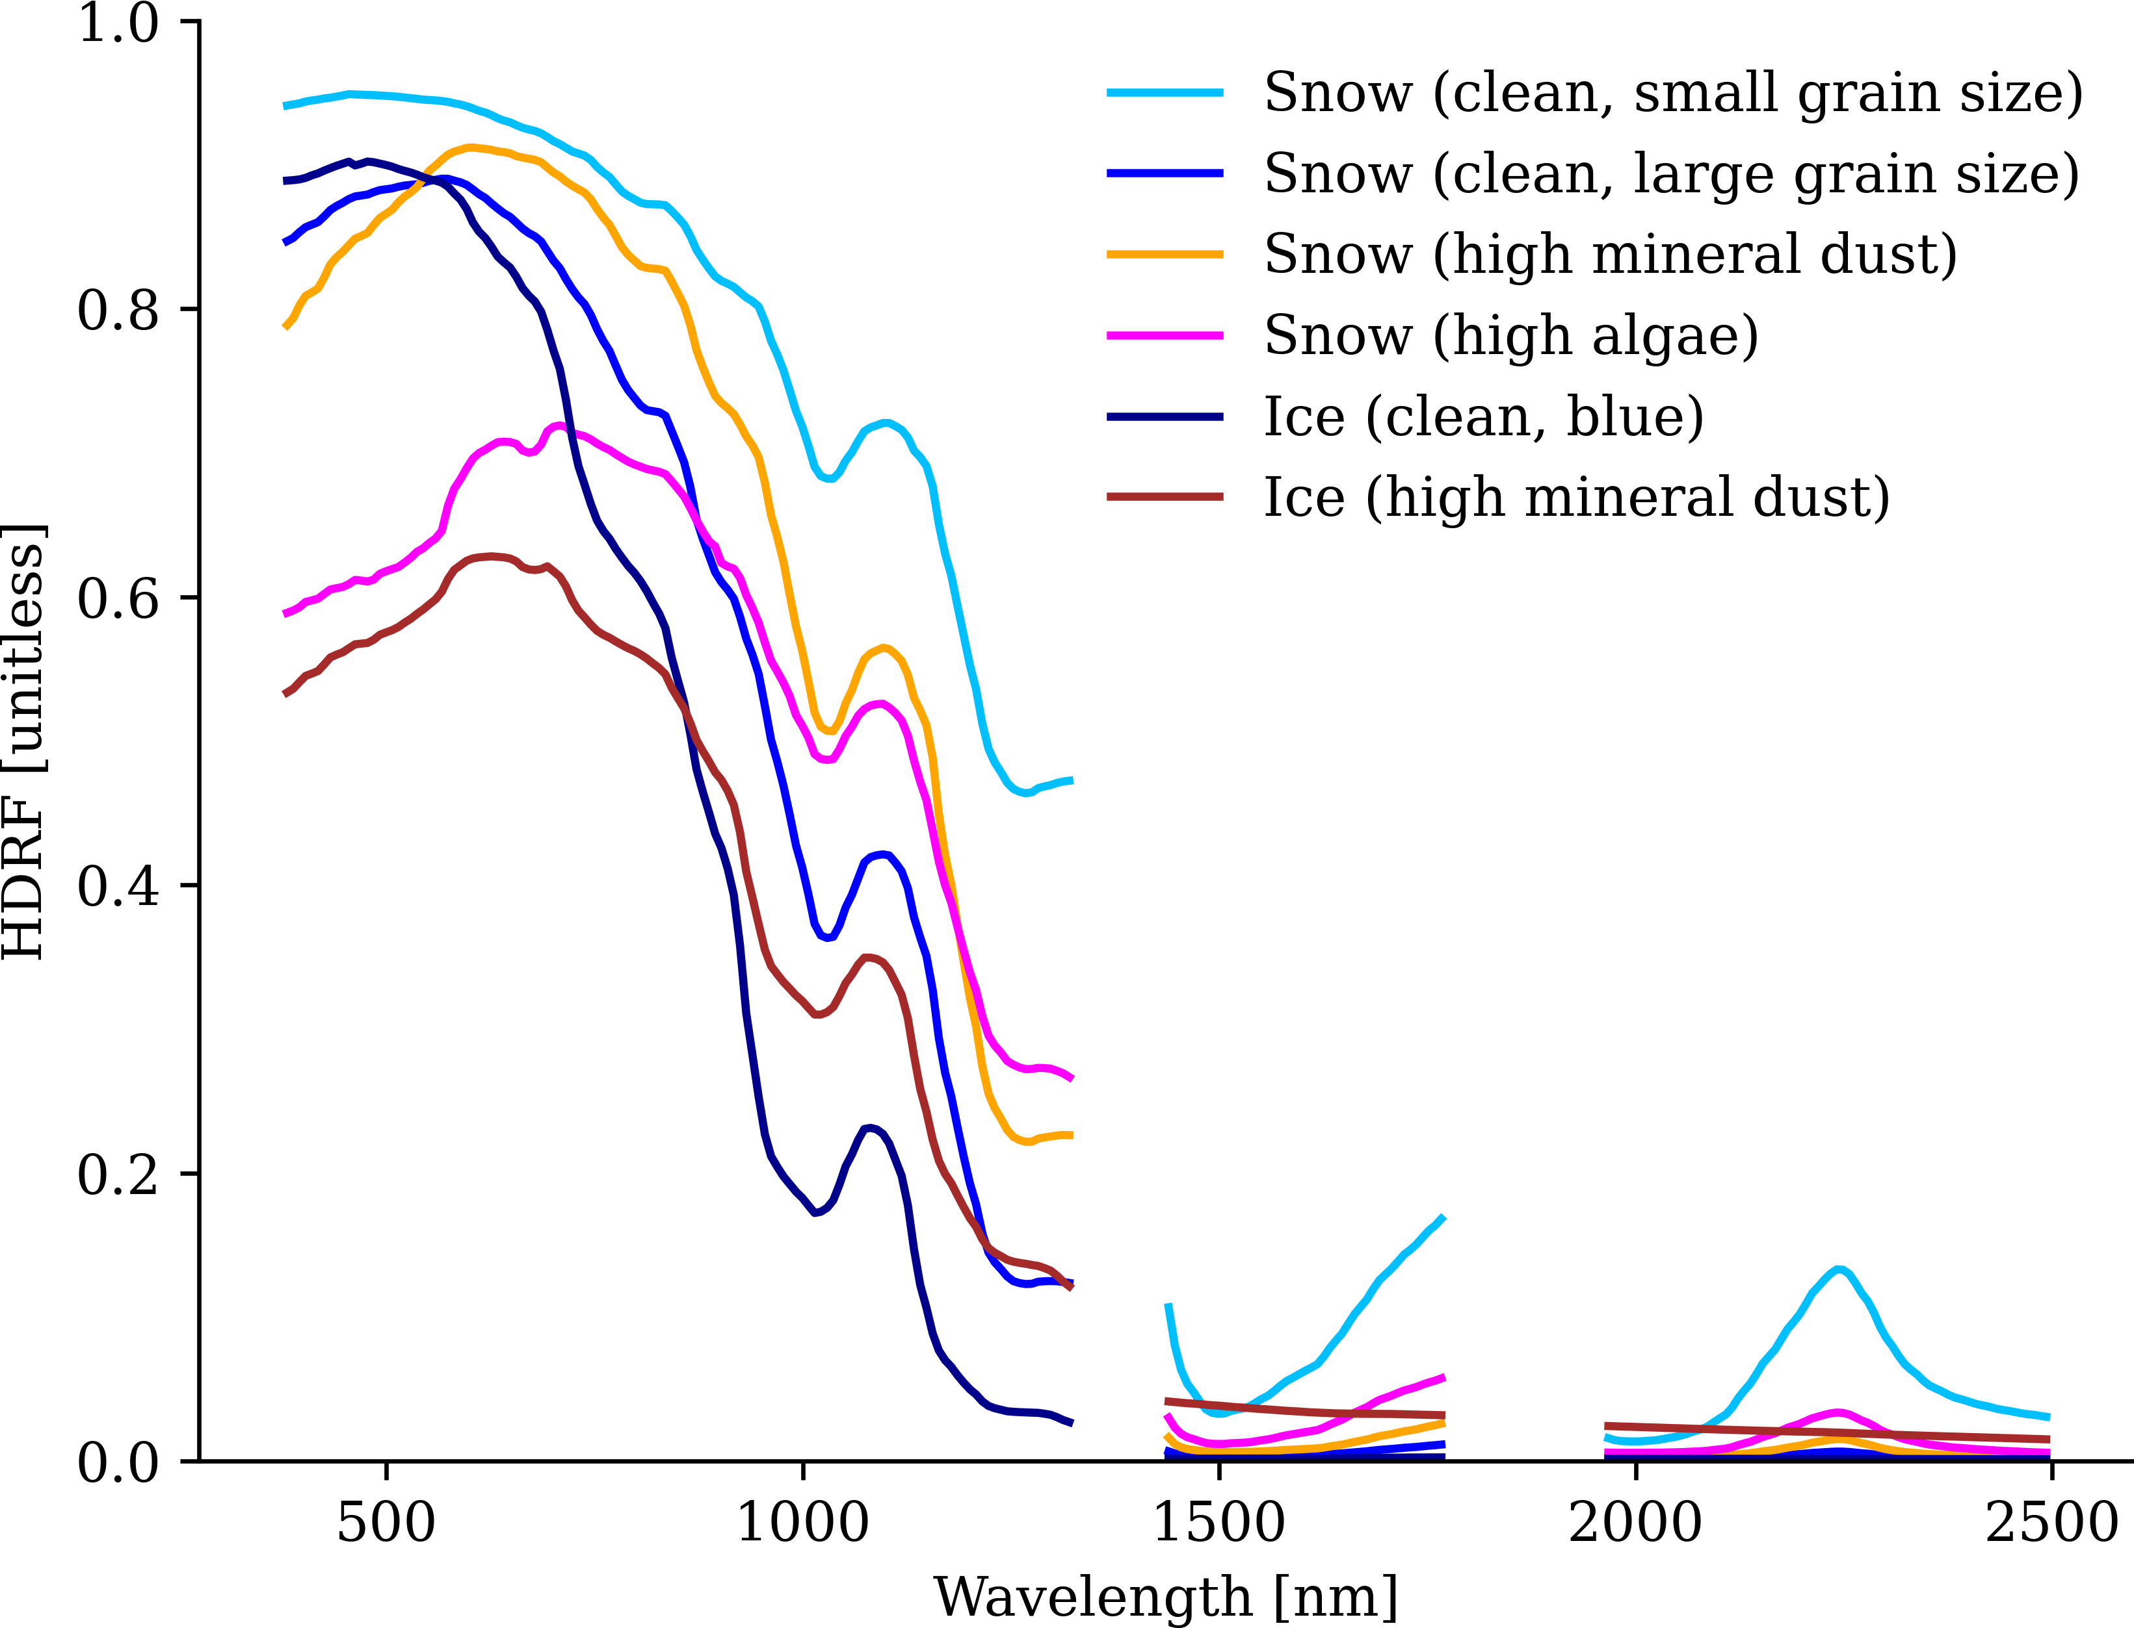
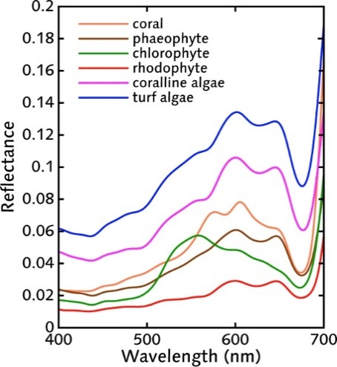
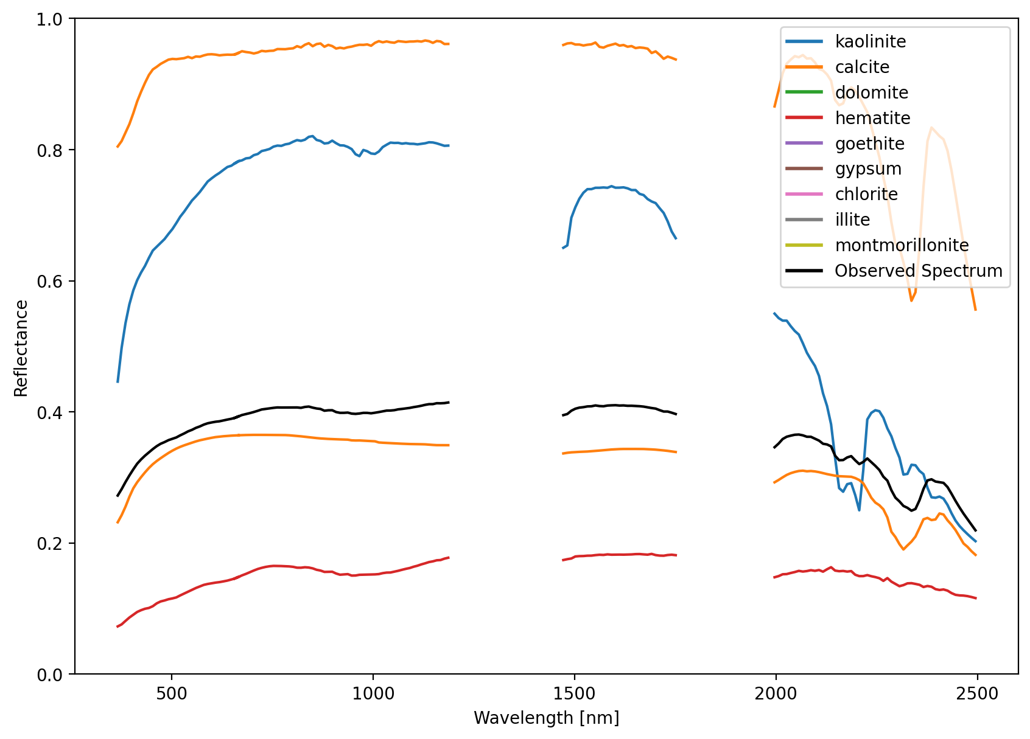
SBG-VSWIR Provides Measurements for Earth Action
SBG supports Earth Action themes and needs with full VSWIR imaging spectroscopy:
Food security and agriculture
Water quality
Health and air quality
Critical minerals
Greenhouse gas monitoring
Wildland fire risk & recovery
Coastal risk
Energy and infrastructure
Disasters and extreme events
Water resources
Biodiversity and Ecosystem change
Water Management
Ecosystem Conservation
Water Resources
Mineral Resources
Coral Reefs

Slide 3
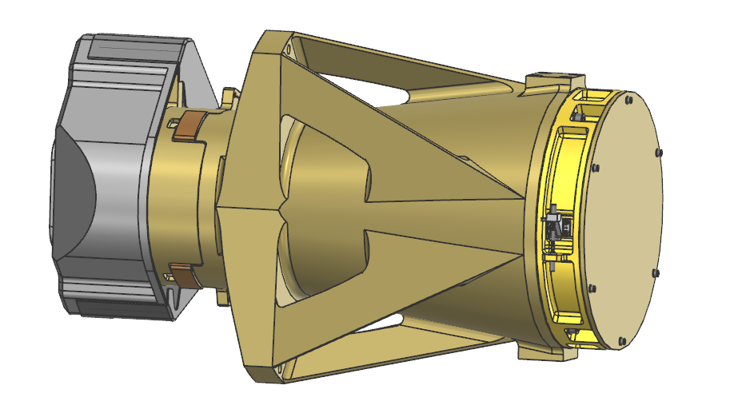
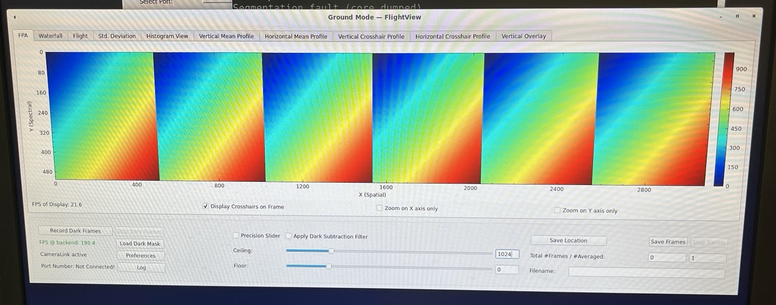
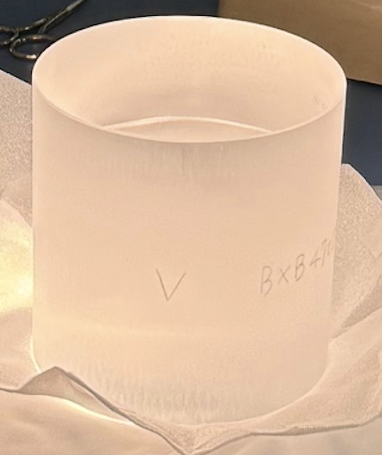
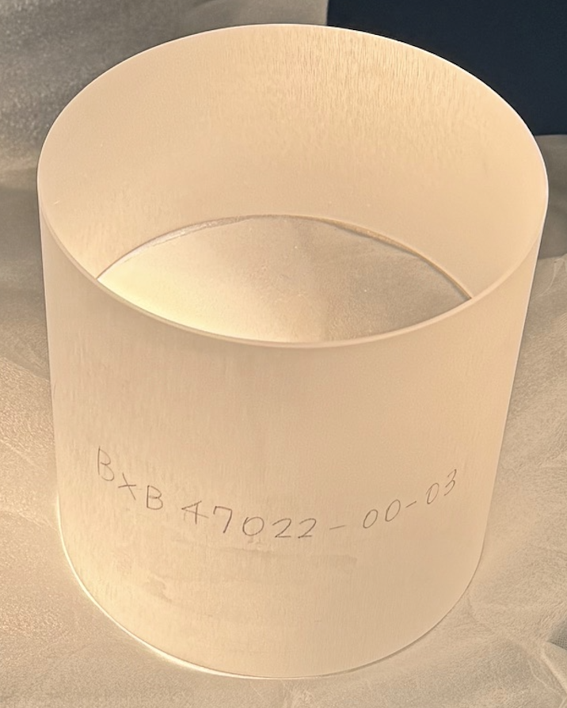
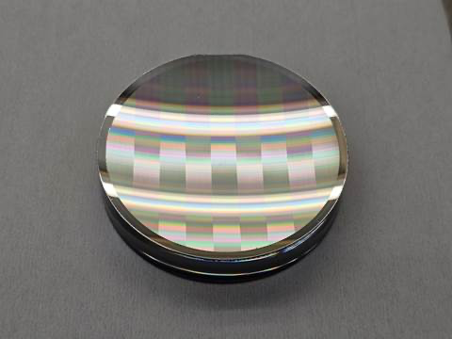
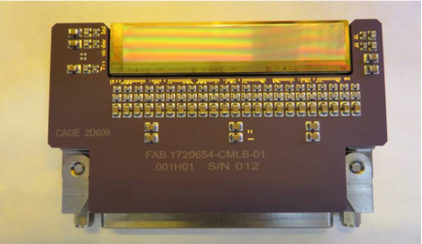
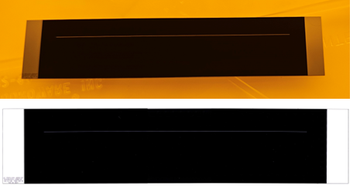
SBG-VSWIR Dyson Imaging Spectrometer
CHROMA-D 3072x512
Thermal
shields
FPA Assembly
CaF2 Dyson lens
Housing
Grating Assembly
CHROMA-D FPA at JPL
(Flight FPAs in development)
Slit and Zolt
Order Sorting Filter (OSF) in procurement
CaF2 lens blocks procured and received at JPL
Grating in development
(VSWIR type grating from AVIRIS 5 shown)

Slide 4
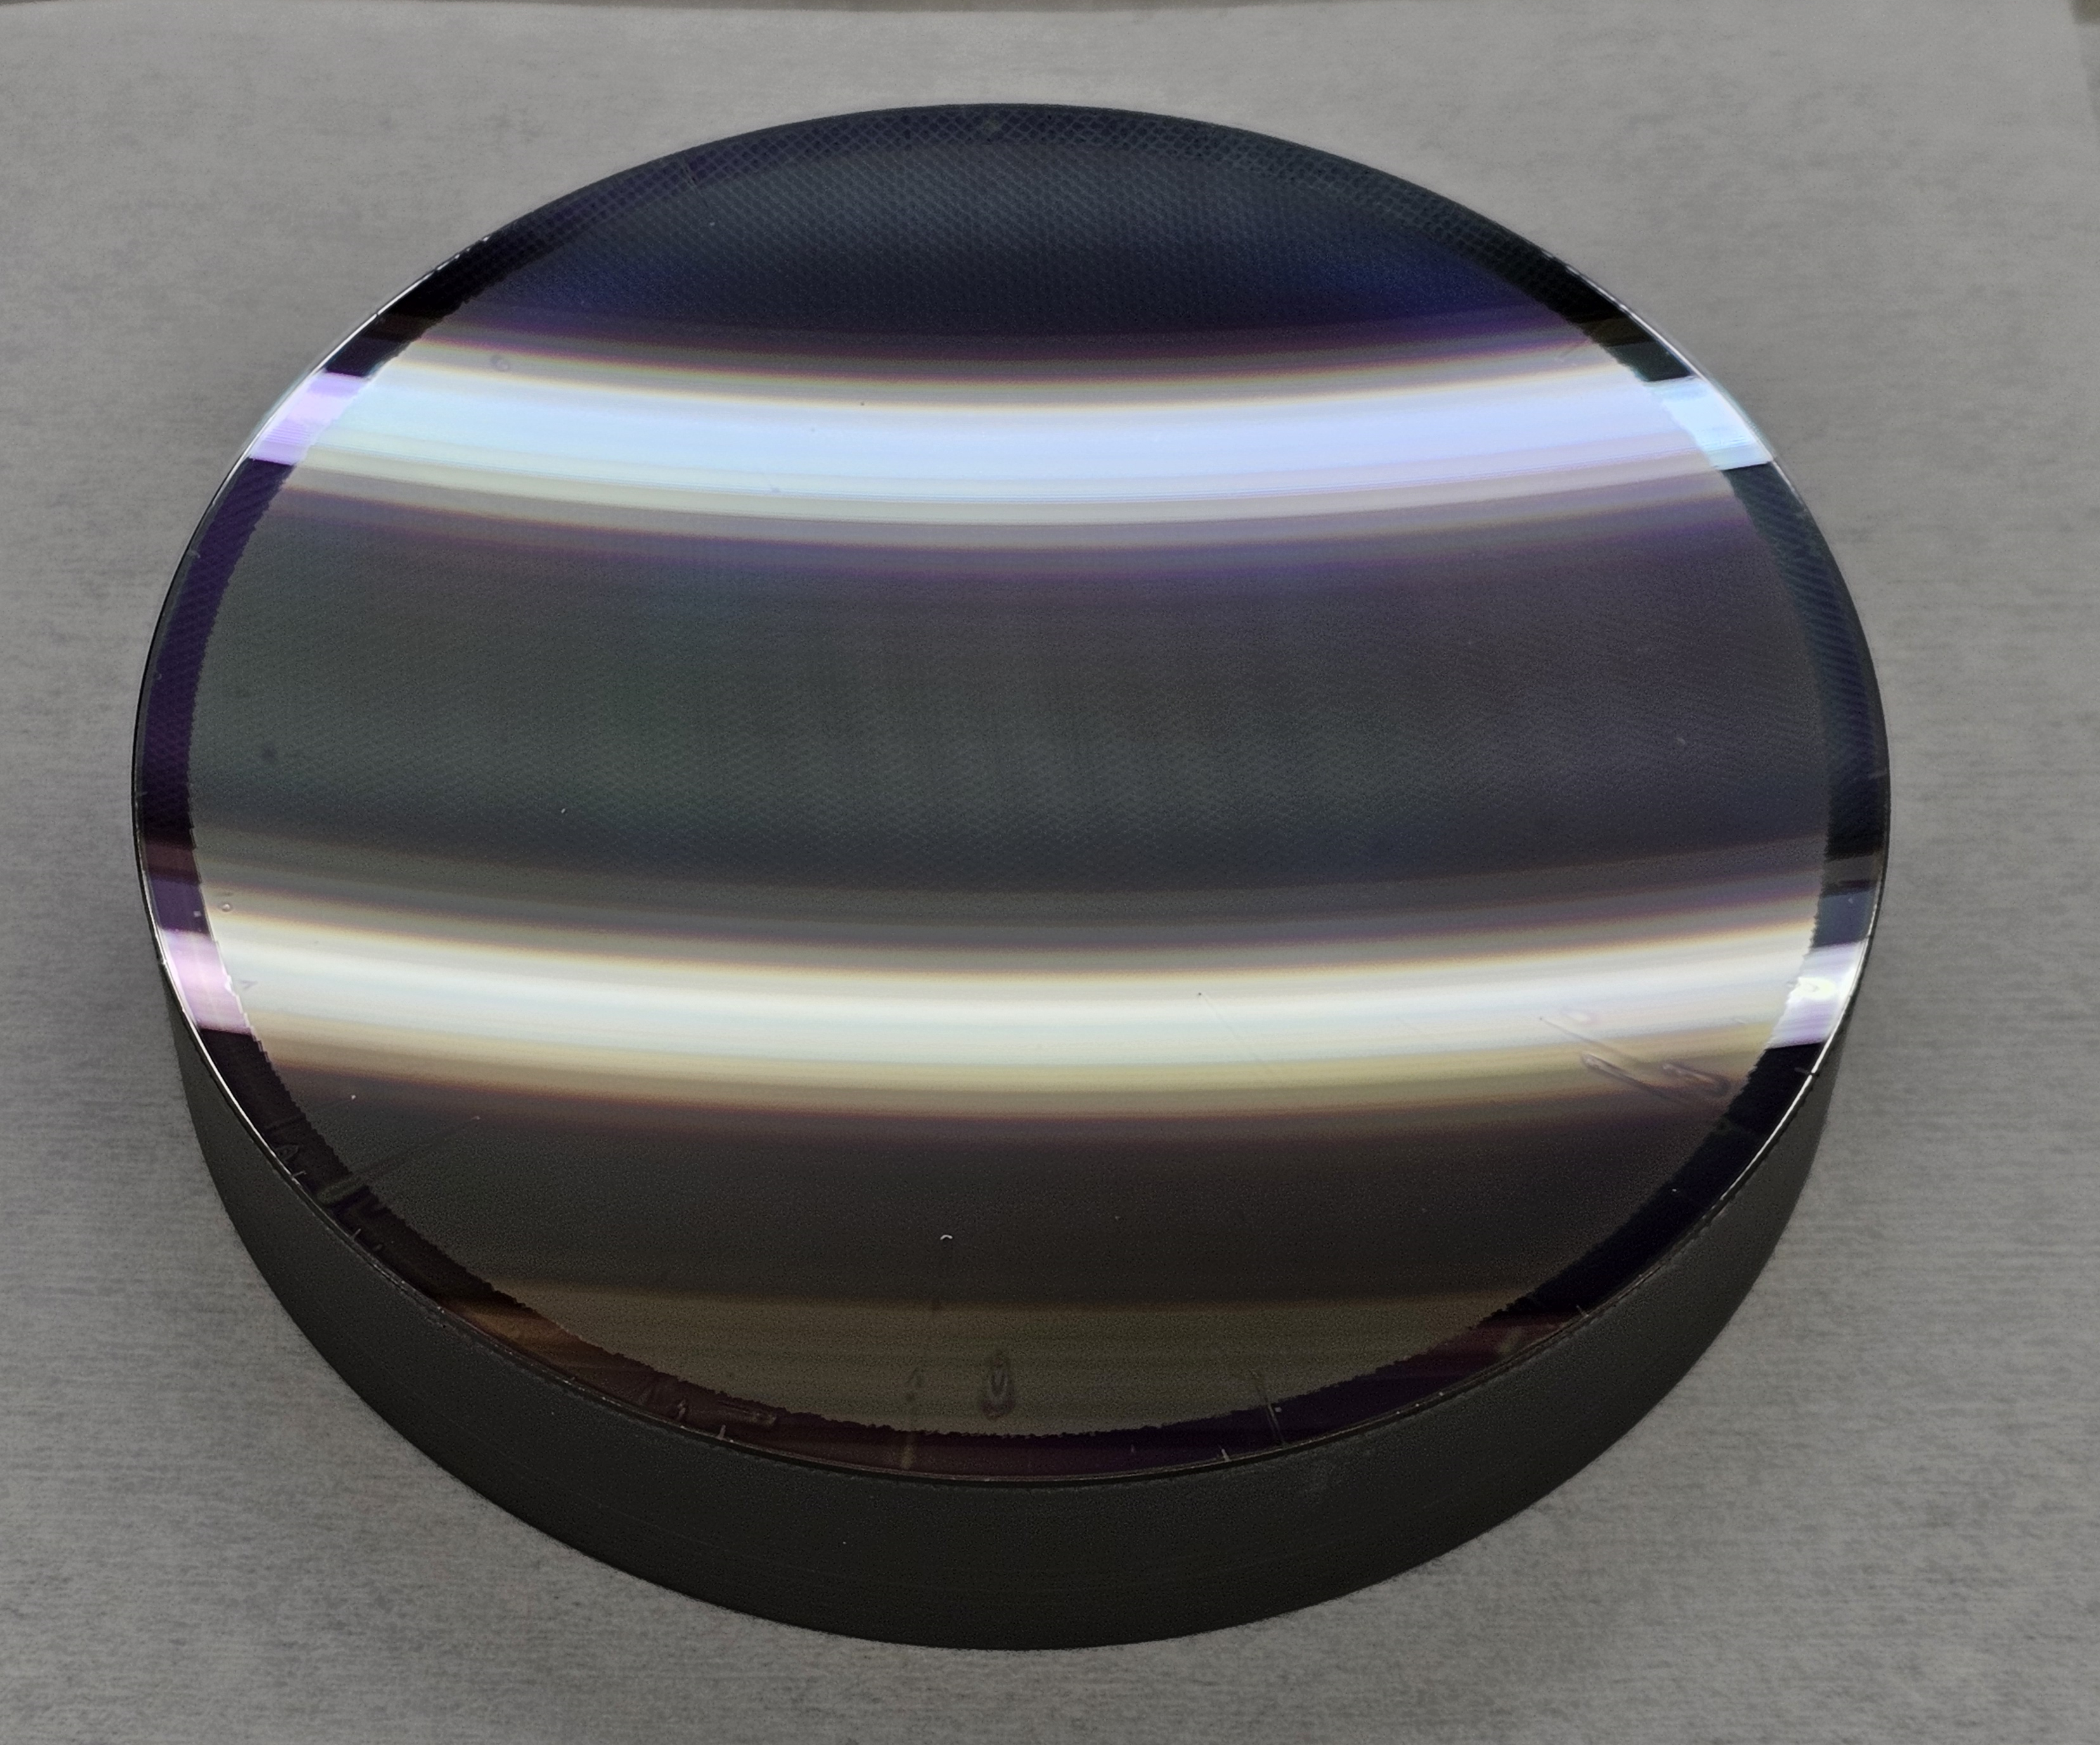
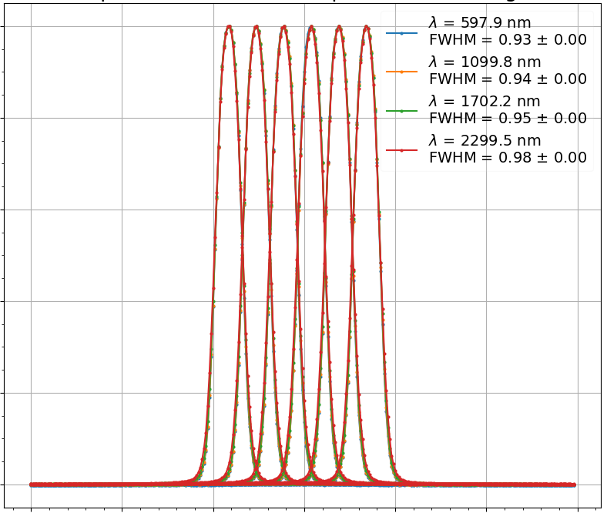
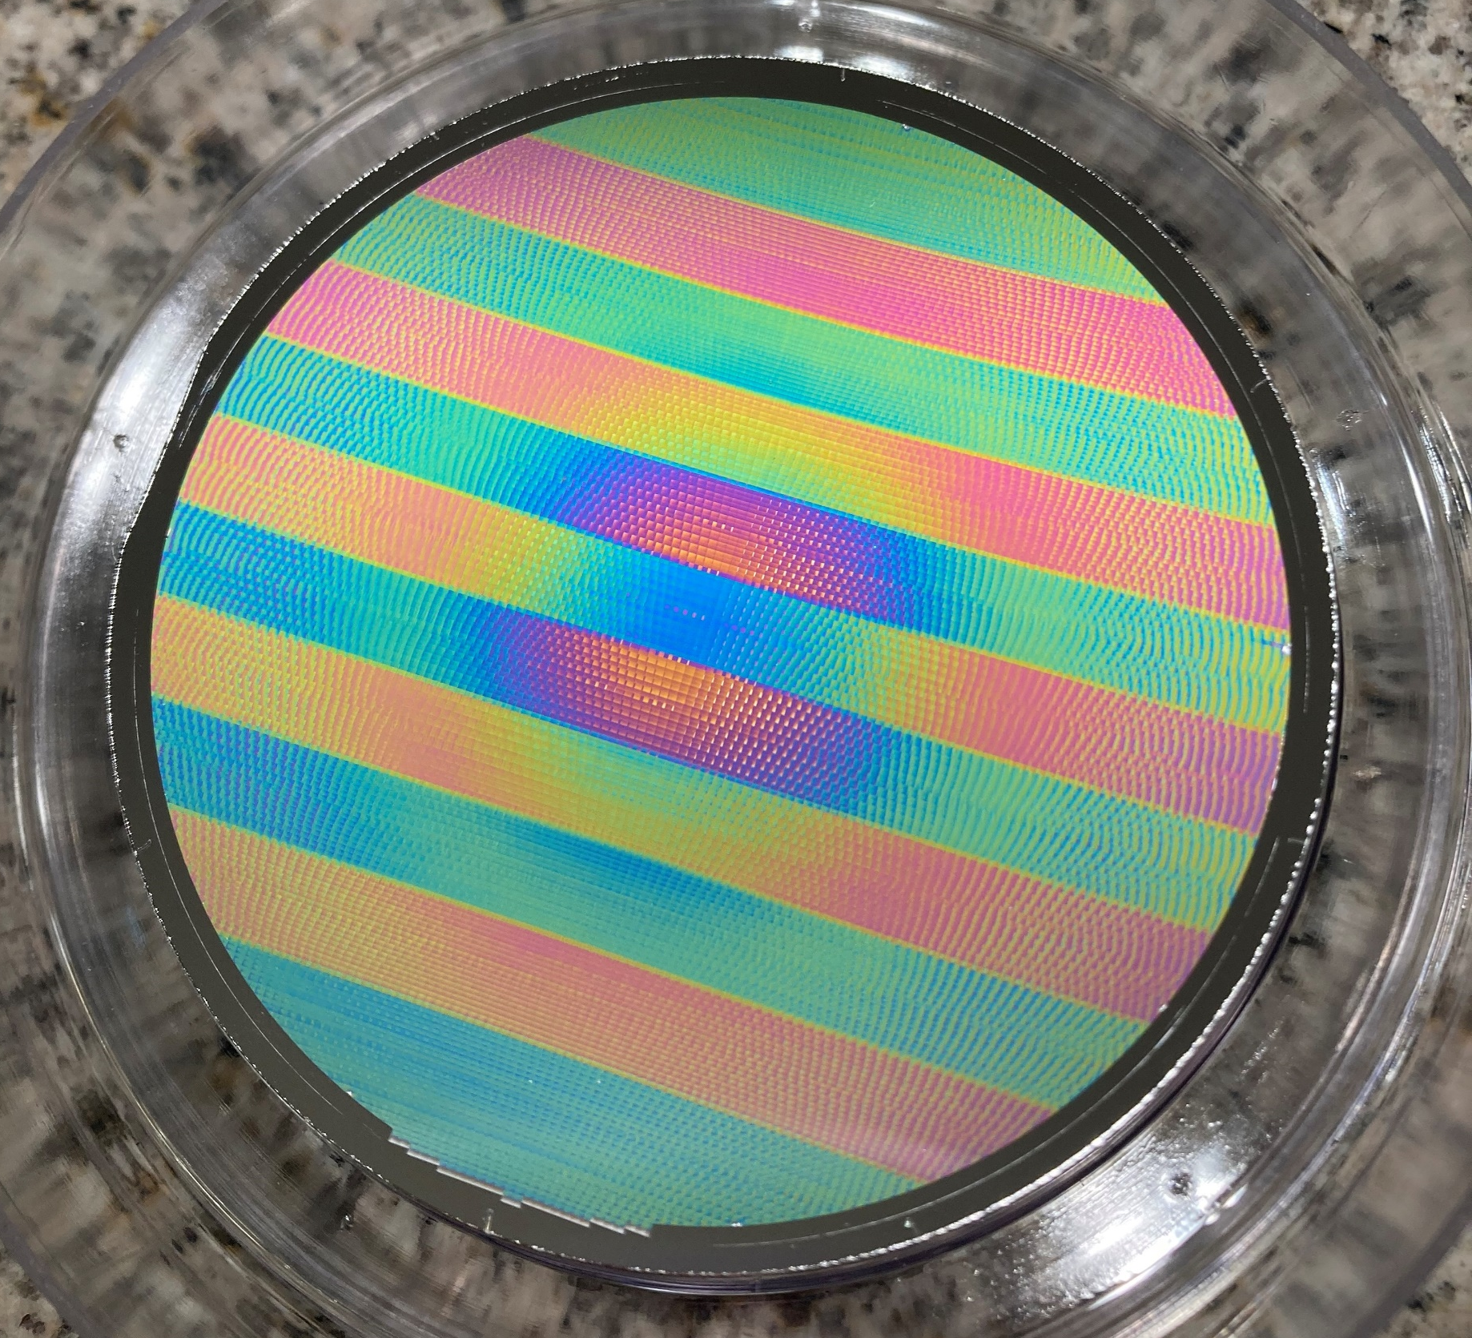
SBG-VSWIR Development Advances
SBG-VSWIR Grating
New AlignmentMethod Testing (AVIRIS-5)

Slide 5
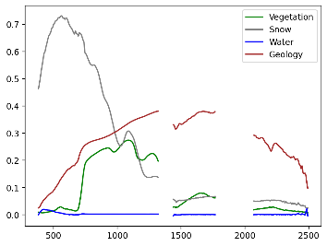
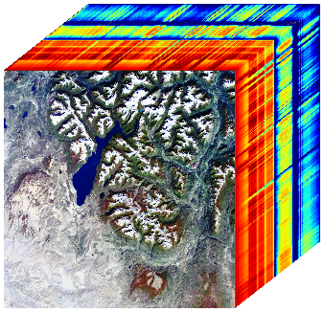
SBG VSWIR Uniquely Observes the Earth System Closing Critical Knowledge Gaps
Atmosphere
GHG Point Source Emissions
Water Vapor
Aerosols
Clouds, etc.
Hydrology Snow/Ice Physics
Aquatic Ecosystems
Coastal Ocean
Inland Lakes
Aquatic biomass
Benthic composition
Seasonal snow
Mountain snow
Water Resources
High latitude snow
Ice Sheets
Sea Ice
Snow Melt
Reflectance (HRDF)
Glacial
Algae
Sediment
Land Interface
Coastal Erosion
Wavelength (nm)
Snow and Ecosystems
Glaciers
Floating Vegetation
Snow and Rock/Soil
Terrestrial
Ecosystems
Geobotany
Soil-Ecosystems
Solid Earth
Geology and Soils
Plant Composition,
Function, and Structure
Ecosystems
Biodiversity
Agriculture
Forests
Mineralogy
Exposed Outcrops
Open Desert
Climate Weather Connections

Slide 6
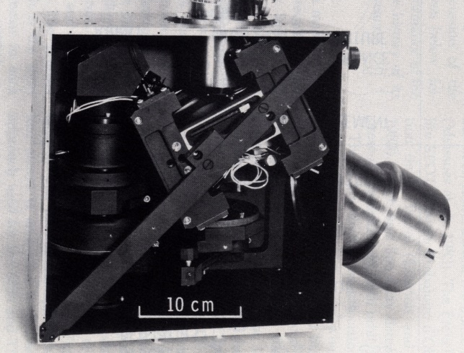
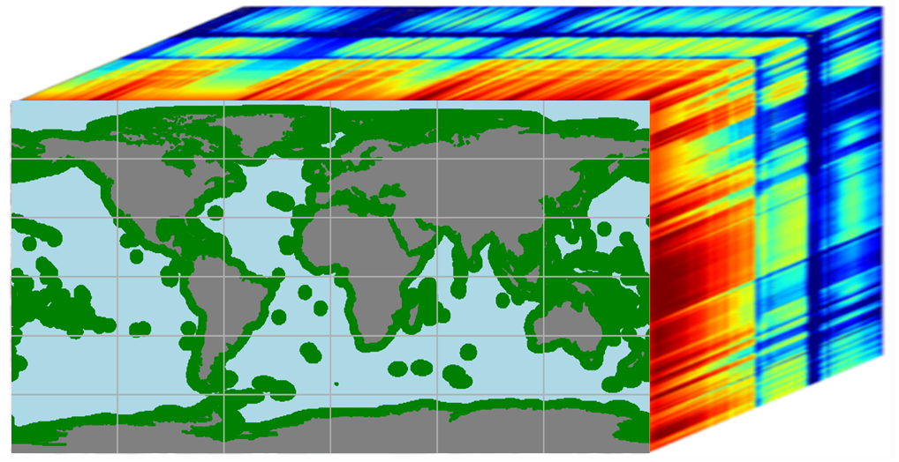
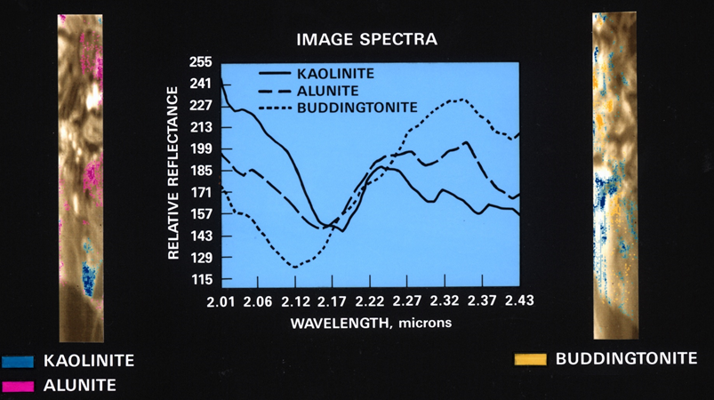
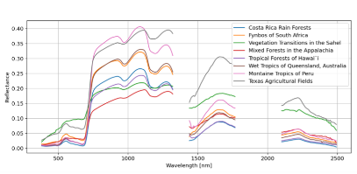
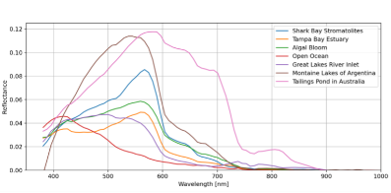
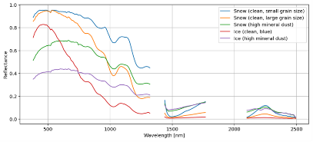
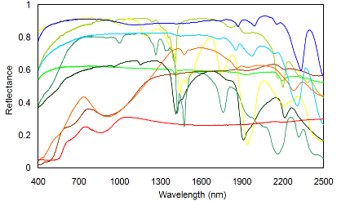
Surface Biology and Geology Visible to Short Wavelength Imaging Spectrometer
Airborne Imaging Spectrometer (AIS), 1982
SBG VSWIR 1.5 Million Spectra per Second
Ecosystems and Agriculture
Coasts, Lakes, Rivers
Snow, Ice, Hydrology
Geology, Minerals, Soils

