Slide 1
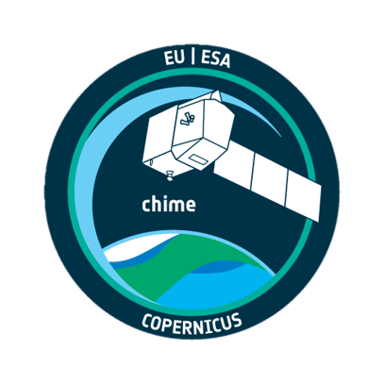
The Copernicus Hyperspectral Imaging Mission For The Environment (CHIME)
Marco Celesti and Jens Nieke, on behalf of the CHIME Team
13 November 2024

Slide 2
Notes:
CHIME Is one of the six sentinel expansions missions, aimed at expanding the current capabilities of the Copernicus constellation

Slide 3
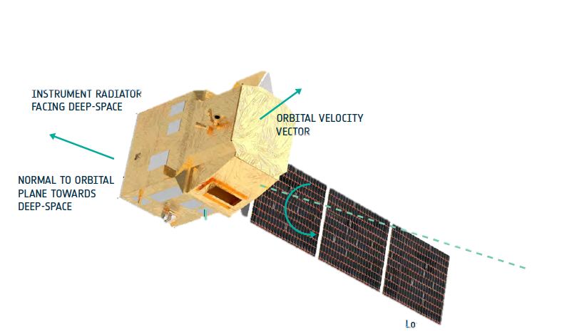
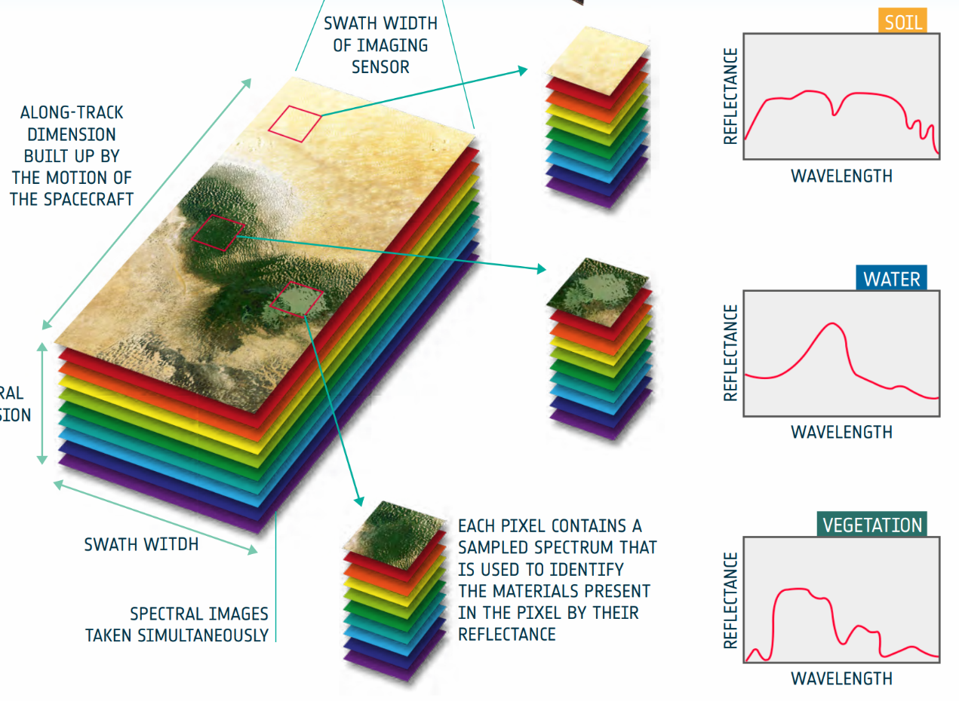
CHIME in-brief
KEY MISSION FEATURES:
Carpet-mapping observations of land and coastal areas
Revisit: 11 days with 2 satellites (see dedicated poster)
12-hour max timeliness and 95% availability
High radiometric accuracy and SNR, low spectral/spatial mis-registration
Launch readiness end of 2028
PRODUCTS under development:
Top-of-atmosphere (TOA) radiance in sensor geometry
Ortho-rectified TOA reflectance
Bottom-of-atmosphere (BOA) land surface and aquatic reflectance
E2E simulator to support products development (see poster)
400 – 2500 nm
SSI < 10 nm
INTERNATIONAL Co-operation
SBG-VSWIR: Regular Meetings and workshops for product harmonization
Regular exchanges with ENMAP and PRISMA teams
AVIRIS-NG-PRISMA-DESIS Campaigns (see poster)
Swath 130 km
Ground Resolution 30 m

Slide 4
Marco.Celesti@esa.int Jens.Nieke@esa.int
THANK YOU!

