Slide 2
Welcome and Introduction
Wednesday 13th November 2024 - 9:00 – 10:00
Marco Celesti, Anke Schickling

Slide 3
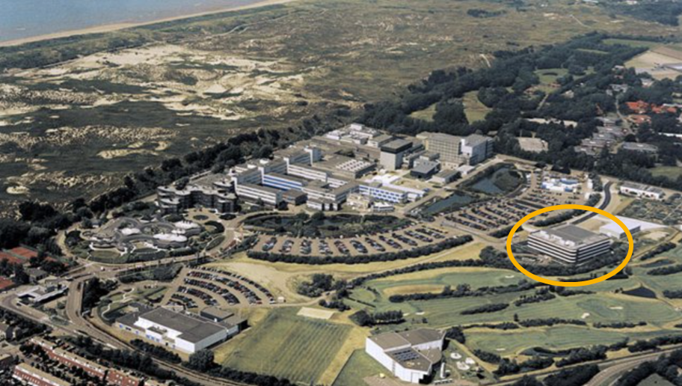
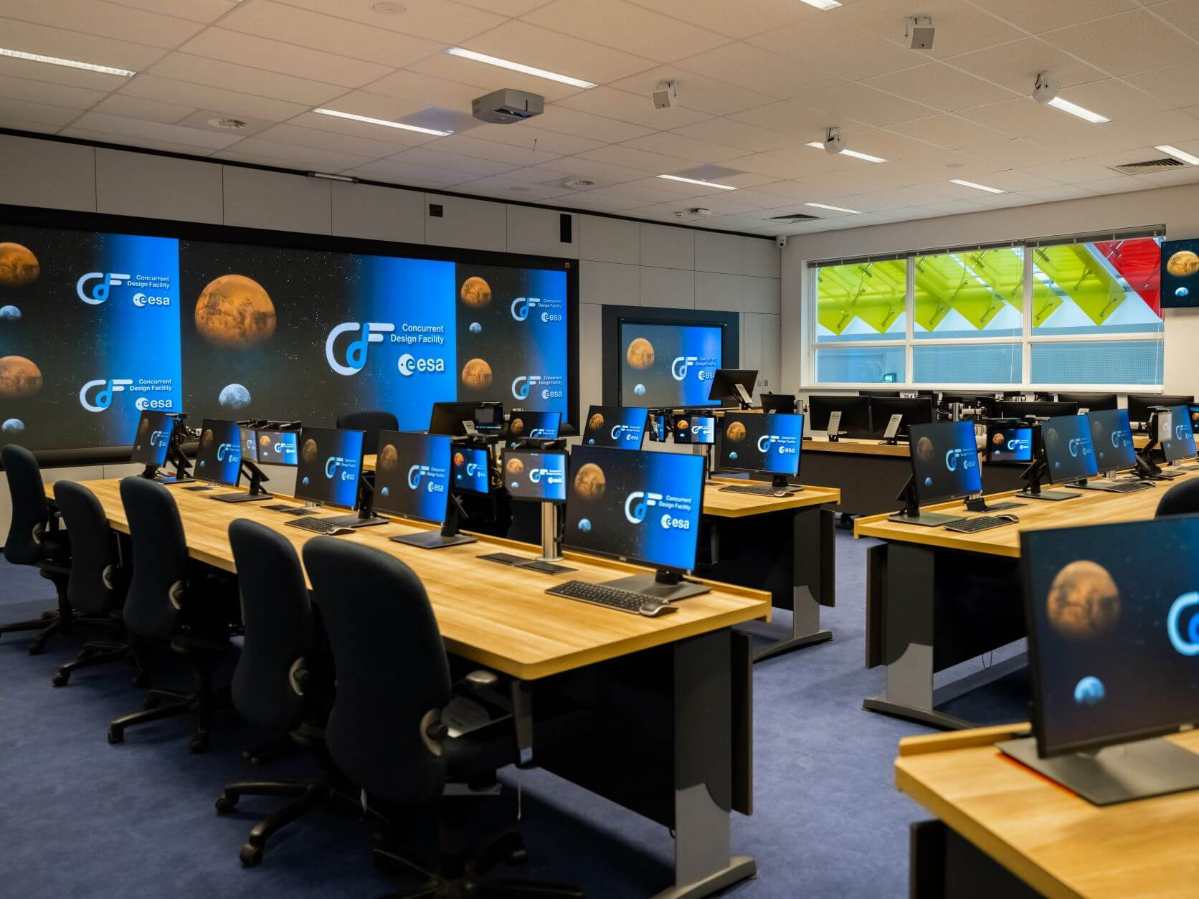
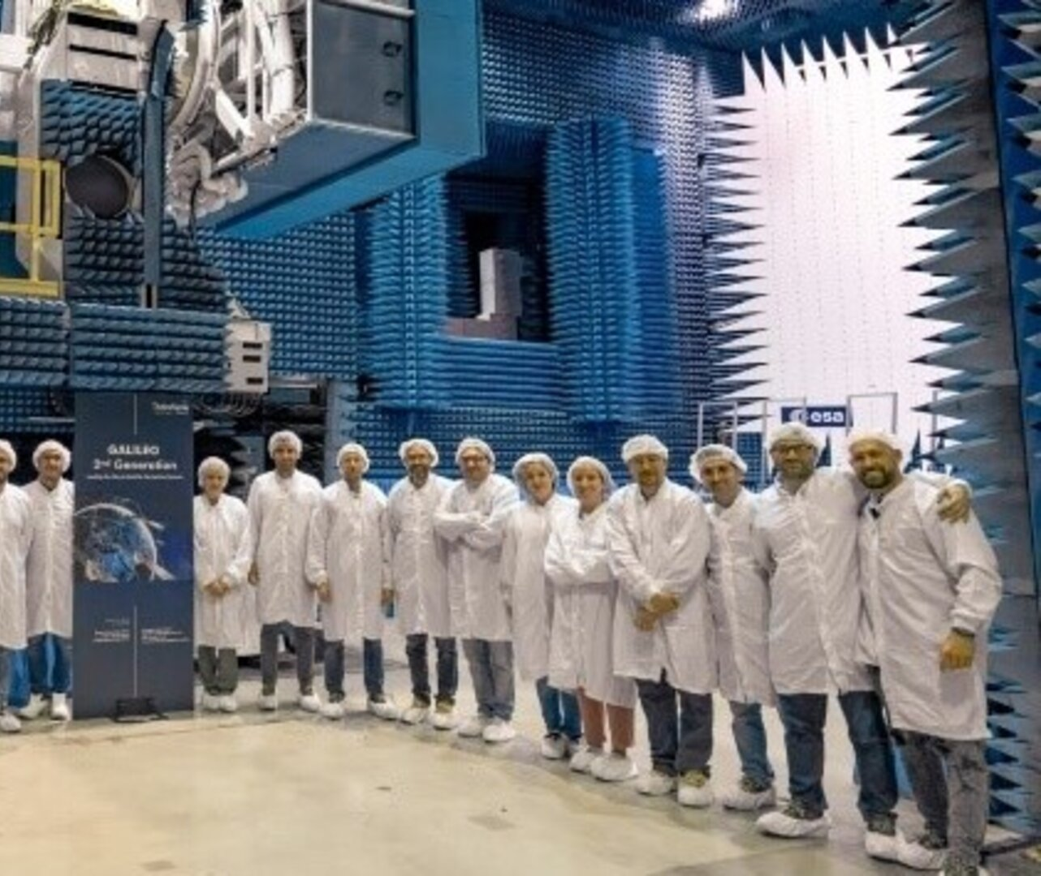
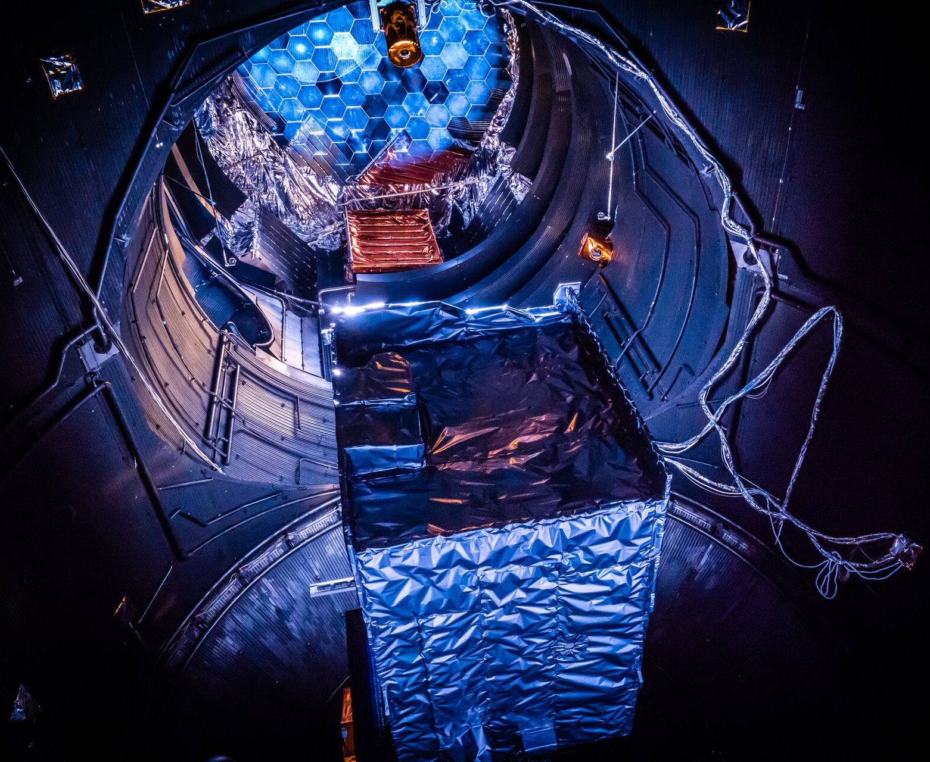
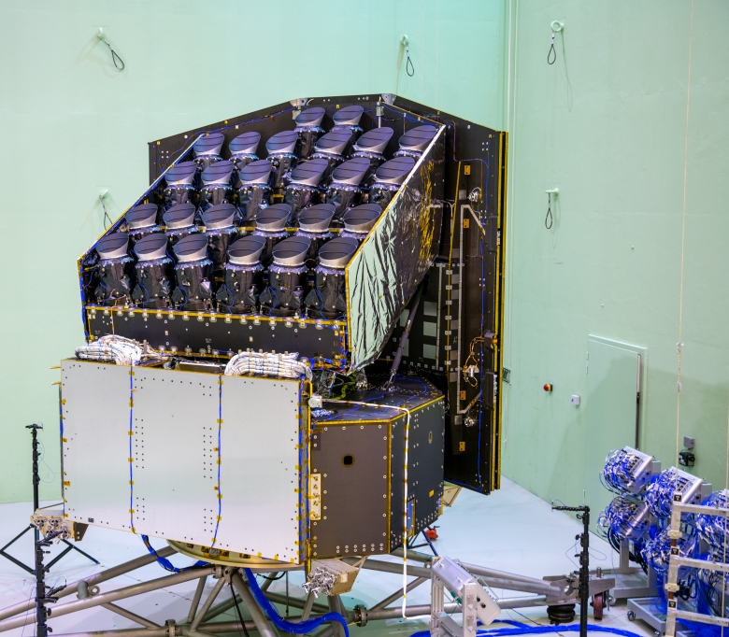
Welcome to ESA - ESTEC -- European Space Research and Technology Centre
Notes:
Welcome to ESTEC the largest establishment of the European Space Agency, where all ESA missions are conceived, developed, in some cases tested, basically “from cradle to grave”

Slide 4
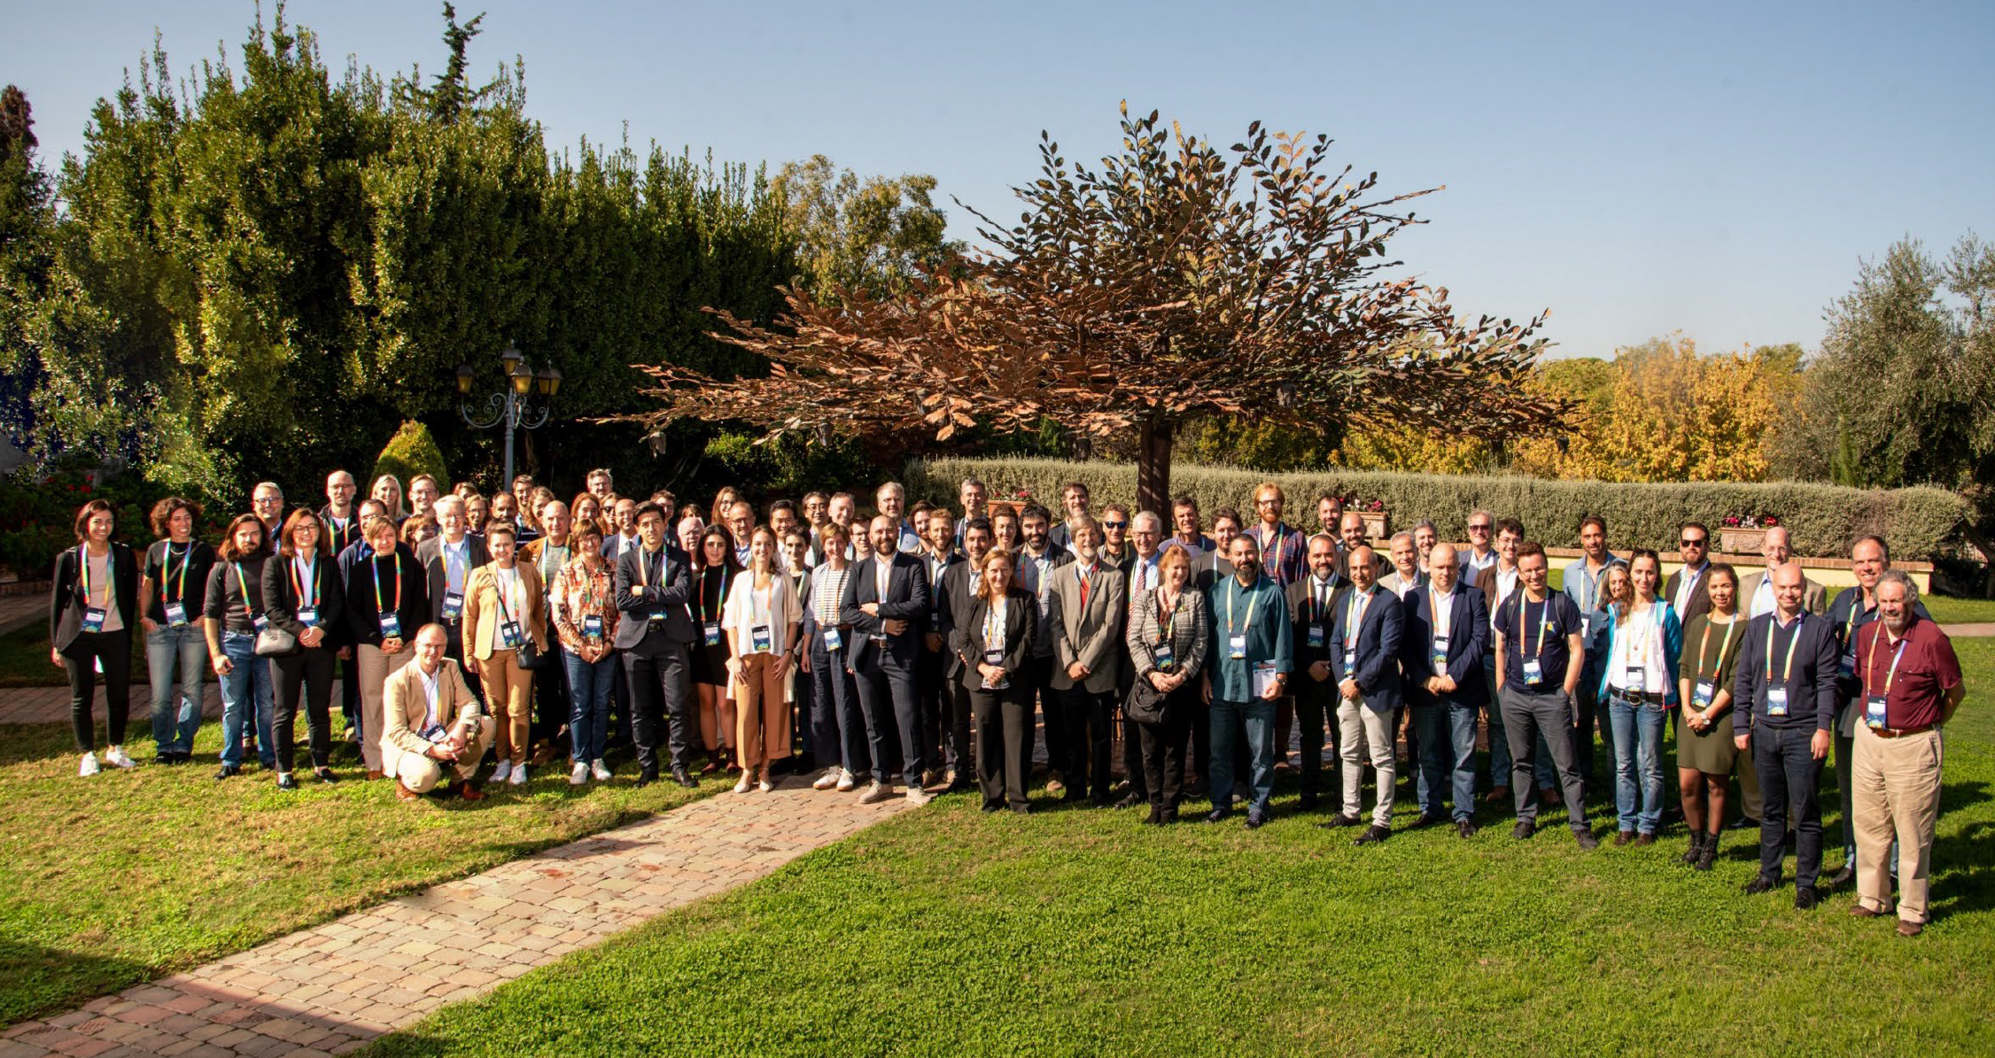
… and to the 3rd Workshop on International Cooperation in Spaceborne Imaging Spectroscopy
Series of workshops started in 2019 …
… and 2022 in Frascati, IT
First edition outside IT, so we know that you are not here for the weather nor the food ☺
First open edition, double number of participants
Focus on cross-cutting elements, in an attempt to be complementary to other key events for the IS community (e.g. EARSeL SIG IS WS, LPS, WHISPERS)
Short presentations (and limited number), poster sessions and discussions / breakout
Joint event from ASI, DLR, ESA and NASA
. ~200 registered participants + ~50 following online
… countries over … continents represented
Notes:
Allow me to spend a moment for a warm thought to the people of Valencia who greatly hosted us earlier this year for EARSeL and are going through a challenging time, and some of you are here today, our best wishes to you and the region to recover as soon as possible

Slide 5
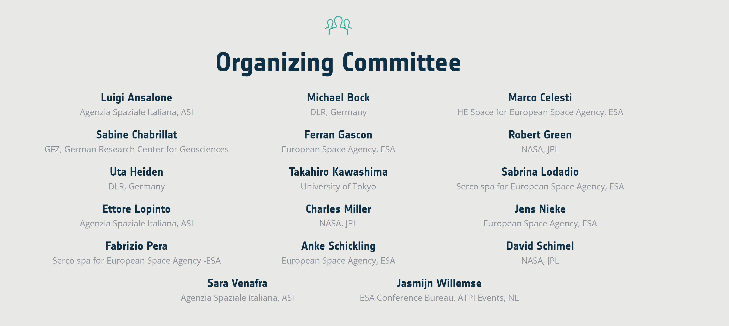
Notes:
We take the chance to thank the org and sci comm for their work over the last months, this is not an event that materialises by itself

Slide 6
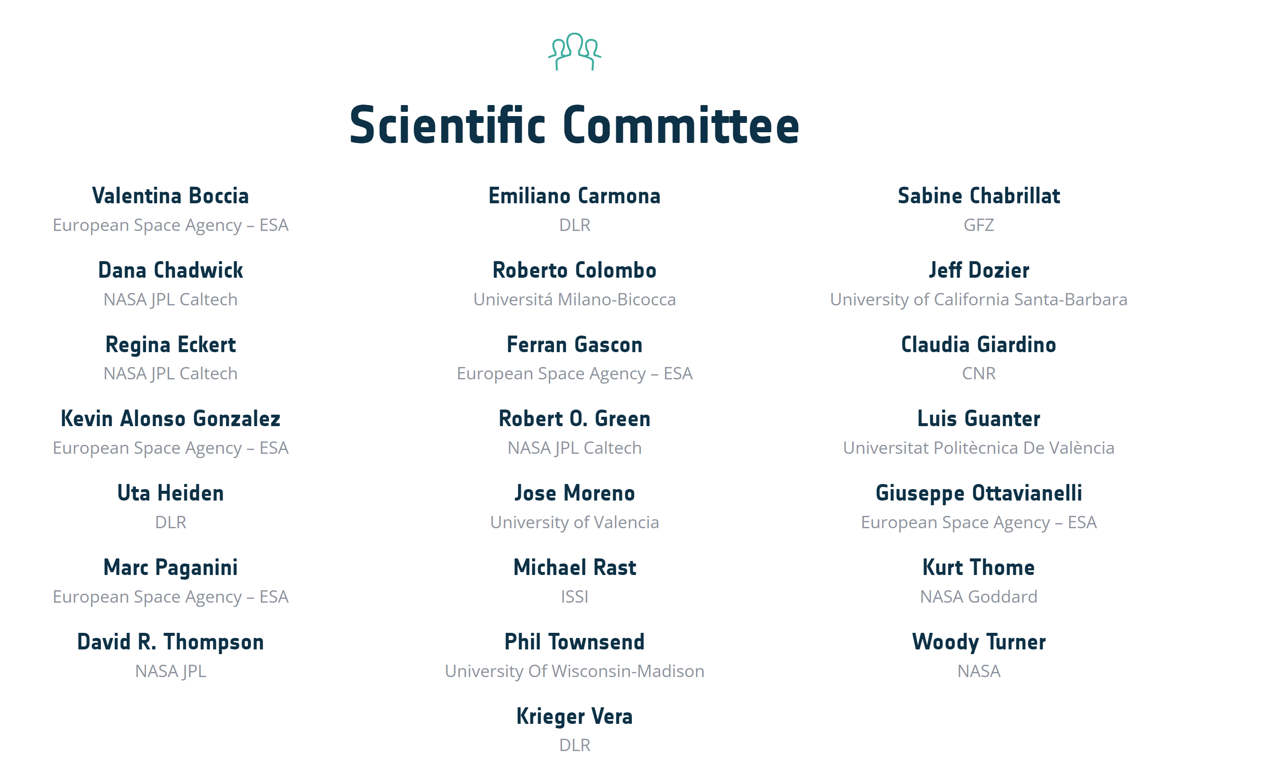
Notes:
Unfortunately not everyone could make it in person, including the director of earth observation programmes at ESA, Simonetta Cheli, who sent a recorded message

Slide 7
Welcome message from
ESA Director of Earth Observation Programmes
Simonetta Cheli
Notes:
Amit, Laura and Luigi should come on stage and briefly talk after the video

Slide 8
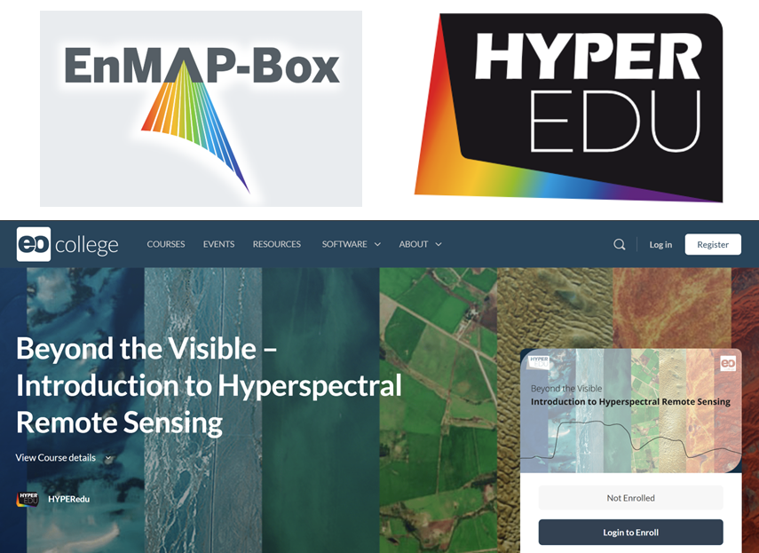
We are living a unique moment in the history of Earth Observation, and Imaging Spectroscopy in particular
Rapid increase in availability of spaceborne IS products over the last five years
Notes:
Building on the messages we have heard from Simonetta and the agencies collegues…

Slide 9
We are living a unique moment in the history of Earth Observation, and Imaging Spectroscopy in particular
Rapid increase in availability of spaceborne IS products over the last five years
opportunities and challenges for the community…
first IS time series from space, regional scale coverage, increased visibility and recognition
accessibility, data format, lack of full predictability of acquisitions, storage and computational resources
… and for the space agencies
increased revisit / coverage, access to larger user base, access to algorithms developed for other missions, increased outreach
different users / user needs >> different designs, storage and computational resources, conflict in user requests (e.g. for new acquisitions)
Notes:
Building on the messages we have heard from Simonetta and the agencies collegues…

Slide 10
Objectives of the Workshop:
Assess the status of current and planned international imaging spectroscopy missions designed for Earth surface monitoring
Identify major gaps and opportunities for the scientific and user community linked to the development of future imaging spectroscopy missions
Strengthen international cooperation and coordination in the space and ground segment operation, calibration and validation, products definition, data access and data exploitation
Notes:
Considering the recent developments, the current status and data availability from different missions as well as upcoming future missions we defined the objects of the worshop as follow…

Slide 11
Two types of interactive elements:
Q&A and discussion slots moderated by session chairs (end of each session)
Breakout groups for working/discussion meetings (on Thursday PM)
Topic | Room | Moderators
Calibration and Validation | High-bay | Valentina Boccia / Roberto Colombo / Regina Eckert / Rob Green / Charles Miller
Products Harmonisation + Instrument Agnostic Algorithms | Auditorium | Marco Celesti / Sabine Chabrillat / David Thompson
Open Science Development (incl. open source and open data) | Earth Room | Philip Brodrick / Vera Krieger
Notes:
In order to achieve these objectives we foresee (envisage) a highly interactive WS, two types …
No explicit breakout on Open challenges towards high level (L3/L4) global products
because we expect you to highlight your challenges in the most relevant of the breakout groups. E.g. when they think their main problem is lack of validation data, they can bring this up in the cal/val group...

Slide 12
Two types of interactive elements:
Q&A and discussion slots moderated by session chairs (end of each session)
Breakout groups for working/discussion meetings (on Thursday PM)
Expected outcome
Updated set of recommendations from the user community
Notes:
In order to achieve these objectives we foresee (envisage) a highly interactive WS, two types …
No explicit breakout on Open challenges towards high level (L3/L4) global products
because we expect you to highlight your challenges in the most relevant of the breakout groups. E.g. when they think their main problem is lack of validation data, they can bring this up in the cal/val group...

Slide 13
Some logistical info:
Please make sure to read the welcome package
Walking to the canteen together; after lunch we will meet at the ESTEC reception at 14:15 to walk back to Erasmus
You can walk freely in Zone 1 only
Shuttle Buses for participants who have booked their hotel in Noordwijk
Reminder: organise your shuttle or taxi for last day (Taxi Brouwer: tel. +31-71-361 1000)
Please upload your presentation during the coffee break and stick to timing (both chairs and presenters!) to preserve time for the discussion!
Centre first row is reserved for the upcoming speakers

Slide 14
Time | Day 1 – Wednesday 13th November 2024 | Location
08.00-09.00 | Registration and coffee | Erasmus building - High-bay (this room)
09.00-10.00 | Welcome and Introduction
10.00-10.30 | Coffee break
10:30-11:30 | Spaceborne IS Missions Overview - lightning talks
11.30-12.00 | Q&A
12.00-13.00 | Poster Session
13.00-14.30 | Lunch break | ESTEC canteen
14.30-16.00 | Instrument Agnostic Algorithm | Erasmus building - High-bay
16.00-16.30 | Coffee break
16.30-18-00 | Product Harmonization
18.00-20.00 | Ice Breaker | ESTEC winter garden (close to coffee corner)

Slide 15
Time | Day 1 – Wednesday 13th November 2024 | Location
08.00-09.00 | Registration and coffee | Erasmus building - High-bay (this room)
09.00-10.00 | Welcome and Introduction
10.00-10.30 | Coffee break
10:30-11:30 | Spaceborne IS Missions Overview - lightning talks
11.30-12.00 | Q&A
12.00-13.00 | Poster Session
13.00-14.30 | Lunch break | ESTEC canteen
14.30-16.00 | Instrument Agnostic Algorithm | Erasmus building - High-bay
16.00-16.30 | Coffee break
16.30-18-00 | Product Harmonization
18.00-20.00 | Ice Breaker | ESTEC winter garden (close to coffee corner)

Slide 16
Time | Day 2 – Thursday 14th November 2024 | Location
08.00-09.00 | Registration and coffee | Erasmus building - High-bay (this room)
09.00-10:30 | Calibration and validation activities I
10:30-11.00 | Coffee break
11:00-12:00 | Calibration and validation activities II
12.00-13.00 | Open Science developements
13.00-14.30 | Lunch | ESTEC canteen
14.30-16.30 | Breakout discussion | See previous slide
16.30-17:00 | Coffee break | Erasmus building - High-bay
16.30-18.00 | Poster Session
19:00-22:00 | Social Dinner | De Zeemeuw, Noordwijk

Slide 17
Time | Day 3 – Friday 15th November 2024 | Location
08.00-09.00 | Registration and coffee | Erasmus building - High-bay (this room)
09.00-10.30 | Open challenges towards high level (L3/L4) global products
10.30-11.00 | Coffee break
11.00-13.00 | Summary and Conclusions
13:00-… | Lunch | ESTEC canteen

Slide 18
Safety and Security video

Slide 19
